Slide 1
Learning Path 02: Implement Azure Functions

Slide 2
Agenda
Explore Azure Functions
Develop Azure Functions

Slide 3
Module 1: Explore Azure Functions

Slide 4
Introduction
After completing this module, you'll be able to:
Explain functional differences between Azure Functions, Azure Logic Apps, and WebJobs
Describe Azure Functions hosting plan options
Describe how Azure Functions scale to meet business needs

Slide 5

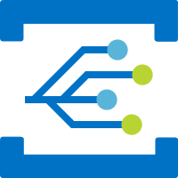


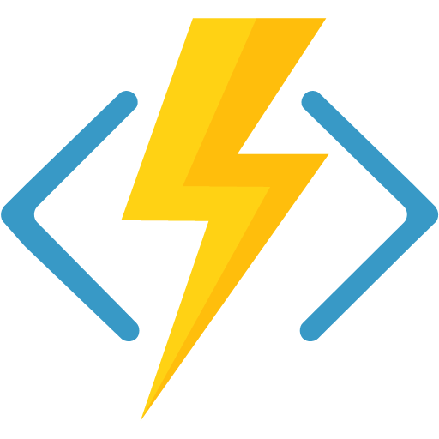


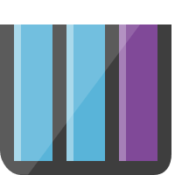
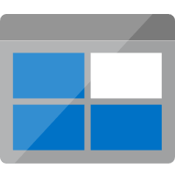
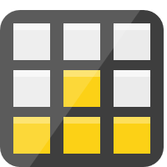


Discover Azure Functions (1 / 3)
Overview
Azure Functions are a great solution for processing data, integrating systems, working with the internet-of-things (IoT), and building simple APIs and microservices.
Consider Functions for tasks like image or order processing, file maintenance, or for any tasks that you want to run on a schedule.
Azure Functions supports triggers, which are ways to start execution of your code, and bindings, which are ways to simplify coding for input and output data.
Notification Hubs
Event Grid
Event Hubs
Cosmos DB
Twilio
Azure
Functions
Storage
Service Bus
Queue
Blob
Table
Topics
Queues

Slide 6
Discover Azure Functions (2 / 3)
Compare Azure Functions and Azure Logic Apps
 | Functions | Logic Apps
Development | Code-first (imperative) | Designer-first (declarative)
Connectivity | About a dozen built-in binding types, write code for custom bindings | Large collection of connectors, Enterprise Integration Pack for B2B scenarios, build custom connectors
Actions | Each activity is an Azure function; write code for activity functions | Large collection of ready-made actions
Monitoring | Azure Application Insights | Azure portal, Azure Monitor logs
Management | REST API, Visual Studio | Azure portal, REST API, PowerShell, Visual Studio
Execution context | Can run locally or in the cloud | Supports run-anywhere scenarios
Notes:
Both Functions and Logic Apps enable serverless workloads. Azure Functions is a serverless compute service, whereas Azure Logic Apps provides serverless workflows. Both can create complex orchestrations. An orchestration is a collection of functions or steps, called actions in Logic Apps, that are executed to accomplish a complex task.
For Azure Functions, you develop orchestrations by writing code and using the Durable Functions extension. For Logic Apps, you create orchestrations by using a GUI or editing configuration files.
You can mix and match services when you build an orchestration, calling functions from logic apps and calling logic apps from functions.

Slide 7
Discover Azure Functions (3 / 3)
Compare Functions and WebJobs
 | Functions | WebJobs with WebJobs SDK
Serverless app model with automatic scaling | Yes | No
Develop and test in browser | Yes | No
Pay-per-use pricing | Yes | No
Integration with Logic Apps | Yes | No
Trigger events | Timer Azure Storage queues and blobs Azure Service Bus queues and topics Azure Cosmos DB Azure Event Hubs HTTP/WebHook (GitHub Slack) Azure Event Grid | Timer Azure Storage queues and blobs Azure Service Bus queues and topics Azure Cosmos DB Azure Event Hubs File system
Notes:
Like Azure Functions, Azure App Service WebJobs with the WebJobs SDK is a code-first integration service that is designed for developers. Both are built on Azure App Service and support features such as source control integration, authentication, and monitoring with Application Insights integration.
Azure Functions is built on the WebJobs SDK, so it shares many of the same event triggers and connections to other Azure services.
Azure Functions offers more developer productivity than Azure App Service WebJobs does. It also offers more options for programming languages, development environments, Azure service integration, and pricing. For most scenarios, it's the best choice.

Slide 8
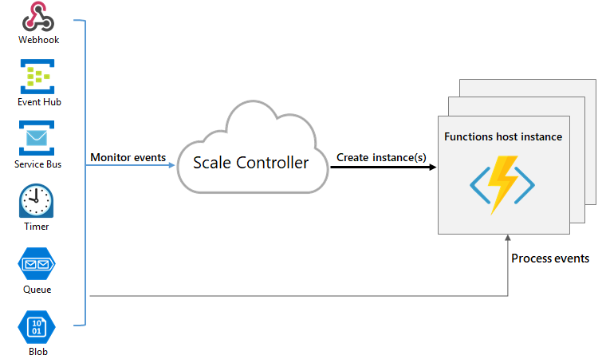
Scale Azure Functions (1 / 3)
Overview
In the Consumption and Premium plans, Azure Functions scales CPU and memory resources by adding additional instances of the Functions host.
Runtime scaling
Azure Functions uses a component called the scale controller to monitor the rate of events and determine whether to scale out or scale in. The scale controller uses heuristics for each trigger type.
Notes:
Runtime scaling
The unit of scale for Azure Functions is the function app.
When the function app is scaled out, additional resources are allocated to run multiple instances of the Azure Functions host.
Conversely, as compute demand is reduced, the scale controller removes function host instances.
The number of instances is eventually "scaled in" to zero when no functions are running within a function app.
NOTE: After your function app has been idle for a number of minutes, the platform may scale the number of instances on which your app runs down to zero. The next request has the added latency of scaling from zero to one. This latency is referred to as a cold start.

Slide 9
Scale Azure Functions (2 / 3)
Scaling behaviors
Scaling can vary on a number of factors, and scale differently based on the trigger and language selected. There are a few intricacies of scaling behaviors to be aware of:
Maximum instances: A single function app only scales out to a maximum of 200 instances. A single instance may process more than one message or request at a time though, so there isn't a set limit on number of concurrent executions.
New instance rate: For HTTP triggers, new instances are allocated, at most, once per second. For non-HTTP triggers, new instances are allocated, at most, once every 30 seconds.

Slide 10
Scale Azure Functions (3 / 3)
Limit scale out
You may wish to restrict the maximum number of instances an app used to scale out.
This is most common for cases where a downstream component like a database has limited throughput.
Azure Functions scaling in a Dedicated plan
Using an App Service plan, you can manually scale out by adding more VM instances. You can also enable autoscale.
Notes:
Limit scale out
By default, Consumption plan functions scale out to as many as 200 instances, and Premium plan functions will scale out to as many as 100 instances. You can specify a lower maximum for a specific app by modifying the functionAppScaleLimit value. The functionAppScaleLimit can be set to 0 or null for unrestricted, or a valid value between 1 and the app maximum.

Slide 11
Module 2: Develop Azure Functions

Slide 12
Introduction
After completing this module, you'll be able to:
Explain the key components of a function and how they are structured
Create triggers and bindings to control when a function runs and where the output is directed
Connect a function to services in Azure
Create a function by using Visual Studio Code and the Azure Functions Core Tools

Slide 13
Lab 02: Implement task processing logic by using Azure Functions
http://aka.ms/az204labs
Duration

Slide 14
Closing slide

