Slide 1
Learning Path 04: Develop solutions that use Azure Cosmos DB

Slide 2
Agenda
Explore Azure Cosmos DB
Work with Azure Cosmos DB

Slide 3
Module 1: Explore Azure Cosmos DB

Slide 4
Introduction
After completing this module, you'll be able to:
Identify the key benefits provided by Azure Cosmos DB.
Describe the elements in an Azure Cosmos DB account and how they are organized.
Explain the different consistency levels and choose the correct one for your project.
Explore the APIs supported in Azure Cosmos DB and choose the appropriate API for your solution.
Describe how request units impact costs.
Create Azure Cosmos DB resources by using the Azure portal.

Slide 5
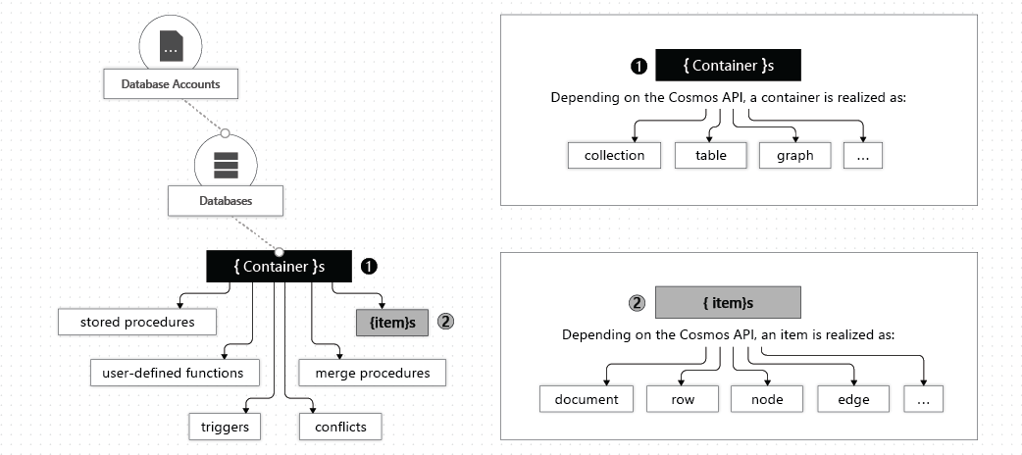
Explore the resource hierarchy (2 / 2)

Slide 6
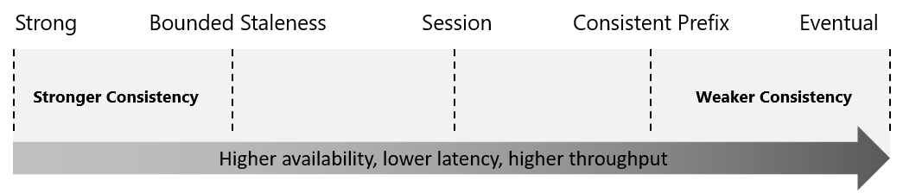
Explore consistency levels (1 / 2)
Azure Cosmos DB approaches data consistency as a spectrum of choices instead of two extremes.
Notes:
Strong consistency and eventual consistency are at the ends of the spectrum, but there are many consistency choices along the spectrum.
The consistency levels are region-agnostic and are guaranteed for all operations regardless of the region from which the reads and writes are served,

Slide 7
Explore consistency levels (2 /2)
Consistency Level | Description
Strong | When a write operation is performed on your primary database, the write operation is replicated to the replica instances. The write operation is committed (and visible) on the primary only after it has been committed and confirmed by all replicas.
Bounded Staleness | This level is similar to the Strong level with the major difference that you can configure how stale documents can be within replicas. Staleness refers to the quantity of time (or the version count) a replica document can be behind the primary document.
Session | This level guarantees that all read and write operations are consistent within a user session. Within the user session, all reads and writes are monotonic and guaranteed to be consistent across primary and replica instances.
Consistent Prefix | This level has loose consistency but guarantees that when updates show up in replicas, they will show up in the correct order (that is, as prefixes of other updates) without any gaps.
Eventual | This level has the loosest consistency and essentially commits any write operation against the primary immediately. Replica transactions are asynchronously handled and will eventually (over time) be consistent with the primary. This tier has the best performance, because the primary database does not need to wait for replicas to commit to finalize its transactions.
Notes:
The consistency levels range from very strong consistency—where reads are guaranteed to be visible across replicas before a write is fully committed across all replicas—to eventual consistency, where writes are readable immediately, and replicas are eventually consistent with the primary.

Slide 8
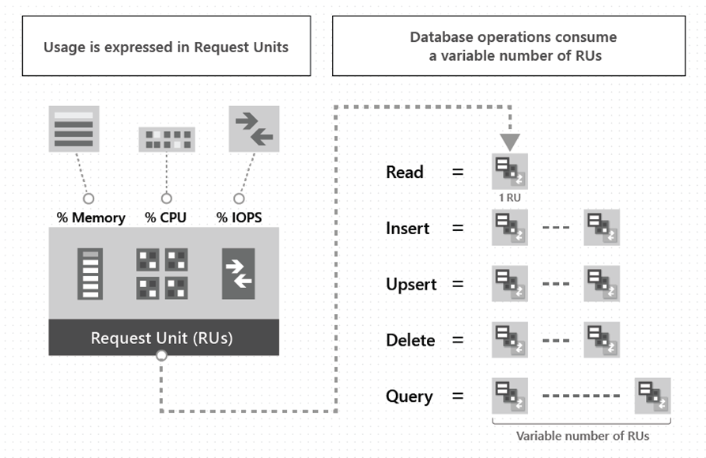
Discover request units
Account types and Request Units
The type of Azure Cosmos DB account created determines the way RUs are charged, there are three modes of account creation:
Provisioned throughput: You manage the number of RUs for your app in 100 RUs per second increments.
Serverless: Billed for the number of RUs consumed by your database operations.
Autoscale: Automatically and instantly scale RUs based on usage.
Notes:
Request unit: A request unit represents the system resources such as CPU, IOPS, and memory that are required to perform the database operations supported by Azure Cosmos DB.
The type of Azure Cosmos account you're using determines the way consumed RUs get charged. There are three modes in which you can create an account:
Provisioned throughput mode: In this mode, you provision the number of RUs for your application on a per-second basis in increments of 100 RUs per second. To scale the provisioned throughput for your application, you can increase or decrease the number of RUs at any time in increments or decrements of 100 RUs. You can make your changes either programmatically or by using the Azure portal. You can provision throughput at container and database granularity level.
Serverless mode: In this mode, you don't have to provision any throughput when creating resources in your Azure Cosmos account. At the end of your billing period, you get billed for the amount of request units that has been consumed by your database operations.
Autoscale mode: In this mode, you can automatically and instantly scale the throughput (RU/s) of your database or container based on its usage. This mode is well suited for mission-critical workloads that have variable or unpredictable traffic patterns, and require SLAs on high performance and scale.

Slide 9
Module 2: Work with Azure Cosmos DB

Slide 10
Introduction
After completing this module, you'll be able to:
Identify classes and methods used to create resources.
Create resources by using the Azure Cosmos DB .NET v3 SDK.
Write stored procedures, triggers, and user-defined functions by using JavaScript.
Implement change feed notifications

Slide 11
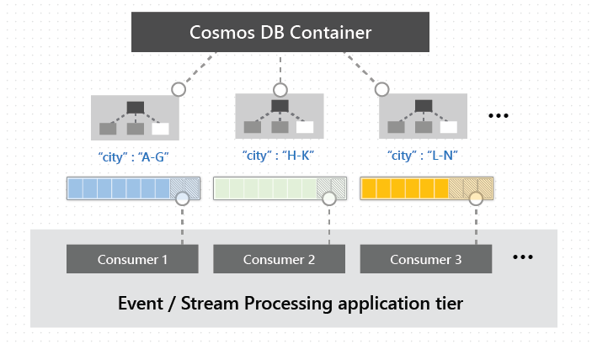
Explore change feed in Azure Cosmos DB
A persistent record of changes to a container in the order they occur.
The persisted changes can be processed asynchronously and incrementally.
Output can be distributed across one or more consumers for parallel processing.

Slide 12
Lab 04: Constructing a polyglot data solution
http://aka.ms/az204labs
Duration

Slide 13
Closing slide

