Slide 1
Learning Path 05: Implement containerized solutions

Slide 2
Agenda
Manage container images in Azure Container Registry
Run container images in Azure Container Instances
Implement Azure Container Apps

Slide 3
Module 1: Manage Container Images in Azure Container Registry

Slide 4
Introduction
After completing this module, you'll be able to:
Explain the features and benefits Azure Container Registry offers
Describe how to use ACR Tasks to automate builds and deployments
Explain the elements in a Dockerfile
Build and run an image in the ACR by using Azure CLI
Notes:
Prerequisites
You should be familiar with container concepts and terminology.
An understanding of cloud computing and some experience with the Azure portal.

Slide 5
Module 2: Run Container Images in Azure Container Instances

Slide 6
Introduction
After completing this module, you'll be able to:
Describe the benefits of Azure Container Instances and how resources are grouped.
Deploy a container instance in Azure by using the Azure CLI.
Start and stop containers using policies.
Set environment variables in your container instances.
Mount file shares in your container instances.
Notes:
Prerequisites
You should be familiar with container concepts and terminology.
An understanding of cloud computing and some experience with the Azure portal.

Slide 7
Explore Azure Container Instances (1 / 3)
Feature | Description
Fast startup times | Containers can start in seconds without the need to provision and manage VMs
Public IP connectivity and DNS name | Containers can be directly exposed to the internet with an IP address and a fully qualified domain name (FQDN)
Hypervisor-level security | Container applications are as isolated in a container as they would be in a VM
Custom sizes | ACI provides optimum utilization by allowing exact specifications of CPU cores and memory
Persistent storage | Containers support direct mounting of Azure Files shares
Linux and Windows containers | The same API is used to schedule both Linux and Windows containers
Co-scheduled groups | Container Instances supports scheduling of multicontainer groups that share host machine resources
Virtual network deployment | Container Instances can be deployed into an Azure virtual network
Notes:
Fast startup: ACI can start containers in Azure in seconds, without the need to provision and manage VMs
Container access: ACI enables exposing your container groups directly to the internet with an IP address and a fully qualified domain name (FQDN)
Hypervisor-level security: Isolate your application as completely as it would be in a VM
Customer data: The ACI service stores the minimum customer data required to ensure your container groups are running as expected
Custom sizes: ACI provides optimum utilization by allowing exact specifications of CPU cores and memory
Persistent storage: Mount Azure Files shares directly to a container to retrieve and persist state
Linux and Windows: Schedule both Windows and Linux containers using the same API.
For scenarios where you need full container orchestration, including service discovery across multiple containers, automatic scaling, and coordinated application upgrades, we recommend Azure Kubernetes Service (AKS).

Slide 8
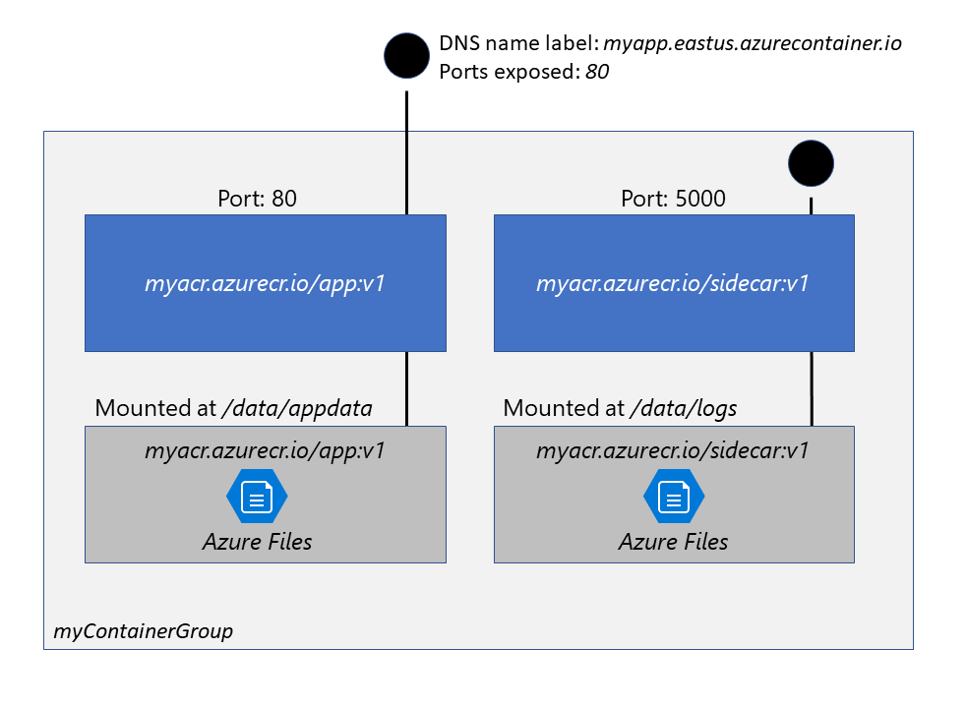
Explore Azure Container Instances (2 / 3)
Container groups
The top-level resource in Azure Container Instances is the container group.
The containers in a container group share a lifecycle, resources, local network, and storage volumes.
Notes:
This example container group:
Is scheduled on a single host machine.
Is assigned a DNS name label.
Exposes a single public IP address, with one exposed port.
Consists of two containers. One container listens on port 80, while the other listens on port 5000.
Includes two Azure file shares as volume mounts, and each container mounts one of the shares locally.
Note: Multi-container groups currently support only Linux containers. For Windows containers, Azure Container Instances only supports deployment of a single instance.

Slide 9
Explore Azure Container Instances (3 / 3)
Deployment
There are two common ways to deploy a multi-container group: ARM template or a YAML file.
Resource allocation
Azure Container Instances allocates resources such as CPUs, memory, and optionally GPUs (preview) to a container group by adding the resource requests of the instances in the group.
Networking
Container groups share an IP address and a port namespace on that IP address.
Storage
Specify external volumes to mount within a container group.
Map those volumes into specific paths within the individual containers in a group.
Common scenarios
Multi-container groups are useful in cases where you want to divide a single functional task into a small number of container images.
Notes:
Deployment
A Resource Manager template is recommended when you need to deploy additional Azure service resources (for example, an Azure Files share) when you deploy the container instances.
Due to the YAML format's more concise nature, a YAML file is recommended when your deployment includes only container instances.
Resource allocation
Taking CPU resources as an example, if you create a container group with two instances, each requesting 1 CPU, then the container group is allocated 2 CPUs.
Networking
To enable external clients to reach a container within the group, you must expose the port on the IP address and from the container. Because containers within the group share a port namespace, port mapping isn't supported. Containers within a group can reach each other via localhost on the ports that they have exposed, even if those ports aren't exposed externally on the group's IP address.
Storage
Supported volumes include:
Azure file share
Secret
Empty directory
Cloned git repo
Common scenarios
These images can then be delivered by different teams and have separate resource requirements.
Example usage could include:
A container serving a web application and a container pulling the latest content from source control.
An application container and a logging container. The logging container collects the logs and metrics output by the main application and writes them to long-term storage.
An application container and a monitoring container. The monitoring container periodically makes a request to the application to ensure that it's running and responding correctly, and raises an alert if it's not.
A front-end container and a back-end container. The front end might serve a web application, with the back end running a service to retrieve data.

Slide 10
Module 3: Implement Azure Container Apps

Slide 11
Introduction
After completing this module, you'll be able to:
Describe the features benefits of Azure Container Apps
Deploy container app in Azure by using the Azure CLI
Utilize Azure Container Apps built-in authentication and authorization
Create revisions and implement app secrets

Slide 12
Explore Azure Container Apps
Azure Container Apps enables you to run microservices and containerized applications on a serverless platform that runs on top of Azure Kubernetes Service.
Supports dynamic scaling based on any KEDA-supported scaler
Container apps are deployed to a single Container Apps environment, which acts as a secure boundary around groups of container apps.
Independently develop, upgrade, version, and scale core areas of functionality in an overall system.
Native Distributed Application Runtime (Dapr) integration

Slide 13
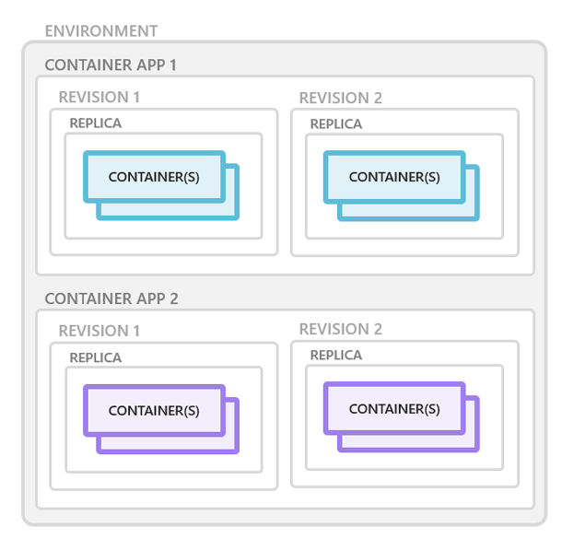
Explore containers in Azure Container Apps
Containers for an Azure Container App are grouped together in pods inside revision snapshots.
Can define multiple containers in a single container app to implement the sidecar pattern.
Deploy images hosted on private registries by providing credentials in the Container Apps configuration.
Notes:
Azure Container Apps manages the details of Kubernetes and container orchestration for you. Containers in Azure Container Apps can use any runtime, programming language, or development stack of your choice.

Slide 14
Explore Dapr integration with Azure Container Apps
The Distributed Application Runtime (Dapr) provides capabilities for enabling application intercommunication, whether through messaging via pub/sub or reliable and secure service-to-service calls.
Dapr API | Description
Service-to-service invocation | Discover services and perform reliable, direct service-to-service calls with automatic mTLS authentication and encryption.
State management | Provides state management capabilities for transactions and CRUD operations.
Pub/sub | Allows publisher and subscriber container apps to intercommunicate via an intermediary message broker.
Bindings | Trigger your applications based on events.
Actors | Dapr actors are message-driven, single-threaded, units of work designed to quickly scale.
Observability | Send tracing information to an Application Insights backend.
Secrets | Access secrets from your application code or reference secure values in your Dapr components.

Slide 15
Lab 05: Deploy compute workloads by using images and containers
http://aka.ms/az204labs
Duration

Slide 16
Closing slide

