Slide 1
Learning Path 09: Develop event-based solutions

Slide 2
Agenda
Explore Azure Event Grid
Explore Azure Event Hubs

Slide 3
Module 1: Explore Azure Event Grid

Slide 4
Introduction
After completing this module, you'll be able to:
Describe how Event Grid operates and how it connects to services and event handlers.
Explain how Event Grid delivers events and how it handles errors.
Implement authentication and authorization.
Route custom events to web endpoint by using Azure CLI.

Slide 5
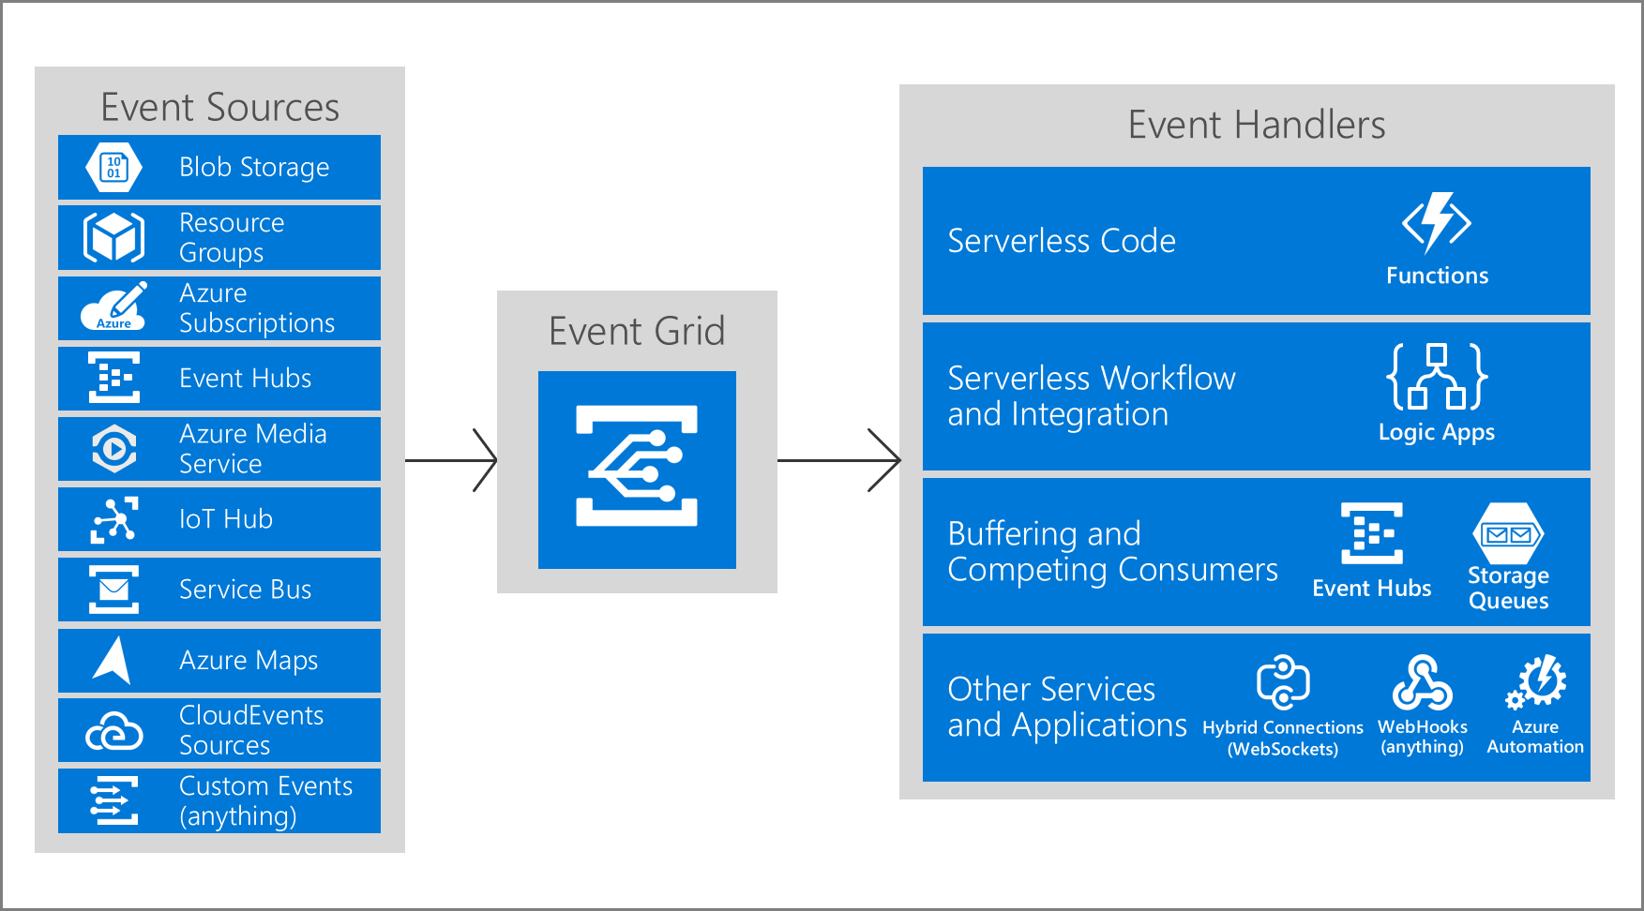
Explore Azure Event Grid (1 / 2)
What is the event grid
Azure Event Grid is an eventing backplane
Built-in support for events coming from Azure services
Create events with custom topics
Use filters to route specific events to different endpoints
Notes:
In an event-driven architecture, events are delivered in nearly real time, so that consumers can respond immediately to events as they occur.
An event-driven architecture can use a pub/sub model or an event-stream model.
Pub/sub: The messaging infrastructure keeps track of subscriptions. When an event is published, it sends the event to each subscriber. After an event is received, it cannot be replayed, and new subscribers do not observe the event.
Event streaming: Events are written to a log. Events are strictly ordered (within a partition) and durable. Clients don't subscribe to the stream. Instead, a client can read from any part of the stream. The client is responsible for advancing its position in the stream. That means that a client can join at any time, and can replay events.
On the consumer side, there are some common variations:
Simple event processing. An event immediately triggers an action in the consumer. For example, you could use Microsoft Azure Functions with a Service Bus trigger, so that a function executes whenever a message is published to a Service Bus topic.
Complex event processing. A consumer processes a series of events, observing patterns in the event data by using a technology such as Azure Stream Analytics or Apache Storm. For example, you could aggregate readings from an embedded device over a time window, and generate a notification if the moving average crosses a certain threshold.
Event stream processing. Use a data-streaming platform, such as Azure IoT Hub or Apache Kafka, as a pipeline to ingest events and feed them to stream processors. The stream processors act to process or transform the stream. There may be multiple stream processors for different subsystems of the application. This approach is a good fit for Internet of Things (IoT )workloads.
The source of the events might be external to the system, such as physical devices in an IoT solution. In that case, the system must be able to ingest the data at the volume and throughput that is required by the data source.

Slide 6
Module 2: Explore Azure Event Hubs

Slide 7
Introduction
After completing this module, you'll be able to:
Describe the benefits of using Event Hubs and how it captures streaming data.
Explain how to process events.
Perform common operations with the Event Hubs client library.

Slide 8
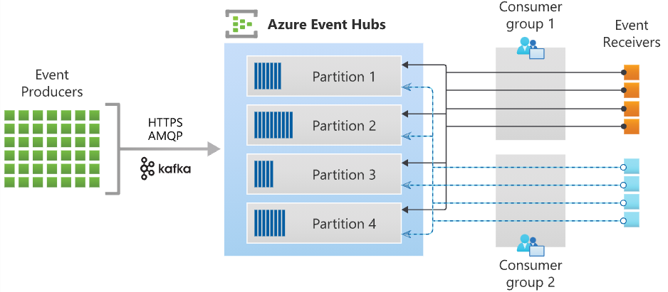
Discover Azure Event Hubs (2 / 2)
Notes:
Key components:
An Event Hub client is the primary interface for developers interacting with the Event Hubs client library. There are several different Event Hub clients, each dedicated to a specific use of Event Hubs, such as publishing or consuming events.
An Event Hub producer is a type of client that serves as a source of telemetry data, diagnostics information, usage logs, or other log data, as part of an embedded device solution, a mobile device application, a game title running on a console or other device, some client or server based business solution, or a web site.
An Event Hub consumer is a type of client which reads information from the Event Hub and allows processing of it. Processing may involve aggregation, complex computation and filtering. Processing may also involve distribution or storage of the information in a raw or transformed fashion.
A partition is an ordered sequence of events that is held in an Event Hub. Partitions are a means of data organization associated with the parallelism required by event consumers. Azure Event Hubs provides message streaming through a partitioned consumer pattern in which each consumer only reads a specific subset, or partition, of the message stream. As newer events arrive, they are added to the end of this sequence. The number of partitions is specified at the time an Event Hub is created and cannot be changed.
A consumer group is a view of an entire Event Hub. Consumer groups enable multiple consuming applications to each have a separate view of the event stream, and to read the stream independently at their own pace and from their own position. There can be at most 5 concurrent readers on a partition per consumer group; however it is recommended that there is only one active consumer for a given partition and consumer group pairing. Each active reader receives all of the events from its partition; if there are multiple readers on the same partition, then they will receive duplicate events.
Event receivers: Any entity that reads event data from an event hub. All Event Hubs consumers connect via the AMQP 1.0 session. The Event Hubs service delivers events through a session as they become available. All Kafka consumers connect via the Kafka protocol 1.0 and later.
Throughput units or processing units: Pre-purchased units of capacity that control the throughput capacity of Event Hubs.

Slide 9
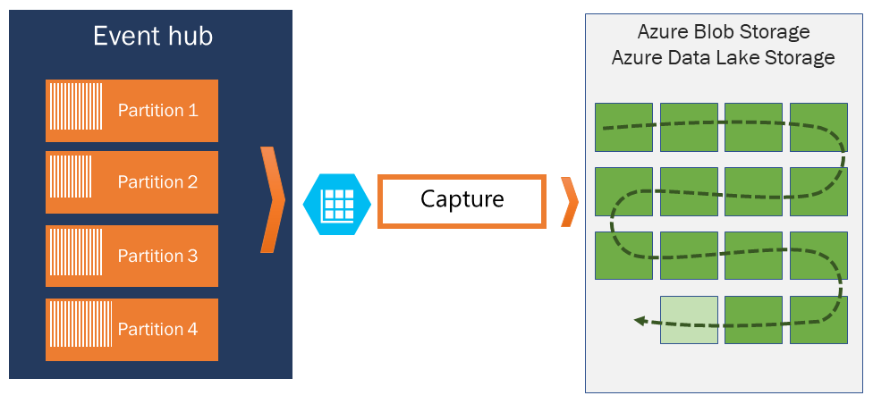
Explore Event Hubs Capture (1 / 2)
Azure Event Hubs enables you to automatically capture the streaming data in Event Hubs in an Azure Blob storage or Azure Data Lake Storage account of your choice.
Event Hubs Capture enables you to process real-time and batch-based pipelines on the same stream.

Slide 10
Lab 09: Publish and subscribe to Event Grid events
http://aka.ms/az204labs
Duration

Slide 11
Closing slide

