Slide 1
Learning Path 11: Troubleshoot solutions by using Application Insights

Slide 2
Agenda
Monitor app performance

Slide 3
Module 1: Monitor app performance

Slide 4
Introduction
After completing this module, you'll be able to:
Describe how Application Insights works and how it collects events and metrics.
Instrument an app for monitoring, perform availability tests, and use Application Map to help you monitor performance and troubleshoot issues.

Slide 5
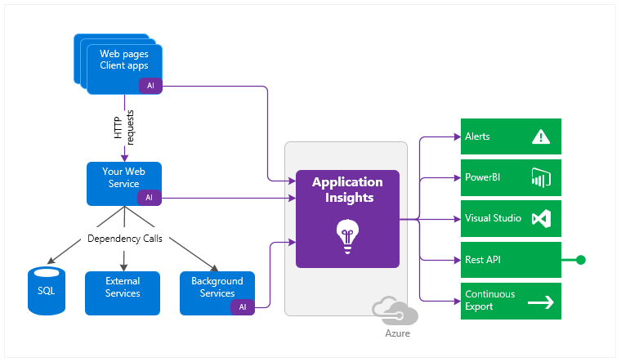
Explore Application Insights (2 / 2)
Notes:
How Application Insights works
You install a small instrumentation package (SDK) in your application or enable Application Insights using the Application Insights Agent when supported. The instrumentation monitors your app and directs the telemetry data to an Azure Application Insights Resource using a unique GUID that we refer to as an Instrumentation Key.
You can instrument not only the web service application, but also any background components, and the JavaScript in the web pages themselves. The application and its components can run anywhere - it doesn't have to be hosted in Azure.
https://docs.microsoft.com/azure/azure-monitor/app/pre-aggregated-metrics-log-metrics
In addition, you can pull in telemetry from the host environments such as performance counters, Azure diagnostics, or Docker logs. You can also set up web tests that periodically send synthetic requests to your web service.

Slide 6
Lab 11: Monitor services that are deployed to Azure
http://aka.ms/az204labs
Duration

Slide 7
Closing slide

