Slide 1
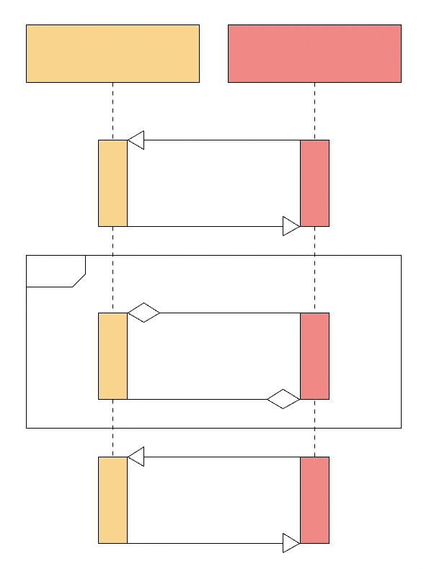



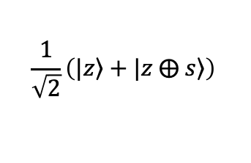
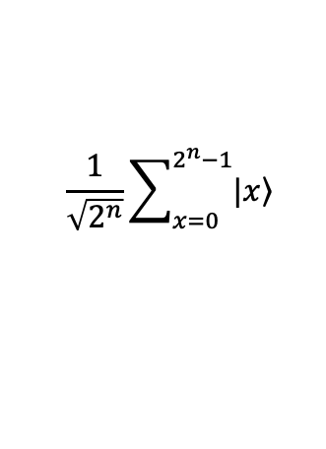
<<Quantum Server>>
Guinevere
<<Quantum Client>>
Nimue
Admittance Request
$$n$$
$$n+20$$
$$\frac{1}{\sqrt{2^{n}}}\sum_{x=0}^{2^{n}−1}{|\left.x\right\rangle }$$
$$\frac{1}{\sqrt{2}}\left(|\left.z\right\rangle +|\left.z ⨁ s\right\rangle \right)$$
$$s$$
Admit

Slide 2
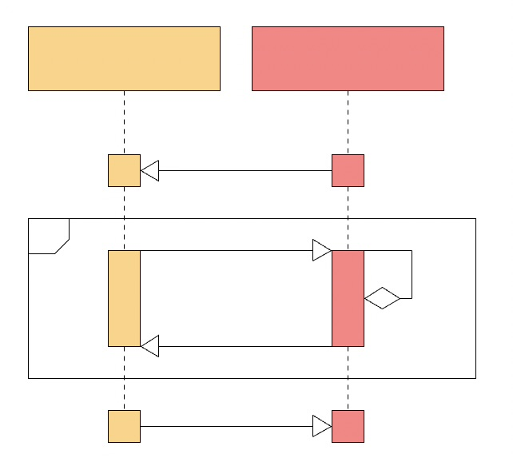




<<Quantum Server>>
Guinevere
<<Quantum Client>>
Nimue
Admittance Request
$$m$$
$$f$$
$$n+20$$
$$s$$
Admit

Slide 3
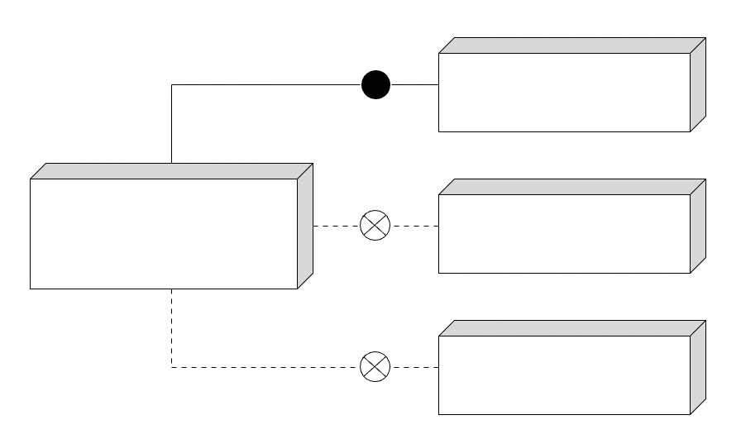
<<Quantum Client>>
Nimue
<<Quantum Server>>
Guinevere
<<Classical Client>>
Merlin
<<Noisy Quantum Client>>
Morgan le Fay

