Slide 1
Vertex AI
Endpoints
Cloud
Scheduler
Vertex AI
Training
BigQuery
Severless
Spark
Cloud
Function
Google
Cloud
Storage

Slide 2
Vertex AI
Endpoints
Vertex AI
Training
BigQuery
Severless
Spark
Cloud
Function
Google
Cloud
Storage

Slide 3
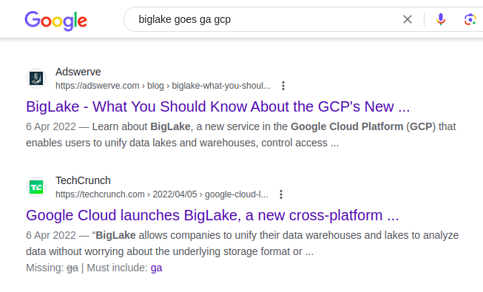
BigQuery
Google
Cloud
Storage

Slide 4
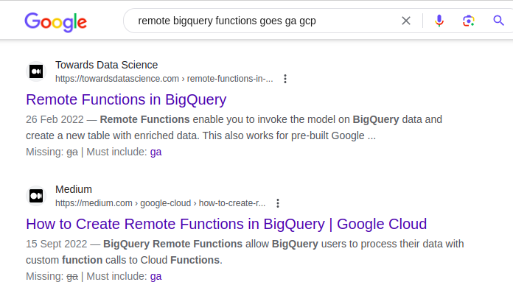
BigQuery
Cloud
Function
Google
Cloud
Storage

Slide 5
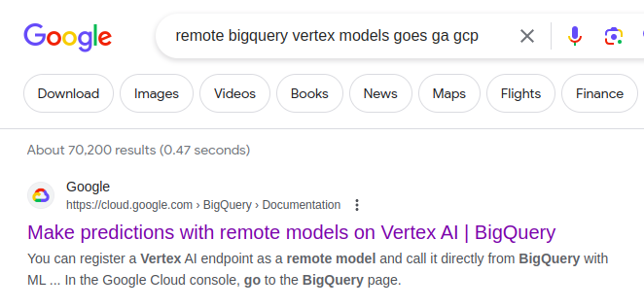
Vertex AI
Endpoints
Vertex AI
Training
BigQuery
Cloud
Function
Google
Cloud
Storage

Slide 6
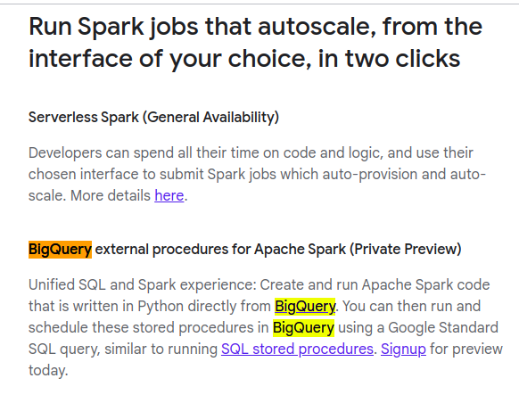
Vertex AI
Endpoints
Vertex AI
Training
BigQuery
Severless
Spark
Cloud
Function
Google
Cloud
Storage

Slide 7
Vertex AI
Endpoints
Dataform
Vertex AI
Training
BigQuery
Severless
Spark
BigQuery
Omni
Analytics
Hub
Cloud
Function
Google
Cloud
Storage

