Slide 1
Aircraft Safety and Risk Analysis
A data-driven recommendation for low-risk aircraft investment
By Warren Patsi

Slide 2
Overview
This project analyzes historical aircraft accident records to help identify low-risk aircraft types.
We explore accident frequency, injury severity, and contributing causes like weather and flight phase.
Tools used: Python (for data cleaning and analysis) and Tableau (for interactive visualizations).
The goal is to make safe, data-backed investment decisions in the aviation sector.

Slide 3
Business Understanding
Our company is expanding into the aviation industry to diversify operations.
The Aviation department needs guidance on selecting aircraft types with minimal operational and safety risk.
Past accident data can help identify which models have better safety records.
Understanding the risk profile of aircraft helps prevent financial loss, regulatory issues, and reputation damage.

Slide 4
Data Understanding
Data sourced from Kaggle: US and international aircraft accident reports (1960s–2020s).
Each record represents an accident or incident, with details on aircraft type, weather, damage, and injuries.
Key columns used: Event.Date, Make, Model, Weather.Condition, Aircraft.Damage, Injury Severity, Flight Phase.
Data helped me to understand when, where, and how different aircraft models encounter risk.

Slide 5
Data Cleaning
I found that the raw data had some unclear or inconsistent entries.
For example, 'Unknown', 'UNK', and 'Unk' were treated differently even though they mean the same.
I combined similar entries and filled in important missing details where possible.
This made the information more accurate and easier to analyze for decision-making.

Slide 6
Data Analysis Approach
I used a tool called Python to help organize and explore the data quickly.
Charts and summaries were created to find patterns in aircraft accidents.
I focused on: how often accidents happen, how serious they are, and what usually causes them.
To make things easier to understand, I built visual dashboards using a tool called Tableau.

Slide 7
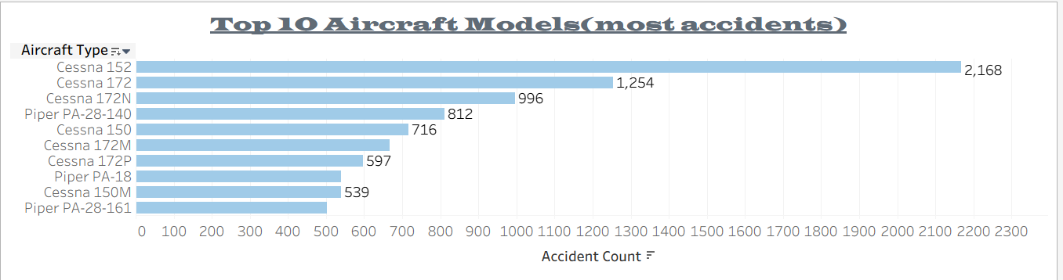
Top 10 Aircraft by Accident Count
Some aircraft types appear in accidents more frequently than others.
These models may be older, more widely used, or operated in higher-risk conditions.
By identifying high-frequency models, we can focus our attention on safer alternatives.

Slide 8
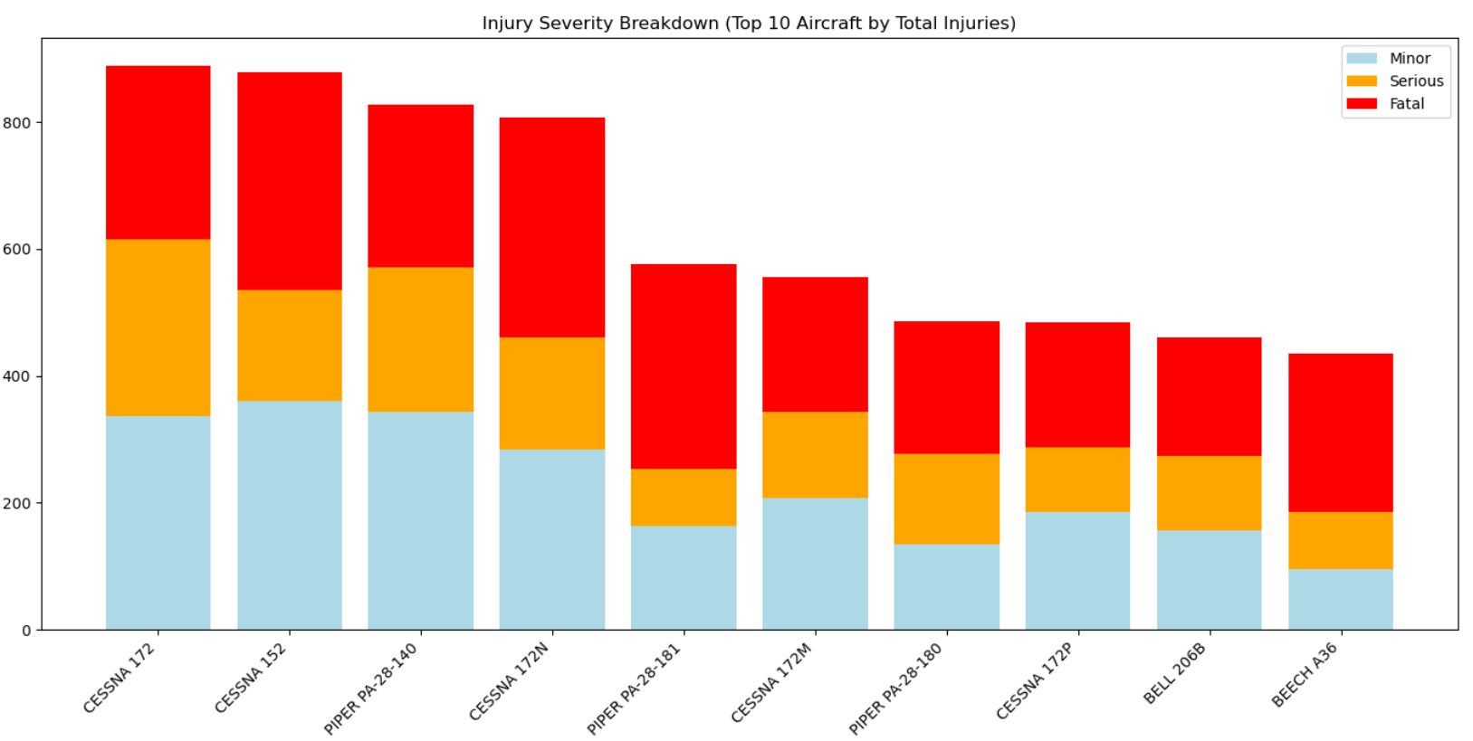
Injury Severity Breakdown
Not all accidents are equally severe, some result in only minor injuries or none at all.
Certain aircraft types e.g Cessna 172 have more survivable accident records than others.
I prioritized aircraft where passengers are more likely to walk away unharmed.

Slide 9
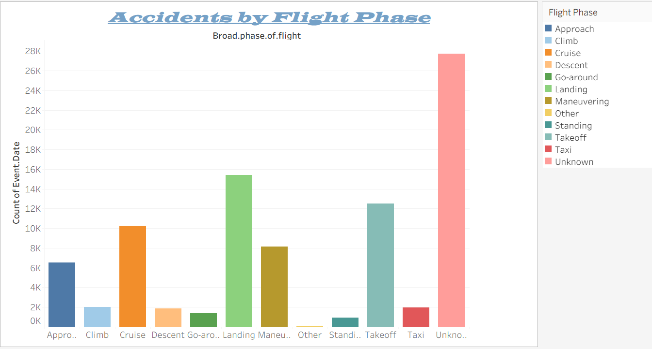
Accidents by Flight Phase
Most accidents happen during takeoff, landing, and approach.
These phases are more complex and require precise handling.
Training and equipment decisions should focus on reducing risk in these moments of flight.

Slide 10
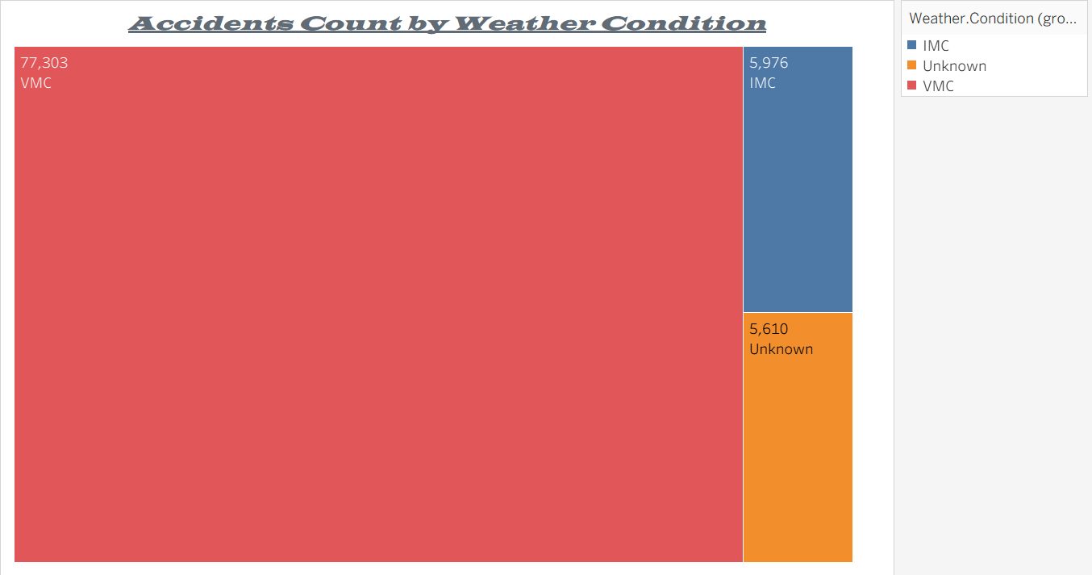
Accidents by Weather
Most accidents happen in good weather, but poor weather increases the risk of severe outcomes.
Flying in Instrument Meteorological Conditions (IMC) requires more advanced training and equipment.
Weather awareness and preparedness are key to safe operations, especially for private aircraft.

Slide 11
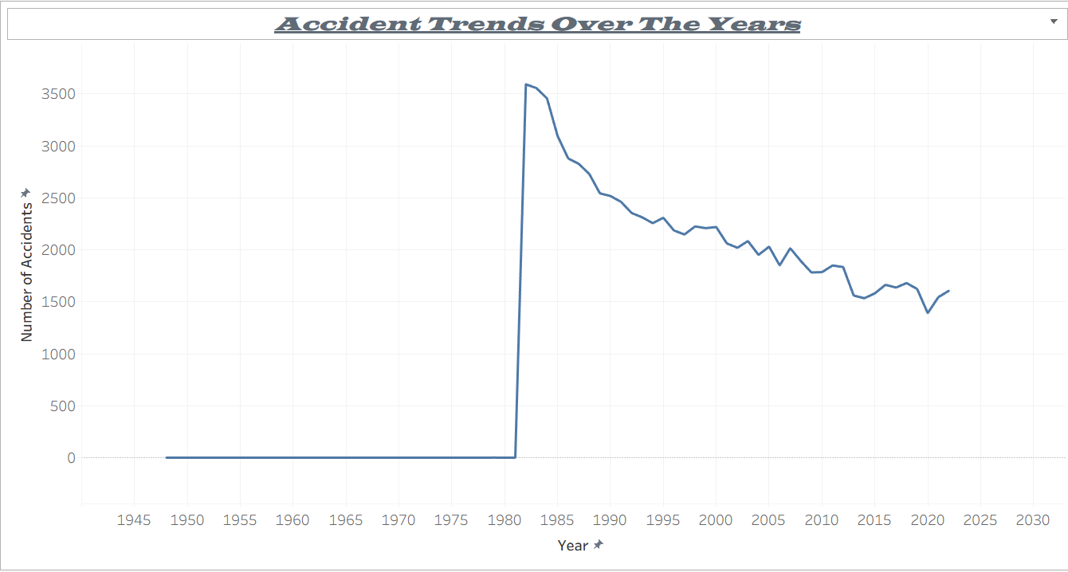
Trend Over Time
The number of accidents has generally declined over the years.
Improvements in technology, regulation, and training are making flying safer.
Investing in newer, modern aircraft models aligns with long-term safety trends.

Slide 12
Business Recommendations
Choose aircraft models with low accident and fatality history for investment.
Avoid types that frequently crash during landing or in poor weather.
Prioritize models with high survivability and modern safety features.

Slide 13
Next Steps
Conduct cost-benefit analysis for top recommended aircraft types.
Engage manufacturers to validate safety records and support readiness.
Create internal training and safety plans for risky flight phases and poor weather.
Continue monitoring trends to adjust strategies as the aviation industry evolves.

Slide 14
Thank You + Questions
Thank you for your attention!
Please feel free to ask any questions.
Warren Patsi
Email: patsiwarren@gmail.com
LinkedIn: linkedin.com/in/yourprofile

