Slide 1
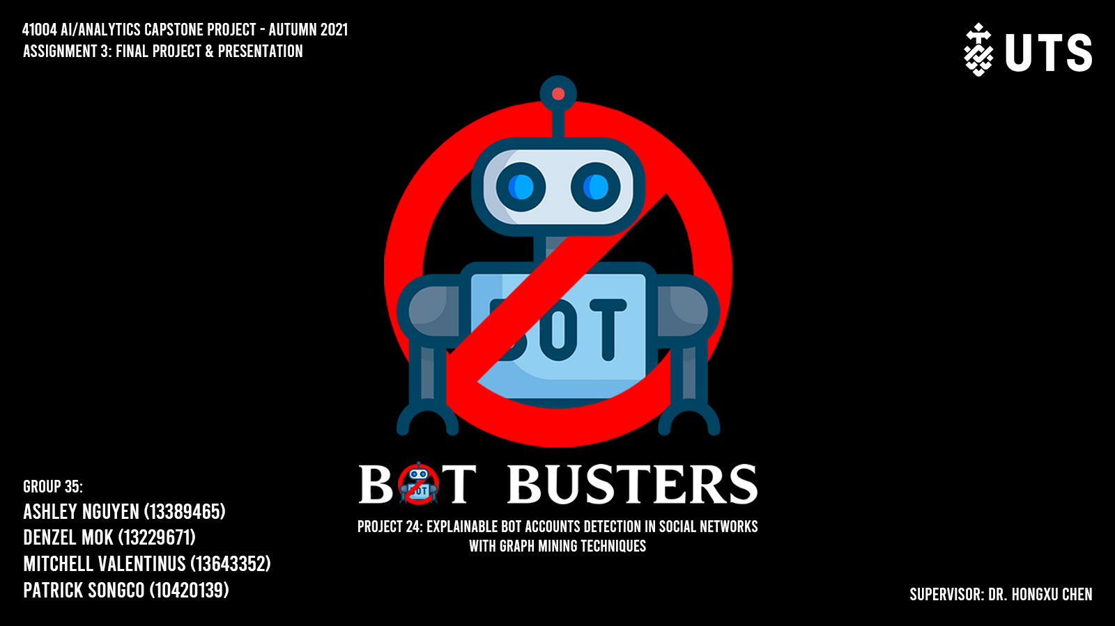
Notes:
Good afternoon everyone, we are Group 35: Bot Busters and our project is explainable bot accounts detection in social networks with graph mining techniques.
The goal of this project is to analyse current progress in social bot detections, visualise it and study the possible application of graph-based algorithms to the detection procedure.

Slide 2






Problem
Data Preparation
Modelling
Difficulties
Future Work
Findings
The Problem with Bots in the Cryptocurrency Ecosystem
In 2018 based on Lielacher & Pickering (2020),
1.3 BILLION FAKE ACCOUNTS
40% FAKE ACCOUNTS
5% FAKE MONTHLY USERS
One of the biggest issues with modern social media is the prevalence of fake or inauthentic accounts. These fake accounts and bot accounts are often made by hackers, scammers, or even nation-states with the purpose of:
Misinformation
Increasing fake engagements
Making scams easier
Notes:
Bots have been around for a long time, in 2018. Facebook disclosed that they have 1.3b fake accounts and their monthly users, 5% of them are fake. For Twitter, they estimated that 40% of their users are not real. These high numbers surely are not healthy for the social ecosystem.
Now, after we know how important social medias are to cryptocurrency, bots can be a real threat to the ecosystem. Bots themselves are fake or inauthentic accounts that are made to provide misinformation, increasing fake engagements, and even making scams easier.

Slide 3
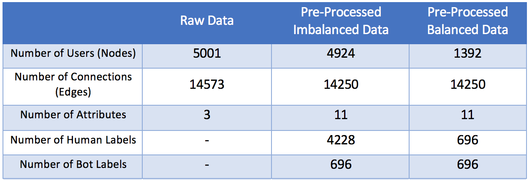
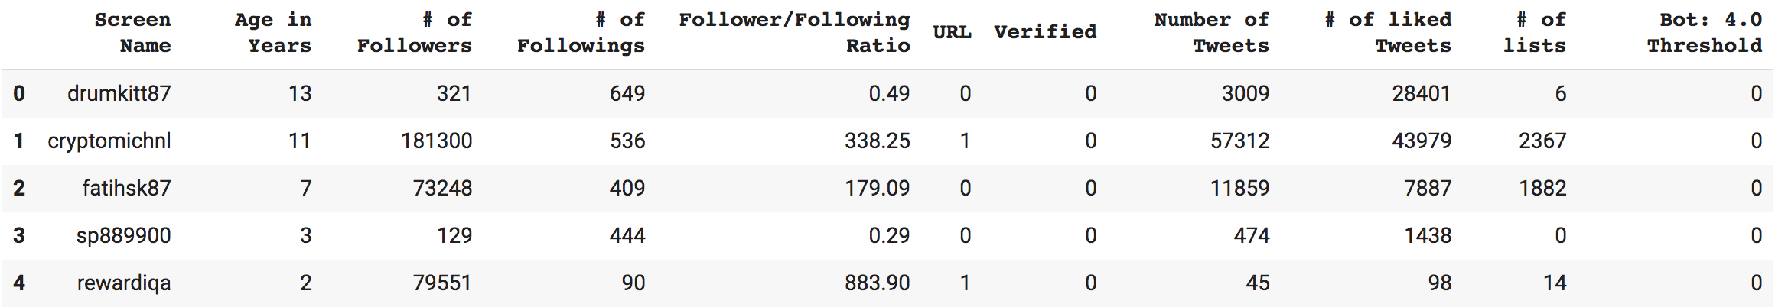
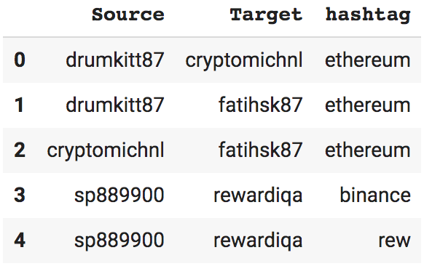
Problem
Data Preparation
Modelling
Difficulties
Future Work
Findings
Data Collection Process
Twitter and Gephi API to scrape Twitter users
Botometer API to label users as bot/human
Data Pre-Processing
Address the class imbalance
Nodes Table
Edges Table
Notes:
Brief overview of data collection process ~30 sec
To obtain a dataset with labelled bots we used the Twitter and Gephi API’s to scrape 5001 users connected by 14573 connections. This gave us a nodes and an edges table. These users were then labelled as bot or human using the Botometer API. Some further data pre-processing such as adding or removing features and outliers detection was completed. Finally, a balanced dataset was created by down sampling the majority class (humans). The final dataset statistics and the examples of the two tables are shown.

Slide 4
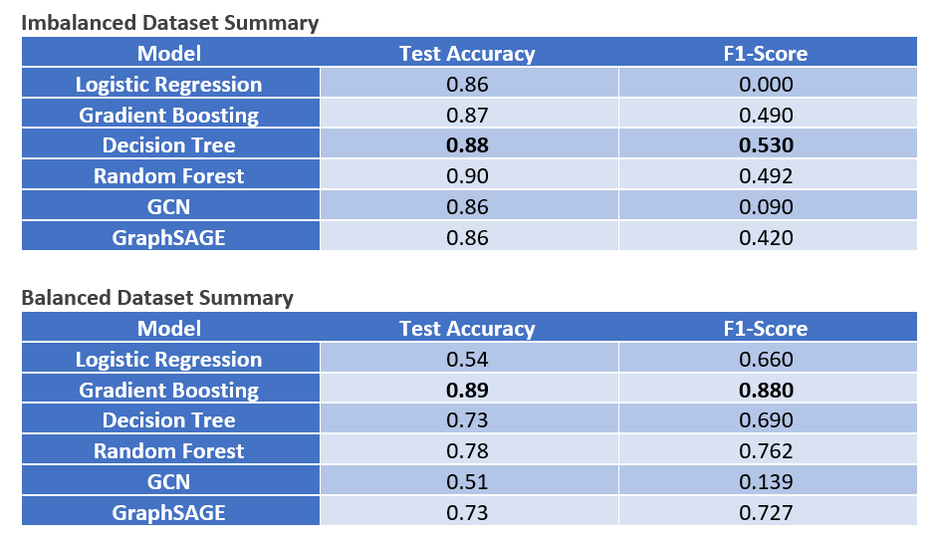
Problem
Data Preparation
Modelling
Difficulties
Future Work
Findings
Results
Notes:
Now we present the results of our modelling.
In summary, the model that obtained the highest accuracy and F1-score was the Gradient Boosting model with a bot detection accuracy of 89% and an F1-score of 0.88.
This model was trained on a balanced dataset, meaning there was no class imbalance. This may propose some problems going forward because in real world datasets, it may be difficult to obtain a dataset with such a large number of labelled bots. K-fold validation, up sampling the minority class (bots) and down sampling the majority class (humans) is recommended when training models to ensure a higher accuracy in bot detection.
Of the graph-based machine learning models, GraphSAGE performed the best. We have also tested unsupervised models for this bot detection task, however their F1 scores (well below 0.1) seem to prove that a supervised or semi-supervised model would be more suitable for this project.

Slide 5
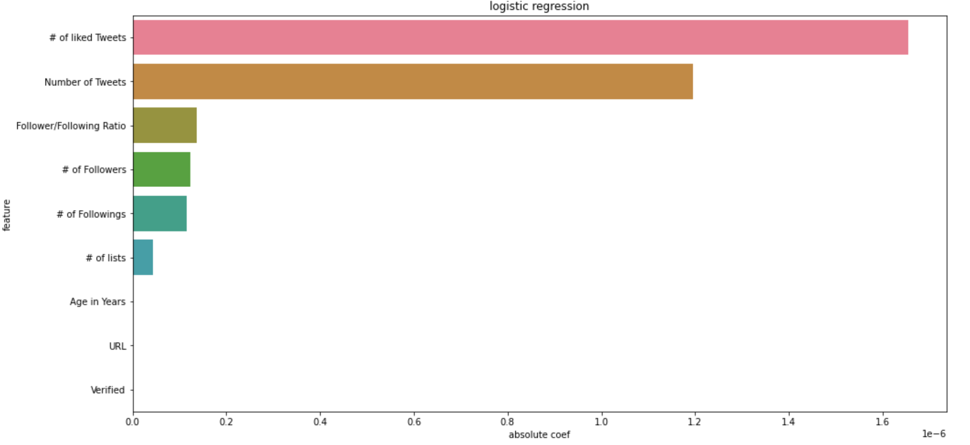
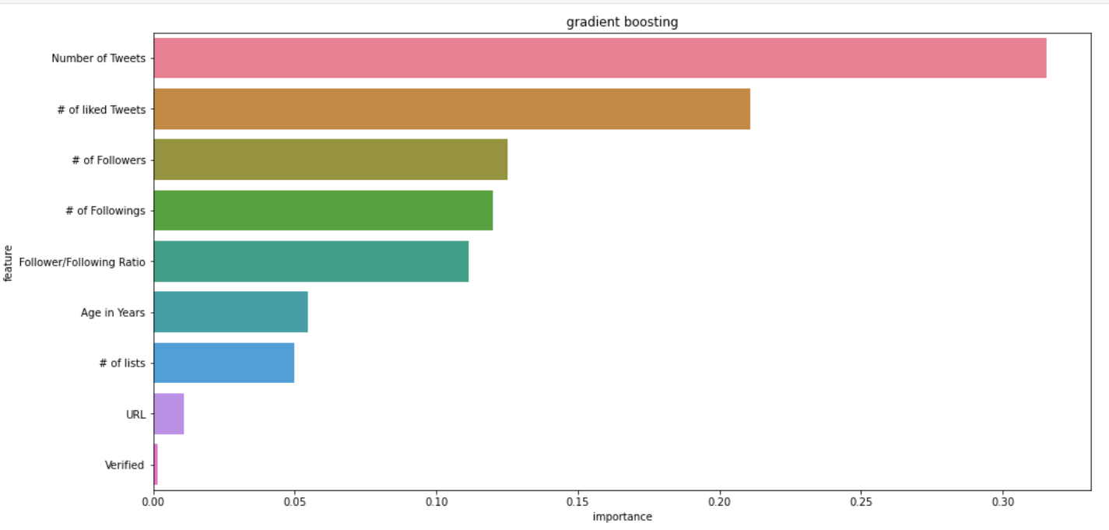
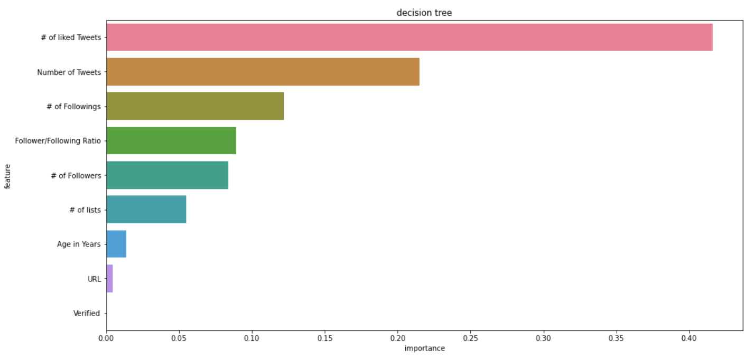
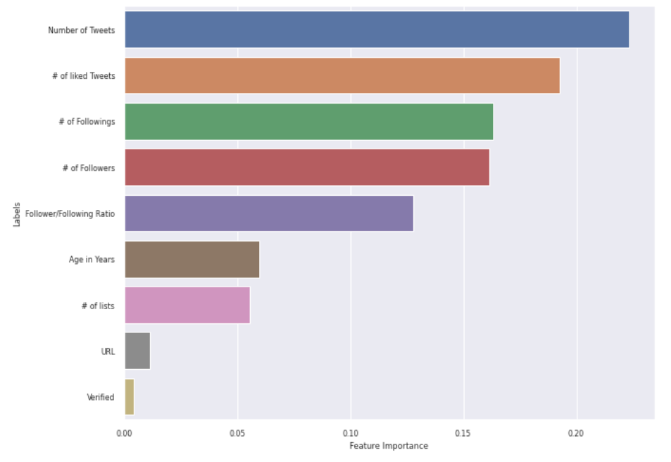
Problem
Data Preparation
Modelling
Difficulties
Future Work
Findings
Feature Importance
Notes:
Next, we move onto the findings of our project. These figures rank importance of features using the traditional machine learning methods. This was obtained by plotting the amount of times a feature was used in the predictive model. From these results we can see that all models concluded that the Number of liked Tweets and Number of Tweets were the most important features when detecting bots.

Slide 6
Problem
Data Preparation
Modelling
Difficulties
Future Work
Findings
Network Visualization
Bot
Human
Notes:
Next we visualise the entire dataset on Tableau with the bot accounts coloured in red and the human accounts coloured in blue. Qualitatively, we can see that bots are distributed around the entire network and the bot clusters tend to aggregate around the human clusters suggesting that the bot accounts may be trying to imitate human behaviour to evade detection.

Slide 7
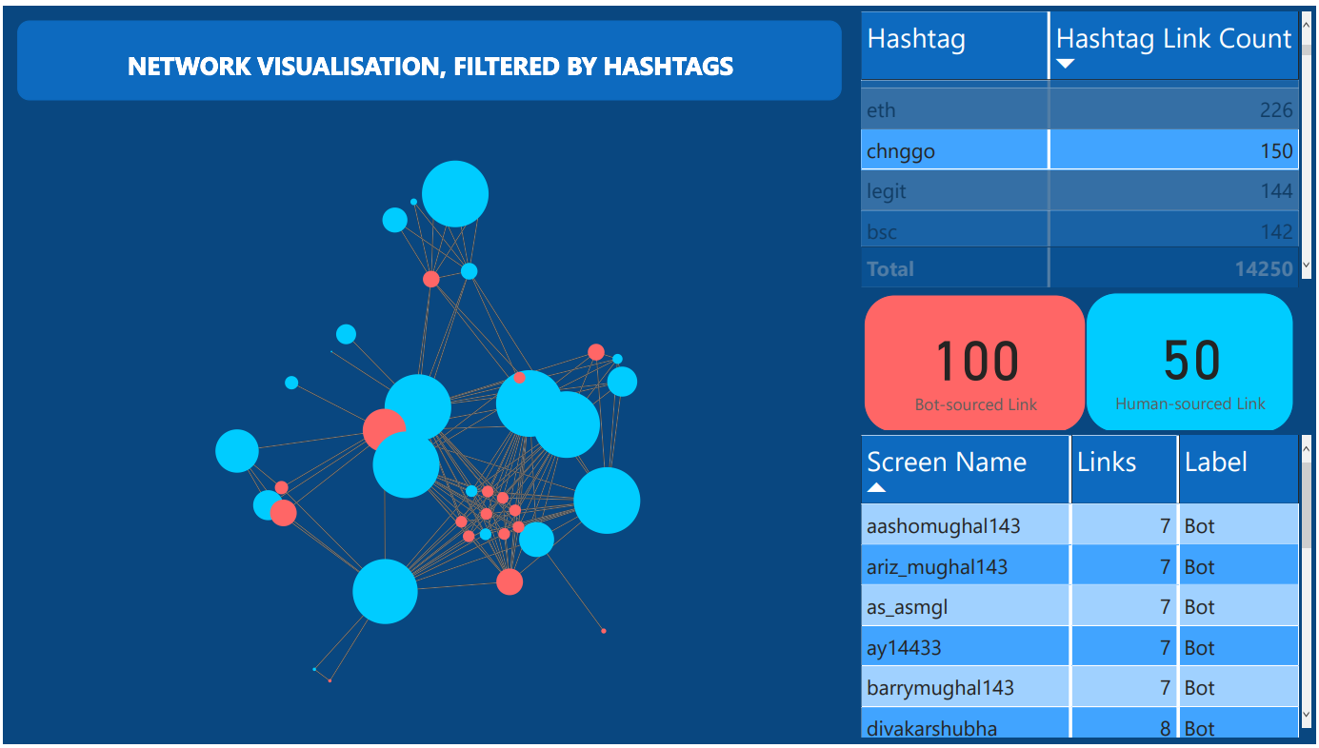
Problem
Data Preparation
Modelling
Difficulties
Future Work
Findings
Possible Hashtag-triggered Botnet
Notes:
From the network visualisation above, we suspected that these Twitter bots might have been triggered by certain hashtags. By plotting the network graph on Power BI, we have been able to identify the hashtag with most connections from bots (out of the most popular 20). Above is a visualisation for bots connected together via the hashtag #chnggo, with two thirds of its activities started by accounts categorised as bots. The weight of the nodes was deemed by the number of connections it has (from either a source or a target position). Since bots accounts are smaller in sizes, meaning that it has less interaction with other accounts, we can assume that the activities by bot accounts happen after the human one was posted. In future research activity timestamps could be added to further explore this.
As the graph suggested, most of these bot accounts will interact with the human accounts, assuming to either disguise themself as legitimate users or to boost the interaction of the original Tweet by human accounts. The results from Screen Name table suggested that these bot-deemed accounts all have very similar names, meaning in future research NLP can be applied to help improve bot detection process.
After adding username as node labels, we found out the circled cluster includes all the similar names showed on the table.

Slide 8
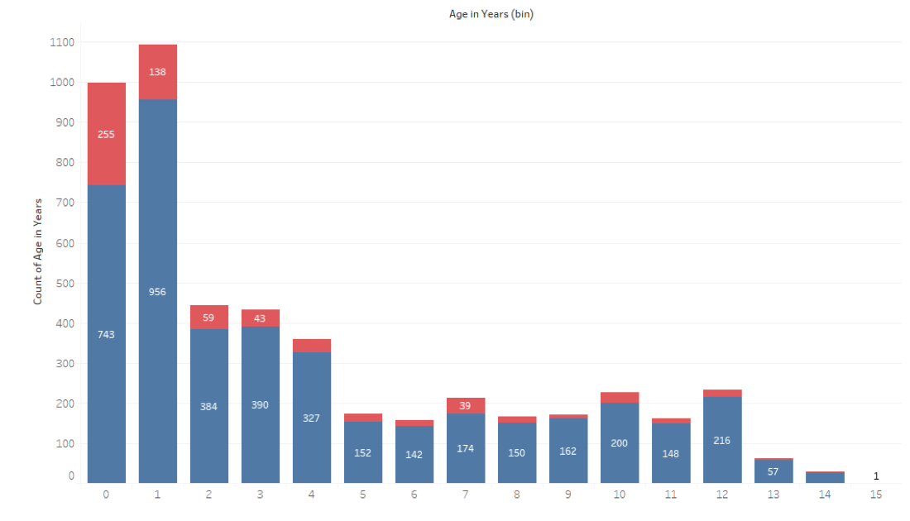
Problem
Data Preparation
Modelling
Difficulties
Future Work
Findings
Age of Account Distribution
Bot
Human
Notes:
We would also like to mention some previous findings from our data analytics process, such as most bots accounts are "fresh" - meaning they were around a year or less

Slide 9
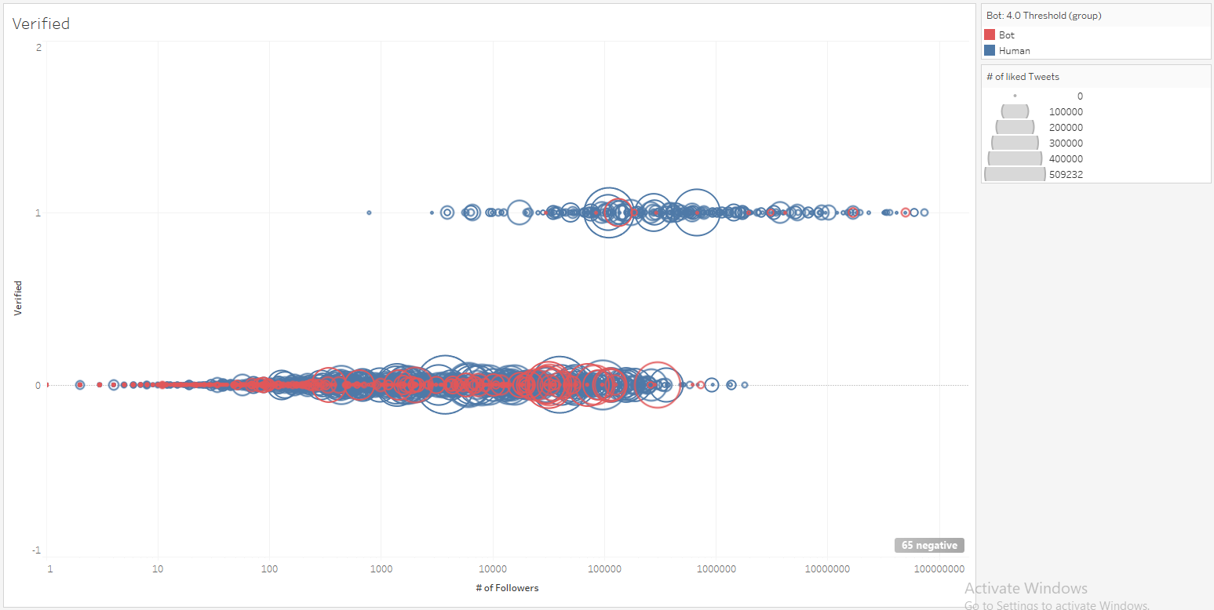
Problem
Data Preparation
Modelling
Difficulties
Future Work
Findings
Verification Check
Bot
Human
Number of Liked Tweets
Notes:
Almost all bot accounts are non-verifiable.

Slide 10
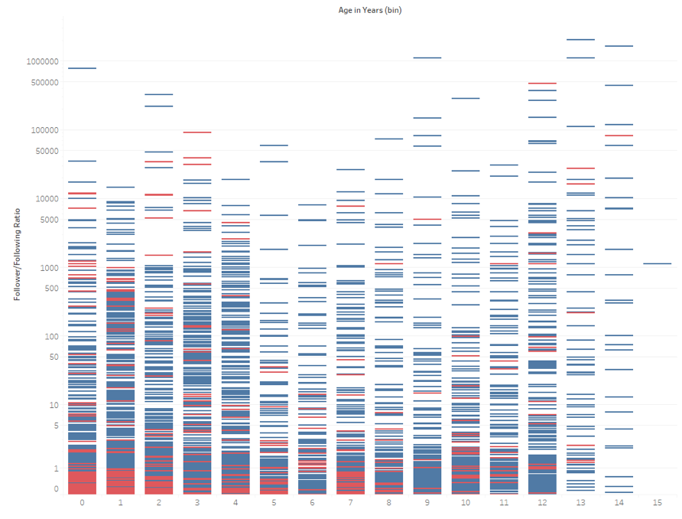
Problem
Data Preparation
Modelling
Difficulties
Future Work
Findings
Follower/Following Ratio vs Age in Years
Bot
Human
Notes:
Only newer bots followed the assumption that social bots have a low follower/following ratio.

Slide 11
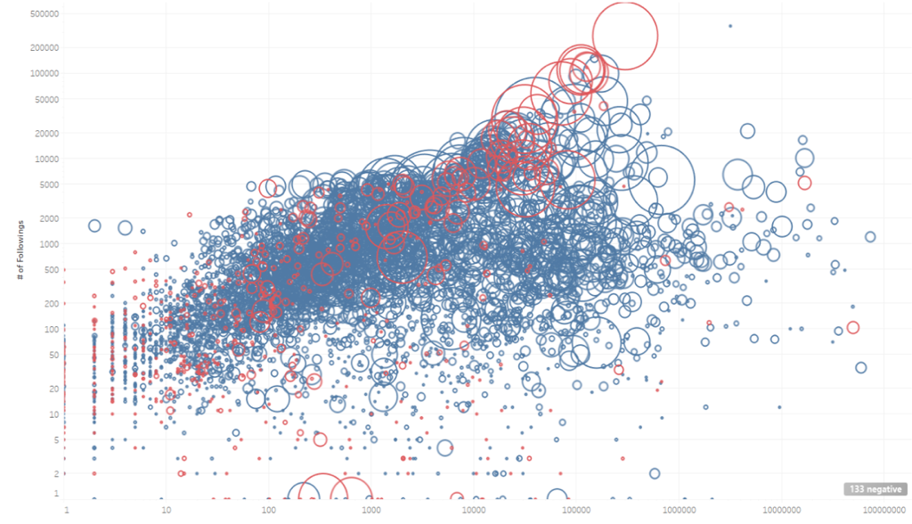
Problem
Data Preparation
Modelling
Difficulties
Future Work
Findings
Follower vs Following Ratio
Bot
Human
Notes:
Bot accounts with higher number of followers and followings tend to have higher number of liked Tweets as well. Possibly attempting to mimic human users.

Slide 12
Problem
Data Preparation
Modelling
Difficulties
Future Work
Findings
Findings Summary - Detection
Supervised Learning > Unsupervised Learning
Traditional ML Methods > Graph-Based ML Methods
Most Important Features: # of liked Tweets & # of Tweets (Twitter user interactive activities)
Notes:
After training and test different bot detection models based on both traditional Machine Learning algorithms and graph-based models, we have come to the conclusion that an ideal bot detective model must be supervised as unsupervised models don’t seem to perform well with the features as well as the given dataset (For instance, PCA as an unsupervised model did not work well with large dimension datasets, or one hot encoded features – we have several in the dataset). Another finding is that traditional ML models tend to perform better than graph-based when considering an individual bot account.
We have also identified # of liked Tweets and # of Tweets as the most important feature used in ML models, meaning that these models categorise these bots based on their interaction activities online.

Slide 13
Problem
Data Preparation
Modelling
Difficulties
Future Work
Findings
Finding Summary - Explainability
Correlation Matrix and Initial Data Understanding
Model Accuracy and Feature Importance
Applied Explainability on Traditional ML models
Bot Cluster Detection
NLP data processing: Tweet contents, hashtags, usernames, etc.
Notes:
Although we have not been able to develop a novel methodology using explainable artificial intelligence for bot detection, through our research we have been able to address key findings for future development of such model. The findings on Correlation Matrix and dataset analysis provide us with an understanding of the fields used in Twitter bot detections, meaning that we are provided with an initial understanding of which field values could indicate a bot account (Age of Account, Verification, and how active the account is on Twitter via Tweets postings/liked Tweets and Follower/Following). These features are then double checked and ranked by the predictive models to determine the most influential features (that we now learned as # of liked Tweets and # of Tweets).
By running the models we have also noticed that the implementation of an explainable method must be a supervised model for the best result (as Gradient Boosting and Decision Tree in our model). Graph-based models might be suitable for detecting bot clusters, however, not only they provided a lower accuracy, but also they would not be as explainable as the tradition machine learning models.
From the network visualisations, bot clusters have also proved to be triggered by certain hashtags, meaning that in an XAI model the ratio between bot-sourced connections and human-sourced connection can also be taken into consideration. Other identified aspects that could be included in explainability are NLP with the Tweet contents, hashtags and usernames, as well as timestamps of Twitter activities.
However, our visualisations and evaluation also illustrate the propensity for bots to mimic human behaviour leading to a widespread distribution of bot accounts within the network. This makes the task of bot detection increasingly complicated and difficult to generalise. We recommend further analysis into this behaviour as it is likely an ongoing issue due to the sophistication of the available methods.
~2 mins

Slide 14

Problem
Data Preparation
Modelling
Difficulties
Future Work
Findings
Difficulties Encountered
Imbalanced dataset with more human labels than bots
Rate limits on data collection and bot scoring procedures
Different pre-processing techniques with initial modelling
Handling accounts removed by Twitter
Selecting appropriate Twitter tags for data collection
Solutions
Apply under-sampling and K-fold validation
Plan and prepare in advance
Generate a common pre-processed dataset
Assume deleted accounts are Bots
Supplement selection with trending and popular tags
Default Twitter Profile Picture
Image from: https://inspiretothrive.com/twitter-eggheads/

Slide 15

Problem
Data Preparation
Modelling
Difficulties
Future Work
Findings
Deployment Issues
Requires more data to generalise Bot detection outside of cryptocurrency
Future Work
Conduct further investigations into mining techniques
Incorporate Natural Language Processing to examine text-based features
Compare Bot behaviour across different social networks
Investigate Bot attempts to mimic human behaviour
Implement XAI on machine learning models and investigate the use of LIME novel methodology
Lesson Learned
Complex and advanced modelling may not lead to better results
Image from: https://www.gradjobs.co.uk/news-and-advice/so-whats-next

Slide 16
Questions?
Thank you
WHO YOU GONNA CALL? BOT BUSTERS

Slide 17
References
Boshmaf, Y., Muslukhov, I., Beznosov, K., and Ripeanu, M. (2013). Design and analysis of a social botnet. Computer Networks, 57(2):556–578.
Lielacher, A., and Pickering, A. (2020). Fake views: How social media bots distort the crypto narrative. Brave New Coin. https://bravenewcoin.com/insights/fake-views-how-social-media-bots-are-distorting-the-crypto-narrative
Shao, C., Ciampaglia, G. L., Varol, O., Yang, K.-C., Flammini, A., & Menczer, F. (2018). The spread of low-credibility content by social bots. Nature Communications, 9(1), 4787.

