Slide 1

EMACS: More Than A Text Editor
B.J.B Autonomous College
APR 25, 2022

Slide 2


Nitish Kumar Pattanaik
🌏https://nitishtalks.com/
PRESENTED BY:
71924531 | +3 Third Year | Computer Science |
Notes:
Hello, friends my name is Nitish Kumar Pattanaik and I’m a currently a student of BJB autonomous college 2019 batch. This id is my twitter id and this is my personal blog. Feel free to check it out. And that is my digital sign. This is all about me. Let’s jump into the topic.
This seminar is going to be a little bit practical oriented. Because I think whatever I will tell here, you should apply that in your day to day workflow. Otherwise what’s the point of this seminar.
When I joined +3 for computer science in 2019 there were a lot of enthusiasm about learning something new about technology. As I had one laptop which still runs windows, I try to do little bit of C coding with the notepad. And try to run that with the GCC compiler. But that notepad doesn’t make sense to use. Therefore I tried NetBeans IDE to code a little bit in “C” language. And then someone tells my that IDE is not good for beginners, you should use different text editors.

Slide 3
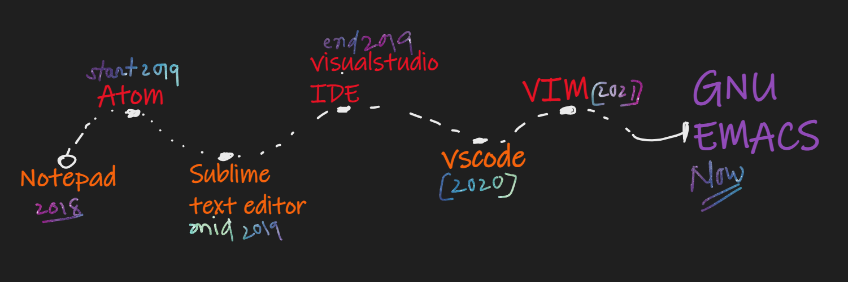
EDITORS I TRIED

Slide 4

WELCOME TO THE CHURCH
OF EMACS
EMACS Is More Than A Text Editor

Slide 5
EMACS INTRO
Definition: The extensible, customizable, self-documenting, real-time display editor.
Emacs was an acronym for "Editor Macros".
The original emacs was written in 1976 by David A. Moon. And Guy L. Steele Jr. as a set of editor macros for the TECO editor.
James Gosling write the UNIX variant of EMACS.
Now the most popular Emacs variant is GNU Emacs, which was created by Richard Stallman for GNU project.

Slide 6


REASONS TO CHOOSE EMACS
Customization
Org-mode
Evil-mode
Elisp language
Other features...

Slide 7
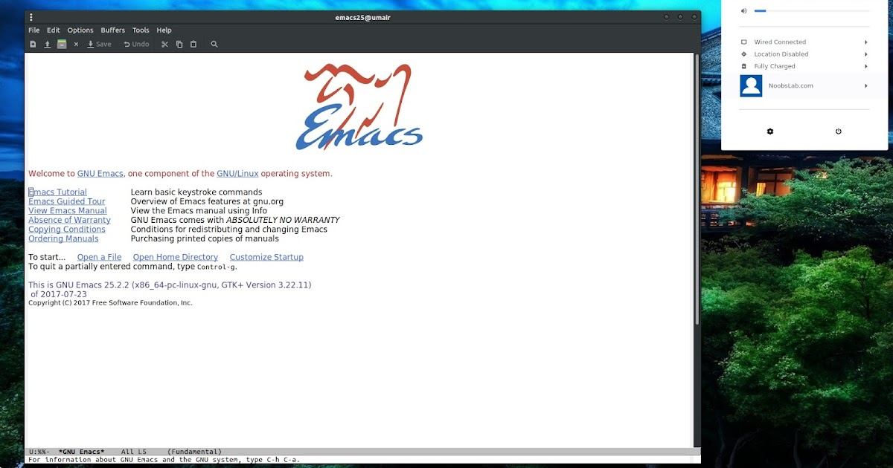
FIRSTLOOK @EMACS

Slide 8
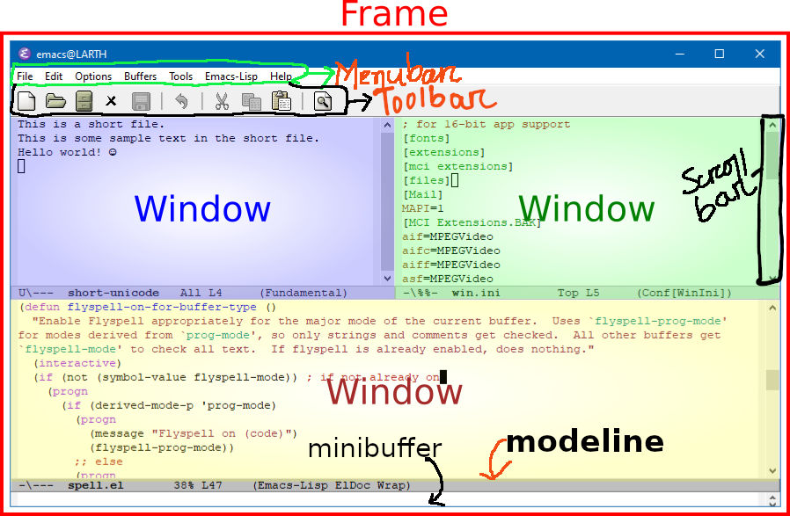
EMACS JARGON
menubar
toolbar
frame
windows
minibuffer
modeline
scrollbar

Slide 9
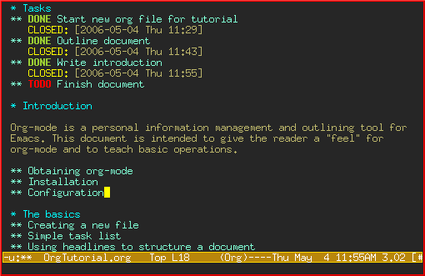

MY FAVORITES
org-mode
evil-mode

Slide 10
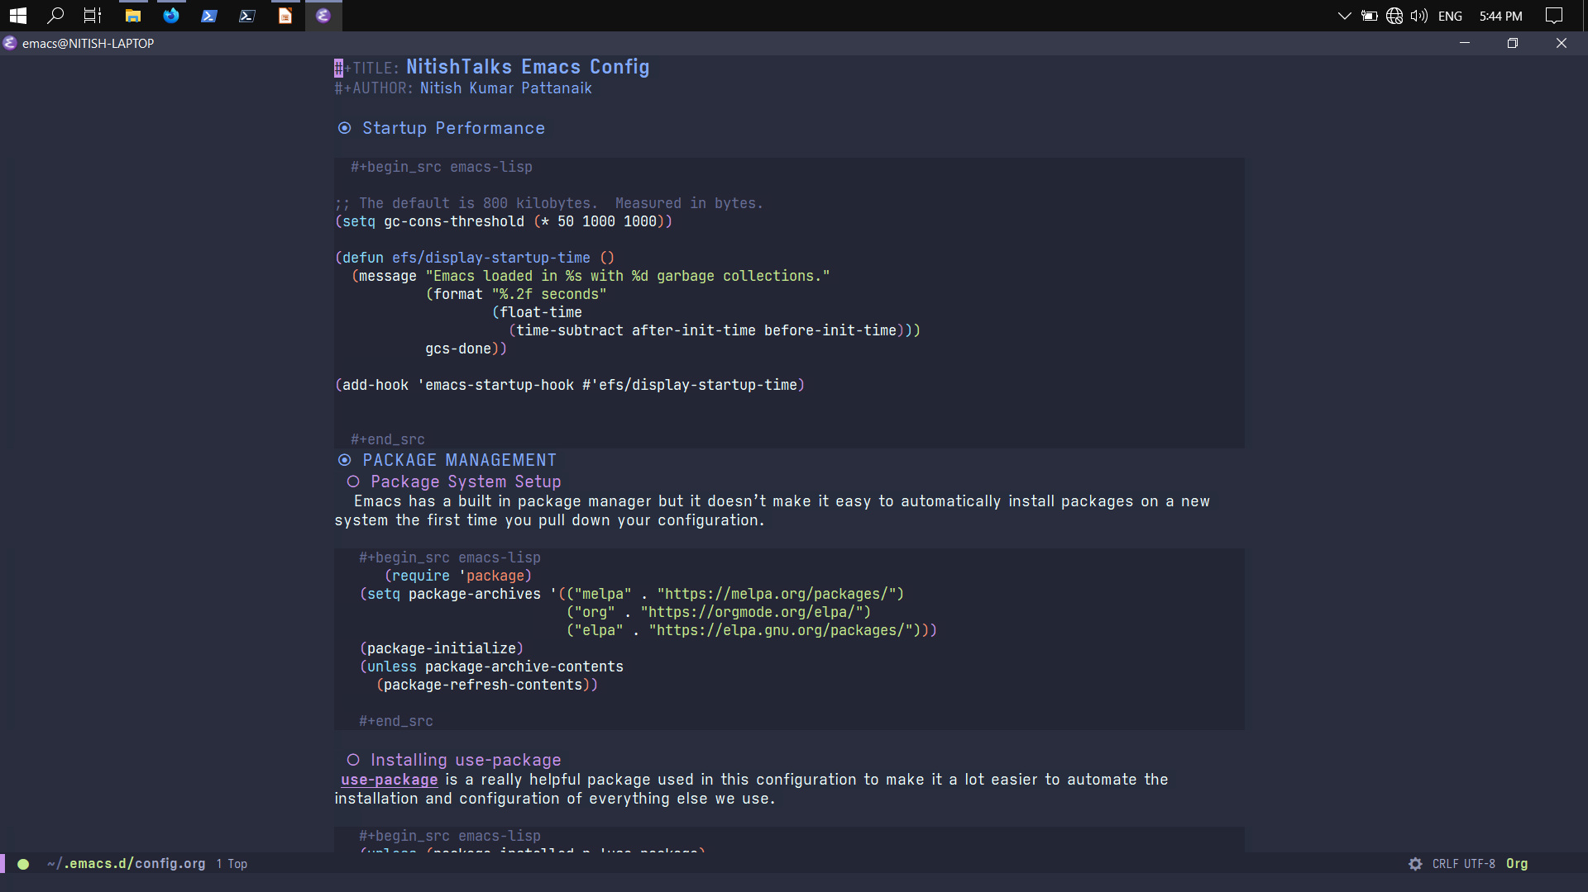
ORG MODE

Slide 11
THINGS THAT YOU CAN DO
All DEVELOPMENT FEATURES
Dired (file browser)
Magit (git client)
EWW(emacs browser)
Eshell (shell in emacs)
Mu4e (mail client)
EXWM (window manager)
Templates
Code completion
Inline code evaluation
Debugging
Intelliesense
Lsp support
- calculator
- calendar
- tetris
- ascii-art

Slide 12
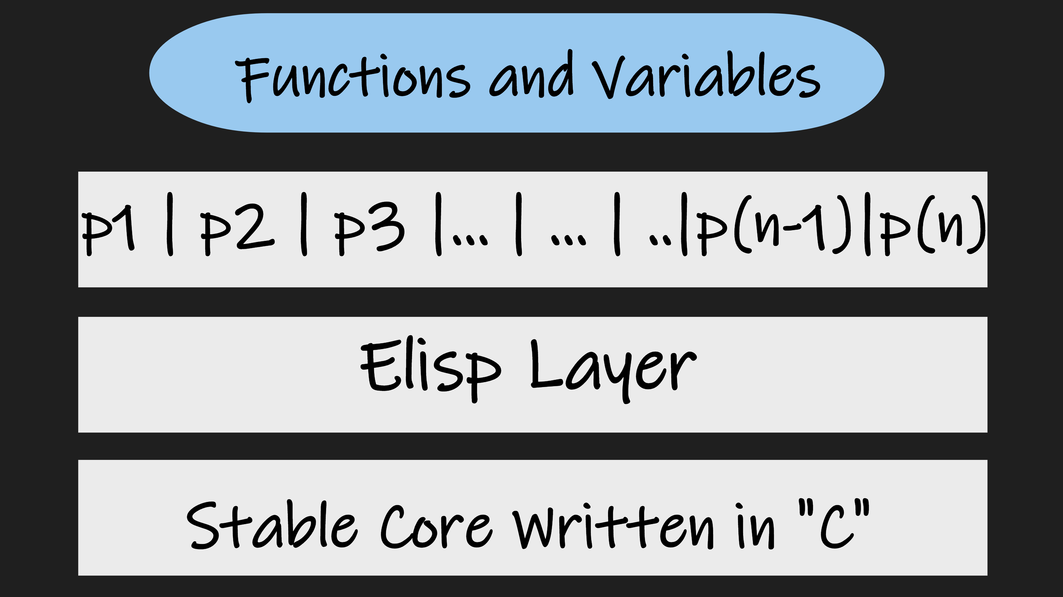
GENERAL ARCHITECTURE

Slide 13
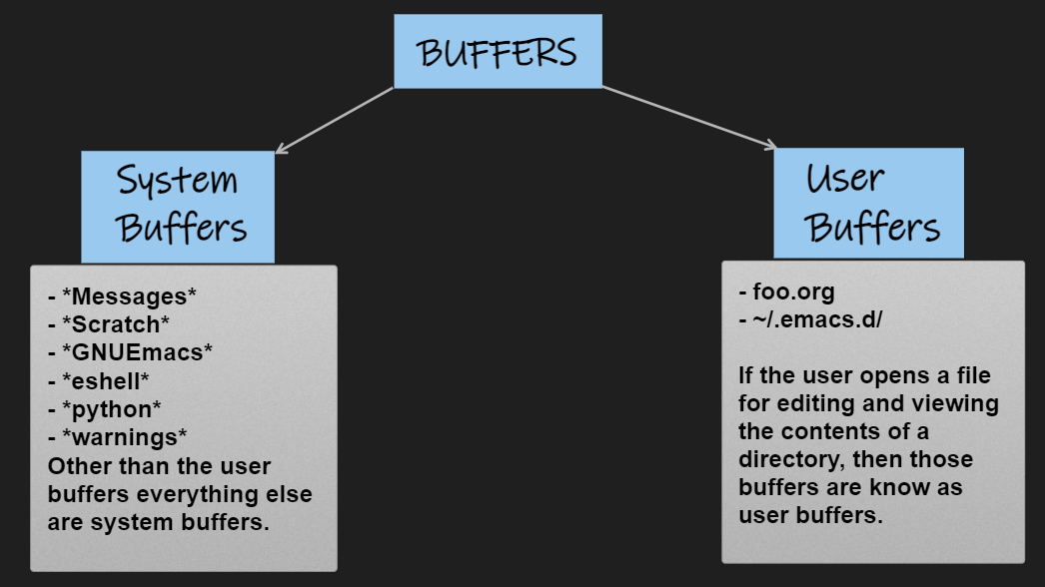
EMACS BUFFERS

Slide 14
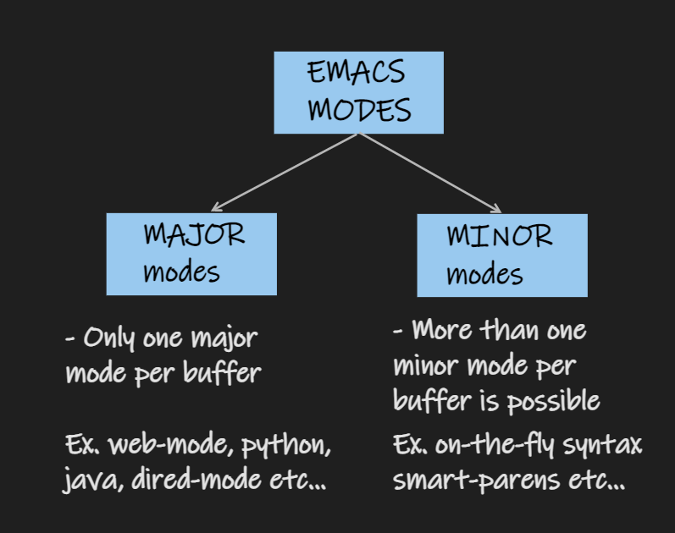
EMACS MODES
- MAJOR MODES
- MINOR MODES

Slide 15
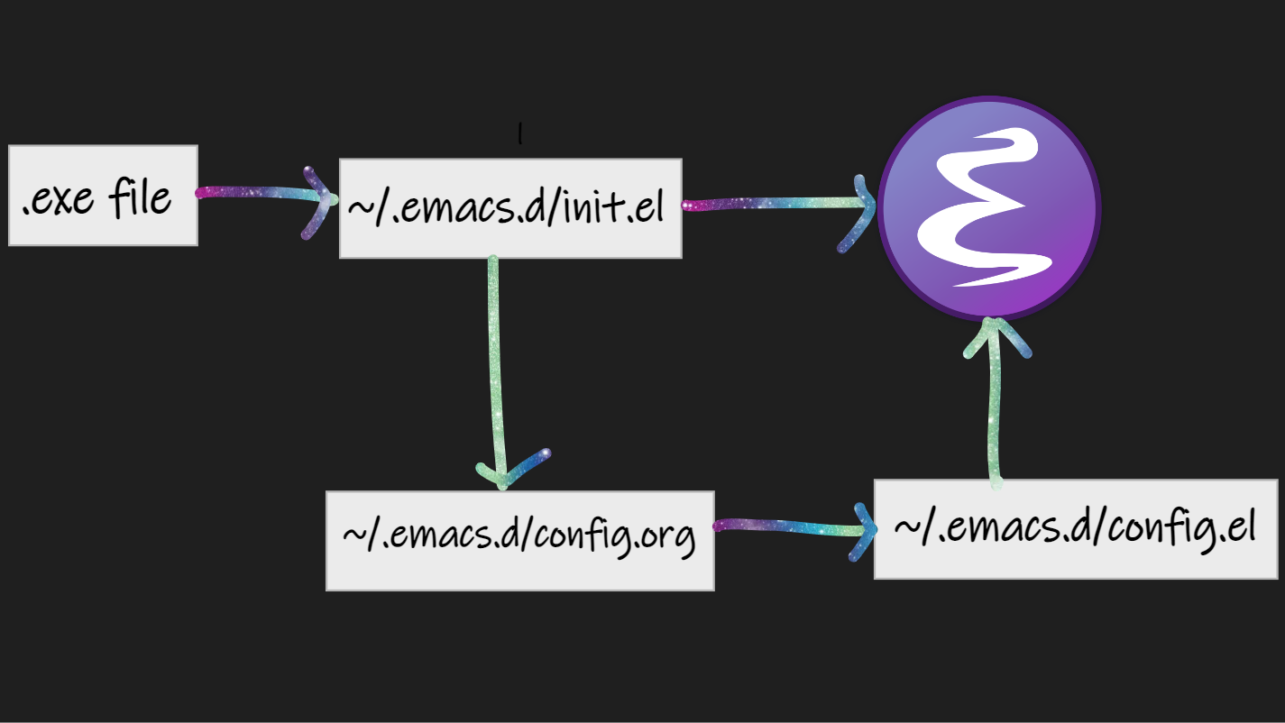
STARTUP PROCESS

Slide 16
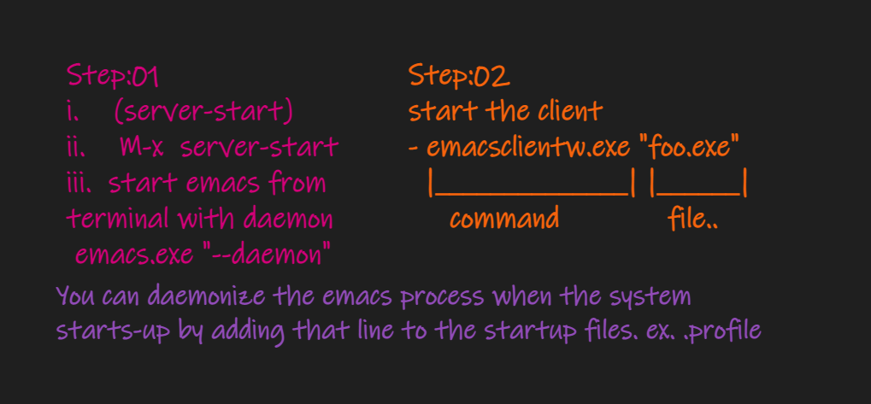
CLIENT –SERVER MODEL

Slide 17
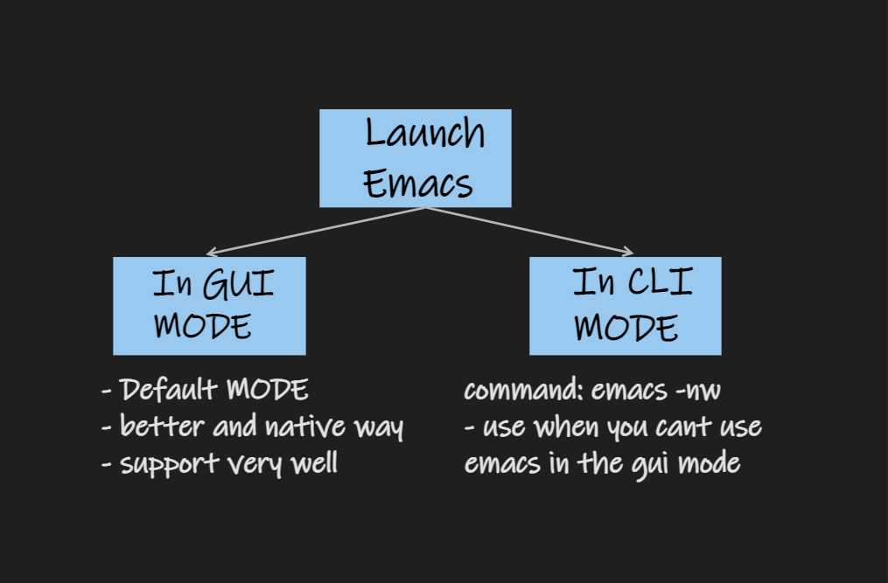
GUI AND CLI

Slide 18
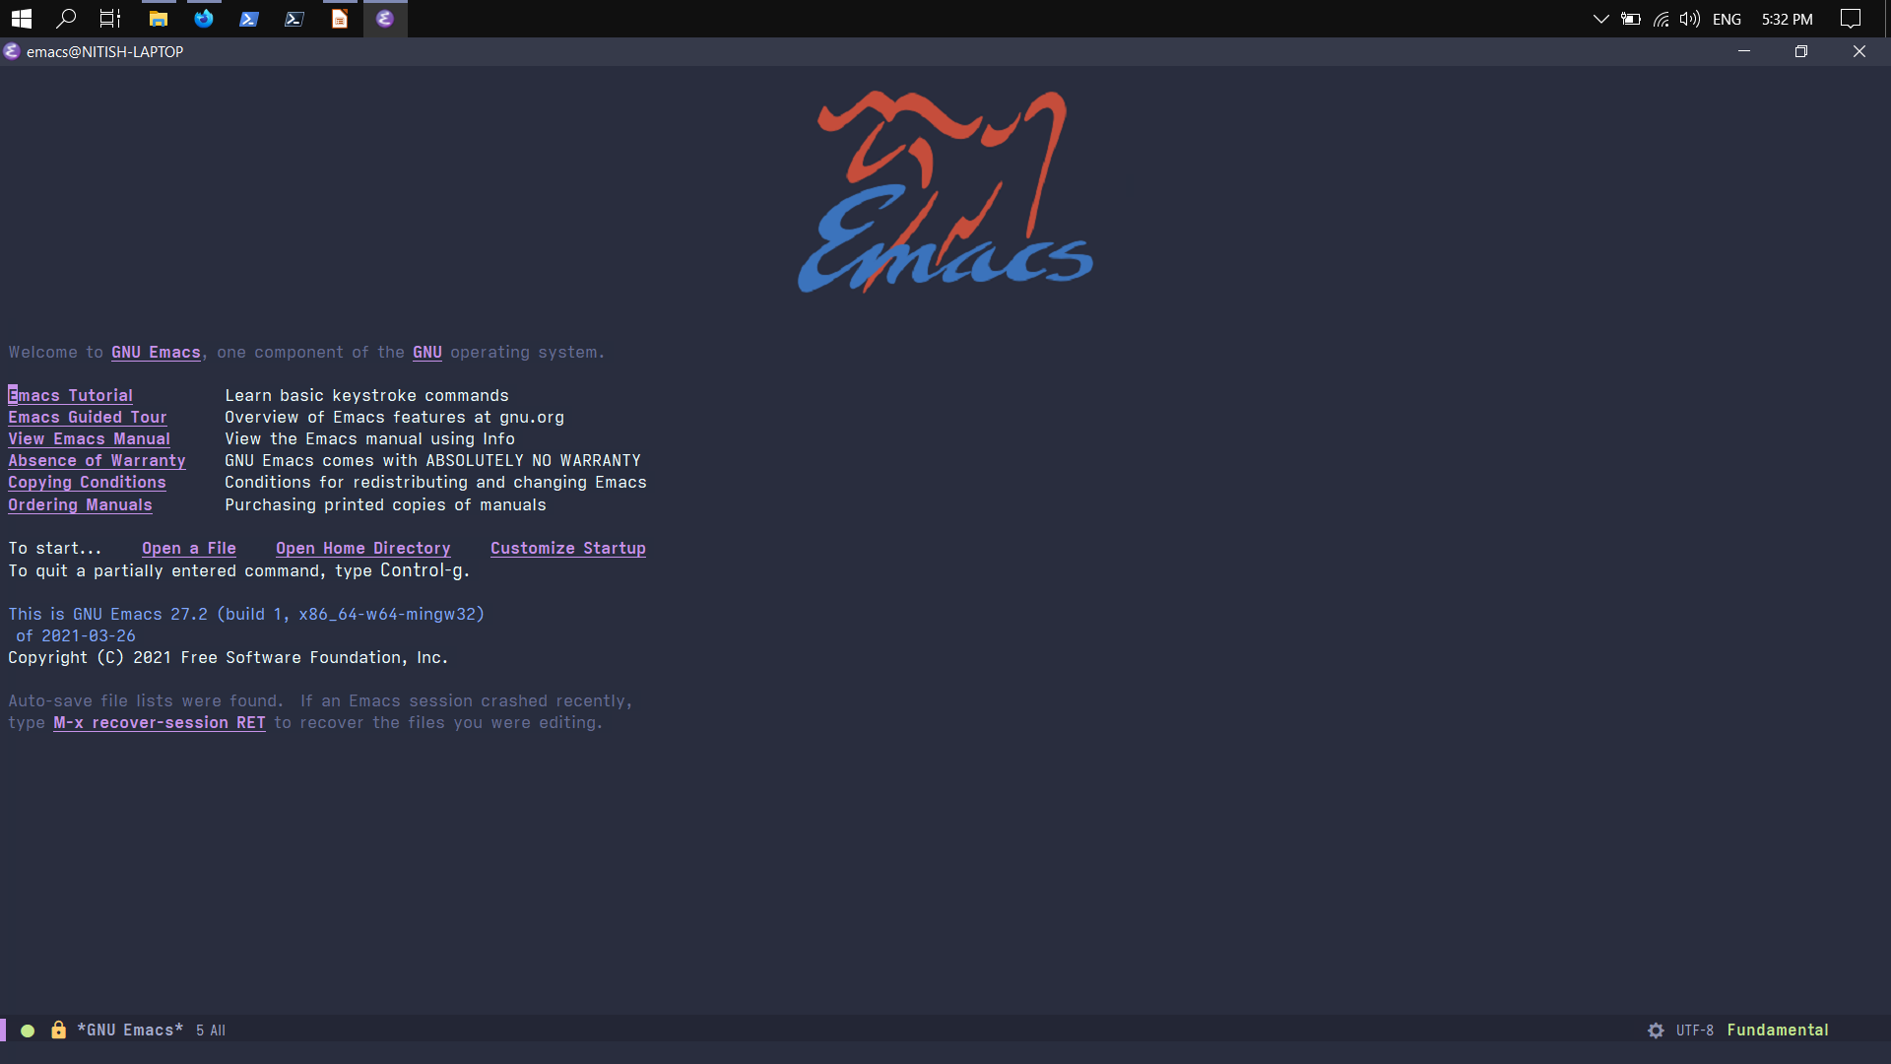
MY DASHBOARD

Slide 19
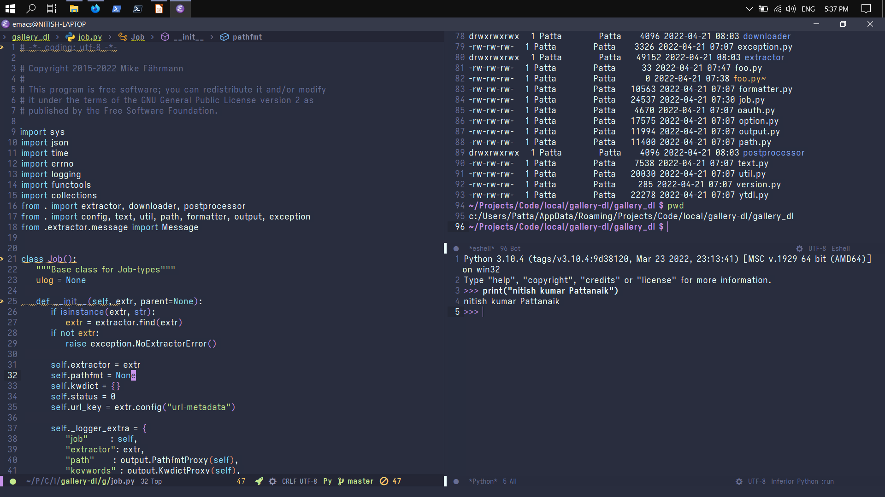
PYTHON DEVELOPMENT

Slide 20
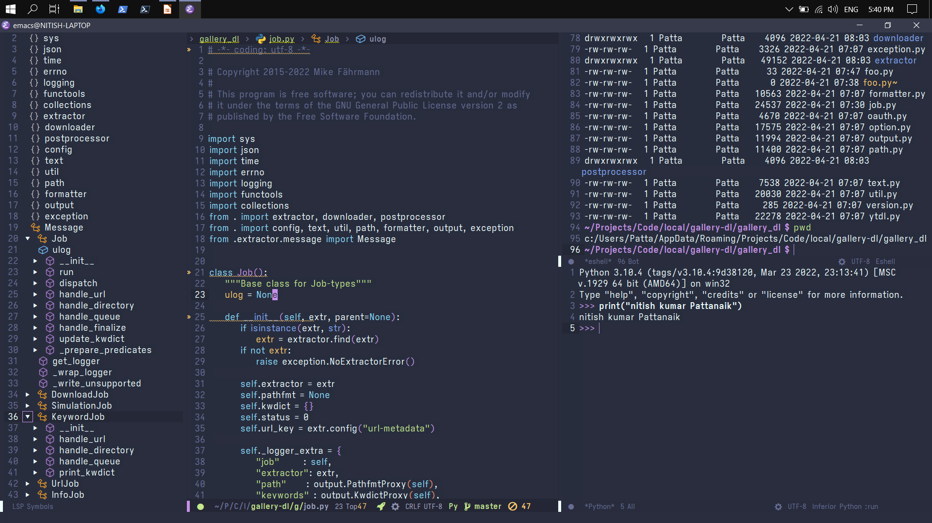

Slide 21

ANY QUERIES?
ASK ME ANYTHING>>>

Slide 22
ENDING QUOTE!!!
“Emacs is a great operating system, probably lacking only a decent text editor.”
THANK YOU>>>

