Slide 1




Nitish Kumar Pattanaik
🌏https://nitishtalks.com/
PRESENTED BY:
71924531 | +3 Third Year | Computer Science |
BJB Autonomous College, 2022
Notes:
Hello, friends my name is Nitish Kumar Pattanaik and I’m a currently a student of BJB autonomous college 2019 batch. This id is my twitter id and this is my personal blog. Feel free to check it out. And that is my digital sign. This is all about me. Let’s jump into the topic.
This seminar is going to be a little bit practical oriented. Because I think whatever I will tell here, you should apply that in your day to day workflow. Otherwise what’s the point of this seminar.
When I joined +3 for computer science in 2019 there were a lot of enthusiasm about learning something new about technology. As I had one laptop which still runs windows, I try to do little bit of C coding with the notepad. And try to run that with the GCC compiler. But that notepad doesn’t make sense to use. Therefore I tried NetBeans IDE to code a little bit in “C” language. And then someone tells my that IDE is not good for beginners, you should use different text editors.

Slide 2
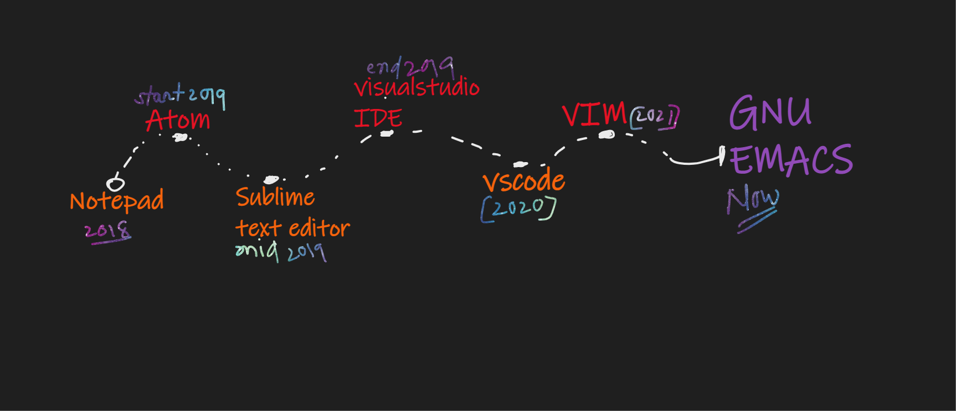
EDITORS I TRIED

Slide 3

WELCOME TO THE CHURCH OF EMACS
EMACS Is More Than A Text Editor
Notes:
WELCOME TO THE CHURCH OF EMACS>>>
What happened with me that I switched over to emacs..
What are the featured does it provide ?
First thing first what it is?
…
HOW MANY of you know about this text editor i.e. EMACS.
EMACS is more than a text editor. It can do a lot of things. But before that, I want to tell you why I switched over to emacs as my main text editor.
NEXT SLIDE>>>

Slide 4
EMACS INTRO
Definition: The extensible, customizable, self-documenting, real-time display editor.
Emacs was an acronym for "Editor Macros".
The original emacs was written in 1976 by David A. Moon. And Guy L. Steele Jr. as a set of editor macros for the TECO editor.
James Gosling write the UNIX variant of EMACS.
Now the most popular Emacs variant is GNU Emacs, which was created by Richard Stallman for GNU project.

Slide 5


REASONS TO CHOOSE EMACS
Customization
Org-mode
Evil-mode
Elisp language
Other Features
Notes:
Basically, I like 3 to 4 things about the EMACS which is really fascinating and interesting to me.
First thing first i.e. CUSTOMIZABILITY.. ( you can literally do anything with the EMACS)
ORG-mode (probably the most efficient way to take notes , organize your work flow, making to-do lists etc…
Don’t worry I will show you everything..

Slide 6
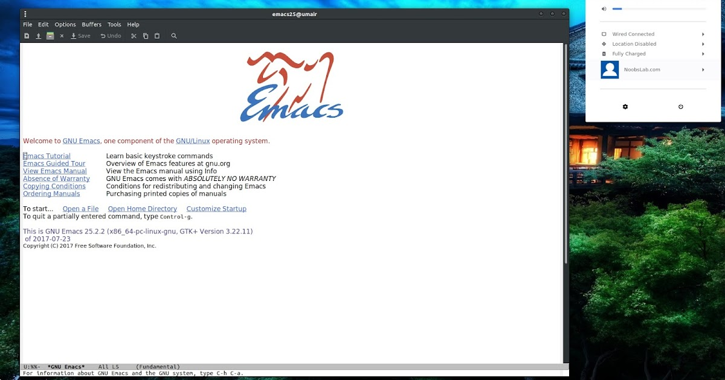
FIRST LOOK @EMACS

Slide 7
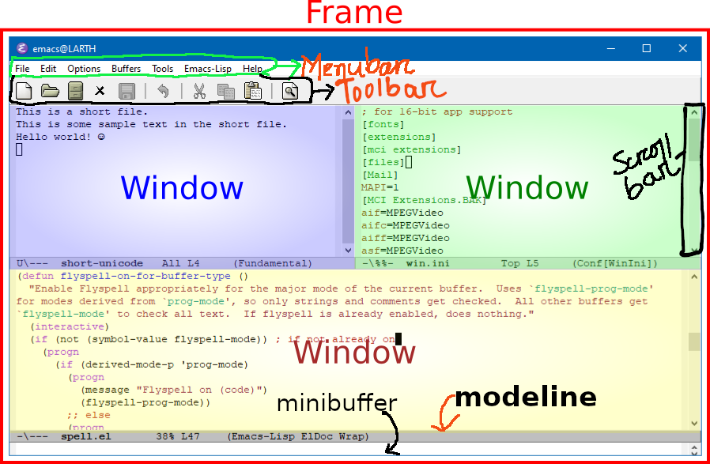
EMACS JARGON
Menubar
Toolbar
Frame
Windows
Minibuffer
Modeline
Scrollbar

Slide 8
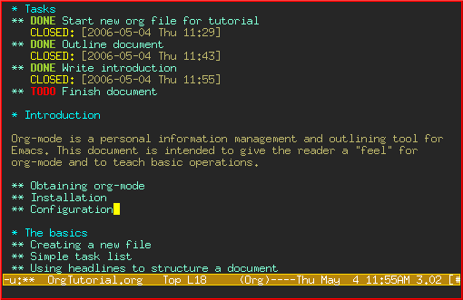

MY FAVORITES
Org-Mode
Evil-Mode

Slide 9
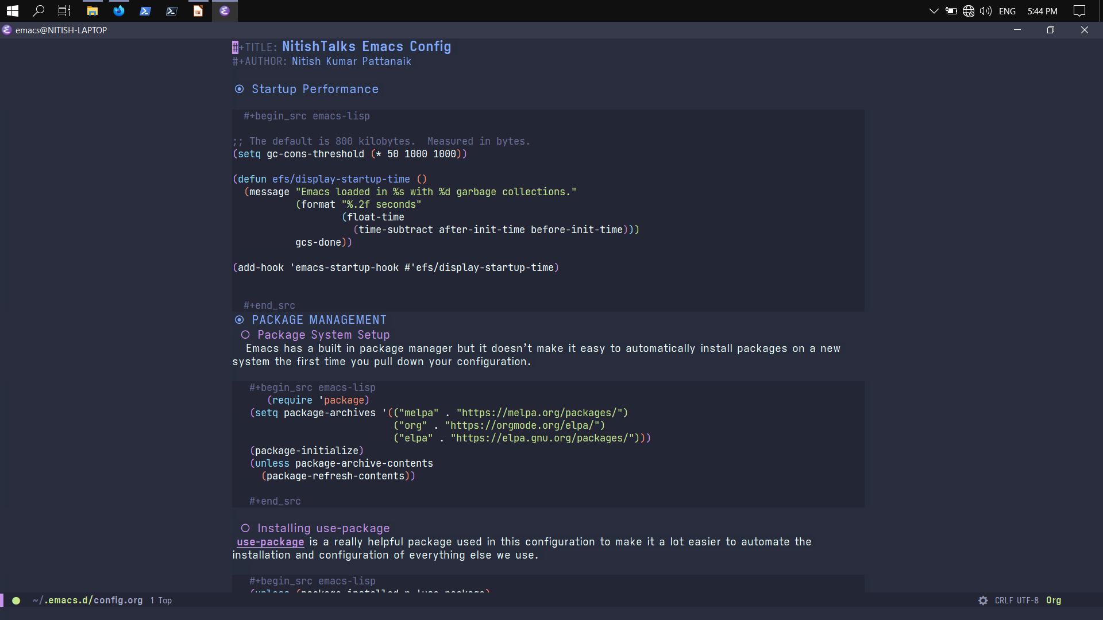
ORG MODE

Slide 10
THINGS THAT YOU CAN DO
Dired (file browser)
Magit (git client)
EWW (emacs browser)
EShell (Shell in Emacs)
Mu4E (Mail) Client)
EXWM ( Emacs Window manager)
Development Features
Templates
Code Completion
Inline Code Evaluation
Debugging
Intellisense
Lsp support

Slide 11
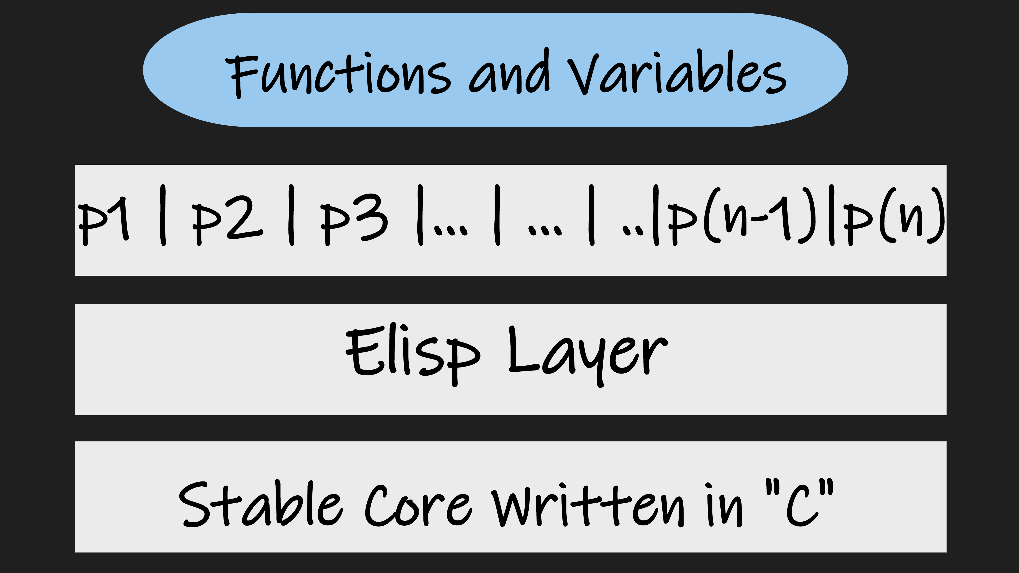
GENERAL ARCHITECTURE

Slide 12
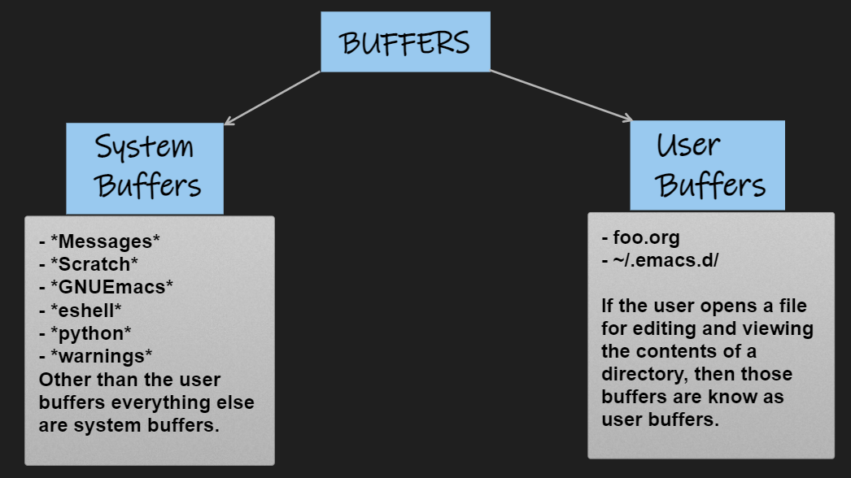
EMACS BUFFERS

Slide 13
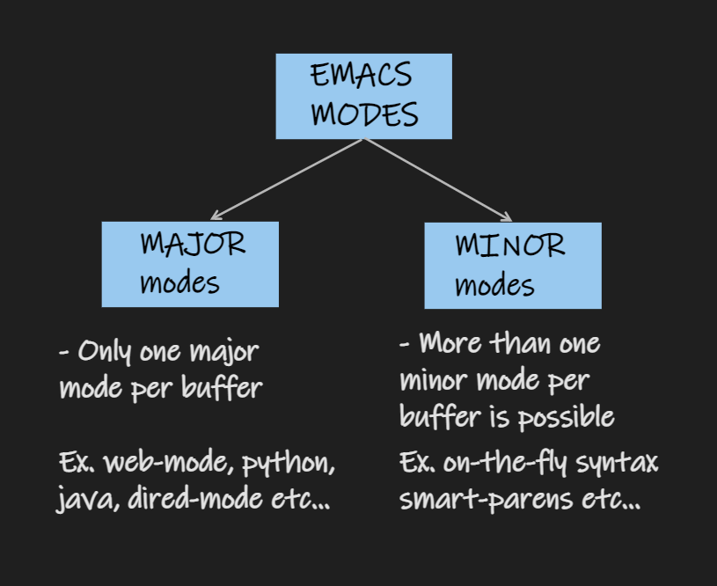
EMACS MODES
- MAJOR MODES
- MINOR MODES

Slide 14
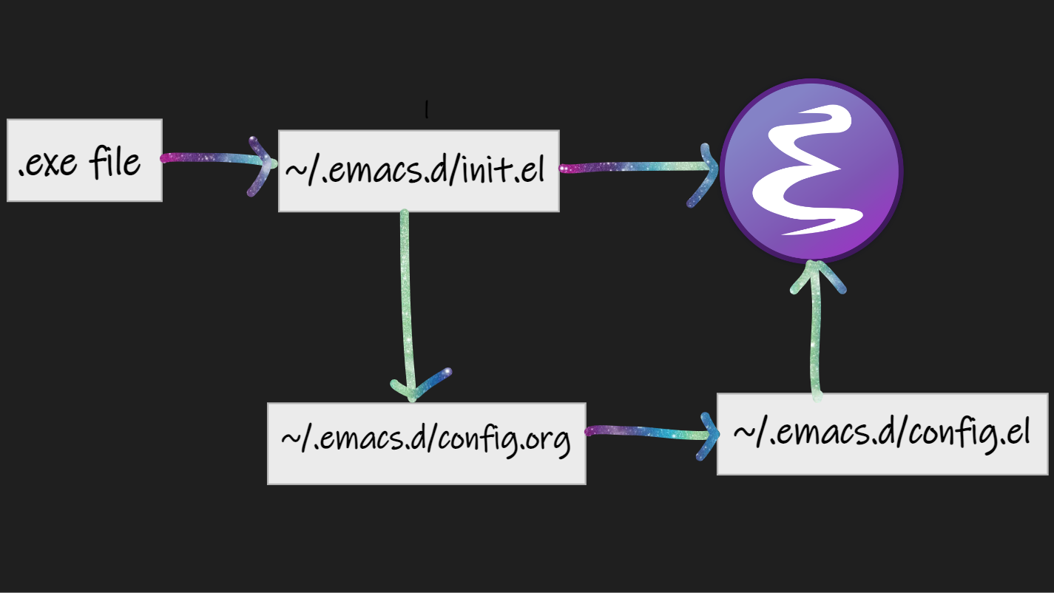
STARTUP PROCESS

Slide 15
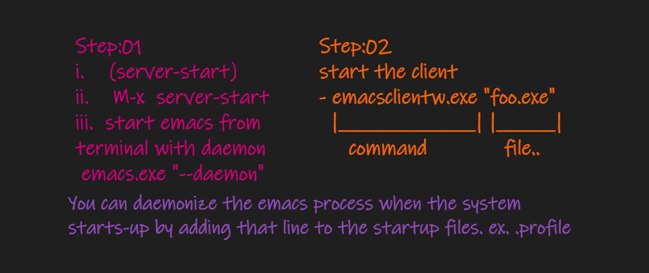
CLIENT –SERVER MODEL

Slide 16
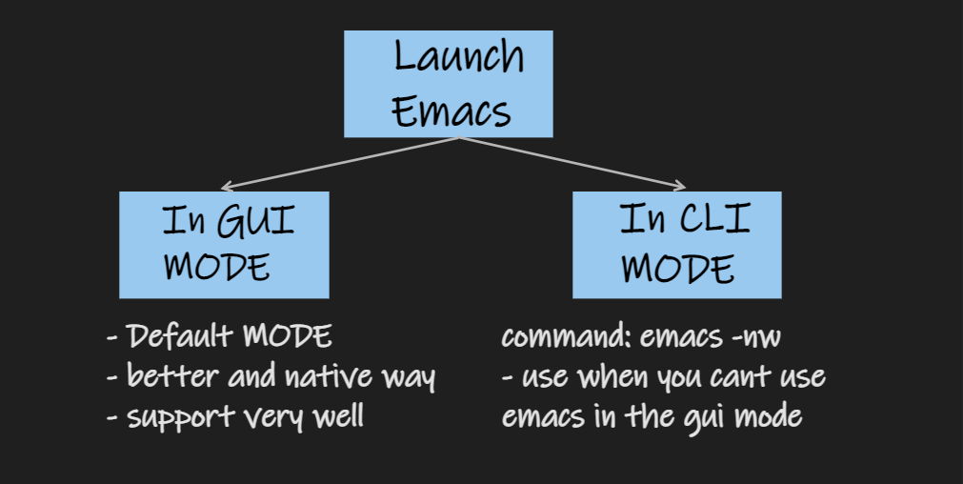
GUI AND CLI

Slide 17
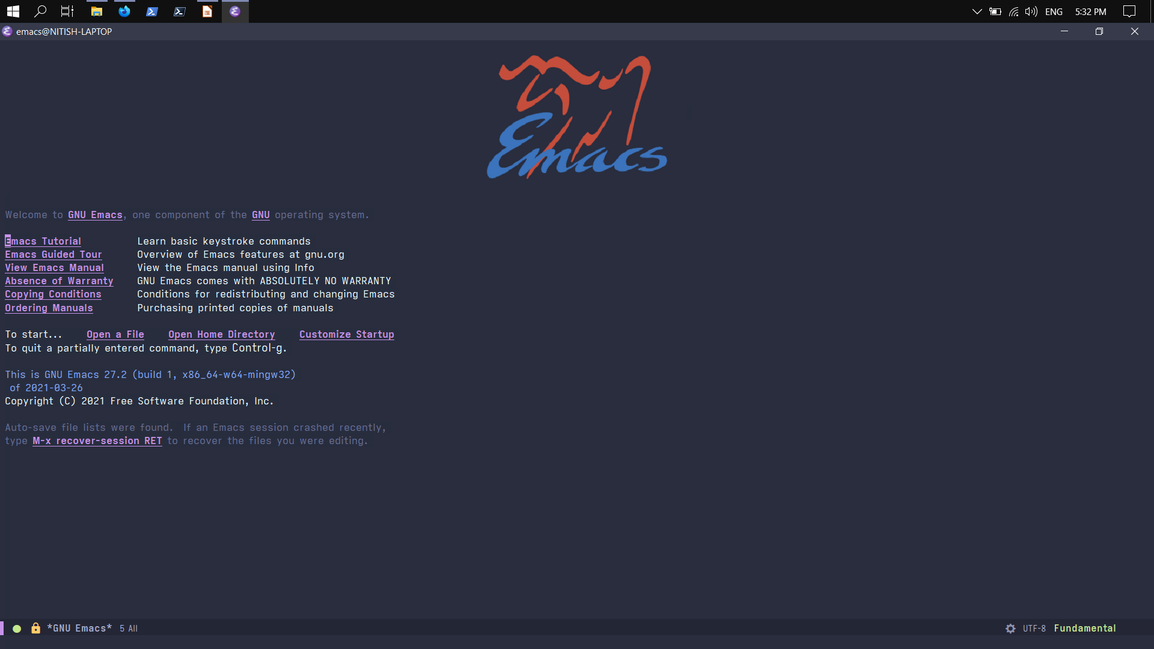
MY DASHBOARD

Slide 18
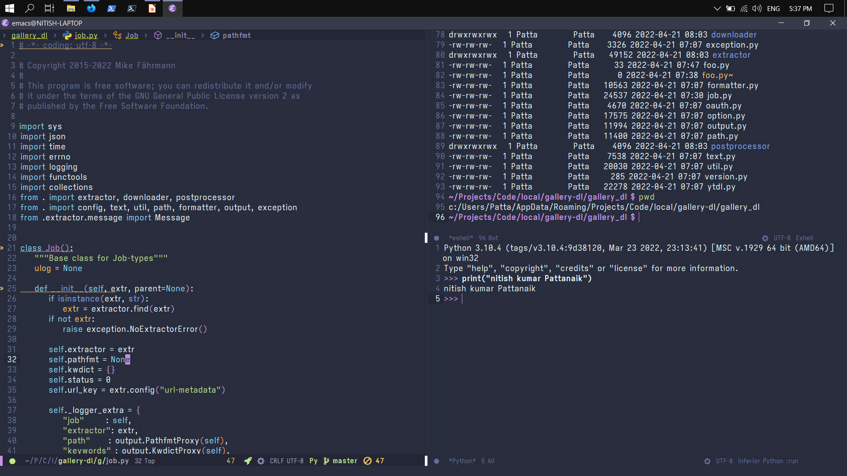
PYTHON DEVELOPMENT

Slide 19
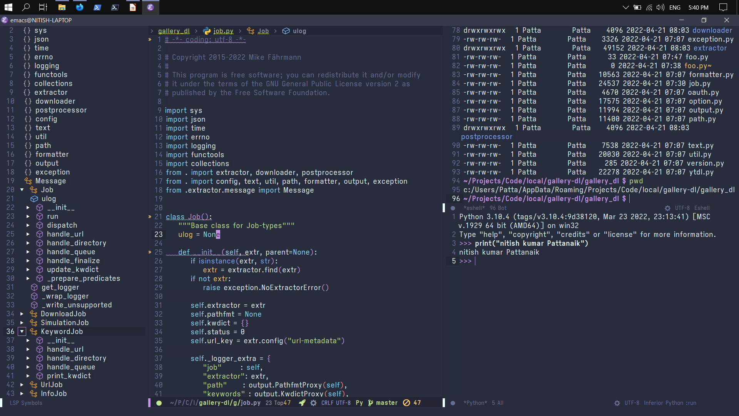

Slide 20

ANY QUERIES?
ASK
ME
ANYTHING

Slide 21
ENDING QUOTE…
“Emacs is a great operating system, probably lacking only a decent text editor.”
THANK YOU !!!

