Slide 1
Model Design
S1 Group 7 -จบเถอะ
Thanawat Thaset 1811340015
Pattanai Puangwijit 58113062-2
Supawit Srimahachot 58113077-0

Slide 2
Model Design : Automatic Fan
Case study 1: Automatic Fan
Given information
Ultrasonic Sensor
- Turn on when near the fan
- Turn off when away from the fan
7-Segment
- Display status of the fan

Slide 3
Model Design : Automatic Fan
Specification
System information
-MCU : STM32L152RB
-Sensor : HC-SR04 module
-Seven Segment
-Software :Keil/Language : C
Function
Function
-Detect user when near the fan
-Automatic on/off control
-Show status of the fan
-Delay 10 seconds to turn off after user leave the fan

Slide 4
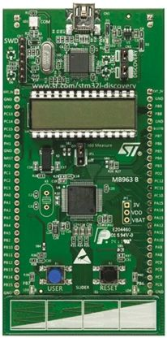
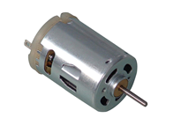
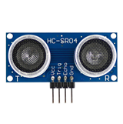
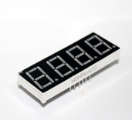
Model Design : Automatic Fan
Architectural Design
Motor
Ultrasonic Sensor
7-segment
Input
STM32l152RB
Output

Slide 5
Model Design : Automatic Fan
Architectural Design
Pin Used

Slide 6
Model Design : Automatic Fan
Start
Detailed design
Flowchart
7-Seg show off
Detect User
User
Sit?
no
yes
Turn on fan
7-Seg show on
yes
User Sit?
no
yes
>10 sec
no

Slide 7
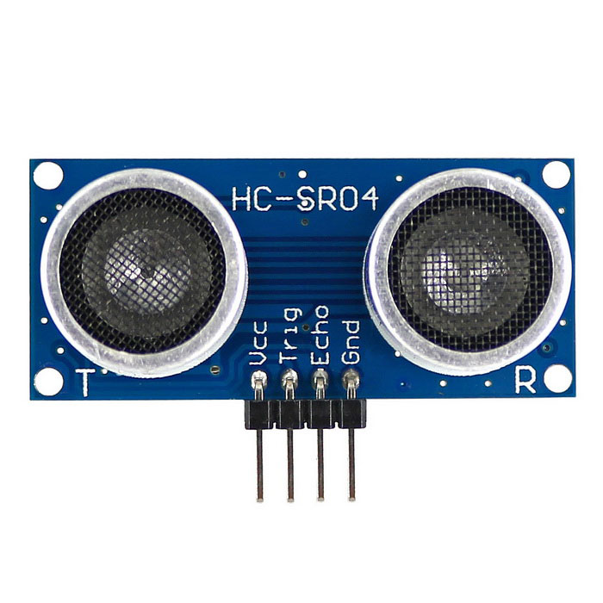


Model Design : Automatic Fan
Detailed design
Ultrasonic Sensor
Function:
Automatic on/off
Function:
Show status
Motor
7-segment

Slide 8
Model Design : Automatic Fan Project Plan

