Slide 1
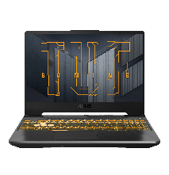
NODEMCU ESP32
start
Set model
Control motor
Feedback hip , knee and load knee
Send data Arduino to Python
Send data to computer
Send data Python to Arduino
Get data from computer
Update hip and knee

Slide 2
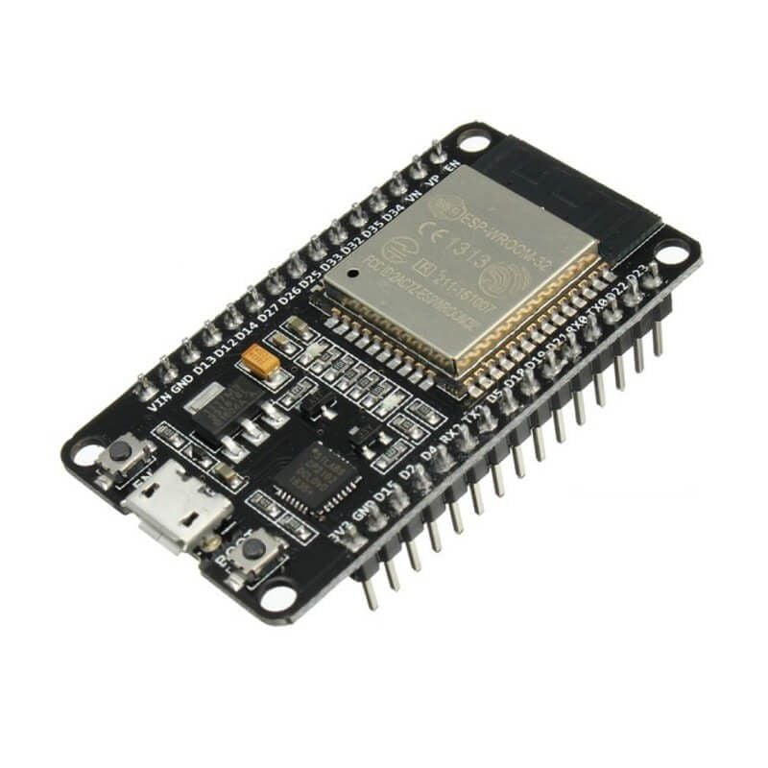
Computer
start
Send data Arduino to Python
Update hip , knee and load
Calculate O1 , O2
Update global O1 , O2
Update time peak global
Send position hip and knee
Send data Python to Arduino

