Slide 1


Network Policy Process
Red Hat Advisory — Shifting from perimeter to in-cluster segmentation.
Notes:
Welcome the audience and set context. This deck presents Red Hat's recommended approach for operationalizing in-cluster network segmentation on OpenShift. The customer's starting point is common: perimeter and east-west controls run through the firewall team on a traditional appliance, there is no in-cluster network policy, and developers have never written a firewall rule. The goal is not to pick tools or assign owners — it is to describe a process and a maturity path that the organization can adopt at its own pace. We will walk through where customers typically start, how to handle the developer skill gap, the CI/CD flow for policy changes, repo structure, day-two operations, the firewall team's evolving role, and what maturity looks like. Ask the audience: do you have a documented process for who authors, reviews, and approves network policies in your clusters today? The answer usually reveals the gap this deck fills.

Slide 2

STARTING POINT
Where you are today
Perimeter and east-west controls run through the firewall team on a traditional appliance today.
The organization wants to shift network segmentation left into the cluster — NetworkPolicy, AdminNetworkPolicy, EgressFirewall — but hasn't defined the workflow.
Developers are not security specialists. Most have never written a firewall rule and don't inherently know what traffic their applications require.
The goal: a recommended process for operationalizing in-cluster network segmentation, not a tool selection exercise or an ownership assignment.
This is Red Hat's recommended approach based on customer engagements.
2
Notes:
Frame the customer's current state without judgment. The perimeter firewall handles everything — north-south and east-west traffic controls run through the firewall team on Palo Alto. There is no Kubernetes NetworkPolicy in the cluster. Developers are not security specialists — most have never written a firewall rule and do not inherently know what traffic their applications require. This is not unusual. Most organizations we work with started in exactly this position. The shift to in-cluster segmentation is not about replacing the firewall team or the perimeter — it is about extending the organization's security posture into a layer the perimeter cannot see. The perimeter firewall has no visibility into pod-to-pod traffic inside the cluster. A compromised pod behind the perimeter can reach every other pod unless the cluster itself enforces segmentation. That is the gap this process fills.

Slide 3
MATURITY PATH
The four-phase journey
Phase 1 — Observe: understand what traffic actually flows today using ACS network graph. No enforcement yet.
Phase 2 — Baseline: apply default-deny in every namespace, auto-generate policies from ACS baselines, clean up observed flows.
Phase 3 — Guardrails: introduce cluster-scoped ANP and BANP policies owned by the platform team.
Phase 4 — Developer ownership: app teams author and own their namespace-scoped NetworkPolicies via PR.
The timeline for each phase depends on the organization's complexity, team capacity, and risk tolerance. Each phase builds on the previous.
Most common failure: skipping Phase 1 and jumping to enforcement.
3
Notes:
Walk through the four phases. The most important point is that these are sequential and the timeline depends on the organization's complexity and risk tolerance. Phase 1 is observation — using ACS to discover what traffic actually flows before writing any policy. Phase 2 is baseline — applying default-deny and cleaning up ACS-generated policies. Phase 3 is guardrails — the platform team introduces cluster-scoped ANP and BANP rules that developers cannot override. Phase 4 is developer ownership — app teams author their own namespace-scoped NetworkPolicies via pull request. The most common failure we see is skipping Phase 1 and jumping straight to enforcement. Customers who did this caused outages from denied traffic they did not know existed. The observation phase pays for itself by revealing undocumented dependencies and unauthorized connections. Stress that each phase builds on the previous — you cannot do Phase 3 well without Phase 2's baseline, and Phase 2 is reckless without Phase 1's visibility.

Slide 4
PHASE 1
Observe with ACS
ACS automatically discovers network flows between deployments, namespaces, and external destinations and builds a network baseline.
The Network Graph renders every connection the cluster has seen — the source of truth for what traffic is expected.
The firewall team and platform team review the graph together and identify which services talk to each other, which make outbound calls, and which cross namespace boundaries.
What Red Hat typically sees: customers are surprised by the volume of east-west traffic that was invisible behind the perimeter.
Nothing is denied in Phase 1. The goal is visibility.
4
Notes:
Explain what ACS does in the observation phase. Red Hat Advanced Cluster Security automatically discovers network flows between deployments, namespaces, and external destinations. It builds a network baseline — a map of every connection the cluster has seen — and renders it in the Network Graph. At this stage, nothing is denied. The goal is pure visibility. The firewall team and platform team review the ACS network graph together. They identify which services talk to each other and which should not, which services make outbound calls to external endpoints, which connections cross namespace boundaries, and which traffic patterns were previously invisible behind the perimeter. What we typically see: customers are surprised by the volume of east-west traffic they did not know existed. A frontend directly querying a database it should go through an API for. A monitoring agent making outbound calls to a SaaS endpoint. Discovery is the highest-value step.

Slide 5
PHASE 2
Baseline: default-deny + ACS policies
Apply default-deny NetworkPolicy in every namespace — the single highest-impact security measure.
Use ACS to auto-generate NetworkPolicy YAML from observed baselines. Each policy is named stackrox-generated-<deployment> with ingress rules from observed source pods.
Generated policies capture what traffic did flow, not what should flow. The platform team reviews, removes unauthorized connections, and applies cleaned-up policies alongside default-deny.
The first default-deny rollout reveals undocumented dependencies — monitoring agents, legacy batch jobs, SaaS sidecars. Discovering these in dev/test is the point.
ACS-generated policies are a starting point, not the final state.
5
Notes:
Walk through the baseline phase. The first action is applying default-deny NetworkPolicy in every namespace — podSelector empty, policyTypes Ingress and Egress. This is the single highest-impact security measure. Simultaneously, use ACS to auto-generate NetworkPolicy YAML from the observed baseline. ACS generates one policy per deployment, named stackrox-generated plus the deployment name, with ingress rules based on observed source pods and namespace selectors. These generated policies capture what traffic did flow, not what traffic should flow. The platform team reviews the generated policies, removes connections that should not have existed — and this audit step is extremely valuable — and applies the cleaned-up policies alongside the default-deny. The first default-deny rollout in a non-prod namespace immediately reveals undocumented dependencies: a monitoring agent scraping every pod, a legacy batch job connecting to an external database, a sidecar phoning home to a SaaS endpoint. Discovering these in dev or test is the point.

Slide 6
PHASES 3-4
Guardrails and developer ownership
Phase 3: the platform team introduces cluster-scoped guardrails using AdminNetworkPolicy (ANP) and BaselineAdminNetworkPolicy (BANP). These are the policies developers cannot override.
Phase 4: app teams begin authoring their own namespace-scoped NetworkPolicies via pull request, with CI validation and platform team review.
The transition from Phase 3 to Phase 4 is gradual — developers start by reviewing ACS-generated baselines, then modify them, then eventually author from scratch.
The platform team controls the guardrails. Developers control their application connectivity. Even if a developer writes no policies at all, the BANP safety net ensures default-deny.
BANP addresses the developer skill gap directly — safety by default.
6
Notes:
Explain the transition from platform-owned guardrails to developer ownership. In Phase 3, the platform team introduces AdminNetworkPolicy and BaselineAdminNetworkPolicy — cluster-scoped rules that developers cannot override. These enforce non-negotiable boundaries: deny cross-environment traffic, allow monitoring, restrict control-plane access. In Phase 4, app teams begin authoring their own namespace-scoped NetworkPolicies. The transition is gradual — developers start by reviewing ACS-generated baselines, then modify them, then eventually author from scratch as they build familiarity. The key architectural point: even if a developer writes no NetworkPolicies at all, the BANP safety net ensures default-deny behavior. This directly addresses the developer skill gap — the platform provides safety by default, and developers add precision as they learn. This is a fundamentally different model from asking every developer to be a firewall engineer.

Slide 7
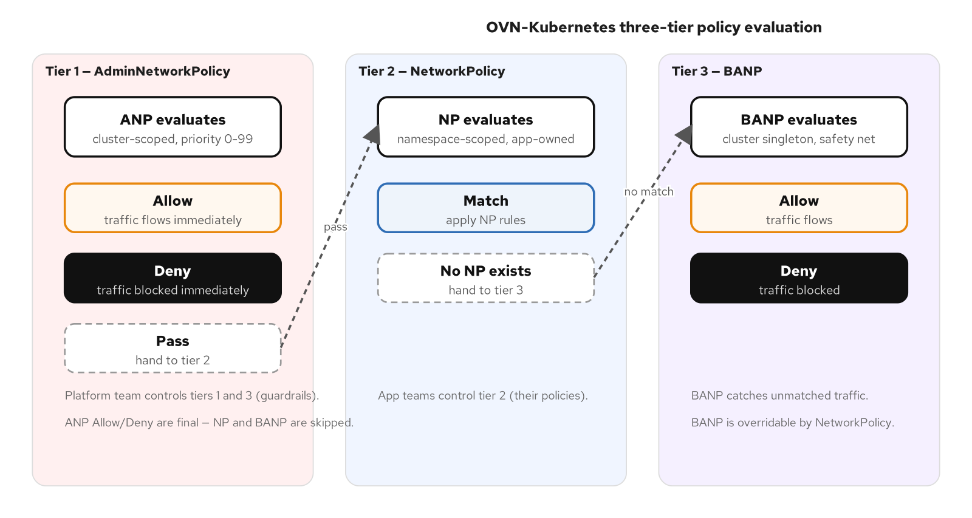
THREE-TIER MODEL
The policy evaluation model
Tier 1 — AdminNetworkPolicy (ANP): cluster-scoped, priority 0-99, Allow/Deny/Pass. Cannot be overridden by tenants.
Tier 2 — NetworkPolicy (NP): namespace-scoped, owned by app teams. Only evaluated if ANP passed the traffic.
Tier 3 — BaselineAdminNetworkPolicy (BANP): cluster singleton, safety net. Overridable by NetworkPolicy.
ANP Allow/Deny are final — NP and BANP are skipped. ANP Pass hands evaluation to the next tier.
Platform team controls tiers 1 and 3. App teams control tier 2.
7
Notes:
This is the most important conceptual slide. OpenShift's OVN-Kubernetes network plugin evaluates traffic against three tiers of policy. Tier 1 is AdminNetworkPolicy — cluster-scoped, priority zero to ninety-nine, with Allow, Deny, or Pass actions. If the traffic matches an ANP Allow or Deny rule, tiers 2 and 3 are skipped entirely. If it matches a Pass rule, evaluation hands to tier 2. Tier 2 is standard Kubernetes NetworkPolicy — namespace-scoped, owned by app teams. Tier 3 is BaselineAdminNetworkPolicy — the cluster singleton safety net. BANP catches traffic that was passed by ANP and not matched by any NetworkPolicy. Point to the diagram showing the evaluation flow. The value proposition for the customer: the platform team controls tiers 1 and 3 — the guardrails. Developers control tier 2 — their application's policies. This separation of concerns is what makes the model scalable.

Slide 8
ANP · BANP
AdminNetworkPolicy and BaselineAdminNetworkPolicy
ANP enforces non-negotiable rules: deny traffic to the control plane, allow monitoring agents to scrape all pods, deny cross-environment traffic (dev → prod).
A Pass rule explicitly delegates to the NetworkPolicy tier — the platform team says 'app teams, this one is yours to decide.'
BANP is the safety net. Recommended: configure BANP as default-deny. If no ANP and no NP allows the traffic, BANP denies it.
Critical: an ANP with an empty namespace selector ({}) matches all namespaces including openshift-* and kube-system. Use workload-specific label selectors.
An overly broad ANP can lock the cluster. Use workload-specific labels.
8
Notes:
Dive deeper into ANP and BANP. ANP enforces non-negotiable rules: deny traffic to the control plane from application namespaces, allow monitoring agents to scrape all pods, deny cross-environment traffic like dev to prod. A Pass rule explicitly delegates the decision to the NetworkPolicy tier — this is how the platform team says app teams, this one is yours to decide. BANP is the safety net configured as default-deny. If no ANP rule and no NetworkPolicy allows the traffic, BANP denies it. This means a namespace with no NetworkPolicies still has default-deny posture without requiring the app team to create it themselves. Critical caution: an ANP with an empty namespace selector matches all namespaces including openshift-star and kube-system. This can lock the cluster. Always use workload-specific label selectors. Best practice is to label application namespaces with a specific label and use that as the namespace selector in the ANP.

Slide 9
DEVELOPER SKILL GAP
Bridging the gap
ACS-generated baselines: developers review generated policies, not author from scratch. Reviewing a concrete policy is dramatically easier than writing one from zero.
Platform-authored starter templates: web-facing service, internal API, batch job, database archetypes. Developers pick the template, customize selectors, submit a PR.
BANP as safety net: a developer who deploys without any NetworkPolicy gets default-deny automatically. Missing policies become connectivity issues, not security gaps.
Golden-path provisioning: new namespaces come with default-deny, EgressFirewall, starter templates, and RBAC bindings pre-installed.
Invert the skill requirement: review, don't author.
9
Notes:
Walk through the four approaches for bridging the developer skill gap. First, ACS-generated baselines invert the skill requirement: developers review a generated policy, they do not author one from scratch. Reviewing a concrete policy — does this look right, should this connection exist — is dramatically easier than writing one from zero. Second, platform-authored starter templates for common workload archetypes — web-facing, internal API, batch job, database. Developers pick the template, customize the namespace and label selectors, and submit a PR. Third, BANP as a safety net converts missing policies from a security gap into a connectivity issue that surfaces immediately in testing. Fourth, golden-path namespace provisioning includes default-deny, EgressFirewall, starter templates, and RBAC bindings automatically — the developer starts with a secured namespace. They never see the everything-is-open starting point that leads to procrastination.

Slide 10
TEMPLATES
Starter policy templates
Web-facing service — accepts ingress from ingress controller on 8080/8443, allows egress to backend services and database.
Internal API — accepts ingress from specific consumer services, allows egress to database and Kafka.
Batch job — no ingress, allows egress to database and specific external endpoints.
Database — accepts ingress from application services on port 5432, no egress.
Start with 3-5 archetypes, not twenty. Refine based on actual PR volume and developer feedback.
Over-engineering templates is a common early mistake.
10
Notes:
Describe the starter template library. The platform team maintains a small set of NetworkPolicy templates for common workload archetypes. A web-facing service template accepts ingress from the ingress controller on ports 8080 and 8443 and allows egress to backend services and the database. An internal API template accepts ingress from specific consumer services and allows egress to the database and Kafka. A batch job template has no ingress and allows egress to the database and specific external endpoints. A database template accepts ingress from application services on port 5432 and has no egress. Developers pick the template that matches their workload, customize the namespace and label selectors, and submit a PR. The template handles the hard parts — the deny-all baseline, correct policyTypes, CIDR ranges for external services. Start with three to five archetypes, not twenty. Over-engineering the first set of templates is a common mistake. Refine based on actual PR volume and developer feedback.

Slide 11
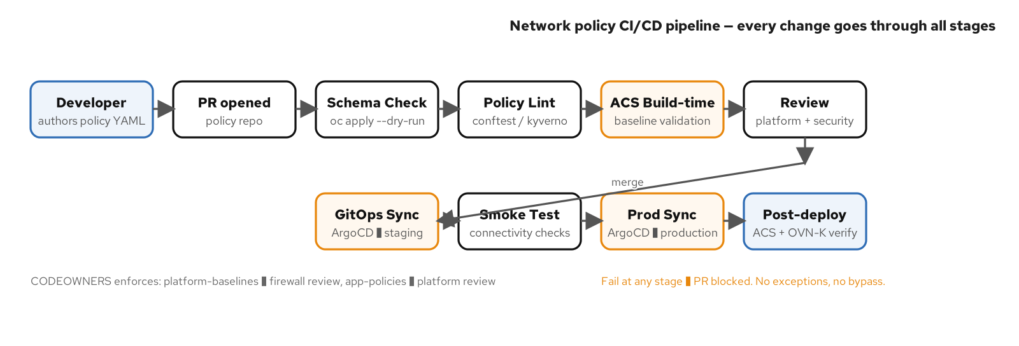
CI/CD PIPELINE
Policy validation end-to-end
Schema check: oc apply --dry-run=client validates YAML and API version.
Policy lint: conftest / kyverno CLI enforces organizational rules (no allow-all, required labels).
ACS build-time: validates against known baselines, flags traffic outside the baseline.
Review: CODEOWNERS enforces — app teams author NP (platform reviews), platform authors ANP/BANP (firewall reviews).
Fail at any stage → PR blocked. No exceptions, no bypass.
11
Notes:
Walk through the policy CI/CD pipeline. Every policy change — NetworkPolicy, ANP, BANP, EgressFirewall — flows through the same pipeline. Schema check with oc apply --dry-run=client catches invalid YAML and wrong API versions. Policy lint with conftest or kyverno CLI catches organizational policy violations like allow-all rules or missing labels. ACS build-time tools validate against known baselines and flag policies that would allow traffic outside the baseline. Platform or security team reviews the PR — CODEOWNERS enforces who reviews based on the file path. Merge triggers ArgoCD sync to staging, smoke tests validate connectivity, then sync to production. Post-deploy validation uses ACS network graph and OVN-K flow logs. Point to the diagram. The key principle: the CI pipeline is the only path to production. No exceptions, no emergency oc apply, no just this once.

Slide 12
REPO STRUCTURE
Three-layer policy repo
platform-baselines/ — ANP, BANP, EgressFirewall. Platform team authors, firewall/security team reviews. Cluster-wide scope.
onboarding/ — starter NetworkPolicy templates per workload archetype. Platform team maintains, app teams consume.
app-policies/ — per-namespace NetworkPolicy. App teams author, platform team reviews. Kustomize overlays for dev/test/prod.
CODEOWNERS enforces review requirements by path. The same PR flow applies regardless of target environment.
Separate ownership boundaries with clear review rules.
12
Notes:
Describe the three-layer repository model. The platform-baselines directory contains ANP, BANP, and EgressFirewall resources — cluster-scoped policies authored by the platform team and reviewed by the firewall and security team. The onboarding directory contains starter NetworkPolicy templates per workload archetype — maintained by the platform team, consumed by app teams as starting points. The app-policies directory contains per-namespace NetworkPolicies authored by app teams, with base and overlay directories for Kustomize-based environment promotion. CODEOWNERS enforces review requirements by path: platform-baselines requires firewall team review, app-policies requires platform team review. This separation provides clear ownership boundaries. The same PR that modifies a policy flows through the same CI pipeline regardless of whether it targets dev, test, or production — only the Kustomize overlay differs.

Slide 13
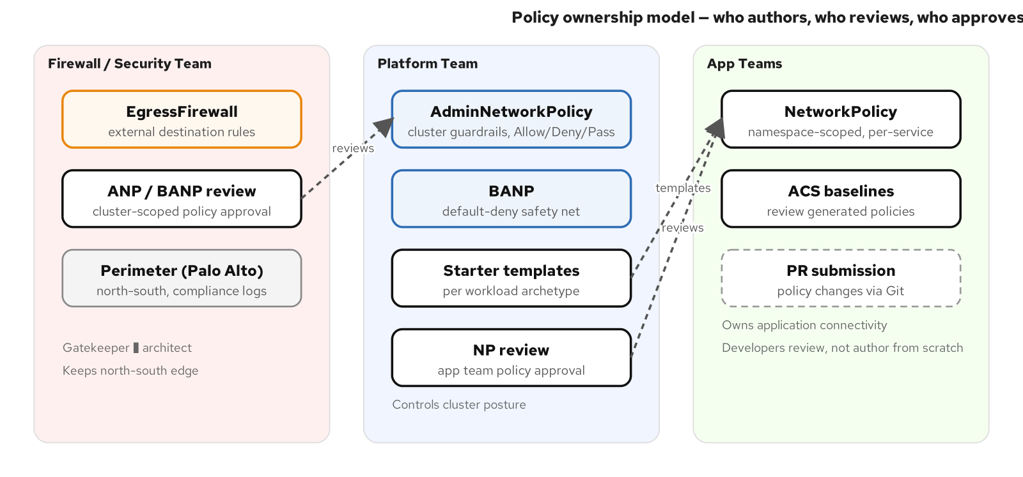
OWNERSHIP
Who owns what
Firewall team: authors EgressFirewall, reviews ANP/BANP, owns perimeter (Palo Alto for north-south and compliance).
Platform team: authors ANP/BANP and starter templates, reviews app NetworkPolicies, owns cluster security posture.
App teams: author namespace-scoped NetworkPolicy, consume templates and ACS baselines, own application connectivity.
The firewall team moves from 'approve every rule' to 'set the boundaries and review the exceptions.'
Faster for developers, safer for the organization.
13
Notes:
Describe the three-team ownership model and point to the diagram. The firewall team authors EgressFirewall rules for external destinations, reviews all cluster-scoped policies (ANP, BANP) because they have cluster-wide blast radius, and continues to own the perimeter for north-south traffic, TLS inspection, and compliance logging. The platform team authors ANP and BANP guardrails, maintains starter templates, reviews app team NetworkPolicies, and owns the overall cluster security posture. App teams author namespace-scoped NetworkPolicy for their services, consume starter templates and ACS-generated baselines, and own their application's connectivity. The critical framing: the firewall team moves from approve every rule to set the boundaries and review the exceptions. This is faster for developers, safer for the organization, and a better use of the firewall team's expertise.

Slide 14
DAY-2 OPS
Denied-flow triage
Step 1: check ACS network graph for anomalous flows — was this connection ever in the baseline?
Step 2: check OVN-Kubernetes flow logs — which tier (ANP, NP, or BANP) denied the traffic? This tells you who needs to update the policy.
Step 3: oc adm must-gather — collects network policy state, OVN-K configuration, and flow logs for offline analysis or Red Hat support escalation.
Target: denied-flow triage should take under 30 minutes. If it takes longer, the observability tooling is not configured correctly.
OVN-K logs identify which tier denied the traffic.
14
Notes:
Walk through the denied-flow triage process. When a developer reports my service cannot reach X, the first step is checking the ACS network graph for anomalous flows — was this connection ever in the baseline? If not, it was likely never policy-allowed, and the decision is whether to add a policy or investigate why the new connection exists. The second step is checking OVN-Kubernetes flow logs — these identify which tier denied the traffic: ANP, NetworkPolicy, or BANP. This tells you who needs to update the policy. If ANP denied it, the platform team needs to act. If a NetworkPolicy denied it, the app team needs to update their policy. If BANP denied it, no one wrote a policy for this connection at all. The third step is oc adm must-gather for offline analysis or escalation to Red Hat support. The target is under 30 minutes for triage. If it regularly takes longer, the observability tooling is not configured correctly.

Slide 15
DAY-2 OPS
Break-glass and drift detection
Break-glass: platform team creates a temporary ANP Pass rule at high priority, time-boxed with an expiration annotation, logged via incident ticket. Proper policy change follows within 24 hours via normal PR.
ArgoCD drift detection: if someone manually applies a policy via oc apply instead of the PR pipeline, ArgoCD detects the drift and alerts or auto-reverts.
ACS baseline drift: new traffic flows outside the baseline trigger anomalous-flow alerts — catches both policy drift and application drift.
All break-glass events are reviewed in the quarterly policy review.
Define the break-glass process before you enforce anything in production.
15
Notes:
Explain the break-glass process and drift detection. When a denied flow is blocking a production incident and the normal PR process is too slow, a platform team member creates a temporary ANP with a Pass rule at high priority. This is time-boxed with an expiration annotation and logged via an incident ticket. Within 24 hours, the proper policy change goes through the normal PR and CI pipeline, and the temporary rule is removed. All break-glass events are reviewed in the quarterly policy review. For drift detection: ArgoCD reports sync status for every policy manifest — if someone manually applies a policy, ArgoCD detects the drift and alerts or auto-reverts. ACS baseline drift catches new traffic flows that are outside the baseline, whether from policy changes or application changes. The critical lesson: define the break-glass process before you enforce anything in production. The first denied-flow incident without a break-glass process causes panic and a rollback of all policies.

Slide 16
FIREWALL TEAM
The evolving role
What stays: north-south edge controls (Palo Alto for TLS inspection, DDoS, compliance logging), EgressFirewall authorship (approved CIDRs, DNS rules), ANP/BANP review (cluster-wide blast radius).
What shifts: east-west traffic segmentation moves to NetworkPolicy authored by app teams. The firewall team does not approve every pod-to-pod rule — that does not scale.
The new model: the firewall team's expertise is applied at a new layer. Position this as elevation, not replacement.
Customers who presented in-cluster policy as a replacement met resistance. Customers who positioned it as the firewall team's expertise at a new layer got buy-in.
Gatekeeper → architect. Faster for developers, safer for the org.
16
Notes:
Frame the firewall team's evolving role as elevation, not replacement. What stays with the firewall team: north-south edge controls on the perimeter firewall for TLS inspection, DDoS mitigation, and compliance logging. EgressFirewall authorship — the firewall team catalogs approved external destinations and authors EgressFirewall CRDs, which is their domain expertise. ANP and BANP review — the firewall team reviews all cluster-scoped policies because they have cluster-wide blast radius. What shifts to the platform and app teams: east-west traffic segmentation is handled by NetworkPolicy authored by app teams. The firewall team does not need to approve every pod-to-pod rule — that does not scale. The key framing for the customer: customers who presented in-cluster policy as a replacement for the firewall team met resistance. Customers who positioned it as the firewall team's expertise applied at a new layer got buy-in.

Slide 17
EGRESSFIREWALL
Controlling outbound traffic
EgressFirewall is a per-project OpenShift CRD that restricts outbound traffic from pods to external destinations.
Supports both CIDR-based and DNS-based rules — critical for external services that change IP addresses without notice.
The firewall team's domain: they catalog approved external endpoints and author the EgressFirewall per namespace.
Combine with NetworkPolicy: use NetworkPolicy for intra-cluster segmentation and EgressFirewall for external traffic control. They complement each other.
Cataloging external endpoints is the most time-consuming part of the shift.
17
Notes:
Explain the EgressFirewall CRD. This is a per-project OpenShift resource that restricts outbound traffic from pods to external destinations. It supports both CIDR-based rules and DNS-based rules — the DNS capability is critical for external services that change IP addresses without notice. The firewall team's domain: they catalog approved external endpoints and author the EgressFirewall per namespace. This is a natural extension of what they already do at the perimeter — controlling which destinations workloads can reach — applied at the cluster level where the perimeter has no visibility. Combine EgressFirewall with NetworkPolicy: use NetworkPolicy for intra-cluster segmentation and EgressFirewall for external traffic control. They complement each other — NetworkPolicy controls east-west, EgressFirewall controls north-south from the pod perspective. Important caveat: use caution with DNS-based deny rules, as DNS resolution inconsistencies between nodes can cause unexpected behavior.

Slide 18
MATURITY
What 'good' looks like
Default-deny in every namespace — no namespace without coverage.
ACS baselines active — new flows trigger anomalous-flow alerts.
ANP guardrails enforced — cross-environment traffic blocked, monitoring allowed.
BANP default-deny — the cluster-wide safety net catches unmatched traffic.
App teams authoring policies via PR — not oc apply.
CI validates before merge — schema, lint, ACS, dry-run on every PR.
EgressFirewall per project — outbound traffic restricted to approved destinations.
Denied-flow triage under 30 minutes. Quarterly policy review cadence.
The maturity timeline is agreed upon by the organization.
18
Notes:
Walk through the maturity checklist. Default-deny in every namespace — no namespace without coverage. ACS baselines active — new flows trigger anomalous-flow alerts. ANP guardrails enforced — cross-environment traffic blocked, monitoring allowed, control-plane access restricted. BANP default-deny — the cluster-wide safety net catches any traffic not explicitly allowed. App teams authoring policies via PR — not oc apply. CI validates before merge — schema checks, policy linting, ACS build-time validation, and dry-run apply on every PR. EgressFirewall per project — outbound traffic restricted to approved destinations. Firewall team reviews not blocks — turnaround on ANP and BANP reviews is prompt. Denied-flow triage under 30 minutes. Quarterly policy review cadence covering break-glass events, stale policies, baseline refreshes, and RBAC audits. The maturity timeline is agreed upon by the organization — there is no universal pace.

Slide 19
LESSONS LEARNED
What customers wish they'd done
1. 'We should have started with observation, not enforcement.' Jumping to default-deny without ACS observation caused outages from denied traffic they didn't know existed.
2. 'We over-engineered the templates.' Start with 3-5 archetypes, not twenty. Refine based on actual usage.
3. 'We underestimated the EgressFirewall work.' Cataloging every external endpoint is the most time-consuming part. Start this inventory in Phase 1.
4. 'We should have involved the firewall team earlier.' Position as elevation, not replacement.
5. 'We needed a break-glass process on day one.' The first denied-flow incident without break-glass caused panic and a rollback of all policies.
These lessons come from real customer engagements.
19
Notes:
Walk through the top five lessons from real customer engagements. First, customers who jumped to default-deny without ACS observation caused outages from denied traffic they did not know existed. The observation phase pays for itself. Second, the first set of starter templates should be simple — three to five archetypes, not twenty. Start broad and refine based on actual PR volume. Third, cataloging every external endpoint every service needs to reach is the most time-consuming part of the shift. Start this inventory in Phase 1 alongside ACS observation. Fourth, customers who presented in-cluster policy as a replacement for the firewall team met resistance. Customers who positioned it as the firewall team's expertise applied at a new layer got buy-in. Fifth, the first denied-flow incident in production without a break-glass process caused panic and a rollback of all policies. Define break-glass before you enforce. These lessons are from real engagements — they are patterns, not hypotheticals.

Slide 20
REFERENCES
References
OpenShift AdminNetworkPolicy — docs.redhat.com/openshift_container_platform/4.18/html/network_security/admin-network-policy
BaselineAdminNetworkPolicy — docs.openshift.com/container-platform/4.16/.../ovn-k-banp.html
OpenShift EgressFirewall — docs.redhat.com/openshift_container_platform/4.18/html/network_security/egress-firewall
ACS network policies — docs.redhat.com/red_hat_advanced_cluster_security_for_kubernetes/3.69/html/operating/manage-network-policies
Kubernetes Network Policies — kubernetes.io/docs/concepts/services-networking/network-policies/
CNCF Cloud Native Security Whitepaper — github.com/cncf/tag-security
Companion: Kubernetes Environment Access Policies (k8s-environment-policies.md)
20
Notes:
Point the audience to authoritative sources. The OpenShift AdminNetworkPolicy documentation covers the three-tier evaluation model and ANP syntax. The BaselineAdminNetworkPolicy page covers the cluster singleton safety net. The EgressFirewall documentation covers per-project egress control with CIDR and DNS rules. The ACS network policy management page covers baseline discovery, anomalous flow detection, and auto-generated policy YAML. The Kubernetes Network Policies documentation covers the standard NetworkPolicy API that app teams will author. The CNCF Cloud Native Security Whitepaper is the industry-consensus framework for cloud-native security posture. The companion document — Kubernetes Environment Access Policies — covers the broader governance framework including RBAC, admission control, GitOps, and audit that surrounds the network policy process described in this deck.

