Slide 1


CLOUD-NATIVE ARCHITECTURE
Designing
Cloud-Native APIs
From principles to a running system on Kubernetes — communication, composition, data, events, and the platform that governs them.
Robert Sedor
Chief Architect, Application Development
Notes:
Welcome and framing. This is a working architect's tour of designing cloud-native APIs on .NET 10 — not a survey of buzzwords. The audience: .NET developers who lived on .NET Framework 4.x, IIS, WCF and COM+ and now need to ship on Kubernetes. We'll bridge that world to this one at every step, not pretend the old world didn't exist. Set expectations: we build one realistic system (five services and a gateway) and re-examine it from twelve angles, then deep-dive appendices on protocol internals, versioning, WebSockets (including Blazor's place in this story), and saga mechanics. Mention the running stack up front: .NET 10 (LTS through 2028, MIT) with ASP.NET Core for REST, Grpc.AspNetCore for gRPC, HotChocolate for GraphQL, MassTransit + Confluent.Kafka for events, Streamiz.Kafka.Net for stream processing, Temporal .NET SDK for durable workflows (Stateless for the lightweight alternative), SignalR for WebSockets, OpenTelemetry .NET for observability — every library MIT or Apache 2.0. On Kubernetes with Kafka (Strimzi), Istio and KEDA. The platform around the code — Strimzi, Apicurio, OpenMetadata, the LGTM stack — is unchanged from any language choice; .NET 10 is just how we write the services.

Slide 2
AGENDA
Agenda
Setting up · Patterns in the age of AI
01 · Cloud-Native Principles
02 · Communications
03 · Composition
04 · Data
05 · Event-Driven
06 · Stream Processing
07 · Workflows & Jobs
08 · API Management
09 · API Registry
10 · API Metadata
11 · Observability
12 · Security
13 · Anti-Patterns
Appendices A–D · Protocols, Versioning, WebSockets, Sagas
Appendices E–I · Errors, DDD & Hexagonal, Coupling, Shutdown, L7 Routing
Appendix J · .NET 10 Toolkit & Migration Reference
Appendices K–L · Monolith → Microservices, Caching Patterns
Appendices M–O · Failure modes, Feature Flags, API Testing
Appendix P · .NET on Linux — Runtime, Kestrel, Containers
Appendix Q · Blazor Server + SignalR
Glossary of acronyms
1
Notes:
The agenda — thirteen sections plus a short setup, and the deep-dive appendices at the end. The setup slide motivates why patterns matter in the age of AI. Sections 1–6 build the system from principles up through data and streaming; 7–13 cover the operational platform around it (workflows, management, registry, metadata, observability), then security as a first-class section, and close on anti-patterns. The appendices (A–L, plus a glossary) are backup material for the questions that always come up — protocols, versioning, WebSockets, sagas, errors, DDD, coupling, shutdown, L7 routing, monolith→microservices decomposition, and caching patterns. Tell the audience which sections you'll cover given the session length. The next slide reframes this as the narrative arc — what we build and in what order.

Slide 3
OVERVIEW
What we'll build, and the order we'll build it
Foundations — cloud-native principles and the canonical system we carry throughout
Communications — REST, gRPC, GraphQL, and synchronous vs. asynchronous
Composition & Data — gateways, federation, database-per-service, outbox, sagas
Event-driven & Stream processing — the log, schemas, derived streams, KEDA scaling
Workflows & Jobs — orchestration, choreography, batch and scheduled work
The API platform — gateway, registry (Apicurio), metadata (OpenMetadata), observability
Anti-patterns — and the heuristics that keep you out of them
2
Notes:
Walk the arc quickly; don't dwell. The order is deliberate: principles first because they justify every later choice, then the synchronous surface (comms, composition), then data ownership, then the asynchronous backbone (events, streams), then the operational concerns (workflows, the platform planes), and finally anti-patterns as a reflective close. Tell people there are four deep-dive appendices at the end (protocols, versioning, WebSockets, sagas) they can jump to. For a 90-minute talk, cover the main twelve; for the full three hours, work through the appendices too.

Slide 4
SETTING UP
Why patterns matter more in the age of AI
AI tooling — Claude, Claude Code, frontier models — turns intent into code at a rate that wasn't possible before. The bottleneck shifted: it's no longer typing, it's knowing what to ask for and what to accept.
Patterns are your vocabulary at three layers: design patterns (factory, strategy, observer), architecture patterns (hexagonal, microservices, event-driven), system design patterns (sagas, caching, strangler fig — the scope of this deck).
Without that vocabulary you can't specify precisely, can't evaluate what comes back, can't tell good code from plausible-looking code, or notice when an anti-pattern is dressed as a solution. The AI is fluent; you still need to be literate.
All architecture is the LEAST-WORST decision — every choice trades something away.
All management is RISK management — you manage the distribution of failures, not their existence.
There is no such thing as a FREE LUNCH — every pattern has a cost; ask whether you can afford it.
There is no problem which cannot be MADE WORSE — the wrong fix amplifies the original pain.
3
Notes:
Open the deck by naming the elephant. AI coding tools — Claude, Claude Code, Cursor, Copilot, every frontier model — are now in production engineering workflows. They produce code very fluently. They will produce a microservices decomposition, a saga, a cache layer, a strangler fig wrapper, a CQRS write side — plausible enough to compile, deploy and run — from a one-sentence prompt. The risk is also new: a developer who doesn't have the vocabulary to evaluate what comes back is rolling dice in production. The patterns in this deck are not nostalgic computer-science trivia; they are the literacy that lets you direct AI tooling instead of being directed by it. Walk the three layers of patterns briefly: design patterns are code-level vocabulary (Gang of Four); architecture patterns describe how applications fit together (hexagonal, microservices, BFF, event-driven); system design patterns — the focus of this deck — span services, data and runtime (sagas, caching, the strangler fig, outbox, decomposition, L7 routing). The four maxims are the philosophical spine. ‘Least-worst decision’: every architecture choice is a set of trades — latency for throughput, consistency for availability, simplicity for flexibility — and the job is not to find the optionless option but to make the trades visible and deliberate. ‘Risk management’: you manage the distribution of failures, not their existence. ‘No free lunch’: every pattern (cache, saga, eventing, decomposition) has a cost — a stale read window, a compensation path, a coordination tax, an operational complexity. The question is whether you are buying the right thing for what you are paying. ‘No problem cannot be made worse’ is the warning corollary: a confidently-wrong intervention amplifies the original pain, and AI tooling makes confident interventions easy and cheap. The closing line is the audience take-home: AI is the amplifier; the patterns are the literacy that decides which direction it amplifies.

Slide 5
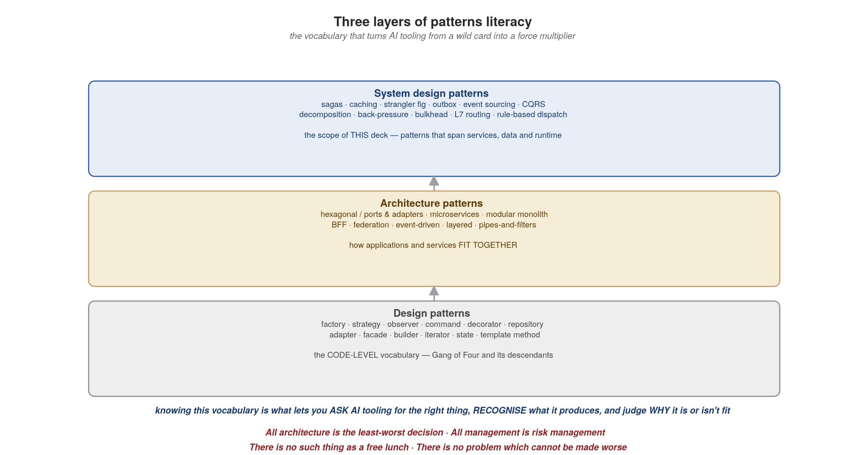
SETTING UP
Three layers of patterns literacy
4
Notes:
The visual companion to the previous slide. Three stacked boxes: design patterns at the bottom (Gang of Four — factory, strategy, observer, decorator, repository, etc.); architecture patterns in the middle (hexagonal, microservices, modular monolith, BFF, federation, pipes-and-filters, event-driven, layered); and at the top, system design patterns — the scope of this deck — sagas, caching, the strangler fig, outbox, event sourcing, CQRS, decomposition, back-pressure, bulkhead, L7 routing, rule-based dispatch. The arrows up the middle show how each lower layer informs the next: you can't reason about a saga (system layer) without knowing what a state machine and a compensation are (architecture / design layer); you can't reason about content-based routing without understanding the strategy pattern. The blue caption in the middle is the through-line: knowing this vocabulary is what lets you ask AI tooling for the right thing, recognise what it produces, and judge why it is or isn't fit. The four maxims at the bottom in red are the philosophical anchors that follow you through the rest of the deck — every concrete choice you'll see is a deliberate exercise in those four principles. Make the audience comfortable with the maxims, especially the last one (no problem cannot be made worse) — it's the warning at the heart of using AI tooling well.

Slide 6
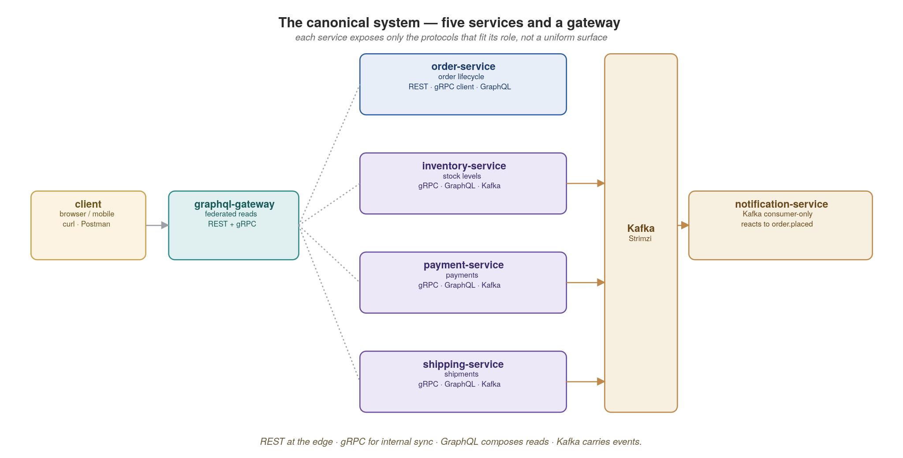
THE RUNNING EXAMPLE
One system, carried end to end
We will design every concern against these five services and a gateway — the same example, re-examined from each angle.
5
Notes:
This is the single most important slide to anchor on — every later example refers back to it. Walk each service: order-service owns the order lifecycle and exposes REST at the edge; inventory, payment and shipping are internal, reached by gRPC and contributing to GraphQL reads; notification-service is Kafka-only, consuming order.placed. The graphql-gateway composes reads across them. Emphasize that each service exposes only the protocols that fit its role — not a uniform surface. Promise the audience we'll return to this picture a dozen times.

Slide 7


01
Cloud-Native Principles
Properties first, tools second.
Notes:
Transition into section one. The core message: cloud-native is not a stack you buy, it is a set of runtime properties your service must exhibit. Tools (Kubernetes, Istio, KEDA) exist to make those properties cheap to obtain — but if your service isn't written to lean on them, no platform can rescue it. Before the pillars themselves, one slide for the audience: a Rosetta-stone from the Windows world (IIS, WCF, COM+, MSMQ) to the Kubernetes world. Almost every pattern you knew has a direct cloud-native analog — the platform owns more, your code owns less.

Slide 8
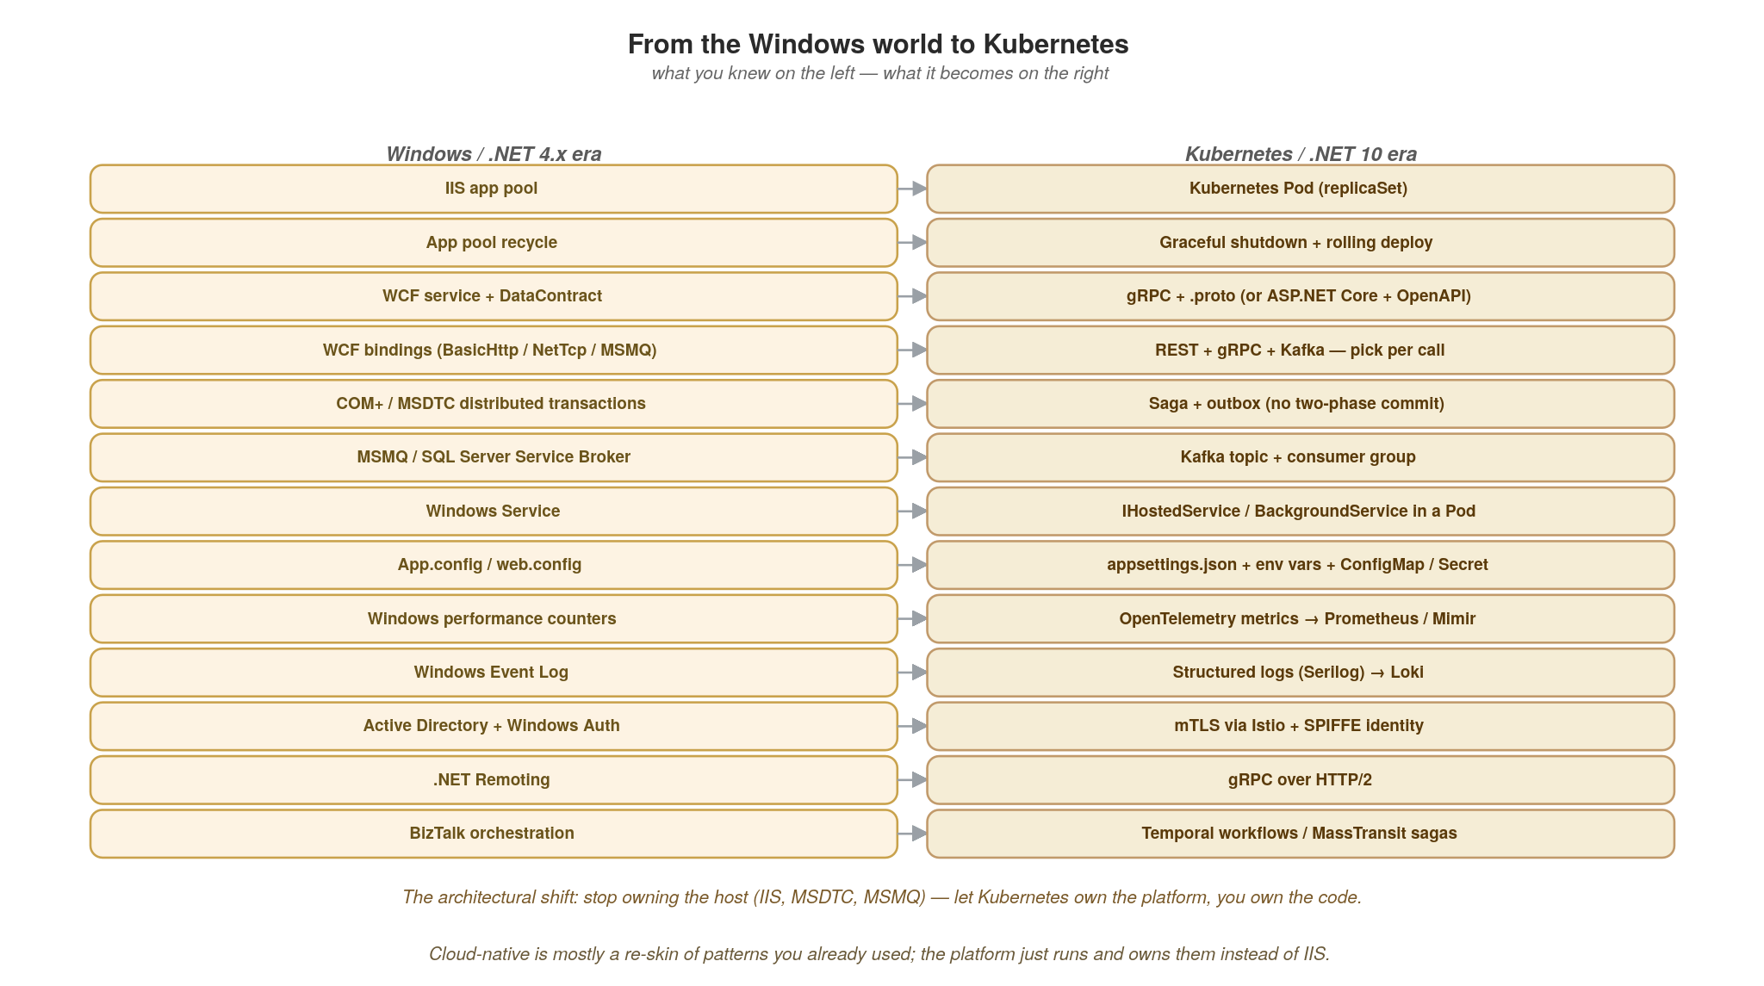
CLOUD-NATIVE PRINCIPLES
From the Windows world to Kubernetes
Almost every pattern you knew — IIS, WCF, COM+, MSMQ — maps onto a Kubernetes-native equivalent. Mostly a re-skin, not a rewrite of the concepts.
6
Notes:
This slide is the orientation gift to the audience. Most of you spent years on .NET Framework 4.x, hosting in IIS, talking via WCF, doing distributed transactions with MSDTC and COM+, queuing with MSMQ or SQL Server Service Broker, and configuring everything through web.config. Cloud-native isn't a rejection of those patterns — it's a re-platforming where Kubernetes owns the host and the messaging substrate, and your code owns less infrastructure plumbing. Walk the audience through 4-5 rows they'll recognise: app pool → Pod, app pool recycle → graceful shutdown + rolling deploy, WCF service → gRPC or ASP.NET Core, COM+ distributed transactions → saga + outbox (which we'll cover deeply in Appendix D), MSMQ → Kafka. The bottom line below the table is the architectural shift to make explicit: you stop owning the host and start owning the code, because the platform now provides the host as a primitive. The pillars on the next slide are the rubric Kubernetes is enforcing on you when you make that switch.

Slide 9
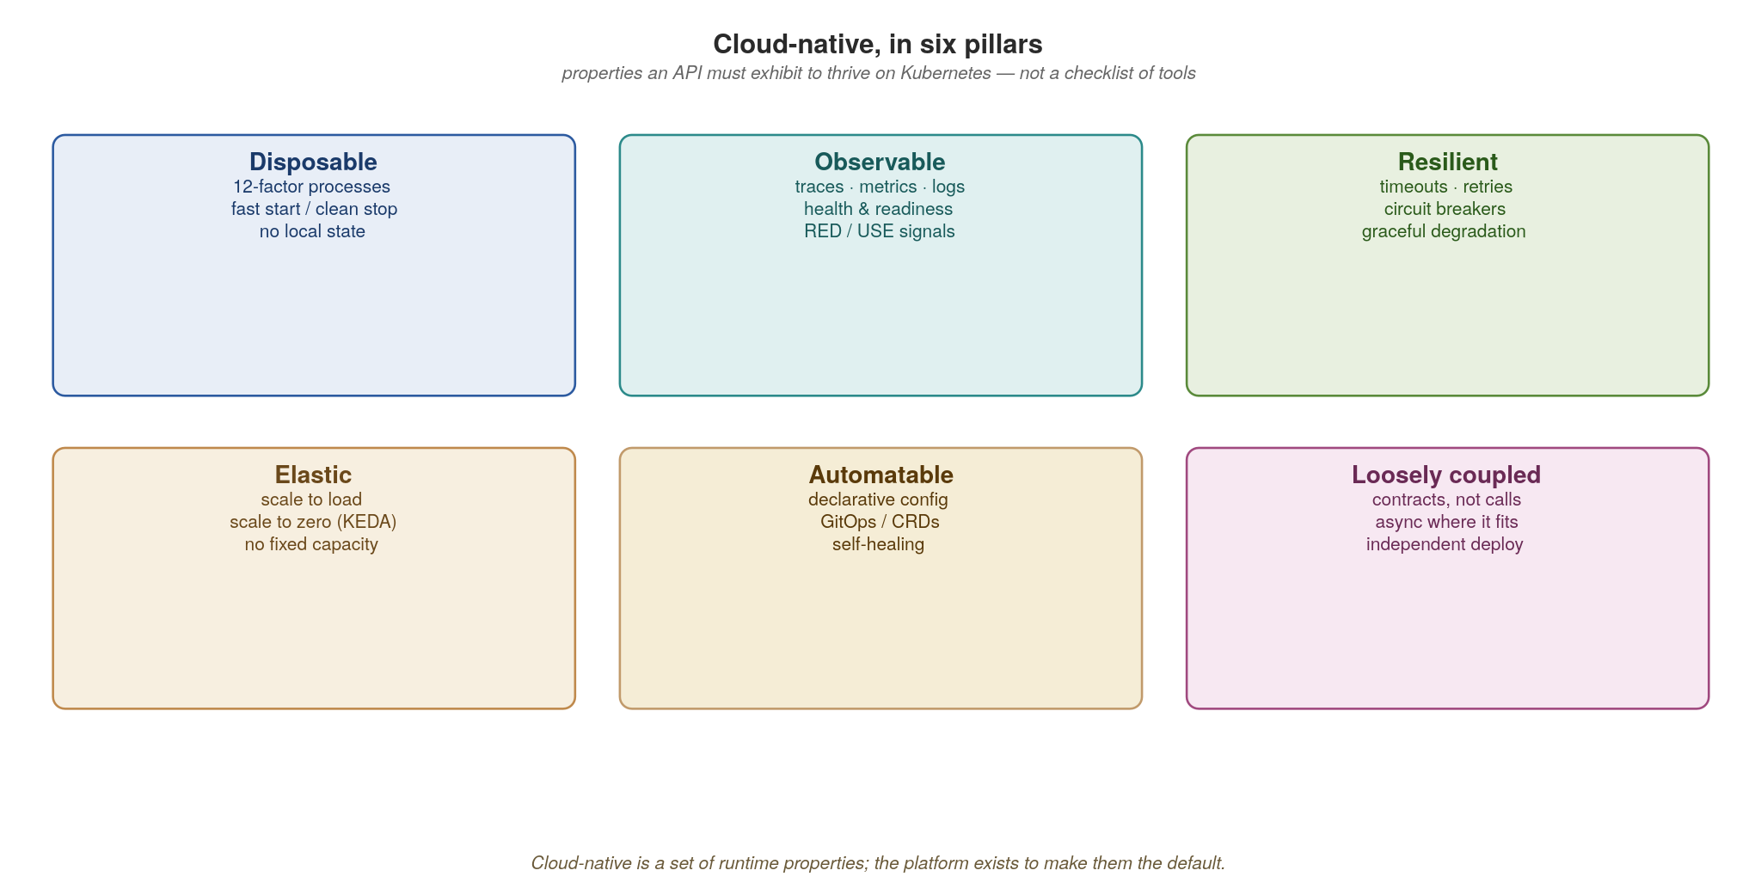
CLOUD-NATIVE PRINCIPLES
Cloud-native is a set of runtime properties
If your API isn't disposable, observable, resilient, elastic, automatable and loosely coupled, the platform can't help it.
7
Notes:
Six pillars. Spend a sentence on each: disposable (12-factor, fast start, clean stop, no local state), observable (traces/metrics/logs, health probes), resilient (timeouts, retries, circuit breakers, graceful degradation), elastic (scale to load and to zero), automatable (declarative config, GitOps, self-healing), loosely coupled (contracts not calls, async where it fits). The pillars are the rubric for the rest of the talk — every design decision later either earns or spends one of these properties. Tie back to the previous slide: IIS gave you some of these (process recycle, health monitoring) but on a single Windows host; Kubernetes gives you all six, across many hosts, declaratively.

Slide 10
CLOUD-NATIVE PRINCIPLES
The platform makes the properties the default
Kubernetes gives you the disposable process model: liveness/readiness probes, rolling deploys, self-healing.
KEDA (and the http-add-on) make elasticity real — scale on lag or RPS, all the way to zero.
Istio supplies resilience and security at the wire: timeouts, retries, circuit breaking, mTLS.
OpenTelemetry + Tempo / Mimir / Prometheus / Grafana / Kiali make every request observable.
Your job is to write services that lean on these — not to reimplement them per service.
8
Notes:
The punchline is the bold line: your job is to lean on the platform, not reimplement it. Concretely — don't write your own retry library when Istio does it at the wire; don't build a bespoke autoscaler when KEDA scales on lag and RPS; don't hand-roll metrics plumbing when OpenTelemetry plus the LGTM stack gives it to you. Every line of resilience code you write per service is a line you maintain forever and that drifts between teams. The platform makes the good behaviour the default.

Slide 11
CLOUD-NATIVE PRINCIPLES
Design-first: the contract precedes the code
Agree the interface before implementing it — OpenAPI for REST, .proto for gRPC, AsyncAPI for events.
The contract is a versioned artifact in the registry, gated in CI, owned by the producing domain.
Consumers code against the contract and generated stubs, never against your database or internals.
This is what makes services independently deployable — the promise the contract encodes is the boundary.
Tooling: the dotnet CLI and NuGet (central package management via Directory.Packages.props) for reproducible builds; Microsoft.AspNetCore.OpenApi (or Swashbuckle) emits the OpenAPI spec; buf / protoc with Grpc.Tools for gRPC; HotChocolate exports the GraphQL SDL.
9
Notes:
Design-first is the cultural prerequisite for everything that follows. The contract — OpenAPI, .proto, AsyncAPI — is agreed and registered before code is written, owned by the producing domain, and gated in CI. Consumers code against the contract and generated stubs, never against your database. Make the point that this is what actually delivers independent deployability: the promise the contract encodes is the service boundary. If you skip this, you get distributed coupling that's worse than a monolith because it fails over the network. In the .NET world the contract artifacts come naturally: Microsoft.AspNetCore.OpenApi (built into .NET 9+) emits the REST spec from your controller and minimal-API endpoints, Grpc.Tools compiles the .proto into both server bases and client stubs at build time, and HotChocolate generates the GraphQL SDL from your code-first types (or loads .graphql files if you prefer schema-first) — all checked into the registry.

Slide 12
CLOUD-NATIVE PRINCIPLES
The twelve-factor app, revisited
The twelve-factor app (2011) is the original recipe for software that's disposable, scalable and portable — the discipline beneath the runtime properties we just saw.
It predates Kubernetes but maps onto it almost one-to-one: most factors are now things the platform provides, not code you write.
So read the factors by ownership — a few you still author (config from the environment, statelessness, clean start/stop, logs as streams) and the rest the platform hands you (scaling, build/release/run, attached backing services).
In a microservices, event-driven system they get richer: “backing services” means Postgres, Kafka and the schema registry as swappable URLs; “logs” becomes correlated traces, metrics and logs.
Treat it as a pre-flight check — “will this survive the platform?” — the next slides list the twelve factors and map each to where it lives in our architecture.
10
Notes:
Frame the twelve-factor app for the audience: it's the 2011 Heroku methodology that first codified what we now call cloud-native, and it's worth revisiting because it predates Kubernetes yet maps onto it almost perfectly. The key reframing here is ownership — don't recite the list; split it into the few factors you still write (config from the environment, stateless processes, fast clean startup and shutdown, logs as event streams) versus the many the platform now provides for free (build/release/run via images and GitOps, concurrency via KEDA, attached backing services). Note that in a microservices/event-driven world several factors deepen — backing services now includes Kafka and the registry, and 'logs' has become full observability. End by teeing up the list and the mapping diagrams.

Slide 13
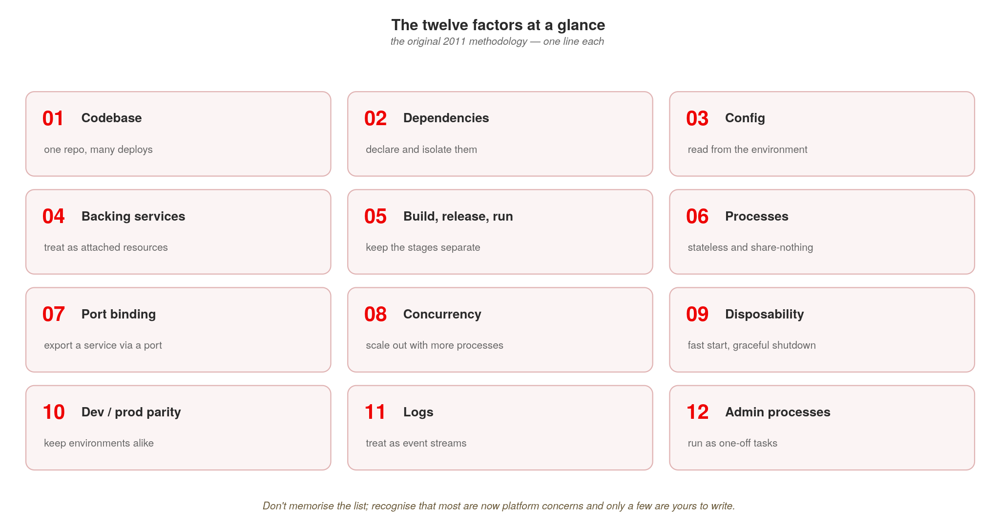
CLOUD-NATIVE PRINCIPLES
What the twelve factors are
The original 2011 checklist — most are now platform concerns; only a few are yours to write.
11
Notes:
A lot of people nod along to ‘twelve-factor’ without being able to name the twelve, so here they are at a glance, one line each. Don't read them aloud — let people scan. Two takeaways to say: first, this 2011 list essentially predicted cloud-native a decade early; second, notice how many are now handled by the platform (build/release/run, concurrency, disposability, port binding, backing services) versus the few you still actively write (config from the environment, statelessness, logs as streams). That sets up the next slide, which maps each factor onto our architecture.

Slide 14
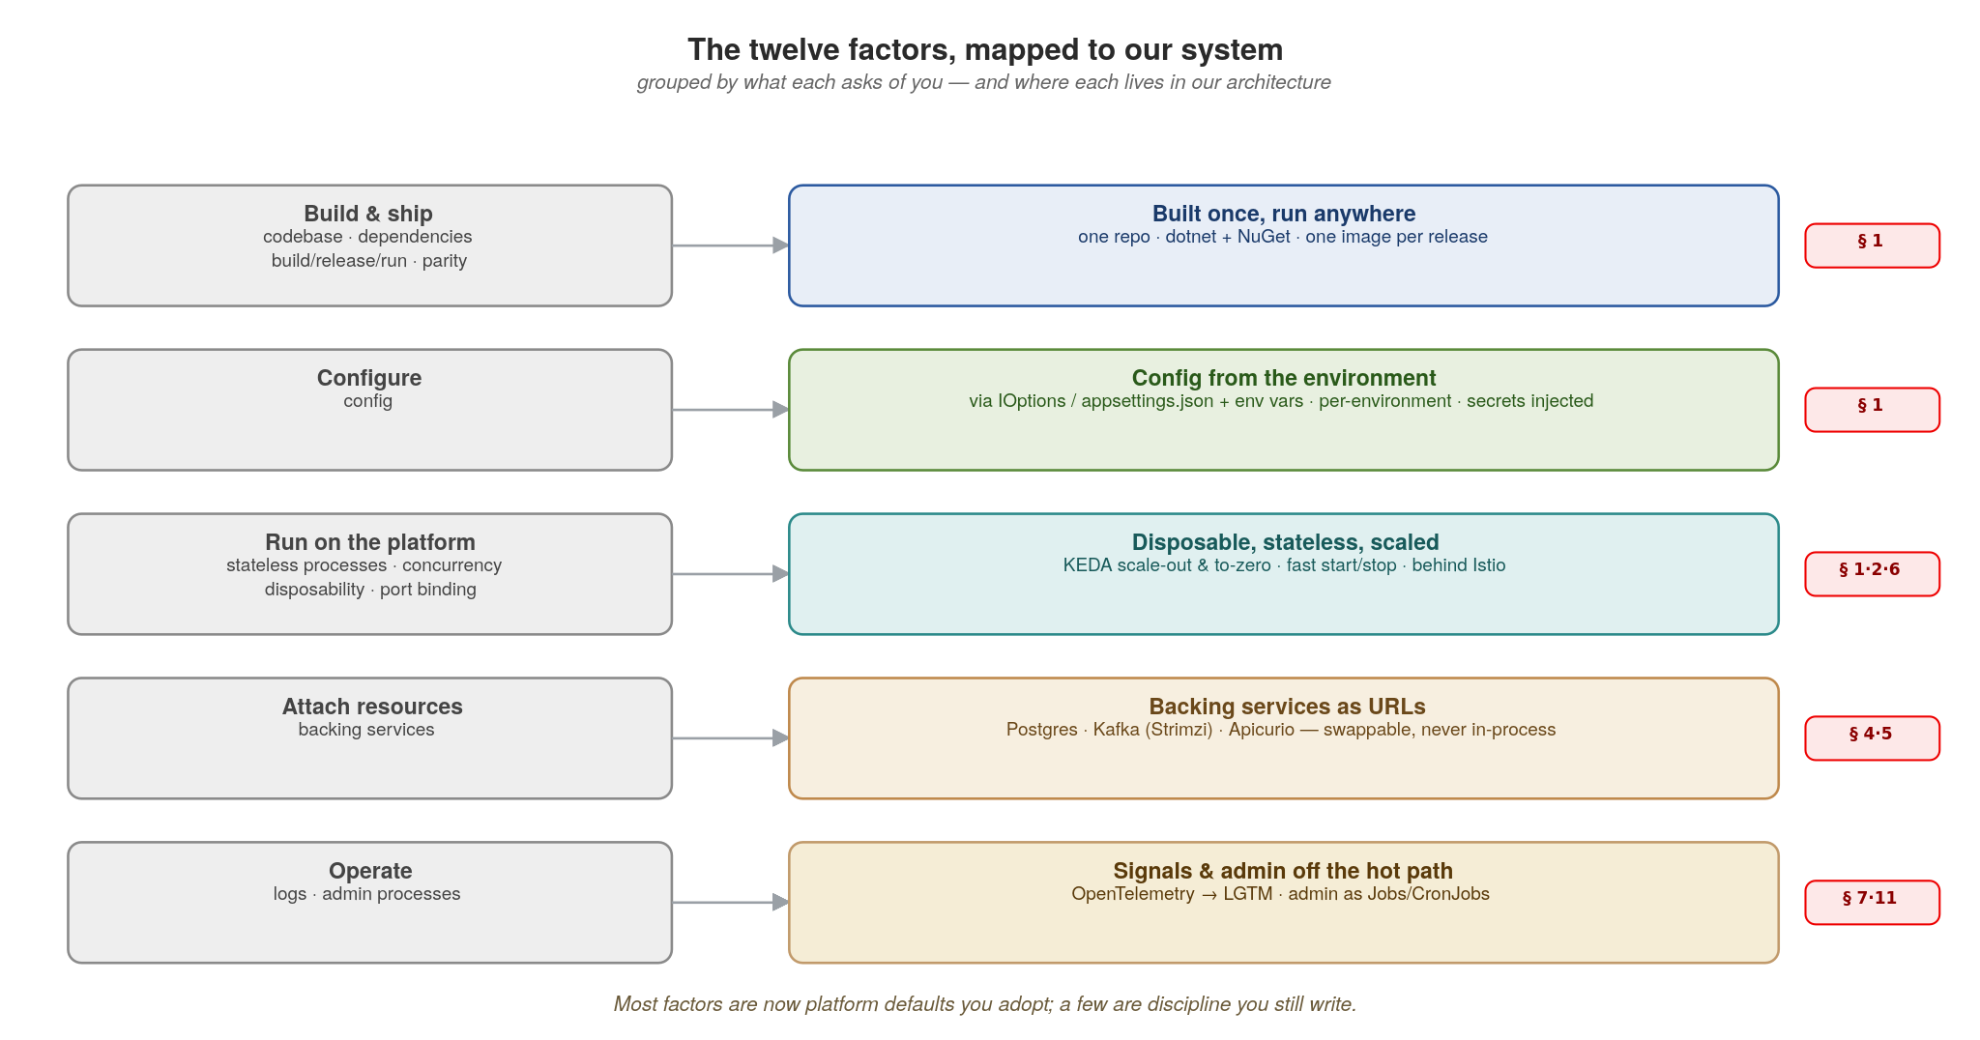
CLOUD-NATIVE PRINCIPLES
Twelve factors, mapped to our system
Most factors are now platform defaults you adopt; a few are discipline you still write.
12
Notes:
This is the payoff — not the traditional twelve-factor table, but a map of where each factor actually lives in the system we're building. Read it left to right: the twelve factors cluster into five things they ask of you, and each maps to a concrete piece of our stack and the section that covers it. Build & ship (codebase, dependencies, build/release/run, parity) becomes one repo, one image per release, the same image everywhere (§1). Configure becomes environment config (§1). Run on the platform (stateless processes, concurrency, disposability, port binding) becomes stateless pods, KEDA scaling, fast start/stop, and services behind Istio (§1, 2, 6). Attach resources becomes Postgres, Kafka and Apicurio as swappable URLs (§4–5). Operate (logs, admin processes) becomes OpenTelemetry into the LGTM stack and admin work as Jobs/CronJobs (§7, 11). The caption is the message: most of these are now defaults you adopt, not code you write — which is exactly what 'cloud-native' buys you.

Slide 15
CLOUD-NATIVE PRINCIPLES
A 12-factor ASP.NET Core service, ready for the platform
csharp · .NET 10 + ASP.NET Core + AspNetCore.HealthChecks
// Program.cs — minimal hosting, env-driven config (factor III)
var builder = WebApplication.CreateBuilder(args);
builder.Configuration.AddEnvironmentVariables(); // overrides appsettings.json
// Health checks: liveness vs readiness, just like the WCF heartbeat
// only Kubernetes calls them now, not your monitoring server
builder.Services.AddHealthChecks()
.AddCheck("self", () => HealthCheckResult.Healthy(), tags: new[] { "live" })
.AddNpgSql(builder.Configuration.GetConnectionString("Db")!,
name: "db", tags: new[] { "ready" }); // AspNetCore.HealthChecks
var app = builder.Build();
// Endpoints Kubernetes probes call — the cloud-native equivalent of
// IIS "Ping" + ARR health probes, but baked into the app, not the host
app.MapHealthChecks("/healthz/live", new() { Predicate = c => c.Tags.Contains("live") });
app.MapHealthChecks("/healthz/ready", new() { Predicate = c => c.Tags.Contains("ready") });
app.Run();
Probes, env-config and a thin Program.cs are the price of admission for a Kubernetes Deployment. Same liveness/readiness split a WCF host had — just owned by the cluster now.
13
Notes:
Walk the code: ASP.NET Core 10 uses minimal hosting (Program.cs as a top-level script). Config flows from appsettings.json overridden by environment variables (factor III) — the cloud-native equivalent of web.config Transforms and ASP.NET configBuilders, but the cluster injects the values via ConfigMaps and Secrets instead of an MSDeploy package. Health checks are first-class: IHealthCheck instances are tagged 'live' or 'ready' and mapped to separate endpoints. Liveness asks 'am I alive? if not, restart me' (Kubernetes kills the Pod); readiness asks 'can I serve? if not, take me out of rotation but don't kill me' (Kubernetes removes the Pod from the Service endpoints). Getting these wrong is a top cause of cascading restarts — the same way wrong IIS app-pool ping settings used to crash apps under load. Bonus: the AspNetCore.HealthChecks.* community packages (MIT) ship probes for Postgres, Redis, Kafka, RabbitMQ, SQL Server, and 50+ other dependencies, so you almost never write your own. The .NET runtime side: this is published as a Linux container image (dotnet publish -t:PublishContainer in .NET 8+), not an MSI deployed to IIS.

Slide 16
02
Communications
Match the interaction style to the call.
Notes:
Section two. The thesis: there is no single right protocol — there is a right protocol per interaction. Resist the urge to standardize on one wire for everything. The next slides give you a decision rule and then show each protocol in code against the running system.

Slide 17
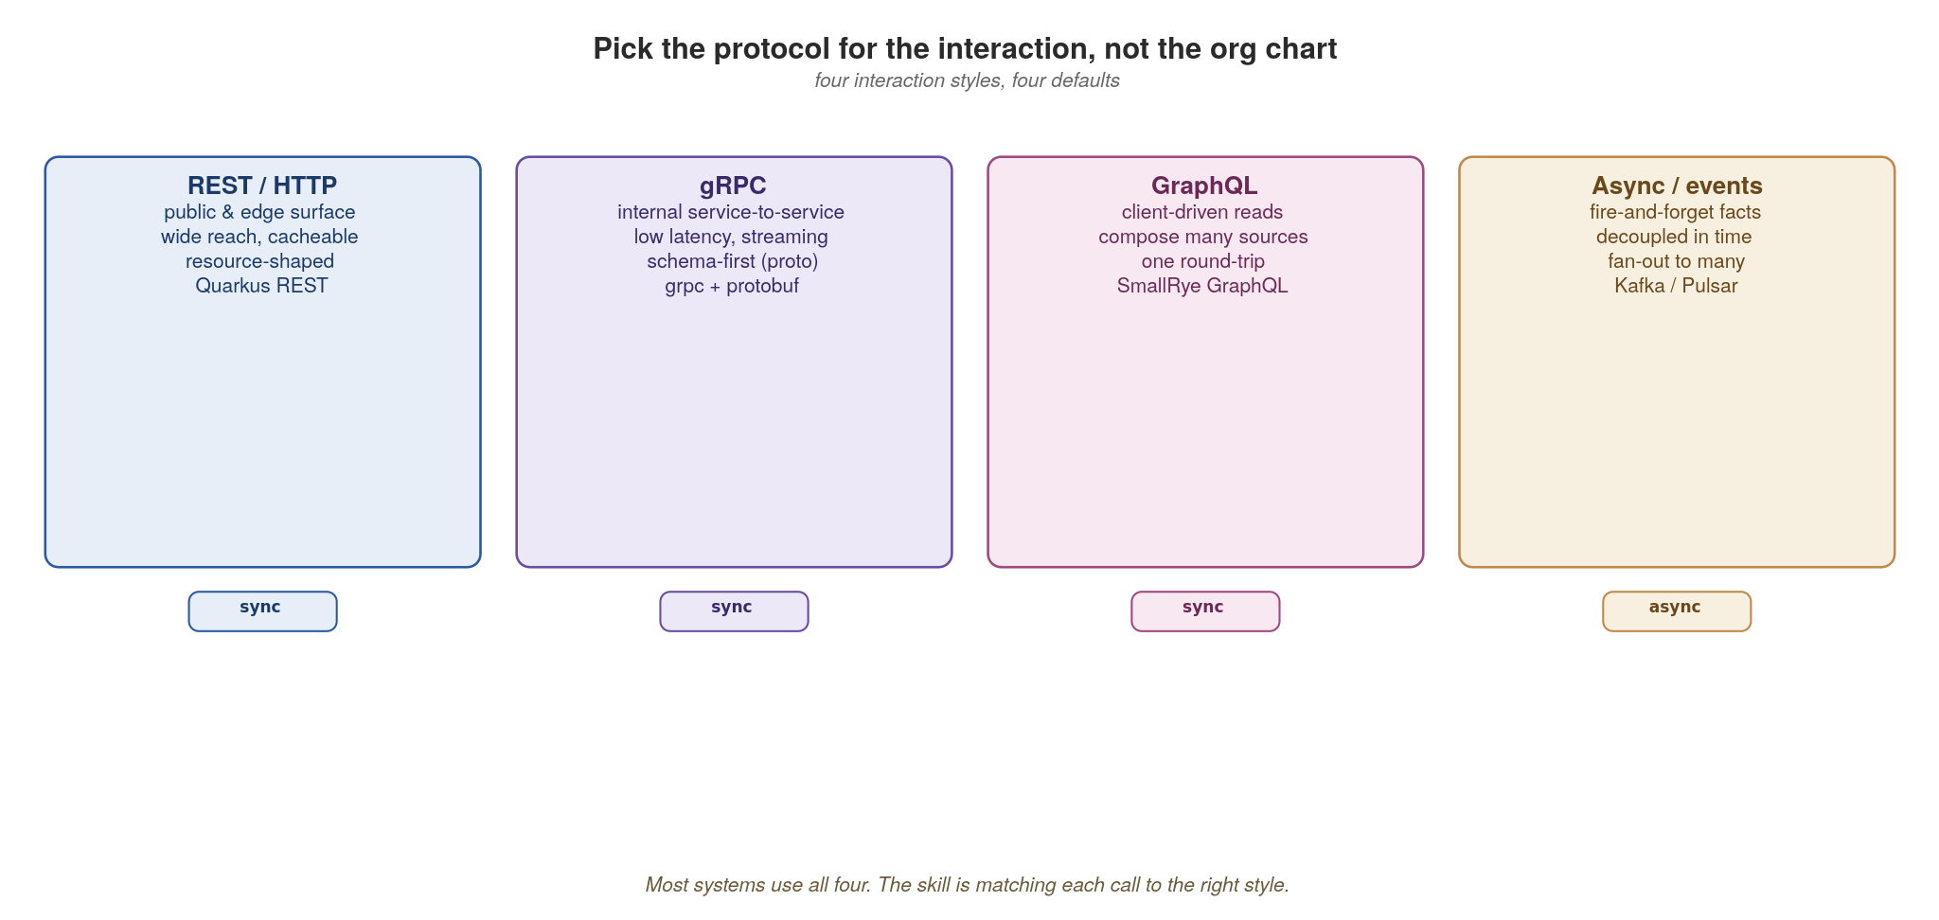
COMMUNICATIONS
Pick the protocol for the interaction
REST for reach, gRPC for internal speed, GraphQL for client-driven reads, async for decoupled facts.
14
Notes:
Four interaction styles, four defaults. REST for the public/edge surface where reach and caching matter; gRPC for internal service-to-service where latency and streaming matter; GraphQL for client-driven reads that compose many sources in one round trip; async events for decoupled facts that fan out. Most real systems use all four — the skill is matching each call to the right one. Note the sync/async chips at the bottom. This slide is the map for the whole section.

Slide 18
COMMUNICATIONS
REST at the edge with ASP.NET Core
csharp · .NET 10 + ASP.NET Core minimal APIs
// Program.cs — minimal API style; .NET 8+ has FluentValidation built in
var orders = app.MapGroup("/orders").WithOpenApi();
// Request record — immutable, validated; the WCF DataContract replacement
public record OrderIn(
[Required, StringLength(64)] string Sku,
[Range(1, 1_000)] int Quantity);
orders.MapPost("/", async (
[FromBody] OrderIn body,
IValidator<OrderIn> validator, // FluentValidation
IOrderService svc,
IEventPublisher events) =>
{
var result = await validator.ValidateAsync(body);
if (!result.IsValid) return Results.ValidationProblem(result.ToDictionary());
var order = await svc.CreateAsync(body);
await events.PublishAsync("order.placed", order);
return Results.Created($"/orders/{order.Id}", order); // 201, not 200
})
.Produces<Order>(StatusCodes.Status201Created)
.ProducesValidationProblem();
// GET with cursor pagination — never offset, breaks under concurrent writes
orders.MapGet("/", (string? after, int limit = 50, IOrderService svc) =>
svc.PageAsync(after, limit));
Resource-shaped URLs, FluentValidation contracts, correct status codes, cursor pagination — the WCF endpoint replacement for the outside world.
15
Notes:
This is the edge surface. For WCF refugees the mental shift: a Controller or minimal-API endpoint replaces an OperationContract; DataContract becomes a C# record with validation attributes; the binding (BasicHttp, NetTcp, MSMQ) becomes 'pick the right protocol per call' — here REST, gRPC and Kafka coexist instead of one endpoint multi-bound. Point out four things teams routinely get wrong: (1) resource-shaped URLs (nouns, not verbs) — not /GetOrder?id=123 like an .asmx service; (2) request contracts validated declaratively — records with [Required], [Range], or FluentValidation rules, so bad input never reaches your logic; (3) correct status codes — Results.Created (201) on create, Results.ValidationProblem (RFC 9457) for validation failures, not 200 with success=false in the body; (4) cursor pagination, not offset, because offset breaks under concurrent writes and gets slow at depth. Microsoft.AspNetCore.OpenApi (built in since .NET 9) emits the OpenAPI spec automatically — the equivalent of WCF's WSDL but generated at build time, versioned in the registry, and gated in CI. NSwag and Swashbuckle (both MIT) are the alternatives if you need richer customisation.

Slide 19
COMMUNICATIONS
gRPC for internal service-to-service calls
protobuf + csharp · .NET 10 + Grpc.AspNetCore
// inventory.proto — the contract, registered in Apicurio
syntax = "proto3";
service Inventory {
rpc ReserveStock (ReserveRequest) returns (ReserveReply);
}
message ReserveRequest { string sku = 1; int32 quantity = 2; }
message ReserveReply { bool reserved = 1; int32 remaining = 2; }
// Grpc.AspNetCore + Grpc.Tools compiles .proto to C# at build time
// (the cloud-native replacement for WCF NetTcpBinding service contracts)
public class InventoryService : Inventory.InventoryBase // generated base
{
private readonly IStockRepository _stock;
public InventoryService(IStockRepository stock) => _stock = stock;
public override async Task<ReserveReply> ReserveStock(
ReserveRequest req, ServerCallContext ctx)
{
var r = await _stock.ReserveAsync(req.Sku, req.Quantity);
return new ReserveReply { Reserved = r.Ok, Remaining = r.Remaining };
}
}
// Program.cs
builder.Services.AddGrpc(); // server registration
app.MapGrpcService<InventoryService>(); // expose the service
Schema-first, binary, multiplexed over HTTP/2 — the WCF NetTcpBinding replacement for chatty internal paths. Test with ghz.
16
Notes:
gRPC for the internal paths. For WCF refugees this is the most familiar protocol in cloud-native: the .proto file IS the service contract, exactly like a WCF [ServiceContract] interface, and the wire format is binary like NetTcpBinding. The Grpc.Tools NuGet package compiles the .proto with protoc at build time, generating both the C# message classes (similar to DataContracts) and an Inventory.InventoryBase abstract class — you derive from it and override the operations. Highlight that the field numbers (=1, =2) are the wire contract — we return to exactly why in Appendix B. Streaming RPCs (server, client, bidirectional) are first-class through IAsyncEnumerable<T>. The right default for chatty service-to-service calls where you control both ends, and the natural migration target for internal WCF endpoints. Load-test it with ghz. (Optional: mention that for browser clients, gRPC-Web via Grpc.AspNetCore.Web exposes the same service over HTTP/1.1 with limitations.)

Slide 20
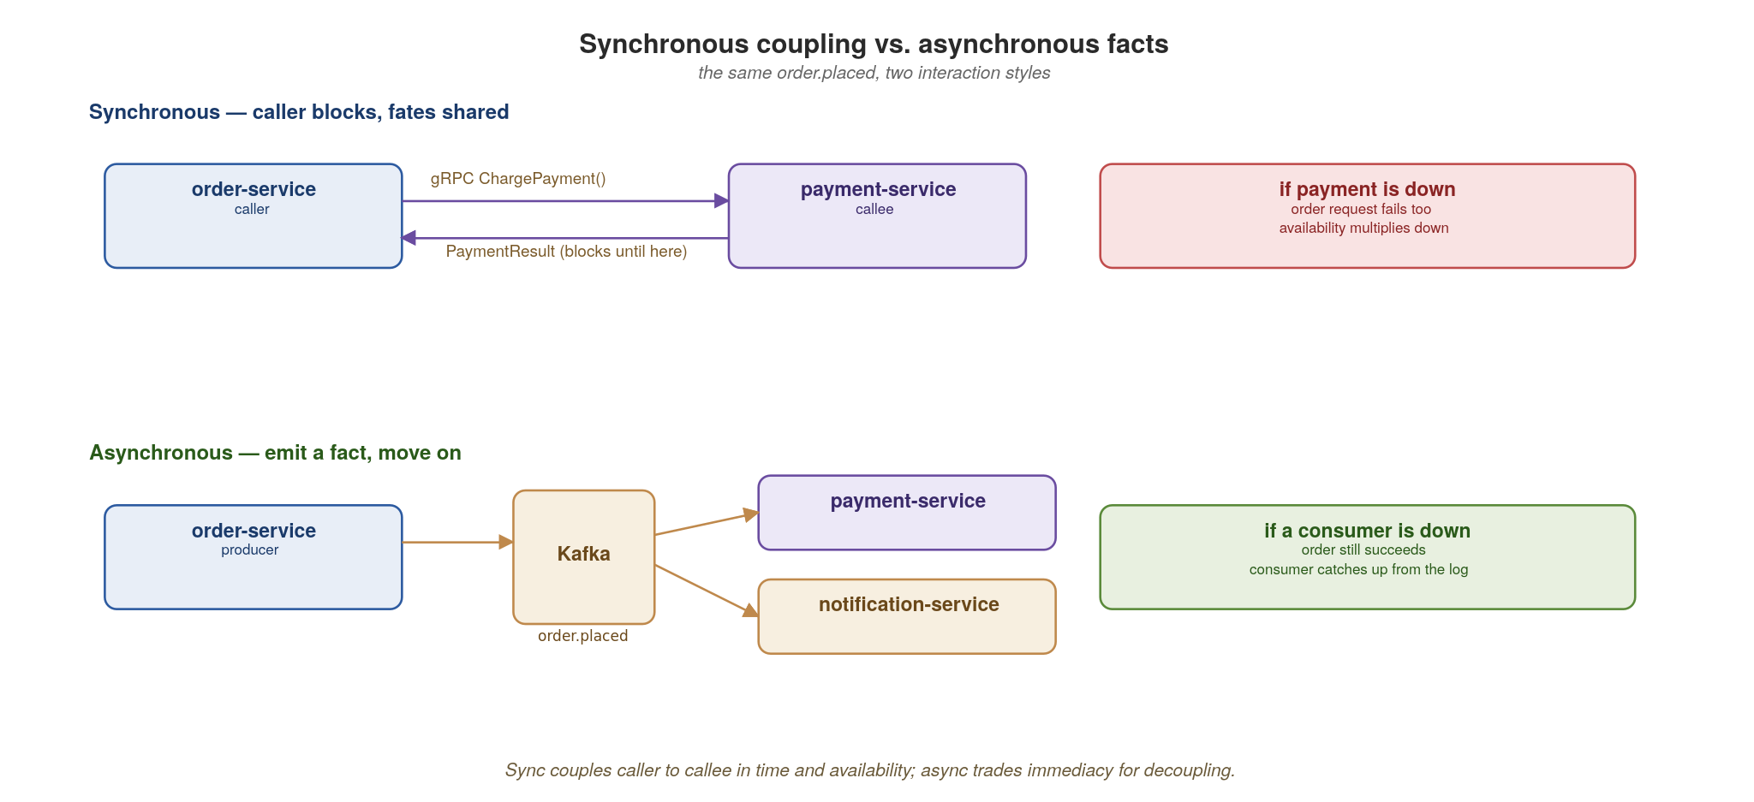
COMMUNICATIONS
Synchronous coupling vs. asynchronous facts
A synchronous call shares fate; an event shares a fact. Reach for async wherever immediacy isn't required.
17
Notes:
The central trade-off of the whole talk in one picture. Top row: a synchronous call couples caller to callee in time and availability — if payment-service is down, the order request fails too, and availability multiplies downward across a chain. Bottom row: emitting order.placed as a fact lets the order succeed immediately; consumers catch up from the log if they were down. The rule: reach for async wherever immediacy isn't strictly required. This sets up the entire event-driven section later.

Slide 21
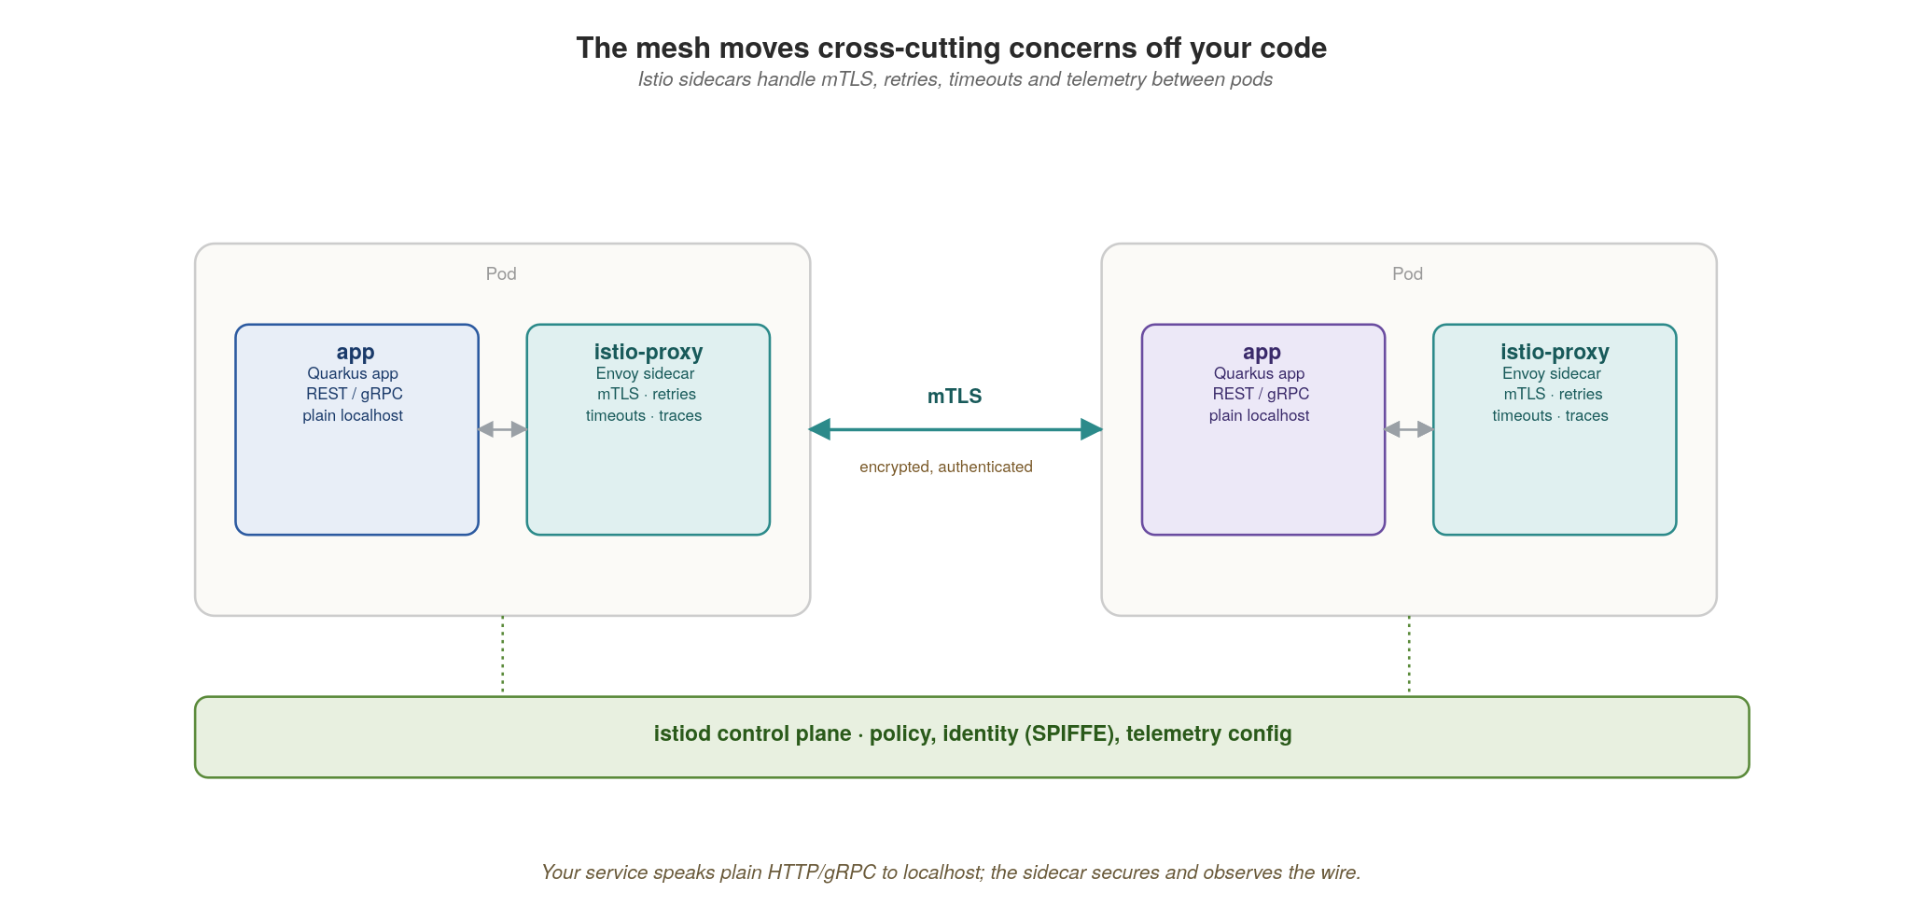
COMMUNICATIONS
The mesh handles the wire, not your code
Istio sidecars give you mTLS, retries, timeouts and telemetry — uniformly, without per-service code.
18
Notes:
Service mesh in one picture. Your app speaks plain HTTP or gRPC to localhost; the Istio sidecar (Envoy) intercepts and adds mTLS, retries, timeouts and telemetry on the wire — uniformly, for every service, with zero application code. istiod is the control plane distributing policy and identity (SPIFFE). The key insight ties back to principles: resilience and security become platform defaults, not per-service reimplementations. The next slide shows the actual config.

Slide 22
COMMUNICATIONS
Resilience as configuration, not per-call code
yaml · istio
# Istio: retries, timeout and outlier detection for inventory-service
apiVersion: networking.istio.io/v1
kind: VirtualService
metadata: { name: inventory }
spec:
hosts: [inventory]
http:
- timeout: 2s
retries:
attempts: 2 # bounded — never an unbounded retry storm
perTryTimeout: 800ms
retryOn: connect-failure,unavailable
route:
- destination: { host: inventory }
Bounded retries with backoff live in the mesh. Unbounded client retries are how an incident becomes an outage.
19
Notes:
Resilience as configuration. This VirtualService gives inventory a 2-second timeout, two retry attempts with an 800ms per-try timeout, retrying only on connect-failure and unavailable. The critical word is bounded — attempts: 2, not infinite. Tell the war story: unbounded client-side retries are how a brief blip becomes a full outage, because every caller piles on the struggling service (a retry storm). Putting this in the mesh means it's consistent across every service and tunable without redeploying code.

Slide 23
03
Composition
Aggregate at the edge, not inside services.
Notes:
Section three. The question: when a client needs data from several services, where does the joining happen? The answer that keeps services decoupled: at the edge, in a gateway or BFF — never by services calling each other in deep chains. That chaining is how you accidentally rebuild a monolith over the network.

Slide 24
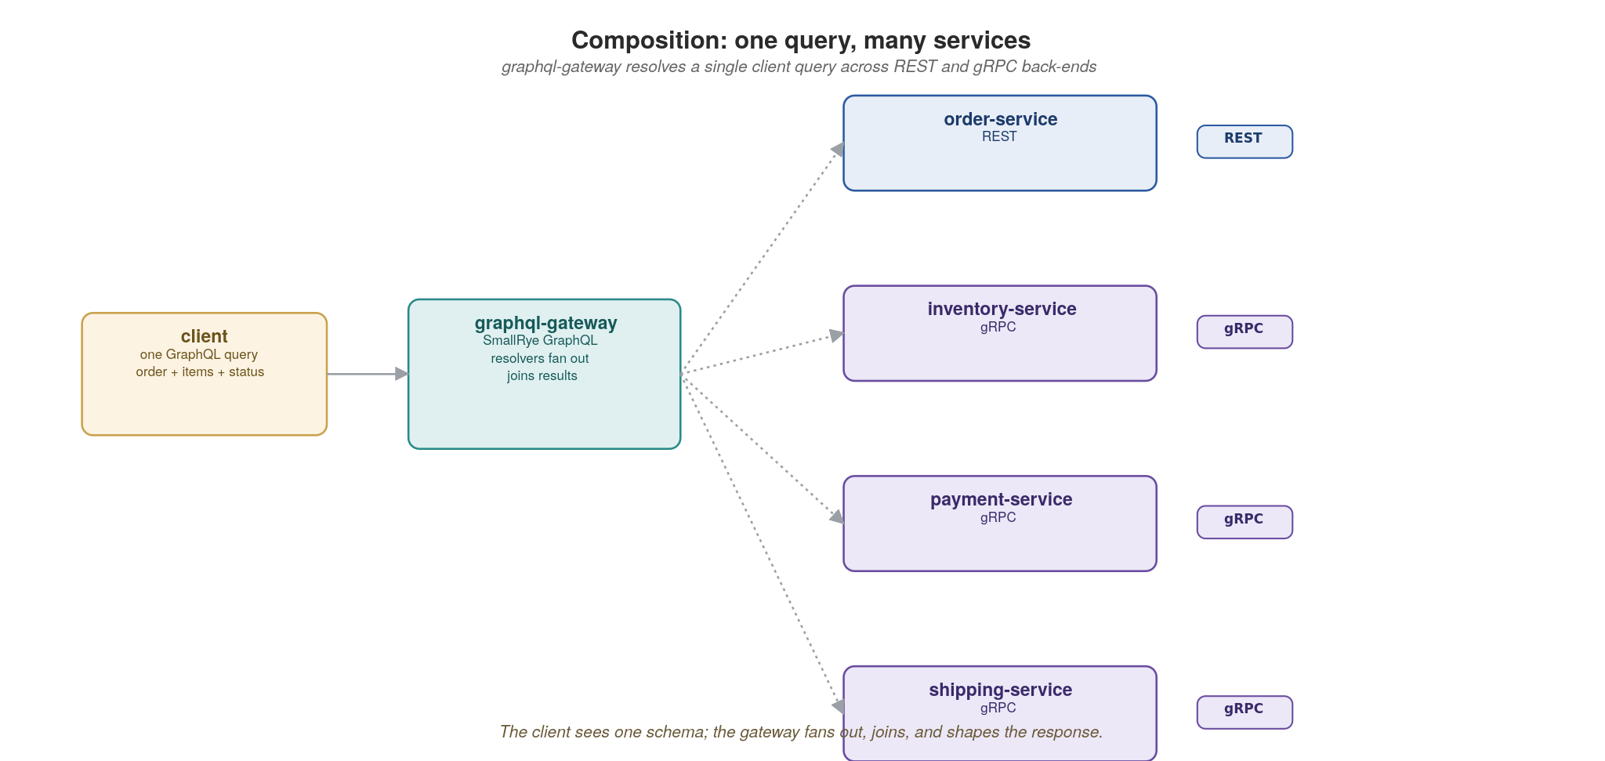
COMPOSITION
One query, many services
The gateway presents one schema and fans out to REST and gRPC back-ends, then joins and shapes the result.
20
Notes:
GraphQL federation against the running system. The gateway presents one schema to clients and fans out to REST and gRPC back-ends, then joins and shapes the result. The client makes one round trip and asks for exactly the fields it needs. Crucially, the services stay unaware of each other — the gateway owns the composition. Contrast this with services calling services, which we'll warn against on the patterns slide. Next slide shows the resolver code.

Slide 25
COMPOSITION
A composing resolver in HotChocolate
csharp · .NET 10 + HotChocolate
// HotChocolate (MIT, by ChilliCream) — the dominant open-source GraphQL server
// for .NET. Code-first or schema-first. Built-in DataLoader for N+1.
public class Query // the gateway's schema
{
public async Task<Order?> GetOrder(string id, // REST call to order-service
[Service] IOrderClient orders) =>
await orders.GetAsync(id);
}
[ExtendObjectType<Order>] // adds fields to Order type
public class OrderExtensions
{
// batched per-request to kill N+1: one gRPC call for N orders
public async Task<int> GetStock(
[Parent] Order order,
IInventoryStockDataLoader loader) => // generated DataLoader
await loader.LoadAsync(order.Sku);
}
// Program.cs registration
builder.Services
.AddGraphQLServer()
.AddQueryType<Query>()
.AddTypeExtension<OrderExtensions>()
.AddDataLoader<IInventoryStockDataLoader, InventoryStockDataLoader>();
app.MapGraphQL(); // POST /graphql + IDE
The gateway owns aggregation; each field resolves against the owning service. DataLoader batches N orders into one gRPC call.
21
Notes:
The resolver makes federation concrete in HotChocolate. The top-level GetOrder Query calls order-service over REST; [ExtendObjectType<Order>] adds a stock field that resolves against inventory-service over gRPC. Each field resolves against its owning service — the gateway is just the composition layer. Mention the N+1 risk: naive per-field resolution can explode into many back-end calls — HotChocolate's DataLoader (in fact the same DataLoader pattern Facebook open-sourced for JavaScript) batches N orders into one upstream call automatically; the IInventoryStockDataLoader interface is generated by source-generators from your loader implementation. HotChocolate ships first-class Apollo Federation support if you go that route. The schema is exposed at POST /graphql plus an in-browser GraphQL IDE (Banana Cake Pop / Nitro) at /graphql in development. Where this lands for a .NET-from-Windows audience: think of it as the long-overdue replacement for SOAP composition or for hand-rolled aggregation endpoints — one wire, one schema, many backends.

Slide 26
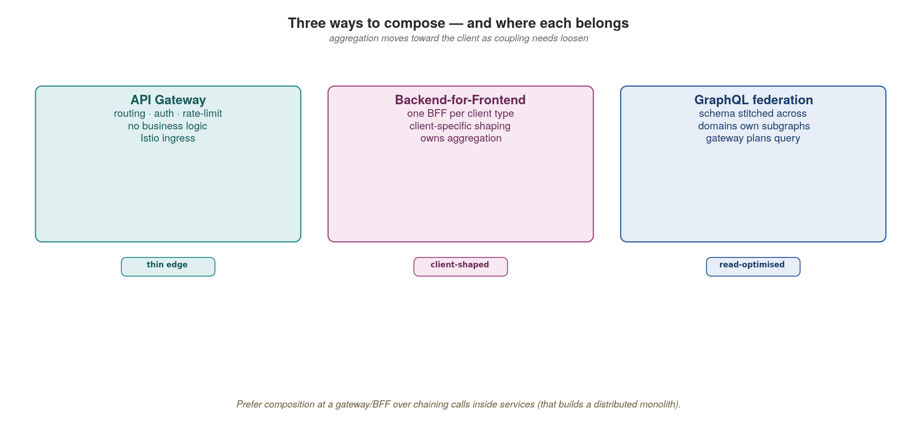
COMPOSITION
Three ways to compose — and where each belongs
Push aggregation to a gateway or BFF. Chaining calls inside services quietly rebuilds the monolith.
22
Notes:
Three composition patterns: an API gateway (one composed schema for everyone), a backend-for-frontend (a tailored aggregate per client type — web vs mobile), and GraphQL federation (a distributed graph). All three push aggregation outward to the edge. The anti-pattern to call out explicitly: service-to-service call chains, where order calls inventory calls pricing calls… — synchronous, deeply coupled, and impossible to reason about. That quietly rebuilds the monolith with network latency between the pieces.

Slide 27
COMPOSITION
Blazor Server as a line-of-business BFF
Blazor Server is inherently BFF-shaped: a server-side .NET process holds the UI's view-model and pushes UI diffs to the browser over a SignalR channel — the client is thin.
Inside that server-side process you can aggregate from REST, gRPC and Kafka back-ends with normal .NET code (typed HttpClient, gRPC client, MassTransit consumer) — no client-side fan-out, no CORS dance, no token-passing through the browser.
Runs on Kubernetes as a regular ASP.NET Core Pod — no Azure App Service, no Azure SignalR Service. The SignalR backplane is open-source Redis (we cover the pinning + backplane story in Appendix C).
When to choose it: internal LOB apps, admin consoles, dashboards — where you want server-rendered state, server-side auth, and a single trust boundary. Pair with Blazor WebAssembly for the offline / high-interactivity client surface (Appendix C).
When NOT to choose it: SEO-critical public sites (use static rendering or SSR), or anything that must work without a persistent connection — every Blazor Server interaction is a SignalR round-trip and inherits all the WebSocket scaling concerns in Appendix C.
23
Notes:
The slide makes the BFF pattern from the previous diagram concrete in the .NET world. Blazor Server is more than a UI framework — architecturally it IS a backend-for-frontend: the server-side process maintains the user's session-scoped component tree and pushes UI updates (Render Tree Diffs) to a thin JavaScript client over SignalR. That means everything happens server-side: authentication is server-side cookie-based, calls to inventory and pricing are server-to-server (typed HttpClient or gRPC stub), and the browser never sees a back-end URL or token. For LOB and admin tooling this collapses three problems at once (composition, auth boundary, real-time updates) into one server-side process. The Kubernetes posture is straightforward: containerized ASP.NET Core, plus Redis as the SignalR backplane (covered in Appendix C). What we explicitly avoid: Azure SignalR Service (cloud-coupled, paid), Azure App Service hosting (Kubernetes is the deployment target), Azure Static Web Apps (Blazor WASM is hosted as static files inside an nginx Pod or the ASP.NET Core process itself). The trade-off in the bold line is the real one: every interaction is a round-trip, every component instance is a per-user session living in a Pod, and SCALING THE BLAZOR SERVER POOL has the same head-of-line / pinning / connection-count concerns we cover in Appendix C — don't pick it for traffic shapes where those bite. For high-interactivity client-side execution use Blazor WebAssembly, also covered in Appendix C.

Slide 28
04
Data
Own your data; share it through contracts.
Notes:
Section four, and arguably the hardest discipline to hold. The rule: each service owns its data and shares it only through APIs and events — never through a shared database or by reaching into another service's tables. This is what makes independent deployment and independent scaling real. The slides cover ownership, the dual-write trap, and the saga.

Slide 29
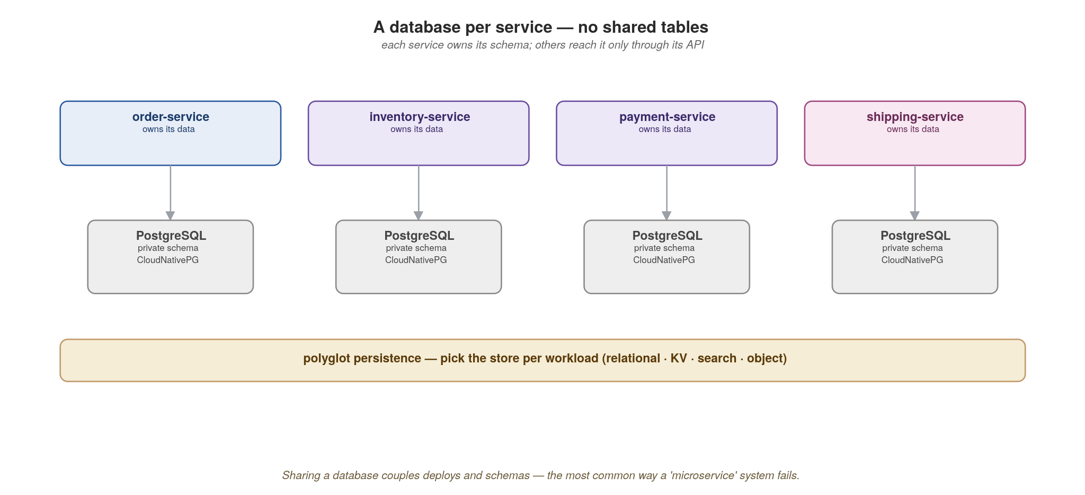
DATA
A database per service
Each service owns its schema and storage engine; no other service touches its tables directly.
24
Notes:
Database-per-service. Each service owns its schema and even its storage engine — order and payment on Postgres, something else on a document store if that fits. No other service touches those tables directly; the only doors in are the API and the events. The hard part is social, not technical: someone will always want to 'just join across two services' databases' for a report. That shortcut is the single most common way microservice independence dies. Reporting needs go through the metadata/lineage layer or a dedicated read model, not direct table access.

Slide 30
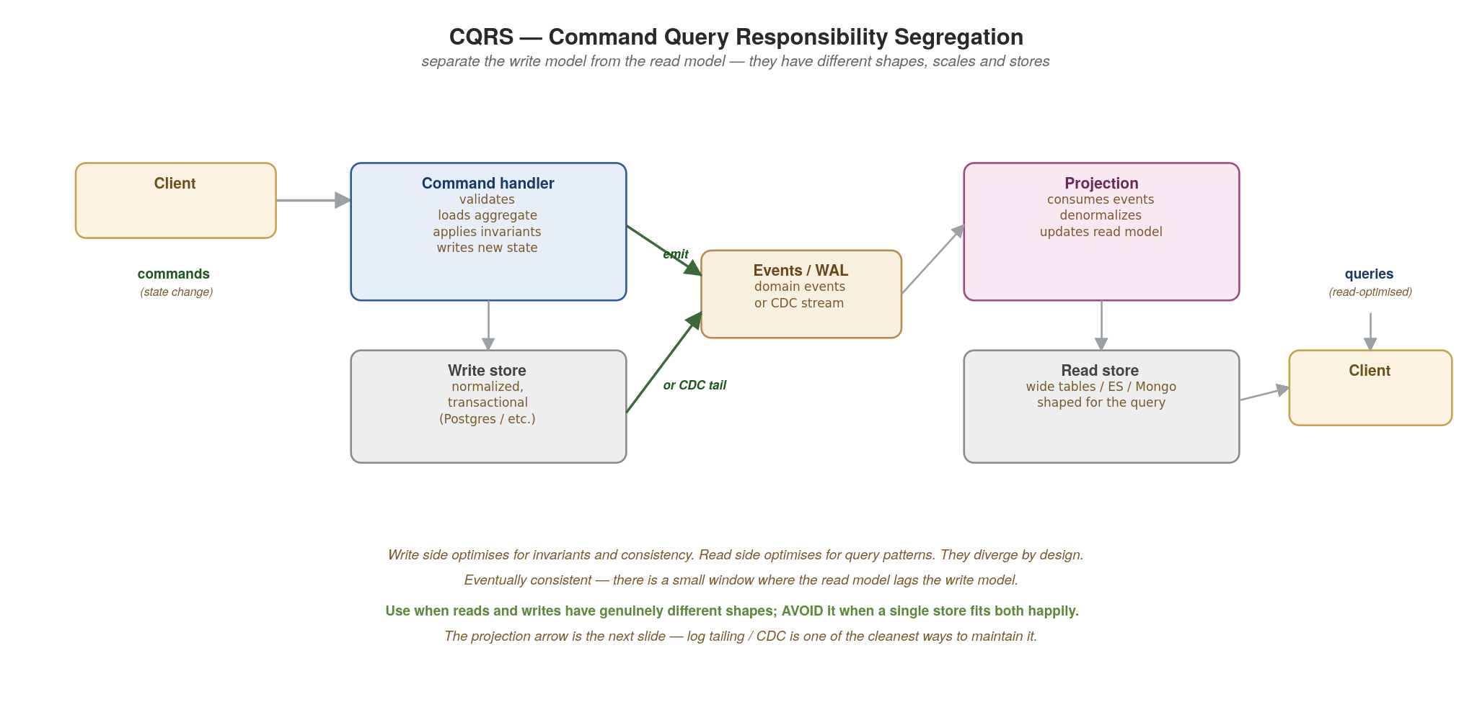
DATA
CQRS — Command Query Responsibility Segregation
Separate the write model from the read model. They have different shapes, scales and even different stores.
25
Notes:
CQRS — Command Query Responsibility Segregation — is the pattern of using DIFFERENT models for writes and reads. The write side optimises for invariants and consistency: a normalised schema in a transactional store (Postgres, MySQL). The read side optimises for query shape: denormalised wide tables, an Elasticsearch index, a Mongo document, or whatever fits the question being asked. The two are linked by a stream of events — either domain events emitted by the write side, or the database commit log itself via CDC (the next slide). The cost: eventual consistency — there is a small lag between the write committing and the read model catching up. The benefit: each side can scale, schema-evolve and even be stored independently. Use this pattern when reads and writes have GENUINELY different shapes and access patterns. Avoid it when a single store happily handles both — CQRS adds operational complexity that isn't free. The classic motivating case: a service that takes thousands of writes per second but is read by analytics, dashboards and search — the write model serves the writes, the read model serves the rest. CQRS pairs naturally with event sourcing on the write side and event streaming for projections — we cover both distinctions in section 5.

Slide 31
DATA
CQRS in practice
csharp · ASP.NET Core 10 + EF Core + MassTransit
// Write side — command handler
[ApiController, Route("orders")]
public class OrderWriteController(WriteDb writes, IPublishEndpoint bus) : ControllerBase {
[HttpPost]
public async Task<ActionResult<Order>> Create(OrderIn body, CancellationToken ct) {
var order = new Order(body);
writes.Orders.Add(order);
await writes.SaveChangesAsync(ct); // write model
await bus.Publish(new OrderCreatedEvent(order), ct); // → projection
return Ok(order);
}
}
// Read side — reads from a DIFFERENT, denormalised store
[ApiController, Route("orders")]
public class OrderReadController(ReadDb reads) : ControllerBase {
[HttpGet("{id}/summary")]
public async Task<ActionResult<OrderSummary>> Summary(string id, CancellationToken ct) {
var s = await reads.OrderSummaries.FindAsync([id], ct);
return s is null ? NotFound() : Ok(s); // NOT write store
}
}
// Projection — MassTransit consumer; idempotent upsert into the read model
public class OrderSummaryProjection(ReadDb reads) : IConsumer<OrderCreatedEvent> {
public async Task Consume(ConsumeContext<OrderCreatedEvent> ctx) {
reads.OrderSummaries.Update(OrderSummary.From(ctx.Message));
await reads.SaveChangesAsync(ctx.CancellationToken);
}
}
26
Notes:
The .NET shape with primary constructors. Two ApiControllers: OrderWriteController handles writes via WriteDb (EF Core context wired to the write database), OrderReadController handles reads via ReadDb (a separate context wired to the read database — could be a different Postgres, an Elasticsearch via a custom provider, or anything). MassTransit's IPublishEndpoint emits the OrderCreatedEvent which routes to Kafka, RabbitMQ, or Azure Service Bus depending on transport configuration. The projection is a MassTransit IConsumer<OrderCreatedEvent> that updates the read model — the SaveChangesAsync is idempotent because we use Update (or you'd use ON CONFLICT semantics via a database-specific upsert). Different scaling for read vs write side.

Slide 32
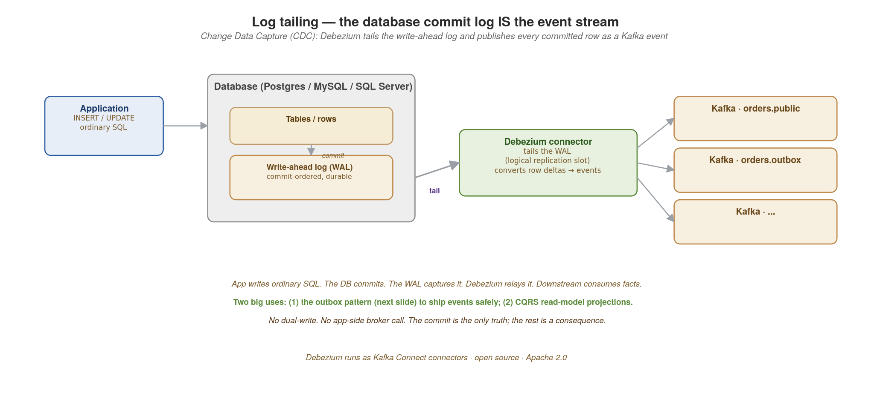
DATA
Log tailing — the database commit log IS the event stream
Debezium tails the WAL and publishes every committed row as a Kafka event. No dual-write.
27
Notes:
The mechanism that makes CQRS projections AND the outbox pattern (next slide) work: Change Data Capture, or CDC. The application writes ordinary SQL. The database commits and the change lands in the write-ahead log (WAL on Postgres, redo log on Oracle, binlog on MySQL, transaction log on SQL Server). Debezium — an Apache 2.0 open-source project running as a set of Kafka Connect connectors — tails that log via the database's native replication protocol (logical replication slots on Postgres, etc.), translates row-level deltas into Kafka events, and publishes them with commit ordering preserved. The application doesn't know Debezium exists. There is no dual-write — the commit is the SINGLE source of truth, and the event is a strictly downstream consequence. This is why log tailing matters before we get to the outbox slides: the outbox is just a deliberate use of CDC for a specific case (publishing events that aren't naturally row-level), and CQRS projections are the other big use. Debezium supports Postgres, MySQL, MariaDB, SQL Server, Oracle, MongoDB, Db2, Cassandra, and Vitess out of the box. Run mode: deploy as Kafka Connect workers, or use Debezium Server (standalone) if you don't want a Kafka Connect cluster. WAL = Write-Ahead Log: the database's commit-ordered durable log that already exists for replication and crash recovery; Debezium just subscribes to it.

Slide 33
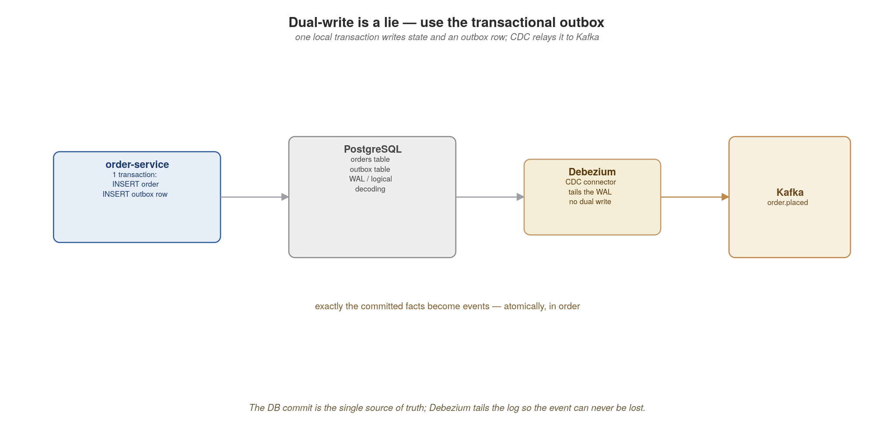
DATA
Dual-write is a lie — use the outbox
Write state and the outbox row in one transaction; CDC relays the committed fact to Kafka.
28
Notes:
This is the slide that prevents a class of production bugs. The dual-write problem: if you write to your database and then publish to Kafka as two separate operations, a crash between them leaves you inconsistent — the order exists but the event was never sent, or vice versa. The fix is the transactional outbox: write the state change and an outbox row in ONE local transaction, then a change-data-capture tool (Debezium) tails the database log and relays the committed row to Kafka. The database commit is the single source of truth. Next slide is the actual transaction.

Slide 34
DATA
The outbox write — one transaction, no lost events
csharp · EF Core + Debezium CDC
// EF Core + Debezium CDC — the .NET reading of the outbox pattern.
// For WCF/COM+ refugees: this REPLACES the MSDTC two-phase commit you used
// to make 'save the order AND queue the event' atomic across databases.
public class OrderService(OrdersDbContext db) : IOrderService
{
public async Task<Order> CreateAsync(OrderIn body)
{
await using var tx = await db.Database.BeginTransactionAsync();
var order = Order.From(body);
db.Orders.Add(order); // state change
db.Outbox.Add(new OutboxEntry( // same txn — outbox row
EventType: "order.placed",
AggregateType: "orders",
AggregateId: order.Id,
Payload: JsonSerializer.Serialize(order),
CreatedAt: DateTimeOffset.UtcNow));
await db.SaveChangesAsync(); // single local commit
await tx.CommitAsync(); // Debezium tails WAL → Kafka
return order;
}
}
// No Kafka call on the request path: if the broker is down, the order still
// commits and the event ships when the Debezium connector catches up.
// MassTransit has a built-in transactional outbox if you prefer the framework path.
One local DB commit replaces MSDTC. Debezium tails the write-ahead log and turns the outbox row into a guaranteed, ordered Kafka event.
29
Notes:
For the WCF/COM+ audience this is THE most important pattern. You used to write code like 'TransactionScope: save order, write to MSMQ, commit' — and MSDTC made it atomic across the SQL Server and MSMQ resource managers. Kubernetes has no MSDTC. You DON'T want one (two-phase commits across services don't scale and create coupling). Instead: write the state change AND an outbox row in ONE local database transaction — atomic by definition because it's a single resource manager. There's no Kafka call inside the request path — if Kafka is down, the order still commits, and the event ships later when Debezium tails the Postgres WAL (or SQL Server CDC) and relays the outbox row in commit order. This decouples your request latency and availability from Kafka's, which COM+ never could. Two ways to wire it up in .NET: write the OutboxEntry entity manually as shown (Postgres/SQL Server + the Debezium Outbox Event Router single-message transform handles the unwrap on the connector side); OR use MassTransit's built-in transactional outbox, which gives you the same guarantees with framework-managed plumbing — we'll see MassTransit for events on the next section. Either way: this same commit-together discipline reappears in the saga appendix.

Slide 35
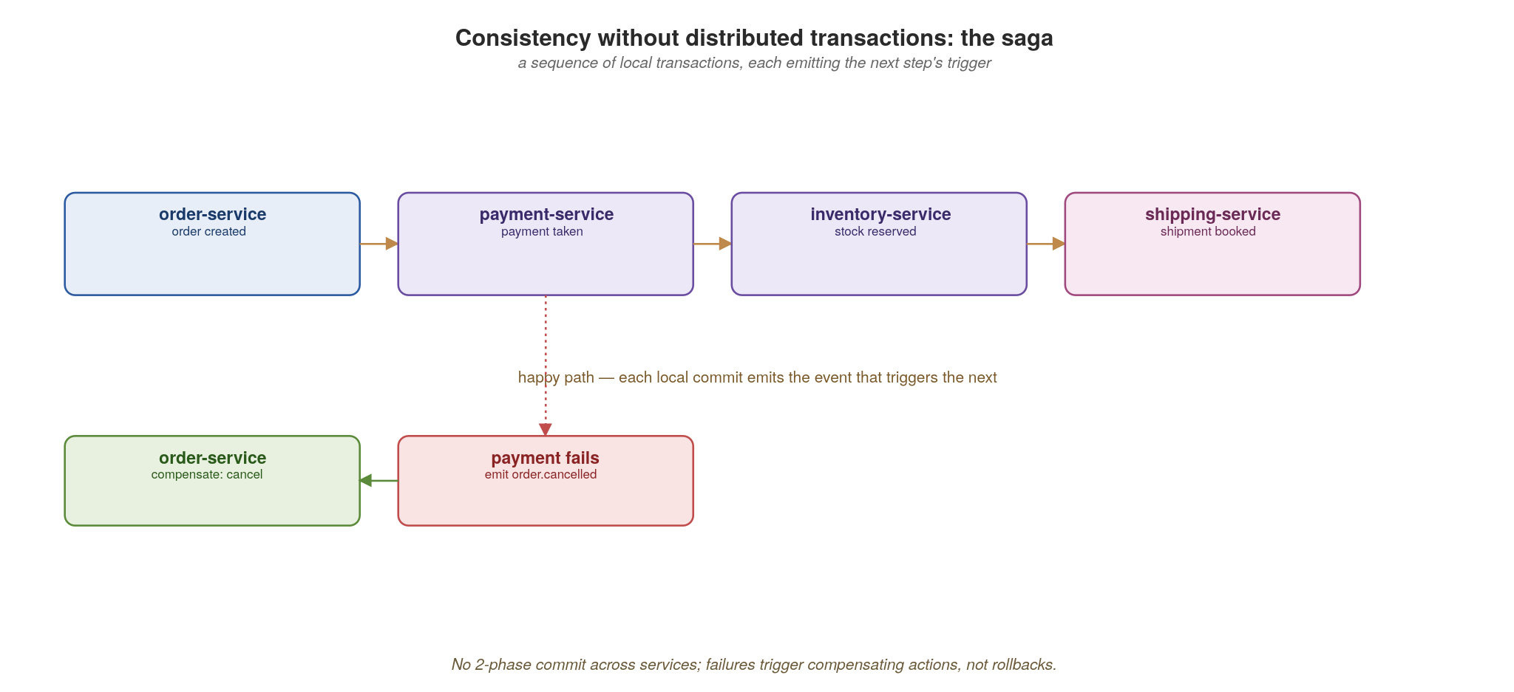
DATA
Consistency without distributed transactions: the saga
A chain of local transactions; failures trigger compensating actions, never a cross-service rollback.
30
Notes:
The saga is how you get consistency across services without a distributed transaction (there is no two-phase commit here, and you don't want one). It's a sequence of local transactions, each emitting the event that triggers the next: order created, payment taken, stock reserved, shipment booked. When a step fails — payment fails — you don't roll back; you run compensating actions for the steps that already committed (cancel the order). Flag that Appendix D goes deep on saga state, compensation and a genuinely tricky data-dependency case, for anyone who wants the mechanics.

Slide 36
05
Event-Driven
Emit facts; let consumers decide.
Notes:
Section five — the asynchronous backbone we kept pointing at. The mental shift: a producer emits a fact about something that happened (order.placed) and does not know or care who consumes it. Consumers decide what to do. This inverts the dependency direction and is what truly decouples services in time and ownership.

Slide 37
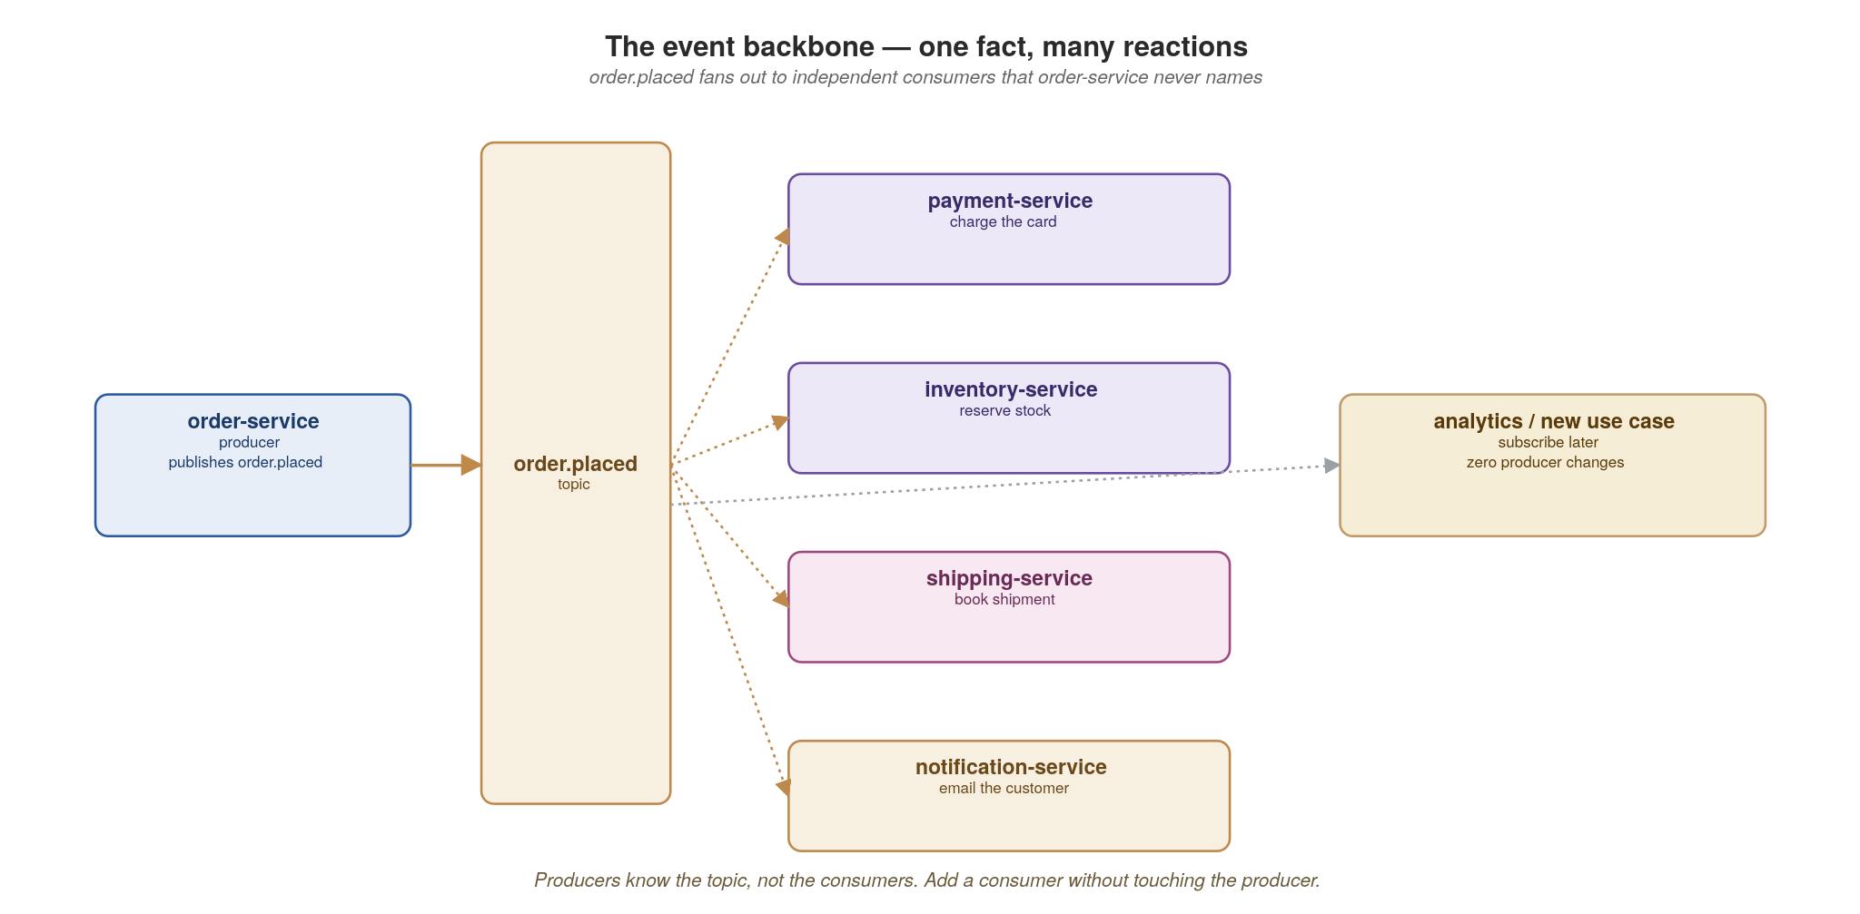
EVENT-DRIVEN
The event backbone — one fact, many reactions
order.placed fans out to consumers the producer never names. Add a consumer without touching the producer.
31
Notes:
order.placed fans out to payment, shipping and notification — and the producer names none of them. The power move: you can add a new consumer (say, a fraud-check service) without touching or redeploying the producer. Contrast with the synchronous world, where adding a dependency means changing the caller. This is the open/closed principle at the architecture level. Kafka (run by Strimzi on Kubernetes) is the backbone; Pulsar is an alternative with similar semantics.

Slide 38
EVENT-DRIVEN
Producing and consuming with MassTransit
csharp · .NET 10 + MassTransit + Confluent.Kafka
// MassTransit (Apache 2.0) is the BizTalk/NServiceBus open-source heir for .NET.
// One programming model over Kafka, RabbitMQ or Azure Service Bus.
// Sagas, retries, scheduling, transactional outbox — all built in.
public record OrderPlaced(string OrderId, string Sku, int Quantity);
// producer — order-service emits the fact
public class OrderEvents(IBus bus) // primary constructor
{
public Task PublishAsync(Order o) => bus.Publish(
new OrderPlaced(o.Id, o.Sku, o.Quantity)); // keyed by message type
}
// consumer — notification-service, Kafka-only by design
public class Notifier(IEmailSender mail) : IConsumer<OrderPlaced>
{
public async Task Consume(ConsumeContext<OrderPlaced> ctx)
{
await mail.SendAsync(ctx.Message); // do the work first
// ctx auto-acks on successful return — at-least-once delivery
}
}
// Program.cs
builder.Services.AddMassTransit(x => {
x.AddConsumer<Notifier>();
x.UsingKafka((ctx, k) => { // also: UsingRabbitMq, UsingAzure...
k.Host("kafka:9092");
k.TopicEndpoint<OrderPlaced>("order-placed", "notifier-group",
e => e.ConfigureConsumer<Notifier>(ctx));
});
});
MassTransit is the BizTalk/NServiceBus replacement: one API over Kafka, RabbitMQ, Azure Service Bus. Handlers are idempotent; at-least-once is the contract.
32
Notes:
For this audience MassTransit lands as 'BizTalk for the open-source cloud-native era' — one programming model that abstracts over Kafka, RabbitMQ, Azure Service Bus, and Amazon SQS. The IConsumer<T> interface replaces what you'd have done with a BizTalk orchestration receive shape or a Windows Service polling MSMQ. Two things to drill home: (1) we ack only AFTER the work succeeds — if you ack before and then crash, you've lost the work. Because we ack after, a crash mid-handler means redelivery, so delivery is at-least-once and your handlers MUST be idempotent (dedupe by message id or an idempotency key). Exactly-once is mostly at-least-once plus idempotency. (2) MassTransit handles the Kafka consumer-group, offset commits, retry policies, faulted-message routing and even has a built-in transactional outbox — you almost never touch Confluent.Kafka directly unless you need stream processing (Section 6) or very low-level control. The alternative if MassTransit is too opinionated: KafkaFlow (MIT) is lighter; Silverback (MIT) has strong schema-registry integration; or plain Confluent.Kafka if you want zero abstraction. Apicurio holds the schemas.

Slide 39
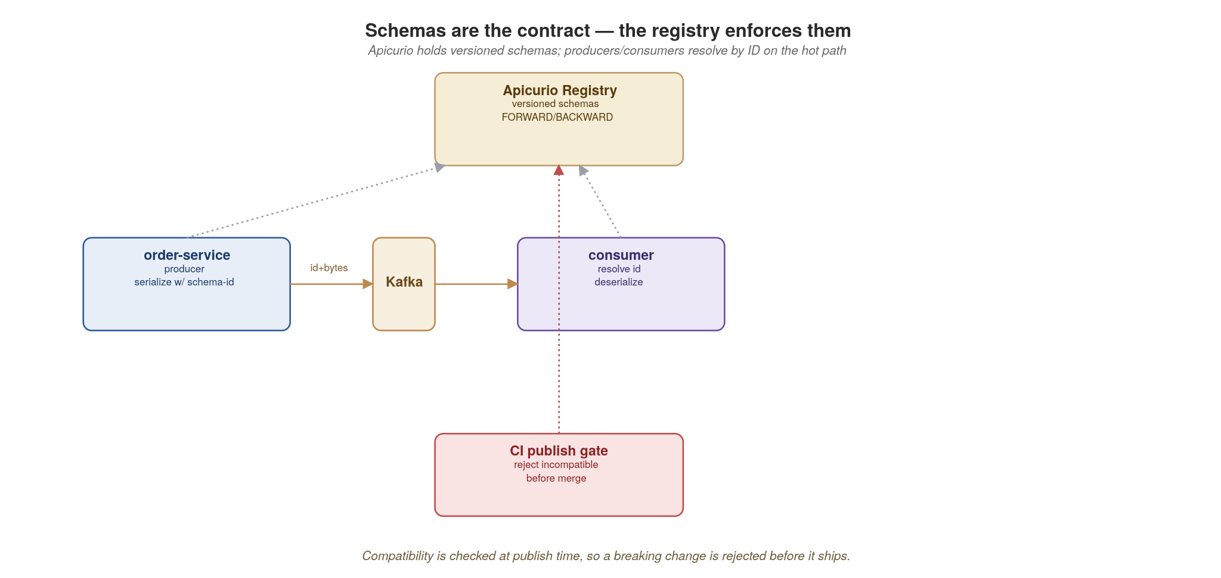
EVENT-DRIVEN
Schemas are the contract — the registry enforces them
Apicurio holds versioned schemas; compatibility is checked at publish time so breaking changes are rejected early.
33
Notes:
Events need contracts just as much as REST and gRPC do — arguably more, because consumers are anonymous and you can't just call them to coordinate. The schema (Avro, Protobuf or JSON Schema) lives in Apicurio. Producers and consumers fetch it; compatibility is checked at publish time so a breaking change is rejected before it ever reaches the topic. This is what makes adding-a-consumer-safely actually safe. We come back to event versioning rules in Appendix B.

Slide 40
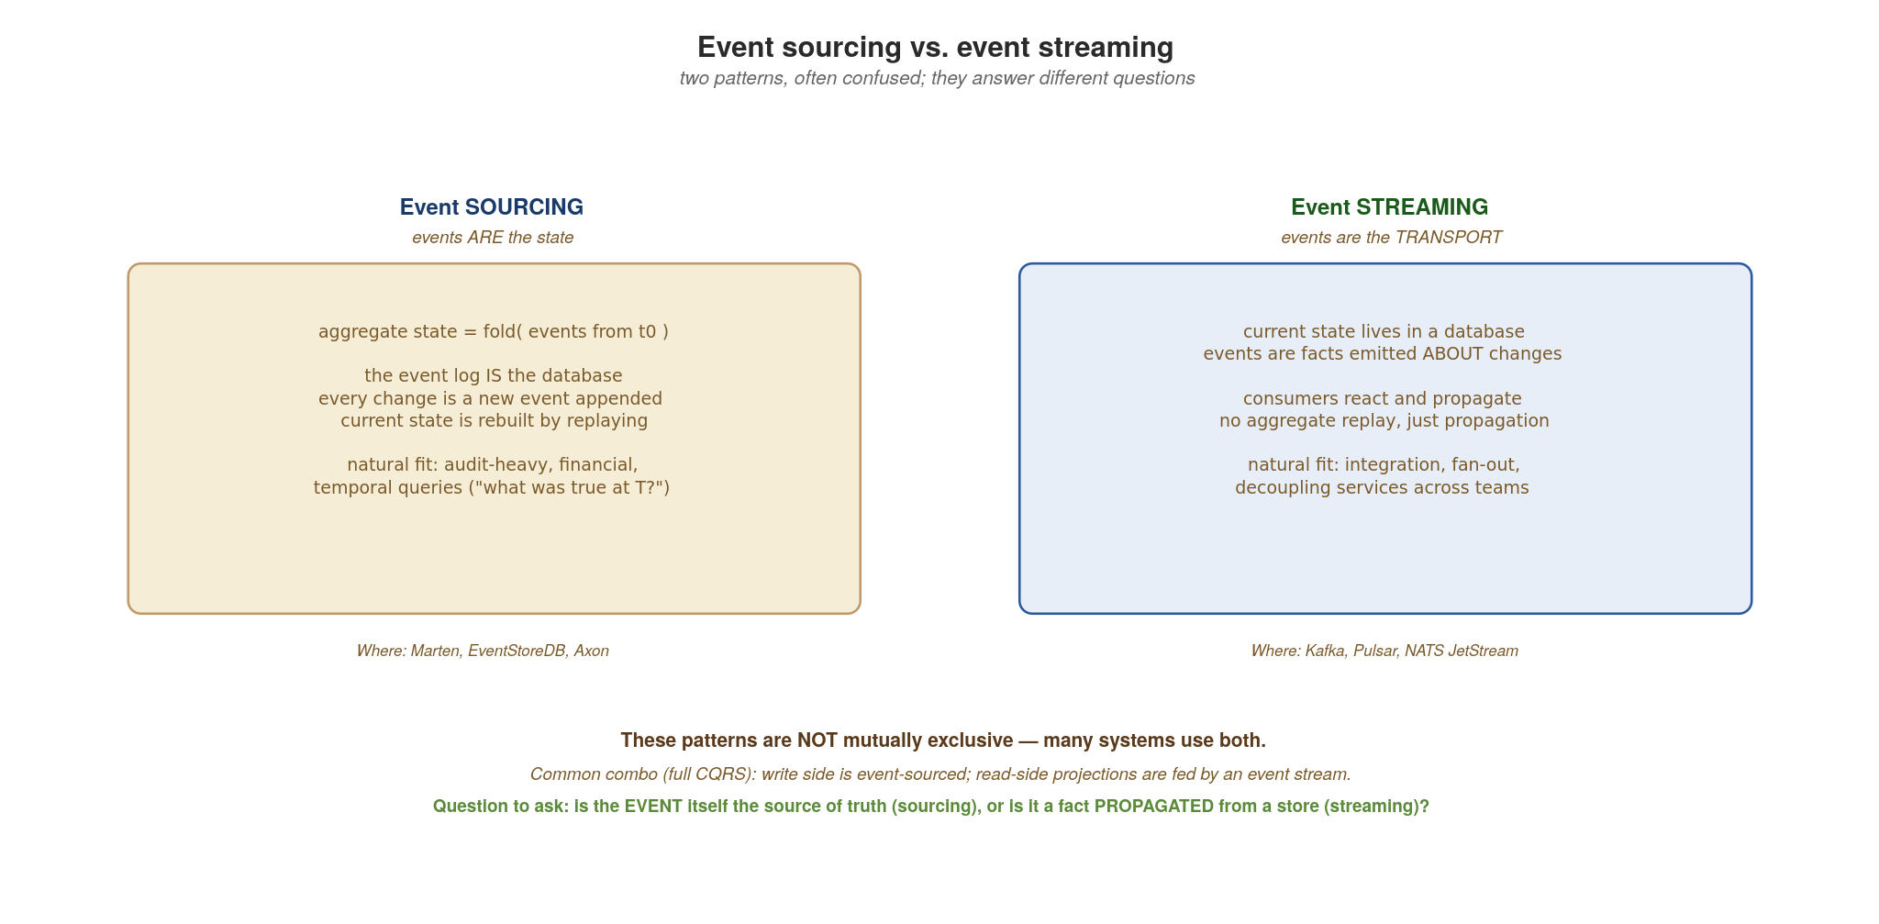
EVENT-DRIVEN
Event sourcing vs. event streaming
Two patterns, often confused. Sourcing: events ARE the state. Streaming: events are the TRANSPORT.
34
Notes:
The vocabulary clarification most teams need before they go further with events. EVENT SOURCING means events are the database — there is no 'current state' row anywhere; current state is computed by folding the entire event history. Adding a credit to an account isn't UPDATE balance SET balance = balance + 100; it's INSERT INTO events VALUES ('credit', 100), and reading the balance means summing every event for that account (with snapshots for performance). Strong fit for audit-heavy systems (banking, healthcare records, regulatory), temporal queries ("what was the balance on March 3rd?"), and any domain where the history is itself a primary asset. Tools: Marten (Postgres-backed, .NET), EventStoreDB, Axon (JVM). EVENT STREAMING means events are how facts move between services — each service still keeps its current state in a normal database, but emits events ("order.placed", "payment.processed") that other services subscribe to. The event is a transport mechanism, not a storage mechanism. Strong fit for integration, fan-out, decoupling. Tools: Kafka, Pulsar, NATS JetStream. These are NOT mutually exclusive. A common combination is full CQRS: the write side is event-sourced (so you have an audit trail of state changes), and the read-side projections are fed by streaming those events to consumers that build denormalised views. The acid test: is the event itself the source of truth (sourcing), or is it a propagated FACT about a change that happened in a store (streaming)? In most enterprise architectures, streaming is far more common than sourcing — sourcing is a deliberate choice for domains where audit and replay are core.

Slide 41
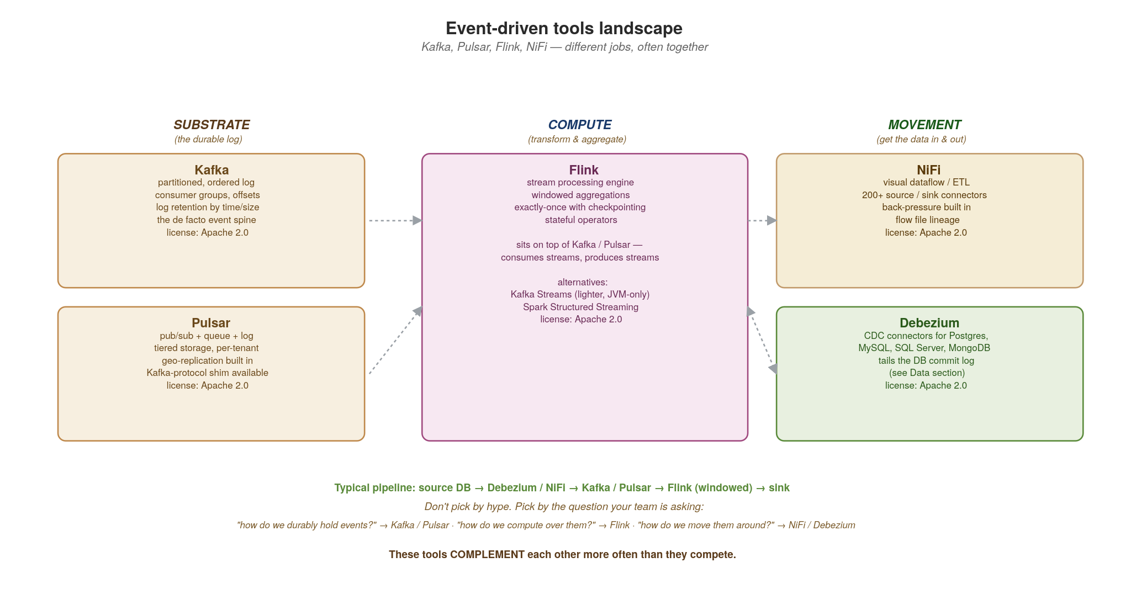
EVENT-DRIVEN
Event-driven tools landscape — Kafka, Pulsar, Flink, NiFi
Different jobs, often together: substrate (Kafka, Pulsar), compute (Flink), movement (NiFi, Debezium).
35
Notes:
Four tools, four different jobs. KAFKA is the SUBSTRATE — a partitioned, ordered, durable log. Consumers track their own offsets and can replay. It's the de facto event spine for cloud-native architectures; Strimzi runs it natively on Kubernetes. PULSAR is also substrate — same broad category as Kafka but with native pub/sub PLUS queue semantics in the same product, tiered storage that pushes cold data to cheap object stores automatically, and multi-tenancy built into the broker. Pulsar has a Kafka-protocol shim so consumers can speak Kafka while writing to Pulsar. FLINK is COMPUTE — not a transport layer at all, but a stateful stream-processing engine. Flink sits ON TOP of Kafka or Pulsar, consumes streams, applies operators (windowed aggregations, joins, filters, stateful transformations) with exactly-once semantics via checkpointing, and produces new streams. Alternatives: Kafka Streams (lighter, JVM-only, embedded library), Spark Structured Streaming (heavier, batch-mindset). NIFI is MOVEMENT — a visual dataflow / ETL tool with 200+ source-and-sink connectors and back-pressure built in. Think of it as the answer to 'I need to get data from SFTP to Kafka to S3 with these transforms in the middle' — you draw the flow in the UI rather than writing a pipeline. Debezium (covered in the Data section) is the CDC variant of movement. Together they compose: typical pipeline is source DB → Debezium or NiFi → Kafka or Pulsar → Flink for windowed aggregations → sink. The mistake is treating these as competitors. They complement — pick by the question your team is asking: durably hold events (substrate), compute over them (Flink), move them around (NiFi/Debezium).

Slide 42
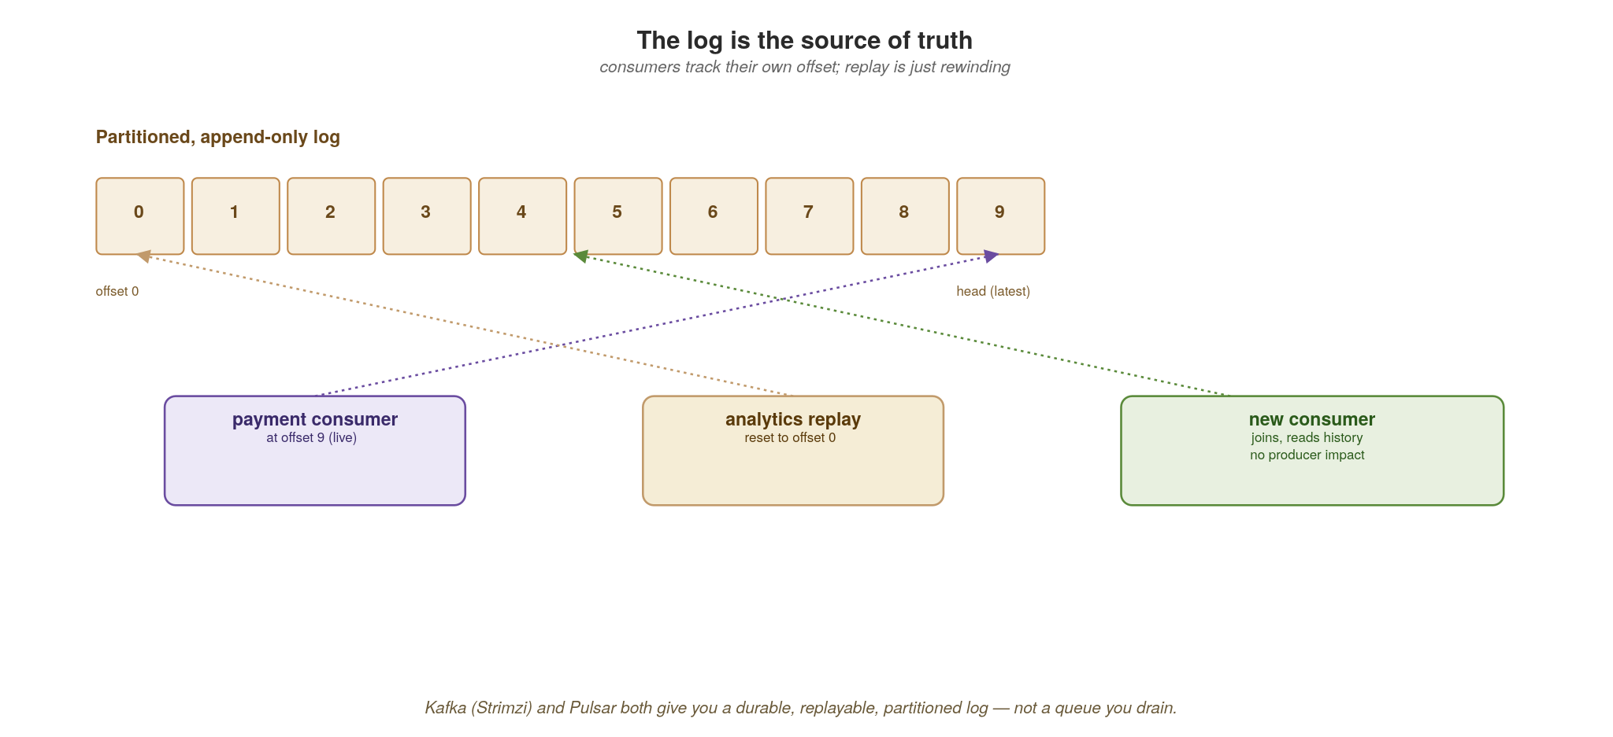
EVENT-DRIVEN
The log is the source of truth
Consumers track their own offset; replay is just rewinding. Kafka (Strimzi) and Pulsar are logs, not queues.
36
Notes:
The mental model correction most people need: Kafka is a log, not a queue. Messages aren't deleted when read — they're retained, and each consumer group tracks its own offset. That means replay is just rewinding an offset: a new consumer can process all of history, and a buggy consumer can be fixed and replayed. This is the foundation for event sourcing and for rebuilding stream-processing state, which is the next section. Strimzi runs Kafka on Kubernetes; Pulsar offers similar log semantics with tiered storage.

Slide 43
06
Stream Processing
Streams in, derived streams out.
Notes:
Section six builds directly on the log. Once events are a durable, replayable stream, you can compute over them continuously — filtering, joining, windowing, aggregating — and emit new derived streams. This is where real-time analytics, materialized views and complex event reactions live.

Slide 44
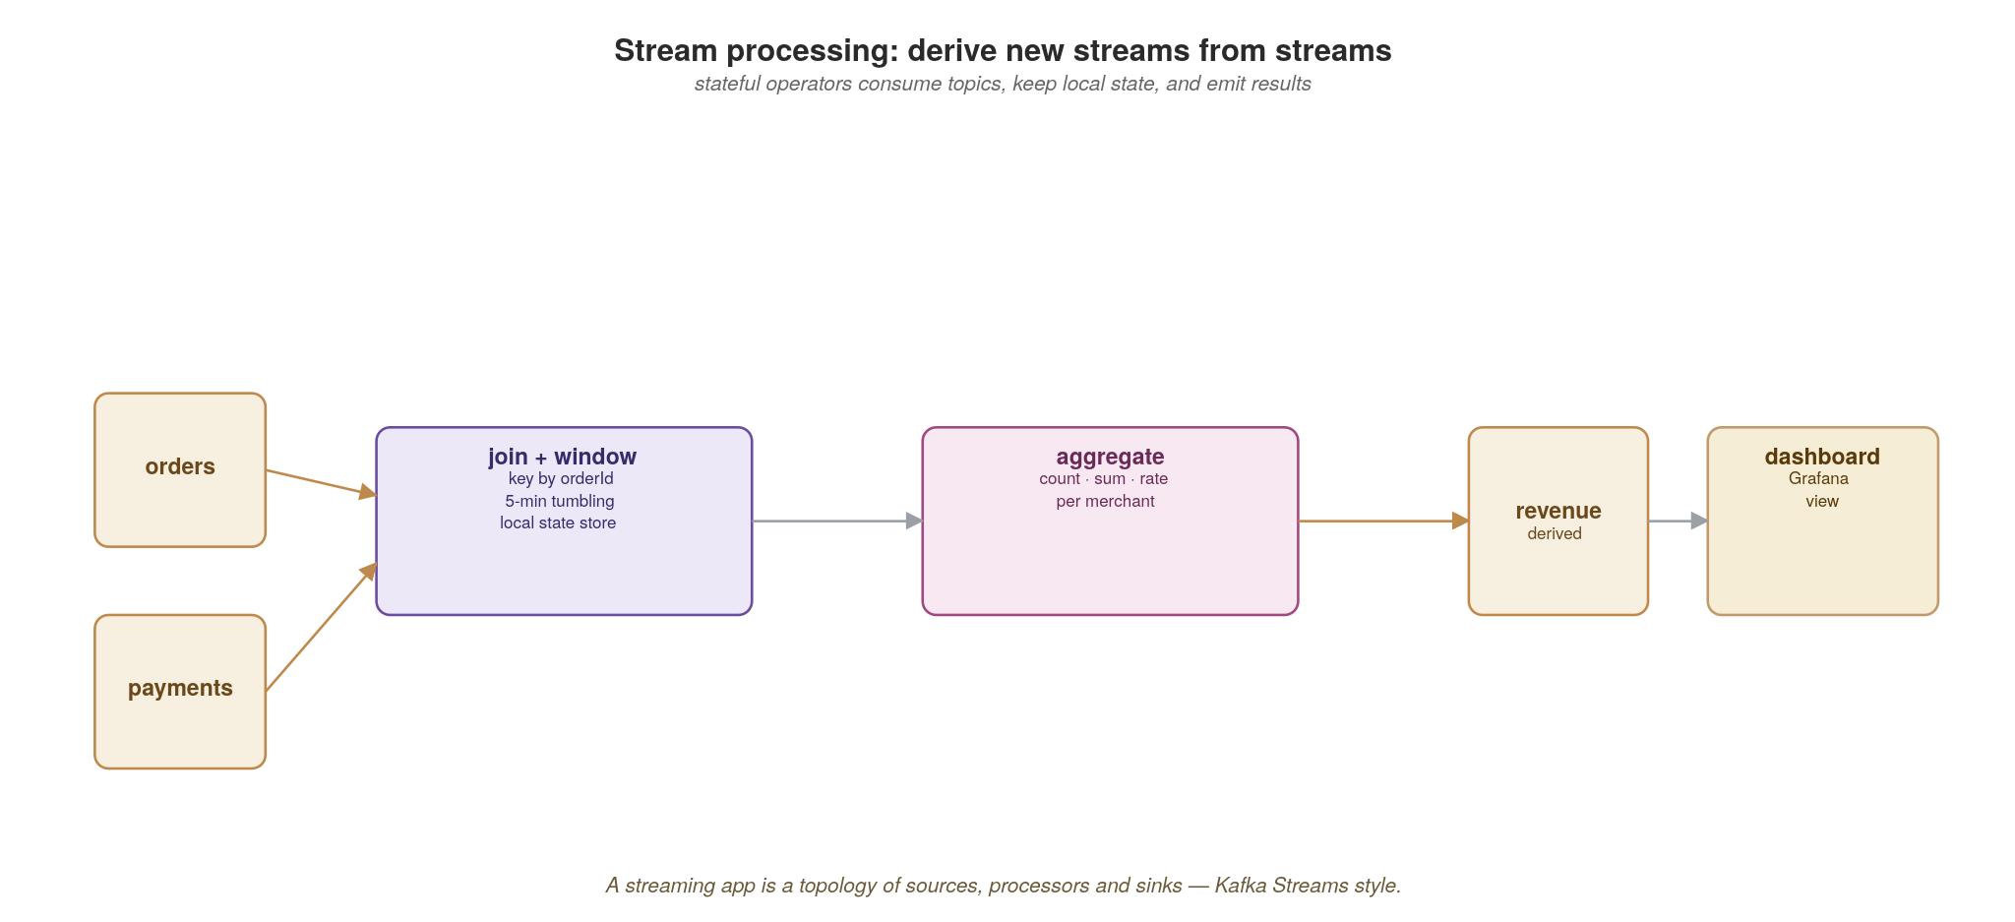
STREAM PROCESSING
Derive new streams from streams
A streaming app is a topology of sources, stateful processors and sinks — joins, windows and aggregates.
37
Notes:
A stream-processing app is a topology: sources (input topics), stateful processors (filter, join, window, aggregate) and sinks (output topics or stores). The output of one topology is just another stream that other services consume. Emphasize stateful — unlike a simple consumer, these processors keep local state (running totals, window buffers) that must survive restarts. That state-management problem is what the next code slide and KEDA slide address.

Slide 45
STREAM PROCESSING
A windowed aggregation with Streamiz.Kafka.Net
csharp · .NET 10 + Streamiz.Kafka.Net
// Streamiz.Kafka.Net (MIT) is a .NET rewrite of Kafka Streams — same
// topology / state-store / changelog model, native C#. Active development,
// 1.8.0 released 2026-03. No JVM in your container, no Flink cluster needed.
var config = new StreamConfig<StringSerDes, OrderSerDes>
{
ApplicationId = "revenue-aggregator",
BootstrapServers = "kafka:9092",
StateDir = "/var/streamiz/state", // local RocksDB, changelog-backed
};
var builder = new StreamBuilder();
builder.Stream<string, Order>("order.placed")
.GroupBy((k, o) => o.MerchantId)
.WindowedBy(TumblingWindowOptions.Of(TimeSpan.FromMinutes(5)))
.Aggregate<double, MerchantTotal>(
initializer: () => 0.0, // local state
aggregator: (mId, o, total) => total + o.Total,
Materialized<string, double, IWindowStore<Bytes, byte[]>>
.Create("revenue-by-merchant")) // state store + changelog
.ToStream()
.To<StringSerDes, DoubleSerDes>("revenue.5m");
var stream = new KafkaStream(builder.Build(), config);
await stream.StartAsync(); // run as IHostedService
Local RocksDB + a Kafka changelog topic gives fault-tolerant aggregation — no JVM, no separate Flink cluster, just C# in a Pod.
38
Notes:
This is the slide where .NET pulls level with the JVM: Streamiz.Kafka.Net is an MIT-licensed .NET rewrite of Kafka Streams, very actively maintained (1.8.0 shipped March 2026, ~990K NuGet downloads). Same Topology / state-store / changelog model, same windowing primitives (tumbling, hopping, session, sliding), native C# all the way down. The Materialized state store is the key idea: the per-merchant running total is local RocksDB, but it's backed by a Kafka changelog topic, so if the Pod dies the state rebuilds by replaying the changelog — fault-tolerant local state with no external database in the hot path. Run the KafkaStream as an IHostedService in your ASP.NET Core app, and it joins/leaves the consumer group on graceful shutdown automatically. The 5-minute tumbling window buckets the aggregation by time. For this audience: this is the stream-processing slot you'd previously have filled with SQL Server Service Broker activation procedures or a hand-rolled Windows Service consuming MSMQ — except now it's a horizontally-scalable, fault-tolerant streaming computation that KEDA can scale on lag. The alternative if Streamiz doesn't fit: Apache Flink in a separate cluster, called over Kafka from .NET; Akka.NET Streams (Apache 2.0) for in-process reactive streams; or Orleans Streams (MIT) if you're already on the virtual-actor model.

Slide 46
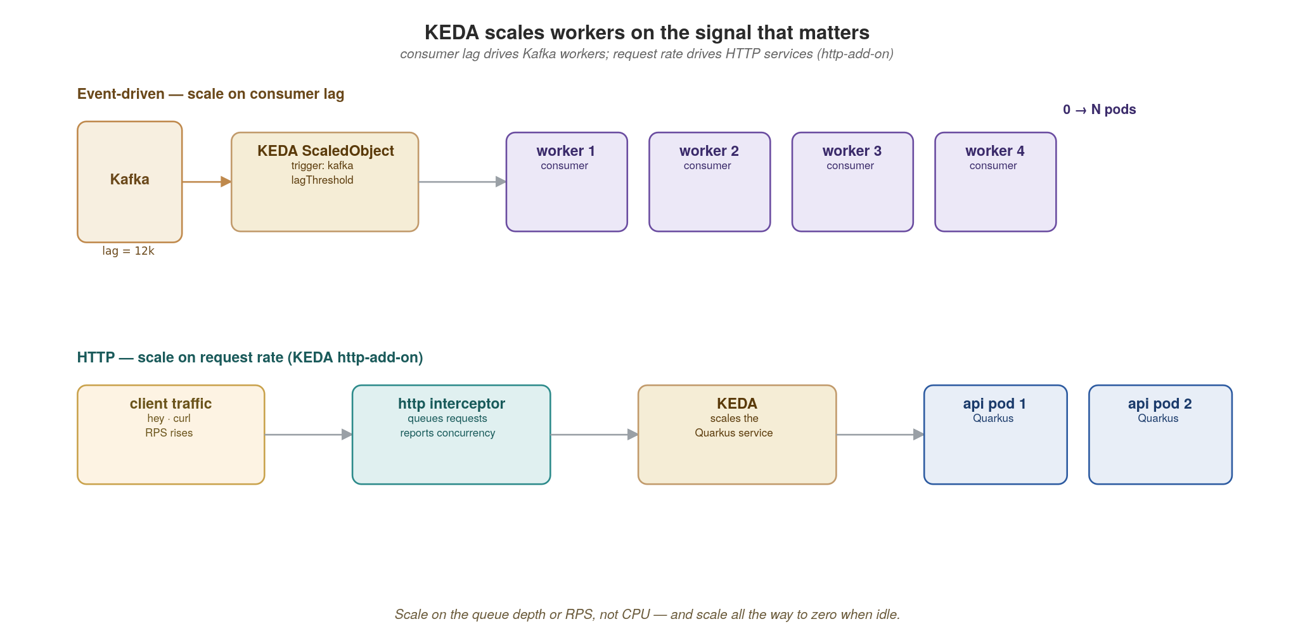
STREAM PROCESSING
KEDA scales workers on the signal that matters
Scale Kafka workers on consumer lag and HTTP services on request rate — both down to zero when idle.
39
Notes:
KEDA closes the elasticity loop. The right scaling signal for an event consumer is consumer lag — how far behind the log it is — not CPU. KEDA reads that lag and scales workers up, and crucially down to zero when there's no lag. For synchronous HTTP services, the KEDA http-add-on scales on request concurrency/rate. One mechanism, two signals. Scale-to-zero is a real cost lever for spiky workloads. The next slide shows both configs.

Slide 47
STREAM PROCESSING
Scale on lag (events) and on RPS (HTTP)
yaml · KEDA
# event-driven: scale consumers on Kafka lag
apiVersion: keda.sh/v1alpha1
kind: ScaledObject
spec:
scaleTargetRef: { name: payment-consumer }
minReplicaCount: 0 # scale to zero when no lag
maxReplicaCount: 20
triggers:
- type: kafka
metadata: { topic: order.placed, consumerGroup: payment, lagThreshold: "100" }
---
# HTTP: scale the ASP.NET Core service on concurrent requests (KEDA http-add-on)
kind: HTTPScaledObject
spec: { scaleTargetRef: { service: order-service }, replicas: { min: 0, max: 30 } }
One mechanism, two signals: queue depth for async workers, concurrency for synchronous APIs.
40
Notes:
Two manifests, one idea. The ScaledObject scales payment-consumer on Kafka lag for the order.placed topic, with minReplicaCount: 0 — true scale to zero when the topic is quiet, springing back when lag builds. The HTTPScaledObject does the same for the synchronous order-service based on request load via the http-add-on. The lagThreshold of 100 is the tuning knob: how many messages of backlog before adding a worker. Point out that scale-to-zero plus a cold-start budget is the trade-off to discuss with the audience for latency-sensitive paths.

Slide 48
07
Workflows and Jobs
Not every unit of work is a request.
Notes:
Section seven. A lot of real work isn't a synchronous request at all — it's a multi-step business process, or batch and scheduled work. This section covers how to coordinate multi-step flows (orchestration vs choreography) and where long-running and periodic work belongs on Kubernetes. For orchestration in this stack we feature the Temporal .NET SDK for durable execution as the primary approach, with the Stateless library as a lighter-weight in-process alternative for state-driven flows. Dapr Workflows gets a brief mention for environments that prefer the sidecar pattern. Appendix D shows the primary pair (Temporal .NET + Stateless), side by side, against the saga from the data section.

Slide 49
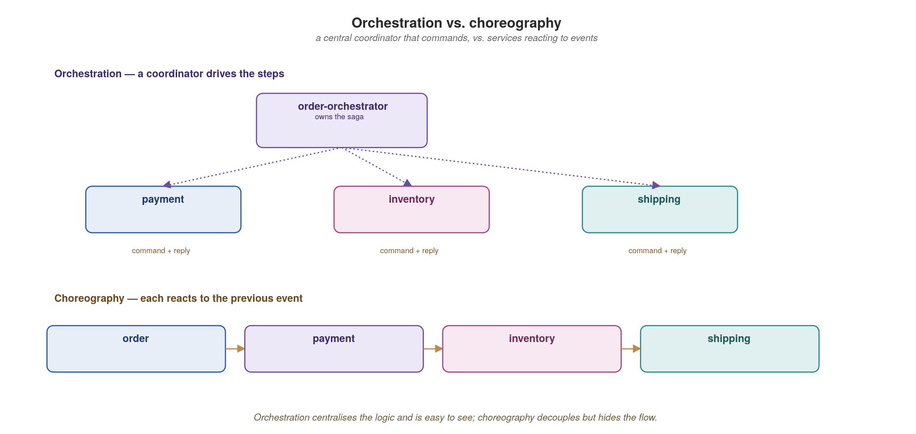
WORKFLOWS AND JOBS
Orchestration vs. choreography
A coordinator that commands is easy to follow; events that trigger each other decouple but hide the flow.
41
Notes:
The two ways to coordinate a multi-step process. Orchestration: a central coordinator explicitly commands each service in turn — easy to follow and observe, but the coordinator can become a god-service. Choreography: each service reacts to the previous one's event with no central brain — maximally decoupled, but the end-to-end flow is emergent and hard to see. Neither is universally right; the next slide gives the selection criteria. This connects straight to the saga discussion and Appendix D.

Slide 50
WORKFLOWS AND JOBS
Choosing between the two
Orchestration
Choreography
One coordinator owns the saga and its state
Flow is explicit and centrally observable
Easy to reason about, change and audit
Risk: the orchestrator becomes a god-service
Good for complex, long-lived business processes
Each service reacts to the previous event
Maximally decoupled; no central bottleneck
Flow is emergent — harder to see end-to-end
Risk: nobody owns the overall process
Good for simple, additive event reactions
42
Notes:
The decision heuristic: use orchestration for complex, long-lived business processes where you need auditability and a clear owner (order fulfillment, loan approval). Use choreography for simple, additive reactions where decoupling matters more than visibility (send a welcome email when a user signs up). The failure modes are mirror images: orchestration risks a god-service; choreography risks nobody owning the process and no one able to answer 'where is order 42 stuck?'. Observability (section 11) is what makes choreography survivable.

Slide 51
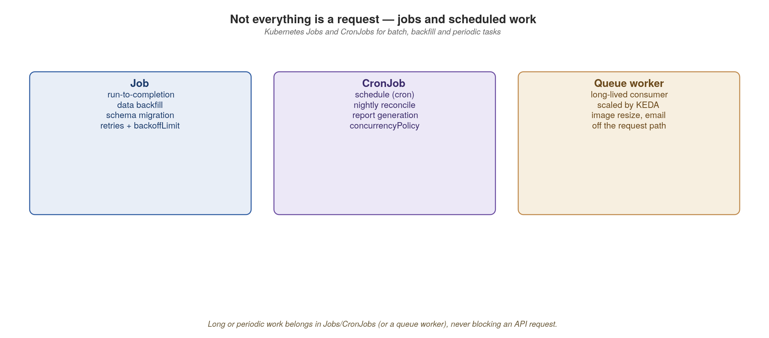
WORKFLOWS AND JOBS
Jobs, CronJobs and queue workers
Long, batch or periodic work belongs in Jobs/CronJobs or a scaled queue worker — never on the request path.
43
Notes:
Where non-request work lives on Kubernetes. A Job runs a task to completion (a data migration, a nightly export). A CronJob schedules Jobs (the reconciliation that runs at 2am). A queue worker continuously drains a topic and is scaled by KEDA on lag. The anti-pattern: doing long or heavy work inside an HTTP handler, blocking the request and timing out the client. The rule of thumb on screen — long, batch or periodic work never belongs on the request path. Hand it to a Job or a worker and return immediately, ideally with a status URL the client can poll. In-app, BackgroundService with PeriodicTimer (or Quartz.NET for cron expressions, with DistributedLock for cluster-aware locking) covers recurring work in the same process; Kubernetes Jobs and CronJobs own the heavier or isolated batch runs; and KEDA's Cron scaler is the declarative way to wake a worker on a schedule — typically how Windows Scheduled Tasks become cloud-native.

Slide 52
08
API Management
Treat the API surface as a platform.
Notes:
Section eight zooms out from individual services to the API surface as a whole. Management isn't a product you buy — it's four cooperating concerns: runtime control (gateway and mesh), contracts (registry), discovery (metadata), and signals (observability). The next three sections each take one of these in depth.

Slide 53
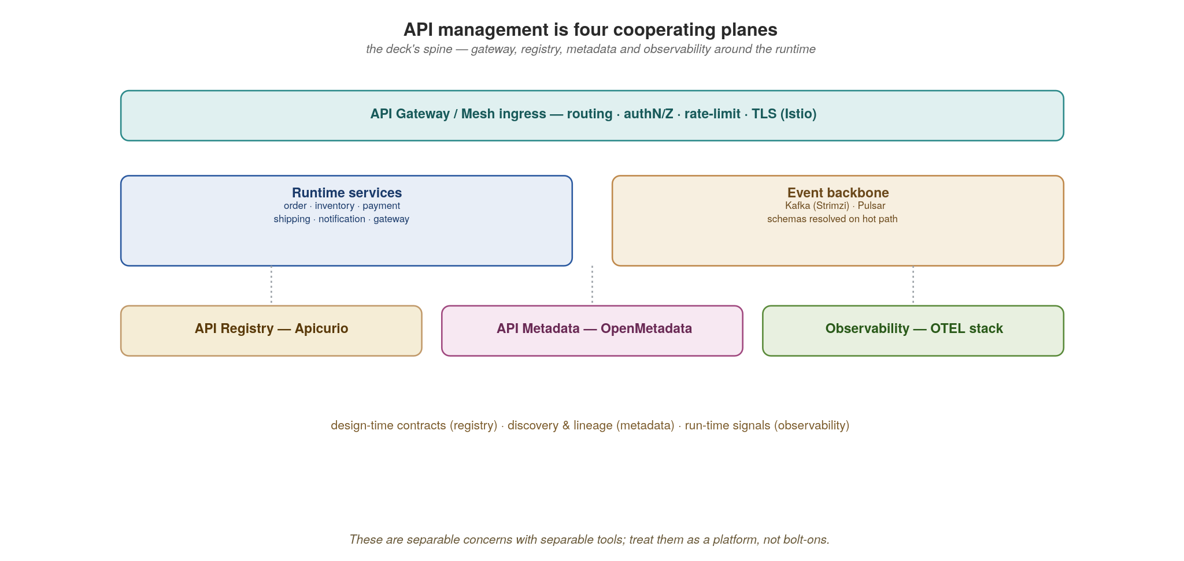
API MANAGEMENT
Four cooperating planes
Gateway and mesh at runtime; registry for contracts; metadata for discovery; observability for signals.
44
Notes:
The four planes, and they map exactly to the rest of the platform sections. Runtime plane: the gateway and Istio mesh handle traffic, auth, rate-limiting and resilience. Contract plane: the registry (section 9) holds every API and event schema, versioned and gated. Discovery plane: metadata/catalog (section 10) lets people find and trust APIs. Signal plane: observability (section 11) tells you what's actually happening. The point: these are distinct responsibilities with distinct owners, not one monolithic 'API gateway product' that tries to do everything.

Slide 54
API MANAGEMENT
Versioning and evolution are part of management
Evolve additively — new optional fields and endpoints; never repurpose or remove without a new version.
Carry a major version in the path (/v2) or media type; deprecate with headers and a sunset date.
The registry's compatibility rules (BACKWARD / FORWARD / FULL) enforce this mechanically at publish time.
Run old and new side by side; migrate consumers off the old contract before you retire it.
Lifecycle: design → register → publish → consume → deprecate → retire — each step has an owner and a gate.
45
Notes:
Versioning is a management concern, not an afterthought. The core discipline: evolve additively — add optional fields and new endpoints, never repurpose or silently remove. When you must break, carry a major version (in the path or media type) and run old and new side by side with a published sunset date, migrating consumers off before retiring. The registry's compatibility rules enforce the additive discipline mechanically at publish time. The bold lifecycle line is the takeaway: every contract moves design → register → publish → consume → deprecate → retire, and each transition has an owner and a gate. Appendix B drills into how REST, gRPC and GraphQL each handle this differently.

Slide 55
09
API Registry
One versioned home for every contract.
Notes:
Section nine. If contracts are the boundary, they need one authoritative home. The registry is where every OpenAPI spec, .proto, AsyncAPI doc and event schema lives — versioned, compatibility-checked, and gated in CI. This is the difference between 'we have contracts somewhere in git' and 'contracts are enforced before code ships'.

Slide 56
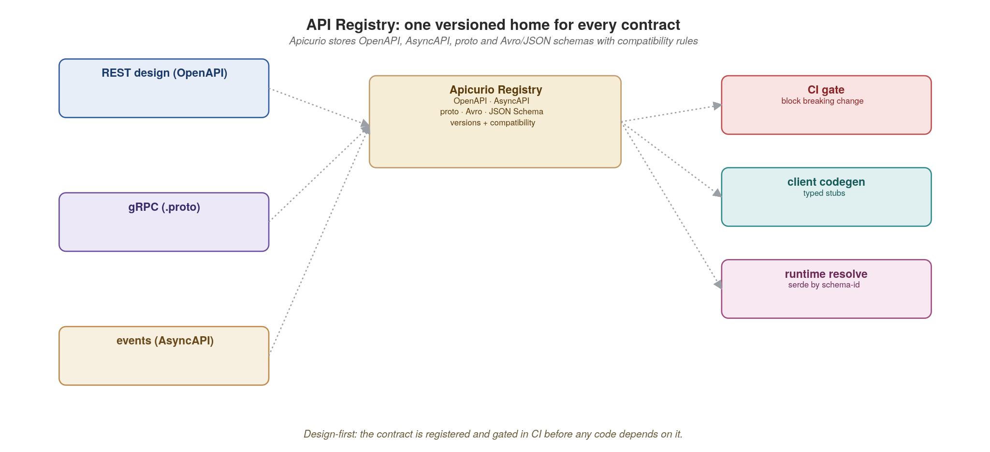
API REGISTRY
Apicurio: contracts, versioned and gated
OpenAPI, AsyncAPI, proto and Avro/JSON schemas live in one registry with compatibility rules and CI gating.
46
Notes:
Apicurio is the concrete registry in this stack. Every contract type lands here: REST OpenAPI, GraphQL SDL, gRPC .proto, and event schemas (Avro/JSON). Each artifact has versions and a compatibility rule (BACKWARD, FORWARD, FULL). At publish time the registry checks the new version against the rule and rejects incompatible changes. Producers register; consumers fetch and generate stubs. The serde libraries for Kafka pull schemas from here by ID at runtime. Next slide shows the CI gate that turns this into an automatic guardrail.

Slide 57
API REGISTRY
Gate breaking changes in CI
yaml · CI + Apicurio v3 REST
# No Maven plugin for .NET - gate breaking changes via the Apicurio v3 REST API.
# A dryRun create-version runs the COMPATIBILITY rule server-side, then rolls back.
# .github/workflows/contracts.yml (runs on every PR; no app build needed)
jobs:
schema-compat:
runs-on: ubuntu-latest
steps:
- uses: actions/checkout@v4
- name: Gate the new Avro schema against the registry rule
env:
REGISTRY: http://apicurio.registry.svc/apis/registry/v3
run: |
code=$(curl -s -o resp.json -w '%{http_code}' -X POST \
"$REGISTRY/groups/orders/artifacts/order-value/versions?dryRun=true" \
-H 'Content-Type: application/json' \
--data-binary @src/Schemas/order.avsc) # the new schema version
# 409 = COMPATIBILITY rule violated -> incompatible (breaking) change
[ "$code" = "200" ] || { echo 'Breaking schema change'; cat resp.json; exit 1; }
The dry-run fails the build on an incompatible change — the contract is enforced before code ships, not after.
47
Notes:
This is the guardrail that makes the whole contract story real, done the .NET way. A CI step posts the new schema to the Apicurio Registry v3 REST API as a dry-run create-version, which runs the artifact's compatibility rule server-side WITHOUT persisting it — and fails the build (and the merge) if it's incompatible. The point to make: the contract is enforced before code ships, not discovered broken in production by a downstream team. The rule (e.g. BACKWARD — new consumers can read old data) is set once per artifact and enforced automatically forever; a separate (non-dry-run) POST publishes the version on the main branch after merge. Tie it back: this is design-first from section 1, now mechanized in the build.

Slide 58
10
API Metadata
If they can't find it, it doesn't exist.
Notes:
Section ten. A contract that's enforced but undiscoverable is half useless. Metadata is the discovery and trust layer: a searchable catalog of every API, topic and table, with ownership, lineage and quality signals. If a consumer can't find your API and trust it, they'll build their own or screen-scrape — and your boundary erodes.

Slide 59
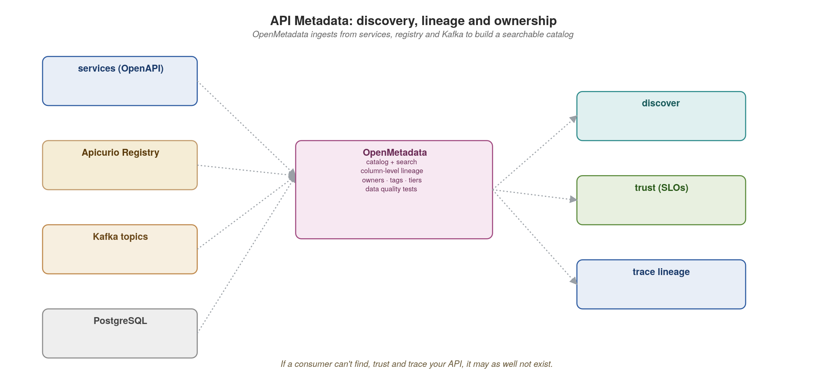
API METADATA
Discovery, lineage and ownership
OpenMetadata ingests from services, the registry and Kafka to build a searchable catalog with lineage.
48
Notes:
OpenMetadata is the catalog in this stack. It ingests from many sources — OpenAPI specs, the Apicurio registry, Kafka topics, Postgres schemas — and builds one searchable catalog. The differentiator over a wiki is automated lineage: it knows that this topic feeds that table feeds this API, so it can answer 'if I change this field, who breaks?' before you change it. Ingestion is a scheduled connector, so the catalog stays current without manual upkeep. Next slide lists what consumers actually get from it.

Slide 60
API METADATA
What the catalog gives every consumer
Discovery — search across APIs, topics and tables; find the owning team and how to get access.
Trust — published SLOs, data-quality test results, freshness, and a tier/criticality rating.
Lineage — column- and topic-level lineage answers 'if I change this, who breaks?' before you change it.
Ownership & governance — tags, classifications (PII), and accountable owners attached to every asset.
Ingestion runs as a scheduled connector against OpenAPI specs, the registry, Kafka and Postgres.
49
Notes:
Four concrete payoffs for consumers. Discovery: search across APIs, topics and tables, and find the owning team and how to get access — no more asking around in Slack. Trust: published SLOs, data-quality results, freshness and a criticality tier tell you whether to depend on it. Lineage: column- and topic-level impact analysis answers the change-safety question proactively. Ownership and governance: tags, PII classifications and accountable owners on every asset — which is also what your compliance team needs. The throughline of sections 9–10: a contract is only as good as your ability to find it, trust it, and know who owns it.

Slide 61
11
Observability
Instrument once; correlate everything.
Notes:
Section eleven, and the one that makes everything else operable. In a distributed system you cannot debug by reading one log file — a single user action touches five services. Observability is how you reconstruct that story. The key word is correlate: traces, metrics and logs only become powerful when they share a trace_id so you can pivot between them.

Slide 62
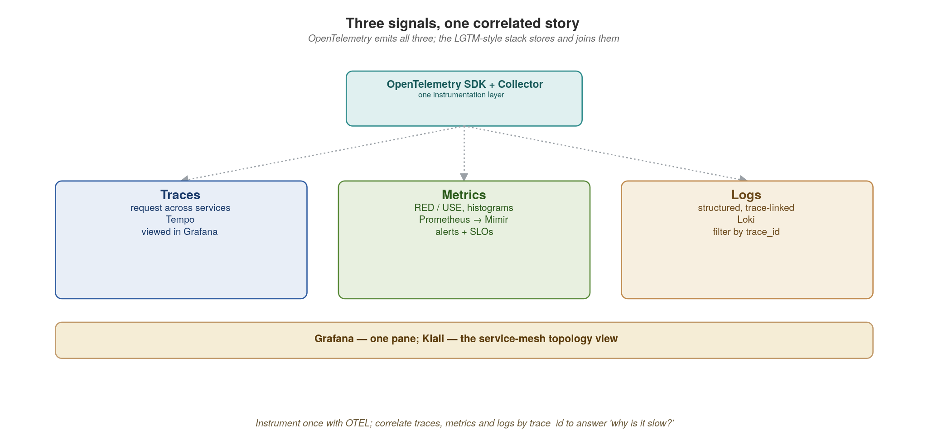
OBSERVABILITY
Three signals, one correlated story
OpenTelemetry emits traces, metrics and logs; the LGTM-style stack stores them and Grafana joins them.
50
Notes:
Three signals, each answering a different question. Traces: where did the time go and which service failed in this one request? Metrics: what are the aggregate rates, errors and latencies over time? Logs: what exactly happened in this component? OpenTelemetry is the vendor-neutral way to emit all three from your code. The LGTM-style stack stores them — Tempo for traces, Mimir/Prometheus for metrics, Loki for logs — and Grafana joins them. The magic is the shared trace_id linking a metric spike to the exact traces and logs behind it. Next slide shows the instrumentation, then the trace.

Slide 63
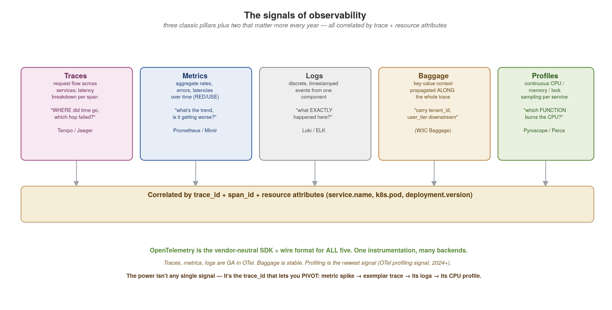
OBSERVABILITY
The signals in depth — traces, metrics, logs, baggage, profiles
Three classic pillars plus two that matter more every year. OpenTelemetry emits all five; one trace_id correlates them.
51
Notes:
Expand the 'three pillars' framing into the five signals modern observability actually uses. Traces answer WHERE the time went and which hop failed in one request. Metrics answer the trend question — aggregate rates, errors, latencies over time (the RED method: Rate, Errors, Duration; the USE method: Utilisation, Saturation, Errors). Logs answer what EXACTLY happened in one component. Baggage is the signal most people miss — it's key-value context (tenant_id, user_tier, feature_flag) that propagates ALONG the whole trace, so a value set at the edge is readable in a Kafka consumer three hops downstream. Profiles are the newest signal — continuous CPU / memory / lock sampling per service, answering which FUNCTION is burning the CPU (Pyroscope, Parca, Grafana Phlare). The correlation bar at the bottom is the whole point: traces, metrics, logs, baggage and profiles all share trace_id + span_id + resource attributes (service.name, k8s.pod.name, deployment.version), so you can PIVOT — a metric spike leads to an exemplar trace, which leads to its logs, which leads to its CPU profile. OpenTelemetry is the vendor-neutral SDK and wire format for all five; traces/metrics/logs are GA, baggage is stable, profiling is the newest (the OTel profiling signal reached the ecosystem in 2024).

Slide 64
OBSERVABILITY
What each signal answers — and when to reach for it
Traces — 'where did the time go in THIS request, which hop failed?' Reach for it when debugging latency or a specific failed request. Stored in Tempo / Jaeger.
Metrics — 'what is the aggregate rate / error / latency trend, is it getting worse?' Reach for it for dashboards, alerting, capacity. RED (Rate, Errors, Duration) for request-driven services; USE (Utilisation, Saturation, Errors) for resources. Stored in Prometheus / Mimir.
Logs — 'what EXACTLY happened in this component at this instant?' Reach for it for detail the trace doesn't carry. Structured (JSON), keyed by trace_id. Stored in Loki / ELK.
Baggage — 'carry a value (tenant_id, user_tier) along the whole request so downstream services and their telemetry can use it.' Set once at the edge, readable everywhere downstream. W3C Baggage spec.
Profiles — 'which FUNCTION is burning CPU / allocating memory / holding locks, continuously, in production?' Reach for it for the latency the trace shows but doesn't explain. Pyroscope / Parca.
The discipline: emit traces + metrics + logs always; add baggage when downstream needs request-scoped context; add profiling when you have CPU/memory mysteries a trace can't resolve.
52
Notes:
Walk each signal and the question it answers — the framing 'what question does this answer' is more useful to an engineer than 'what is this signal.' Traces are per-request; metrics are aggregate; logs are detail. The two newer ones deserve emphasis. Baggage is underused: most teams propagate trace context but never realise they can also propagate their own key-values (tenant, user tier, AB-test cohort) for free along the same mechanism — and then filter traces and logs by tenant. Profiling is the frontier: continuous profilers (Pyroscope, Parca, Grafana Phlare) run in production at low overhead and answer the 'the trace says this span took 200ms but WHY' question by showing the actual call stack burning the CPU. The sub-bullet is the practical guidance on which to adopt when.

Slide 65
OBSERVABILITY
Auto-injection vs. instrumentation — three distinct things
Manual instrumentation — you write the spans. tracer.start_span(...), span.set_attribute(...), span.add_event(...). Needed for BUSINESS operations the libraries can't know about ('reserve_stock', 'score_fraud'). The most signal per line, the most effort.
Auto-instrumentation — a library / agent wraps known frameworks for you. HTTP servers and clients, gRPC, JDBC / database drivers, Kafka, Redis — each becomes spans with zero code change. Covers the plumbing; misses your domain.
Auto-injection — the platform puts the auto-instrumentation agent INTO the pod for you. The OpenTelemetry Operator watches for an annotation (instrumentation.opentelemetry.io/inject) and mutates the pod at admission — no agent in your image, no Dockerfile change, no redeploy of the app to add tracing.
How they layer: auto-injection delivers the agent → the agent provides auto-instrumentation of frameworks → you add manual spans for business logic on top. All three coexist in the same trace.
Trade-off: auto-instrumentation is convenient but can be noisy (every framework call becomes a span) and slightly slower. Manual is precise but is work you own. Most teams: auto for the plumbing, manual for the domain, injection to roll it out fleet-wide.
53
Notes:
This is the slide the user specifically asked for: distinguish auto-INJECTION from auto-INSTRUMENTATION from MANUAL instrumentation — three things people conflate. Manual: you call the tracer API yourself; necessary for domain operations. Auto-instrumentation: the OTel instrumentation libraries (or a language agent) wrap known frameworks — your HTTP handler, your DB driver, your Kafka client all emit spans without you touching them. Auto-injection: a Kubernetes-level mechanism — the OpenTelemetry Operator sees a pod annotation and injects the language agent + config as an init container / env vars at admission time, so you don't even put the agent in your image. Per-language specifics: Python — 'opentelemetry-instrument' wrapper or the operator injects it; instrumentation packages per library. Java/Quarkus — the OTel Java agent (-javaagent) auto-instruments everything; Quarkus also has build-time OTel extension. Spring — Micrometer Tracing + the OTel bridge, or the Java agent. .NET — OTel auto-instrumentation via the OpenTelemetry.AutoInstrumentation package or the operator's .NET injection; manual via System.Diagnostics.ActivitySource. The bold line is the mental model: injection delivers the agent, the agent instruments frameworks, you add manual spans on top — they layer into one trace.

Slide 66
OBSERVABILITY
Auto-instrument with OpenTelemetry .NET
csharp · .NET 10 + OpenTelemetry.NET
// Program.cs — OpenTelemetry .NET is the cloud-native replacement for
// Windows performance counters + ETW + Event Log, unified in one model.
builder.Services.AddOpenTelemetry()
.ConfigureResource(r => r.AddService("order-service"))
.WithTracing(t => t
.AddAspNetCoreInstrumentation() // every HTTP request → span
.AddHttpClientInstrumentation() // outbound HttpClient → span
.AddGrpcClientInstrumentation() // gRPC stub calls → span
.AddEntityFrameworkCoreInstrumentation() // EF Core queries → span
.AddSource("OrderService") // your own ActivitySource
.AddOtlpExporter(o => o.Endpoint = new("http://otel-collector:4317")))
.WithMetrics(m => m
.AddAspNetCoreInstrumentation()
.AddRuntimeInstrumentation() // GC, threadpool, allocations
.AddOtlpExporter());
// Custom business spans use the BCL ActivitySource (no extra dependency)
public class OrderService(IInventoryClient inventory)
{
private static readonly ActivitySource s_activity = new("OrderService");
public async Task<ReserveReply> ReserveAsync(string sku, int qty)
{
using var activity = s_activity.StartActivity("reserve_stock");
activity?.SetTag("sku", sku);
return await inventory.ReserveStockAsync(sku, qty);
}
// trace_id flows REST → gRPC → Kafka → consumer, automatically
}
ASP.NET Core, HttpClient, gRPC and EF Core all emit spans with zero code; ActivitySource is the built-in API for your own spans. OTLP ships traces to Tempo, metrics to Mimir, logs to Loki.
54
Notes:
OpenTelemetry .NET is a first-class implementation of the OTel spec, and the .NET runtime itself was designed for it — System.Diagnostics.ActivitySource is the OTel-equivalent type baked into the BCL since .NET 6, so 'starting a span' has zero extra dependencies. The Add*Instrumentation calls plug in auto-instrumentation for the framework hot paths: every HTTP request handled by ASP.NET Core, every outbound HttpClient call, every gRPC stub invocation, every EF Core query — all emit spans with W3C Trace Context propagation. AddRuntimeInstrumentation gets you GC, threadpool, exception and allocation metrics out of the box (which is where Windows perf counters land in this model). For custom business operations: declare a static ActivitySource once and start activities anywhere with 'using var activity = source.StartActivity(...)' — the using ensures it's stopped when the scope exits. The OTLP exporter ships everything to the Collector keyed by trace_id, then Tempo/Mimir/Loki/Grafana correlate it. The trade for this audience: this REPLACES Windows performance counters, ETW providers, the Event Log, and bespoke logging libraries with one model that works the same on Linux containers, in CI, in dev, and on any cluster.

Slide 67
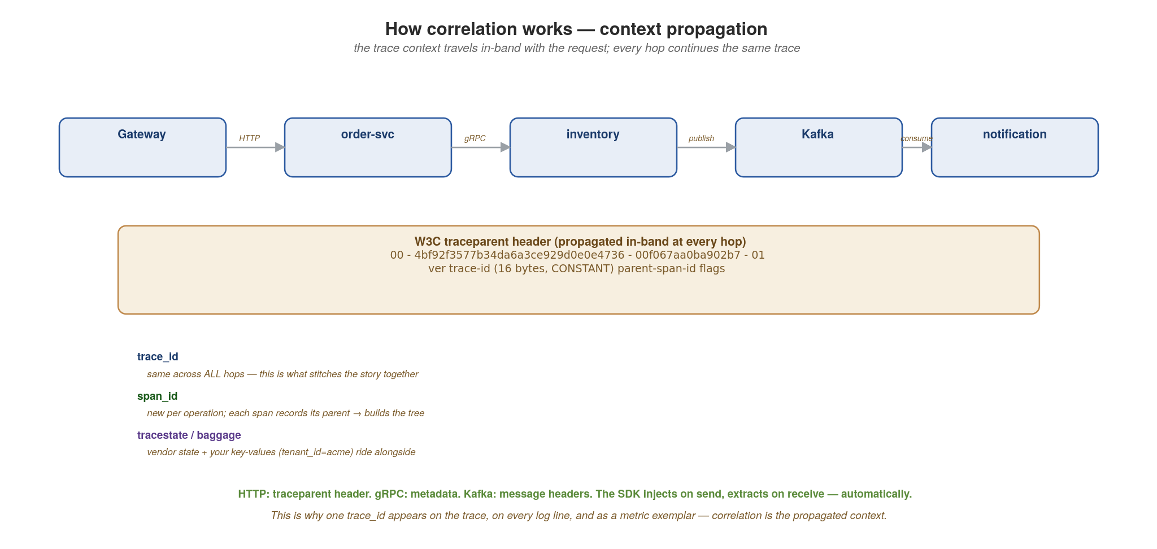
OBSERVABILITY
How correlation works — context propagation
The trace context rides in-band with the request (W3C traceparent). The same trace_id at every hop is what stitches the story.
55
Notes:
Demystify the magic word 'correlation.' It is not a backend join — it's the trace context physically travelling WITH the request, in-band, at every hop. The W3C traceparent header is the standard: version-traceid-parentspanid-flags. The trace_id (16 bytes) is CONSTANT across every hop of the request — that constancy is literally what stitches the distributed story into one trace. The span_id is new per operation, and each span records its parent span_id, which is how the backend rebuilds the tree. The flags byte carries the sampling decision (01 = sampled) so every hop honours the same decision. Alongside traceparent rides tracestate (vendor-specific) and baggage (your key-values). The transport differs per hop but the mechanism is identical: HTTP uses the traceparent header, gRPC uses metadata, Kafka uses message headers. The SDK injects the context on the way out and extracts it on the way in — automatically, which is why auto-instrumentation 'just works' across services. This propagated context is exactly why the same trace_id shows up on the trace waterfall, on every structured log line, and as an exemplar on your metrics — they all read it from the same in-band context.

Slide 68
OBSERVABILITY
Baggage in practice — carry request context downstream
csharp · .NET System.Diagnostics.Activity + OpenTelemetry
using System.Diagnostics;
// .NET propagates baggage on Activity automatically (W3C Baggage header).
// Set at the edge in middleware:
app.Use(async (ctx, next) =>
{
Activity.Current?.AddBaggage("tenant_id",
ctx.Request.Headers["X-Tenant"].FirstOrDefault() ?? "unknown");
Activity.Current?.AddBaggage("user_tier", LookupTier(ctx));
await next(); // rides the whole trace
});
// Read anywhere downstream — even in a MassTransit consumer
public class OrderConsumer : IConsumer<OrderPlaced>
{
public Task Consume(ConsumeContext<OrderPlaced> ctx)
{
var tenant = Activity.Current?.GetBaggageItem("tenant_id");
Activity.Current?.SetTag("tenant_id", tenant); // filterable in trace UI
return Handle(ctx.Message);
}
}
Activity.AddBaggage at the edge; GetBaggageItem anywhere downstream. SetTag to filter traces.
56
Notes:
In .NET, baggage lives on System.Diagnostics.Activity (which is what OpenTelemetry .NET builds on — an Activity IS a span). AddBaggage at the edge in middleware; the OTel SDK propagates it via the W3C baggage header on every downstream call (HttpClient, gRPC, MassTransit to Kafka) automatically. A downstream MassTransit consumer reads Activity.Current.GetBaggageItem('tenant_id') with no explicit plumbing. Note the distinction in .NET: AddBaggage propagates across services (on the wire); SetTag (span attributes) does NOT propagate but IS recorded on the span for querying. The idiom is to read baggage and re-tag it on the local span so it's filterable in the trace UI. Caution: baggage is on the wire to every downstream hop — never put secrets or PII in it.

Slide 69
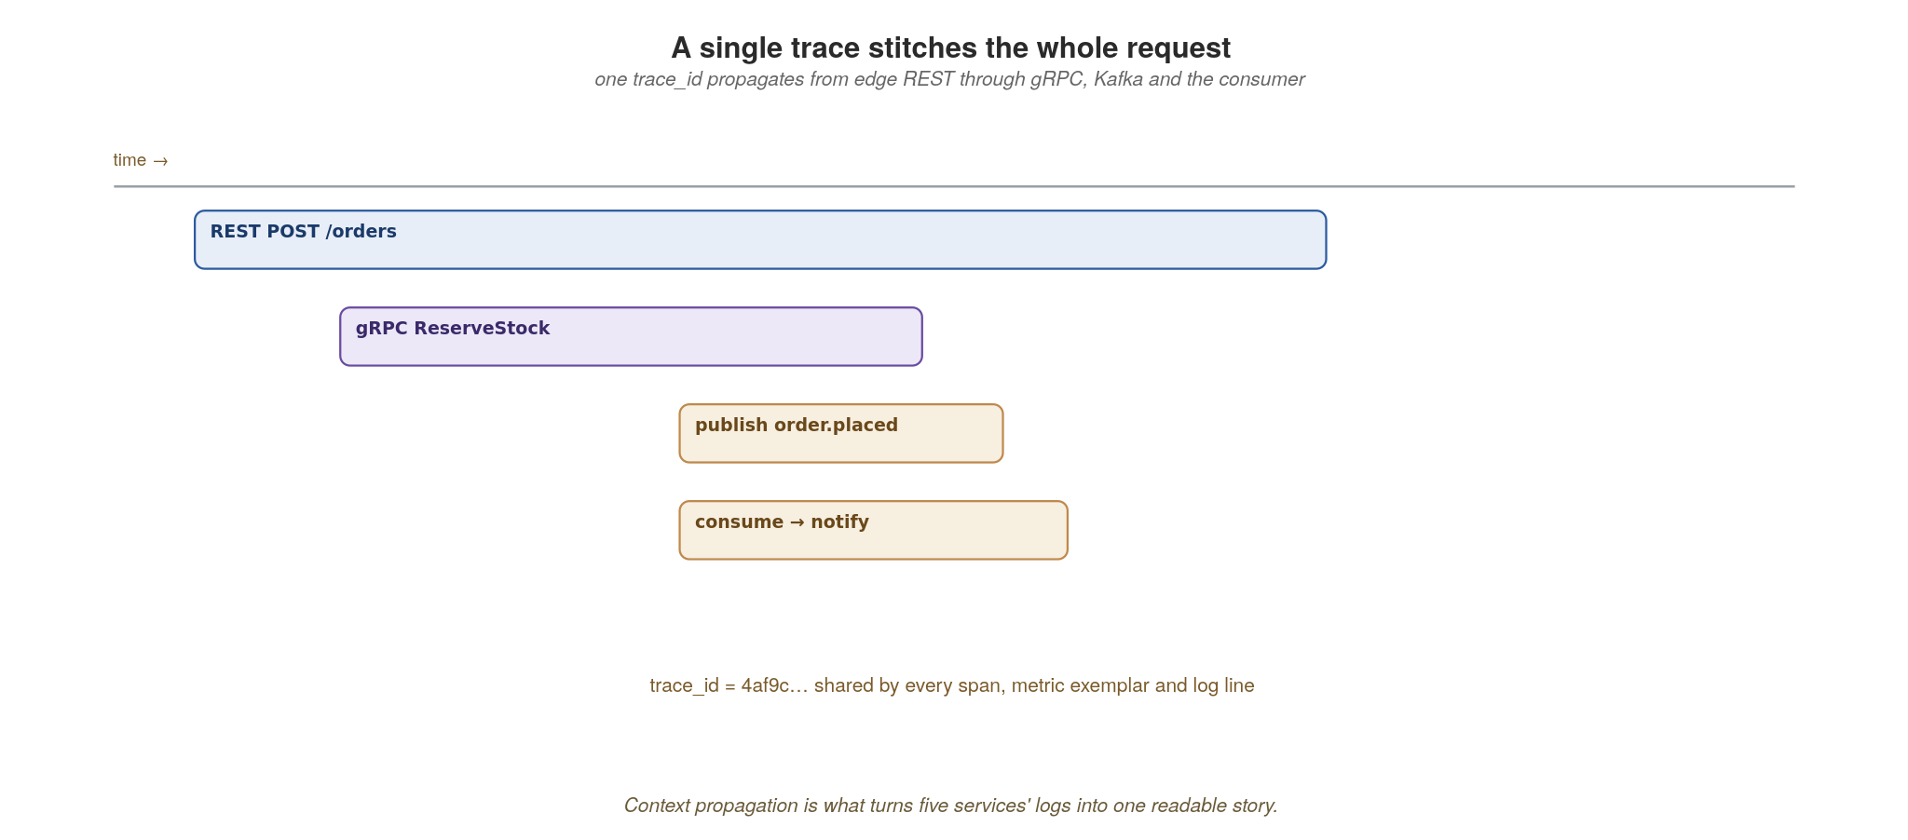
OBSERVABILITY
A single trace stitches the whole request
One trace_id propagates from the edge REST call through gRPC, Kafka and the consumer — five services, one story.
57
Notes:
This is what the instrumentation buys you, visually. One trace_id propagates from the edge REST POST through the gRPC ReserveStock call, onto the published order.placed event, and into the consumer that sends the notification. Five services, one readable waterfall. Point at the time axis: you can see exactly which span dominated latency. That same trace_id appears as an exemplar on your metrics and on every log line, so a latency alert is one click from the offending trace and its logs. This is what makes the choreographed, event-driven design from earlier sections debuggable.

Slide 70
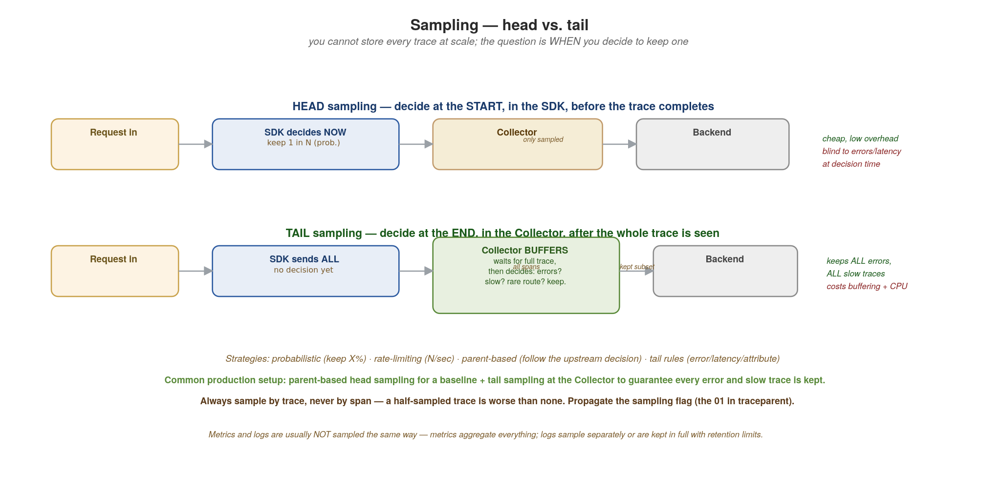
OBSERVABILITY
Sampling — head vs. tail
You can't store every trace at scale. Head decides at the start (cheap, blind); tail decides at the end (smart, costly).
58
Notes:
The cost-control reality: at scale you cannot store every trace, so you sample. The key question is WHEN the keep/drop decision is made. HEAD sampling decides at the START, in the SDK, before the trace even completes — typically 'keep 1 in N' (probabilistic) or 'keep N per second' (rate-limiting). It's cheap and low-overhead, but it's BLIND at decision time: it can't keep a trace because it errored or was slow, because it decides before knowing. TAIL sampling decides at the END, in the Collector, after the whole trace has been seen — the Collector buffers spans, waits for the trace to complete, then applies rules: keep all errors, keep all traces over 500ms, keep rare routes, sample the boring successful ones at 1%. Tail is smart but costs memory (buffering in-flight traces) and CPU (the Collector does real work). The strategies, named: probabilistic (keep X%), rate-limiting (cap per second), parent-based (follow the upstream's decision so a trace isn't half-sampled), and tail rules (error / latency / attribute based). The common production setup is BOTH: a parent-based head sample for a representative baseline, plus tail sampling at the Collector to guarantee every error and every slow trace is captured regardless of the baseline rate. Two rules to drill home: always sample by TRACE not by span (a half-sampled trace is worse than no trace), and propagate the sampling flag (the 01 in traceparent) so every service agrees. Note that metrics and logs are usually NOT sampled the same way — metrics aggregate everything (you don't sample a counter), and logs are typically kept in full with retention limits or sampled on their own policy.

Slide 71
OBSERVABILITY
Choosing a sampling strategy
Probabilistic (head) — keep a fixed percentage (e.g. 10%). Simplest; predictable volume; blind to errors. Good baseline for high-traffic, low-stakes services.
Rate-limiting (head) — keep at most N traces/sec per service. Protects your backend from traffic spikes; good when load is bursty.
Parent-based (head) — honour the upstream service's sampling decision (carried in the traceparent flags). ESSENTIAL in distributed systems: it stops a trace being sampled at service A but dropped at service B, which would give you broken half-traces.
Tail-based (Collector) — buffer the whole trace, then keep by rule: ALL errors, ALL traces over a latency threshold, rare routes, plus a small % of the rest. The gold standard for keeping what matters, at the cost of Collector memory + CPU.
Recommended production setup: parent-based head sampling at a modest baseline (1-10%) for representativeness, PLUS tail sampling at the Collector to guarantee every error and slow trace is kept.
Don't sample metrics the way you sample traces (metrics aggregate everything). Keep logs in full with retention limits, or sample them on their own policy keyed by trace_id so a kept trace keeps its logs.
59
Notes:
The decision guide for sampling. Probabilistic is the simplest and the most common starting point — keep 10%, predictable volume. Rate-limiting is better when traffic is bursty because it caps absolute volume. Parent-based is non-negotiable in a distributed system: without it, service A samples a trace but service B independently drops it, and you get a broken trace with holes — worse than no trace. Tail-based is the most powerful: because the Collector sees the whole trace before deciding, it can guarantee you keep every error and every slow request, which is exactly the traces you actually want during an incident. The cost is the Collector must buffer in-flight traces (memory) and evaluate rules (CPU), and it must see all spans of a trace (which constrains how you load-balance the Collector — use a trace-ID-aware load balancer). The recommended setup combines head (for a cheap representative baseline) and tail (for guaranteed capture of the interesting traces). The sub-bullet is the reminder the user asked for: traces, metrics and logs are sampled differently — you never sample a metric counter, and logs typically follow their own retention or are sampled to match their parent trace.

Slide 72
OBSERVABILITY
Prove it with simple tools before you ship
curl / Postman — exercise REST contracts and inspect status codes, headers and pagination.
hey — quick HTTP load to watch latency, error rate and the KEDA http-add-on scale the service.
ghz — load-test gRPC endpoints and confirm timeouts and retries behave under pressure.
GraphQL UI (GraphiQL) — explore the composed schema and watch the gateway fan out in Tempo.
Kiali — read the live service-mesh topology, mTLS status and request flow during a load test.
60
Notes:
Keep testing pragmatic — you don't need a heavy framework to validate this architecture. curl and Postman exercise REST contracts and check status codes and pagination. hey throws quick HTTP load so you can watch latency and error rate and literally see the KEDA http-add-on add replicas. ghz is the gRPC load tester — confirm your Istio timeouts and retries behave under pressure. The GraphQL IDE (Nitro / Banana Cake Pop, which HotChocolate serves at /graphql in dev) explores the composed schema and, with tracing on, shows the gateway fanning out in Tempo. Kiali visualizes the live mesh: topology, mTLS status and real-time request flow during a load test. The message: prove the behaviour with simple tools before you ship, not after an incident.

Slide 73
12
Security
Defence in depth, in layers.
Notes:
Section 12 — security. The Anti-Patterns section that used to be 12 has shifted to 13. We organise this section around two ideas: the 4 C's of cloud-native security (concentric layers, each protecting what is inside it), and the seven patterns that you'll meet over and over in practice. The bias of this section: security is not a single product or a single team. It's a property of how the system is designed and run, owned at every layer. Each pattern here exists because the layer below it is not enough on its own.

Slide 74
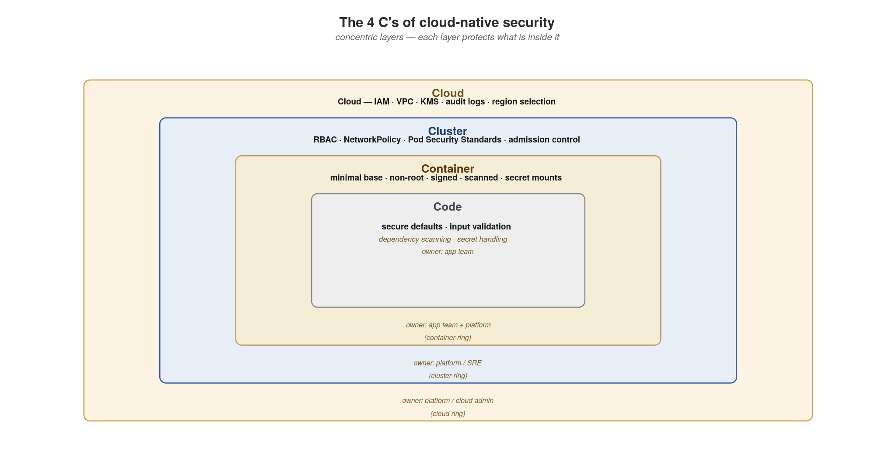
SECURITY
The 4 C's of cloud-native security
Cloud → Cluster → Container → Code. Concentric layers, each layer protects what is inside.
61
Notes:
The mental model from the CNCF security paper. Four concentric layers of responsibility, each enforcing controls appropriate to its scope. Cloud is the outermost — IAM, VPC, KMS, audit logs, region selection — owned by the platform team or cloud admin. Cluster is the Kubernetes layer — RBAC, NetworkPolicy, Pod Security Standards, admission control — owned by platform/SRE. Container is the workload — minimal base images, non-root users, signed images, vulnerability scanning, secret mounting — owned jointly by app teams and platform. Code is the innermost — secure defaults, input validation, dependency scanning, secrets handling — owned by app teams. The point of the concentric metaphor: a weakness in any layer leaks into the inner ones. Strong code on a weak container is still vulnerable. Strong container on a weak cluster is still vulnerable. We design controls at all four. The next slide covers what each layer's controls actually are.

Slide 75
SECURITY
The 4 C's — what each layer enforces, and who owns it
Cloud — IAM (principles of least privilege), VPC isolation, KMS for keys, CloudTrail / audit logging, region & data-residency controls. Owner: platform / cloud admin.
Cluster — Kubernetes RBAC, NetworkPolicy (default-deny + targeted allows), Pod Security Standards (restricted profile), admission control (OPA Gatekeeper / Kyverno), secret encryption at rest, etcd encryption. Owner: platform / SRE.
Container — minimal base images (distroless, UBI-minimal), non-root users, read-only root filesystems, image signing (Sigstore / Cosign), vulnerability scanning (Trivy, Grype) on every build, secret mounting via projected volumes (never bake secrets into images). Owner: app team + platform.
Code — secure defaults (parameterised queries, output encoding), input validation at the trust boundary, dependency scanning (Dependabot, Snyk, OSV-Scanner), secrets handling (no plaintext in source, no logging secrets), CSRF / SSRF / XXE awareness, threat modeling. Owner: app team.
Cross-cutting: observability (audit who did what when), incident response runbooks, threat modeling per service, regular dependency updates.
The pattern: a control at the WRONG layer is the most common source of false confidence. Network ACLs cannot save you from an SQL injection. Code-level input validation cannot save you from a compromised image. Defence in depth is real.
62
Notes:
Walk each layer. The Cloud layer is where you control the perimeter and the identities and the keys; failures here often look like 'someone left an S3 bucket open' or 'an over-permissive IAM role enabled lateral movement to another account.' The Cluster layer is the Kubernetes operating system for your workloads; failures look like 'the developer Pod could reach the database Pod' (no NetworkPolicy) or 'a privileged container was admitted' (no Pod Security Standards). The Container layer is about the image and runtime; failures look like 'a CVE in the base image' or 'the container ran as root and got out via a kernel exploit' or 'a secret was in the image.' Code is where most developer focus already lives. The sub-bullet is the take-home: a control at the wrong layer is false confidence. The next slide opens the pattern catalog — seven patterns that show up across these four layers.

Slide 76
SECURITY
Seven patterns to know
Sidecar — move security concerns out of the app into a companion process. mTLS, JWT, audit, rate-limiting belong there.
Valet Key — hand the client a short-lived signed token to access a resource directly. Less app proxying, less attack surface.
Strangler Fig (for security modernisation) — encapsulate legacy auth behind an API gateway, replace pieces over time.
Zero-Trust / Identity-Aware Proxy — every request authenticated and authorised. Perimeter trust is dead.
Policy-as-Code — security gates declared in Git, evaluated at admission and at build. No human runs a checklist.
Bulkhead — isolate resources so one failure (or compromise) cannot starve or cascade into others.
Claim-Check — send a reference, not the payload. Keeps PII out of message bus history and limits the blast radius if a topic leaks.
The seven appear in different layers and combine. Each slide that follows shows the pattern, then implementation — platform config where it's mostly YAML, code where it's mostly code.
63
Notes:
The roadmap for the next fourteen slides. Note that these patterns span the 4 C's: Zero-Trust and Policy-as-Code are cluster-layer; Sidecar straddles cluster and container; Valet Key, Bulkhead, and Claim-Check are mostly code-layer; Strangler Fig is architecture-layer (modernisation). You'll see each pattern with a diagram explaining how it works, then either a YAML configuration block (for the platform-heavy patterns) or language-specific code (for the code-heavy patterns). Use the sub-bullet to set audience expectation that the next slides alternate between pattern-and-implementation pairs.

Slide 77
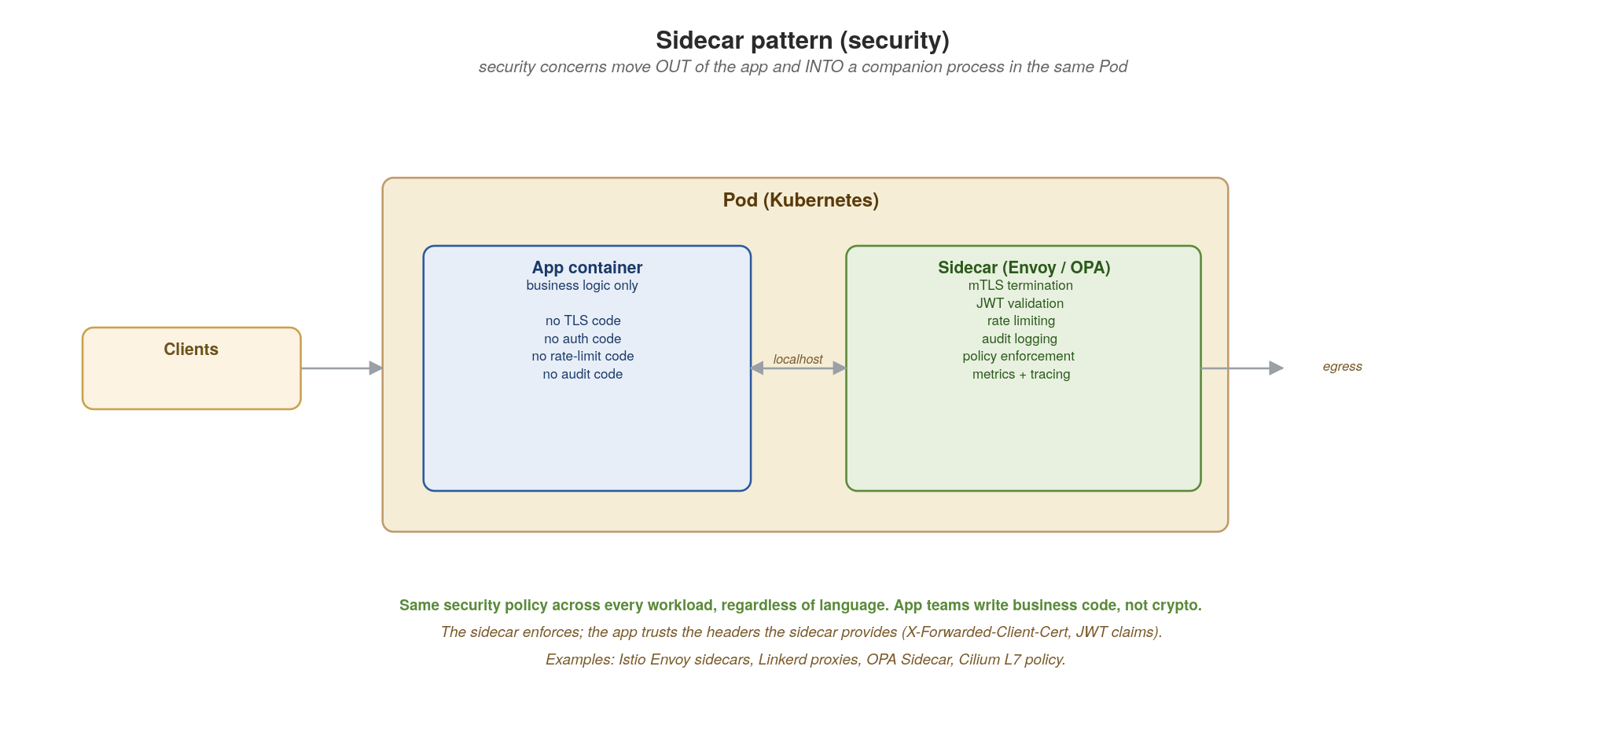
SECURITY · SIDECAR
Sidecar pattern — push security out of the app
mTLS, JWT validation, rate limiting, audit logging — a companion process in the same Pod handles them all.
64
Notes:
The sidecar pattern — a separate container running in the same Pod as the application, sharing localhost. The sidecar handles cross-cutting security concerns: terminates mTLS, validates JWTs, rate-limits, audits, enforces policy. The app receives only authenticated, authorised requests with trusted headers attached (X-Forwarded-Client-Cert, the validated JWT claims, the request ID). Why this is powerful: ONE security policy applied uniformly across every workload regardless of language. Same Envoy sidecar protects your Java app, your Python app, your Go app. App teams write business code, not crypto code. The sidecar is enforced by the platform (Istio injects them automatically) so it can't be disabled by accident. Examples in the field: Istio Envoy sidecars (the dominant choice), Linkerd2-proxy, OPA Sidecar for policy decisions, Cilium L7 with per-endpoint policy.

Slide 78
SECURITY · SIDECAR
Reading the sidecar's trusted headers
The sidecar handles mTLS, JWT validation, and policy decisions — the app trusts the headers the sidecar attaches and reads them as plain values.
X-Forwarded-Client-Cert — the validated client identity from mTLS. Includes the SPIFFE ID (spiffe://cluster.local/ns/orders/sa/order-service) or the X.509 Subject. Set ONLY by the sidecar; the app must reject requests that don't have it.
JWT claims — the sidecar validates the signature, then passes the claims forward as a header or sets request.auth.claims via an envoy filter. The app reads sub, aud, scope, custom claims; it never re-validates the signature.
Request ID — the sidecar attaches X-Request-Id for traceability. Log it; propagate it to downstream calls; correlate it with audit logs.
Mode: only trust these headers when the sidecar is in front. In direct-to-Pod traffic (port-forward, debugging, mistakes), they could be spoofed. Use a NetworkPolicy to ensure traffic only enters via the sidecar's mTLS port.
Examples: Istio Envoy sidecars (auto-injected), Linkerd2-proxy, OPA Sidecar (policy decisions), Cilium L7 policy. License: all Apache 2.0.
65
Notes:
The audience point: the sidecar pattern only works if the app actually USES the headers the sidecar attaches. The most common failure mode is an app that ignores X-Forwarded-Client-Cert and falls back to 'allow if you got here.' Make the headers required, not optional. The second-most-common failure mode is forgetting that traffic can sometimes bypass the sidecar (port-forward for debugging, host networking, direct pod-to-pod calls within the same node). NetworkPolicy is what closes that gap — only allow inbound traffic on the sidecar's mTLS port, never the app's container port directly. With both the sidecar and the NetworkPolicy, the app can fully trust the headers and become much simpler — no crypto code, no JWT parsing library, just header reads.

Slide 79
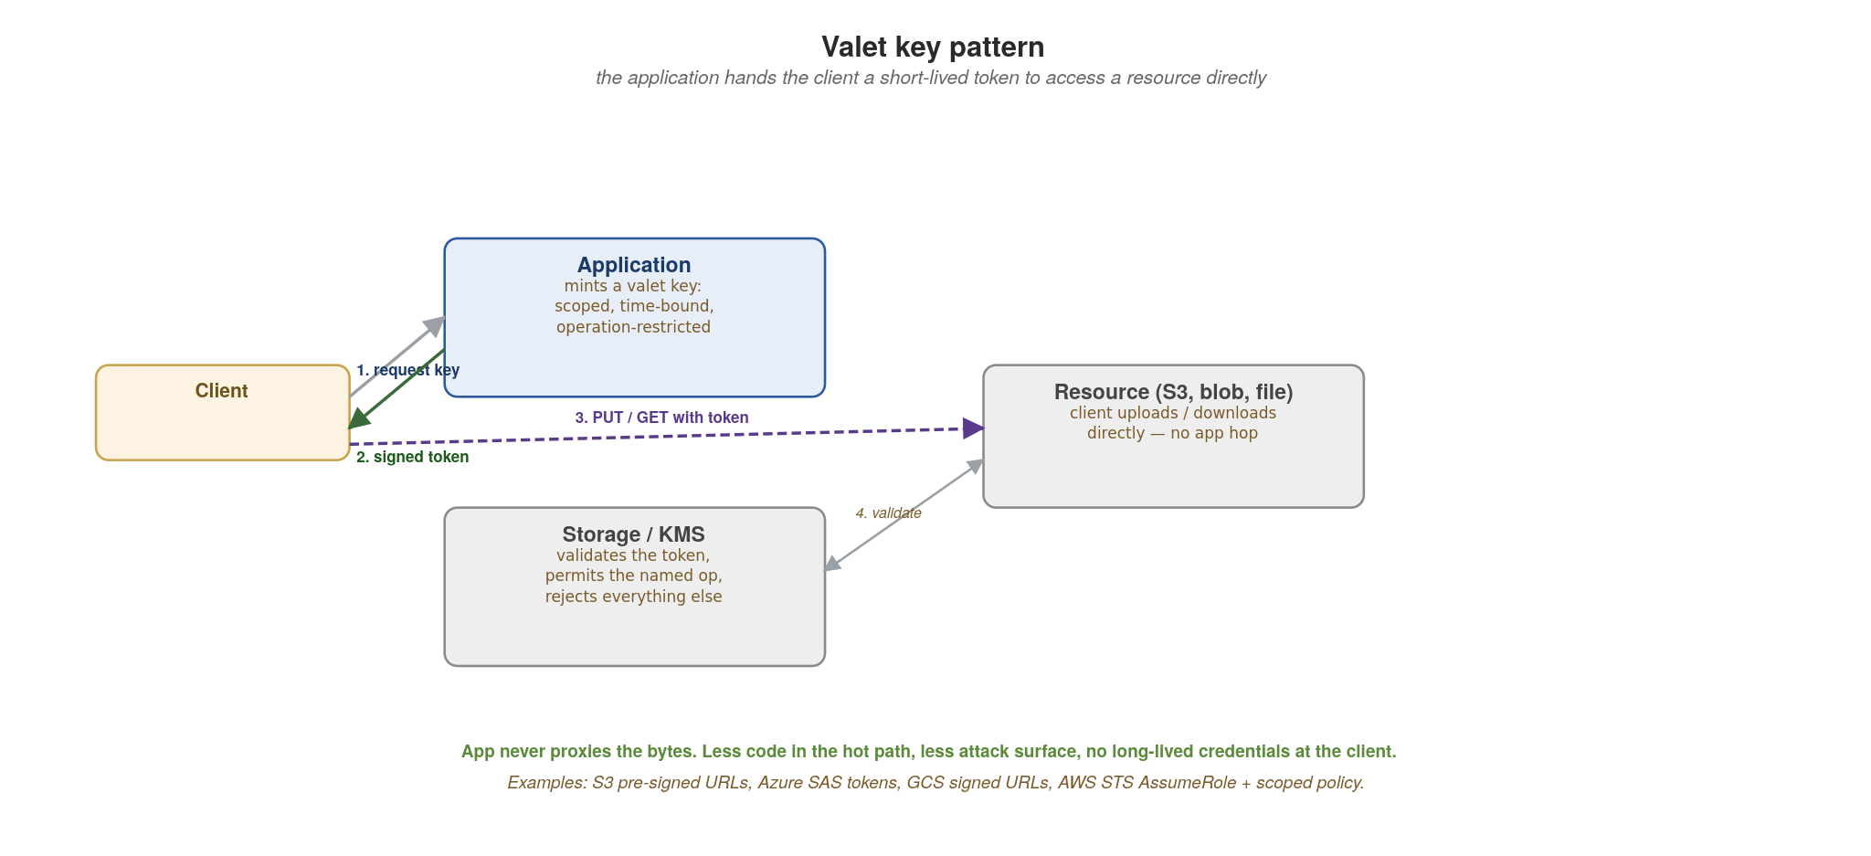
SECURITY · VALET KEY
Valet key pattern — short-lived signed token, direct access
App mints a scoped, time-bound token; client uses it directly against the resource. App never proxies the bytes.
66
Notes:
The valet key pattern: instead of streaming a large file through your application, the application mints a scoped, time-bound, operation-restricted token (a 'valet key') and the client uses it to interact directly with the storage system. Pros: dramatically less data through the application (memory, bandwidth, latency); no long-lived credentials at the client; no app-side credential to leak; the token can expire and be revoked. Cons: requires the storage service to validate tokens (S3, Azure Blob, GCS all do); the token's permissions and TTL must be carefully scoped — a leaked token still has its window. The canonical implementations: S3 pre-signed URLs (15-minute upload tokens for a specific bucket+key+method), Azure SAS tokens (Shared Access Signatures with per-resource scoping), GCS signed URLs, AWS STS AssumeRole with a tight scoping policy. The next slide shows the code.

Slide 80
SECURITY · VALET KEY
S3 pre-signed URL — scoped, time-bound, op-restricted
csharp · ASP.NET Core 10 + AWS SDK for .NET
[ApiController, Route("uploads")]
public class UploadController(IAmazonS3 s3) : ControllerBase
{
[HttpPost("sign"), Authorize(Roles = "uploader")]
public async Task<ActionResult<UploadTicket>> Sign(
SignRequest body, CancellationToken ct)
{
var userId = User.Identity!.Name!;
var key = $"u/{userId}/{Guid.NewGuid()}/{body.Name}";
var request = new GetPreSignedUrlRequest {
BucketName = "uploads",
Key = key,
Verb = HttpVerb.PUT,
ContentType = "application/octet-stream",
Expires = DateTime.UtcNow.AddMinutes(5) // valet window
};
var url = await s3.GetPreSignedURLAsync(request);
return Ok(new UploadTicket(url, key, 300));
}
}
// Client: PUT <ticket.url> with the bytes — no app hop
// S3 enforces the signature, ContentType, and Expires
67
Notes:
ASP.NET Core's [Authorize(Roles=...)] enforces RBAC at the action; User.Identity carries the authenticated principal. IAmazonS3 from the AWS SDK for .NET (registered via AWSSDK.Extensions.NETCore.Setup) generates the pre-signed URL. The Verb, ContentType and Expires are all enforced by S3 on the PUT itself — the application is out of the data path. For Azure-native shops the equivalent is Azure Blob SAS tokens via BlobSasBuilder; same valet-key semantics, different SDK.

Slide 81
SECURITY · STRANGLER FIG
Strangler Fig for security modernisation
Use case: encapsulate legacy authentication (LDAP-only, HTTP Basic, hardcoded session cookies) behind a modern API gateway, then replace the legacy auth path one service at a time.
Step 0: introduce the gateway in front of the monolith. Clients now hit the gateway, which forwards to the legacy auth. Day-zero behaviour unchanged.
Step 1: the gateway terminates TLS, validates JWTs from a modern IdP (Keycloak, Auth0, Azure AD), and translates to whatever the legacy expects — it speaks BOTH languages.
Step 2: per route, switch the gateway from 'forward legacy headers' to 'forward only the JWT claims to the new service'. Legacy auth is no longer in the path for that route.
Step 3: when no routes still need legacy auth, remove it.
Bounded blast radius: each route's auth migration is a config change in the gateway, reversible without a release.
See Appendix K for the general strangler-fig family (identify → move → redirect, with proxy, with shared database, with content-based routing). Same mechanics, applied to auth instead of business logic.
68
Notes:
The strangler fig was covered as a general pattern in Appendix K — here it shows up specifically for security modernisation, which is a common need: most enterprises have legacy auth (LDAP-only, custom SSO, NTLM, hardcoded API keys) buried in critical systems, and a 'big bang' replacement is too risky. The gateway becomes the bilingual translator: it validates modern JWTs from your IdP at the edge and translates to whatever the legacy backend expects (X-Remote-User header, basic auth, NTLM, custom session cookie). Per route, you migrate when the new path is verified — if anything breaks, flip the gateway config back to forwarding legacy headers. The sub-bullet points to Appendix K for the full mechanics; this slide is the application of those mechanics to a specific security need.

Slide 82
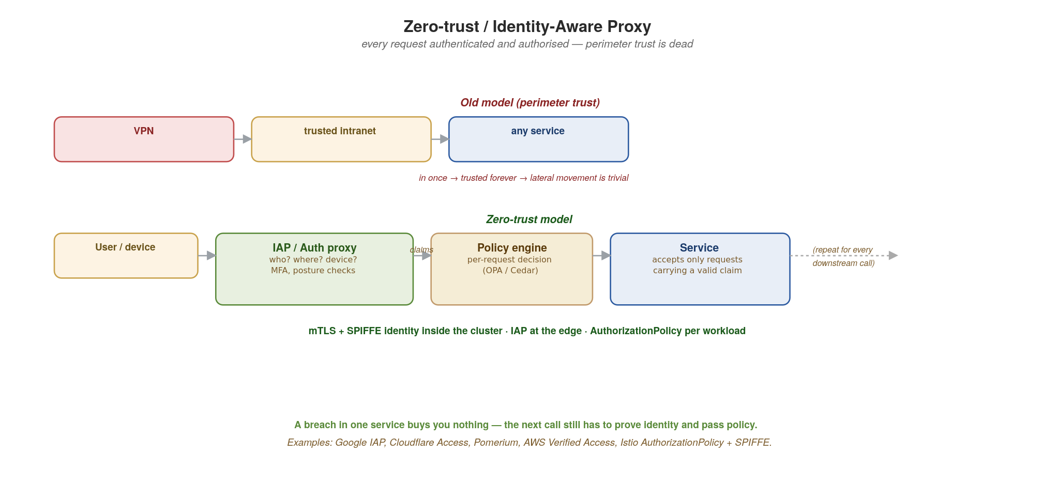
SECURITY · ZERO-TRUST
Zero-trust / Identity-Aware Proxy
Every request authenticated and authorised, on every hop. Perimeter trust is dead. SPIFFE inside, IAP at the edge.
69
Notes:
The model: there is no trusted network. Every request, from any source, to any service, on every hop — authenticated and authorised. The old model (top of the diagram) was 'get inside the VPN, everything inside is trusted' — once an attacker is in, they move laterally trivially. The new model (bottom): the user authenticates to an IAP (Identity-Aware Proxy) which evaluates identity, device posture, location, MFA. The IAP then forwards to a policy engine (OPA, Cedar) which returns an allow/deny per-request. The downstream service still authenticates the caller (mTLS + SPIFFE ID) and re-authorises against policy. Inside the cluster: mTLS via SPIFFE identity (every workload has an X.509 cert identifying its service account), AuthorizationPolicy per workload restricting which other workloads can call which endpoints. A breach in one service gives you nothing because the next call still has to prove identity and pass policy.

Slide 83
SECURITY · ZERO-TRUST
Implementing zero-trust
Edge (IAP): Google IAP, Cloudflare Access, Pomerium, AWS Verified Access — they terminate TLS, validate identity (OAuth/OIDC against your IdP), check device posture, then issue a JWT the downstream service sees in X-Forwarded-* headers.
Inside the cluster (mTLS): Istio + SPIFFE assigns every workload an X.509 cert identifying its service account (spiffe://cluster.local/ns/orders/sa/order-service). Every service-to-service call is mutually authenticated automatically.
Authorization: Istio AuthorizationPolicy declares 'order-service can call payment-service /charge but nothing else, only when carrying a valid customer JWT.' Per-workload, fine-grained, declarative.
Policy decisions: OPA / Cedar evaluate context (user, time, device, target, action) and return allow/deny. Out-of-process so policy can change without redeploying every service.
App-side discipline: read the validated peer identity from X-Forwarded-Client-Cert; never accept calls that arrive without it; log every authorization decision.
License notes: Istio, SPIFFE/SPIRE, OPA, Cedar — all open source (Apache 2.0 or similar). Pomerium is open source; Google IAP / Cloudflare Access / AWS Verified Access are managed services.
70
Notes:
Concrete implementations to ground the model. The edge IAP is what your users hit — they authenticate against your IdP (Keycloak, Auth0, Azure AD, Google Workspace), the IAP issues a session, every request from then on carries identity. Inside the cluster, SPIFFE is the service-identity mechanism that makes mTLS work without manual cert management — it's what gives every Pod a verifiable identity. Istio's AuthorizationPolicy is the declarative layer on top: 'who can call what.' OPA / Cedar is the more flexible policy engine when your decision logic is complex (per-tenant, per-time-of-day, per-data-classification). The bold line is the app-side discipline: don't make these external policies redundant by accepting unauthenticated calls in your code; use the peer identity from the headers as a required input.

Slide 84
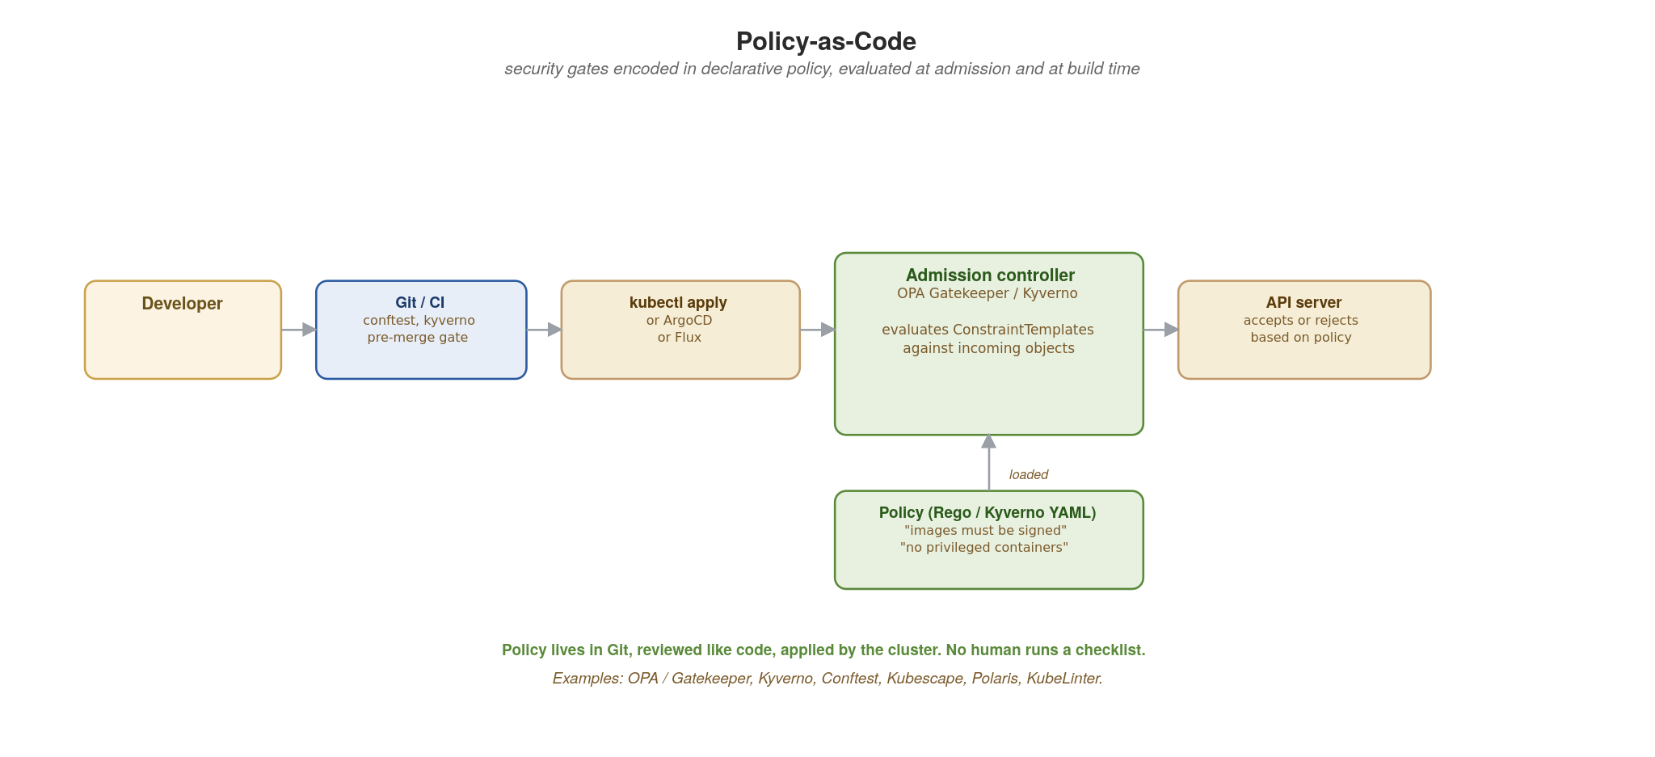
SECURITY · POLICY-AS-CODE
Policy-as-Code — security gates in Git
OPA Gatekeeper / Kyverno enforce declarative policies at admission. CI runs the same policies pre-merge.
71
Notes:
Security policies as code: declarative, version-controlled, tested, applied automatically. The flow on the diagram: a developer commits manifests; CI runs conftest or Kyverno against the manifests pre-merge (catches violations before they reach the cluster); on `kubectl apply` (or ArgoCD / Flux), the Kubernetes API server calls the admission controller (OPA Gatekeeper / Kyverno) which evaluates the ConstraintTemplate / ClusterPolicy against the incoming object. Non-conformant resources are REJECTED — they never become running Pods. The policy file lives in Git, reviewed like code, applied by the cluster. No human runs a checklist; consistency is enforced uniformly. Example policies: images must come from approved registries, no privileged containers, no host network, no host path mounts, all containers have resource limits, all images are signed.

Slide 85
SECURITY · POLICY-AS-CODE
OPA Gatekeeper ConstraintTemplate (Rego)
yaml · OPA Gatekeeper (language-neutral)
# ConstraintTemplate — reusable policy logic in Rego
apiVersion: templates.gatekeeper.sh/v1
kind: ConstraintTemplate
metadata:
name: k8srequiresignedimages
spec:
crd:
spec:
names: { kind: K8sRequireSignedImages }
validation:
openAPIV3Schema:
properties:
allowedRegistries: { type: array, items: { type: string } }
targets:
- target: admission.k8s.gatekeeper.sh
rego: |
package k8srequiresignedimages
violation[{"msg": msg}] {
container := input.review.object.spec.containers[_]
not startswith(container.image, input.parameters.allowedRegistries[_])
msg := sprintf("image %v not from an allowed registry", [container.image])
}
---
# Constraint — applies the policy to namespaces
apiVersion: constraints.gatekeeper.sh/v1beta1
kind: K8sRequireSignedImages
metadata: { name: must-be-signed }
spec:
match:
kinds: [{apiGroups: [""], kinds: ["Pod"]}]
excludedNamespaces: ["kube-system", "gatekeeper-system"]
parameters:
allowedRegistries: ["registry.acme.com/", "quay.io/redhat/"]
72
Notes:
The two-piece pattern: ConstraintTemplate defines the LOGIC (in Rego, OPA's policy language), Constraint is the INSTANCE that applies the logic to specific resources with specific parameters. The Rego in violation[{msg}] reads as 'for every container in the Pod, if its image doesn't start with any of the allowed registries, emit a violation with this message.' Gatekeeper translates that into an admission webhook that rejects non-conformant Pods before they're scheduled. The Constraint binds the template to the kinds (Pods) and namespaces (everything except system namespaces), with the allowedRegistries list as the parameter. Lives in Git, applied via `kubectl apply` (or ArgoCD), versioned and reviewed like code. Equivalent Kyverno expression is much more YAML-native if your team prefers it; Rego is more powerful for complex logic.

Slide 86
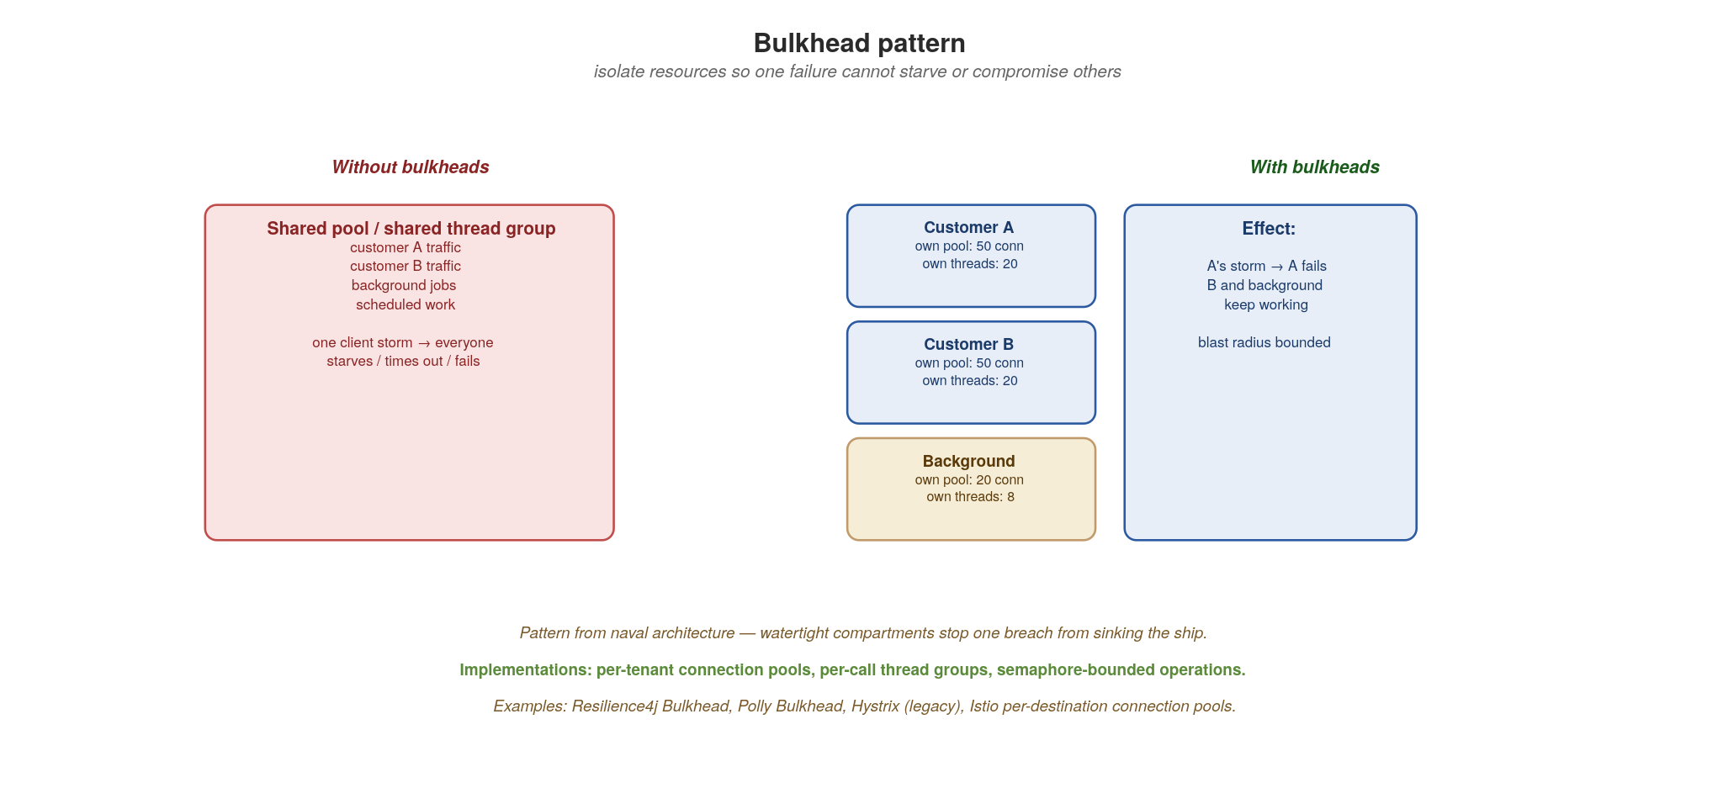
SECURITY · BULKHEAD
Bulkhead — isolate resources, bound the blast radius
Per-tenant / per-call / per-priority pools. One tenant's storm cannot starve others. One compromise cannot cascade.
73
Notes:
Bulkhead: borrowed from naval architecture, where watertight compartments stop one breach from sinking the ship. In software, you isolate resources — connection pools, thread pools, async semaphores, queues — by tenant, by call type, or by priority. The left side of the diagram (red) shows the default: one shared pool means a single tenant's traffic storm starves everyone else's. The right side: separate pools, each with its own bounded size. A storm from tenant A consumes tenant A's pool and rejects further A requests — tenants B and background workloads keep running. Why this matters for security as well as resilience: a compromised tenant or a compromised endpoint can be used to mount a denial-of-service against the shared system; bulkheads cap that to its own pool. Implementations: Resilience4j Bulkhead (JVM), Polly (.NET), asyncio.Semaphore (Python), Istio per-destination connection pools at the mesh layer.

Slide 87
SECURITY · BULKHEAD
Polly concurrency limiters in ASP.NET Core
csharp · ASP.NET Core 10 + Polly v8
// Polly v8 resilience pipeline — concurrency limiter is the bulkhead
public class OrderService(IHttpClientFactory factory)
{
private static readonly ResiliencePipeline<Order> _pipeline =
new ResiliencePipelineBuilder<Order>()
.AddConcurrencyLimiter(new ConcurrencyLimiterOptions {
PermitLimit = 50, // 50 concurrent
QueueLimit = 100, // 100 may wait
QueueProcessingOrder = QueueProcessingOrder.OldestFirst
})
.AddTimeout(TimeSpan.FromSeconds(3))
.Build();
public async Task<Order> Place(OrderRequest req, CancellationToken ct) =>
await _pipeline.ExecuteAsync(async token =>
await factory.CreateClient("payments")
.PostAsJsonAsync<Order>("/charge", req, token), ct);
// Per-tenant bulkheads via cached named pipelines
private readonly ConcurrentDictionary<string, ResiliencePipeline<Order>> _tenants = new();
public Task<Order> PlaceForTenant(string tenant, OrderRequest req, CancellationToken ct) {
var pipeline = _tenants.GetOrAdd(tenant, _ =>
new ResiliencePipelineBuilder<Order>()
.AddConcurrencyLimiter(new() { PermitLimit = 30, QueueLimit = 50 })
.Build());
return pipeline.ExecuteAsync(async ct2 =>
await factory.CreateClient("payments")
.PostAsJsonAsync<Order>("/charge", req, ct2), ct).AsTask();
}
}
74
Notes:
Polly v8's ResiliencePipelineBuilder is the modern .NET fault-tolerance composition. AddConcurrencyLimiter is the bulkhead — PermitLimit caps concurrent in-flight work; QueueLimit caps waiting work; further requests are rejected immediately. Combined with AddTimeout to fail fast on slow downstream. For per-tenant isolation, cache one pipeline per tenant in a ConcurrentDictionary; each tenant gets its own concurrency budget. Microsoft.Extensions.Http.Resilience can also register pipelines onto named HttpClients via AddHttpClient(...).AddResilienceHandler(...). At the platform layer, Istio (if you run with mesh) gives you connection-pool-level bulkheading per destination, complementing these in-process limits.

Slide 88
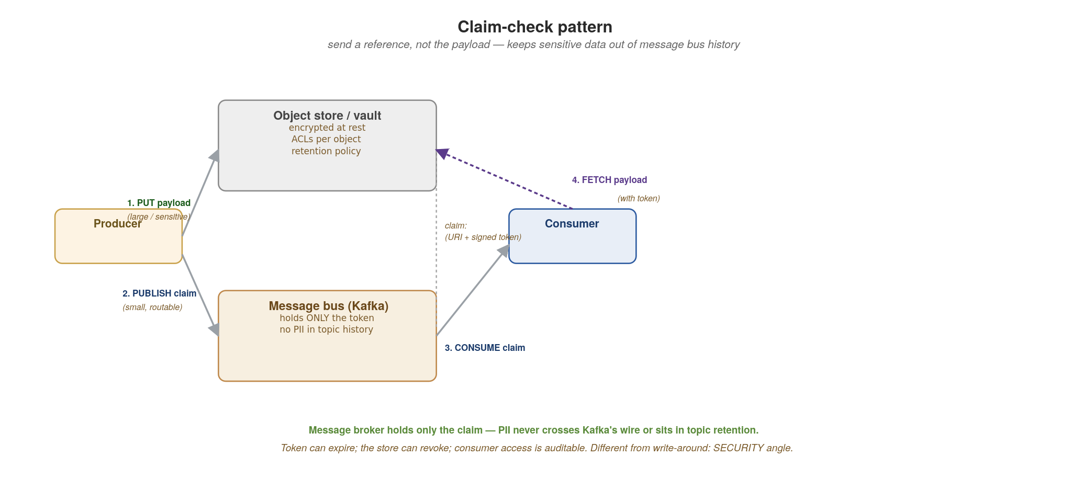
SECURITY · CLAIM-CHECK
Claim-check — send a reference, not the payload
Large or sensitive payload goes to a secure store; the message bus carries only an opaque token to fetch it.
75
Notes:
The claim-check pattern: a producer puts the (large or sensitive) payload into a secure object store (S3, Azure Blob, GCS) and publishes only a CLAIM TICKET (an opaque token plus a fetch URI) to the message bus. The consumer receives the ticket, fetches the payload from the store with the token. Two big security wins: PII never sits in Kafka's topic history (which is replicated, retained, and possibly visible to operators and other tools); and the token can expire and be revoked, while a Kafka message cannot. The pattern also has performance benefits — you don't push 50MB messages through the message bus — but in this section we frame it for SECURITY. Compare to the write-around caching pattern: same shape, different motivation. Where: any flow where sensitive payloads (health records, financial documents, customer PII) cross messaging infrastructure that shouldn't see them; any flow where payloads are large enough that the bus would be the bottleneck.

Slide 89
SECURITY · CLAIM-CHECK
Producer mints claim, consumer fetches payload
csharp · ASP.NET Core 10 + AWS SDK for .NET + MassTransit
// Producer — store payload, publish only the claim ticket
public class ClaimPublisher(IAmazonS3 s3, IPublishEndpoint bus)
{
public async Task PublishWithClaim<T>(T payload, CancellationToken ct)
{
var objId = Guid.NewGuid().ToString();
var bytes = JsonSerializer.SerializeToUtf8Bytes(payload);
await s3.PutObjectAsync(new PutObjectRequest { // 1. store payload
BucketName = "claims",
Key = objId,
InputStream = new MemoryStream(bytes),
ServerSideEncryptionMethod = ServerSideEncryptionMethod.AES256
}, ct);
await bus.Publish(new ClaimTicket(objId, $"s3://claims/{objId}"), ct); // 2.
}
}
// Consumer — MassTransit pulls the claim, we fetch the payload
public class ClaimConsumer(IAmazonS3 s3) : IConsumer<ClaimTicket>
{
public async Task Consume(ConsumeContext<ClaimTicket> ctx)
{
var obj = await s3.GetObjectAsync("claims", ctx.Message.ClaimId,
ctx.CancellationToken);
var payload = await JsonSerializer.DeserializeAsync<Payload>(
obj.ResponseStream, cancellationToken: ctx.CancellationToken);
await Handle(payload!);
}
}
76
Notes:
IAmazonS3 (AWS SDK for .NET) is registered via AWSSDK.Extensions.NETCore.Setup in Program.cs. The publisher PUTs the payload to S3 with AES256 server-side encryption, then publishes only a ClaimTicket via MassTransit's IPublishEndpoint (which routes to Kafka, RabbitMQ, or Azure Service Bus depending on transport configuration). The consumer is an IConsumer<ClaimTicket> that fetches the payload from S3 and processes it. The audit trail is on S3 (CloudTrail GetObject events with the principal that fetched), not on the message bus — better for compliance reporting.

Slide 90
SECURITY
Choosing the right pattern
Sidecar — when you want one security policy uniformly across every workload, regardless of language. Cost: an extra container per Pod (memory + startup time).
Valet Key — when clients need direct access to a large or specific resource (file upload, image download). Cost: storage system must validate tokens (most do).
Strangler Fig (auth) — when you have legacy authentication you can't change all at once. Cost: a gateway running translation logic during the transition.
Zero-Trust / IAP — the default model for any system with users outside your immediate control. Cost: mTLS everywhere has real CPU and operational overhead.
Policy-as-Code — always. Always. The cost of NOT having it (drift, inconsistency, forgotten review steps) is much higher than the cost of adopting OPA / Kyverno.
Bulkhead — any multi-tenant system, any system with mixed-priority workloads. Cost: pools are extra moving parts to size and tune.
Claim-Check — when payloads carry PII or are large enough to bloat the message bus. Cost: an extra fetch hop and the store-and-bus must agree on token semantics.
Most production systems use ALL of these, in combinations — not as a checklist, but as deliberate decisions per concern.
77
Notes:
Close the section with the decision rules. The cost lines are deliberately included — every pattern is a trade. Sidecar costs a container per Pod (a few MB of memory, a couple hundred ms of startup); for most systems the security uniformity makes it worth that. Valet key requires storage-side validation — S3, Azure Blob, GCS all support it natively, so the cost is usually just understanding the SDK. Strangler fig (auth) is a deliberate transition strategy; the gateway running translation is the cost. Zero-trust / mTLS everywhere has real CPU overhead (TLS handshakes are not free) — mesh implementations like Istio amortise it well but it's not zero. Policy-as-code's cost is the upfront investment in writing policies; the ongoing cost is near zero. Bulkheads are extra moving parts to tune. Claim-check adds a hop. The bold line is the take-home: real production systems use all seven, in deliberate combinations per concern — not as a one-size-fits-all checklist.

Slide 91
SECURITY
Take-aways and references
Defence in depth across the 4 C's: cloud, cluster, container, code. A control at the wrong layer is false confidence.
Identity is the new perimeter. mTLS + SPIFFE inside; IAP / OIDC at the edge. Every request authenticated and authorised, on every hop.
Policy in Git, enforced by the cluster. OPA Gatekeeper or Kyverno at admission; conftest in CI for early feedback.
PII never crosses your message bus in cleartext. Claim-check or end-to-end encrypt.
Isolate by tenant, by call, by priority. Bulkheads bound the blast radius of both incidents and outages.
References: NIST SP 800-204A (microservices security); CNCF Cloud Native Security Whitepaper; OWASP API Security Top 10; the OpenSSF SLSA framework; Istio AuthorizationPolicy docs; OPA Gatekeeper library; Microsoft Cloud Adoption Framework: security patterns.
Open-source pillars: Istio (Apache 2.0), SPIFFE/SPIRE (Apache 2.0), OPA / Gatekeeper (Apache 2.0), Kyverno (Apache 2.0), Sigstore (Apache 2.0), Falco (Apache 2.0), Trivy (Apache 2.0).
78
Notes:
Close with the take-aways the audience should remember. Defence in depth across the 4 C's is the philosophical anchor. Identity-as-perimeter is the operational anchor. Policy-in-Git is the automation anchor. The PII-never-in-cleartext and bulkhead lines are the specific applications. The reference list is what you'd recommend for further reading — NIST 800-204A is the canonical microservices security paper; CNCF's Cloud Native Security Whitepaper organises the same material; OWASP API Top 10 is the application-layer reference; SLSA covers supply-chain security (signing, provenance, build integrity). The open-source list emphasises that the entire security stack is buildable with Apache 2.0 components.

Slide 92
13
Anti-Patterns
Most outages re-couple what you separated.
Notes:
The final main section, and the most memorable framing of the whole talk: nearly every cloud-native failure is coupling sneaking back in. You did the work to separate things; entropy and deadlines pull them back together. This section names the specific ways that happens and gives heuristics to catch it early.

Slide 93
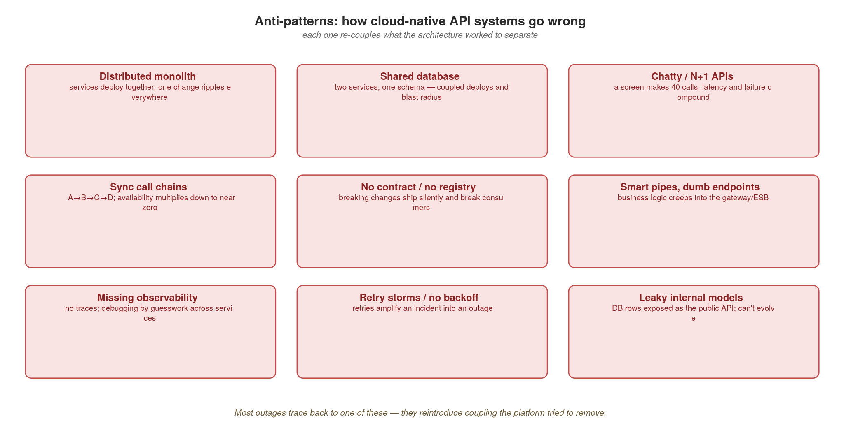
ANTI-PATTERNS
How cloud-native API systems go wrong
Each anti-pattern reintroduces the coupling the architecture worked to remove.
79
Notes:
Walk the grid briefly — most of these are callbacks to earlier sections. Distributed monolith (services that must deploy together), shared database (two services on one table), chatty calls (deep synchronous chains), no contract/leaky internal models (DB rows as the public API), missing observability (debugging by guesswork), retry storms (no backoff). The unifying diagnosis is on screen: each one reintroduces the coupling the architecture worked to remove. If you only remember one slide for code review, it's this one. The next slide turns these into positive heuristics.

Slide 94
ANTI-PATTERNS
The heuristics that keep you out of them
If two services must deploy together, they are one service — merge them or fix the contract.
One writer per dataset; everyone else reads through the API or subscribes to its events.
Push aggregation to a gateway/BFF; forbid service-to-service call chains deeper than one hop.
No contract in the registry, no merge — and every retry has a timeout and a bound.
If you can't trace it, you can't run it: observability is a launch requirement, not a follow-up.
80
Notes:
These are the five tests to apply in design and code review. (1) If two services must deploy together, they're really one — merge them or fix the contract. (2) One writer per dataset; everyone else reads through the API or subscribes to events — no shared tables. (3) Push aggregation to a gateway or BFF and forbid synchronous call chains deeper than one hop. (4) No contract in the registry, no merge — and every retry has a timeout and a bound. (5) If you can't trace it, you can't run it — observability is a launch requirement, not a follow-up. Offer these as a checklist the team can literally paste into a PR template.

Slide 95
IN CLOSING
The whole talk, in five lines
Cloud-native is a set of properties; the platform exists to make them the default.
Match each interaction to its style — REST, gRPC, GraphQL or async — and compose at the edge.
Own your data; share it as contracts and facts, never as shared tables.
Make the contract a governed artifact: registry to enforce it, metadata to find it, observability to run it.
Every anti-pattern is coupling sneaking back in. Design to keep things apart.
81
Notes:
The recap — read these five as the entire talk compressed. If the audience remembers nothing else: cloud-native is properties not tools; match the protocol to the interaction and compose at the edge; own your data and share it as contracts and facts; make the contract a governed artifact (registry, metadata, observability); and watch for coupling sneaking back in. Pause here before References and Q&A. If it's the long-form session, this is the natural point to say 'and now the appendices go deeper on four things people always ask about' and continue.

Slide 96
REFERENCES
The shoulders this stands on
Cloud-Native Patterns and Architecture
Building Microservices, 2nd ed. — Sam Newman (O'Reilly)
Designing Data-Intensive Applications, 2nd ed. — Martin Kleppmann & Chris Riccomini (O'Reilly)
Building Event-Driven Microservices — Adam Bellemare (O'Reilly)
Cloud Native Patterns — Cornelia Davis (Manning)
Patterns of Distributed Systems — Unmesh Joshi (Addison-Wesley)
Architecture Modernization — Nick Tune & Jean-Georges Perrin (Manning)
Cloud Native Anti-Patterns — Gerald Bachlmayr
Principles of Web API Design — James Higginbotham (Addison-Wesley)
Patterns for API Design — Olaf Zimmermann et al. (Addison-Wesley)
API Design Patterns — JJ Geewax (Manning)
Learning Domain-Driven Design — Vlad Khononov (O'Reilly)
Balancing Coupling in Software Design — Vlad Khononov (Addison-Wesley)
ASP.NET Core 10 reference (learn.microsoft.com/aspnet/core), OpenTelemetry .NET, Temporal .NET SDK (docs.temporal.io/dev-guide/dotnet), MassTransit, HotChocolate, Streamiz.Kafka.Net, EF Core and Debezium docs — for the runtime specifics
82
Notes:
The reading list this talk stands on. Call out a couple of pairings: Newman's Building Microservices for the boundaries and integration story; Kleppmann's Designing Data-Intensive Applications for the data and consistency foundations behind the outbox and saga; Bellemare for the event-driven backbone; and the API-design trio (Higginbotham, Zimmermann et al., Geewax) for contract and versioning depth. The architecture books are language-agnostic — they apply whether you build on .NET, Java, Go, or anything else. The ASP.NET Core reference docs, OpenTelemetry .NET guides, Temporal .NET SDK docs and Debezium docs are the practical references for the runtime specifics shown in the code. Tell people the slides and these references are enough to actually build the system, not just talk about it.

Slide 97
Thank you
Questions?
Notes:
End of the main talk. Thank the audience and open for questions. The four appendices that follow are deep-dive backup material — pull them up on demand during Q&A, or work through them directly if you're running the full-length session. They cover the questions that always come up: how the three protocols really differ, how to version each one, how to run WebSockets on Kubernetes, and the hard parts of saga state and compensation.

Slide 98
REFERENCE
Glossary of acronyms (1 of 2) — protocols, data, events
Protocols & APIs — REST (Representational State Transfer); RPC (Remote Procedure Call); gRPC (Google's RPC framework, over HTTP/2 + Protobuf); HTTP (HyperText Transfer Protocol); TLS / mTLS (Transport Layer Security / mutual TLS — both peers present certificates); SSE (Server-Sent Events); BFF (Backend-For-Frontend); SDK (Software Development Kit); API (Application Programming Interface).
Messaging & integration — AMQP (Advanced Message Queuing Protocol); ESB (Enterprise Service Bus); DLQ (Dead-Letter Queue — where un-processable messages go); SerDe (Serializer / Deserializer); pub/sub (publish-subscribe).
Data & persistence — CQRS (Command Query Responsibility Segregation); CDC (Change Data Capture); WAL (Write-Ahead Log — the DB's commit-ordered durable log); ACID (Atomicity, Consistency, Isolation, Durability); TTL (Time-To-Live — how long a cached key lives before expiring); LRU (Least Recently Used — a cache eviction policy); SETEX (the Redis "SET with EXpiry" command — sets a key and its TTL atomically); ORM (Object-Relational Mapping); EF Core (Entity Framework Core — .NET's ORM); LINQ (Language-Integrated Query).
Domain modelling & flow — DDD (Domain-Driven Design); OHS (Open Host Service — a published, stable interface a context offers others); ACL (Anti-Corruption Layer in DDD — translates between models; note: ACL also means Access Control List in security); Saga (not an acronym — a sequence of local transactions with compensating actions).
83
Notes:
Glossary part 1, the protocol/data/event vocabulary. Call out the ones most likely to trip people up: gRPC is recursively 'gRPC Remote Procedure Call' but practically it's Google's high-performance RPC over HTTP/2 with Protocol Buffers. mTLS (mutual TLS) is the one people often gloss — ordinary TLS authenticates the server to the client; mutual TLS also authenticates the client to the server, which is the basis of zero-trust service identity. The data row has the SETEX and TTL the audience asked about explicitly: TTL is the expiry duration on a cached key; SETEX is the Redis command that sets a value and its TTL in one atomic operation (SETEX key seconds value). LRU is the eviction policy that drops the least-recently-touched key when the cache is full. CDC and WAL go together — CDC tails the WAL. The ACL ambiguity is worth flagging out loud: in the DDD/data sections ACL means Anti-Corruption Layer; in the security section it means Access Control List.

Slide 99
REFERENCE
Glossary of acronyms (2 of 2) — platform, security, observability
Kubernetes & cloud — K8s (Kubernetes); RBAC (Role-Based Access Control); HPA (Horizontal Pod Autoscaler); KEDA (Kubernetes Event-Driven Autoscaling); PSS (Pod Security Standards); CRD (Custom Resource Definition); IAM (Identity & Access Management); KMS (Key Management Service); VPC (Virtual Private Cloud); CNI (Container Network Interface).
Identity & security — SPIFFE (Secure Production Identity Framework For Everyone); SPIRE (the SPIFFE Runtime Environment); OPA (Open Policy Agent); IAP (Identity-Aware Proxy); JWT (JSON Web Token); OIDC (OpenID Connect); OAuth (Open Authorization); SAS (Shared Access Signature — Azure's scoped token); MFA (Multi-Factor Authentication); PII (Personally Identifiable Information); SLSA (Supply-chain Levels for Software Artifacts); CVE (Common Vulnerabilities & Exposures); SBOM (Software Bill of Materials).
Observability — OTel (OpenTelemetry); RED (Rate, Errors, Duration — the request-driven metrics method); USE (Utilisation, Saturation, Errors — the resource metrics method); MDC (Mapped Diagnostic Context — per-thread log context); LGTM (Loki, Grafana, Tempo, Mimir); SLO / SLI / SLA (Service-Level Objective / Indicator / Agreement); p99 (99th-percentile latency).
Runtime & build — CLR (Common Language Runtime — .NET's execution engine); BCL (Base Class Library); JIT (Just-In-Time compilation); AOT (Ahead-Of-Time / Native AOT compilation); GC (Garbage Collection); DI (Dependency Injection); DTO (Data Transfer Object); LINQ (Language-Integrated Query).
84
Notes:
Glossary part 2, the platform/security/observability vocabulary. The Kubernetes row: HPA scales on CPU/memory, KEDA scales on event sources (queue depth, Kafka lag, HTTP rate) — the distinction matters in the autoscaling discussion. PSS (Pod Security Standards) replaced the deprecated PodSecurityPolicy. The security row has the terms from section 12: SPIFFE/SPIRE give workloads cryptographic identities for mTLS; OPA is the policy engine behind policy-as-code; IAP is the zero-trust edge proxy; JWT/OIDC/OAuth are the token/identity standards; SAS is Azure's valet-key token; SLSA/CVE/SBOM are supply-chain security. The observability row has RED and USE, the two metrics methods worth memorising: RED (Rate, Errors, Duration) for services, USE (Utilisation, Saturation, Errors) for resources. p99 means the 99th-percentile latency — 99% of requests are faster than this; it's what you alert on, not the average. The runtime row is tailored to this deck's language.

Slide 100
A
Appendix A · Protocols in Depth
REST, gRPC and GraphQL — how they actually differ.
Notes:
Appendix A. This is the deep dive behind the 'pick the protocol' slide from section 2. We compare the three on three axes: the mental model each imposes, how they handle fetching and round trips, and what actually travels on the wire. By the end the audience should be able to defend a protocol choice on technical grounds, not fashion.

Slide 101
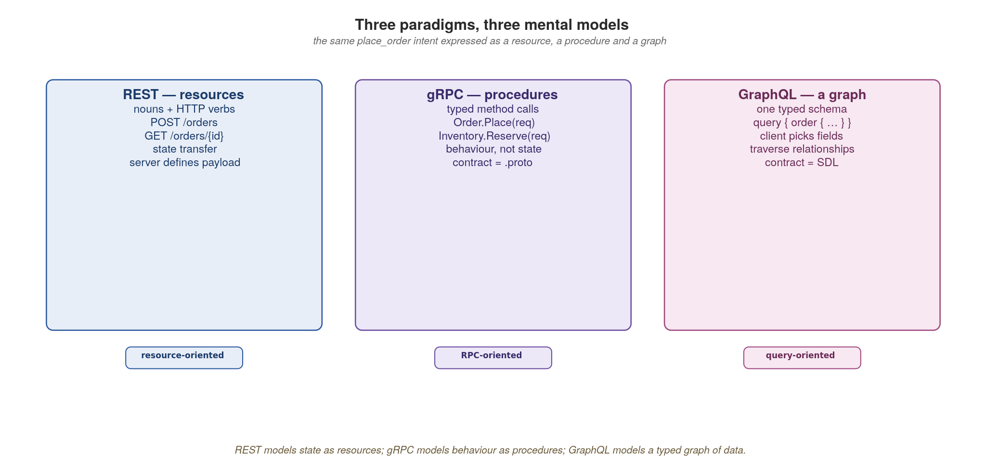
APPENDIX A · PROTOCOLS
Three paradigms, three mental models
REST models resources, gRPC models procedures, GraphQL models a typed graph — the same intent, three shapes.
85
Notes:
Start with the mental model, because it drives everything else. REST is resource-oriented: nouns and HTTP verbs, you transfer representations of state. gRPC is procedure-oriented: you call typed methods, it's behaviour not state, and the .proto is the contract. GraphQL is graph-oriented: one typed schema the client traverses, picking exactly the fields it wants. The same place_order intent takes three different shapes. Most arguments about 'which is best' are really arguments about which mental model fits the problem — and often the answer is different per interaction.

Slide 102
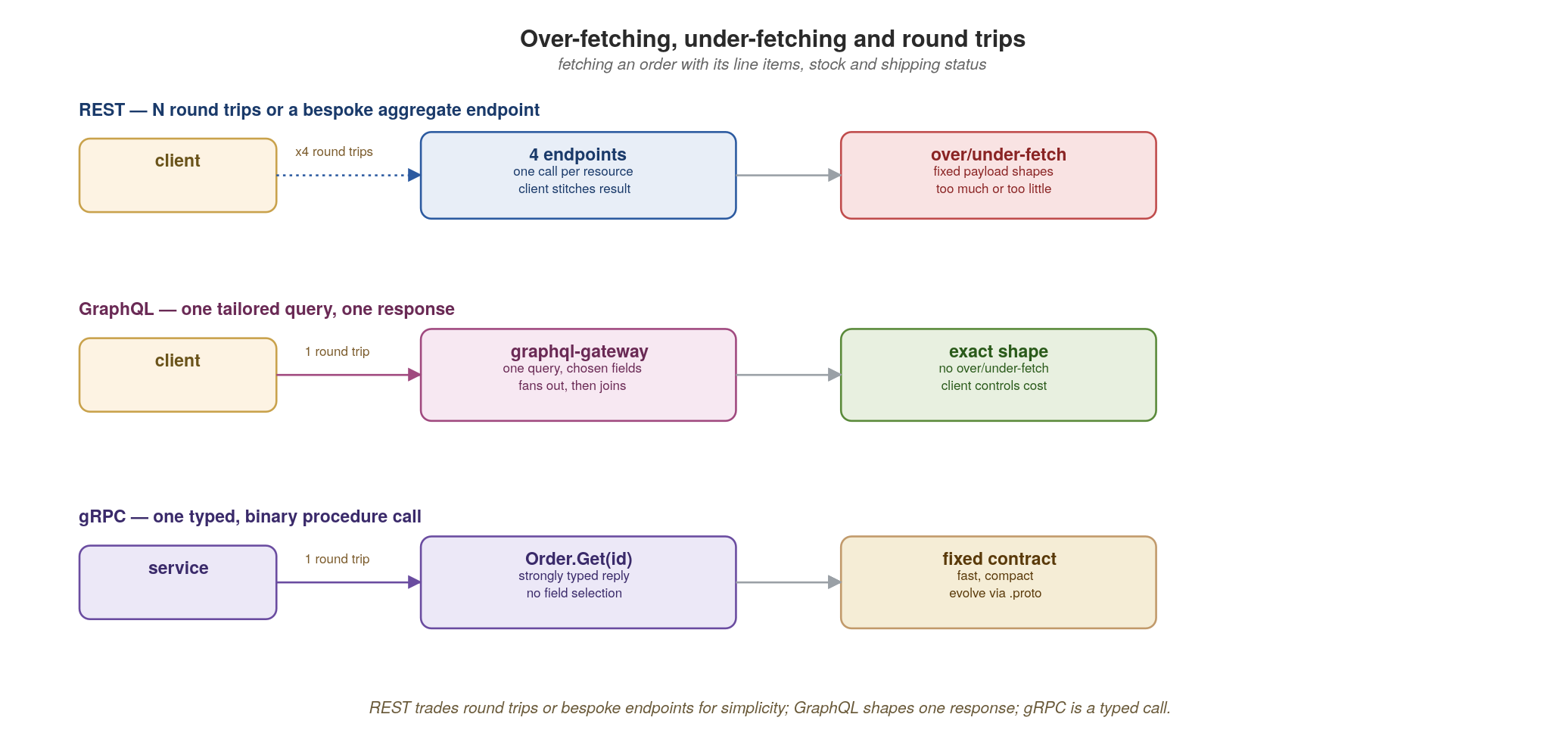
APPENDIX A · PROTOCOLS
Over-fetching, under-fetching and round trips
REST trades round trips or bespoke endpoints for simplicity; GraphQL shapes one response; gRPC is a typed call.
86
Notes:
This is the practical difference clients feel. With REST you often need several round trips (order, then its items, then stock, then shipping) or you build a bespoke aggregate endpoint — and you still get fixed payload shapes that over- or under-fetch. GraphQL collapses that into one tailored query where the client names the fields, so no over- or under-fetching and the client controls the cost. gRPC is a single typed, binary call with a fixed reply shape — no field selection, but extremely fast. The trade: GraphQL gives clients flexibility at the cost of gateway complexity; gRPC gives speed at the cost of rigidity; REST gives reach and simplicity at the cost of round trips.

Slide 103
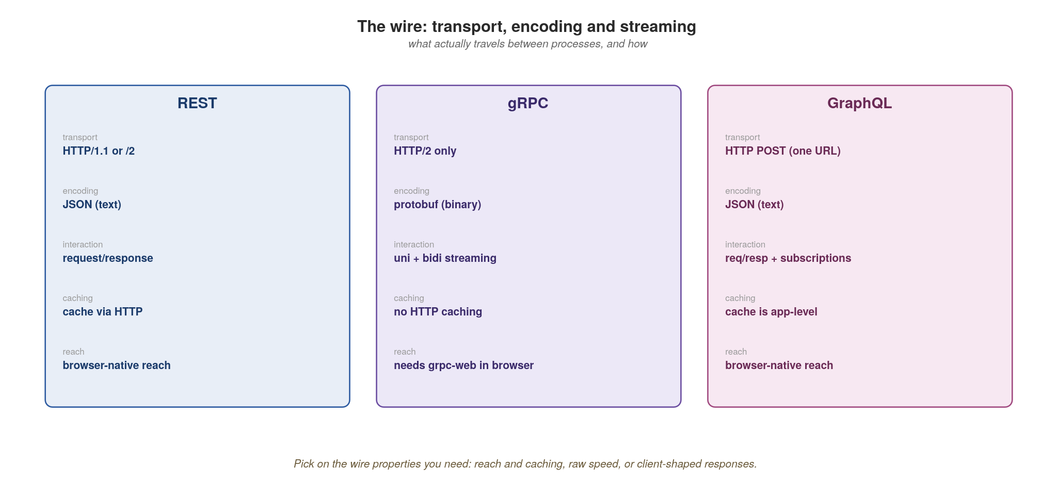
APPENDIX A · PROTOCOLS
The wire: transport, encoding and streaming
Reach and caching, or raw speed, or client-shaped responses — choose on the wire properties you need.
87
Notes:
What actually travels, and why it constrains your choice. REST: HTTP/1.1 or /2, JSON text, request/response, cacheable via standard HTTP, browser-native — maximum reach. gRPC: HTTP/2 only, protobuf binary, full uni- and bidirectional streaming, no HTTP caching, and it needs grpc-web to work from a browser. GraphQL: HTTP POST to a single URL, JSON, request/response plus subscriptions, caching is application-level (not HTTP), browser-native. The decision rule: if you need broad reach and HTTP caching, REST; if you need raw speed and streaming between services you control, gRPC; if you need client-shaped responses over many sources, GraphQL.

Slide 104
APPENDIX A · PROTOCOLS
Choosing between them in practice
Public or partner-facing, browser or third-party clients, caching matters → REST.
Internal service-to-service, low latency, high call volume, streaming → gRPC.
Aggregating many back-ends for varied clients that each want different fields → GraphQL at the gateway.
A fact that many consumers react to, decoupled in time → none of the above; emit an event.
Real systems use all four; standardizing on one wire for everything is itself an anti-pattern.
88
Notes:
The decision guide, said plainly. Public/partner/browser with caching → REST. Internal, hot, streaming → gRPC. Client-driven aggregation across back-ends → GraphQL at the gateway. A fact many consumers react to → don't make it a call at all, emit an event. The bold closing point ties back to the whole talk: forcing one protocol everywhere — 'we're a gRPC shop' or 'everything is GraphQL' — is itself an anti-pattern, because you'll be paying gRPC's browser tax or GraphQL's gateway complexity where a plain cacheable GET would have done.

Slide 105
APPENDIX A · PROTOCOLS
Common mistakes with each
REST: verbs in URLs (/createOrder), 200-for-everything, offset pagination, and ignoring cache headers.
gRPC: exposing it directly to browsers without grpc-web; treating it as REST-with-protobuf and ignoring streaming.
GraphQL: the N+1 resolver explosion; no query depth/complexity limits; using it for simple single-resource reads.
All three: leaking internal database models straight onto the wire, so you can never evolve them.
Async: using a queue when you needed a log (no replay), or a request when you needed a fact.
89
Notes:
The failure modes, drawn from real review comments. REST: verbs in URLs, returning 200 with an error body, offset pagination that breaks under load, and throwing away free HTTP caching. gRPC: trying to call it straight from a browser without grpc-web, or using it as 'REST with protobuf' and never touching its streaming superpower. GraphQL: the classic N+1 resolver explosion (fix with DataLoader batching), no depth or complexity limits so a malicious query melts the gateway, and reaching for it when a plain GET would do. The universal one is the last bold-adjacent: leaking your database schema onto the wire kills your ability to evolve — the same leaky-internal-models anti-pattern from section 12.

Slide 106
B
Appendix B · Versioning & Evolution
REST vs RESTful, proto breaking changes, GraphQL evolution.
Notes:
Appendix B answers the question every team fights about: how do we version this without breaking everyone? The answer differs sharply by protocol. REST has several strategies with real trade-offs; gRPC has precise wire-compatibility rules; GraphQL rejects versioning entirely in favour of evolution. We'll see each, with code.

Slide 107
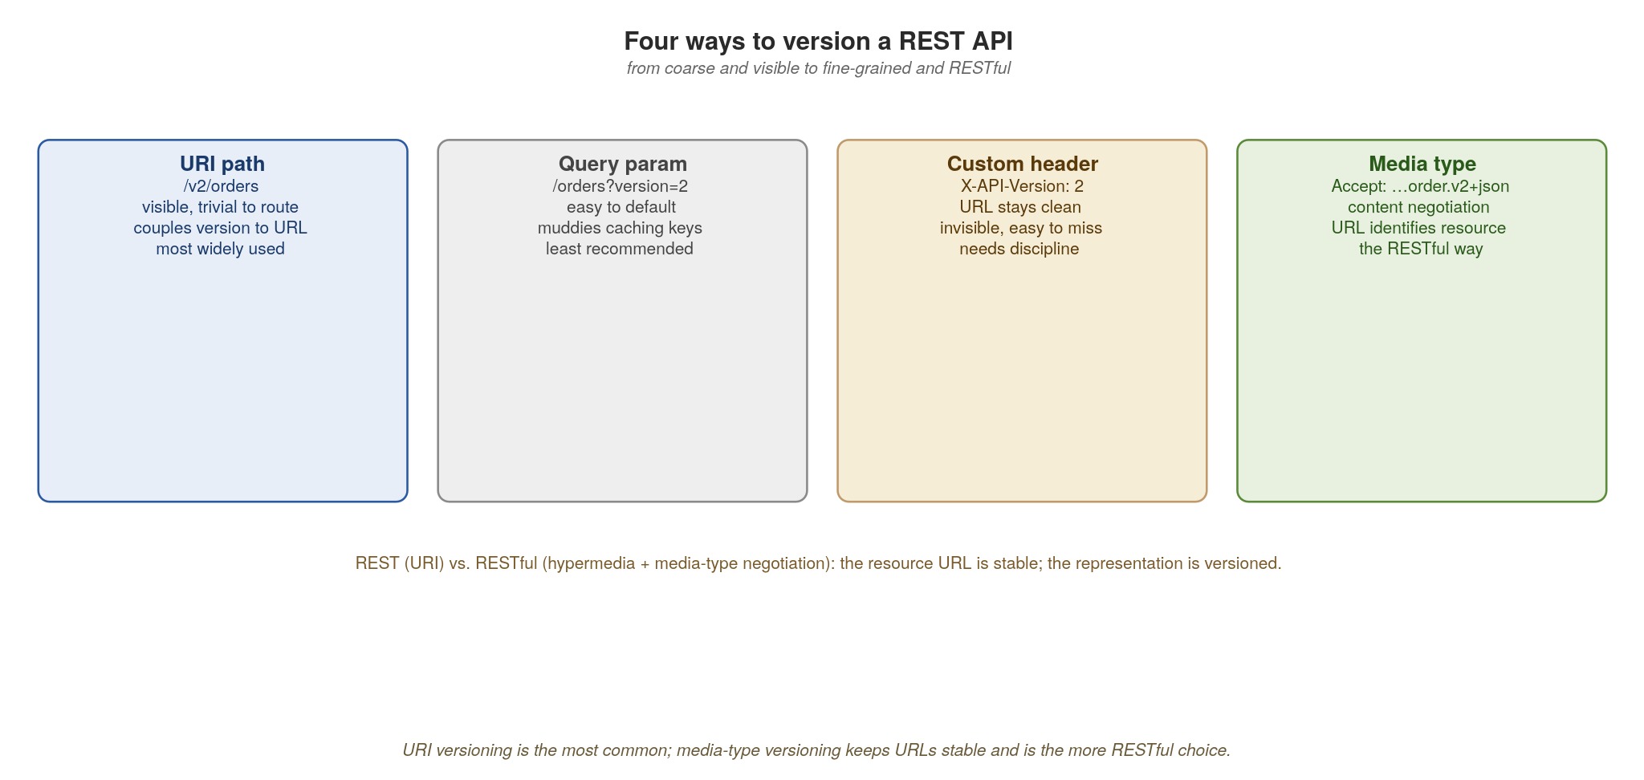
APPENDIX B · VERSIONING
Four ways to version a REST API
URI versioning is common and visible; media-type versioning keeps URLs stable — the more RESTful choice.
90
Notes:
REST has four strategies, ordered from coarse to fine. URI path (/v2/orders): visible, trivial to route, but couples the version to the URL and arguably breaks REST's idea that a URL identifies a resource, not a representation. Query param: easy to default but muddies caches. Custom header: keeps URLs clean but is invisible and easy to forget. Media-type versioning (Accept: application/vnd.acme.order.v2+json): content negotiation, the URL stays stable and identifies the resource, the representation is what's versioned — this is the genuinely RESTful approach. The honest take: URI versioning is the most common because it's pragmatic; media-type is the most correct. Know which you're choosing and why. Code on the next slide.

Slide 108
APPENDIX B · VERSIONING
Media-type versioning with ASP.NET Core
csharp · .NET 10 + Asp.Versioning
// Asp.Versioning.Http (Apache 2.0, by the .NET Foundation) supports media-type,
// URI segment, query string, or header versioning — picked centrally.
// Program.cs
builder.Services.AddApiVersioning(o => {
o.ApiVersionReader = new MediaTypeApiVersionReader("v"); // Accept header
o.DefaultApiVersion = new ApiVersion(1, 0);
o.AssumeDefaultVersionWhenUnspecified = true;
});
// Two records, two versions — the resource URL stays /orders/{id}
public record OrderV1(string Id, double Total);
public record OrderV2(string Id, double Total, string Currency);
// One handler, content-negotiated by API version (carried in Accept media-type)
var orders = app.MapGroup("/orders").WithApiVersionSet();
orders.MapGet("/{id}", (string id, IOrderService svc) =>
OrderV2.From(svc.Get(id)))
.HasApiVersion(2, 0)
.Produces<OrderV2>(StatusCodes.Status200OK,
"application/vnd.acme.order.v2+json");
orders.MapGet("/{id}", (string id, IOrderService svc) =>
OrderV1.From(svc.Get(id)))
.HasApiVersion(1, 0) // legacy default for old clients
.Produces<OrderV1>(StatusCodes.Status200OK,
"application/vnd.acme.order+json");
The resource URL is stable; the representation is negotiated. New clients ask for v2; old clients keep getting v1.
91
Notes:
ASP.NET Core has had a versioning library since the early Core days; in .NET 8+ it lives under the Asp.Versioning namespace (Apache 2.0, hosted by the .NET Foundation). The strategy is pluggable: MediaTypeApiVersionReader picks the version from the Accept media-type (the most RESTful choice), and you can swap in UrlSegmentApiVersionReader (path /v2/orders), QueryStringApiVersionReader, or HeaderApiVersionReader without changing your handlers. There's one URL for the order resource — it never changes. Two handler registrations share the path but declare different versions; ASP.NET Core's content negotiation routes to the right one based on the Accept header. New clients ask for the v2 media type and get the currency field; old clients send the default and get v1, completely unaffected. Contrast with /v2/orders, where you've now got two URLs for the same underlying thing. The OrderV1 / OrderV2 records are explicit representation DTOs — exactly the pattern that keeps your wire contract decoupled from your domain entity (a discipline WCF DataContracts taught you, but for HTTP).

Slide 109
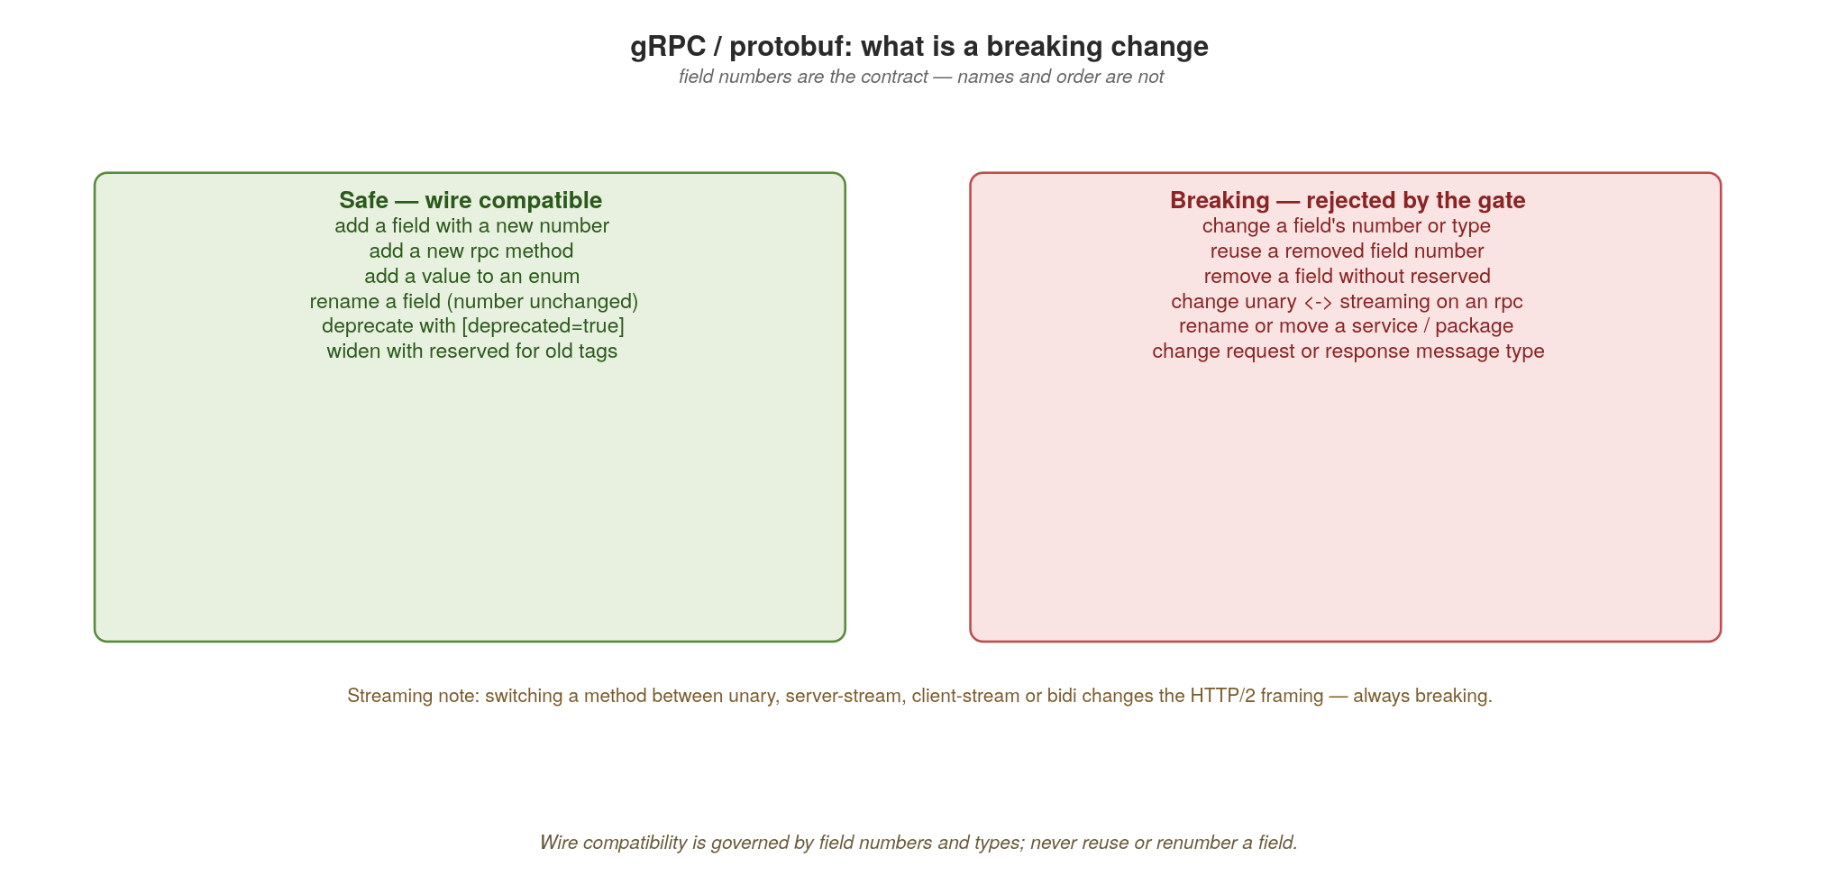
APPENDIX B · VERSIONING
gRPC / protobuf: what is a breaking change
Field numbers are the contract — names and order are not. Never reuse or renumber a field.
92
Notes:
gRPC's rules are precise because the wire format is positional. Safe, wire-compatible changes: add a field with a NEW number, add an rpc method, add an enum value, rename a field (the number is what matters, not the name), mark fields deprecated, and reserve removed tags. Breaking changes: change a field's number or type, reuse a removed number, remove a field without reserving its tag, rename or move a service or package, or change the request/response message type. The one people miss is on screen at the bottom: changing a method between unary and any streaming mode changes the HTTP/2 framing and is always breaking. The discipline: field numbers are forever; never reuse or renumber. Code shows safe evolution next.

Slide 110
APPENDIX B · VERSIONING
Evolving a .proto safely
protobuf
syntax = "proto3";
message Order {
string id = 1;
string sku = 2;
int32 qty = 3;
reserved 4; // tag 4 once held 'notes' — never reuse it
reserved "notes";
string currency = 5; // SAFE: brand-new field, new tag number
PaymentState state = 6; // SAFE: new field; old clients ignore it
}
enum PaymentState { PENDING = 0; PAID = 1; REFUNDED = 2; } // 0 must exist
// BREAKING (don't): qty -> int64, or moving 'sku' to tag 7, or reusing tag 4
Add with new tags, reserve what you remove, and never change an existing field's number or type.
93
Notes:
Walk the safe pattern. We removed an old 'notes' field — so we reserve both its tag number (4) AND its name, permanently, so nobody can ever reuse them and silently corrupt old data on the wire. We add currency and state as brand-new fields with new tag numbers; old clients simply ignore unknown fields, new clients read them — that's forward and backward compatibility for free. Note the enum must keep a zero value as its default. The comment at the bottom lists the things that would break the wire: widening qty's type, moving an existing field to a new tag, or reusing a reserved tag. Apicurio's compatibility check (section 9) enforces exactly these rules in CI.

Slide 111
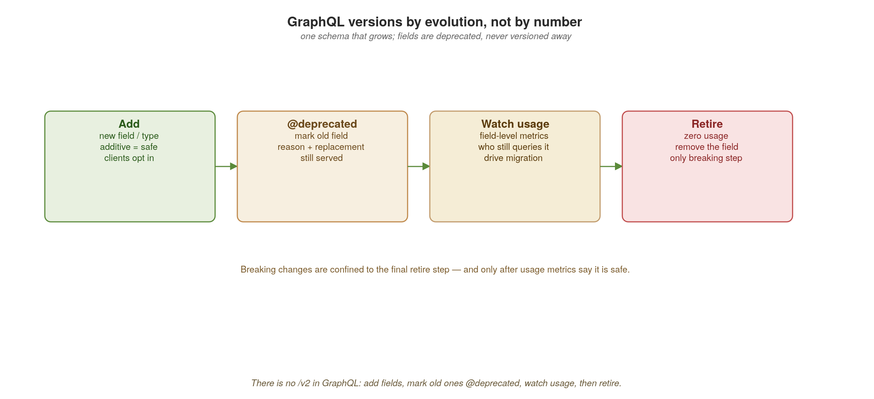
APPENDIX B · VERSIONING
GraphQL versions by evolution, not by number
There is no /v2 in GraphQL: add fields, mark old ones @deprecated, watch usage, then retire.
94
Notes:
GraphQL takes a completely different stance: there are no versions. There's one schema that evolves continuously. The lifecycle on screen: ADD new fields and types (additive is always safe — existing queries are unaffected because they didn't ask for the new field); mark superseded fields @deprecated with a reason and a pointer to the replacement, while still serving them; WATCH field-level usage metrics to see who still queries the old field and drive their migration; and only RETIRE — the single breaking step — once usage hits zero. The insight: GraphQL pushes you toward data-driven deprecation instead of big-bang version cutovers. Code shows the @deprecated directive next.

Slide 112
APPENDIX B · VERSIONING
Deprecating a field in HotChocolate
csharp + graphql · .NET 10 + HotChocolate
// HotChocolate is code-first by default in .NET; types are inferred from C# records
// and classes. Deprecation maps to the GraphQL native @deprecated directive.
public record Order(
string Id,
[GraphQLDeprecated("Use TotalMinor (integer cents) instead.")] // → @deprecated
double Total, // still served
int TotalMinor // replacement, additive
);
// Schema-first alternative — if your team prefers .graphql files:
// type Order {
// id: ID!
// total: Float @deprecated(reason: "Use totalMinor (integer cents) instead.")
// totalMinor: Int!
// }
// @deprecated surfaces in introspection and in HotChocolate's GraphQL IDE
// (Banana Cake Pop / Nitro) at /graphql with the reason.
// Field-level usage metrics — enable via .ModifyOptions(o => o.UseXmlDocumentation = true)
// and emit per-field counters through OpenTelemetry — tell you when 'Total' has zero
// callers. Only then do you remove it. No /v2 endpoint ever exists.
Additive change plus [GraphQLDeprecated] plus usage metrics replaces versioning entirely.
95
Notes:
The mechanics in HotChocolate. Code-first is the dominant style in .NET GraphQL: you write a C# record (or class) and HotChocolate infers the schema from your types. We add TotalMinor additively and mark the old Total field with [GraphQLDeprecated("reason")] — the attribute maps directly to GraphQL's native @deprecated schema directive. If your team prefers schema-first, the .graphql file syntax works identically and the C# resolvers bind to it. The field keeps working — nothing breaks — but the deprecation shows up in introspection, in any IDE plugin that reads the schema, and in HotChocolate's bundled GraphQL IDE (called Banana Cake Pop / Nitro) at /graphql. The crucial operational piece is the comment: you instrument field-level usage (HotChocolate has IDiagnosticEventListener hooks; pair with OpenTelemetry to push per-field counters), and you only remove Total when its usage drops to zero. That's the whole GraphQL philosophy — evolution governed by data, with the breaking removal deferred until provably safe. Three protocols, three genuinely different answers to the same problem.

Slide 113
APPENDIX B · VERSIONING
Principles that cut across all three
Additive change is always safe; removal and mutation are where you break people.
Make compatibility mechanical — the registry's BACKWARD/FORWARD/FULL rules, checked in CI, not by reviewers' memory.
Never break silently: deprecate with a reason, a replacement and a sunset date; measure who's still on the old version.
Run old and new in parallel and migrate consumers before retiring — retirement is the only step that can break.
Version data the same way you version APIs: event schemas in the registry follow the identical rules.
96
Notes:
Step back to the universal principles, because the protocol-specific rules all rhyme. Additive change is safe; removal and mutation break people — so design to add. Make compatibility mechanical: the registry's rules checked in CI, never a reviewer remembering. Never break silently — deprecate with a reason, a replacement, a sunset date, and measure who's still on the old thing. Run old and new in parallel and migrate before you retire, because retirement is the only inherently breaking move. And the bold line that connects this back to the event-driven section: your event schemas version by exactly the same rules — the registry treats an Avro schema and an OpenAPI spec identically. Versioning data and versioning APIs are the same discipline.

Slide 114
C
Appendix C · WebSockets at Scale
SignalR, pod pinning, the backplane, binary framing, reconnection — and where Blazor fits.
Notes:
Appendix C tackles the protocol we deliberately left out of the main interaction-styles discussion, because it behaves so differently on Kubernetes. WebSockets are long-lived, stateful and pinned to a Pod — the opposite of the stateless request model the platform assumes. We'll build one with SignalR (the de-facto .NET WebSocket library), see why it fights scaling, fix it with a Redis backplane (no Azure SignalR Service), make it fast and versioned with MessagePack, and make it survivable with reconnection. Then we close on Blazor — because Blazor Server sits on the SignalR pinning side of this discussion, and Blazor WebAssembly sits on the opposite side; both run on Kubernetes as plain ASP.NET Core Pods.

Slide 115
APPENDIX C · WEBSOCKETS
A WebSocket endpoint with SignalR
csharp · .NET 10 + SignalR
// SignalR ships in the box with ASP.NET Core — Apache 2.0, MIT-licensed
// runtime. Hub abstraction handles framing, heartbeats, reconnect, scaleout.
public class OrdersHub : Hub // one Hub per logical channel
{
private readonly IOrderService _orders;
public OrdersHub(IOrderService orders) => _orders = orders;
public override async Task OnConnectedAsync()
{
var userId = Context.UserIdentifier!; // server-side auth
await Groups.AddToGroupAsync(Context.ConnectionId, $"user:{userId}");
await base.OnConnectedAsync();
}
// client-callable method — invoked as connection.invoke('PlaceOrder', body)
public async Task<Order> PlaceOrder(OrderIn body) =>
await _orders.CreateAsync(body);
// server pushes to a group: every connection in user:42 gets the message
public async Task NotifyUser(string userId, OrderUpdate update) =>
await Clients.Group($"user:{userId}").SendAsync("OrderUpdated", update);
}
// Program.cs
builder.Services.AddSignalR(); // single line; protocols negotiated
app.MapHub<OrdersHub>("/ws/orders"); // mounts at /ws/orders
Declarative and easy — but Hub state lives in this Pod. The Groups dictionary, the Context registry, the heartbeats: all per-Pod. That single fact is the scaling problem.
97
Notes:
SignalR is .NET's WebSocket framework and one of the best in any language. The Hub abstraction handles a lot for you: connection lifecycle (OnConnectedAsync, OnDisconnectedAsync), heartbeats, automatic JSON/MessagePack protocol negotiation, transport fallback (WebSockets → Server-Sent Events → long polling), client-callable methods (RPC-style invocation), and server-pushed Groups. The client SDK (JavaScript, .NET, Java, Swift) gives you automatic reconnection with backoff out of the box — which is more than you'd typically build by hand. But point hard at the implicit state: the Groups dictionary, the connection registry, the per-connection heartbeats all live in THIS Pod's memory. SignalR's strength is the framework leans into per-Pod state by default — which is also why it scales poorly without a backplane. Every Hub instance is created per-invocation (transient) but the connection bookkeeping lives in the Pod-scoped IHubContext. The next few slides cover the pinning problem and the Redis backplane fix — no Azure SignalR Service needed, the open-source Redis backplane is built in.

Slide 116
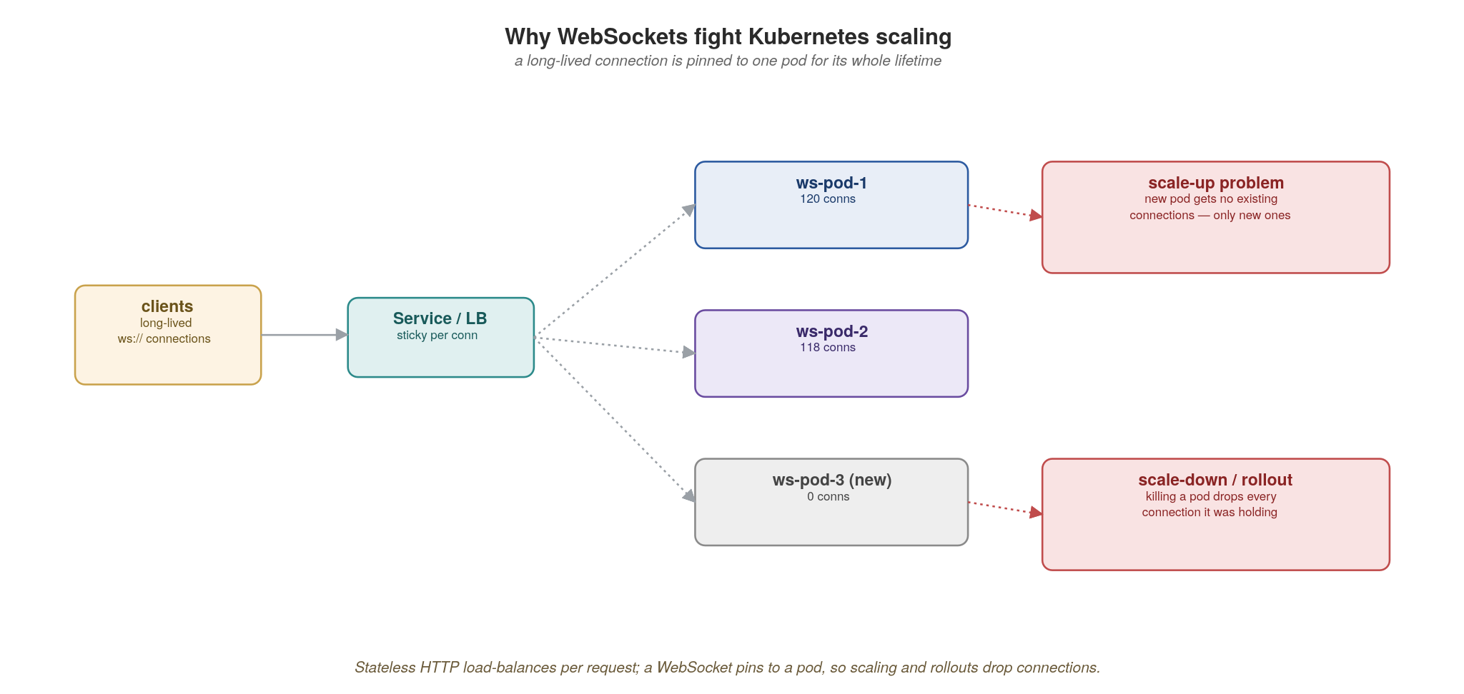
APPENDIX C · WEBSOCKETS
Why WebSockets fight Kubernetes scaling
A long-lived connection pins to one pod; new pods get no existing connections and scale-down drops them.
98
Notes:
Here's the collision with Kubernetes. A WebSocket connection, once established through the load balancer, is pinned to one pod for its entire lifetime. Two problems follow. Scale-up: the HPA or KEDA adds ws-pod-3, but it gets zero existing connections — only new ones — so a hot pod stays hot and the new pod sits idle; scaling doesn't relieve the load you already have. Scale-down and rollouts: terminating a pod severs every connection it was holding, so a routine deploy disconnects thousands of users at once. Stateless HTTP shrugs both off; WebSockets don't. The fix isn't to avoid scaling — it's to stop making any single pod the home of a conversation, which is the backplane.

Slide 117
APPENDIX C · WEBSOCKETS
The scaling problem, stated precisely
Pinning: a connection is bound to one pod; the LB can't move it without dropping it.
Uneven load: new replicas only receive new connections, so existing hotspots persist.
Rollouts hurt: every deploy or scale-down severs the connections on the affected pods.
Cross-pod delivery: to push to user X you must reach whichever pod holds X — which you don't track.
Connection limits & memory: each socket is held-open state; pods cap out on file descriptors, not CPU.
99
Notes:
Name the five distinct problems so the audience can recognize them. Pinning: the LB can't migrate a live socket. Uneven load: scaling adds capacity for new connections but doesn't rebalance existing ones. Rollouts hurt: every deploy is a mass disconnect event — you need graceful drain and client reconnection. Cross-pod delivery: to push a message to user X you must route to the specific pod holding X's socket, and nothing tracks that by default. And the resource shape is different — the bold point — you scale on open-connection count and file descriptors and memory, not CPU, so your KEDA/HPA trigger has to change too. Every one of these is solved or eased by the backplane on the next slide.

Slide 118
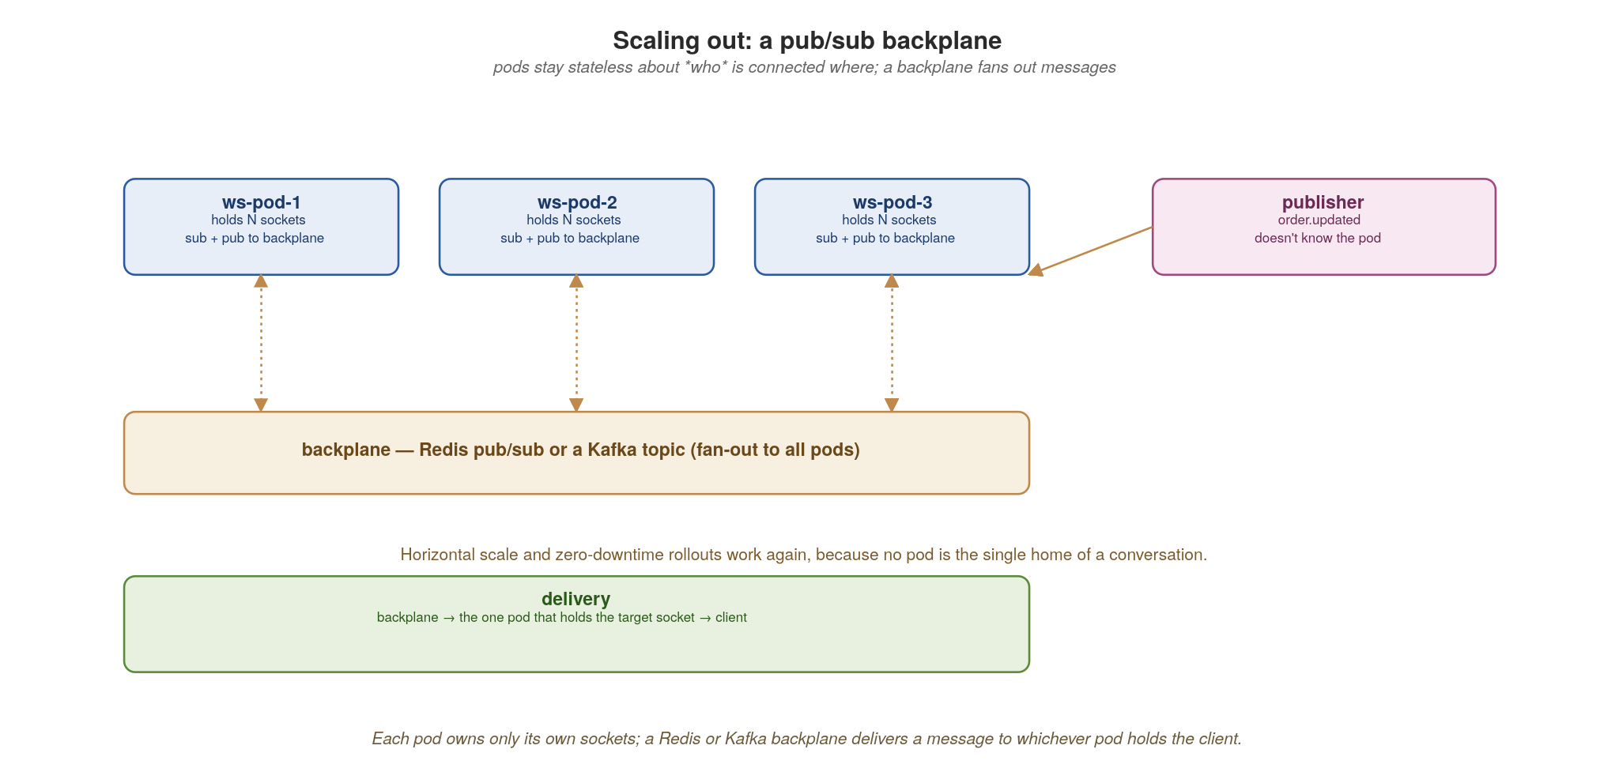
APPENDIX C · WEBSOCKETS
Scaling out: a pub/sub backplane
Each pod owns only its own sockets; a Redis or Kafka backplane fans a message out to whichever pod holds the client.
100
Notes:
The pattern that makes WebSockets horizontally scalable. Each Pod still owns only its own sockets — that's fine — but every Pod subscribes and publishes to a shared backplane: Redis pub/sub for low latency, or a Kafka topic if you want durability and replay. In SignalR specifically, this is one line of code: services.AddSignalR().AddStackExchangeRedis("redis:6379") wires up the Microsoft.AspNetCore.SignalR.StackExchangeRedis package (Apache 2.0). When a publisher calls Clients.User("X").SendAsync(…), the message goes to the backplane without knowing which Pod holds X; the backplane fans it to all Pods, and the one Pod that actually holds X's connection delivers it. Now scale-up and zero-downtime rollouts work again, because no Pod is the single home of a conversation — connections can land anywhere and still receive everything. Redis is the common open-source default; Kafka if you already run it and want the durability. Notably: we do NOT use Azure SignalR Service — that's the cloud-coupled option; the OSS Redis backplane is what runs on your own Kubernetes.

Slide 119
APPENDIX C · WEBSOCKETS
Binary framing with MessagePack — fast and versioned
csharp · .NET 10 + SignalR + MessagePack
// SignalR negotiates a hub protocol per connection: JSON (default) or MessagePack
// (binary, schema-evolution friendly via msgpack maps). Both shipped by Microsoft.
// Microsoft.AspNetCore.SignalR.Protocols.MessagePack — Apache 2.0.
// Program.cs
builder.Services.AddSignalR()
.AddMessagePackProtocol() // adds binary as a negotiated option
.AddStackExchangeRedis("redis:6379"); // backplane in one line
// Versioned envelope — same pattern as the .proto envelope, but in MessagePack:
[MessagePackObject]
public record Envelope(
[property: Key(0)] uint Version, // bump for incompatible payloads
[property: Key(1)] string Type, // "order.updated", "ping", …
[property: Key(2)] byte[] Payload, // MessagePack-encoded body
[property: Key(3)] ulong Seq); // monotonic per-connection — drives resume
public class OrdersHub : Hub
{
public async Task Send(Envelope env) // client invokes — binary on the wire
{
await Clients.Caller.SendAsync("Ack", new Envelope(
Version: 2, Type: "ack", Payload: [], Seq: env.Seq));
}
// client checks env.Version; unknown major version → reconnect & renegotiate
}
MessagePack frames are smaller and faster than JSON; the versioned envelope and seq number enable evolution and resume.
101
Notes:
Two wins in one slide. Performance: SignalR negotiates a hub protocol per connection — JSON by default, MessagePack when both client and server have AddMessagePackProtocol() registered. MessagePack binary frames are markedly smaller and cheaper to parse than JSON, meaningful when pushing high-frequency updates to many connections. The MessagePack-CSharp library (MIT) is already a dependency of the SignalR MessagePack protocol, and its source-generator-driven serialization is fast enough that JSON is rarely the right choice for high-throughput hubs. Versioning: because WebSocket messages have no URL to hang a version on, you version the envelope. A Version field lets the client detect an incompatible payload format and renegotiate; the Type field dispatches to the right typed payload; and — critically for the next slide — a monotonic Seq number per connection is what makes reconnection and replay possible. So the envelope solves both 'make it fast' and 'how do I version a socket message' at once. SignalR also supports custom hub protocols if MessagePack isn't enough — you can plug in protobuf with a small adapter — but for >95% of cases the built-in MessagePack option is the right call.

Slide 120
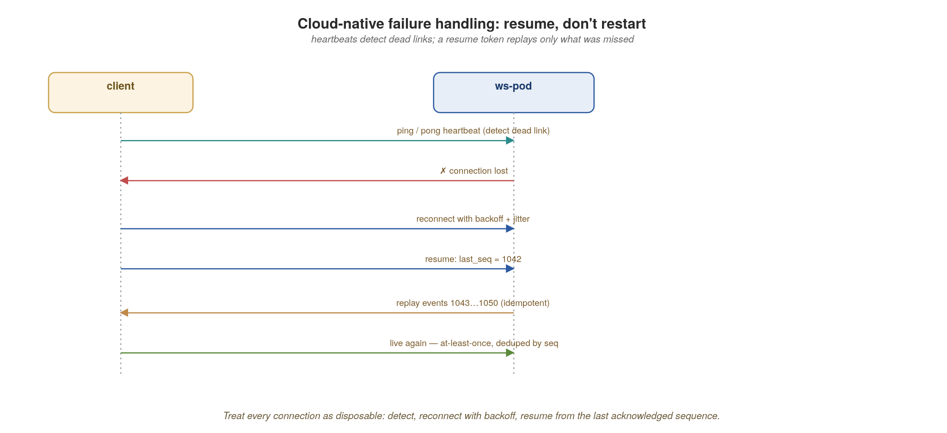
APPENDIX C · WEBSOCKETS
Failure handling: resume, don't restart
Heartbeats detect dead links; the client reconnects with backoff and resumes from the last acknowledged sequence.
102
Notes:
The cloud-native posture: treat every connection as disposable and design for its loss. Heartbeats (ping/pong) detect a dead link quickly — TCP alone can hang for minutes. When the connection drops, the client reconnects with exponential backoff plus jitter (so ten thousand clients don't reconnect in lockstep and hammer your pods after a rollout). On reconnect, the client sends its last-seen sequence number (last_seq = 1042); the server replays only the events the client missed (1043 onward), and because each frame carries a seq, the client can dedupe — so the whole thing is at-least-once and idempotent. The principle on screen: resume, don't restart. A reconnect should be invisible to the user, not a full state reload.

Slide 121
APPENDIX C · WEBSOCKETS
A cloud-native WebSocket checklist
Externalize fan-out to a backplane (Redis or Kafka); never assume one pod holds the client.
Scale and trigger on connection count and memory, not CPU; set realistic per-pod connection caps.
Drain gracefully on shutdown: stop accepting, signal clients to reconnect, let backoff spread the herd.
Heartbeat to detect dead links (SignalR ships keep-alive built in: KeepAliveInterval defaults to 15s, ClientTimeoutInterval to 30s); reconnect with exponential backoff + jitter (also built into the JS / .NET clients); resume via a per-connection seq.
Use binary frames with a versioned envelope; authenticate on connect and re-check on resume.
103
Notes:
The operational checklist to leave on screen. Externalize fan-out to a backplane so no pod is special. Scale and set your KEDA/HPA trigger on connection count and memory, not CPU, and cap connections per pod realistically. Drain gracefully on shutdown — stop accepting, tell clients to reconnect, and let backoff-with-jitter spread the reconnect storm across your rollout. Heartbeat to detect dead links fast; reconnect with backoff and jitter; resume from a per-connection sequence number so the user never notices. And the security note in bold that's easy to forget: authenticate on connect AND re-authenticate on resume, because a resume is a new TCP connection that could come from anywhere. Do these and WebSockets are just another well-behaved cloud-native workload.

Slide 122

APPENDIX C · WEBSOCKETS
Blazor on Kubernetes: Server vs WebAssembly
Two Blazor hosting models, two very different scaling profiles — both run on plain ASP.NET Core Pods, both open source, no Azure SignalR Service.
104
Notes:
Blazor deserves its own slide in this appendix because it sits on BOTH sides of the WebSocket scaling discussion. Walk the picture left to right. Blazor Server (left): a server-side ASP.NET Core process holds the user's component tree and view-model; a thin JS client renders DOM diffs streamed over a persistent SignalR WebSocket. Every UI interaction — every button click — is a round-trip. Every component instance is pinned to one Pod for its session lifetime. Calls to inventory, payment, etc. happen server-to-server. Once you scale to N Pods, you need a Redis backplane (one line: AddStackExchangeRedis), and every pinning / connection-count / drain concern from this appendix applies in full — it IS a WebSocket workload, just one that drives UI updates. Blazor WebAssembly (right): the entire .NET runtime ships to the browser as WebAssembly; your C# components run client-side; the Pod is just a static-file host (nginx or ASP.NET Core serving .wasm + .dll + .css + .html). No SignalR, no per-user server state, no backplane — scales like any other static site. The trade: WASM has a one-time download cost (.NET 8+ AOT trims it considerably; .NET 10 trims it further) and your APIs must be browser-callable (CORS, public auth, gRPC-Web instead of gRPC). The decision rule at the bottom: pick Server for line-of-business apps where you want server-side auth and real-time state with minimal client work; pick WebAssembly for offline, high-interactivity, or SEO-friendly client surfaces. Most production .NET shops run BOTH — Blazor Server for the admin console, Blazor WebAssembly for the customer-facing app. The cloud-native posture in either case: a containerised ASP.NET Core Pod, open-source Redis if needed, KEDA scaling on connections (Server) or RPS (WASM static host).

Slide 123
APPENDIX C · WEBSOCKETS
Choosing between Blazor Server and Blazor WebAssembly
Blazor Server — inherits everything in this appendix. SignalR-pinned; needs Redis backplane to scale (Microsoft.AspNetCore.SignalR.StackExchangeRedis, Apache 2.0); KEDA scales on connection count, not CPU; every deploy disconnects everyone.
Blazor WebAssembly — escapes everything in this appendix. No persistent connection; static-file host scales like nginx; deploys are an atomic file swap; client runs .NET in WASM with full C# capability.
Cost trade: Server has tiny client download but pays per-interaction round-trip latency and server-side memory per user. WebAssembly has a larger first-load (mitigated by AOT + trimming in .NET 8+, smaller again in .NET 10) but zero server state per user.
Auth trade: Server uses normal cookie / server-side identity (the WCF / IIS-era mental model). WebAssembly uses bearer tokens visible to the browser — OAuth2 / OIDC with public clients.
Both are MIT, both run on Kubernetes as plain ASP.NET Core Pods, both work without ANY Azure service — no Azure SignalR Service, no Azure App Service, no Azure Static Web Apps. Open Redis for the backplane is all you need.
105
Notes:
The take-home for the audience. For the WCF/IIS-era developer, Blazor Server feels familiar — server-side state, cookie auth, classic web app shape — which is both its appeal and its scaling problem. Blazor WebAssembly feels foreign at first (real client-side .NET running in a sandbox), but it scales the way the rest of cloud-native does: stateless static hosting + back-end APIs. There's no wrong answer; there are appropriate answers per workload. The bold final line is the one to leave up: nothing here requires Azure. SignalR is in-box ASP.NET Core. The Redis backplane is the StackExchangeRedis package (Apache 2.0) against any Redis (or Valkey, or KeyDB). The static-file host can be nginx or ASP.NET Core's UseStaticFiles. Hosting on Kubernetes is just two Deployments and two Services. If your team is moving off Azure App Service to Kubernetes, you don't lose Blazor — you just stop paying for Azure SignalR Service and run Redis yourself, with the same throughput characteristics.

Slide 124
D
Appendix D · Saga State & Compensation
Persisting state, compensating cleanly, and the step-B-needs-A's-data problem.
Notes:
Appendix D is the deep mechanics behind the saga slide in the Data section. Three hard parts that the happy-path picture glosses over: where the orchestrator actually keeps its state so it survives a crash, how compensation really works when a step fails midway, and a specific gnarly case people hit — when step B needs data that only step A produced, and how to resume after a crash between them.

Slide 125

APPENDIX D · SAGAS
Where a saga keeps its state
Memory won't survive a Pod restart — persist every step transition in a DB, an event log, or a workflow engine.
106
Notes:
First problem: the orchestrator must survive a crash mid-flow, so in-memory state is a non-starter — a Pod restart would strand every in-flight saga with no idea what to compensate. Three real options. A DB-backed state machine: one row per saga instance holding its status and a context blob; you own the transitions with EF Core — simplest, and great for most cases. Event-sourced: append each step as an event and rebuild state by replay — full audit history; Marten on Postgres is the natural .NET fit, or EF Core for hand-rolled. A workflow engine like Temporal: durable execution with retries and timers built in — most power, least code, but a new dependency to run. Stateless is a lighter in-process alternative we'll show side by side. For the WCF/COM+ audience: this slide is where MSDTC distributed transactions get permanently retired — you can't have a two-phase commit across services in this world, so you reach for compensation-based consistency instead. The cross-cutting rule on screen: the state transition and the outbound command must commit together (the outbox pattern again), or you get lost or duplicated steps.

Slide 126
APPENDIX D · SAGAS
A persisted saga state machine (EF Core)
csharp · .NET 10 + EF Core
// EF Core 10 + pessimistic row lock — the in-process saga state store.
// The PostgreSQL/SQL Server commit replaces what MSDTC used to make atomic.
static readonly string[] Steps = {
"charge_payment", "reserve_stock", "book_shipping" };
public class SagaCoordinator(SagaDbContext db) : ISagaCoordinator
{
public async Task AdvanceAsync(string sagaId, CancellationToken ct)
{
await using var tx = await db.Database
.BeginTransactionAsync(IsolationLevel.ReadCommitted, ct);
// pessimistic row lock so two workers can't advance the same saga
var s = await db.Sagas.FromSqlInterpolated(
$"SELECT * FROM sagas WHERE id = {sagaId} FOR UPDATE")
.FirstAsync(ct);
if (s.Status != "RUNNING") return; // idempotent: already done/failed
var step = Steps[s.StepIndex];
try {
var result = await InvokeAsync(step, s.Context, ct); // call the service
s.Context[step] = result; // accumulate output
if (++s.StepIndex == Steps.Length) s.Status = "DONE";
}
catch (StepException) {
s.Status = "COMPENSATING"; // hand off to the unwinder
}
await db.SaveChangesAsync(ct); // durable after every step
await tx.CommitAsync(ct);
}
}
One locked row per saga, advanced one durable step at a time. A crash just means 'load the row and call AdvanceAsync again.'
107
Notes:
This is the DB-backed option made concrete with EF Core — the one I'd reach for first when the saga is bounded and I want to own the transitions. Key ideas: one Saga entity row, loaded with a pessimistic lock (FOR UPDATE in Postgres, equivalent in SQL Server) so two workers can't advance the same saga concurrently. The status guard makes AdvanceAsync idempotent — calling it on a finished saga is a no-op, which matters because retries and redeliveries will call it again. Each successful step accumulates its result into the Context dictionary (remember that — it's the whole point of the data-dependency slide) and bumps the step index; the EF Core SaveChangesAsync makes the row durable after every step. Recovery is beautifully boring: a BackgroundService with PeriodicTimer (or Quartz.NET on a cron) plus DistributedLock loads RUNNING sagas and calls AdvanceAsync again — the cloud-native equivalent of a Windows Service that processed an MSMQ queue. If you want the managed alternative, the next few slides show Temporal .NET and Stateless — same problem, different point on the build-vs-buy spectrum.

Slide 127

APPENDIX D · SAGAS
Compensating transactions unwind a failed saga
Each committed step has an inverse; on failure they run in reverse order — there is no cross-service rollback.
108
Notes:
Compensation is how a saga 'rolls back' when there's no actual rollback available across services. Each forward step that committed — payment.charge, inventory.reserve — has a defined semantic inverse: payment.refund, inventory.release. When book_shipping fails, you don't undo a database transaction (the payment really happened at the provider); you run the compensations for the already-committed steps, in reverse order, newest first. Two things that bite people, both on screen: compensations must themselves be idempotent and durable, because a crash mid-unwind has to resume cleanly; and a compensation can itself fail, so it needs its own retries. The saga ends in a persisted FAILED state with a full audit trail of what was done and undone.

Slide 128
APPENDIX D · SAGAS
Running compensations in reverse
csharp · .NET 10 + EF Core
static readonly Dictionary<string, string> Compensations = new() // inverse per step
{
["charge_payment"] = "refund_payment",
["reserve_stock"] = "release_stock",
["book_shipping"] = "cancel_shipping",
};
public async Task CompensateAsync(string sagaId, CancellationToken ct)
{
await using var tx = await db.Database
.BeginTransactionAsync(IsolationLevel.ReadCommitted, ct);
var s = await db.Sagas.FromSqlInterpolated(
$"SELECT * FROM sagas WHERE id = {sagaId} FOR UPDATE").FirstAsync(ct);
// undo only the steps that actually completed, newest first
foreach (var step in Steps.Take(s.StepIndex).Reverse())
{
await InvokeAsync(Compensations[step], s.Context,
idempotencyKey: $"{sagaId}:{step}", ct); // safe to retry
}
s.Status = "FAILED";
await db.SaveChangesAsync(ct);
await tx.CommitAsync(ct);
}
Compensate only completed steps, in reverse, with an idempotency key so a retry never double-refunds.
109
Notes:
The compensation logic. A simple dictionary gives each forward step its inverse. We iterate the completed steps (Take(StepIndex) then Reverse) and invoke each compensation. The idempotency key built from sagaId plus step is the line that prevents the nightmare scenario: a retry double-refunding a customer. The compensating service dedupes on that key. In production you'd track per-step compensation status too, so if compensation itself crashes halfway you resume from the right place — but the idempotency key makes even naive re-runs safe. This is why compensations are designed up front, as part of each step, not bolted on after. For this audience: this REPLACES the old MSDTC rollback semantics — in a distributed system the 'transaction' is the saga, the 'rollback' is the compensation sequence, and the 'commit' is when the last step succeeds. If you use Temporal .NET instead, its Saga utility (Saga.AddCompensation / Saga.CompensateAsync via the Workflow runtime) drives the unwind for you with the same guarantees; the next few slides show it.

Slide 129

APPENDIX D · SAGAS
When step B needs data only step A produced
Don't make B call A. Persist A's output into the saga context and pass it forward; on resume, read it back.
110
Notes:
This is the specific case you asked about, and it's a genuinely common source of bad designs. The orchestrator calls service A, then service B — but B needs a value that only A produced (say A returns a reservation_id and a warehouse region that B requires to proceed). The tempting wrong answer is to have B call A directly — now you've created a hidden synchronous dependency between B and A, exactly the chatty coupling the whole architecture fights. The right answer is on screen: the orchestrator owns a saga context (a 'blackboard'), persists A's output into it after step A, and passes the needed values into B's call. B never knows A exists. And note this is already in our state-machine code — that 's.Context[step] = result' line is exactly this. Temporal .NET does the same automatically through its workflow input/output passing; Stateless does it via the OnTransitioned listener that lets you write the payload into the saga's persisted state.

Slide 130
APPENDIX D · SAGAS
Two ways to make a saga durable without rolling your own
When you outgrow the hand-rolled EF Core state machine, you have two well-trodden open-source paths in the .NET ecosystem — both featured in the diagrams that follow.
Temporal .NET SDK — a durable execution engine (Temporal Server MIT, .NET SDK Apache 2.0, on NuGet as Temporalio.Temporal). You write workflows and activities as plain C#; the Server persists every event and replays them deterministically on recovery. Most power, separate cluster to run.
Stateless — a tiny in-process state-machine library (Apache 2.0). States, triggers, transitions, guards, entry/exit actions; you persist the current state to your own DB. Lighter weight, no extra cluster, less ceremony. MassTransit Sagas is a closely-related alternative if you're already on MassTransit for events.
Decision rule: reach for Temporal when the saga is long, complex, or shared across services and you want first-class retries, timers, signals and child workflows. Reach for Stateless when it's small, in-process and you'd rather keep one fewer thing to operate.
Sidebar: Dapr Workflows is a third option if your platform already runs Dapr sidecars (CNCF Incubating, MIT) — same durable-execution model as Temporal, exposed via the Dapr sidecar instead of a direct SDK. Use it when the team's already invested in Dapr.
111
Notes:
Frame the choice as 'managed durability vs. lightweight in-process,' both open source, both production-grade. Temporal: founded by the original Cadence team, MIT-licensed Server and Apache-2.0 .NET SDK, very actively maintained (multi-language SDK family, mature .NET binding shipping on NuGet as Temporalio.Temporal). You get durable execution, deterministic replay, automatic retries with backoff, timers, sagas with built-in compensation helpers, child workflows, signals/queries, and a CLI/UI to inspect runs — the cost is operating a Temporal cluster on your own Kubernetes (no SaaS required, but you can choose Temporal Cloud if you prefer not to operate it yourself). Stateless: a tiny in-process .NET state-machine library (a community project, not from MS). No extra cluster; you persist the CurrentState property to your own DB (one column!), restore it before firing the next trigger. Better when the saga is small, the team is already deep in EF Core, and adding another runtime is overkill. MassTransit Sagas is the closely-related alternative when you're already using MassTransit — same Configure → States → Events pattern, integrated with the message bus. Dapr Workflows is mentioned as a sidebar because it's a genuine third option, but explicitly NOT the centre of this deck — use Dapr when your environment already commits to the sidecar pattern. The bold decision rule is what to leave audience with: it's not Temporal vs Stateless in a vacuum, it's 'how much engine do I need for THIS saga.'

Slide 131

APPENDIX D · SAGAS
Temporal .NET: your saga is plain C#, the Server makes it crash-proof
Worker (your ASP.NET Core BackgroundService) runs Workflow + Activity code; the Temporal Server persists every event and replays deterministically.
112
Notes:
Walk the picture. Three boxes. On the left, your client — a REST handler in an ASP.NET Core app — injects ITemporalClient and calls StartWorkflowAsync(…) to kick off a workflow. In the middle, the Temporal Server: a cluster of Frontend, Matching and History services backed by Postgres (or MySQL / Cassandra) that persists every workflow event — every activity invocation, every result, every timer firing — so the workflow can be reconstructed from scratch by replay. On the right, the Worker: another ASP.NET Core app where you implement the workflow as a regular C# class annotated [Workflow] with a [WorkflowRun] method, and activities as plain C# classes annotated [Activity]. The worker runs as a BackgroundService that polls a task queue, gets the next workflow task, executes the next deterministic step. Crash the worker mid-flow and Temporal reissues the task to another worker, which replays history and resumes exactly where you were — no lost steps, no double-charges. That's durable execution. For this audience: think of it as 'BizTalk orchestration done right, open-source, polyglot, on Kubernetes' — except the workflow is just C# code with normal IDE tooling and unit testing, not a BizTalk visual designer. The bottom captions confirm the open-source posture: Temporal Server is MIT, the .NET SDK is Apache 2.0, both running on your Kubernetes if you want, no SaaS lock-in.

Slide 132
APPENDIX D · SAGAS
Temporal .NET workflow + activity, in ASP.NET Core
csharp · Temporalio.Temporal + ASP.NET Core
// 1) Activity classes — plain C# methods, registered with the worker
public class PaymentActivity
{
[Activity] public async Task<string> ChargeAsync(SagaInput input) =>
await _payments.ChargeAsync(input);
[Activity] public async Task RefundAsync(string paymentId) =>
await _payments.RefundAsync(paymentId);
}
// 2) Workflow class — plain C#, deterministic; runs in the Worker
[Workflow]
public class FulfillmentWorkflow
{
[WorkflowRun]
public async Task<string> RunAsync(SagaInput input)
{
var saga = new Saga(); // SDK helper for compensations
try
{
var paymentId = await Workflow.ExecuteActivityAsync(
(PaymentActivity a) => a.ChargeAsync(input),
new() { StartToCloseTimeout = TimeSpan.FromSeconds(10) });
saga.AddCompensation(() => Workflow.ExecuteActivityAsync(
(PaymentActivity a) => a.RefundAsync(paymentId), new()));
var reservationId = await Workflow.ExecuteActivityAsync(
(InventoryActivity a) => a.ReserveAsync(input, paymentId), new());
saga.AddCompensation(() => Workflow.ExecuteActivityAsync(
(InventoryActivity a) => a.ReleaseAsync(reservationId), new()));
return await Workflow.ExecuteActivityAsync(
(ShippingActivity a) => a.BookAsync(input, reservationId), new());
}
catch (ActivityFailureException)
{
await saga.CompensateAsync(); // unwinds in reverse order
throw;
}
}
}
Workflow + Activities are plain C# classes; Temporal's built-in Saga helper owns the unwind. State is durable on the Server.
113
Notes:
This is the whole story on one slide. Activity classes are plain C#; methods annotated [Activity] are registered with the worker at startup. The Workflow class is annotated [Workflow] with one [WorkflowRun] entry point; the body is plain C# that LOOKS synchronous but every activity call goes through Temporal's task queue and is durably scheduled, retried (configurable retry policy on the ActivityOptions), and timed-out on the Server. The output of each activity (paymentId, reservationId) is captured in a workflow-local variable AND in Temporal's event history; if the worker dies between charge and reserve, a replacement worker replays history, recovers paymentId, and continues at reserve without re-running charge. Note the Saga helper from the Temporal .NET SDK: AddCompensation registers an undo for each completed step, and saga.CompensateAsync() runs them in reverse on failure — the same compensation discipline from earlier, but built into the SDK. Bootstrapping in ASP.NET Core: register the Temporal client (services.AddTemporalClient), register a TemporalWorker as a BackgroundService that points at your Temporal Server, list the workflow types and activity instances. The Temporalio.Extensions.Hosting NuGet package does most of that wiring — the WorkerService is just another IHostedService in your app.

Slide 133

APPENDIX D · SAGAS
Stateless: lighter, in-process, no extra cluster
States, triggers, transitions, guards — plus a tiny serialization of CurrentState to save/restore across crashes.
114
Notes:
Walk the picture. The top row IS the saga as a state machine: Created → Paid → Reserved → Shipped → Done, with each transition triggered by an event (PayOk, ReserveOk, ShipOk, Delivered). On StepFail at any point, the machine drops down into the Compensating state and ultimately Failed — the same compensation discipline expressed as state transitions. Below: three pieces. The StateMachine<TState, TTrigger> itself, configured in a small builder method via the Stateless package's fluent API — you declare states, transitions, guards (predicates that gate a transition), entry/exit actions (code that runs on a transition, where you'd call _payments.ChargeAsync or _inventory.ReserveAsync), and OnTransitioned listeners for notifications. The 'persist state yourself' block is the lightweight bit: serialize the CurrentState property to a single column in your saga row using EF Core or Dapper, restore it before firing the next trigger. No persister framework needed. And on the right, the code that drives the machine: await sm.FireAsync(Trigger.PayOk, payload) runs guards, actions, transitions, and the OnTransitioned hook writes the new state to your DB. The whole thing runs in-process inside your ASP.NET Core app — no extra cluster, Apache-2.0 open source. The MassTransit Sagas callout is for shops already using MassTransit: it gives you the same state-machine + persister + bus integration but with one more framework on the dependency list.

Slide 134
APPENDIX D · SAGAS
Stateless: configure and drive
csharp · Stateless package + EF Core
public enum State { Created, Paid, Reserved, Shipped, Done, Compensating, Failed }
public enum Trigger { PayOk, ReserveOk, ShipOk, Delivered, StepFail }
// 1) Configure the machine — states, triggers, actions
public class FulfillmentSagaMachine
{
private readonly StateMachine<State, Trigger> _sm;
public State CurrentState => _sm.State;
public string OrderId { get; }
public FulfillmentSagaMachine(string orderId, State initial,
IPaymentService payments,
IInventoryService inventory,
IShippingService shipping)
{
OrderId = orderId;
_sm = new StateMachine<State, Trigger>(initial);
_sm.Configure(State.Created)
.Permit(Trigger.PayOk, State.Paid)
.OnEntry(() => payments.ChargeAsync(orderId));
_sm.Configure(State.Paid)
.Permit(Trigger.ReserveOk, State.Reserved)
.Permit(Trigger.StepFail, State.Compensating)
.OnEntry(() => inventory.ReserveAsync(orderId));
_sm.Configure(State.Reserved)
.Permit(Trigger.ShipOk, State.Shipped)
.OnEntry(() => shipping.BookAsync(orderId));
_sm.Configure(State.Compensating)
.Permit(Trigger.StepFail, State.Failed)
.OnEntry(() => CompensateAsync(orderId));
}
public Task FireAsync(Trigger t) => _sm.FireAsync(t);
}
// 2) Drive it — events come from REST, Kafka, anywhere
public class FulfillmentService(SagaDbContext db, ISagaActivityResolver resolver)
{
public async Task OnAsync(string orderId, Trigger trigger, CancellationToken ct)
{
var row = await db.Sagas.FindAsync([orderId], ct); // restore state
var sm = resolver.Build(orderId, row!.CurrentState);
await sm.FireAsync(trigger); // run transition
row.CurrentState = sm.CurrentState;
await db.SaveChangesAsync(ct); // save new state
}
}
All in your ASP.NET Core process: states + triggers declared, entry actions invoke services, CurrentState persisted to your own DB.
115
Notes:
Everything in one place. The FulfillmentSagaMachine wraps a Stateless StateMachine<State, Trigger> with enums for both type parameters — type-safe states, type-safe triggers, refactor-friendly. Configure() declares each state's permitted transitions and entry actions (OnEntry runs business logic when the state is entered, where you'd call payment.ChargeAsync). The Permit chain is the readable equivalent of the state-diagram you saw on the previous slide. The FulfillmentService.OnAsync() method is the entry point — it gets called from an [HttpPost] handler or a MassTransit consumer, restores the saga's prior state by orderId from EF Core, rebuilds the state machine in that state, fires the trigger (which runs guards, entry actions, and transitions), then saves the new CurrentState to the DB. The transactional discipline is yours — wrap in a DbContext transaction so the action's effects and the state save commit together — exactly the same commit-together discipline as the hand-rolled EF Core version a few slides back, just with a typed state machine on top. The trade-off vs Temporal: less ceremony (no separate server), but you don't get automatic retries, timers or replay-on-crash; you write recovery logic (the BackgroundService sweeper from the earlier slide still applies). Use this when the saga is bounded in-process and the team already lives in .NET — it's the smallest sensible step up from the hand-rolled state machine. If you want the same DSL but integrated with the message bus, MassTransit Sagas (Apache 2.0) wraps a similar state-machine model with bus-aware persistence and event correlation — same idea, more framework.

Slide 135
E
Appendix E · API Error Handling
One discipline, four wire formats.
Notes:
Appendix E. Error handling is where cloud-native systems quietly fall apart — not in the happy path. The thesis: agree ONE error contract (a stable machine code, a safe human message, a correlation id, a retryable flag, field details) and then map that same model onto REST, gRPC, Kafka and GraphQL. We finish on the failure mode that turns a blip into an outage — the retry storm — and the handful of controls that prevent it.

Slide 136

APPENDIX E · ERRORS
One error model, four wire formats
The same five facts in every error; only the encoding changes per protocol.
116
Notes:
Start with what every error must carry, regardless of protocol: a STABLE machine-readable code clients can branch on (not a localized string), a human-readable message safe to show, a correlation/trace id that ties the error to the distributed trace from section 11, a retryable flag (with retry-after when known), and structured field-level details. The four protocols just encode those same five facts differently — REST as problem+json, gRPC as status+details, Kafka via headers and a DLQ record, GraphQL as an errors[] entry with extensions. Agree this once as a shared contract; never leak stack traces or internal type names to callers.

Slide 137

APPENDIX E · ERRORS
REST: status, then Problem Details
The status code is the category; the problem+json body carries the machine code and specifics.
117
Notes:
REST has two layers. First the HTTP status CLASS, which is the category and drives client behaviour: 4xx means the client must fix the request and should not blindly retry; 429 and 503 mean 'busy' and must be paired with a Retry-After header so clients back off; 5xx means a server fault that idempotent calls may retry with backoff. Second, the body: RFC 9457 Problem Details (application/problem+json, which superseded RFC 7807) gives a standard envelope — type, title, status, detail, instance — and you extend it with your stable code and the traceId. Status for the category, body for the specifics.

Slide 138
APPENDIX E · ERRORS
REST errors with ASP.NET Core ProblemDetails
csharp · .NET 10 + IExceptionHandler
// ProblemDetails (RFC 9457) ships in the box with ASP.NET Core since .NET 6.
// .NET 8 added IExceptionHandler — the central mapping seam for typed exceptions.
// Program.cs
builder.Services.AddProblemDetails(); // standard problem+json output
builder.Services.AddExceptionHandler<DomainExceptionHandler>();
app.UseExceptionHandler(); // wires up the chain
// One place: domain → wire (the single global exception-to-response seam)
public class DomainExceptionHandler : IExceptionHandler
{
public async ValueTask<bool> TryHandleAsync(HttpContext ctx, Exception ex,
CancellationToken ct)
{
var (status, problem) = ex switch
{
StockException s => (StatusCodes.Status409Conflict,
new ProblemDetails {
Type = "https://errors.acme.io/stock",
Title = "Insufficient stock",
Status = StatusCodes.Status409Conflict,
Detail = s.Message,
Extensions = {
["code"] = "STOCK_UNAVAILABLE", // stable
["traceId"] = Activity.Current?.TraceId.ToString(),
}
}),
_ => (StatusCodes.Status500InternalServerError, new ProblemDetails())
};
ctx.Response.StatusCode = status;
await ctx.Response.WriteAsJsonAsync(problem, ct);
ctx.Response.ContentType = "application/problem+json"; // RFC 9457
return true;
}
}
ProblemDetails + IExceptionHandler give you RFC 9457 out of the box — stable code, safe message, trace id; never a raw stack trace.
118
Notes:
ASP.NET Core has had ProblemDetails (RFC 9457) built into Microsoft.AspNetCore.Mvc since .NET 6 — the wire format, the media type (application/problem+json), and the integration with minimal APIs (Results.Problem) and controllers ([ProducesProblemDetails]) are all included. The IExceptionHandler interface added in .NET 8 is the central mapping seam — register one or more, each one inspects the exception and returns true if it handled it, false to defer to the next. Use it for domain-to-wire mapping so you never scatter ad-hoc error JSON across handlers. The status matches the category (409 here — a conflict the client can act on), and Extensions carries the stable machine code and the W3C trace id from System.Diagnostics.Activity for correlation. What's deliberately absent: any stack trace, exception class name, or SQL — those leak internals and are an attack surface (and the WCF-era habit of returning SoapFault detail with full stack traces is exactly what this replaces). For validation specifically, ValidationProblemDetails is the typed subclass and Results.ValidationProblem the minimal-API helper.

Slide 139

APPENDIX E · ERRORS
gRPC: status codes + rich details
A small fixed set of canonical codes, plus structured google.rpc.Status details in the trailers.
119
Notes:
gRPC gives you a small, fixed set of canonical status codes — and choosing the right one IS the contract, because clients (and the Istio mesh) decide retry behaviour from it. INVALID_ARGUMENT and NOT_FOUND are client bugs: don't retry. FAILED_PRECONDITION and ALREADY_EXISTS are state issues: don't retry. UNAVAILABLE and ABORTED are transient: retry with backoff. RESOURCE_EXHAUSTED means you're being rate-limited — honour the RetryInfo delay. DEADLINE_EXCEEDED means tune the timeout. Beyond the code, attach a google.rpc.Status in the trailers with rich details — ErrorInfo (machine reason + domain) and RetryInfo (how long to wait) — so the client gets the same five facts as everywhere else.

Slide 140
APPENDIX E · ERRORS
gRPC errors with rich status details
csharp · grpc-dotnet + Google.Rpc
using Grpc.Core;
using Google.Rpc; // ErrorInfo, RetryInfo, Status
public override async Task<ReserveReply> ReserveStock(
ReserveRequest req, ServerCallContext context)
{
if (_inventoryDown)
{
var status = new Google.Rpc.Status
{
Code = (int)Code.Unavailable, // canonical code
Message = "inventory temporarily down",
Details =
{
Any.Pack(new ErrorInfo {
Reason = "STOCK_DOWN", Domain = "inventory" }),
Any.Pack(new RetryInfo {
RetryDelay = Duration.FromTimeSpan(TimeSpan.FromSeconds(2)) }),
}
};
// grpc-dotnet: throw RpcException with the rich status in trailers
throw status.ToRpcException(); // extension from Grpc.StatusProto
}
return ToReply(await _stock.ReserveAsync(req));
}
Pick the canonical code (Unavailable = retryable) and attach ErrorInfo + RetryInfo so clients back off correctly.
120
Notes:
This is grpc-dotnet's standard rich-error model — the same wire shape as every other gRPC stack because google.rpc.Status is the cross-language contract. The canonical code Unavailable tells the client and the mesh this is transient and retryable; the Status carries structured details — ErrorInfo with a machine reason and domain, and RetryInfo telling the client exactly how long to wait. The Grpc.StatusProto NuGet package provides the ToRpcException extension that packs the rich Status into the trailers, and throwing the RpcException signals the failure. For the audience: this is the gRPC equivalent of WCF's FaultException<T> with a fault contract — except the contract is google.rpc.Status (standard across languages), the codes are canonical, and the mesh (Istio) can act on them. The key discipline: don't overload a generic Internal code for everything — the code is how automated clients and Istio decide whether and when to retry, so getting it right is what prevents both lost work and retry storms.

Slide 141

APPENDIX E · ERRORS
Kafka: retry topics and a dead-letter queue
Commit the offset, route the failed record aside, and keep consuming — a poison record never blocks the partition.
121
Notes:
Kafka error handling has a failure mode unique to logs: a single poison record can block the whole partition forever if you keep retrying it in place, because the offset never advances — head-of-line blocking that stalls every record behind it. The fix is to move failures aside: try a bounded number of in-place retries, then route the record to a delayed-retry topic (reprocessed after a delay without blocking the live stream), and after N attempts send it to a dead-letter queue for humans or tooling. Crucially, you commit the offset either way, so the main consumer keeps making progress. With MassTransit this is declarative configuration (UseMessageRetry + UseInMemoryOutbox + routing to a faulted-message endpoint), not hand-rolled plumbing.

Slide 142
APPENDIX E · ERRORS
Kafka retry + DLQ with MassTransit
csharp · .NET 10 + MassTransit + Confluent.Kafka
// MassTransit treats Kafka topics as receive endpoints with full retry policies
// (in-process) and redelivery policies (delayed retry via scheduler).
builder.Services.AddMassTransit(x =>
{
x.AddConsumer<OrderConsumer>(cfg =>
{
cfg.UseMessageRetry(r => // in-place retries
r.Exponential(retryLimit: 3,
minInterval: TimeSpan.FromMilliseconds(200),
maxInterval: TimeSpan.FromSeconds(5),
intervalDelta: TimeSpan.FromMilliseconds(500))
.Ignore<ValidationException>()); // 4xx → fault now
cfg.UseScheduledRedelivery(r => // delayed-retry topics
r.Intervals(TimeSpan.FromSeconds(5),
TimeSpan.FromSeconds(30),
TimeSpan.FromMinutes(5)));
});
x.UsingKafka((ctx, k) =>
{
k.Host("kafka:9092");
k.TopicEndpoint<Order>("orders", "order-group", e =>
{
e.ConfigureConsumer<OrderConsumer>(ctx);
// faulted messages → orders_error topic automatically
});
});
});
public class OrderConsumer(IEmailSender mail) : IConsumer<Order>
{
public Task Consume(ConsumeContext<Order> ctx) => mail.SendAsync(ctx.Message);
// retry policy fires; exhausted → redelivery; exhausted again → _error topic
}
UseMessageRetry + UseScheduledRedelivery + automatic _error topic — declaratively, so a poison record can't stall the partition.
122
Notes:
MassTransit wires this up declaratively. UseMessageRetry gives bounded in-place retries with exponential backoff (200ms initial, doubling, capped at 5s, 3 attempts) and an explicit ignore list — ValidationException is non-retryable, so it skips straight to the fault path (no point retrying a 4xx). UseScheduledRedelivery adds the delayed-retry-topic dimension on top: when in-place retries are exhausted, MassTransit re-publishes the message to itself with a delay (via the bus scheduler) and tries again after 5s, 30s, 5m. When even those are exhausted, MassTransit moves the message to a sibling _error topic (the DLQ) and commits the original offset, so the consumer keeps making progress — a poison record never causes head-of-line blocking. Make Consume idempotent — at-least-once delivery means retried records may have partially applied. For the WCF/MSMQ audience: this is the exact equivalent of the MaxRetryCount + ReceiveErrorHandling + poison-message queue model MSMQ had, just declarative, cross-broker (works the same on RabbitMQ or Azure Service Bus), and integrated with OpenTelemetry. If MassTransit is too opinionated you can hand-roll the same pattern over Confluent.Kafka directly, but you'll write 50+ lines of retry/backoff/dispatch code.

Slide 143

APPENDIX E · ERRORS
GraphQL: partial success with errors[]
One HTTP 200; the failed field is null and explained in errors[] with a machine code in extensions.
123
Notes:
GraphQL breaks the one-request-one-status assumption: a single query can touch many resolvers, so the response is almost always HTTP 200 and carries both a data object and an errors array. When one field fails — say stock can't reach inventory — that field is set to null, an entry is added to errors[] with a message and the path to the failed field, and the machine code goes in extensions.code along with retryable and traceId. The rest of the data still returns. The anti-pattern to call out: blanket-failing the whole query (or returning a 500) when only one field broke — that throws away useful data the client already asked for. Partial success is a feature; let the client decide whether to retry just the failed field.

Slide 144
APPENDIX E · ERRORS
GraphQL field errors with HotChocolate
csharp · .NET 10 + HotChocolate
// HotChocolate: implement IErrorFilter to map exceptions to GraphQL errors[]
// The failing field becomes null, the rest of the data still returns.
public class GraphQLErrorFilter : IErrorFilter
{
public IError OnError(IError error) =>
error.Exception switch
{
InventoryUnavailable iu => error
.WithMessage(iu.Message)
.WithCode("UNAVAILABLE") // → extensions.code
.SetExtension("retryable", true)
.SetExtension("traceId", Activity.Current?.TraceId.ToString())
.RemoveException(), // don't leak stack trace
_ => error // default for everything else
};
}
// Program.cs
builder.Services.AddGraphQLServer()
.AddErrorFilter<GraphQLErrorFilter>()
.AddQueryType<Query>();
// Field resolver — throws normally; the filter turns it into a GraphQL error
[ExtendObjectType<Order>]
public class OrderExtensions
{
public async Task<int> GetStock(
[Parent] Order order, IInventoryService inventory)
{
try { return await inventory.RemainingAsync(order.Sku); }
catch (UpstreamException)
{
throw new InventoryUnavailable("inventory unavailable"); // nulls field
}
}
}
Throw from the field resolver; an IErrorFilter nulls that field and adds it to errors[] with code + retryable + traceId in extensions.
124
Notes:
Throwing from a single field's resolver is exactly right: HotChocolate's exception-resolution chain catches it, sets that field to null, and appends an entry to errors[] with the message and path — while every other field resolves and returns normally. The IErrorFilter is the central mapping point — one IErrorFilter implementation, one method per exception family (here using a switch expression), return a transformed IError with WithCode and SetExtension calls. The .WithCode("UNAVAILABLE") sets the standard GraphQL error code in extensions.code; SetExtension lets you add any structured fields — retryable flag, traceId from Activity.Current, anything else you want. The .RemoveException() call is critical security hygiene: by default HotChocolate may include the exception type and stack in extensions during development; in production you strip it. Resist letting the exception bubble to the top and fail the whole operation — that's the blanket-failure anti-pattern. The client sees the order and total, sees stock is null, reads extensions.code, and decides whether to retry just stock. The same discipline works for HotChocolate's mutation errors (the 6a-style error unions) if you go that route for richer error contracts.

Slide 145

APPENDIX E · ERRORS
How a retry storm forms — and how to stop it
Naive retries multiply load on a struggling service; bounded, spaced, circuit-broken retries break the feedback loop.
125
Notes:
This is the failure mode that turns a brief blip into a full outage, and it's worth dwelling on. The loop: a service slows, calls start timing out, clients retry — often 3x — which triples the load on the already-struggling service, causing more timeouts, causing more retries. It's a positive feedback loop, and naive retry logic is the amplifier. The controls that break it, bottom of the slide: bound every call with a timeout; cap retries to a small number and only for idempotent calls; space them with exponential backoff PLUS jitter (so clients don't retry in lockstep); add a circuit breaker to fail fast while the dependency is down; enforce a retry budget (cap retries as a percentage of traffic); and shed load early with 429/UNAVAILABLE rather than queueing work you can't do. In .NET, Polly is the canonical resilience library (BSD-3, ships under Microsoft.Extensions.Resilience and Microsoft.Extensions.Http.Resilience) — retries, circuit breakers, bulkheads, timeouts, hedging, all composable into a single ResiliencePipeline. Plus the Istio config from section 2, you get these at both the code and mesh layers.

Slide 146
APPENDIX E · ERRORS
Error-handling heuristics across all four
One contract, four encodings: a stable code, a safe message, a trace id, a retryable flag, field details — everywhere.
The category lives in the protocol: HTTP status, gRPC code, GraphQL errors[] entry, Kafka DLQ vs retry topic.
Make retryability explicit and honour it: Retry-After, RetryInfo, extensions.retryable — don't make clients guess.
Never leak internals: no stack traces, SQL, or class names on the wire; map them to a code and log the detail server-side.
Bound every retry — @Timeout, @Retry + jitter, @CircuitBreaker, retry budget — and make handlers idempotent.
126
Notes:
The cross-cutting checklist to leave on screen. One contract expressed four ways — the same five facts whether it's problem+json, google.rpc.Status, a GraphQL extensions object, or a Kafka DLQ header. Let each protocol carry the category natively rather than inventing your own. Make retryability explicit and machine-readable so clients and the mesh back off correctly instead of guessing. Never leak internals — that's both a security issue and a coupling issue. And the bold line is the one that prevents outages: every retry is bounded and spaced (Polly's AddRetry with exponential backoff and jitter, AddCircuitBreaker, AddTimeout composed into a ResiliencePipeline), protected by a retry budget, and every handler idempotent so a redelivered or retried request is safe. Get these right and your failure paths become as boring as your happy paths.

Slide 147
F
Appendix F · DDD & Hexagonal Architecture
Where the boundaries — and the contracts — come from.
Notes:
Appendix F. The whole talk assumes you've drawn good service boundaries and know what each API should say — this is where those come from. Domain-Driven Design gives you the strategic tools to place boundaries (subdomains, bounded contexts) and the tactical tools to model what's inside (aggregates, domain events); hexagonal architecture keeps the four protocols we've discussed as mere adapters around a clean domain core. Together they answer: where does an API boundary go, what should its contract say, and how do I keep REST/gRPC/GraphQL/Kafka out of my business logic. The reference is Vlad Khononov's Learning Domain-Driven Design.

Slide 148
APPENDIX F · DDD
Why DDD belongs in an API talk
An API is a contract between two bounded contexts — so “where's the boundary?” and “what does the contract say?” are DDD questions before they're API questions.
Strategic DDD places the boundaries: subdomains (core, supporting, generic) and bounded contexts, each with its own model and ubiquitous language.
Tactical DDD models what's inside: aggregates (consistency boundaries), entities, value objects and domain events — which become your resources and your Kafka events.
Hexagonal architecture keeps it clean: the domain core is isolated, and REST, gRPC, GraphQL and Kafka are just adapters plugged into ports.
Get the boundaries right and the APIs almost design themselves; get them wrong and no amount of REST polish will save you.
127
Notes:
Set up why a DDD appendix belongs in an API talk. The throughline: an API is the contract between two bounded contexts, so the hardest API questions — where to split, what the contract should contain, what stays private — are really boundary questions, and DDD is the discipline for boundaries. Distinguish strategic DDD (where the lines go) from tactical DDD (how you model inside a line), and preview that hexagonal architecture is what stops the four protocols from contaminating the domain. The closing line is the one to land: boundaries dominate outcomes far more than protocol polish.

Slide 149

APPENDIX F · DDD
Strategic DDD: subdomains & bounded contexts
Place boundaries by business value and rate of change; each context owns one model and exposes it through an API.
128
Notes:
Strategic DDD first. Classify the business into subdomains by value and volatility: core subdomains are your competitive edge — complex and fast-changing, where your best people belong; supporting subdomains are necessary but not differentiating, so build them simply; generic subdomains are solved problems you buy or adopt (auth, notifications). Each subdomain becomes one or more bounded contexts — a boundary inside which one model and one ubiquitous language are consistent. The punchline here is the bottom box: that boundary is exactly where the API sits, and the contract translates between two contexts' models rather than sharing internals. Map it to our system: order and pricing are core, inventory and shipping supporting, auth and notification generic.

Slide 150
APPENDIX F · DDD
A bounded context is a service-and-API boundary
A bounded context is the scope within which one model and one ubiquitous language stay consistent — the natural unit for a service and its API.
The same word means different things across contexts: an “order” in fulfillment is not an “order” in billing. Don't force one shared model across the system.
The context's published API is its only public surface; the schema, storage and internal types stay private — this is the “no leaky internal models” rule from anti-patterns, restated.
Put boundaries where the business naturally splits and where a team can own them end-to-end (Conway's law) — that's where the integration cost is worth paying.
129
Notes:
Make the bounded context concrete as the service/API boundary. The vivid example is the word 'order' meaning different things in fulfillment versus billing — that's why a single shared canonical model across the whole company fails, and why each context exposes its own model through an API instead. Tie back explicitly to the anti-patterns section: 'no leaky internal models' is just 'keep the bounded context's internals private.' And invoke Conway's law: boundaries that don't match team ownership generate constant cross-team coordination.

Slide 151

APPENDIX F · DDD
Context mapping: how contexts integrate
The relationship patterns between contexts — and which ones your API actually implements.
130
Notes:
Context mapping catalogues the ways two contexts relate. Walk the starred ones because they're what APIs implement: an Open-Host Service is a context that, because many others integrate with it, publishes a stable public API; the Published Language is the shared, versioned schema that API speaks; and an Anticorruption Layer is the translation you build when consuming someone else's context so their model doesn't leak into yours. The others are trade-offs: Conformist means you just accept the upstream model; Shared Kernel means you share a model and therefore change in lockstep — high coupling, use sparingly; Partnership means two contexts co-evolve; Separate Ways means don't integrate. The starred three are the ones to design deliberately.

Slide 152
APPENDIX F · DDD
Open-Host Service & Published Language
Open-Host Service: a context integrated by many publishes a stable, documented API as its public protocol — that's your REST / gRPC / GraphQL surface.
Published Language: the shared, versioned schema that API speaks — OpenAPI, .proto, Avro — which is exactly what lives in the Apicurio registry.
Anticorruption Layer: when you consume another context, translate their model into yours at the edge so their concepts never leak into your domain.
Conformist is the cheap opposite — accept their model wholesale and inherit their changes; choose an ACL instead when the upstream model is messy or volatile.
So the registry-backed contract from section 9 IS a Published Language, and edge/gateway translation IS an Anticorruption Layer.
131
Notes:
This slide does the real work of connecting DDD vocabulary to the platform we built. Open-Host Service = the public API; Published Language = the schema in the registry; Anticorruption Layer = the translation at your edge. The bold line is the payoff: students have already built these things in sections 9 and 8 without the names — now they have the names and the theory. Emphasize the ACL-vs-Conformist choice as a real decision: conform when the upstream is clean and stable, build an ACL when it's messy or changes a lot, because the ACL localizes the blast radius of their changes to one translation layer.

Slide 153

APPENDIX F · HEXAGONAL
Hexagonal architecture: ports & adapters
The domain core is isolated; REST, gRPC, GraphQL and Kafka are just adapters that plug into ports.
132
Notes:
This is the architectural payoff of the whole protocols discussion. The domain core in the middle holds entities, aggregates and domain logic and depends on nothing — no framework, no I/O. It declares ports: inbound ports (what it can be asked to do) and outbound ports (what it needs from the world). Driving adapters on the left — REST, gRPC, GraphQL — translate an incoming protocol into a call on an inbound port. Driven adapters on the right — a Postgres repository, a Kafka publisher — implement the outbound ports. The arrows all point inward: adapters depend on the domain, never the reverse. The consequence we care about: the four protocols we spent the talk on are interchangeable adapters; you can add gRPC alongside REST, or a Kafka consumer, without touching a line of domain logic.

Slide 154
APPENDIX F · HEXAGONAL
Ports & adapters in code
csharp · ports & adapters in .NET
// domain — the core declares the interfaces (ports) it needs; no framework
public interface IOrderRepository { Task SaveAsync(Order order, CancellationToken ct); }
public interface IEventPublisher { Task PublishAsync(IDomainEvent e, CancellationToken ct); }
// pure application logic; C# 12 primary constructor — no DI annotations needed
public class PlaceOrder(IOrderRepository repo, IEventPublisher events)
{
public async Task<Order> HandleAsync(PlaceOrderCmd cmd, CancellationToken ct)
{
var order = Order.Create(cmd); // aggregate enforces invariants
await repo.SaveAsync(order, ct);
await events.PublishAsync(new OrderPlaced(order.Id), ct);
return order;
}
}
// adapter — a driving adapter; gRPC/GraphQL adapters look the same
[ApiController, Route("orders")]
public class OrderController(PlaceOrder placeOrder) : ControllerBase
{
[HttpPost] public Task<Order> Place(
[FromBody] OrderIn body, CancellationToken ct) =>
placeOrder.HandleAsync(body.ToCmd(), ct);
}
// outbound adapters (separate project): EfCoreOrderRepository : IOrderRepository,
// MassTransitEventPublisher : IEventPublisher.
// Wire them up in Program.cs: builder.Services.AddScoped<IOrderRepository, …>();
The domain depends only on ports it declares; the .NET container injects the adapters (EF Core repo, MassTransit publisher). Swap or add one without touching PlaceOrder.
133
Notes:
Walk the three blocks. Ports: the domain declares plain C# interfaces — a repository and an event publisher — and depends on nothing else (no ASP.NET Core, no EF Core, no MassTransit imports anywhere in the domain project). The application service PlaceOrder is pure logic: it creates the aggregate, saves via the port, publishes a domain event via the port, and never references framework types directly. C# 12 primary constructors give you the cleanest possible injection — no [Inject] attribute and no explicit constructor, just the parameter list on the class, available everywhere in the class body. The Microsoft.Extensions.DependencyInjection container resolves them at construction. The REST controller is a thin driving adapter — turn the HTTP body into a command and call the use case; a gRPC service or HotChocolate resolver is the same shape. The outbound ports are implemented by adapters (EfCoreOrderRepository for persistence, MassTransitEventPublisher for events) in separate projects so the domain project has zero infrastructure references — enforced by the .csproj graph. That's dependency inversion serving the boundary: protocols are replaceable, the domain stays stable. For audiences coming from MVC's classic Service → Repository → DAL stack: this is the same instinct, formalised by the .csproj dependency direction (domain depends on nothing; infrastructure depends on domain; web depends on application; nothing depends on web).

Slide 155
APPENDIX F · DDD
Aggregates and domain events
An aggregate is a cluster of objects treated as one consistency unit — the boundary inside which invariants hold and a single transaction commits. It's usually what sits behind one API resource.
That makes the aggregate the natural transaction boundary, and therefore the outbox boundary: the state change and the domain event commit together (section 4).
Domain events (“OrderPlaced”) are first-class in DDD; they become the Kafka events other contexts react to (section 5) — choreography between bounded contexts.
Keep aggregates small: one aggregate per transaction, reference others by id, and let events connect them — which is exactly the saga story in Appendix D.
134
Notes:
Tactical DDD, and it ties three earlier sections together. The aggregate is the consistency boundary — invariants hold within it and one transaction commits it — and it typically maps to a single API resource. Because it's the transaction boundary, it's also the outbox boundary from section 4: state plus event commit atomically. Domain events are the DDD concept that becomes your Kafka topic payloads, enabling choreography across contexts (section 5). And the small-aggregate rule — one per transaction, reference others by id, connect via events — is precisely why cross-aggregate consistency needs a saga (Appendix D). This slide is where DDD stops being abstract and visibly underpins the data, event and saga designs.

Slide 156
APPENDIX F · DDD
How DDD maps to our API stack
Bounded context → a service and its API boundary.
Open-Host Service / Published Language → the REST/gRPC/GraphQL contract + the Apicurio registry.
Anticorruption Layer → model translation at the gateway / consumer edge.
Aggregate → an API resource and the transaction/outbox boundary behind it.
Domain event → a Kafka event other contexts consume.
Reference: Vlad Khononov — Learning Domain-Driven Design (O'Reilly, 2021).
135
Notes:
The summary map — leave it up while you recap. Every DDD concept on the left has shown up concretely on the right somewhere in the talk: contexts are services, the OHS/Published Language is the registry-backed contract, the ACL is edge translation, aggregates are resources and outbox boundaries, domain events are Kafka events. The message: DDD isn't a separate methodology bolted on — it's the naming and reasoning behind the boundaries the whole architecture already relies on. Point people to Khononov's Learning Domain-Driven Design for the full treatment.

Slide 157
G
Appendix G · Balancing Coupling
Coupling isn't the enemy — imbalance is.
Notes:
Appendix G. We've thrown around “coupled” and “decoupled” throughout as if loose is always better. This sharpens it, using Vlad Khononov's Balancing Coupling model. The reframe: coupling is necessary — a system with zero coupling does nothing — so the goal is to balance it, not eliminate it. Coupling has three dimensions — integration strength, distance and volatility — and a coupling only hurts when all three are high together. This gives precise language for why a shared database is bad but a registry-backed API contract is fine, and it ties every anti-pattern from section 12 back to one model.

Slide 158
APPENDIX G · COUPLING
Coupling is necessary — balance it, don't eliminate it
Components must share some knowledge to collaborate; a system with zero coupling also has zero behaviour. “Loosely coupled” is too blunt a goal.
Khononov's model evaluates the connection between two components — not the components themselves — along three dimensions: integration strength, distance and volatility.
The headline: a coupling is only painful when strength, distance and volatility are all high at once — reduce any one and the pain drops.
This is why “just split it into microservices” can backfire: spreading strong, volatile coupling across a network maximises all three dimensions — a distributed monolith.
136
Notes:
Frame the appendix. The central, slightly contrarian idea: coupling is not a defect to be driven to zero — it's necessary, and the real skill is balancing it. Credit Khononov's Balancing Coupling model and stress that it measures the connection between components, not the components, along three dimensions. The headline sentence is the whole model in one line — pain needs all three of strength, distance and volatility to be high. The bold line is the cautionary tale that resonates with anyone burned by microservices: splitting strongly- and volatile-coupled code across a network doesn't remove the coupling, it just adds distance to it — the distributed monolith.

Slide 159

APPENDIX G · COUPLING
Coupling has three dimensions
Integration strength × distance × volatility — a coupling only hurts when all three are high.
137
Notes:
The model in one picture. Integration strength is how much knowledge two parts share — the more they share, the more likely a change in one forces a change in the other. Distance is how far apart they sit — same method, class, module, service, or system — and it sets the cost of a change that has to cross the boundary. Volatility is how often the coupled thing actually changes. The cost box at the bottom is the key relationship: strong plus distant is global complexity — the distributed monolith — but, crucially, it only bites when the code is volatile. A strong, distant coupling on something that never changes costs you nothing. That's why all three dimensions have to be considered together rather than chasing “lose coupling” in the abstract.

Slide 160
APPENDIX G · COUPLING
The three dimensions, in practice
Integration strength: how much knowledge two parts share — from intrusive (private internals) down to contract (an explicit interface). Less shared knowledge = looser coupling.
Distance: how far apart they sit — method, class, module, service, system. Greater distance raises the cost of any change that crosses the boundary.
Volatility: how often the coupled thing changes. Khononov derives it from DDD subdomain type — core is volatile, generic is stable.
Modularity = strength XOR distance: keep strong coupling local, and make anything distant a weak (contract) coupling. Being both strong and distant is the trap.
138
Notes:
Unpack each dimension with a concrete handle. Strength is a ladder we'll see next (intrusive to contract). Distance is intuitive — the further apart, the more it costs to change across the seam. Volatility is the clever part of the model: you can't know the future, but you can predict change-rate from DDD subdomain type (core changes a lot, generic barely changes), which connects this appendix straight back to Appendix F. The bold line is Khononov's modularity rule rendered as a slogan — strength XOR distance — you want exactly one of them, not both; strong-and-local (a cohesive module) is fine, weak-and-distant (microservices via contracts) is fine, strong-and-distant is the distributed monolith.

Slide 161

APPENDIX G · COUPLING
Integration strength: a ladder, worst to best
From intrusive (shared internals) to contract (a versioned schema) — across distance, aim for the bottom rung.
139
Notes:
Integration strength has four levels, worst to best. Intrusive coupling: one component reaches into another's private internals — the classic case is two services on one database, where either can break the other invisibly. Functional coupling: they share business logic or rules and must change together for functional reasons. Model coupling: they share a data model or DTOs — a shared library of types. Contract coupling: they integrate only through an explicit, stable, versioned contract — and that's our REST, gRPC, GraphQL and Kafka schemas in the registry. Lower on the ladder means less shared knowledge and looser coupling. The rule that matters: the greater the distance between two components, the further down this ladder you need to be.

Slide 162
APPENDIX G · COUPLING
Strength in our system
Intrusive (worst): two services sharing one database, or reaching into another's internals — any change can break the other invisibly. This is the shared-database anti-pattern.
Functional / Model: sharing business logic or a model — e.g. a shared library of types. Fine within a context; risky across teams because it forces lockstep change.
Contract (best across distance): integrate only through an explicit, versioned schema — our REST/gRPC/GraphQL APIs and Kafka event schemas, governed by the registry.
The rule: the greater the distance, the weaker the coupling must be. Across services that means contract coupling — never shared state.
140
Notes:
Map the ladder onto decisions in our system. The shared database is intrusive coupling and it's the worst precisely because the integration strength is maximal and invisible — neither side knows what the other depends on. Shared libraries are model/functional coupling: perfectly fine inside one bounded context or team, dangerous when they force two independently-deployed teams to release together. Contract coupling — APIs and event schemas in the registry — is the only strength level appropriate across service distance. The bold rule is the actionable takeaway and it's exactly why every cross-service integration in the talk went through a registered contract rather than a shared table.

Slide 163

APPENDIX G · COUPLING
Balancing coupling: strength vs. distance
Strong OR distant, rarely both — and put any unavoidable strong-and-distant coupling where volatility is low.
141
Notes:
This brings strength and distance together into the design rule. Read the quadrants: high strength and close together is a cohesive module — perfectly healthy, keep it local. Low strength and distant is healthy microservices — services integrating through contracts. Low strength and close is needless indirection — you've split things that could just be merged. And the danger quadrant, top-right, is high strength at high distance: the distributed monolith, global complexity, where one change ripples across services and teams. The right-hand panel adds the third dimension: even a top-right coupling is tolerable if it never changes, but on volatile core-domain code it's where slow delivery and outages come from. So the formula: balance equals strength-XOR-distance, OR low volatility.

Slide 164
APPENDIX G · COUPLING
Distance and volatility
Distance is the cost multiplier: a change contained in one module is cheap; the same change spanning two services and two teams is slow and expensive.
Volatility is the trigger: a strong, distant coupling on code that never changes is harmless; on volatile core-domain code it's where outages and slow delivery originate.
Predict volatility from the domain: core subdomains change often — keep their couplings weak and local; generic subdomains are stable, so you can afford more coupling.
Balance = (strength XOR distance) OR low volatility — put any unavoidable strong-and-distant coupling where the code rarely changes.
142
Notes:
Deepen distance and volatility. Distance is why the same logical change can be a one-line edit or a multi-team, multi-deploy project — it multiplies cost. Volatility is what decides whether a less-than-ideal coupling actually matters: a textbook-ugly coupling on frozen code is a non-problem; a textbook-fine coupling that's actually on hot, ever-changing core code can still hurt. The DDD connection (from Appendix F) is the practical tool: subdomain type predicts volatility, so you deliberately route your strongest couplings away from core and toward stable, generic areas. The bold formula is Khononov's balance condition — worth writing on a whiteboard in a design review.

Slide 165
APPENDIX G · COUPLING
Coupling and our APIs
Every protocol choice we've made is a coupling choice: REST, gRPC, GraphQL and events are all contract coupling — the loosest kind that still lets services collaborate.
The registry is what keeps that contract coupling stable: compatibility rules stop a producer from silently raising the integration strength on its consumers.
Connascence (Page-Jones) is a finer lens on the same idea — API versioning is managing connascence of name and position in your schemas (why protobuf field numbers matter).
Every anti-pattern from section 12 is an imbalance: shared DB = intrusive at distance; chatty sync chains = strong + distant + volatile; leaky models = model coupling across a boundary.
143
Notes:
Bring it home to the talk's content. The reframe to offer: every protocol decision was secretly a coupling decision, and we kept choosing contract coupling because it's the loosest that still works across distance. The registry's compatibility gate is, in this language, a guard against a producer silently increasing integration strength on consumers — that's what a breaking change is. Mention connascence as the finer-grained classical model (Page-Jones) that versioning manages — protobuf field numbers are connascence of position made explicit and stable. The bold line re-diagnoses the anti-patterns section through the coupling model, which is a satisfying way to show these aren't separate lists of rules but one underlying principle.

Slide 166
APPENDIX G · COUPLING
Heuristics for balanced coupling
Don't chase zero coupling — chase balance. Strong coupling is fine when it's local and stable.
As distance grows, drive strength down: across services, integrate only through versioned contracts, never shared state.
Keep strong, volatile couplings inside a single bounded context or aggregate, where distance is small.
Use DDD subdomain types to predict volatility, and put your weakest couplings around the parts that change most.
References: Vlad Khononov — Learning Domain-Driven Design (O'Reilly) and Balancing Coupling in Software Design (Addison-Wesley).
144
Notes:
The closing heuristics — the slide to leave up. Don't eliminate coupling, balance it; lower strength as distance rises; keep strong-and-volatile couplings local (inside an aggregate or context); and use subdomain types to predict volatility so your loosest seams are around your most-changing code. These five lines are a usable design-review checklist. Close by pointing to both Khononov books — Learning Domain-Driven Design for the boundary tools in Appendix F, and Balancing Coupling in Software Design for this model — as the two references that underpin both of these appendices.

Slide 167
H
Appendix H · Graceful Shutdown
Disposability, kept as a promise.
Notes:
Appendix H. This is the operational flip side of factor 9 (disposability) and the cloud-native pillars: pods are killed and replaced constantly, so a service has to be able to go away cleanly. Ungraceful exits are the source of the 5xx blips users see during otherwise-healthy rolling deploys. The thesis: graceful shutdown isn't one setting, it's a short protocol between your app and Kubernetes — stop new traffic, finish in-flight work, drain consumers and sockets, then exit before the grace period runs out.

Slide 168
APPENDIX H · SHUTDOWN
Disposability is a promise you have to keep
Pods are cattle: every deploy, scale-down, autoscale event or reschedule kills and replaces them — often many times a day.
An ungraceful exit drops in-flight requests, abandons unacked messages and leaves work half-done — the 5xx blips users actually notice during a rollout.
Graceful shutdown is the flip side of factor 9, disposability: stop taking new work, finish what you accepted, release resources, then exit.
It's a protocol between your app and the platform — not a single setting — and the platform gives you a fixed budget to do it in.
145
Notes:
Set up the appendix by connecting it to two earlier ideas: factor 9 (disposability) from the twelve-factor arc, and the resilience pillar. The motivating story is the one every team has lived: a rolling deploy that looks healthy in tests but throws a scatter of 5xx errors in production because pods were torn down mid-request. Stress that this is not about a magic flag — it's a sequence the app and Kubernetes perform together, on a clock. The rest of the appendix walks that sequence, then shows the code on both sides of it.

Slide 169

APPENDIX H · SHUTDOWN
What happens when Kubernetes stops a pod
SIGTERM starts a race; readiness-down plus a short preStop keep new traffic off until you've drained.
146
Notes:
Walk the two lanes. Top, Kubernetes: it sends SIGTERM to PID 1, starts the terminationGracePeriodSeconds clock, and will SIGKILL you if you overrun. The catch is the red box — removing the pod from the Service endpoints is asynchronous (kube-proxy, kubelet, the mesh all have to catch up), so for a moment after SIGTERM traffic can still arrive. Bottom, your pod: the response is to flip readiness DOWN immediately (which starts the deregistration) and run a short preStop sleep to cover the lag, THEN stop accepting, drain in-flight work, stop consumers and close resources, and exit — ideally well before the grace period ends. The red arrows are the whole point: readiness + preStop are what keep new traffic off your dying pod during the race.

Slide 170
APPENDIX H · SHUTDOWN
The contract with Kubernetes
SIGTERM is the signal: Kubernetes sends it to PID 1, then waits terminationGracePeriodSeconds (default 30s) before SIGKILL.
Readiness DOWN is how you stop NEW traffic — the pod leaves the Service endpoints but keeps running to finish in-flight work.
There's a race: endpoint removal is asynchronous, so traffic can still arrive briefly after SIGTERM — a short preStop sleep covers the lag.
Liveness must stay UP during the drain, or the kubelet restarts a pod that's deliberately winding down.
Set the grace period larger than your longest acceptable in-flight operation — too short cuts work off, too long stalls deploys.
147
Notes:
These five points are the rules of the protocol. The distinction that trips people up is readiness vs liveness during shutdown: you WANT readiness to fail (it stops new traffic) but you must NOT let liveness fail (the kubelet would restart a pod that's intentionally draining). The asynchronous-deregistration race is the subtle one — it's why a preStop sleep exists at all; it's not about doing work, it's about waiting for the rest of the cluster to stop routing to you. And the sizing rule on the grace period is the practical lever: it must exceed your real worst-case in-flight operation, with headroom, or you'll be SIGKILLed mid-request.

Slide 171

APPENDIX H · SHUTDOWN
Graceful means something different per workload
Only HTTP drains automatically; Kafka consumers, WebSockets and jobs each need their own drain.
148
Notes:
The trap is assuming 'graceful shutdown' is one thing. Only HTTP request draining tends to be automatic (the server stops accepting and finishes in-flight). Everything else you wire up yourself in your shutdown hook. Kafka consumers: stop polling, finish the records already in hand, commit offsets, and leave the group so the rebalance is clean. WebSockets (from Appendix C): you can't finish a long-lived connection, so send a close/go-away and rely on client reconnection plus the per-connection seq and backplane. Jobs and schedulers: stop starting new work and either let running jobs finish or checkpoint so they resume after restart. The green footer is the safety net under all of it — because a hard SIGKILL is always possible, idempotent handlers make a redelivered request or message harmless.

Slide 172
APPENDIX H · SHUTDOWN
Graceful shutdown in ASP.NET Core
csharp · .NET 10 + ASP.NET Core
// Program.cs — set the budget; the host honours it on SIGTERM
builder.Services.Configure<HostOptions>(o =>
{
o.ShutdownTimeout = TimeSpan.FromSeconds(30); // total budget
o.BackgroundServiceExceptionBehavior = // tolerate handler errors
BackgroundServiceExceptionBehavior.Ignore;
});
// Flip readiness DOWN on shutdown via a mutable IHealthCheck
public class ReadinessCheck : IHealthCheck
{
private volatile bool _ready = true;
public void MarkUnready() => _ready = false;
public Task<HealthCheckResult> CheckHealthAsync(
HealthCheckContext ctx, CancellationToken ct) =>
Task.FromResult(_ready ? HealthCheckResult.Healthy() : HealthCheckResult.Unhealthy());
}
// One BackgroundService per long-running concern; StopAsync gets the drain hook
public class KafkaConsumerHost(IConsumer<string, Order> consumer,
ReadinessCheck readiness,
IHostApplicationLifetime lifetime) : BackgroundService
{
protected override async Task ExecuteAsync(CancellationToken ct)
{
while (!ct.IsCancellationRequested)
{
var result = consumer.Consume(ct);
await Handle(result, ct); // your work
consumer.Commit(result); // ack after side-effect
}
}
public override async Task StopAsync(CancellationToken ct) // ← the drain hook
{
readiness.MarkUnready(); // /healthz/ready → 503
consumer.Close(); // commit + leave group cleanly
await base.StopAsync(ct); // bounded by ShutdownTimeout
}
}
HostOptions.ShutdownTimeout bounds the drain; each BackgroundService's StopAsync is your hook. Flip readiness DOWN first so Kubernetes stops routing.
149
Notes:
ASP.NET Core has clean graceful shutdown built in. When Kubernetes sends SIGTERM, the .NET host signals IHostApplicationLifetime.ApplicationStopping (cancelation token tripped), then iterates registered IHostedService implementations and calls StopAsync on each — bounded by HostOptions.ShutdownTimeout (default 30s, override as shown). The pattern: one BackgroundService per long-running concern (Kafka consumer here, but also schedulers, the Temporal worker from Appendix D, the Streamiz stream-processor from Section 6), each gets its own StopAsync hook to drain cleanly — consumer.Close() commits offsets and leaves the consumer group; for a SignalR Hub you'd send goaway frames; for Temporal you'd call worker.Shutdown(). For the WCF refugees: this is the in-box equivalent of the old WCF ServiceHost.Close pattern, except SIGTERM (not a graceful Stop button) triggers it and the budget is enforced by HostOptions.ShutdownTimeout rather than a per-binding timeout. Flipping readiness DOWN is the cloud-native bit — a mutable IHealthCheck that the Kubernetes readiness probe polls. Setting it Unhealthy at the start of StopAsync removes the Pod from the Service endpoints (so new traffic stops) while the Pod keeps running long enough to finish in-flight work. The K8s YAML on the next slide is the platform half of the contract.

Slide 173
APPENDIX H · SHUTDOWN
The Kubernetes side: probes, preStop, grace period
yaml · Kubernetes
# deployment.yaml — give the pod time to deregister and drain
spec:
terminationGracePeriodSeconds: 30 # >= preStop + drain + buffer
containers:
- name: order-service
readinessProbe: # flips the Pod out of the Service
httpGet: { path: /healthz/ready, port: 8080 }
periodSeconds: 5
failureThreshold: 2 # ~10s to stop routing after DOWN
livenessProbe: # must NOT fail during the drain
httpGet: { path: /healthz/live, port: 8080 }
lifecycle:
preStop:
exec:
command: ["sh", "-c", "sleep 5"] # cover async endpoint removal
Readiness removes you from the Service; preStop covers the dereg lag; terminationGracePeriodSeconds must exceed your full drain or you get SIGKILLed mid-flight.
150
Notes:
This is the platform half of the contract, and it's the same whatever language the service is in. Three knobs to land: terminationGracePeriodSeconds is your total budget and must exceed preStop plus your worst-case drain plus a buffer. The readiness probe's periodSeconds times failureThreshold sets how fast Kubernetes actually stops routing after you report DOWN — here roughly ten seconds, which your preStop sleep should cover. And liveness deliberately points at /healthz/live (which stays UP during the drain, returning the static 'self' health check) so the kubelet doesn't restart a Pod that's cleanly winding down. The preStop sleep looks crude but it's the pragmatic fix for the async-deregistration race; align it with the probe timing rather than picking an arbitrary number.

Slide 174
APPENDIX H · SHUTDOWN
Beyond HTTP: messages, sockets, jobs
Only HTTP drains for free — everything else needs explicit drain code in your shutdown hook.
Kafka consumers: stop polling, finish the records in hand, commit offsets, and leave the group so the rebalance is clean (ties to Event-Driven).
WebSockets: send a close / go-away, let clients reconnect to another pod, and lean on the per-connection seq + backplane from Appendix C.
Jobs and schedulers: don't start new work; let running jobs finish or checkpoint so they resume after restart.
A hard SIGKILL is always possible — idempotent handlers make a redelivered request or message safe, which is your real safety net.
151
Notes:
Reinforce the per-workload point from the diagram with the concrete drain steps. The Kafka sequence is the one to emphasize because it connects to the at-least-once delivery discussion from the Event-Driven section: committing offsets on the way out minimizes redelivery, and leaving the group makes the rebalance fast. WebSockets can't be 'finished,' so graceful there means handing the client off, which is exactly what the Appendix C reconnection design enables. The closing bold point is the philosophical anchor of the whole appendix: you cannot guarantee a graceful exit — the kubelet will sometimes SIGKILL you — so idempotency is what actually makes the system safe, and graceful shutdown just makes the unsafe window rare.

Slide 175
APPENDIX H · SHUTDOWN
Graceful shutdown checklist
Handle SIGTERM; flip readiness DOWN first so the Service stops routing before you stop accepting.
Add a short preStop sleep to cover asynchronous endpoint removal; keep liveness UP throughout the drain.
Drain in-flight HTTP, commit consumer offsets, close sockets and pools — all bounded by terminationGracePeriodSeconds.
Make the work idempotent so the inevitable occasional SIGKILL is survivable.
Test it under a real SIGTERM during a rolling deploy — not just a happy-path integration test.
References: ASP.NET Core hosting — “BackgroundService / IHostedService” and “IHostApplicationLifetime” on learn.microsoft.com; HostOptions.ShutdownTimeout; MassTransit consumer Stop semantics; Kubernetes “Termination of Pods” documentation.
152
Notes:
The leave-up summary. Read it as an ordered runbook: readiness first, preStop to cover the race, then the actual drains, all inside the grace budget. The fourth point is the one that turns shutdown from fragile to robust — idempotency means the occasional hard kill is a non-event. And the bold final point is the one teams skip: graceful shutdown that's never tested under a real SIGTERM during a rollout is just hopeful configuration. Encourage a small script (or a chaos test) that kills a Pod mid-request and asserts the client still got an answer — a 30-line `dotnet test` integration test with a `kubectl delete pod` step is enough to prove the contract holds.

Slide 176
I
Appendix I · L7 Routing & Traffic Management
Software-defined, north/south and east/west.
Notes:
Appendix I. This one is large enough to be its own talk — the user explicitly suggested it could be cut later for that. The thesis: L7 routing isn't one box in a rack any more; it's a four-layer stack of software (edge, gateway, mesh, in-app) that makes decisions on every HTTP and gRPC envelope crossing the network, north/south AND east/west. We'll walk what each layer can see and decide, show real config in HAProxy/Nginx/Istio, cover sticky sessions, traffic steering, payload modifications and latency, then go inside the app for rule-based routing with MassTransit RoutingSlip + NRules, then circle back to east/west where the most decisions actually happen.

Slide 177
APPENDIX I · L7 ROUTING
L7 routing: software, not silicon
The hardware load balancer used to be where routing decisions lived. In a cloud-native system that work has moved into software — programmable, observable, and runnable anywhere.
L7 means application layer: the router sees the HTTP or gRPC envelope (host, path, method, headers, cookies, gRPC service.method) and can route on any of it.
It lives in four layers — edge / ingress, API gateway, service mesh, and (sometimes) inside the app itself. Each makes a different kind of L7 decision.
It runs both directions: north/south (clients into your system) and east/west (service to service). Internal traffic is where most L7 decisions actually happen.
The non-hardware stack is open source and composable: HAProxy, Nginx, Envoy, Istio, Linkerd, Kong, Traefik, YARP, MassTransit, NRules — plus a YAML or two.
153
Notes:
Open the appendix by reframing what L7 routing IS in 2026: not an appliance, but layered software that runs inside Kubernetes alongside everything else. The four-layer mental model (edge, gateway, mesh, in-app) is the backbone of the whole appendix — we'll touch each layer in turn. Stress north/south plus east/west early; people default to thinking about ingress, but inside a microservices system the volume of east/west calls dwarfs north/south, and that's where mTLS, retries and locality routing earn their keep. Name the open-source pieces explicitly so the audience knows the talk is about real, free, runnable software.

Slide 178

APPENDIX I · L7 ROUTING
L4 vs L7: what each layer can decide on
L4 sees connections; L7 sees the conversation — paths, headers, methods, cookies, gRPC service.method.
154
Notes:
Anchor the discussion in the OSI model just enough to be useful. L4 is the layer of IPs, ports and TCP — a classic load balancer can pick a backend by 5-tuple and hash-balance traffic, but it cannot read URLs, headers, cookies, methods or gRPC metadata. L7 sees the full HTTP/gRPC envelope: host, path, headers, cookies, JWT claims, query parameters, methods, and the gRPC service.method pair. That's the entire menu of inputs every later slide will use to make routing decisions. The TLS SNI line in both columns is worth highlighting — L4 LBs can route by SNI without terminating TLS (cheap, opaque), while L7 LBs typically terminate TLS so they can see everything else (richer, slightly slower).

Slide 179
APPENDIX I · L7 ROUTING
The L7 capability menu
Routing rules: path / host / header / method / cookie / gRPC method → backend.
TLS termination: decrypt at the edge, re-encrypt (or use mTLS) inward.
Traffic management: canary, blue/green, A/B, header-based, geo, shadow.
Payload modification: inject / strip headers, rewrite URLs, transform bodies.
Resilience: timeouts, retries with backoff + jitter, circuit breakers, outlier ejection — the same toolkit from Appendix E, applied at the network.
Cross-cutting: authn/authz, rate limiting, WAF, request mirroring, full traces and metrics on every hop.
155
Notes:
Read this as the menu of L7 features you can mix and match across layers. The bold last point is the operational payoff: every L7 router emits traces and metrics, which is how you actually see what's happening across the four layers — ties straight back to the observability section. Most of these features used to be hardware appliances; now they're an annotation or a YAML block away. Worth calling out: the resilience capabilities (timeouts, retries, circuit breakers) overlap with what Appendix E said about avoiding retry storms — the mesh implements many of them for free, but you still need bounded retries and budgets to prevent amplification.

Slide 180

APPENDIX I · L7 ROUTING
Where L7 lives: the layered stack
Four layers, north/south at the top, east/west at the bottom — each making a different kind of L7 decision.
156
Notes:
This is the backbone diagram for the whole appendix. North/south traffic (clients into the system) enters through the EDGE/INGRESS layer (HAProxy, Nginx, Envoy, Traefik) — where TLS terminates and coarse host/path routing happens — then through the API GATEWAY (Kong, Apigee, Istio gateway, YARP) which handles product-level concerns like auth, rate limiting and transformation. Once inside the cluster, east/west traffic is governed by the SERVICE MESH (Istio + Envoy sidecars, or Linkerd) — every internal call gets mTLS, retries, outlier detection and locality-aware load balancing. Finally, when L7 decisions need to consider business rules the platform doesn't know about, you push routing into the APP itself (.NET + MassTransit RoutingSlip + NRules). Each layer is the right place for a different KIND of decision — we'll see that throughout the rest of the appendix.

Slide 181

APPENDIX I · L7 ROUTING
A request's L7 journey
One HTTP request is really a chain of L7 decisions made by four independent components.
157
Notes:
Walk a single request left to right. It starts at the client — say a browser or another service. The edge load balancer terminates TLS, does host/path routing and maybe WAF; the API gateway authenticates the caller, applies rate limits and may transform; the mesh sidecar adds mTLS for the cluster's internal hop, applies retries and locality routing; and finally the service can do its own in-app routing if the business rules demand it. Each box can refuse, transform or branch the request, and each emits a trace span so the full journey is observable end-to-end. This is the request lifecycle from section 11, viewed through the L7 lens.

Slide 182
APPENDIX I · L7 ROUTING
Open-source L7 building blocks
HAProxy: fast, battle-tested L7 LB; ACL-driven config; classic ingress.
Nginx: ubiquitous web server / LB; location-block routing; widely used as ingress controller.
Envoy: the modern L7 proxy; HTTP/2, gRPC, dynamic config; the sidecar of choice.
Istio: a control plane built on Envoy; CRDs for routing, security, observability across the mesh.
Kong, Traefik, YARP: opinionated API gateways with plugin ecosystems. YARP (Yet Another Reverse Proxy, MIT, from Microsoft) is the .NET-native one — a reverse proxy library you embed in an ASP.NET Core app for full code-level control.
MassTransit RoutingSlip + NRules: when the routing logic is a business rule, push it into the app — EIP-shaped pipeline + a rule engine.
158
Notes:
Differentiate the pieces so the audience knows when to reach for which. HAProxy and Nginx are the workhorses of the edge — mature, fast, predictable. Envoy is the modern choice for sidecars because it speaks HTTP/2 and gRPC natively and supports dynamic configuration via xDS. Istio (and Linkerd) wrap Envoy in a control plane and give you the mesh CRDs we'll see next. Kong, Traefik and YARP are API gateways with plugin ecosystems and a more product-aware feature set; YARP (MIT, from Microsoft) is the .NET-native option — a library you embed in an ASP.NET Core app for full code-level control of routing, transforms and load-balancing. The bold last point teases the rule-based section: when the decision is 'route based on a business rule a non-developer needs to change weekly,' the right place isn't a YAML file in the cluster — it's a rule engine inside the app.

Slide 183
APPENDIX I · L7 ROUTING
Content-based routing with HAProxy
haproxy.cfg
frontend http_in
bind *:443 ssl crt /etc/haproxy/certs/ # TLS termination here
acl is_api path_beg /api/
acl is_grpc req.hdr(content-type) -m beg application/grpc
acl is_internal req.hdr(x-internal) -m str 1
acl is_canary hdr(cookie) -m sub canary=on
use_backend grpc_pool if is_grpc # by content-type
use_backend order_v2_pool if is_canary # by cookie
use_backend order_int_pool if is_internal # by header
use_backend order_pool if is_api # by path
default_backend web_pool
backend order_v2_pool
balance roundrobin
server v2a 10.1.0.10:8080 check
server v2b 10.1.0.11:8080 check
ACLs read the L7 envelope (path, header, cookie, content-type) and use_backend dispatches — classic, fast, predictable.
159
Notes:
HAProxy is the lingua franca of L7 LBs. The pattern is always the same: declare ACLs that read parts of the L7 envelope (path_beg for URL prefixes, hdr/req.hdr for headers, content-type for the body type), then use_backend dispatches based on those ACLs in order. This single frontend shows four different content-based routing decisions — by content-type (gRPC traffic goes to a gRPC pool), by cookie (canary users), by header (internal users), by path. Notice TLS terminates at this frontend; everything inside is plaintext within the cluster (or re-encrypted via mTLS at the mesh layer). HAProxy's reload semantics are graceful by default — it can drain old workers while new ones take traffic, which matters for Appendix H's shutdown discipline.

Slide 184
APPENDIX I · L7 ROUTING
Content-based routing with Nginx
nginx.conf
# map directive — declarative routing table on a header value
map $http_x_app_version $upstream_pool {
default order_v1;
"v2" order_v2;
"v2beta" order_v2_beta;
}
server {
listen 443 ssl http2;
ssl_certificate /etc/nginx/certs/tls.crt;
ssl_certificate_key /etc/nginx/certs/tls.key;
location /api/orders/ { # path-based routing
proxy_pass http://$upstream_pool; # picked by the map
proxy_set_header X-Request-Id $request_id;
}
location ~ ^/api/grpc/ { # gRPC traffic
grpc_pass grpc://orders_grpc_pool;
}
}
map turns a header value into an upstream pool name; location blocks dispatch by path and protocol — HTTP and gRPC side by side.
160
Notes:
Nginx's content-based routing is built around location blocks and the map directive. The map is the elegant bit: it converts a header value into a variable, which then drives proxy_pass — you express the routing table declaratively, then point a single location at the variable. Location blocks split HTTP from gRPC (grpc_pass) so you can run both protocols through one server. The X-Request-Id injection is a tiny example of payload modification that we'll see more of — the L7 router can inject correlation headers so downstream traces can be stitched together. Nginx as an ingress controller in Kubernetes (the ingress-nginx project) is one of the most-deployed L7 routers in the world.

Slide 185
APPENDIX I · L7 ROUTING
Content-based routing in the mesh: Istio VirtualService
yaml · Istio VirtualService
apiVersion: networking.istio.io/v1
kind: VirtualService
metadata: { name: orders }
spec:
hosts: [orders]
http:
- match: # gRPC by service.method
- uri: { prefix: /acme.orders.v1.OrderService/ }
route: [{ destination: { host: orders, subset: v2 } }]
- match: # by header
- headers: { x-internal: { exact: "1" } }
route: [{ destination: { host: orders, subset: v2 } }]
- match: # by cookie
- headers: { cookie: { regex: ".*canary=on.*" } }
route: [{ destination: { host: orders, subset: v2 } }]
- route: [{ destination: { host: orders, subset: v1 } }] # default
Match by URI prefix (gRPC service.method), header, or cookie — same L7 inputs, expressed as Kubernetes CRDs.
161
Notes:
The same content-based routing primitives, but expressed as Kubernetes CRDs that the mesh control plane (Istio) compiles down to Envoy sidecar configuration. Three match rules — by URI prefix (which is how you route on gRPC service.method, since gRPC paths look like /package.Service/Method), by header, and by cookie — each sending to a different DestinationRule subset. The default route at the bottom is critical; without it, unmatched requests have nowhere to go. The CRD lives in Git, gets reviewed like any other change, and Istio reconfigures every sidecar in the cluster within seconds. This is the modern face of L7 routing — declarative, GitOps-managed, distributed across thousands of pods.

Slide 186
APPENDIX I · L7 ROUTING
SSL / TLS termination at L7
Edge terminates TLS so the L7 router can read and route on the request — you cannot inspect headers or paths through an encrypted connection.
Re-encrypt or mTLS inward: terminate at the edge, then either plaintext within the cluster (rare today) or mTLS via the mesh (the modern default).
Certificate management: cert-manager + Let's Encrypt for public certs; SPIFFE / SDS for service identity inside the mesh; Istio rotates pod certs automatically.
TLS passthrough — don't terminate — when you need end-to-end encryption (gRPC client mTLS, regulated payloads); route by SNI only.
Cost: TLS handshakes are real CPU. Modern stacks use session resumption, TLS 1.3 and HTTP/2 to amortise the cost across many requests.
162
Notes:
Cover the three modes of TLS at the edge: terminate-and-decrypt (the common case, lets you do L7 things), terminate-and-re-encrypt (most secure default in a mesh, since mTLS inside is automatic), and passthrough (when you must not see the payload, e.g. client mTLS for regulated traffic — route by SNI only). cert-manager is the standard cluster-side answer for public certificates; SPIFFE-style identity and Envoy's SDS handle service-to-service certs automatically inside the mesh. Mention the CPU cost briefly so the latency-budget slide later makes sense — a TLS handshake is milliseconds, and you want to amortise it via session resumption, TLS 1.3 and HTTP/2 multiplexing.

Slide 187

APPENDIX I · L7 ROUTING
Sticky sessions: cookie vs IP-hash vs none
Convenient for legacy state, hostile to elastic scaling — prefer stateless behind a JWT.
163
Notes:
Three modes worth knowing about. No affinity is the default and what you want — any pod gets any request, load is even, and client state lives somewhere else (Redis, the JWT, the database). Cookie-based stickiness is what you fall back to when something stateful (a shopping cart in memory, a legacy session) has to stay with one pod; the LB sets a cookie on the first response and uses it to route subsequent requests to the same pod. It works behind any L7 LB but ties the user's session to one pod's lifetime — restart that pod, lose the session. IP-hash hashes the source IP to a pod; it needs no cookies but is fragile to NAT and mobile networks where many users share an IP, leading to skewed load. The red footer is the real cost: stickiness fights elastic scaling, hurts pod restarts and breaks scale-to-zero. Use it as a deliberate choice for a known constraint, never as a default.

Slide 188
APPENDIX I · L7 ROUTING
Sticky sessions in practice
When you actually need them: legacy session state, a stateful WebSocket that hasn't been moved off-process yet, certain rate-limit windows tied to a token bucket per pod.
Cookie-based is almost always the right choice over IP-hash — it's robust to NAT and lets clients explicitly drop the cookie.
What stickiness breaks: even load balancing, fast pod restarts, scale-to-zero, blue/green flips, and a clean Appendix H graceful shutdown for any stateful pod.
The right fix is usually upstream: move session state to Redis or the JWT, use a backplane for WebSocket fan-out (see Appendix C), and treat every pod as truly disposable.
164
Notes:
Make stickiness a last resort, not a first reach. Cookie-based affinity is the safer of the two stickiness options because clients can drop the cookie deliberately and NAT doesn't break it. The list of things stickiness breaks is the real argument against it: it actively fights the entire cloud-native delivery model — elastic scaling, fast restarts, graceful shutdown. The bold final point is the architectural fix: externalise the state. Redis for session data, JWT claims for user identity, the WebSocket backplane from Appendix C for fan-out. With that done, your LB is back to no-affinity and the platform works the way it wants to.

Slide 189

APPENDIX I · L7 ROUTING
Intelligent traffic steering
Six familiar shapes — each is a header or weight rule away.
165
Notes:
Six patterns that all share the same L7 primitives. Canary: 90/10 weighted routing to a new version, watching metrics and ramping. Blue/green: two identical environments, traffic flipped atomically (and rolled back atomically). A/B test: a stable cohort maps to a variant via a user identifier so the same user always sees the same variant — critical for valid measurement. Header-based: dark launches and internal-only previews by routing on x-internal or similar. Geo / latency: send EU users to EU pods for RTT and data residency. Shadow / mirror: copy a percentage of real traffic to a new version silently, observe its behaviour, but don't return its responses to the client — great for testing under realistic load. The point is they're not different things mechanically; they're the same routing rule expressed with different inputs and weights. The DIFFICULT part is the deploy discipline around them: alerts that trigger an automatic rollback, gradual ramps, and the metrics that tell you the canary is bad before users do.

Slide 190
APPENDIX I · L7 ROUTING
Canary release: weighted Istio routing
yaml · Istio canary
apiVersion: networking.istio.io/v1
kind: VirtualService
metadata: { name: orders }
spec:
hosts: [orders]
http:
- route:
- destination: { host: orders, subset: v1 }
weight: 90 # 90% on the stable version
- destination: { host: orders, subset: v2 }
weight: 10 # 10% on the canary
---
apiVersion: networking.istio.io/v1
kind: DestinationRule
metadata: { name: orders }
spec:
host: orders
subsets:
- name: v1
labels: { version: v1 }
- name: v2
labels: { version: v2 }
VirtualService splits traffic by weight; DestinationRule defines the subsets by pod labels — the canonical canary release pattern.
166
Notes:
The canonical Istio canary. Two CRDs working together: DestinationRule defines subsets by pod label (version=v1 and version=v2), and VirtualService routes by weight to those subsets. Changing the weights in Git and reconciling the cluster ramps the canary — typically through 10%, 25%, 50%, 100% over hours or days, with metric gates between each step. If error rate or latency on v2 crosses a threshold, an automated controller (Flagger, Argo Rollouts) flips the weights back to 100/0 in seconds. The same weighted-routing primitive does shadow traffic, geo balance, and blue/green flips — the only thing that changes is which subsets you target and what the weights are.

Slide 191
APPENDIX I · L7 ROUTING
Header-based steering: dark launches
yaml · Istio header-based
# route internal beta users to v2; everyone else stays on v1
apiVersion: networking.istio.io/v1
kind: VirtualService
metadata: { name: orders }
spec:
hosts: [orders]
http:
- match:
- headers:
x-acme-beta: { exact: "true" } # set by your auth proxy
route: [{ destination: { host: orders, subset: v2 } }]
- match:
- headers:
user-agent: { regex: ".*AcmeInternal.*" }
route: [{ destination: { host: orders, subset: v2 } }]
- route: [{ destination: { host: orders, subset: v1 } }]
First match wins; an internal-only header (set upstream by auth) hands real production traffic to v2 — with zero blast radius.
167
Notes:
Header-based steering is how you do dark launches and betas safely. An upstream identity proxy sets an x-acme-beta header for opted-in users, and the VirtualService routes those users to v2 — in real production traffic, on real data, but with zero exposure to anyone outside the beta. First match wins, so order the rules from most-specific to least, ending with the catch-all default. This is also how you do internal-only previews (route by an internal user-agent string) and per-tenant feature gates (route by an x-tenant-id). Combined with weighted routing, you can do 'roll the canary forward only for the beta cohort,' which is the most surgical release pattern in the toolbox.

Slide 192
APPENDIX I · L7 ROUTING
Payload modifications
Header injection: X-Request-Id, traceparent, X-Forwarded-For, identity claims — propagate context downstream so the trace stitches together.
Header stripping: drop Authorization or PII headers before forwarding to a less-trusted backend; strip Server / X-Powered-By outbound.
URL rewrites: /api/v1/orders → /orders internally; clean public URLs over messy service paths.
Body transformation: rare but possible — protocol translation, redaction, format conversion (Envoy filters, Camel transforms).
Cost: body inspection means reading the full request into memory — the slowest L7 thing you can do. Use it sparingly, never on every request.
168
Notes:
Distinguish the cheap modifications from the expensive ones. Header inject/strip and URL rewrites are essentially free — the router is already parsing the HTTP line and headers anyway. Body transformation is the expensive one because it forces the router to buffer the full payload, which kills streaming, blows memory on large requests and can become a bottleneck under load. Two examples worth mentioning: trace context propagation (the W3C traceparent header is how the spans from earlier in the journey stitch together with the spans downstream — that's why the request-id injection in the Nginx slide mattered), and identity propagation (the auth proxy validates a JWT once at the edge and injects validated claims as headers so downstream services don't each re-validate). The bold point is the practical advice: if you can do it in the headers, do it in the headers.

Slide 193
APPENDIX I · L7 ROUTING
Header injection and URL rewrites
yaml · Envoy / Istio
# Envoy / Istio: inject identity headers, strip secrets, rewrite paths
apiVersion: networking.istio.io/v1
kind: VirtualService
metadata: { name: orders }
spec:
hosts: [orders.acme.io]
http:
- match: [{ uri: { prefix: /api/v1/orders } }]
rewrite:
uri: /orders # external -> internal path
route: [{ destination: { host: orders } }]
headers:
request:
set:
x-request-id: "%REQ(x-request-id)%" # propagate or create
x-tenant-id: "%DOWNSTREAM_PEER_CERT_V_END%"
remove: [ authorization, cookie ] # don't leak inward
response:
remove: [ server, x-powered-by ] # don't leak outward
Rewrite paths, inject correlation and identity, strip secrets — all declaratively in the VirtualService.
169
Notes:
Show payload modification as configuration, not code. URL rewrite cleans up the path before forwarding (public /api/v1/orders becomes internal /orders). Request header set propagates the request-id (creating one if absent) and injects a tenant-id derived from the client mTLS cert — a really clean pattern, identity at the network layer. Request header remove strips the Authorization header before forwarding to the backend (after the gateway has already validated and turned it into trusted claims). Response header remove drops Server and X-Powered-By so we don't tell attackers what we're running. All of this is declarative and reconciled from Git; no per-service code is needed for any of it.

Slide 194
APPENDIX I · L7 ROUTING
Beyond the edge: routing inside the app
Sometimes the routing decision is a BUSINESS rule the platform doesn't know about: route 'high-value-customer claims' here, 'European HL7 messages of type A03' there.
Pushing those rules into HAProxy ACLs or VirtualService matches doesn't scale — they're owned by domain experts, change often, and depend on the payload, not just the envelope.
The pattern: an in-app router (MassTransit RoutingSlip, Wolverine routing, a custom dispatcher) calls a rule engine (NRules) and routes on the result.
It runs INSIDE one service, behind the mesh — not on the network. The mesh still does mTLS, retries and locality; the rule engine just decides where to send the message next.
170
Notes:
Pivot from network-layer routing to in-app routing. The threshold is roughly: if the decision can be expressed in a few YAML lines and depends only on the envelope, do it at the mesh. If it depends on the payload, requires a decision table that domain experts edit, or involves complex conditions, push it into the app. The classic example (and the one we'll see code for) is HL7 healthcare messages: route by patient class, encounter type, message subtype — dozens of intersecting conditions a non-developer needs to maintain. That belongs in a rule engine, not a VirtualService. Stress that this isn't an alternative to the mesh; it sits BEHIND the mesh, complementing it. In the .NET ecosystem, MassTransit's RoutingSlip activity is the EIP-flavoured router (literally that name — the canonical Hohpe/Woolf 'routing slip' pattern, native to MassTransit), and NRules (MIT, Rete-based, same algorithm as Drools) is the open-source decision engine. The next slide shows them together.

Slide 195

APPENDIX I · L7 ROUTING
.NET + MassTransit RoutingSlip + NRules: rule-based routing
MassTransit owns the EIP plumbing; NRules owns the decision logic; the whole thing runs in-process behind the Istio mesh.
171
Notes:
This is the .NET-native take on the rule-based routing pattern. Inputs arrive over REST, gRPC or Kafka. They land in a MassTransit pipeline — declared as a Consumer or receive endpoint — which does two things: (1) ENRICH the message by calling out for additional context (HttpClient lookup of customer, region, tier, etc.); (2) EVALUATE the enriched message against an NRules session. NRules is an MIT-licensed Rete-algorithm rules engine, the same algorithm Drools uses; rules are authored as C# classes with a fluent Match/Do API (so the IDE catches typos and the test runner runs them), or as external NRules.Language files when domain experts need to edit the routing rules independently of code. The rule engine sets a WhereTo property on the message context. Then a MassTransit RoutingSlip activity dispatches the message to one or more destinations in sequence — the literal 'routing slip' EIP from the Hohpe/Woolf book, native to MassTransit. Compensations are first-class: a failed activity triggers MassTransit's built-in compensation chain, just like Appendix D's saga story. Everything runs in your ASP.NET Core Pod — no separate rule server, no Drools cluster — behind Istio, which still owns mTLS, retries and locality. Open source: MassTransit Apache 2.0, NRules MIT.

Slide 196
APPENDIX I · L7 ROUTING
A MassTransit RoutingSlip in .NET, calling NRules
csharp · .NET 10 + MassTransit + NRules
// MassTransit (Apache 2.0) + NRules (MIT) — both NuGet, both open source.
// Consumer enriches the message, evaluates rules, then builds a RoutingSlip.
public record OrderFact(string OrderId, long AmountCents, Customer Customer)
{
public string? WhereTo { get; set; } // rules write this
}
public class OrderRouter(
HttpClient lookup, // customer-svc
ISession rulesSession) : IConsumer<OrderInbound> // NRules session
{
public async Task Consume(ConsumeContext<OrderInbound> ctx)
{
// 1) enrich — fetch the customer for the decision
var customer = await lookup.GetFromJsonAsync<Customer>(
$"http://customer-svc/lookup/{ctx.Message.OrderId}")
?? throw new NotFoundException();
var fact = new OrderFact(ctx.Message.OrderId,
ctx.Message.AmountCents, customer);
// 2) evaluate — NRules fires matching rules, sets fact.WhereTo
rulesSession.Insert(fact);
rulesSession.Fire();
// 3) dispatch — build a RoutingSlip from WhereTo and execute
var builder = new RoutingSlipBuilder(NewId.NextGuid());
foreach (var dest in (fact.WhereTo ?? "queue:orders.default").Split(','))
builder.AddActivity("Forward",
new Uri($"queue:forward-to_{Sanitize(dest)}"),
new { Destination = dest });
await ctx.Execute(builder.Build()); // MassTransit dispatches
}
}
// Program.cs
builder.Services.AddSingleton<ISessionFactory>(_ => CreateNRulesFactory());
builder.Services.AddScoped<ISession>(p => p.GetRequiredService<ISessionFactory>().CreateSession());
builder.Services.AddMassTransit(x => { x.AddConsumer<OrderRouter>(); /* + UsingKafka */ });
enrich → NRules evaluate → RoutingSlip dispatch — the canonical content-based-router EIP, with the decision externalised to NRules.
172
Notes:
This is the .NET reading of the Camel + Drools pattern. The IConsumer<OrderInbound> is MassTransit's receive endpoint — it handles Kafka, RabbitMQ or Azure Service Bus uniformly. Constructor injection (primary or classic) wires in HttpClient for the enrichment lookup and an NRules ISession scoped per-request. The flow: enrich the message by HTTP-calling customer-svc (Polly resilience policies attach here via Microsoft.Extensions.Http.Resilience, see Appendix E); insert the enriched fact into the NRules session and call Fire() — the Rete engine evaluates all rules whose 'when' patterns match and runs the matching 'then' actions, which set the WhereTo property on the fact. Then build a RoutingSlip from the WhereTo — MassTransit's RoutingSlip is the canonical EIP routing-slip activity (literally that name from the Hohpe/Woolf book): a list of itineraries (URIs) the message visits in sequence, with compensations executed in reverse on failure. For domain experts who'd rather edit a separate file: NRules.Language (also MIT) is a separate sub-project that parses an external DSL into the same rule model — the next slide shows the C# class form, but the same logic can live in an external file and be redeployed without rebuilding the consumer. Compare to Apache Camel: the EIP semantics are identical; the API surface is C#-native, with all the type safety, IDE tooling, and source-generator wiring that comes with it.

Slide 197
APPENDIX I · L7 ROUTING
An NRules rule: the decision, externalised
csharp · NRules.Fluent (or external NRules.Language DSL)
// Rules live in their own NuGet/csproj — owned by domain experts via NRules.Language,
// or by developers via this fluent C# form (NRules.Fluent). Same Rete engine either way.
[Name("High-value VIP orders go to the priority queue")]
public class HighValueVipRule : Rule
{
public override void Define()
{
OrderFact order = default!; // declare the fact binding
When()
.Match<OrderFact>(() => order,
f => f.AmountCents > 50_000,
f => f.Customer.Tier == "VIP");
Then()
.Do(ctx => order.WhereTo = "kafka:orders.priority,http:notify-vip");
}
}
[Name("European orders go to the EU region")]
public class EuropeanOrderRule : Rule
{
public override void Define()
{
OrderFact order = default!;
When().Match<OrderFact>(() => order, f => f.Customer.Region == "EU");
Then().Do(ctx => order.WhereTo = "kafka:orders.eu");
}
}
[Name("Default route")] [Priority(-100)] // salience equivalent — fires last
public class DefaultRouteRule : Rule
{
public override void Define()
{
OrderFact order = default!;
When().Match<OrderFact>(() => order, f => f.WhereTo == null);
Then().Do(ctx => order.WhereTo = "kafka:orders.default");
}
}
Each rule is a small business statement: when X is true, then route to Y. Compile-time-checked, IDE-friendly, unit-testable — or move to NRules.Language for domain-expert ownership.
173
Notes:
NRules rules are 'When/Then' statements, structurally identical to Drools 'when/then'. When().Match<T>() is a pattern match against facts in the working memory (here, OrderFact), with one or more predicates that all must hold. Then().Do() is the action — in our case, setting the WhereTo property the RoutingSlip will consume. Two real rules and a default with Priority -100 (salience equivalent) so it fires last if nothing else matched. The point isn't the syntax; it's that these rules are first-class C# classes — type-safe, refactor-friendly, unit-testable through NRules.Testing — and live in their own .csproj. For domain experts who'd rather work outside C# (closer to the Drools .drl experience), NRules.Language is a separate sub-project that parses an external DSL into the same rule model, so non-developers can edit and redeploy the rule file without rebuilding the consumer. Decision tables: if your rules genuinely fit a spreadsheet shape (the DMN sweet spot), the .NET ecosystem doesn't ship a strong open-source DMN runtime — the pragmatic answer is to run Camunda or Kogito DMN as a separate service and call it via REST from the same enrichment step, or implement the table convention in NRules. We'll cover that honestly in the toolkit appendix.

Slide 198

APPENDIX I · L7 ROUTING
Every L7 hop costs time
Typical p50/p99 added per stage — the budget you spend before your service even runs.
174
Notes:
Set expectations honestly. Each L7 capability has a typical cost: TLS termination is sub-2ms, path/header routing is sub-1ms, auth/JWT validation is a few ms, WAF a few more, mesh sidecar another millisecond per hop, rate-limit Redis lookup is a couple of ms. Body inspection is the outlier — it can be 5 to 50 ms depending on size, which is why we say to use it sparingly. The numbers are typical, not authoritative; profile your own stack. The right-side card has the working heuristic: stay under ~10ms total L7 on hot paths. With four layers (edge, gateway, mesh sidecar in, mesh sidecar out) that means every layer must be lean and earn its place. The retry-storm discipline from Appendix E applies here too — timeouts must account for the total L7 budget plus the service's own work, or retries will pile up.

Slide 199
APPENDIX I · L7 ROUTING
L7 pitfalls and how to avoid them
Too many hops: edge → gateway → ingress → mesh sidecar in → mesh sidecar out adds up fast. Collapse layers that aren't earning their place.
Regex-heavy ACLs / matches: each regex evaluation is real CPU. Prefer exact / prefix matches; use regex only when truly needed.
Sticky sessions silently breaking elasticity — the auto-scaler can't rebalance, restarts are painful, scale-to-zero is gone.
Body inspection on every request: blows memory, kills streaming. If you must transform bodies, do it on a small percentage or just at the edge.
Sync auth lookups on the hot path: cache validated tokens, validate JWT signatures locally, never do a per-request DB lookup for identity.
Misaligned timeouts and retries between layers — a 30s gateway timeout + 3 mesh retries with 10s each = a retry storm at the bottom (see Appendix E).
175
Notes:
Run quickly through the failure modes. The hop-count one is the most common: every layer feels free until you measure p99 — then you realise the request crossed seven proxies. The regex point is a perf footgun many people miss. The sticky-session one ties back to the earlier slide. Body inspection is the latency-budget killer. The auth-lookup one is the most common cause of cascading slowdowns under load. And the timeout-misalignment is the gateway-to-mesh-to-service version of the retry storm we covered in Appendix E — the lesson is identical: bound retries, align timeouts top-down, give the deepest layer the strictest budget.

Slide 200

APPENDIX I · L7 ROUTING
East / West: L7 between services, inside the mesh
Every service-to-service call is L7-routable through the sidecars.
176
Notes:
Most L7 decisions in a microservices system don't happen at the edge — they happen east/west, between services, every time service A calls service B. The mesh's sidecar pair handles that traffic: mTLS between services (encryption AND identity), HTTP/2 multiplexing, native gRPC support, retries with backoff and jitter, outlier detection (eject misbehaving pods automatically), locality-aware load balancing (prefer same-zone pods to keep RTT low), header-based routing and canary weights for east/west versions, plus rich per-call traces and metrics. The headline is the second box: all of that, per call, with NO app code. Application services keep talking plain HTTP or gRPC; the sidecars make it secure, reliable and observable in flight. This is the modern answer to 'how do you build a microservices system that actually works in production.'

Slide 201
APPENDIX I · L7 ROUTING
Why east/west L7 matters
Internal traffic dominates: in a microservices system the volume of east/west calls dwarfs north/south by 10x or more.
Security: mTLS everywhere by default — every internal call has an identity, encryption and an audit trail without per-service code.
Resilience: timeouts, retries, circuit breakers and outlier ejection live in the sidecar, applied uniformly to every internal hop.
Observability: every internal call gets a span, latency histogram and per-route success rate — the request lifecycle from section 11, populated automatically.
Locality: prefer same-zone or same-region pods so internal RTT stays in single-digit milliseconds, and graceful failover when a zone goes.
Routing decisions: header-based canaries and weighted releases work east/west too — you can canary a backend service that has no external traffic at all.
177
Notes:
Hammer the volume point first: most production L7 routing happens between services, not at the edge. The security argument is the one that justifies the mesh on its own — mTLS everywhere is otherwise hard to retrofit. The resilience and observability arguments are the operational ones; you stop writing the same boilerplate in every service. Locality is the perf argument: with the right Istio config, two pods in the same zone talk over a few milliseconds; cross-region traffic gets degraded gracefully. And the last point is non-obvious but important: canary releases of a deeply internal service (say, a payments calculation engine that no client touches directly) are possible because the mesh can split east/west traffic by weight — you cannot canary internal services through an edge LB.

Slide 202
APPENDIX I · L7 ROUTING
Istio for east/west: DestinationRule + VirtualService
yaml · Istio east/west
apiVersion: networking.istio.io/v1
kind: DestinationRule
metadata: { name: payments }
spec:
host: payments.acme.svc.cluster.local
trafficPolicy:
connectionPool:
http: { http2MaxRequests: 1000, maxRequestsPerConnection: 10 }
outlierDetection: # eject bad pods
consecutive5xxErrors: 5
interval: 30s
baseEjectionTime: 30s
loadBalancer:
localityLbSetting: { enabled: true } # prefer same zone
subsets:
- { name: v1, labels: { version: v1 } }
- { name: v2, labels: { version: v2 } }
---
apiVersion: networking.istio.io/v1
kind: VirtualService
metadata: { name: payments }
spec:
hosts: [payments.acme.svc.cluster.local] # internal DNS — east/west
http:
- route:
- { destination: { host: payments, subset: v1 }, weight: 95 }
- { destination: { host: payments, subset: v2 }, weight: 5 }
Same CRDs as north/south, but pointed at an internal host — outlier detection, locality LB, canary weights, all between services with no app code.
178
Notes:
Same Istio primitives as the canary slide earlier, but applied to an internal service (note the cluster.local host). DestinationRule sets up the connection pool (HTTP/2 multiplexing for gRPC), enables outlier detection (5 consecutive 5xxs in 30s ejects the pod), enables locality-aware load balancing (same-zone preferred), and defines version subsets. VirtualService weights east/west traffic 95/5 between v1 and v2 — a canary release of a backend service that no external client knows exists. This is what the 'mesh' actually IS: the same routing CRDs the edge uses, but everywhere, between every pair of services, configured centrally and applied by the sidecars.

Slide 203
APPENDIX I · L7 ROUTING
gRPC east/west specifics
gRPC is HTTP/2 under the hood, so it works natively in any L7 router that speaks HTTP/2 (Envoy, Istio, modern HAProxy/Nginx).
Route by gRPC service.method: the URI path is /package.Service/Method — use a uri prefix match in Istio, grpc_pass in Nginx, or path_beg in HAProxy.
Header-based balancing matters more for gRPC: connections are long-lived and multiplexed, so least-request or per-request load balancing beats round-robin.
Streaming RPCs (server-streaming, client-streaming, bidi): retries are dangerous if the stream is non-idempotent — cap retries to UNARY calls in the mesh policy.
Trailers carry status: a 200 + a non-OK trailer is the gRPC equivalent of a 5xx — outlier detection has to be configured to read trailers, not just the status line.
179
Notes:
gRPC has a few sharp edges that are worth calling out separately. Route on the gRPC URI prefix to do per-method canaries. Use least-request (or random-3-choices) load balancing instead of round-robin because gRPC connections are long-lived — a few long-running streams can starve other backends if you round-robin connections instead of requests. Be careful with retries on streaming RPCs: the mesh can retry a UNARY call safely if it's idempotent, but retrying a half-completed streaming RPC will replay half the work — Istio lets you scope retries to specific gRPC status codes and request kinds. And the trailer point is subtle: gRPC returns its real status in HTTP trailers (a 200 with a non-OK gRPC status is a failure), so outlier detection has to know to read those, or it will think a failing service is healthy.

Slide 204
APPENDIX I · L7 ROUTING
When to use which L7 layer
Edge / ingress: TLS termination, host/path routing, WAF, public-facing rate limits. Anything north/south that affects ALL clients.
API gateway: cross-cutting product policy — auth, per-consumer rate limits, request transformation, monetisation, key management.
Service mesh: east/west routing, mTLS, retries, outlier detection, canaries between internal services. The default home for service-to-service L7.
In-app router (MassTransit RoutingSlip + NRules): when routing depends on business rules, payload content, or decisions that domain experts must own.
Rule of thumb: prefer the lowest layer that can fully express the decision, and never push business rules into mesh CRDs.
180
Notes:
This is the decision guide to leave on screen for a beat. The mental model: each layer has a job it's good at, and pushing work to the wrong layer is where complexity comes from. Edge/ingress for the things every client crosses. API gateway for product-shaped policy. Mesh for east/west and everything internal. In-app for business rules. The bold rule of thumb prevents the common antipattern of growing increasingly baroque Istio VirtualService configs to encode rules that domain experts need to maintain — if it's a business rule, it belongs in a rule engine inside a service, not in a network CRD.

Slide 205
APPENDIX I · L7 ROUTING
L7 routing checklist
Pick one ingress, one gateway, one mesh — don't run three competing L7 layers because each team had a favourite.
TLS terminates at the edge; mTLS between services in the mesh; cert rotation is automatic (cert-manager + SDS), not a quarterly outage.
Routing rules live in Git, reviewed like code; GitOps reconciles them; rollback is a git revert.
Every L7 layer emits traces and metrics — sample the spans, alert on per-route SLOs, watch for retry budget exhaustion.
Stickiness is an exception, not a default; business rules belong in a rule engine inside a service, not in network YAML.
Test under load and under failure: bring a pod down, eject a zone, ramp a canary, verify the mesh does what the YAML says.
References: HAProxy / Nginx / Envoy docs; Istio traffic management guide; MassTransit documentation (RoutingSlip activities + receive endpoints); NRules documentation (Fluent API + NRules.Language + NRules.Testing); YARP docs for the reverse-proxy library. For DMN specifically, Camunda DMN engine docs — run as a separate service called over REST when you genuinely need decision tables.
181
Notes:
Leave the checklist up at the end. The first point is the most common organisational failure — a cluster ends up running three ingress controllers because three teams each picked one. Pick one and standardise. The cert-rotation point is the one teams underestimate — expired certs are still a top-3 outage cause in many shops. GitOps for routing is the operational discipline that makes the whole thing reviewable. Observability and the load/failure-test point are non-negotiable. The references sub-bullet is the reading list: official docs for each piece, plus the MassTransit RoutingSlip / NRules samples (the canonical .NET demos for the content-based-router EIP). The architecture itself is language-neutral — the same pattern lives behind any service-mesh stack in any language; we've just made it concrete in .NET.

Slide 206
J
Appendix J · .NET 10 Toolkit & Migration Reference
Pinned stack, expanded migration table, honest gaps.
Notes:
Appendix J is the reference appendix — the tables you keep open in another window while you build. Three diagrams: every NuGet library in your csproj, every cloud-native platform component your Pods rely on, and an expanded version of the Section 1 bridge diagram with concrete migration rationale. Then a candid look at what .NET genuinely doesn't have, and a short closing recipe to start a new cloud-native service. Built specifically for the .NET-developers-moving-from-Windows audience this whole deck is aimed at.

Slide 207

APPENDIX J · TOOLKIT
The pinned .NET 10 toolkit
Every library in your csproj: purpose, license, NuGet package. All MIT or Apache 2.0; no cloud-vendor lock-in.
182
Notes:
This is the consolidated bill of materials for the application side: every NuGet library used anywhere in the deck, grouped by concern. The license column is the one to draw audience attention to — every single entry is MIT, Apache 2.0, or BSD-3, with no commercial-only dependencies and no Azure-only services. Some highlights worth calling out: Microsoft.AspNetCore.OpenApi and SignalR are built into ASP.NET Core 10 (no extra NuGet); MassTransit is the BizTalk / NServiceBus open-source heir for one programming model across Kafka, RabbitMQ and Azure Service Bus; Streamiz.Kafka.Net is the .NET port of Kafka Streams (which means no Flink cluster needed for windowed aggregations); Temporalio.Temporal pairs with the Temporal Server in the platform stack for durable workflows; Stateless covers the lightweight in-process state-machine slot; NRules covers the rules-engine slot; YARP and Wolverine are mentioned where appropriate. The closing footer reinforces the open-source-only posture and the platform-agnostic deployment: every entry runs on plain Kubernetes — nothing here requires Azure (or AWS, or any cloud-specific service).

Slide 208

APPENDIX J · TOOLKIT
The pinned cloud-native platform stack
The cluster-side OSS components your .NET Pods rely on — standard CNCF-friendly stack.
183
Notes:
The platform half of the bill of materials. These components are what your .NET Pods talk TO — the substrate the cluster provides. None of them know or care that your services happen to be .NET; the same stack would serve a Spring Boot, Quarkus or Python deployment identically. That's the point: the .NET library choices on the previous slide are entirely separable from the platform choices on this one. If you're already running this platform with a Java or Python application, you can drop .NET services in alongside without changing anything below the application layer. A few callouts: Strimzi is the Kubernetes-native Kafka operator (open-source, Apache 2.0 — not Confluent Cloud); Apicurio is the open-source schema registry that holds your OpenAPI / .proto / Avro contracts; OpenMetadata is the asset-catalog/lineage tool; LGTM (Tempo + Mimir + Loki + Grafana) is Grafana Labs' open-source observability stack — note the AGPL-3.0 licensing if that's a concern for you; PostgreSQL is the primary OLTP store; Redis (or its BSD-licensed Valkey fork) is the SignalR backplane and distributed-lock substrate; Temporal Server pairs with the Temporal .NET SDK from the application stack. The bottom line: standard cloud-native stack, your .NET Pods are just one workload type running on it.

Slide 209

APPENDIX J · MIGRATION
From Windows / .NET 4.x to Kubernetes / .NET 10
Concrete patterns, side by side, with a one-line rationale per row. Print this and keep it on your desk.
184
Notes:
This is the expanded version of the bridge diagram from Cloud-Native Principles. 22 rows, four columns: the concern, what you came from in the Windows world, what it becomes in the cloud-native world, and what changes most. Read the rightmost column — 'what changes most' — because that's where the architectural shift lives. Almost every row preserves the SHAPE of the pattern (you still have request handlers, background workers, scheduled jobs, distributed locks, health checks, configuration sources, telemetry, etc.) but who owns the substrate changes. IIS owned the host → Kubernetes does. MSDTC owned distributed transactions → the saga + outbox pattern does. MSMQ owned messaging → Kafka + MassTransit does. AD owned identity → SPIFFE + mTLS via Istio does. Perf Counters + Event Log owned telemetry → OpenTelemetry + Loki + Tempo + Mimir does. The pattern doesn't disappear; the substrate becomes open-source and cluster-native. The two genuinely large shifts that ARE conceptual rewrites: COM+ / MSDTC distributed transactions become sagas (you write compensations explicitly because there's no two-phase commit across services), and BizTalk orchestration becomes a Temporal workflow or a MassTransit + NRules routing pipeline (orchestration is now C# code in your repo, not a separate authored artifact in a separate runtime). Everything else is a substrate swap, not a paradigm shift.

Slide 210
APPENDIX J · HONEST GAPS
What the .NET cloud-native story genuinely lacks
Native DMN runtime — .NET doesn't ship an open-source DMN (Decision Model and Notation) engine. If you need spreadsheet-style decision tables for non-developers, run Camunda or Kogito DMN as a separate service and call it over REST from your enrichment step. NRules covers the rule-engine slot but not the DMN UX.
Apache Camel ecosystem — nothing in .NET matches the breadth of Camel's 300+ component connectors. MassTransit's RoutingSlip covers EIP patterns well, but for integration with truly long-tail systems (HL7, AS2, EDI, mainframe connectors) you may still want a Camel sidecar in a JVM Pod — or commercial alternatives like Boomi / MuleSoft if open source isn't a hard constraint.
Stream processing — Streamiz.Kafka.Net is excellent but is one project (one maintainer, MIT) compared to Kafka Streams' larger contributor base. Flink remains the heavyweight option — typically as a separate JVM service if your stream workloads are central.
DI complexity — Microsoft.Extensions.DependencyInjection is intentionally simple. For property injection, decorators, or advanced lifetime scopes, look at Autofac (MIT) or Lamar (MIT) — both drop-in replacements.
MediatR is no longer open source — it moved to a commercial license in late 2024. Wolverine (MIT) is the modern OSS equivalent and arguably better; consider it for new projects.
These are real gaps, not hidden traps — in each case there is either a workable .NET path, a polyglot path, or a commercial path. The .NET cloud-native story is solid for >95% of cases; the remaining 5% is where you mix runtimes or accept a different trade-off.
185
Notes:
Be candid here. Every ecosystem has gaps; pretending .NET doesn't is dishonest and erodes trust. (1) DMN: the closest OSS in .NET is decision-table conventions on top of NRules, but for the genuine DMN experience — spreadsheet authoring tool, decision-table semantics, FEEL expression language — you run Camunda or Kogito as a separate service. (2) Camel breadth: Apache Camel has ~300 components for everything from HL7 over MLLP to FTP to mainframe gateways; MassTransit's transports are narrower. If you're an integration shop with heavy mainframe / EDI / HL7 needs, you may run Camel as a sidecar in a JVM Pod and call it from .NET. (3) Streamiz scale: it works well, but the maintainer count and ecosystem depth are smaller than Kafka Streams' — if streams are central, plan accordingly. (4) DI: M.E.DI is simple enough that complex patterns sometimes want Autofac. (5) MediatR's license shift is a real story; many teams migrating from MediatR are picking Wolverine because the design is genuinely improved. The bold closing line is the audience takeaway: don't oversell, do contextualise. For LOB and SaaS workloads the gaps almost never bite; for integration platforms or heavy stream processing, plan for polyglot.

Slide 211
APPENDIX J · RECIPE
The five-line recipe for a new .NET 10 cloud-native service
1. dotnet new web; add Microsoft.AspNetCore.OpenApi, AspNetCore.HealthChecks.NpgSql, OpenTelemetry.Extensions.Hosting. Map health checks at /healthz/live and /healthz/ready; expose ActivitySource-based telemetry from line one.
2. Pick exactly the protocols you need: ASP.NET Core minimal APIs for REST at the edge, Grpc.AspNetCore for internal service-to-service, HotChocolate if (and only if) you genuinely need GraphQL aggregation. Don't surface all three by default.
3. For data: EF Core for the OLTP store, with the outbox table in the same DbContext as your aggregates. Add Debezium to Kafka via Strimzi. Add MassTransit only when you actually need bus abstraction (or use Confluent.Kafka directly for tighter control).
4. For state across calls: Temporal .NET SDK if the saga is durable, long, or cross-service; Stateless if it's small and in-process. Persist EVERY transition; never trust in-memory state to survive a Pod restart.
5. Ship it on Kubernetes with KEDA scaling on lag (Kafka) or RPS (HTTP); behind Istio for mTLS and retries; with OpenTelemetry exporting to LGTM. Use Asp.Versioning for media-type evolution; never invent your own.
Six libraries get you 95% of the way: ASP.NET Core, EF Core, MassTransit, Temporalio.Temporal, OpenTelemetry, Polly. Add NRules / Streamiz / HotChocolate / SignalR per workload — only when the use case earns them.
186
Notes:
Close the deck with a clear, opinionated recipe. The five steps are deliberately ordered: instrument first (factor 9 + observability), then choose your protocol surface (don't fall into the 'one of each' trap), then settle data ownership (outbox + DbContext), then choose your workflow tier (Temporal vs Stateless), then deploy with the cluster doing the heavy lifting. The six-library sub-bullet is the leave-up: if a new .NET cloud-native service starts with those six NuGet packages and the platform underneath is the standard stack from slide J2, the team has 95% of the patterns in this deck working from day one. Everything else — SignalR / Streamiz / NRules / HotChocolate — is opt-in per workload. The deck closes with that practical concreteness rather than a 'thank you' — the audience leaves with a recipe and the reference tables.

Slide 212
K
Appendix K · Monolith to Microservices
Patterns that survive the migration with the system still running.
Notes:
Appendix K covers the migration patterns. The thesis: you don't decompose a monolith by stopping it and rewriting; you decompose it incrementally, one bounded asset at a time, with the system serving users the whole way through. We'll walk through the monolith as the starting point, modular monoliths as a frequently-correct destination, the strangler-fig family for progressive extraction, content-based routing for fine-grained cutover, and the decorating collaborator for wrapping legacy code you can't touch. Code in this appendix uses ASP.NET Core 10 + IHttpClientFactory + IDistributedCache + MassTransit + FusionCache, but the patterns are language-neutral.

Slide 213

APPENDIX K · MONOLITH
A monolith is a unit of deployment
One process, one binary, one heartbeat. All modules live or die together. Often the right starting point — don't be ashamed of it.
187
Notes:
Define the term before fixing it. A monolith is not a code-organisation problem — it's a DEPLOYMENT-organisation property. Even a well-organised ASP.NET Core codebase with clear Controllers, Services, and 1000 unit tests is a monolith if it ships as one image on one heartbeat. The defining property: change anywhere, redeploy everything; a bug in Reporting can take down Payments; one scaling unit for very different workloads. Importantly: monoliths are not always wrong. For new products, small teams, or anything that fits in one team's head, they're often the simplest and fastest path to value — especially with .NET 10's fast cold-start. Premature decomposition is its own anti-pattern. The conversation is: when does THIS monolith start hurting more than it helps?

Slide 214

APPENDIX K · MODULAR MONOLITH
The modular monolith — often the right destination
Still one deployable, but with strict in-process module boundaries enforced by build tooling — not by gentlemen's agreement.
188
Notes:
The intermediate pattern that's often the right destination, not a stepping stone. Modules within one .NET process have clear public APIs and private internals that other modules cannot reach. In the .NET world, enforcement uses multi-project solutions: each module is a separate .csproj with explicit ProjectReference graphs in CI — ArchUnitNET tests the dependency rules. .NET 8+ also added internal-by-default semantics for new project templates which helps enforce module-internal types. The .NET ecosystem doesn't ship a runtime module-graph framework out of the box, but the discipline is identical — separate projects, internal types per assembly, ArchUnitNET in CI. Modules can share a database, but each owns a schema and no cross-schema joins are allowed.

Slide 215

APPENDIX K · DECOMPOSED DBS
Modular monolith with decomposed databases
Data ownership becomes per-module — the hardest part of the split, done while still one process. The next step is mechanical.
189
Notes:
Splitting the database is the genuinely hard part of decomposition. Do that work while you're still one .NET process. Each module gets its own EF Core DbContext, its own DataSource, its own EF Migrations history. ASP.NET Core makes this clean — multiple AddDbContext<TContext> registrations in Program.cs, each pointing at its own connection string from configuration (appsettings.json sections or environment variables), each module's repositories typed against the right DbContext. Cross-module data is now async or event-driven (typically via MediatR INotificationHandler for in-process events, or MassTransit IPublishEndpoint for cross-service). Once this is done, promoting a module to a separate service is a refactor of the deployment topology, not a data-migration project.

Slide 216

APPENDIX K · STRANGLER FIG
Identify → move → redirect
Named after the strangler fig vine: grow the new system around the old until the old can be removed.
190
Notes:
The Martin Fowler strangler-fig pattern. The three steps you repeat. IDENTIFY: pick a bounded asset — 'order creation' or 'order status query' specifically. The smaller the better. MOVE: build the new ASP.NET Core service alongside the monolith, replicate the behaviour, test it in parallel without production traffic (often by shadowing reads through the new service and comparing outputs in a side-by-side test harness). REDIRECT: switch callers to the new service. Each cycle is independently reversible — if the new service is wrong, redirect back. The next slides cover three ways to do the redirect: via a proxy, via a proxy plus partial routing, or via a shared database.

Slide 217

APPENDIX K · STRANGLER FIG
With a proxy — step zero of every migration
Introduce the routing layer FIRST, before extracting anything. Then redirection becomes a config change, not a release.
191
Notes:
The pre-condition for incremental migration: clients hit the proxy, the proxy forwards to the monolith. Day zero, behaviour is unchanged. But you now have the lever — the proxy is where you'll later route 1% of /orders/* traffic to the extracted .NET service, then 5%, then 100%. Without this step, every cutover is a coordinated client release. With it, every cutover is a proxy config change. For .NET deployments this is typically nginx, Envoy, or Istio gateway as a Kubernetes Service ahead of your application Pods — OR YARP (the Microsoft-built reverse proxy library, MIT licensed) as an in-app gateway if you prefer C# control of routing.

Slide 218

APPENDIX K · STRANGLER FIG
With proxy + redirection
The proxy splits traffic between the new service and the shrinking monolith. Roll forward by widening the route; roll back by narrowing.
192
Notes:
The proxy earns its keep: by path, by header (X-Tenant: acme), by percentage (1% canary), or by feature flag (Microsoft.FeatureManagement). The new ASP.NET Core service handles its slice; the monolith handles everything else. Clients still see one URL. Roll forward by widening; roll back by narrowing. The new service can fail completely and the monolith picks up — bounded blast radius is the whole point. Instrument both paths via OpenTelemetry so you can verify the new service produces the same outcomes as the monolith before widening. For .NET deployments this typically lives in Istio VirtualService rules, nginx server blocks, or YARP RouteConfig + cluster predicates.

Slide 219

APPENDIX K · STRANGLER FIG
With a shared database — a deliberate intermediate state
Process boundary first, data boundary later. Useful intermediate state, NOT a destination. Schema coupling will bite eventually.
193
Notes:
Sometimes the data split is too risky to do at the same time as the process split. The new .NET service and the monolith share a database for a while. Both apps read and write the same tables; the new service owns the API but not the data. Useful for extracting reads first, or as a stepping stone. NOT a destination — every EF Core migration now needs both apps to agree, and the coordination tax grows. The next step is to give the new service its own store: CDC out of the monolith's DB into the new service's via Debezium (running as a Kafka Connect connector), or dual-writing during a brief sync window, or event-sourcing the data into the new service via Marten / EventStore.

Slide 220
APPENDIX K · ROUTING
Content-based routing during migration
csharp · ASP.NET Core 10 minimal API + IHttpClientFactory
// ASP.NET Core minimal API + IHttpClientFactory — content-aware proxy that
// reads the request body and forwards to the new service or the monolith.
// In production this usually lives in a separate sidecar / YARP, but the
// minimal API shape shows the pattern.
// Program.cs
builder.Services.AddHttpClient("monolith", c => c.BaseAddress = new("http://monolith.svc:8080"));
builder.Services.AddHttpClient("orders", c => c.BaseAddress = new("http://orders.svc:8080"));
builder.Services.AddHttpClient("ordersEu", c => c.BaseAddress = new("http://orders-eu.svc:8080"));
app.MapPost("/orders", async (HttpContext ctx, IHttpClientFactory factory) =>
{
var body = await ctx.Request.ReadFromJsonAsync<JsonObject>()
?? throw new BadHttpRequestException("empty body");
// decide by payload content, not URL
var tenant = body["tenant"]?.GetValue<string>() ?? "";
var region = body["region"]?.GetValue<string>() ?? "";
var upstream = (tenant, region) switch
{
("acme", _) => factory.CreateClient("orders"), // new service
(_, "EU") => factory.CreateClient("ordersEu"), // regional
_ => factory.CreateClient("monolith") // default: legacy
};
using var response = await upstream.PostAsJsonAsync("/orders", body);
return Results.Stream(
async stream => await response.Content.CopyToAsync(stream),
response.Content.Headers.ContentType?.ToString());
});
Read the body, decide by content (tenant / region / feature flag), forward via IHttpClientFactory named clients.
194
Notes:
The .NET shape. Three named HttpClients registered via IHttpClientFactory — the canonical pattern for managed HttpClient lifetimes in ASP.NET Core (per-request socket reuse, DNS refresh, Polly resilience policies, OpenTelemetry instrumentation all attach here). The minimal API reads the body as a JsonObject (System.Text.Json), inspects payload fields, and uses a C# switch expression to pick the upstream. PostAsJsonAsync is the one-line serialize+POST. The decision is by payload content: tenant, region, feature flag — not URL pattern. For .NET running behind a real proxy (nginx, Envoy, Istio, YARP), express the same logic in Lua / WASM filters at the gateway. The CPU cost of body parsing is the only real downside — over months it adds up; over a migration window of weeks it's irrelevant compared to the risk control it buys. Add Polly resilience pipelines (Microsoft.Extensions.Http.Resilience) on the AddHttpClient lines for retry / circuit-breaker / timeout on the upstream calls.

Slide 221

APPENDIX K · DECORATOR
The decorating collaborator
The new service wraps the legacy one, adds capability, then becomes the API. Useful when you can't modify the legacy code.
195
Notes:
Different from the proxy patterns: the decorator owns BEHAVIOUR, not just routing. The new ASP.NET Core service sits in front of the legacy API and adds cross-cutting capability: Redis caching via IDistributedCache, Kafka event emission via MassTransit, audit logging, validation, enrichment, rate-limiting, metrics via OpenTelemetry. Legacy service unaware. Clients now talk to the decorator's API, which delegates for the underlying work but contributes everything else. Particularly useful when the legacy system is a 3rd-party product, a vendor system, or fragile code that touching is forbidden. The decorator is a real .NET microservice (own deploy, own scaling, own data) — not just a router. Common implementation: ASP.NET Core + HttpClient + IDistributedCache + MassTransit IPublishEndpoint.

Slide 222
APPENDIX K · DECORATOR
A decorating collaborator in ASP.NET Core
csharp · ASP.NET Core 10 + IDistributedCache + MassTransit + IHttpClientFactory
// ASP.NET Core controller that wraps a legacy /orders API and adds:
// (1) Redis cache via IDistributedCache
// (2) Kafka event emission via MassTransit IPublishEndpoint
// The legacy service is unchanged.
[ApiController, Route("orders")]
public class OrdersDecorator(
IHttpClientFactory factory,
IDistributedCache cache,
IPublishEndpoint bus, // MassTransit
ILogger<OrdersDecorator> log) : ControllerBase
{
private static readonly DistributedCacheEntryOptions TTL =
new() { AbsoluteExpirationRelativeToNow = TimeSpan.FromSeconds(60) };
[HttpGet("{id}")]
public async Task<ActionResult<Order>> Get(string id, CancellationToken ct)
{
var key = $"order:{id}";
var cached = await cache.GetStringAsync(key, ct); // 1. cache
if (cached is not null)
return Ok(JsonSerializer.Deserialize<Order>(cached)); // hit
var legacy = factory.CreateClient("legacy"); // 2. legacy fallback
var order = await legacy.GetFromJsonAsync<Order>(
$"/orders/{id}", ct)
?? throw new KeyNotFoundException();
await cache.SetStringAsync(key, JsonSerializer.Serialize(order), // 3. populate
TTL, ct);
return Ok(order);
}
[HttpPost]
public async Task<ActionResult<Order>> Place(Order body, CancellationToken ct)
{
var legacy = factory.CreateClient("legacy");
var order = await legacy.PostAsJsonAsync("/orders", body, ct) // 1. legacy first
.ContinueWith(t => t.Result.Content
.ReadFromJsonAsync<Order>(ct).Result, ct);
await bus.Publish(new OrderPlaced(order!.Id, order.Total), ct); // 2. emit event
await cache.RemoveAsync($"order:{order.Id}", ct); // 3. invalidate
return Ok(order);
}
}
The decorator adds caching, event emission — capabilities the legacy service can't add on its own.
196
Notes:
The .NET decorator is a primary-constructor ApiController (C# 12 primary constructors are heavily used in .NET 10). Four injected collaborators: IHttpClientFactory for the legacy HTTP client, IDistributedCache for Redis-backed cache (auto-configured by Microsoft.Extensions.Caching.StackExchangeRedis), IPublishEndpoint from MassTransit for emitting Kafka events, and ILogger for observability. The GET path uses cache-aside semantics with IDistributedCache (which serializes via byte arrays — we JSON-serialize manually for type fidelity). The POST path delegates to legacy (still source of truth), publishes an OrderPlaced event via MassTransit (which routes to Kafka, AMQP, or Azure Service Bus uniformly depending on transport configuration), then invalidates the cache. Legacy service has no idea it's been wrapped. Over time you can move more behaviour into the decorator: validation, idempotency keys, dedup, multi-source reads. When you're ready to retire the legacy service, you implement the storage inside the decorator (or in a clean new service it calls) and stop forwarding — the API stays the same for clients.

Slide 223
APPENDIX K · DECISIONS
Choosing the right migration pattern
Modular monolith first, microservices later — with multi-project .NET solutions and ArchUnitNET enforcing module boundaries, the cheapest decomposition is often inside one ASP.NET Core process. Many systems never need to leave this state.
Decompose the database before decomposing the deployment. The data split is the genuinely hard part; doing it with multiple AddDbContext<T> registrations is much cheaper than coordinating across services.
Always introduce the proxy first (YARP, nginx, or Istio) — the routing layer is what makes incremental cutover possible. No proxy = no incremental migration.
Strangler with shared database is a TRANSITION state. Plan its end before you start it. EF Core migration coordination is debt that accrues.
Content-based routing when you need to cut over by tenant / region / segment instead of by URL. Costs CPU at the proxy; buys precise risk control.
Decorating collaborator when you need to add behaviour to a system you can't modify. Most powerful for vendor / 3rd-party / legacy-mainframe wrappers.
Reversibility is the design property to optimise for. Every migration step should be undo-able by a config change, not a release.
197
Notes:
Close the appendix with the decision rules. The first point is the most important and most often skipped — with multi-project solutions and good build discipline, a modular monolith is frequently a fine destination. Microservices have real operational cost. The second point is the most underrated: the database split is where projects get stuck for years; do it early, while still one .NET process. The third point: no proxy, no incremental migration. The fourth: shared-database strangler is OK as a means but never as an end. The bold final line is the architectural take-home: reversibility — every step should be a config change you can undo without coordinating a release — is the property to design for. Migrations fail when they reach an irreversible step too early.

Slide 224
L
Appendix L · Caching patterns
Six patterns for keeping a cache useful and your data correct.
Notes:
Appendix L is the caching reference. Five reasons to cache and six patterns to do it well. The patterns differ in WHO reads/writes the cache, WHEN, and WHO owns the consistency story. We use Redis as the canonical cache because it's the default open-source choice on Kubernetes — same patterns apply to in-memory caches or any KV store. Code uses IDistributedCache (Microsoft.Extensions.Caching.StackExchangeRedis) for the standard patterns, IConnectionMultiplexer (StackExchange.Redis) for advanced operations, and FusionCache for the read-through / declarative pattern.

Slide 225
APPENDIX L · WHY CACHE
Five things a cache earns you
Application performance — a cache hit is microseconds; a database round trip is milliseconds. The hot path becomes ~100x faster on hits.
Backend load — caching shields the database from repeated reads of unchanged data. Read-heavy workloads can offload 80-95% of queries with a sensible TTL.
Throughput — the same Pod fleet serves dramatically more requests because it spends less time waiting on the DB. Vertical scaling without buying anything.
Predictable performance — p99 latency stops being a function of DB load. Tail latencies flatten because the hot path doesn't contend on the same lock-bound resource as everyone else.
Database cost — fewer queries means smaller (or fewer) DB instances, smaller IOPS budgets, less replication bandwidth. Cache is almost always cheaper than the DB tier it offloads.
Trade-off: every cache adds a consistency story, an invalidation story, and a failure-mode story. Pick the pattern that matches the consistency you actually need.
198
Notes:
Five concrete reasons that justify the caching investment. Application performance is the user-facing win. Backend load matters more in steady state — shielding the database is what lets your DB tier stay smaller. Throughput follows from both. Predictable performance flattens p99. Database cost often pays for the caching infrastructure. The sub-bullet is what trips teams up: every cache adds complexity; pick the pattern that matches the consistency you actually need.

Slide 226

APPENDIX L · CACHE-ASIDE
Cache-aside (look-aside) — the default
The application reads cache, falls back to DB, populates cache. Explicit and simple; the most common pattern.
199
Notes:
The pattern everyone starts with. The ASP.NET Core application is in charge: try IDistributedCache first, on a miss query EF Core, populate the cache on the way back, return. Every other pattern in this appendix differs in WHO does the work. Pros: explicit, debuggable, no magic. Cons: every read has the if/else; cache miss costs two round trips; cache logic is repeated across services if you don't extract it. The TTL is the consistency knob — longer = fewer DB hits, more stale-read risk. Use when you want explicit control and reads dominate writes.

Slide 227
APPENDIX L · CACHE-ASIDE
Cache-aside in ASP.NET Core with Redis
csharp · ASP.NET Core 10 + EF Core + IDistributedCache
// ASP.NET Core + EF Core + IDistributedCache (Redis-backed).
// Program.cs:
// builder.Services.AddStackExchangeRedisCache(o => o.Configuration = "redis:6379");
// builder.Services.AddDbContext<ShopDb>(o => o.UseNpgsql(...));
[ApiController, Route("products")]
public class ProductsController(
ShopDb db,
IDistributedCache cache,
ILogger<ProductsController> log) : ControllerBase
{
private static readonly DistributedCacheEntryOptions TTL =
new() { AbsoluteExpirationRelativeToNow = TimeSpan.FromSeconds(60) };
[HttpGet("{id}")]
public async Task<ActionResult<Product>> Get(string id, CancellationToken ct)
{
var key = $"product:{id}";
var cached = await cache.GetStringAsync(key, ct); // 1. cache lookup
if (cached is not null)
return Ok(JsonSerializer.Deserialize<Product>(cached)); // hit
var p = await db.Products.FindAsync([id], ct); // 2. DB on miss
if (p is null) return NotFound();
await cache.SetStringAsync(key, // 3. populate
JsonSerializer.Serialize(p), TTL, ct);
return Ok(p);
}
[HttpPut("{id}")]
public async Task<ActionResult<Product>> Update(
string id, Product body, CancellationToken ct)
{
var p = await db.Products.FindAsync([id], ct) ?? return NotFound();
p.Update(body);
await db.SaveChangesAsync(ct);
await cache.RemoveAsync($"product:{id}", ct); // 4. invalidate
return Ok(p);
}
}
Try cache; on miss, EF query and populate. Invalidate on write. Three operations; the rest is naming conventions.
200
Notes:
Minimal cache-aside in ASP.NET Core. IDistributedCache is the Microsoft.Extensions.Caching abstraction; AddStackExchangeRedisCache wires it to Redis. The cache stores byte arrays (or strings); we JSON-serialize Product manually for type fidelity. The handler tries the cache first, falls back to EF Core's FindAsync on miss, populates the cache with a 60-second TTL, returns. The PUT path removes the cache entry after a successful DB write — invalidate-on-write. Note: IDistributedCache doesn't have a typed get/set API — it's intentionally low-level. For typed caching with retry / hedging / cache stampede protection out of the box, FusionCache (covered on the next slide) is the modern idiomatic alternative. For Redis failures, IDistributedCache's calls can throw RedisConnectionException — wrap in try/catch (or use Polly's resilience pipelines via Microsoft.Extensions.Http.Resilience) so a Redis outage falls back to EF Core and the read still works. For high-cardinality keys, configure Redis with maxmemory-policy allkeys-lru so the cache doesn't grow unbounded.

Slide 228

APPENDIX L · READ-THROUGH
Read-through — the cache fetches on miss
Application sees one interface; the cache library handles DB fallback transparently.
201
Notes:
The variation where the cache library, not the application, calls the database on a miss. The .NET BCL doesn't ship a declarative read-through cache, but FusionCache (MIT, open-source) is the modern idiomatic answer — it gives you GetOrSetAsync with a factory function (the loader), built-in stampede protection, fail-safe fallback, and L1+L2 layering (in-memory + Redis). Pros: cleaner application code, single read interface, built-in protection from cache stampedes (no thundering herd). Cons: you're adding a library; less control over what triggers a DB hit. Use when read paths are repetitive and you want declarative caching with safety nets. Alternative for the conservative shop: HybridCache (new in .NET 9, Microsoft-built, similar semantics to FusionCache but Microsoft-supported).

Slide 229
APPENDIX L · READ-THROUGH
Read-through in ASP.NET Core with FusionCache
csharp · ASP.NET Core 10 + FusionCache (MIT, open-source)
// FusionCache: open-source (MIT), the modern .NET cache library with
// stampede protection, fail-safe, and L1+L2 (memory+Redis) layering.
// Program.cs:
// builder.Services.AddFusionCache()
// .WithSerializer(new FusionCacheSystemTextJsonSerializer())
// .WithDistributedCache(sp => sp.GetRequiredService<IDistributedCache>())
// .WithDefaultEntryOptions(o => o.Duration = TimeSpan.FromSeconds(60)
// .SetFailSafe(true,
// TimeSpan.FromMinutes(5)));
[ApiController, Route("products")]
public class ProductsController(
ShopDb db,
IFusionCache cache) : ControllerBase
{
[HttpGet("{id}")]
public async Task<ActionResult<Product>> Get(string id, CancellationToken ct)
{
// GetOrSetAsync IS read-through. Factory runs only on miss.
// Built-in stampede protection: concurrent misses for the same key
// invoke the factory ONCE; the rest await the result.
var product = await cache.GetOrSetAsync<Product>(
$"product:{id}",
async token => await db.Products.FindAsync([id], token), // loader
token: ct);
return product is null ? NotFound() : Ok(product);
}
[HttpPut("{id}")]
public async Task<ActionResult<Product>> Update(
string id, Product body, CancellationToken ct)
{
var p = await db.Products.FindAsync([id], ct) ?? return NotFound();
p.Update(body);
await db.SaveChangesAsync(ct);
// Write the new value directly (write-through) OR remove (write-with-invalidate):
await cache.RemoveAsync($"product:{id}", token: ct);
return Ok(p);
}
}
GetOrSetAsync IS read-through. Factory runs only on miss. Built-in stampede protection.
202
Notes:
FusionCache is the modern .NET answer for declarative read-through caching — MIT licensed, actively maintained, with features the BCL caches don't have out of the box (stampede protection, fail-safe with stale-fallback, two-level L1+L2 cache). The Program.cs registration shows the typical setup: AddFusionCache, configure a JSON serializer, pair with IDistributedCache (Redis), set default duration and fail-safe behaviour. The controller uses GetOrSetAsync with a factory — the factory runs ONLY on cache miss, and FusionCache's built-in concurrency control ensures that if 100 concurrent requests hit the same missing key, the factory runs ONCE and the other 99 await the result — no thundering herd. The fail-safe option (SetFailSafe) is the killer feature: when the factory throws (DB outage), FusionCache returns the stale cached value if available rather than propagating the failure. The trade vs IDistributedCache: you add a library dependency (24KB DLL), get safer caching out of the box. Alternative: HybridCache (Microsoft.Extensions.Caching.Hybrid, .NET 9+) gives similar L1+L2 semantics but is newer and the API is slightly different.

Slide 230

APPENDIX L · WRITE-THROUGH
Write-through — cache and DB written synchronously
Every write hits both the cache and the DB. Cache is never stale; writes pay both latencies.
203
Notes:
When stale reads are not acceptable, write-through forces every write to update both stores. The ASP.NET Core handler calls SaveChangesAsync on the DbContext and SetStringAsync on the cache; both must succeed. Pros: a read immediately after a write sees the new value. Cons: write latency is the sum of both stores; you have to handle the case where the cache write succeeds but the DB write fails (or vice versa). The discipline: write the DB first inside a SaveChanges call, write the cache second, accept that a failure between them leaves a brief inconsistency. Short TTL self-heals.

Slide 231
APPENDIX L · WRITE-THROUGH
Write-through in ASP.NET Core
csharp · ASP.NET Core 10 + IDistributedCache OR + FusionCache
// Two flavours: explicit IDistributedCache write, or FusionCache.SetAsync.
[ApiController, Route("products")]
public class ProductsController(
ShopDb db,
IDistributedCache cache) : ControllerBase
{
private static readonly DistributedCacheEntryOptions TTL =
new() { AbsoluteExpirationRelativeToNow = TimeSpan.FromSeconds(60) };
[HttpPut("{id}")]
public async Task<ActionResult<Product>> Update(
string id, Product body, CancellationToken ct)
{
var p = await db.Products.FindAsync([id], ct) ?? return NotFound();
p.Update(body);
await db.SaveChangesAsync(ct); // 1. DB first
await cache.SetStringAsync($"product:{id}", // 2. cache second
JsonSerializer.Serialize(p), TTL, ct); // SET, not REMOVE
return Ok(p);
}
}
// FusionCache flavour — SetAsync writes the value directly.
// L1 (memory) and L2 (Redis) both get updated; backplane invalidates other Pods' L1.
[ApiController, Route("products")]
public class ProductsFusionController(
ShopDb db,
IFusionCache cache) : ControllerBase
{
[HttpPut("{id}")]
public async Task<ActionResult<Product>> Update(
string id, Product body, CancellationToken ct)
{
var p = await db.Products.FindAsync([id], ct) ?? return NotFound();
p.Update(body);
await db.SaveChangesAsync(ct);
await cache.SetAsync($"product:{id}", p, token: ct); // write-through
return Ok(p);
}
}
DB first (source of truth), cache second (SET, not REMOVE). FusionCache.SetAsync handles L1+L2 + backplane.
204
Notes:
Two write-through flavours. The first uses IDistributedCache directly: save EF Core changes, then SetStringAsync to update the cache with the new value (SET, not REMOVE — the difference between write-through and cache-aside-with-invalidate). The second uses FusionCache.SetAsync, which has a significant advantage in multi-Pod deployments: FusionCache's backplane (Redis pub/sub by default) automatically invalidates the L1 (in-memory) cache on all OTHER Pods when one Pod writes — critical because each Pod's L1 cache otherwise has its own stale view. For mission-critical durability, consider transactional outbox: write the cache invalidation event to an outbox table inside the SaveChanges transaction, then Debezium drains it to Kafka, then a consumer invalidates the cache — this guarantees the cache invalidation happens iff the DB transaction commits, at the cost of a brief invalidation delay.

Slide 232

APPENDIX L · WRITE-AROUND
Write-around — writes skip the cache
Writes go to the DB only. The next read populates the cache lazily. Good for write-heavy, low-re-read workloads.
205
Notes:
When data is written far more often than it's read — audit logs, event records, telemetry — caching every write is wasteful: most cached entries will expire before being read again. Write-around solves this: write the DB, leave the cache alone. The next reader pays the cache-miss cost and populates the cache. Pros: no cache pollution by write-only data. Cons: the first read after every write is slow (cache miss); reads of recently-written data are slower than under cache-aside. Pair with cache-aside or FusionCache.GetOrSetAsync on the read side. Common use: any 'append-only' or 'mostly-written' workload — audit entries, IoT telemetry.

Slide 233
APPENDIX L · WRITE-AROUND
Write-around in ASP.NET Core
csharp · ASP.NET Core 10 + EF Core + IDistributedCache
// Common with append-heavy data: events, audit logs, telemetry.
// Writes go straight to the DB. Cache is irrelevant on writes.
// Reads use cache-aside / FusionCache (next-read populates).
[ApiController, Route("events")]
public class EventsController(
ShopDb db,
IDistributedCache cache) : ControllerBase
{
[HttpPost]
public async Task<ActionResult<Event>> Record(Event body, CancellationToken ct)
{
db.Events.Add(body);
await db.SaveChangesAsync(ct); // DB only
return CreatedAtAction(nameof(Get), new { id = body.Id }, body);
// deliberately NOT writing the cache — most events read ≤ 1 time
}
[HttpPost("with-invalidate")]
public async Task<ActionResult<Event>> RecordInvalidate(
Event body, CancellationToken ct)
{
db.Events.Add(body);
await db.SaveChangesAsync(ct);
await cache.RemoveAsync($"event:{body.Id}", ct); // defensive invalidate
return CreatedAtAction(nameof(Get), new { id = body.Id }, body);
}
// Standard cache-aside on the read side
[HttpGet("{id}")]
public async Task<ActionResult<Event>> Get(string id, CancellationToken ct)
{
var key = $"event:{id}";
var cached = await cache.GetStringAsync(key, ct);
if (cached is not null) return Ok(JsonSerializer.Deserialize<Event>(cached));
var e = await db.Events.FindAsync([id], ct);
if (e is null) return NotFound();
await cache.SetStringAsync(key, JsonSerializer.Serialize(e),
new DistributedCacheEntryOptions { AbsoluteExpirationRelativeToNow = TimeSpan.FromSeconds(60) }, ct);
return Ok(e);
}
}
Writes skip the cache; first read populates. Avoids cache thrash from one-time writes.
206
Notes:
Two write variants and the standard cache-aside read for context. The pure write-around just calls SaveChangesAsync — the cache is not touched. The defensive variant removes any sibling entry in case some concurrent process populated the cache between the start of the write and its completion. The read side is plain cache-aside. The pattern shines for workloads where the write-to-re-read ratio is high: a security event log might see 10,000 writes a minute and 100 reads a day for active alerts — caching every write would just churn entries. Compare to a product catalog where every read is a probable cache hit — there, write-through makes more sense because you DO want the writer's update to appear immediately in subsequent reads.

Slide 234

APPENDIX L · WRITE-BACK
Write-back (write-behind) — fast writes, eventual durability
Writes return immediately after touching the cache; a background flusher persists to the DB asynchronously.
207
Notes:
The fastest-write pattern, with the most caveats. The ASP.NET Core handler writes to Redis and returns immediately — the cache is the source of truth for that window. A BackgroundService drains the cache to the DB, batching writes for efficiency. Pros: write latency equals cache latency — microseconds, not milliseconds; massive throughput. Cons: a cache crash before the flusher catches up loses unflushed writes; Redis must be configured for persistence (AOF or RDB), and even then you might lose seconds of data. Use only when (a) write throughput is the constraint, (b) eventual durability is acceptable, and (c) you've thought about what 'lost the last 5 seconds of writes' actually means for your business.

Slide 235
APPENDIX L · WRITE-BACK
Write-back with BackgroundService in ASP.NET Core
csharp · ASP.NET Core 10 + BackgroundService + StackExchange.Redis + EF Core
// BackgroundService is the canonical ASP.NET Core long-running task host.
// IConnectionMultiplexer (StackExchange.Redis) gives us SPOP for batch dequeue.
[ApiController, Route("metrics")]
public class MetricsController(IConnectionMultiplexer redis) : ControllerBase
{
[HttpPut("{id}")]
public async Task<IActionResult> Write(string id, Metric body, CancellationToken ct)
{
var r = redis.GetDatabase();
// 1. write only to Redis; return immediately (202)
await r.HashSetAsync($"metric:{id}", body.ToHashEntries());
await r.SetAddAsync("metric:dirty", id); // mark for flush
return Accepted(); // microseconds
}
}
public class MetricsFlusher(
IConnectionMultiplexer redis,
IServiceScopeFactory scopes, // EF Core needs scoped DbContext
ILogger<MetricsFlusher> log) : BackgroundService
{
private const int Batch = 100;
protected override async Task ExecuteAsync(CancellationToken ct)
{
var r = redis.GetDatabase();
while (!ct.IsCancellationRequested)
{
// 2. SPOP up to Batch dirty keys atomically
var ids = await r.SetPopAsync("metric:dirty", Batch);
if (ids.Length == 0) { await Task.Delay(1000, ct); continue; }
try
{
using var scope = scopes.CreateScope();
var db = scope.ServiceProvider.GetRequiredService<ShopDb>();
foreach (var id in ids)
{
var hash = await r.HashGetAllAsync($"metric:{id}");
db.Metrics.Add(Metric.FromHash(id!, hash));
}
await db.SaveChangesAsync(ct); // batch insert
}
catch (Exception ex)
{
log.LogError(ex, "flush failed; re-marking {Count} dirty", ids.Length);
// 3. on failure, re-mark dirty for retry
await r.SetAddAsync("metric:dirty", ids);
}
}
}
}
// Program.cs: builder.Services.AddHostedService<MetricsFlusher>();
The dirty set is the key idea — it tells the flusher what to drain. Failed batches go back on the set for retry.
208
Notes:
Write-back in .NET. The handler writes to a Redis hash (the metric fields) and adds the key to a 'dirty set' — the dirty set tells the flusher what to drain. Returns 202 Accepted immediately, in microseconds. The MetricsFlusher : BackgroundService runs ExecuteAsync in a loop, SPOPing up to Batch dirty keys atomically. SPOP is the right primitive: it removes and returns elements in one call, so two flusher instances would each get a distinct subset of keys — horizontal scale works (though you should also add a distributed lock like DistributedLock.NET if you specifically want only ONE flusher Pod active). EF Core's DbContext is scoped, so we have to create a scope inside the loop iteration — BackgroundService is a singleton. Failed batches go back on the dirty set for retry — idempotent. Caveats: this only works correctly if Redis is configured with persistence (AOF appendonly yes), otherwise a Redis crash loses unflushed writes. For mission-critical durability, write-back is the wrong pattern — use write-through. For high-throughput telemetry where 'lost the last second' is acceptable, write-back is the difference between a service that scales and one that doesn't.

Slide 236

APPENDIX L · REFRESH-AHEAD
Refresh-ahead — keep hot keys warm
A background task refreshes hot keys before their TTL expires. Users never see a cold miss on popular items.
209
Notes:
The pattern for eliminating the cache-miss latency cliff on popular keys. Plain cache-aside has a sharp behaviour: while a key is cached, reads are fast; the moment its TTL expires, the next reader pays the slow DB-fetch path. Refresh-ahead pre-empts this: a BackgroundService watches the cache (or maintains a Redis sorted set of 'hot' keys) and refreshes their values from the DB BEFORE the TTL fires. Users always read warm cache. Pros: no user-visible misses on hot keys. Cons: extra DB load for keys that may not actually be requested again. FusionCache also has 'eager refresh' as a built-in feature — set EagerRefreshThreshold and it'll refresh on access when a value is close to expiry.

Slide 237
APPENDIX L · REFRESH-AHEAD
Refresh-ahead in ASP.NET Core
csharp · BackgroundService + StackExchange.Redis sorted set OR FusionCache eager-refresh
// Two approaches: (1) BackgroundService + sorted-set hot-key tracking,
// (2) FusionCache built-in EagerRefreshThreshold.
// Approach 1: explicit sorted-set tracking
public class ProductService(
ShopDb db,
IConnectionMultiplexer redis)
{
private static readonly TimeSpan TTL = TimeSpan.FromSeconds(60);
public async Task<Product?> FindAsync(string id, CancellationToken ct)
{
var r = redis.GetDatabase();
await r.SortedSetAddAsync("product:hot", id,
DateTimeOffset.UtcNow.ToUnixTimeMilliseconds()); // touch hot-set
var cached = await r.StringGetAsync($"product:{id}");
if (cached.HasValue) return JsonSerializer.Deserialize<Product>(cached!);
var p = await db.Products.FindAsync([id], ct);
if (p is null) return null;
await r.StringSetAsync($"product:{id}", JsonSerializer.Serialize(p), TTL);
return p;
}
}
public class HotKeyRefresher(
IConnectionMultiplexer redis,
IServiceScopeFactory scopes) : BackgroundService
{
protected override async Task ExecuteAsync(CancellationToken ct)
{
var r = redis.GetDatabase();
while (!ct.IsCancellationRequested)
{
await Task.Delay(5000, ct);
// remove keys not touched in 5 minutes; refresh those with low TTL
var cutoff = DateTimeOffset.UtcNow.AddMinutes(-5).ToUnixTimeMilliseconds();
await r.SortedSetRemoveRangeByScoreAsync("product:hot", 0, cutoff);
var hotIds = await r.SortedSetRangeByRankAsync("product:hot");
using var scope = scopes.CreateScope();
var db = scope.ServiceProvider.GetRequiredService<ShopDb>();
foreach (var id in hotIds)
{
var ttl = await r.KeyTimeToLiveAsync($"product:{id}");
if (ttl is { TotalSeconds: > 0 and < 10 })
{
var p = await db.Products.FindAsync([id.ToString()], ct);
if (p is not null)
await r.StringSetAsync($"product:{id}",
JsonSerializer.Serialize(p), TTL); // refresh
}
}
}
}
}
// Approach 2: FusionCache built-in eager refresh
// builder.Services.AddFusionCache().WithDefaultEntryOptions(o =>
// o.Duration = TimeSpan.FromSeconds(60)
// .SetEagerRefresh(0.8f)); // refresh when 80% of TTL elapsed
Hot keys live in a Redis sorted set scored by last-access time. Or use FusionCache's built-in EagerRefresh.
210
Notes:
Two approaches. Approach 1 uses an explicit sorted-set (ZADD) to track hot keys, scored by last-access timestamp. The FindAsync method touches the hot-set on every read. A HotKeyRefresher : BackgroundService runs every 5 seconds: removes keys not accessed in 5 minutes, then for each remaining hot key checks its TTL via KeyTimeToLiveAsync, refreshes if TTL is below 10 seconds. Use DistributedLock.NET around the refresh loop if you want only ONE Pod refreshing at a time. Approach 2 is simpler: FusionCache has a built-in 'eager refresh' feature — set SetEagerRefresh(0.8f) and FusionCache will trigger an async background refresh when a value is accessed and has used 80% of its TTL. The user-facing read STILL returns the cached value (no waiting); the refresh happens in the background. Most production .NET shops use Approach 2 — it's one line of config and FusionCache handles all the locking and stampede prevention. This pattern shines for read-heavy workloads where a small set of keys serves most traffic and miss latency is user-visible.

Slide 238
APPENDIX L · ANTI-PATTERNS
When NOT to cache, and what to watch for
Don't cache by default. Caching adds a consistency story, an invalidation story, and a failure-mode story. If reads are already fast, just don't add a cache — the cheapest cache is no cache.
Don't cache rarely-read data. Caching write-once-read-never data thrashes your cache and gains nothing. Profile read patterns first — OpenTelemetry's cache metrics give you hit/miss ratios per cache.
Don't cache without a TTL. Unbounded caches grow until they evict at random, which gives you the worst kind of failure — unpredictable. Always set explicit AbsoluteExpirationRelativeToNow or maxmemory-policy on Redis (allkeys-lru typical).
Avoid cache stampedes (thundering herd): when a hot key expires and many concurrent ASP.NET Core Pods all miss at once, they all hit the DB. Mitigate with DistributedLock.NET per-key locks, or FusionCache (built-in stampede protection), or refresh-ahead, or jittered TTLs.
Watch for cache aside + write-around without invalidation — the write goes to the DB, but a stale cached value can persist for the full TTL. Always RemoveAsync on writes, or use a short TTL.
Treat the cache as a performance optimisation, never as the source of truth. A Redis outage must mean slower reads, not data loss — always have an EF Core fallback path. Test this by stopping Redis in staging.
211
Notes:
Six things that go wrong with caching. The first point is the most important: caching is a complexity tax, only worth paying when reads genuinely hurt. The second is the profile-first rule. The third is operational. The fourth is the cache stampede problem — FusionCache solves this out of the box, otherwise use DistributedLock.NET. The fifth is the most common stale-data bug. The bold final line is the architecturally important one: the cache is never the source of truth. If Redis dies, you must serve slower reads, not return errors. Test this by killing Redis in staging.

Slide 239
APPENDIX L · DECISIONS
Choosing the right caching pattern
Cache-aside — the default. Use when you want explicit control and reads dominate writes.
Read-through (FusionCache.GetOrSetAsync) — use when the read path is repetitive and you want declarative caching with built-in stampede protection. Like HybridCache (.NET 9), but with fail-safe and stampede protection built in.
Write-through (FusionCache.SetAsync or IDistributedCache.SetStringAsync) — use when zero stale-read risk after a write matters more than write latency.
Write-around — use when writes far outnumber re-reads. Avoids cache pollution by write-once data.
Write-back (BackgroundService + dirty-set) — use only when extreme write throughput is the constraint AND eventual durability is acceptable.
Refresh-ahead (FusionCache eager-refresh, or BackgroundService) — use when a small set of hot keys serves most traffic and miss latency is unacceptable.
Most production ASP.NET Core systems use FusionCache for 95% of cases (it gets you read-through + stampede protection + eager-refresh in one library), with IDistributedCache directly where you need full control. Mix patterns; don't pick one as the rule.
212
Notes:
Decision rules to leave audience with. FusionCache + IDistributedCache is the default modern stack: read-through with stampede protection via GetOrSetAsync, write-through via SetAsync, eager-refresh built in. Drop to IDistributedCache directly when you want full control. Write-around for telemetry. Write-back is the niche extreme-throughput pattern. The bold final line is the take-home: don't pick one pattern as 'the' cache strategy. FusionCache for 95% of cases is the modern default; everything else is a specialization.

Slide 240
M
Appendix M · Failure modes
Where it all breaks — and the patterns that hold.
Notes:
Appendix M is the synthesis appendix — it brings together error handling, graceful shutdown, observability and the resilience patterns from across the deck, and points them at the specific ways distributed systems fail. If you can only take one slide from this appendix, take the matrix at the end: it maps each failure mode to the patterns that address it. This appendix references section 11 (Observability), section 12 (Security — bulkheads), and Appendix H (Graceful shutdown); it is the place where those threads are tied together. If this runs long in your session, it stands alone and can be presented on its own.

Slide 241
APPENDIX M
Distributed systems fail differently
In a single process, an operation succeeds or it throws. Across a network, a call can succeed, fail, hang forever, succeed-but-the-response-is-lost, or succeed-slowly — and you often cannot tell which.
Partial failure is the defining trait: some dependencies are up, some down, some degraded, all at the same time. There is no global 'the system is up'.
Failures are not independent: one slow component can exhaust a caller's resources and take down healthy services around it. Failure spreads.
Some failures lie: a node passes its own health check while failing real traffic (gray failure). What the system believes about itself and what users experience diverge.
The goal is NOT zero failures — that's impossible. The goal is to BOUND the blast radius and recover automatically. All management is risk management.
This appendix: six failure modes, the defensive patterns that address them (with code), Istio's mesh-level role, graceful shutdown, how to observe failures, and a mapping matrix.
213
Notes:
Set the frame. The single most important conceptual shift for developers moving from monoliths is partial failure: in a monolith a function call either returns or throws, synchronously, in-process. Across a network there is a whole spectrum of failure, including the worst kind — the call that hangs, or the one that succeeded on the server but whose response was lost, leaving the client unsure whether to retry. Emphasise that failures are correlated (one failure causes others) and that some failures are actively deceptive (gray failures). Land the bold point hard: we are not trying to prevent failure, we are trying to bound it and recover. This reframes everything that follows from 'how do we stop failures' to 'how do we contain and survive them.'

Slide 242

APPENDIX M
A taxonomy of failure modes
Network failures, component failures, load failures — and the defensive toolkit that addresses them.
214
Notes:
The map for the appendix. Three families. NETWORK failures: partition (nodes alive but unreachable) and split-brain (both sides act as leader). COMPONENT failures: partial (some deps fail) and gray (some degrade and are perceived differently by different observers). LOAD failures: amplification (a failure feeds on itself) and cascading (failure spreads to neighbours). Underneath sits the defensive toolkit — timeouts and deadlines, retry with backoff and jitter, circuit breakers, bulkheads (section 12), load shedding, fallback/degradation, quorum/consensus, Istio mesh policies, graceful shutdown (Appendix H), and observability (section 11). Every pattern addresses specific failure modes; the closing matrix maps which to which. Reconnect to the section-1 maxim: all management is risk management — you manage the distribution of failures, not their existence.

Slide 243

APPENDIX M · NETWORK
Network partition
Nodes are alive and healthy — they simply cannot reach each other. CAP forces a choice: consistency or availability.
215
Notes:
See the diagram notes. The key teaching point: a partition is not a crash. Every node is healthy and running; the network between them is the thing that failed. This is what makes partitions so confusing to debug — every individual component looks fine. CAP theorem becomes concrete here: while partitioned, you choose to stay consistent (the minority side refuses writes, sacrificing availability) or available (both sides accept writes, sacrificing consistency, reconciling later). Most data systems let you tune this. Kubernetes itself uses etcd, which chooses consistency (the minority side of a control-plane partition stops accepting writes). Address with quorum/consensus, idempotent writes (so a retried write after heal is safe), and partition-tolerant design.

Slide 244

APPENDIX M · NETWORK
Split-brain
A partition where BOTH sides think they are the leader and both accept writes. State diverges; the worst partition outcome.
216
Notes:
See the diagram notes. Split-brain is the specific catastrophic outcome of a partition in a system that elects a leader or primary. Both sides lose contact, each assumes the other died, each promotes itself, and now you have two primaries accepting conflicting writes. On heal you have divergent state and no clean way to merge. The prevention is QUORUM: an action requires a majority (N/2 + 1) of nodes to agree, so a minority partition mathematically cannot act — it knows it is the minority and steps down. This is why cluster sizes are odd (3, 5, 7): to always have a clear majority. Fencing tokens (monotonically increasing IDs that let resources reject a stale leader's writes) and leases are complementary. etcd/Raft give the Kubernetes control plane this property out of the box.

Slide 245

APPENDIX M · COMPONENT
Partial failure
The defining trait of distributed systems: some dependencies fail while others keep working. Handle each leg.
217
Notes:
See the diagram notes. This is the slide for developers moving from monoliths. In a monolith, the order service and the inventory service are function calls in the same process — if one is 'down' the whole process is down. Distributed, the order service calls inventory (healthy), payment (down), and shipping (slow) and must make a per-dependency decision for each: use the healthy result, fall back or fail for the down one, time out and fall back for the slow one. The mistake that causes most production incidents is treating a remote call like a local one — no timeout, no fallback, no circuit breaker — so a single down dependency hangs the caller. Address with per-call timeouts, per-dependency circuit breakers, fallbacks, and bulkheads. The next several slides are exactly these patterns, with code.

Slide 246

APPENDIX M · COMPONENT
Gray failure
The insidious one: a component is degraded and is PERCEIVED DIFFERENTLY by different observers. Liveness is green; users suffer.
218
Notes:
See the diagram notes. Gray failure is the failure mode that defeats naive health checking. The classic shape: a node is slow or dropping a fraction of requests, but its liveness probe (GET /healthz returning 200 from a trivial handler) still passes, so Kubernetes keeps it in rotation and the load balancer keeps sending it traffic. The system believes it is healthy; users experience errors and latency. This is 'differential observability' — the observer that matters (the client) sees something different from the observer that decides (the probe). The fixes are all about observing from the right vantage point: deep health checks that exercise real dependencies, RED metrics measured on actual traffic, SLO burn-rate alerts, and — critically — Istio outlier detection, which ejects a host from the pool when it returns consecutive errors, regardless of what its health check claims. This ties directly to section 11.

Slide 247

APPENDIX M · LOAD
Amplification loops & retry storms
A failure triggers retries, which add load, which cause more failures. Backoff, jitter and retry budgets break the loop.
219
Notes:
See the diagram notes. Amplification is a positive feedback loop: the system's own defensive behaviour (retrying) becomes the attack. Two compounding effects. First, retry multiplication across layers: if the gateway retries 3x, and it calls a service that retries 3x, which calls a service that retries 3x, one user request becomes 27 requests to the bottom of the stack. Second, synchronisation: every client that failed at the same moment retries at the same moment, creating a thundering herd. The result can be metastable — the system stays collapsed even after the original trigger is gone, because the retry load alone sustains the failure. Breaking it: exponential backoff with jitter (de-synchronise), retry budgets (cap retries to a small percentage of live traffic so they can never multiply unboundedly), retry at exactly ONE layer, and circuit breakers to stop the doomed calls entirely. This is the failure mode most often caused by well-intentioned resilience code.

Slide 248

APPENDIX M · LOAD
Cascading failure
One component's failure overloads its neighbours, which fail in turn — the domino effect up the call graph.
220
Notes:
See the diagram notes. Cascading failure is how a single slow dependency takes down an entire system. The mechanism: a slow database causes the calling service's request threads (or async tasks, or connection pool) to fill up waiting; with its resources exhausted, that service now fails or slows for ALL callers, not just the ones touching the database; its callers' resources then fill up waiting on it; and so on up the graph until the user-facing edge is down. The amplifiers are synchronous call chains and unbounded resources (unbounded queues, unbounded thread pools, no timeouts). Each defensive pattern breaks one link: timeouts stop threads blocking forever; bulkheads isolate the pool so the database calls can't consume all of it; circuit breakers stop calling the slow dependency entirely; load shedding rejects excess work at the edge before it propagates. This is the failure mode bulkheads (section 12) were invented for.

Slide 249
APPENDIX M
The defensive toolkit — patterns and what they buy
Timeout + deadline propagation — never wait forever; pass the remaining budget downstream so nobody does doomed work. Defends: partial, cascading.
Retry with backoff + jitter — ride out transient failures without building a storm; only for idempotent calls; use a retry budget. Defends: partial, amplification (if done right).
Circuit breaker — stop calling a failing dependency; fail fast; test for recovery. Defends: cascading, amplification, gray.
Bulkhead (§12) — isolate resources by tenant/call/priority so one failure can't starve the rest. Defends: partial, cascading.
Load shedding — when overloaded, reject excess early (503) rather than collapsing. Defends: amplification, cascading.
Quorum / consensus — majority-required action; the only real answer to split-brain. Defends: partition, split-brain.
Fallback / graceful degradation — return a useful degraded response (cache, default, queue-for-later) instead of an error. Defends: partial, gray.
Istio mesh policies + graceful shutdown + observability — the platform layer underneath all of the above. The next slides cover each with code; the final matrix maps patterns to modes.
221
Notes:
The toolkit overview before the deep dives. Each line names a pattern and the failure modes it defends against — this is the verbal version of the closing matrix. The thing to stress: no pattern is sufficient alone, and several patterns interact (retry without a circuit breaker amplifies; a circuit breaker without a fallback just fails faster; bulkheads without timeouts still let threads block within a pool). Production resilience is the deliberate composition of several of these, tuned together. The next slides give each its own diagram and per-language code so developers can implement them; the bold line flags that the platform-level pieces (Istio, shutdown, observability) sit underneath the application-level patterns.

Slide 250

APPENDIX M · TIMEOUTS
Timeouts + deadline propagation
Every remote call needs a timeout; the remaining budget should travel downstream so nobody does doomed work.
222
Notes:
See the diagram notes. Two ideas. First, every remote call MUST have a timeout — the default in many HTTP clients is infinite, which is how a single slow dependency hangs a whole service. Second, deadline propagation: the original deadline (say 1000ms) travels with the request, and each hop subtracts the time it has used and passes the remainder downstream. When the remaining budget is too small to plausibly finish, the downstream fails immediately rather than starting work that will be thrown away. gRPC does this natively with deadlines; for HTTP you pass a deadline header and honour it. The waste this prevents is real: without it, your database spends 500ms on a query for a request the user abandoned 450ms ago, and that wasted work is exactly what tips an overloaded system over. The code on the next slide shows the language-specific mechanics.

Slide 251
APPENDIX M · TIMEOUTS
Timeouts + deadlines
csharp · ASP.NET Core 10 + HttpClient
public class PaymentService(HttpClient http) // http.Timeout set at registration
{
public async Task<Receipt> Charge(Order o, TimeSpan deadline,
CancellationToken ct)
{
if (deadline < TimeSpan.FromMilliseconds(50))
throw new DeadlineExceededException(); // too little budget
// link the caller's token with a deadline-bounded one
using var cts = CancellationTokenSource.CreateLinkedTokenSource(ct);
cts.CancelAfter(deadline);
var req = new HttpRequestMessage(HttpMethod.Post, "/charge")
{ Content = JsonContent.Create(o) };
req.Headers.Add("X-Deadline-Ms", // propagate budget
deadline.TotalMilliseconds.ToString("0"));
var resp = await http.SendAsync(req, cts.Token); // throws on timeout
return (await resp.Content.ReadFromJsonAsync<Receipt>(cts.Token))!;
}
}
223
Notes:
The .NET idiom is CancellationToken-based. HttpClient.Timeout is set when the typed client is registered (AddHttpClient). Per-call, link the caller's CancellationToken with a deadline-bounded one via CreateLinkedTokenSource + CancelAfter — so the call is cancelled when EITHER the caller gives up or the deadline passes. The remaining budget is propagated in a header. CancellationToken flows all the way down through SendAsync and the JSON read, so cancellation is cooperative and prompt.

Slide 252

APPENDIX M · RETRY
Retry with exponential backoff + jitter
Retry transient failures — but spread retries with exponential backoff + jitter, cap them, and only for idempotent calls.
224
Notes:
See the diagram notes. Retry is the most abused resilience pattern because the naive version (retry immediately, a fixed number of times, at every layer) is precisely how you build the amplification storm two slides back. The correct version has four properties: exponential backoff (each retry waits longer: 100ms, 200ms, 400ms), jitter (add randomness so clients don't synchronise), a cap on both attempts and total time, and a retry budget (retries may never exceed, say, 10% of live traffic). And it only applies to idempotent operations — retrying a non-idempotent POST without an idempotency key can double-charge a customer. Always pair retry with a circuit breaker so that once a dependency is clearly down, you stop retrying entirely. The code on the next slide shows the idiomatic library for each language.

Slide 253
APPENDIX M · RETRY
Retry with backoff + jitter
csharp · ASP.NET Core 10 + Polly v8
// Polly v8: exponential backoff WITH jitter is built in
private static readonly ResiliencePipeline _pipeline =
new ResiliencePipelineBuilder()
.AddRetry(new RetryStrategyOptions {
ShouldHandle = new PredicateBuilder()
.Handle<HttpRequestException>(), // transient only
MaxRetryAttempts = 3, // hard cap
BackoffType = DelayBackoffType.Exponential,
UseJitter = true, // de-synchronise
Delay = TimeSpan.FromMilliseconds(100)
})
.AddCircuitBreaker(new CircuitBreakerStrategyOptions { // pair it
FailureRatio = 0.5, MinimumThroughput = 10,
BreakDuration = TimeSpan.FromSeconds(5)
})
.Build();
public Task<Quote?> Quote(string symbol, CancellationToken ct) => // GET
_pipeline.ExecuteAsync(async t =>
await http.GetFromJsonAsync<Quote>($"/quote/{symbol}", t), ct).AsTask();
225
Notes:
Polly v8's ResiliencePipelineBuilder composes strategies in order: the retry strategy with exponential backoff and UseJitter (built in — no manual jitter maths), handling only transient exceptions, capped at 3 attempts; then a circuit breaker wrapping it. Order matters — the breaker is added after retry so it sits outermost and short-circuits retries once tripped. Microsoft.Extensions.Http.Resilience can attach this pipeline to a named HttpClient via AddResilienceHandler. Idempotent calls only.

Slide 254

APPENDIX M · CIRCUIT BREAKER
Circuit breaker — the state machine
Closed → Open (fail fast) → Half-Open (test) → Closed. Stops doomed calls; gives the dependency room to recover.
226
Notes:
See the diagram notes. The circuit breaker is the pattern that most directly stops cascading and amplification. Three states. CLOSED: calls pass through, failures are counted over a rolling window. When the failure ratio crosses the threshold, the breaker trips to OPEN: calls fail immediately without even attempting the downstream, which both gives a fast answer to the caller and gives the struggling dependency room to recover instead of being hammered. After a reset timeout the breaker goes HALF-OPEN: it allows a few trial calls; if they succeed it closes (recovered), if they fail it re-opens. Crucial details: one breaker per dependency (never a single global breaker), and pair it with a fallback so that an open breaker degrades gracefully rather than just erroring faster. Libraries differ per language; the next slide shows each.

Slide 255
APPENDIX M · CIRCUIT BREAKER
Circuit breaker + fallback
csharp · ASP.NET Core 10 + Polly v8
public class PaymentService(HttpClient http, IOutbox outbox)
{
private readonly ResiliencePipeline<Receipt> _pipeline =
new ResiliencePipelineBuilder<Receipt>()
.AddCircuitBreaker(new CircuitBreakerStrategyOptions<Receipt> {
FailureRatio = 0.5, // open at 50%
MinimumThroughput = 10, // over a window of 10
BreakDuration = TimeSpan.FromSeconds(5),
ShouldHandle = new PredicateBuilder<Receipt>()
.Handle<HttpRequestException>()
})
.AddFallback(new FallbackStrategyOptions<Receipt> { // degrade
ShouldHandle = new PredicateBuilder<Receipt>()
.Handle<BrokenCircuitException>(),
FallbackAction = args => {
outbox.Enqueue(args.Context.GetOrder());
return Outcome.FromResultAsValueTask(Receipt.Pending());
}
})
.Build();
}
227
Notes:
Polly v8 composes a circuit breaker and a fallback into one typed pipeline. The breaker opens at a 50% failure ratio over a minimum throughput of 10 calls, stays open 5s, and handles HttpRequestException. The fallback strategy catches BrokenCircuitException (thrown while the breaker is open) and degrades: enqueue to the outbox, return a pending receipt. Adding fallback after the breaker means it wraps the breaker and catches its open-state exception. One pipeline per dependency.

Slide 256
APPENDIX M · BULKHEAD
Bulkhead — isolate so one failure can't sink the rest
Covered in depth in section 12 (Security) as a blast-radius pattern; it is equally a resilience pattern, so it appears here in the failure-mode context.
Isolate resources — connection pools, thread pools, async semaphores, queues — by tenant, by call type, or by priority. A storm in one pool exhausts only that pool.
Against cascading failure: if database calls have their own bounded pool, a slow database exhausts that pool and returns errors for DB-backed calls — but the service's other endpoints keep serving from their own pools.
Against partial failure: a single misbehaving tenant or dependency is contained to its own compartment instead of consuming the shared resource.
Implementation (from §12): Polly v8 AddConcurrencyLimiter strategy on a ResiliencePipeline, paired with AddTimeout. At the mesh: Istio DestinationRule connectionPool gives the same isolation at the network layer.
Pair with timeouts: a bulkhead bounds how many calls run concurrently, but without a timeout those calls can still block forever and keep the bulkhead full. The two patterns need each other.
228
Notes:
Bulkhead got full treatment in section 12, so here we just re-frame it in the failure-mode context and cross-reference. The key insight to land: a bulkhead bounds concurrency, but concurrency-bounding alone doesn't help if the bounded calls block forever — you must combine bulkhead (limit how many) with timeout (limit how long). Point back to section 12 for the per-language code (we don't repeat it here to save slides), and forward to the Istio slide for mesh-level bulkheading via connectionPool limits.

Slide 257
APPENDIX M · SHEDDING & FALLBACK
Load shedding and graceful degradation
Load shedding — when you are over capacity, reject excess work IMMEDIATELY (HTTP 503 + Retry-After) at the edge, before it consumes resources. A system that sheds 20% of load stays up for the other 80%; a system that accepts everything collapses for 100%.
Shed by priority: drop health-check-style or low-value traffic first, protect revenue-critical paths. Adaptive concurrency limits (e.g. Netflix's, or Envoy's) shed automatically based on observed latency.
Graceful degradation — when a dependency is unavailable, return a useful reduced response instead of an error: serve stale cache, omit the personalised section, queue the write for later, show a default recommendation.
Degradation turns a hard failure into a soft one the user may barely notice. A product page that can't reach the reviews service should still show the product — just without reviews.
Both are the application-level complement to the circuit breaker: the breaker decides to stop calling; the fallback decides what to return instead; load shedding decides what not to accept in the first place.
Reference §11: you cannot shed or degrade intelligently without observability — you shed based on measured saturation, and you alert when degradation rates climb.
229
Notes:
Two related patterns that often get skipped. Load shedding is counter-intuitive to engineers — deliberately rejecting requests feels like giving up — but it is the difference between a system that degrades and one that collapses. The maths is simple: if you are at 120% of capacity and accept everything, everything is slow and timing out (0% goodput); if you shed the excess 20%, the 80% you accept is served well. Adaptive limiters do this automatically based on latency. Graceful degradation is the product-level decision about what to return when you can't return everything — it requires the product/design team's input on what's essential vs nice-to-have. The bold line ties shedding, breakers and fallback together as a system: stop accepting (shed), stop calling (break), return something useful (fall back).

Slide 258

APPENDIX M · ISTIO
Istio — resilience at the mesh layer
Timeouts, retries, outlier detection (gray-failure ejection) and circuit breaking — uniform, config-driven, no app code.
230
Notes:
See the diagram notes. The service mesh gives you a large slice of the resilience toolkit without writing code in every service, in every language. VirtualService configures per-route timeouts and retries (with Envoy adding backoff and jitter automatically, and retryOn conditions controlling which failures are retried). DestinationRule configures connectionPool limits (mesh-level bulkheading) and outlierDetection — which is the mesh's answer to gray failure: it watches each host, and when one returns consecutive errors it EJECTS that host from the load-balancing pool for a cooldown period, regardless of what the host's own health check claims. That is exactly the gray-failure defence the health-check can't provide. The important discipline: don't double up. If Istio is retrying, don't ALSO retry in the app (that's amplification). Decide where each concern lives — typically: timeouts and outlier detection at the mesh, business-aware retries and fallbacks in the app.

Slide 259
APPENDIX M · SHUTDOWN
Graceful shutdown (see App. H)
csharp · ASP.NET Core 10
public class GracefulShutdown(IHostApplicationLifetime life) : IHostedService
{
public static volatile bool Draining;
public Task StartAsync(CancellationToken ct) {
life.ApplicationStopping.Register(() => { // SIGTERM → this fires
Draining = true; // 1. readiness → 503
Thread.Sleep(5_000); // 2. let the LB stop routing
}); // 3. host then drains
return Task.CompletedTask;
}
public Task StopAsync(CancellationToken ct) => Task.CompletedTask;
}
// Program.cs
// builder.Services.AddHostedService<GracefulShutdown>();
// builder.Services.Configure<HostOptions>(o =>
// o.ShutdownTimeout = TimeSpan.FromSeconds(30)); // drain window
// app.MapHealthChecks("/readyz",
// new() { Predicate = _ => !GracefulShutdown.Draining });
231
Notes:
ASP.NET Core's IHostApplicationLifetime exposes ApplicationStopping, which fires on SIGTERM. The hosted service registers a callback that flips a Draining flag (so the /readyz health check returns 503 and Kubernetes stops routing) and pauses to let the LB removal propagate. HostOptions.ShutdownTimeout governs how long the host waits for in-flight work to finish. The MapHealthChecks predicate ties the flag to the readiness endpoint. Appendix H covers the Kubernetes preStop hook and terminationGracePeriodSeconds.

Slide 260
APPENDIX M · OBSERVE
Observing failure modes (see §11)
Network partition — watch peer-connectivity and cross-zone error metrics; alert on quorum-loss events from etcd / your datastore.
Split-brain — alert on more-than-one-leader conditions, divergent-replica metrics, and fencing-token rejections in logs.
Partial failure — RED metrics PER DEPENDENCY (rate, errors, duration), not just per service. A spike in errors to one downstream is the early signal.
Gray failure — the hard one: compare health-check status against real-traffic SLOs. Latency percentiles (p99) diverging from the average, and Istio outlier-ejection counts, are your tells.
Amplification — watch request-rate against user-action-rate (if requests >> actions, retries are multiplying), retry-count metrics, and goodput falling while load rises.
Cascading — a distributed trace shows the error spreading service-to-service; saturation metrics (thread pools, queue depth, connection pools) climb together across services.
The unifying tool is the trace_id from §11: when an alert fires, pivot from the metric to an exemplar trace to its logs to find which leg failed first and how it spread.
232
Notes:
Tie the appendix back to section 11. Each failure mode has characteristic signals, and the point is that you must instrument for them deliberately — a default dashboard of CPU and memory will not show you a gray failure or an amplification loop. The most important specific guidance: measure RED per dependency (so partial failures are visible), compare health-check status to real-traffic SLOs (so gray failures are visible), and watch request-rate vs user-action-rate (so amplification is visible). The sub-bullet is the workflow: the trace_id is what lets you pivot from 'something is wrong' (a metric) to 'here is the request that shows it' (a trace) to 'here is what actually failed' (the logs on that trace) — the correlation story from section 11 applied to incident response.

Slide 261

APPENDIX M
Which pattern addresses which failure mode
Read a row to defend a failure mode; read a column to see what a pattern buys you. Production layers several.
233
Notes:
The synthesis slide — if the audience keeps one thing, keep this. Reading across a ROW tells you the portfolio of patterns that defend a given failure mode (e.g. cascading failure is addressed by timeouts, circuit breakers, bulkheads, load shedding, and graceful shutdown together). Reading down a COLUMN tells you what a given pattern buys you across failure modes. Two observations worth stating aloud: first, quorum/consensus is the ONLY real answer to split-brain — no amount of retrying or circuit-breaking helps when the problem is two leaders; you need a majority rule. Second, almost every other cell is about assembling a portfolio — there is no single pattern that handles partial, gray, amplification and cascading failures; you layer timeouts, retries-with-budget, breakers, bulkheads, shedding and fallbacks, and you observe the result. Defence in depth, exactly as in the security section, applied to reliability.

Slide 262
APPENDIX M
Take-aways and references
Design for partial failure from the start: every remote call can succeed, fail, hang, or lie. Timeout everything; the default is often infinite.
Retry only idempotent calls, with backoff + jitter + a budget, at ONE layer, always paired with a circuit breaker. Naive retries cause the outages they were meant to prevent.
Bound the blast radius: bulkheads isolate, circuit breakers stop the bleeding, load shedding protects capacity, fallbacks keep the user served.
Quorum is the only cure for split-brain. Let etcd / Raft / your datastore handle consensus; don't invent your own.
Push uniform concerns (timeouts, outlier detection, mesh bulkheads) to Istio; keep business-aware concerns (fallbacks, idempotency) in the app. Don't double-retry.
Observe from the client's vantage point (RED per dependency, SLOs, outlier ejections) — gray failures are invisible to naive health checks. Drain on shutdown (App. H).
References: Google SRE Book (chapters on Addressing Cascading Failures, Handling Overload); 'Release It!' (Nygard — circuit breaker, bulkhead origin); AWS Builders' Library (timeouts, retries, backoff with jitter); Istio traffic-management docs; the metastable-failures research (Bronson et al., 2021).
234
Notes:
Close the appendix and, since it's the last appendix, effectively close the deck's technical content. The take-aways are the imperatives: design for partial failure, timeout everything, retry carefully, bound the blast radius, use quorum for consensus, split concerns between mesh and app, and observe from the client's perspective. The references are the canonical sources: the Google SRE book's cascading-failures and overload chapters are the single best free resource; Michael Nygard's 'Release It!' is where the circuit breaker and bulkhead patterns were named for software; the AWS Builders' Library has excellent practical articles on timeouts and backoff-with-jitter; and the metastable failures paper (Bronson et al.) is the modern formalisation of amplification loops. Encourage the audience to read the SRE cascading-failures chapter as the next step.

Slide 263

N
Feature Flags
Progressive delivery, decoupled from deploy — OpenFeature + flagd
Notes:
This appendix adds the runtime switch that separates shipping code from releasing a feature. It is a deep-dive you keep open when you are about to roll something out gradually. The whole section is built on two CNCF, open-source projects - OpenFeature for the vendor-neutral SDK and flagd for the backend - so it runs on plain Kubernetes with no managed SaaS, consistent with the rest of the book. The arc: why deploy is not release, the four kinds of flag, how evaluation works, the code to evaluate and target and roll out, flags as a control plane over patterns we already covered, and the lifecycle discipline that keeps flags from becoming debt.

Slide 264

APPENDIX N · FEATURE FLAGS
Deploy is not release
the artifact ships dark; releasing is a runtime flag flip — and so is rollback
235
Notes:
The reframe that makes everything else work: deploying an artifact and releasing a feature are different events, and a flag is what splits them. The artifact ships to production with the new path turned off - a non-event, visible only in the deploy log. Releasing is then a runtime flag flip: on for one percent, then a wider cohort, then everyone, each step reversible by narrowing the flag rather than rolling back a deployment. This is what lets a team merge to main many times a day yet release on its own cadence, and it is the mechanism behind every canary and every safe cutover in the book. Rollback stops being a redeploy and becomes a config change measured in seconds.

Slide 265

APPENDIX N · FEATURE FLAGS
Four kinds of flag
by lifetime and owner — each wants different defaults and lifecycle
236
Notes:
Feature flag covers four genuinely different tools, and conflating them is the root of most flag messes. They differ along two axes - how long the flag lives, and who decides to flip it. Release flags are temporary and developer-owned: they ship new code dark, ramp it, and are then removed. Experiment or A/B flags are temporary and data-owned: they split traffic across variants so a metric can be measured, and they require sticky assignment. Ops or kill-switch flags are long-lived and SRE-owned: a permanent control to disable a feature or dependency fast under load or incident. Permission or entitlement flags are long-lived and product-owned: they gate functionality by plan, tier, or region. The defaults differ too - a release flag fails off, so half-shipped code stays dark, while a kill-switch usually fails on, so the feature survives a flag-system outage.

Slide 266

APPENDIX N · FEATURE FLAGS
Evaluating a flag: OpenFeature + flagd
local evaluation, vendor-neutral SDK, fail-safe to the default
237
Notes:
Evaluation should not couple your code to a vendor. OpenFeature is the CNCF vendor-neutral API standard - one SDK surface across languages - and flagd is its lightweight open-source backend that evaluates flags from a file, ConfigMap, or synced source, in-cluster. Together they keep the whole feature-flag story open-source and running on plain Kubernetes, with no managed SaaS, and swapping flagd for another provider later is a configuration change, not a code change. Two properties matter most. First, evaluation returns the default if the provider is unreachable - a flag-system outage must never take the application down. Second, the SDK is vendor-neutral: the app calls getBooleanValue with a flag key, a default, and an evaluation context, and never names the backend. The context carries the targeting inputs - a stable key plus attributes like plan and region - that the rules act on.

Slide 267
APPENDIX N · FEATURE FLAGS
Evaluating a flag
csharp · .NET
// Program.cs - set the provider once at startup await Api.Instance.SetProviderAsync(new FlagdProvider(new Uri("http://flagd:8013"))); [HttpPost("/checkout")] public async Task<Receipt> Checkout( Cart cart, [FromHeader(Name="X-User")] string user) { var ctx = EvaluationContext.Builder() .SetTargetingKey(user) // sticky key .Set("plan", cart.Plan).Set("region", cart.Region).Build(); var useNew = await flags.GetBooleanValueAsync("new-checkout", false, ctx); return useNew ? NewCheckout(cart) : LegacyCheckout(cart); }
The same one line of code serves an on/off, a per-plan entitlement, or a 25% rollout.
238
Notes:
The provider is registered once at startup; from then on the application asks the client for a value. The crucial thing to notice is that the application code is the same one line regardless of whether the flag is a simple on/off, a per-plan entitlement, or a 5 percent rollout. All of that lives in the flag's configuration, not the code. The default is what gets returned if flagd is unreachable, so the new path stays dark on a flag-system outage rather than erroring. The targeting key is the user id, which is what makes a percentage rollout sticky. Across every language the shape is identical: register a flagd provider, get a client, build an evaluation context with a targeting key and attributes, and call getBooleanValue with a safe default.

Slide 268
APPENDIX N · FEATURE FLAGS
Targeting and rollout live in config
json · flagd
{ "flags": { "new-checkout": { "state": "ENABLED", "variants": { "on": true, "off": false }, "defaultVariant": "off", "targeting": { "if": [ { "==": [ {"var": "plan"}, "enterprise" ] }, "on", { "fractional": [ {"var": "targetingKey"}, ["on", 25], ["off", 75] ] } ] } } } }
Enterprise plans always on (entitlement); everyone else split 25/75 (sticky rollout) — no code change.
239
Notes:
Because the rules live in flagd, changing who sees a feature never touches the application. A flag definition is a set of variants, a default, and a targeting expression. Two operators do most of the work: a conditional for segmentation - here, the enterprise plan always gets the new checkout, an entitlement - and the fractional operator for percentage rollouts, here splitting everyone else 25/75. The fractional operator buckets on the targeting key, which is what gives sticky assignment: the same user hashes to the same bucket every time. Ramping the rollout is editing the 25 upward; rolling back is editing it down - both take effect in the running fleet within flagd's sync interval, with no redeploy. A kill switch is the same file: set a flag's state to DISABLED and it stops evaluating entirely.

Slide 269

APPENDIX N · FEATURE FLAGS
Percentage rollout via sticky bucketing
consistent per-user assignment; instant ramp and rollback
240
Notes:
Sticky bucketing matters for two reasons. For a rollout, it prevents flicker - a user who got the new checkout on their first visit keeps getting it, rather than bouncing between variants on refresh. For an experiment, it is a correctness requirement: a user must stay in one arm of the test for the measurement to mean anything. The mechanism is simple - hash a stable key, the user id, into a bucket from 0 to 99, and compare it to the rollout threshold. Because the hash is stable, the same user always lands in the same bucket. Ramping the rollout is moving the threshold up; rolling back is moving it down, and both take effect in the running fleet within the sync interval with no deploy on the path of either.

Slide 270
APPENDIX N · FEATURE FLAGS
A kill switch
csharp · .NET
// ops kill-switch - default true (fail open): on unless deliberately killed public async Task<Recommendations> Recommend(string user) { if (!await flags.GetBooleanValueAsync("recommendations-enabled", true, Ctx(user))) return Recommendations.Empty; // degrade - still serve the page return await _recs.FetchAsync(user); // pairs with a circuit breaker }
Default true = fail open: only a deliberate flip disables it. The default flips with the flag type.
241
Notes:
A kill switch is the operational flag you reach for during an incident: wrap a risky or expensive dependency in a flag so it can be disabled instantly without a deploy. It is the deliberate, human-driven complement to the circuit breaker from the Failure Modes appendix - the breaker trips automatically on errors; the kill switch is flipped on purpose. Note the default flips with the flag type: a release flag defaults off so half-shipped code stays dark, while this kill switch defaults true, fail-open, so the feature survives a flag-system outage and only a deliberate flip removes it. When it is killed, the page still renders - just without the recommendations - which is graceful degradation, the same idea as the load-shedding discussion in the Failure Modes appendix.

Slide 271

APPENDIX N · FEATURE FLAGS
Flags over the patterns you already have
a flag is a runtime control surface
242
Notes:
Feature flags are not a new subsystem so much as a runtime control plane over patterns already in this book. A canary is a percentage flag deciding which build a request exercises, often paired with the L7 routing from the routing appendix. A strangler-fig cutover is a flag, or the proxy's percentage, steering a widening slice from the monolith to the extracted service. A saga step can be guarded by a flag to switch a new compensation path on cautiously. And an experiment is a sticky-bucketed variant flag with a metric attached. Recognising flags as the control surface for all of these keeps you from building a bespoke mechanism for each - the same decoupling, expressed four ways.

Slide 272

APPENDIX N · FEATURE FLAGS
The flag lifecycle
a release flag is born with a removal ticket
243
Notes:
The failure mode of feature flags is not technical, it is organisational: flags that are never removed. Every flag is a branch in your code and a dimension in your test matrix, and a stale one is dead code, a hidden conditional, and a live risk surface that nobody remembers the meaning of. The discipline that keeps it healthy: give every release flag an owner and an expiry from the moment it is created, and treat removing it as part of finishing the feature, not optional cleanup. Long-lived ops and entitlement flags are exempt - they are permanent by design - which is exactly why distinguishing the four types matters. A short-lived flag that has been at 100 percent for two weeks should be deleted along with the branch it guarded.

Slide 273
APPENDIX N · FEATURE FLAGS
Testing, observing, and anti-patterns
Test BOTH sides of every flag you depend on - a suite that only hits the default path misses the bug behind the flag.
Put the resolved variant on your telemetry - a span attribute and a metric label - so a latency or error change attributes to a specific flag and cohort.
Anti-patterns: flags as a config store; release flags that never die; stacks of flags whose combinations no one reasons about; experiments without sticky assignment; business logic buried in flag rules.
244
Notes:
A flag multiplies the states your system can be in, so test both sides of every flag you depend on; a test suite that only exercises the default path will not catch a bug behind the flag. Keep the number of simultaneously interacting flags small, and default flags off in test environments unless a test sets them deliberately. Observability ties flags back to the Observability section: record the resolved variant as a span attribute and a metric label, so a latency or error change can be attributed to a specific flag and cohort. The recurring anti-patterns: using flags as a general configuration store - they are for release control, not for tuning timeouts; letting release flags become permanent; stacking many flags whose combinations no one reasons about; running experiments without sticky assignment, which makes the data meaningless; and putting real business logic inside flag rules instead of in code.

Slide 274
APPENDIX N · FEATURE FLAGS
Take-aways
Decouple deploy from release: ship dark, release gradually, roll back by narrowing a flag.
Distinguish the four flag types - they want different owners, defaults, and lifecycles.
Evaluate through a vendor-neutral SDK (OpenFeature) against an OSS backend (flagd), always with a safe default.
Keep targeting and rollout in configuration, not code, and make percentage rollouts sticky.
Treat release flags as debt with a removal ticket; put the resolved variant on your telemetry.
References: OpenFeature spec & flagd docs (CNCF) · Hodgson, “Feature Toggles” · Accelerate / DORA · Unleash (OSS alternative).
245
Notes:
Close on the imperatives. Decouple deploy from release: ship dark, release gradually, roll back by narrowing a flag. Distinguish the four flag types, because they want different owners, defaults, and lifecycles. Evaluate through a vendor-neutral SDK against an open-source backend, always with a safe default so a flag outage cannot take the app down. Keep targeting and rollout rules in configuration, not code, and make percentage rollouts sticky. Treat release flags as debt with a removal ticket attached, and put the resolved variant on your telemetry so you can attribute a regression to a cohort. The canonical references are the OpenFeature specification and the flagd documentation, Pete Hodgson's Feature Toggles article for the taxonomy of flag types, and the Accelerate and DORA research for the deploy-versus-release distinction; Unleash is a capable open-source alternative backend behind the same OpenFeature SDK.

Slide 275
O
API Testing with Newman
Postman collections as an automated gate — on plain Podman
Notes:
This appendix turns the Postman collections the team already pokes at by hand into an automated test gate, using Newman, Postman's command-line runner. It is a deep-dive you keep open when you are wiring API tests into CI. The key idea that makes it cheap: Newman tests the API as a black box over HTTP, so one collection is the conformance suite for every implementation in the book, and the only language-specific step is bringing the service under test up. The arc: why Newman, the anatomy of a collection, one collection against five backends, running it and shaping the output, data-driven cases, the CI gate on Podman, and where Newman sits in the test pyramid.

Slide 276

APPENDIX O · API TESTING
Why Newman
the headless runner turns a Postman collection into CI-readable results
246
Notes:
A Postman collection is an executable contract, not just a saved list of requests. Newman runs it without the GUI and emits machine-readable results: a cli reporter for a human watching, a junit reporter that CI turns into a test report, and an html reporter to share. There is no new test framework to learn - the tests are the JavaScript assertions already supported inside Postman, and Newman is the bridge from works-when-I-click-it to verified-on-every-pull-request. The same file serves three audiences: a developer in Postman, a reviewer reading the tests, and a pipeline failing the build when an assertion breaks.

Slide 277

APPENDIX O · API TESTING
Anatomy of a collection
folders of requests, each with assertions; the environment supplies the variables
247
Notes:
A collection nests folders and requests; each request can carry a pre-request script, the HTTP call itself, and a block of tests that run against the response. The tests are small JavaScript blocks using Postman's pm API - asserting the status, the response time, the shape of the body. Environment variables supply the parts that change between runs, like the base URL and an auth token, resolved at run time. Storing a value from one response - a new order id - in a variable lets a later request chain off it, which is how a collection models a whole flow rather than isolated calls.

Slide 278
APPENDIX O · API TESTING
Tests live in the request
json · Postman
{ "name": "Create order", "request": { "method": "POST", "header": [{ "key": "Idempotency-Key", "value": "{{$guid}}" }], "url": "{{base_url}}/orders", "body": { "mode": "raw", "raw": "{\"sku\":\"A-1\",\"qty\":2}" } }, "event": [{ "listen": "test", "script": { "exec": [ "pm.test('201 Created', () => pm.response.to.have.status(201));", "const body = pm.response.json();", "pm.test('returns id', () => pm.expect(body).to.have.property('id'));", "pm.collectionVariables.set('order_id', body.id);" ] } }] }
Assertions run after the response; the saved order_id chains into later requests.
248
Notes:
Here is a request that creates an order and asserts on the result. The test block asserts a 201 Created, parses the body, asserts it carries an id, and stores that id in a collection variable so a later request - fetch, cancel, or pay for the order - can use it. Beyond status codes, a test can validate the response shape against a JSON Schema, which is how you turn the metadata and error-format work from earlier appendices into an enforced contract: assert that an error body matches the Problem Details schema rather than checking exact strings, so the test stays stable as data changes but still catches a removed field or a wrong type.

Slide 279

APPENDIX O · API TESTING
One collection, five backends
Newman tests over HTTP, so one collection validates every implementation
249
Notes:
Because Newman exercises the API as a black box over HTTP, the collection does not know or care which language implements the service. The same collection is the conformance suite for every implementation in this book - point it at whichever service is running and the assertions are identical. This is a quietly powerful idea: the collection is the API specification made executable. Bringing the service under test up is the only language-specific step; the Newman command that follows is the same everywhere.

Slide 280
APPENDIX O · API TESTING
Launch the service under test
bash · .NET
# start the service under test, then run the SAME collection dotnet run & # http://localhost:8080 newman run orders.postman_collection.json \ -e local.postman_environment.json
Only this step is language-specific; the Newman command is identical for all five.
250
Notes:
The only per-language step is starting the service. Each implementation exposes the same HTTP API on the same port, so the base URL in the environment file is identical and the Newman command that follows does not change. That is the whole point of black-box testing: bring up Spring Boot, Quarkus, .NET, Python, or C++, and run the exact same collection against it. In CI you would start the service with podman compose rather than a foreground command, but locally a background process and a newman run is the fastest loop.

Slide 281
APPENDIX O · API TESTING
Running Newman & shaping output
bash
# install once: npm i -g newman newman-reporter-htmlextra newman run orders.postman_collection.json \ --environment local.postman_environment.json \ --reporters cli,junit,htmlextra \ --reporter-junit-export results/newman.xml \ --bail \ # stop on first failure (fail fast in CI) --timeout-request 5000 # per-request ceiling # data-driven: feed many inputs through the same requests newman run orders.postman_collection.json -e local.postman_environment.json \ --iteration-data cases.csv # csv columns become request variables
Reporters target the audience; --bail gates fast; --iteration-data drives edge cases.
251
Notes:
The runner takes the collection and an environment file, and you choose reporters for the audience: cli for a human, junit for the XML CI turns into a report, htmlextra for a shareable page. --bail stops at the first failed assertion, which is what you usually want in a gate; drop it to see every failure in one run. A single set of requests can be run repeatedly over a table of inputs with --iteration-data, which is how you cover boundary values, bad input, and edge cases without duplicating requests - and the expected status can travel in the data too, so one request becomes a table of positive and negative cases.

Slide 282

APPENDIX O · API TESTING
Data-driven tests
one request set, many inputs — boundary values and negative cases from a table
252
Notes:
Data-driven testing runs the same requests once per row of a CSV. The columns become variables in the requests, and a column can carry the expected status so a single assertion checks status against the row's expectation. This is how a handful of requests becomes broad coverage: the happy path, a zero-quantity order that must be rejected with a 422, an over-stock order that must also be rejected - all without copy-pasting requests. Keeping the cases in data rather than in duplicated requests is what makes the suite maintainable as the API grows.

Slide 283
APPENDIX O · API TESTING
Newman in CI
yaml · GitHub Actions
# any runner with Podman + Node works jobs: api-tests: runs-on: ubuntu-latest steps: - uses: actions/checkout@v4 - run: podman compose up -d # order, payment, inventory ... - run: ./scripts/wait-for-ready.sh # poll /readyz before testing - run: npm i -g newman - run: newman run orders.postman_collection.json -e ci.postman_environment.json --reporters cli,junit --reporter-junit-export results/newman.xml
Bring the stack up on Podman, wait for readiness, run the collection — a failed assertion fails the build.
253
Notes:
Newman exits non-zero when any assertion fails, which is all a pipeline needs to gate a merge. The services come up on Podman exactly as they do on a laptop - no managed cloud - and Newman runs against them. The readiness poll matters: start testing only once the services report ready, using the readiness endpoint from the Observability and Graceful Shutdown material, or the first requests race the boot and fail spuriously. Upload the junit report as an artifact even on failure so the failing assertion is visible in the run.

Slide 284

APPENDIX O · API TESTING
The gate on Podman
the same stack you run locally, gating every pull request
254
Notes:
The full gate: a pull request builds the image, podman compose brings the order, payment, and inventory services up, Newman runs the collection against them, and the result gates the merge - pass merges, fail blocks. The important property is parity: the stack in CI is the same stack you run on your laptop, on the same Podman, so a green run in CI means the contract holds against the real services, not a mocked approximation.

Slide 285

APPENDIX O · API TESTING
Where Newman fits
the API/contract tier — above unit tests, below a thin end-to-end layer
255
Notes:
Newman is not a replacement for unit tests - it is the layer above them. It owns the API/contract tier: real HTTP against a running service, fast enough to run on every pull request. Keep the base of fast unit tests broad, use Newman for the contract and integration behaviour that only shows up over real HTTP, and reserve a thin layer of full end-to-end tests for the few journeys that genuinely need the whole system. Pushing everything into Newman makes a slow, brittle suite; ignoring it leaves the contract untested. And test the failure paths as deliberately as the happy path - a 401 with WWW-Authenticate, a 403, a 409 or 422 on a business rule, a 429 with RateLimit headers, and idempotency by sending the same key twice - which ties this appendix back to the error-format, security, idempotency, and rate-limiting material.

Slide 286
APPENDIX O · API TESTING
Take-aways
Treat the Postman collection as the executable specification - Newman runs it headlessly to guard every change.
One collection is the conformance suite for all five implementations: Newman tests over HTTP, as a black box.
Validate response shape against a schema, not just status codes; drive edge cases from data, not duplicated requests.
Assert the failure paths - 401, 403, 409/422, 429, idempotency - as carefully as the happy path.
Gate CI on plain Podman so the build fails on a broken contract; keep Newman in the API/contract tier.
References: Postman docs & Newman CLI docs (reporters, --iteration-data, --bail) · Postman Learning Center (pm API, JSON-schema validation).
256
Notes:
Close on the imperatives. Treat the Postman collection as the executable specification of your API, and let Newman run it headlessly so the same assertions guard every change. Because Newman tests over HTTP, one collection is the conformance suite for all five implementations. Validate response shape against a schema, not just status codes; drive edge cases from data rather than duplicated requests; and assert the failure paths as carefully as the happy path. Wire it into CI on plain Podman so the build fails on a broken contract, and keep Newman in its lane - the API/contract tier, above unit tests and below a thin end-to-end layer. The references are the Postman documentation and the Newman command-line documentation, and the Postman Learning Center guides on writing tests with the pm API and on JSON-schema validation.

Slide 287
P
Appendix P · .NET on Linux
Runtime, Kestrel, and Containers — what changes when Windows goes away.

Slide 288
APPENDIX P · RUNTIME
C# is a language. .NET is a platform.
C# is a statically-typed, garbage-collected language — one of several that target .NET. F# and VB.NET are the others. All three compile to the same intermediate representation.
.NET (since .NET 5) is the platform: CoreCLR runtime, Base Class Library (System.*, Microsoft.Extensions.*), the Roslyn compiler, NuGet, and the dotnet CLI. The platform is cross-platform.
When this book says “.NET 10,” it means the platform. When it says “C#,” it means the language. A .csproj targets a .NET version (net10.0), not a C# version, because the platform version determines what APIs are available.
The distinction matters because conflating them causes architectural confusion — the runtime is language-agnostic.
257

Slide 289

APPENDIX P · COMPILATION
CIL: what dotnet build actually produces
Roslyn compiles C# to CIL bytecode — RyuJIT compiles CIL to native code method-at-a-time at runtime.
258

Slide 290
APPENDIX P · RUNTIME
CoreCLR on Linux: libcoreclr.so
JIT compilation (RyuJIT) — CIL to native x86-64 or ARM64, one method at a time, first call only.
Garbage collection — generational, concurrent GC. Server GC mode (default in ASP.NET Core) allocates one heap per CPU core.
Type system — reflection, generics, interface dispatch.
Threading — maps .NET threads to pthreads; Task and async/await run on the thread pool.
P/Invoke — call native C libraries directly (libpq, librdkafka, openssl).
NativeAOT alternative: ahead-of-time compilation to a single native binary. Faster startup, less memory, but no Reflection.Emit — JIT is the default for full library compatibility.
After JIT, a .NET method is indistinguishable from one compiled by GCC. The runtime stays for GC and exceptions, but the hot path is native code.
259

Slide 291

APPENDIX P · KESTREL
Kestrel: the web server that replaced IIS
Built into ASP.NET Core — no IIS, no nginx needed. Listens on TCP, handles TLS via OpenSSL, parses HTTP, runs the middleware pipeline.
260

Slide 292
APPENDIX P · KESTREL
Why not nginx or Apache in front?
In Kubernetes, the service mesh handles TLS termination, load balancing, and retries. Kestrel handles everything else.
Adding nginx as a sidecar adds latency, memory, and operational complexity for features Kestrel already provides.
Every example in this book: builder.WebHost.UseUrls("http://+:8080")
For gRPC (HTTP/2 only): builder.WebHost.ConfigureKestrel(k => k.ListenAnyIP(50051, o => o.Protocols = HttpProtocols.Http2))
Port 8080 because ports below 1024 require root, which containers should not run as.
Kestrel supports HTTP/1.1, HTTP/2, HTTP/3 natively — gRPC, WebSockets, and REST share the same host.
261

Slide 293

APPENDIX P · CONTAINERS
Multi-stage container build
SDK compiles (∼780 MB image), only the runtime + app DLLs ship (∼200 MB image). The SDK never reaches production.
262

Slide 294
APPENDIX P · CONTAINERS
Red Hat UBI: what ships to production
UBI9 base (∼70 MB) — glibc, openssl, ca-certificates, tzdata, libicu.
ASP.NET Core runtime (∼100 MB) — libcoreclr.so, libclrjit.so, BCL assemblies, ASP.NET shared framework.
Your application (∼5–80 MB) — compiled .dll files, NuGet package DLLs, appsettings.json.
Not in the image: SDK, MSBuild, Roslyn, NuGet, source code, obj/ and bin/ intermediates, test projects.
UBI images are freely redistributable, based on RHEL 9, and supported by Red Hat on OpenShift. They contain the same .NET runtime bits as Microsoft’s images — the difference is the base OS layer.
ubi9/dotnet-100 (SDK, build only) → ubi9/dotnet-100-aspnet (runtime, ships) — both from registry.access.redhat.com.
263

Slide 295
APPENDIX P · LIFECYCLE
Container runtime lifecycle
1. CoreCLR initializes — loads libcoreclr.so, starts the GC, initializes the thread pool.
2. Host builder runs — registers services (DI), configures logging, sets up OpenTelemetry.
3. Kestrel binds to port 8080 — begins accepting HTTP connections.
4. Application is ready — Kubernetes starts sending liveness and readiness probes.
5. On shutdown, SIGTERM arrives — .NET host catches it and begins graceful shutdown: stops accepting new requests, drains in-flight, flushes telemetry, disposes services.
The entire lifecycle is the same as any Linux process. No IIS app pool recycle, no w3wp.exe, no application domain.
The container is the process boundary — SIGTERM is your shutdown signal, HostOptions.ShutdownTimeout is your budget.
264

Slide 296
APPENDIX P · TAKE-AWAYS
Take-aways
C# compiles to CIL bytecode, not native code. The CoreCLR JIT (RyuJIT) compiles to native at runtime, method-at-a-time. After that first call, performance is identical to C or C++.
Kestrel is the built-in web server — it handles TLS (via OpenSSL), HTTP/1.1+2+3, gRPC, and WebSockets natively. No reverse proxy layer is needed inside the Pod.
Multi-stage Dockerfiles separate the SDK (∼780 MB) from the runtime (∼170 MB). Only the published DLLs and the ASP.NET runtime ship to production.
Red Hat UBI images are the same .NET runtime on a RHEL 9 base — freely redistributable, commercially supported on OpenShift.
References: .NET runtime architecture (docs.microsoft.com) · Kestrel web server (ASP.NET Core docs) · Red Hat UBI .NET images (access.redhat.com)
265

Slide 297
Q
Appendix Q · Blazor Server + SignalR
Real-time .NET — server-rendered UI, push updates, and the Redis backplane.

Slide 298

APPENDIX Q · BLAZOR SERVER
What Blazor Server is
Blazor Server is a hosting model where all C# component logic runs on the server. The browser runs a thin JavaScript runtime that sends UI events (clicks, keystrokes) over a persistent WebSocket and applies DOM diffs returned by the server.
The WebSocket is a SignalR “circuit” — one per browser tab. The server keeps a component tree in memory for each circuit, re-renders on state change, and sends only the diff (a binary serialized RenderBatch).
No WASM, no client-side .NET. The trade-off: latency per interaction (each event round-trips), but zero download size and full access to server-side resources (databases, internal APIs, secrets).
Blazor Server requires a persistent WebSocket per tab — the scaling challenge from Appendix C applies directly.
266

Slide 299
APPENDIX Q · SIGNALR
SignalR: the transport underneath
SignalR is ASP.NET Core’s real-time communication library. It abstracts WebSockets (preferred), Server-Sent Events, and long-polling behind a single Hub API.
A Hub is a server-side class with methods that clients can call (client → server), and the server can invoke methods on connected clients (server → client). Groups let you broadcast to subsets of connections.
Blazor Server uses SignalR internally for its circuit, but you can also use SignalR directly in any ASP.NET Core app for push notifications, live feeds, or collaborative editing — independent of Blazor.
The Hub pattern: clients call server methods by name, server invokes client methods by name. No manual frame parsing, no custom protocol — SignalR handles serialization (JSON or MessagePack), reconnection, and connection lifecycle.
SignalR is not Blazor-specific — it is a general-purpose real-time library that Blazor Server happens to use as its transport.
267

Slide 300

APPENDIX Q · SCALING
Scaling with the Redis backplane
The same per-pod pinning problem from Appendix C appears here: a SignalR connection is pinned to the pod that accepted it. If pod A calls Clients.Group("dashboard").SendAsync(), only clients connected to pod A receive the message.
SignalR’s built-in Redis backplane solves this. One line of configuration — AddSignalR().AddStackExchangeRedis(redisConn) — and every hub invocation is published to Redis Pub/Sub. All pods subscribe, so all connected clients receive the update.
builder.Services.AddSignalR().AddStackExchangeRedis(redisConn) — that is the entire backplane setup.
268

Slide 301
APPENDIX Q · CODE
The order dashboard: how the pieces connect
OrderHub.cs — a SignalR Hub with a JoinDashboard method. Clients call it to join the “dashboard” group. The hub itself has no push logic — it is just a group-management entry point.
POST /orders — the REST endpoint creates an order in Postgres, then calls hub.Clients.Group("dashboard").SendAsync("OrderPlaced", order). This pushes the order to every connected dashboard client.
Dashboard.razor — a Blazor Server component. On initialization, it connects a HubConnection to /hubs/orders, calls JoinDashboard, and registers a handler for “OrderPlaced” that prepends the order to the list and calls StateHasChanged().
The result: POST an order via curl, and the Blazor dashboard updates in real time with no polling. The SignalR circuit carries both the Blazor DOM diffs and the explicit OrderPlaced messages.
The example runs on Podman Compose: Blazor app + Postgres + Redis + LGTM stack.
269

Slide 302
APPENDIX Q · COMPARISON
When to use what
Raw WebSockets (Appendix C): full control, cross-language, works anywhere. Use when you need a custom binary protocol (protobuf frames), or when clients are not .NET.
SignalR: managed reconnection, groups, Hub RPC pattern, MessagePack serialization. Use when the server is ASP.NET Core and you want push without managing WebSocket lifecycle.
Blazor Server: server-rendered UI with no client-side framework. Use for internal tools, dashboards, admin panels — where the user count is low and server-side access matters more than offline support.
Blazor WebAssembly: client-side .NET in the browser. Use when you need offline support or want to reduce server load. Not covered here — the scaling model is different (no persistent circuit).
Choose the lowest abstraction that meets your requirements — raw WS for cross-language, SignalR for .NET push, Blazor Server for .NET UI.
270

Slide 303
APPENDIX Q · TAKE-AWAYS
Take-aways
Blazor Server runs all UI logic on the server — the browser is a thin terminal connected by a SignalR circuit. No WASM download, full server access, but every interaction round-trips.
SignalR abstracts WebSockets behind a Hub API with groups, automatic reconnection, and serialization. It is a general-purpose real-time library, not Blazor-specific.
The Redis backplane (AddStackExchangeRedis) lets multiple pods broadcast to all connected clients — the same per-pod pinning solution from Appendix C, built into SignalR.
For internal dashboards with low user counts and high data freshness, Blazor Server + SignalR is a pragmatic choice. For public-facing, high-scale, or cross-language scenarios, use raw WebSockets.
References: ASP.NET Core Blazor hosting models (docs.microsoft.com) · SignalR documentation · Appendix C: WebSocket scaling
271

