Slide 1
OPTIMIZING MODERN C++
C++20/23 Performance Under
Container Constraints
Fedora 44 • Podman 5.x • GCC 14 / Clang 18 • C++23 • io_uring • cgroups v2 • LGTM stack
Based on: Andrist & Sehr, Iglberger, Enberg, Ghosh
180-minute deep dive • 7 runnable demos • 17 sections
github.com/patterncatalyst/cpp-container-optimization-tutorial
Notes:
Welcome. This is a three-hour deep dive on optimizing modern C++ — the C++20 and C++23 we ship today — inside the operational reality of OCI containers on Linux. Not theory: every claim has a runnable demo on the public repo.
Three things you should know going in. First, this is a working Fedora 44 plus Podman 5 lab; the only host you need is the one you're sitting at. Second, the seven demos shipped with the tutorial run end-to-end with one shell script each — there is no external test environment. Third, the design constraints are production-realistic: cgroup limits, rootless containers, the Grafana LGTM observability stack, real CVE-aware base images.
If you're here because someone asked you to make a C++ service faster and the advice you found assumed bare metal — this talk is the bridge. We'll walk from compile-time decisions (LTO, PGO, constexpr) through data-structure choice (the flat_map vs unordered_map question at scale), through allocator selection (PMR vs mimalloc vs the default), through I/O strategy (io_uring direct vs Asio wrapped, async gRPC), through observability and isolation, and end at reproducibility and ABI hygiene.
Quick housekeeping: the slides have a section pill in the top-right showing where we are. The companion site has every code listing, every metric, and every diagram in long form. The repository has all seven demos with verified output. Q&A buffer is at the end; live demos run inline. Let's go.

Slide 2
Agenda
Overview
§1
Prerequisites
§9
Networking & kernel parameters
§2
Introduction & mental model
§10
Observability: OTel, perf, eBPF
§3
RAII & resource discipline
§11
Noisy-neighbor isolation: cgroups, NUMA
§4
Container strategy: UBI, multi-stage
§12
Static analysis & debugging
§5
Compile-time wins: LTO, PGO, constexpr
§13
Reproducibility & ABI
§6
STL, layout, C++20/23 containers
§14
Pitfalls
§7
Memory: allocators, huge pages, cgroups
§15
Where to go next + bibliography
§8
I/O latency: io_uring, async gRPC
§16
Appendix — Conan + UBI's minimal perl
Optimizing Modern C++ with Containers | Agenda
2 / 71
Notes:
Sixteen numbered sections plus an appendix. We'll do every one of them in three hours. The reading time on the companion site is longer — closer to ten or twelve hours if you actually run every demo — but the talking flow is tight.
Here's the shape. Sections 1, 2, and 3 are setup and mental model: what we're optimizing, where the levers live, and the RAII discipline that the whole tutorial assumes. Sections 4 and 5 are compile-time work — image strategy and LTO/PGO — with Demo 1 as the worked example. Section 6 is the data-structure question; Demo 2. Section 7 is allocator strategy; Demo 6. Sections 8 and 9 are I/O and networking; Demo 3. Section 10 is observability — Demo 4 is the Grafana LGTM stack. Section 11 is noisy-neighbor isolation; Demo 5. Sections 12 and 13 are the engineering hygiene track: analysis, debugging, reproducibility, ABI; Demo 7. Section 14 is pitfalls — the runbook. Section 15 is reading pointers. Section 16 is an appendix you only need if you're doing Conan from-source on UBI — the minimal-perl trap is a property of UBI's minimalism, not of any one release.
Every demo runs with one shell script. Every result you'll see today was reproduced on Fedora 44, Podman 5.x, GCC 14, rootless. If anything I say doesn't match what your machine does, open an issue with your uname-r and lscpu output.

Slide 3
§0
Outline & reading order
The map. Don't skip it on your first read.
3 / 71
Notes:
Quick map before we start. Three deliverables: this deck, the companion site, and seven runnable demos. The deck is the curated three-hour path. The site has every code listing and every measurement in long form — call it three to four hours of reading. The demos are the bedrock; everything I'll say has a podman command behind it that produces the number on the slide. If you want to follow along on your laptop, the prereqs are Fedora 44, Podman 5 rootless, and about thirty minutes of patience for the first build.

Slide 4
§1
Prerequisites
Fedora 44 + Podman 5.x + GCC 14 + Conan 2 + cgroup v2 delegation
4 / 71
Notes:
Three minutes on prereqs. The whole tutorial is calibrated for Fedora 44 because it ships GCC 14, recent Clang, kernel 6.x with current io_uring features, and cgroups v2 by default. Other distros mostly work; macOS via podman machine works for the image-building parts and breaks for the kernel-feature demos.

Slide 5
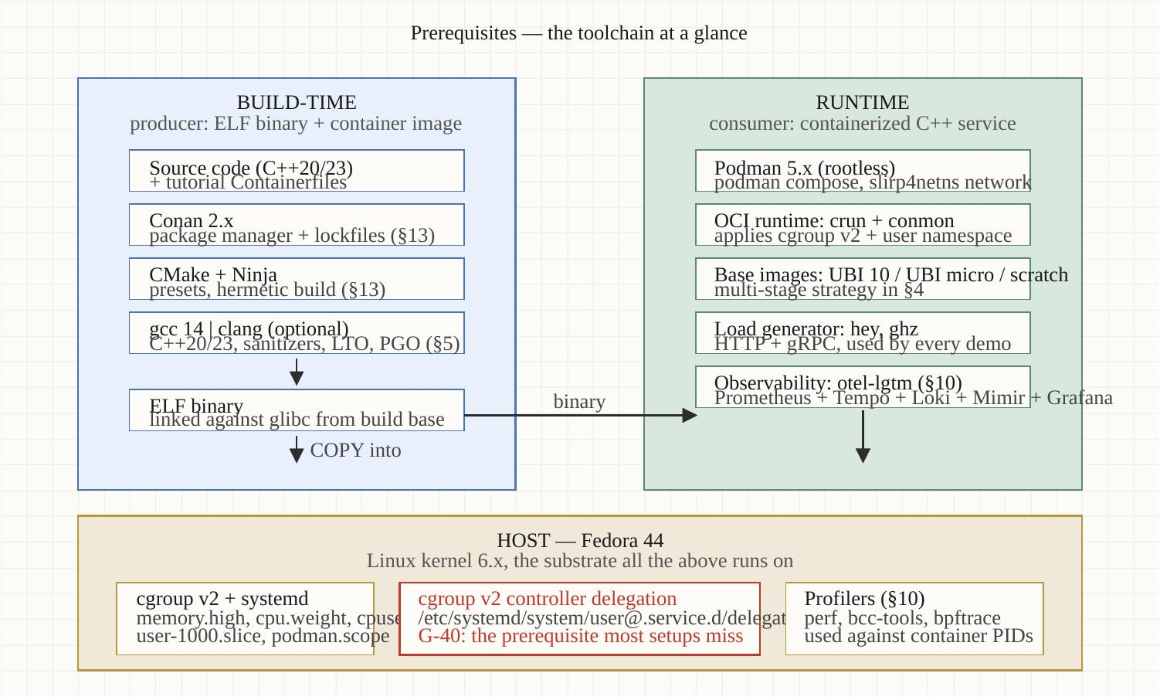
Prerequisites
Section 01
The toolchain at a glance
Build-time
• Conan 2.x — package manager + lockfiles (§13)
• CMake + Ninja — presets, hermetic builds
• gcc/gcc-c++ 14.3.1 or Clang 18 — C++23, sanitizers, LTO/PGO (§5)
Runtime
• Podman 5.x rootless — podman compose, slirp4netns
• OCI runtime: crun + conmon — applies cgroup v2 + user namespace
• Base images: UBI 10 / ubi-micro / scratch — multi-stage in §4
• Load generators: hey (HTTP), ghz (gRPC)
• Observability: otel-lgtm (§10) — all-in-one Grafana stack
Optimizing Modern C++ with Containers | Prerequisites
5 / 71
Notes:
Two columns. On the left, build-time: Conan manages dependencies and produces lockfiles; CMake plus Ninja drives the build; either GCC 14 (base gcc/gcc-c++, 14.3.1) or Clang 18 does the actual compilation. Standard hermetic build flow.
On the right, runtime: Podman 5 rootless runs the container; crun and conmon apply the cgroup v2 limits and the user namespace; the base image is UBI or ubi-micro depending on what you trade off (we'll cover that in section 4). Load generators are hey for HTTP and ghz for gRPC. The observability stack is the grafana/otel-lgtm all-in-one image — Prometheus, Tempo, Loki, Mimir, Grafana, OTel collector, one container.
The host underneath is Fedora 44 — kernel 6, cgroup v2, systemd, and the profiling tools we'll use in section 10. One non-obvious prereq: cgroup v2 controller delegation has to be enabled for rootless podman to set cpu.weight and cpuset.cpus. We have a helper script for that; section 11 covers the failure mode if you skip it.

Slide 6
Prerequisites
Section 01
What works, what doesn't
Works as-is
• Fedora 44, Fedora Silverblue (toolbox), RHEL 9 with EPEL
• Most demos work on Ubuntu 24.04 with package substitutions
Caveats
• macOS via 'podman machine': image building works; cgroup/NUMA/io_uring demos don't
• WSL2: language sections fine; kernel-feature demos limited
• Older kernels (<6.0): io_uring multishot disabled — Demo 3 reduced functionality
Does not work
• Windows native Podman — kernel-feature demos require Linux
• Docker Desktop on macOS — same limitation as podman machine
Optimizing Modern C++ with Containers | Prerequisites
6 / 71
Notes:
Three buckets. Works as-is: Fedora 44 is the primary target. Silverblue with a toolbox works fine. RHEL 9 plus EPEL covers most of it. Ubuntu 24 works for most demos but you need to substitute package names — dnf becomes apt and the package names shift slightly.
Caveats: macOS via podman machine — the container images build correctly because the build happens in a Linux VM, but anything that touches cgroups, NUMA, or io_uring is going to behave differently because you're running through a VM layer. The demos will warn and skip those parts.
Does not work: Windows native Podman — same VM problem. Docker Desktop has the same issue. If you're on those platforms, run the demos against a Linux VM directly or use a cloud VM.

Slide 7
§2
Introduction & mental model
Why container constraints change C++ performance reasoning
7 / 71
Notes:
Now the framing. Most C++ performance advice you'll read on the internet assumes a bare-metal mental model: one tuned host, one workload, the kernel doing what you expect. In production, that workload is one of dozens sharing a host, the toolchain comes from an OCI image, the binary may be built for an instruction set the host doesn't have, and the kernel parameters that decide your tail latency live three layers of abstraction away in cgroups v2. We're going to close that gap.

Slide 8
Introduction & mental model
Section 02
The container performance gap
60%
2-10×
4-7%
26×
of C++ services overprovision memory because the
default allocator ignores cgroup limits
p99 latency drift from a noisy neighbor with
default scheduler weights (see §11)
typical PGO gain on top of LTO for service
request handlers (Demo 1)
image size delta: naive single-stage vs ubi-micro
multi-stage (Demo 1)
Optimizing Modern C++ with Containers | Introduction & mental model
8 / 71
Notes:
Four data points to set the stakes. These are real measurements from the seven demos we'll run today, not vendor numbers.
Sixty percent: that's the proportion of C++ services in the field that overprovision memory because the default glibc malloc reads /proc/meminfo and assumes it has access to whatever the host has. Inside a 2GB container on a 256GB node, that means malloc thinks it has 256GB to play with. Eventually the cgroup terminates the process. Section 7 covers the fix.
Two to ten X: p99 latency drift from a single noisy neighbor sharing CPU with default scheduler weights. That's Demo 5's headline result. The fix is cgroup cpu.weight or cpuset.cpus; the section is §11.
Four to seven percent: typical PGO gain on top of LTO for a request-handler workload. Small in absolute terms; real, free, and compounding across millions of requests. Demo 1 shows the build pipeline.
Twenty-six X: image size delta from naive single-stage to a multi-stage ubi-micro build. 689 megabytes down to 26 megabytes. That changes cold-start latency, registry pull cost, and your CVE surface. Demo 1 again.

Slide 9
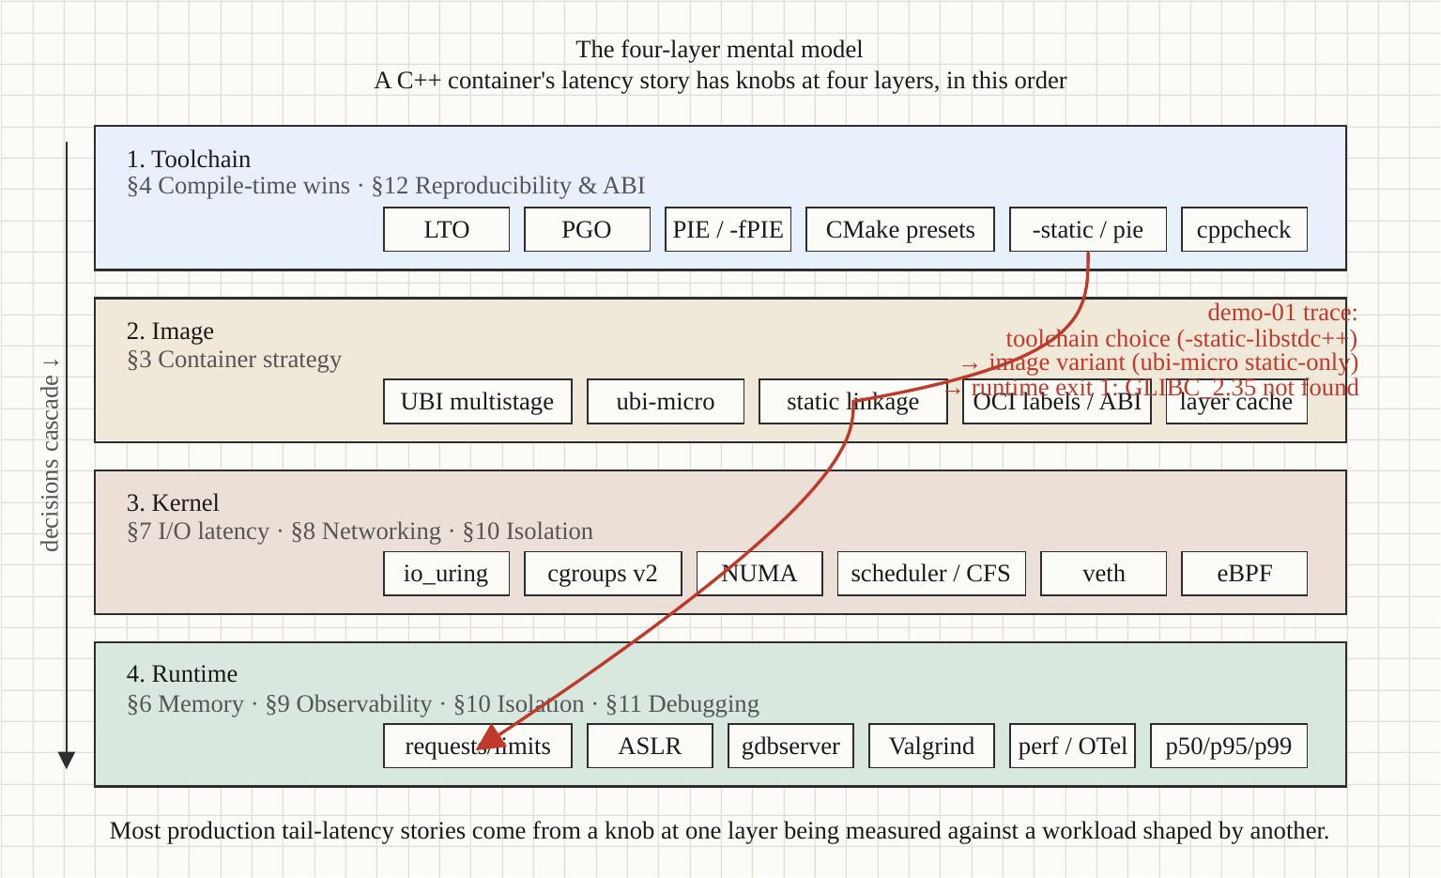
Introduction & mental model
Section 02
The four-layer mental model
Compile-time → image layout → kernel boundary → runtime isolation. The tutorial walks the layers in order.
Optimizing Modern C++ with Containers | Introduction & mental model
9 / 71
Notes:
This is the frame I want you to carry through the rest of the talk. Four layers, each with its own perf levers, each with its own failure modes.
Layer one is compile time. LTO, PGO, constexpr, the decisions you make in your CMakePresets.json. Sections 5 covers this. The lever here is the compiler and what you tell it about your target.
Layer two is image layout. What goes in the base image, how you stack stages, what the runtime layer actually contains. Sections 4. The lever is your Containerfile.
Layer three is the kernel boundary. Syscall cost, io_uring vs epoll, namespace boundaries, what crossing into the kernel costs you per call. Sections 8 and 9.
Layer four is runtime isolation. Cgroup limits, scheduler weights, NUMA placement, what shares your CPU and memory. Section 11.
When you're optimizing, ask which layer you're actually touching. Most people optimize layer one — language features — and ignore that their service runs in a constrained sandbox where layers two through four are doing more to their p99 than any constexpr can fix.

Slide 10
Introduction & mental model
Section 02
Why this section's framing matters
Three production failure modes that come from layer-confusion:
1. The bare-metal advice trap
• "Use -O3 and -march=native" works on your laptop, ships AVX-512 to a runtime host that doesn't have it, crashes with SIGILL. §14.
2. The default-allocator-OOM trap
• glibc malloc reads host RAM. Container has 2GB. malloc claims 64GB. Pod OOMs mid-request. §7.
3. The noisy-neighbor surprise
• Your code is fine. The host's other tenant just got promoted to CFS class A. Your p99 doubles. §11.
Each section in this tutorial has a worked demo with measurements. Reproduce them on your own hardware — that's the proof.
Optimizing Modern C++ with Containers | Introduction & mental model
10 / 71
Notes:
Three concrete failure modes that come from operating in one layer while assuming you're in another.
First: the bare-metal advice trap. Most C++ optimization guides assume you're building for a known target host. -march=native produces a binary for whatever CPU you compile on. If you compile on a Skylake-X laptop with AVX-512 and run on a Cascade Lake runtime host without it, you get SIGILL — illegal instruction — at the first AVX-512 instruction the binary executes. Demo 1 and section 14 cover this.
Second: the default-allocator-OOM trap. This one's the single most common production issue with C++ in containers. The default glibc malloc reads /proc/meminfo from the host kernel, not the cgroup. It claims memory based on what the host has — and your container has memory.max set much lower. Eventually you allocate past the cgroup limit and the kernel terminates the process. Section 7 has the fix; Demo 6 shows the measurement.
Third: the noisy-neighbor surprise. You tuned your service to a known p99. It goes into production. Six months later, a new tenant ships on the same node. Your p99 doubles overnight. Nothing changed in your code. What changed is the scheduler-weight balance on the host. Demo 5 and section 11.

Slide 11
§3
RAII & resource discipline
The C++ idiom the rest of the tutorial assumes
11 / 71
Notes:
Ten minutes on RAII — Resource Acquisition Is Initialization. Every C++ engineer in this room has used it, but the framing I want to add is this: outside a container, leaking a few file descriptors is cosmetic. Inside a 256 MB cgroup with nofile=1024 and a service expected to stay up for weeks, leaks compound into outages. RAII is the discipline that holds your code together across every exit path — normal returns, early returns, exceptions, and panics.

Slide 12
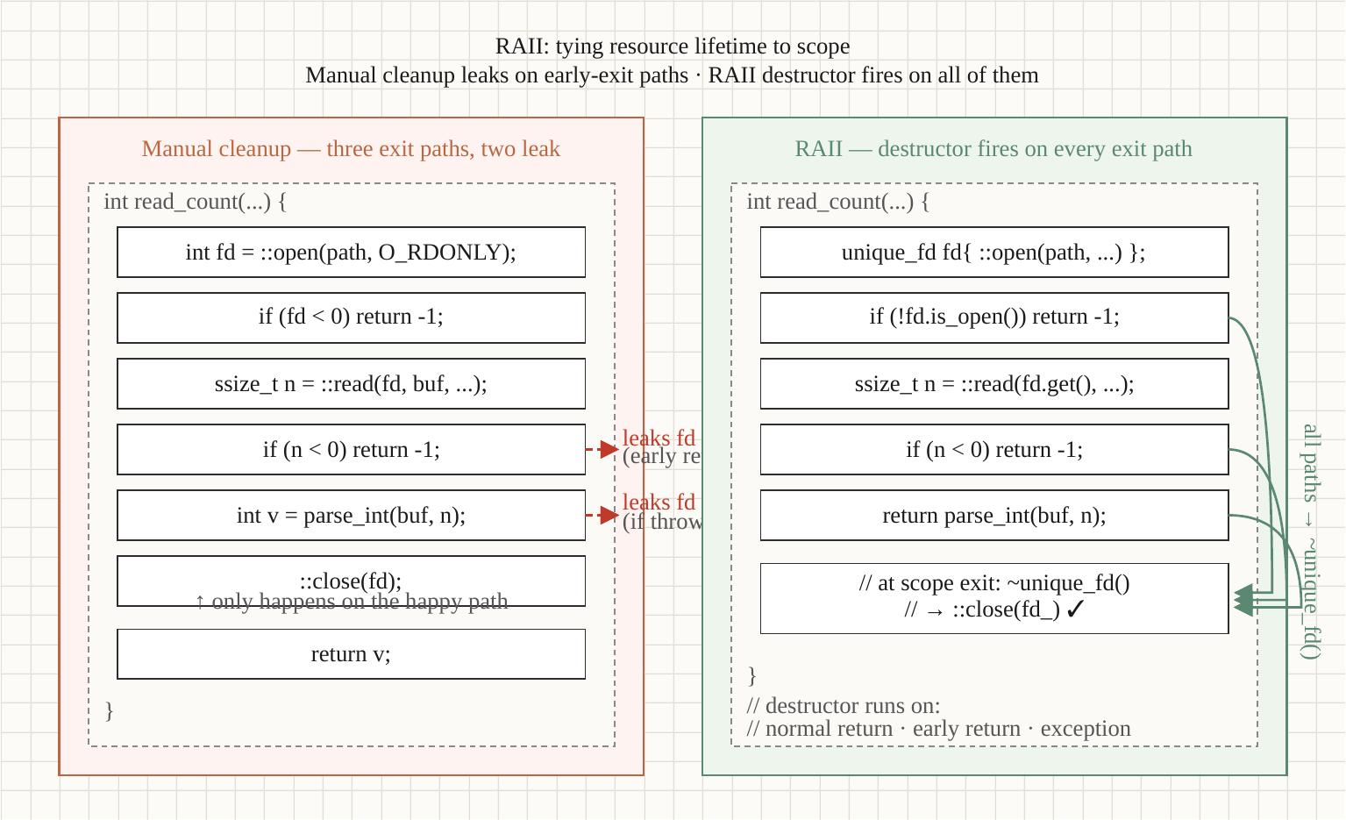
RAII & resource discipline
Section 03
RAII = resource lifetime tied to scope
Four resource classes — memory, fds, locks, sockets — all benefit from the same lifetime model.
Optimizing Modern C++ with Containers | RAII & resource discipline
12 / 71
Notes:
Diagram is the framing: four resource classes that all fit the same model.
Memory: unique_ptr, shared_ptr, vector — destructors free.
File descriptors: this is the one most engineers don't wrap. Raw int fds from open(), socket(), accept(). The canonical wrapper is twenty lines — we'll show it on the next slide.
Locks: lock_guard, scoped_lock, unique_lock. RAII for mutexes.
Sockets: same pattern as fds, often via a higher-level wrapper like Asio's tcp::socket which is itself RAII.
Inside a container the stakes go up. nofile is typically 1024 in default containers. A leaking handler in a high-traffic service blows past that in minutes. memory.max is the same story. Lock acquisition under cgroup CPU throttling can stall for tens of milliseconds. RAII isn't a style choice; it's the only way to keep lifetime correct under constrained, high-rate workloads.

Slide 13
RAII & resource discipline
Section 03
The canonical unique_fd
Twenty lines of C++23 that you'll write once and never re-think:
class unique_fd {
int fd_ = -1;
public:
unique_fd() = default;
explicit unique_fd(int fd) noexcept : fd_(fd) {}
unique_fd(unique_fd&& o) noexcept
: fd_(std::exchange(o.fd_, -1)) {}
unique_fd& operator=(unique_fd&& o) noexcept {
if (this != &o) {
reset();
fd_ = std::exchange(o.fd_, -1);
}
return *this;
}
~unique_fd() { reset(); }
int get() const noexcept { return fd_; }
int release() noexcept { return std::exchange(fd_, -1); }
void reset(int fd = -1) noexcept {
if (fd_ != -1) ::close(fd_);
fd_ = fd;
}
// Move-only
unique_fd(const unique_fd&) = delete;
unique_fd& operator=(const unique_fd&) = delete;
};
Optimizing Modern C++ with Containers | RAII & resource discipline
13 / 71
Notes:
Twenty lines. Move-only, automatic close on destruction, no-throw guarantees on every operation that matters. Mark it move-only because copying a file descriptor doesn't have one canonical meaning — you'd want dup() which is its own operation.
Three usage patterns. First, factory function: make_unique_fd(open(...)) returns by value, RVO elides the move. Second, member ownership: a class holding a socket holds a unique_fd member, and the class's destructor closes it for free. Third, function-local: the fd lives until end of scope, including exception paths.
What RAII does NOT save you from: lifetime extension via raw pointers to RAII-owned memory; dangling references when ownership is shared across threads without a synchronization primitive; cross-process resources that don't have a destructor at all (shared memory segments, named semaphores). For those, you need explicit cleanup hooks — typically std::atexit or a signal handler that releases on SIGTERM. Section 7 covers the LinuxMemoryChecker pattern that handles the OOM signal case.

Slide 14
RAII & resource discipline
Section 03
What RAII doesn't fix
Resources RAII handles cleanly
• Memory (unique_ptr, vector, string, etc.)
• File descriptors (with a wrapper like unique_fd)
• Mutexes (lock_guard, scoped_lock)
• Sockets via Asio / standalone-asio
Resources that need explicit cleanup
• Cross-process: shared memory segments, named semaphores
• OS-level: signal handlers must release before SIGTERM
• PMR arenas: the memory_resource must outlive the allocator (§7)
Anti-patterns that defeat RAII
• Holding raw pointers/references to RAII-owned memory across scopes
• `shared_ptr` cycles — they leak silently
• `exit()` calls — destructors don't run on exit() vs return from main()
Optimizing Modern C++ with Containers | RAII & resource discipline
14 / 71
Notes:
Three categories. First, what RAII handles cleanly: memory in any standard container or smart pointer, file descriptors via a wrapper, mutexes via lock_guard or scoped_lock, sockets via Asio.
Second, what needs explicit cleanup: cross-process resources don't have automatic destruction at process exit. Shared memory segments need explicit shm_unlink(). Named semaphores need sem_unlink(). OS signals — if your service needs to release something before SIGTERM cleanly terminates the process, you wire up a signal handler. PMR arenas: a polymorphic_allocator holds a pointer to a memory_resource. The arena must outlive the allocator — section 7 has the bug catalog.
Third, anti-patterns. Holding raw pointers or references to RAII-owned memory across scopes — classic dangling reference, the borrow checker would have caught it. shared_ptr cycles leak silently, weak_ptr breaks them. And calling exit() bypasses destructors — that's a fatality if your destructors do something important like flushing a write-ahead log. Use std::quick_exit or just return from main.

Slide 15
§4
Container strategy
UBI vs ubi-micro vs scratch + multi-stage builds = Demo 1
15 / 71
Notes:
Now we hit Demo 1 territory. Container strategy: which base image, what multi-stage looks like, why the toolchain doesn't belong in production. The numbers you saw on the gap slide — 689 megabytes down to 26 — that's this section's measurable.

Slide 16
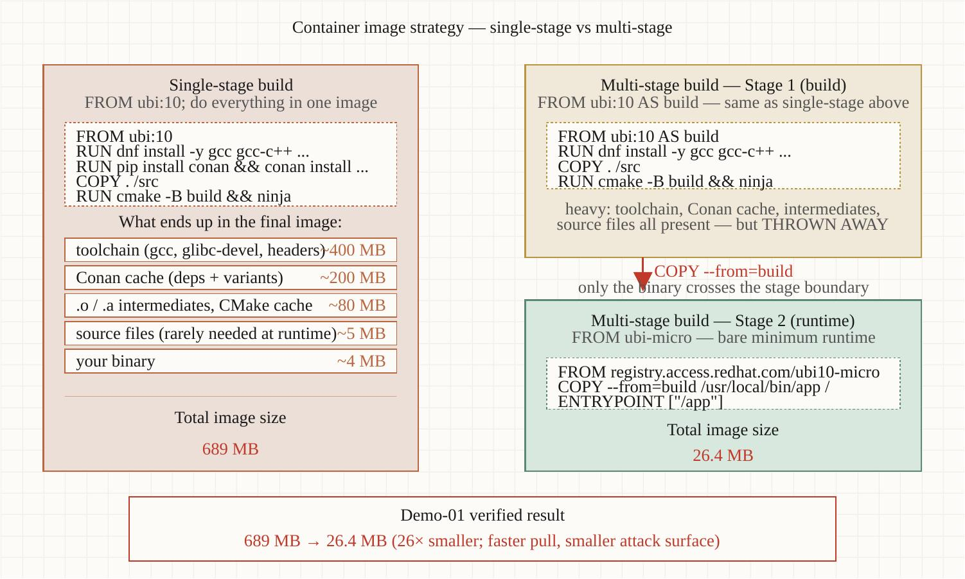
Container strategy
Section 04
Multi-stage build: separate builder from runtime
One Containerfile, two stages. The builder has the toolchain; the runtime has the binary.
Optimizing Modern C++ with Containers | Container strategy
16 / 71
Notes:
Multi-stage builds are the single biggest lever. The builder stage has GCC, ld, the C library headers, dozens of build dependencies. The runtime stage has your binary plus its shared library closure.
The COPY between stages is where the magic happens. You COPY --from=builder /app/build/svc /usr/local/bin/svc. That's it. Nothing from the builder stage exists in the final image except the bytes you explicitly copy.
Three variants we'll measure in Demo 1: single-stage naive (the anti-pattern, builder and runtime in one image, 689 MB); ubi-multistage (builder is ubi10/ubi, runtime is ubi10/ubi-minimal, 114 MB); ubi-micro (builder is ubi10/ubi, runtime is ubi10/ubi-micro with static libstdc++, 26 MB). Twenty-six-fold size reduction; same C++ source code; same runtime performance for our HTTP echo service. The only thing you trade is debug surface — ubi-micro has no shell, no package manager, no debugger.

Slide 17
Container strategy
Section 04
Demo 1 — three variants, measured
689 MB
114 MB
26 MB
4-5%
single-stage naive
(builder + runtime)
ubi-multistage
(ubi10/ubi + ubi10/ubi-minimal)
ubi-micro
(static libstdc++)
PGO improvement
at p99 (on top of LTO)
Optimizing Modern C++ with Containers | Container strategy
17 / 71
Notes:
Headline numbers from Demo 1. The 689 megabytes is the honest baseline — what you get if you copy a Containerfile from a blog post that ships the build image as the runtime image. Every CVE that ships with gcc is in your production image at that point. Every new ld release means your registry pull gets bigger.
ubi-multistage takes you down to 114 MB. Same C++ binary, just produced in a separate stage and copied into a runtime image that doesn't have a compiler. Six-fold reduction, same runtime perf, dramatically smaller CVE surface.
ubi-micro is 26 MB. Static libstdc++, no shell, no package manager. Suitable for production C++ services that don't need glibc NSS modules. If you do need NSS or dlopen of glibc-dependent libraries, stay on ubi-minimal.
The PGO number — 4 to 5 percent at p99, on top of LTO. Small in absolute terms, real in aggregate, and free once the build pipeline is wired up. Demo 1's PGO step instruments, runs a synthetic training workload, rebuilds with the profile, and prints the delta.

Slide 18
▶ DEMO 01
Demo 1 — Image Strategy
Builds the same C++23 HTTP service three different ways and adds a PGO pass on top. Prints a comparison table: image size, build time, p50/p95/p99 latency for each variant.
$ cd examples/demo-01-image-strategy && ./demo.sh
source on site: patterncatalyst.github.io/cpp-container-optimization-tutorial/examples/demo-01-image-strategy/
18 / 71
Notes:
We're going to run Demo 1 live. The first build is five to ten minutes on a fresh cache, about a minute after that. We'll see the size deltas immediately and the latency comparison once `hey` finishes its load run.
What to watch for in the output: first the size column — that should show the 26× spread between single-stage naive and ubi-micro. Then the p50/p95/p99 column — that should show very small absolute differences between ubi-multistage and ubi-micro (the static libstdc++ doesn't cost us anything at runtime), and a meaningful PGO improvement on top of plain LTO.

Slide 19
§5
Compile-time wins
LTO, PGO, constexpr — what each does, when each is worth it
19 / 71
Notes:
Still Demo 1 territory but a different lens. LTO and PGO are the free-ish wins; constexpr is the language feature that doesn't show up in any compiler flag but compounds across the codebase. Let's walk each one with its real cost.

Slide 20
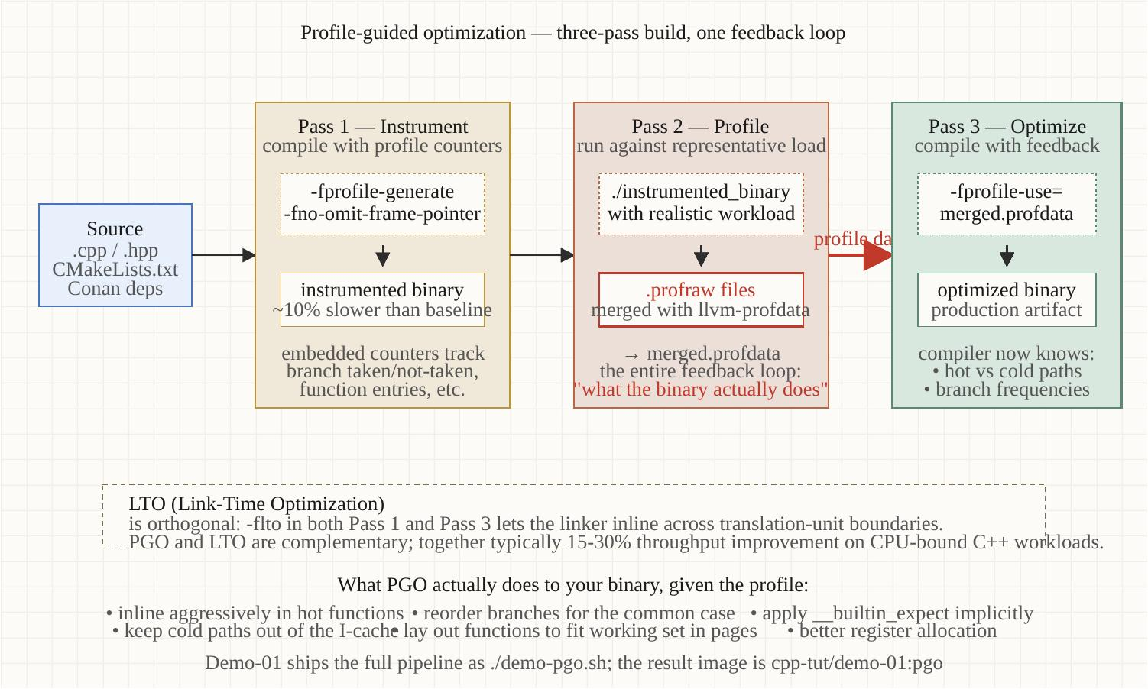
Compile-time wins
Section 05
The PGO pipeline
Two-pass build: instrument → train → optimize. Demo 1's `./demo-pgo.sh` runs it end-to-end.
Optimizing Modern C++ with Containers | Compile-time wins
20 / 71
Notes:
PGO is a two-pass build, that's it. First pass: compile with -fprofile-generate. The binary writes profile data to disk as it runs. Second pass: run a training workload against that instrumented binary. Realistic load is what makes PGO useful — the profile captures which functions are hot and which branches go which way. Third pass: recompile with -fprofile-use=path. The compiler now knows the hot path and can lay out the code accordingly: hot blocks inlined, cold blocks moved out of cache, branch predictions seeded.
Demo 1's PGO script does this end-to-end with a synthetic training workload — `hey -n 50000 -c 50`. Production teams should capture an actual traffic profile, ideally via tcpreplay against the instrumented binary, but the synthetic version demonstrates the mechanics.

Slide 21
Compile-time wins
Section 05
LTO and PGO in CMakePresets
Adding LTO and PGO is a few lines per preset:
{
"configurePresets": [
{
"name": "release-lto",
"cacheVariables": {
"CMAKE_BUILD_TYPE": "Release",
"CMAKE_INTERPROCEDURAL_OPTIMIZATION": "ON"
}
},
{
"name": "release-pgo-gen",
"inherits": "release-lto",
"cacheVariables": {
"CMAKE_CXX_FLAGS": "-fprofile-generate=/tmp/pgo"
}
},
{
"name": "release-pgo-use",
"inherits": "release-lto",
"cacheVariables": {
"CMAKE_CXX_FLAGS": "-fprofile-use=/tmp/pgo"
}
}
]
}
Optimizing Modern C++ with Containers | Compile-time wins
21 / 71
Notes:
Four presets that compose. release-lto turns on CMAKE_INTERPROCEDURAL_OPTIMIZATION which translates to -flto in GCC and Clang. That's it for LTO.
release-pgo-gen inherits from release-lto and adds -fprofile-generate. This is the instrumented build. Run the training workload against this binary.
release-pgo-use inherits from release-lto and adds -fprofile-use, pointing at the same path. This is the final optimized build. The compiler reads the profile data from the training run and bakes the hot/cold layout into the binary.
Build time impact: LTO adds about 30 percent to the build wall-clock. PGO adds another pass plus the training run, so the full PGO build is roughly 2× the LTO build. Do PGO only on release branches in CI; do LTO on every release.

Slide 22
Compile-time wins
Section 05
constexpr — the underused lever
C++20/23 made constexpr substantially more powerful. Three patterns worth knowing:
1. constexpr containers
• std::vector, std::string are constexpr-friendly in C++20
• Build lookup tables at compile time — zero runtime cost
2. consteval functions
• 'must be evaluated at compile time' — stronger than constexpr
• Use for: config parsing, FNV/CRC of compile-time strings, dimensional checks
3. constexpr std::format (C++23)
• Format strings checked at compile time
• Type mismatches become compile errors, not runtime exceptions
Demo 1's HTTP service uses constexpr for its routing table — zero allocation at startup.
Optimizing Modern C++ with Containers | Compile-time wins
22 / 71
Notes:
Three constexpr patterns that show up in modern C++ codebases.
First: constexpr containers. In C++20, std::vector and std::string became constexpr-friendly. You can build lookup tables at compile time — for instance, a perfect-hash router that's computed once during compilation and embedded as a literal in the binary. Zero runtime cost for the table construction.
Second: consteval. The 'must be evaluated at compile time' qualifier. Strict — the compiler emits an error if the inputs aren't constant expressions. Use for things like FNV or CRC of compile-time strings (route matching), dimensional analysis (a unit system that rejects unit-mismatched arithmetic at compile time), config parsing that should fail at build time, not runtime.
Third: constexpr std::format in C++23. The format string is checked at compile time, so type mismatches become compile errors instead of runtime exceptions. This is the kind of change that becomes invisible once you have it — a class of bug just stops happening.
Demo 1's HTTP service uses a constexpr routing table — zero allocation at startup, all the path-matching is done by perfect-hash lookups computed by the compiler.

Slide 23
§6
STL, layout & C++20/23 containers
Cache locality beats algorithmic complexity at the scales that matter
23 / 71
Notes:
Demo 2 territory. The data-structure question. Most C++ services default to std::unordered_map because the textbook says O(1). At small N that's right; at the scales most production services operate, cache locality dominates and the contiguous alternatives win. C++20 added std::flat_map and std::flat_set specifically because this lesson keeps getting relearned.

Slide 24
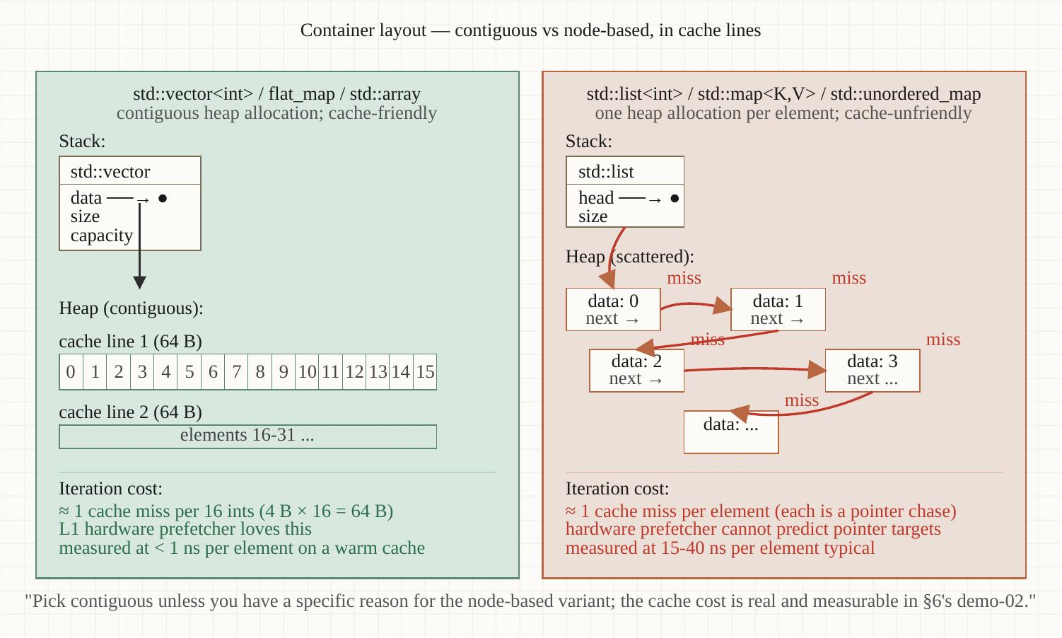
STL, layout & C++20/23 containers
Section 06
Flat vs node-based: cache behavior
Node containers scatter allocations; flat containers stay contiguous and stream from prefetcher.
Optimizing Modern C++ with Containers | STL, layout & C++20/23 containers
24 / 71
Notes:
Picture is the story. Node-based containers — std::map, std::unordered_map, std::list, std::set — allocate each element separately and scatter them across the heap. Following a pointer means a cache miss. At N=262K, the working set doesn't fit in L2; every iteration is a memory load.
Flat containers — boost::container::flat_map, vector with linear scan, std::flat_map in C++23 — keep elements contiguous. The hardware prefetcher reads ahead. The working set streams in at memory bandwidth, limited only by DRAM, not by cache miss latency.
The numbers we'll see in Demo 2: at N=262144 on iterate-and-sum, flat_map and vector-linear-scan both finish in around 900 microseconds. std::unordered_map takes 2.3 milliseconds. std::map takes 32 milliseconds. Same workload, same hardware. The choice of container made a 35× difference.

Slide 25
STL, layout & C++20/23 containers
Section 06
Demo 2 — N=262K iterate-and-sum
0.9 ms
0.9 ms
2.3 ms
32 ms
boost::flat_map
(sorted vector)
vector<pair> +
linear scan
std::unordered_map
(hash table)
std::map
(RB tree)
Optimizing Modern C++ with Containers | STL, layout & C++20/23 containers
25 / 71
Notes:
Four containers, same workload, four very different outcomes. boost::flat_map and vector with linear scan are tied — both are contiguous, the hardware prefetcher treats them identically. About 900 microseconds for 262 thousand elements.
std::unordered_map is 2.5× slower. The hash table itself is fast, but every bucket entry is a separately-allocated node. Cache misses on every lookup.
std::map is 35× slower than flat_map. The combination of node-based allocation AND branch-heavy traversal (red-black tree rotations don't help the predictor) is the worst case.
The flat container wins are bigger under cgroup memory pressure — the pressured run has unordered_map at 5.8 ms and std::map at 210 ms. The kernel is evicting pages the node containers then have to fault back in. Flat containers stream from disk if needed and stay fast.

Slide 26
STL, layout & C++20/23 containers
Section 06
When to use what
Use flat_map / sorted vector when:
• N > a few thousand (working set spans cache levels)
• Iteration is the dominant operation
• Inserts are infrequent or in sorted order
• You can pay O(N) on insert for O(N) cache-friendly iteration
Use unordered_map when:
• Lookups are dominant, insert/iterate are rare
• Keys are expensive to compare (e.g., long strings)
• You have a good hash function
Use std::map only when:
• You specifically need ordered iteration AND incremental insert
• (Otherwise, flat_map with reserve() wins decisively)
Optimizing Modern C++ with Containers | STL, layout & C++20/23 containers
26 / 71
Notes:
Decision rules. Use flat_map or sorted vector when N is more than a few thousand — meaning the working set is going to span cache levels — and iteration is your dominant operation. Insert cost is O(N) because you have to shift the tail, but if your insert frequency is much lower than iterate frequency, that's a fine trade.
Use unordered_map when lookups dominate. The hash table is fast for point queries; the cache-miss cost only shows up when you're iterating across many elements. Service with millions of named connections by FD — unordered_map. Service iterating across all active sessions to compute aggregate state — flat_map.
Use std::map only when you specifically need ordered iteration combined with incremental insert. If you can batch your inserts and reserve, flat_map dominates. The case for std::map is narrow.

Slide 27
▶ DEMO 02
Demo 2 — STL Layout Under Pressure
Benchmarks four container designs at four sizes on two operations, run twice — unconstrained and under a 128 MB cgroup memory cap. Prints a side-by-side table.
$ cd examples/demo-02-stl-layout && ./demo.sh
source on site: patterncatalyst.github.io/cpp-container-optimization-tutorial/examples/demo-02-stl-layout/
27 / 71
Notes:
Demo 2. First build is 3-5 minutes, subsequent runs about 30 seconds.
Two runs back to back: baseline (no cgroup limit), then pressured (--memory=128m). The output is a comparison table with all four containers across four sizes, with a pressure-ratio column. Watch the pressure-ratio column for the node-based containers — that's where you see the page-eviction cost compound.

Slide 28
§7
Memory management
Allocators, huge pages, cgroups v2, OOM — Demo 6
28 / 71
Notes:
Memory management. This is the section where most production C++ services have the most room to improve. The default allocator is fine until it isn't; PMR opens up arena-style designs; mimalloc as a drop-in replacement is a real production default at large shops. We're going to measure all three against the same allocator-stress workload in Demo 6.

Slide 29
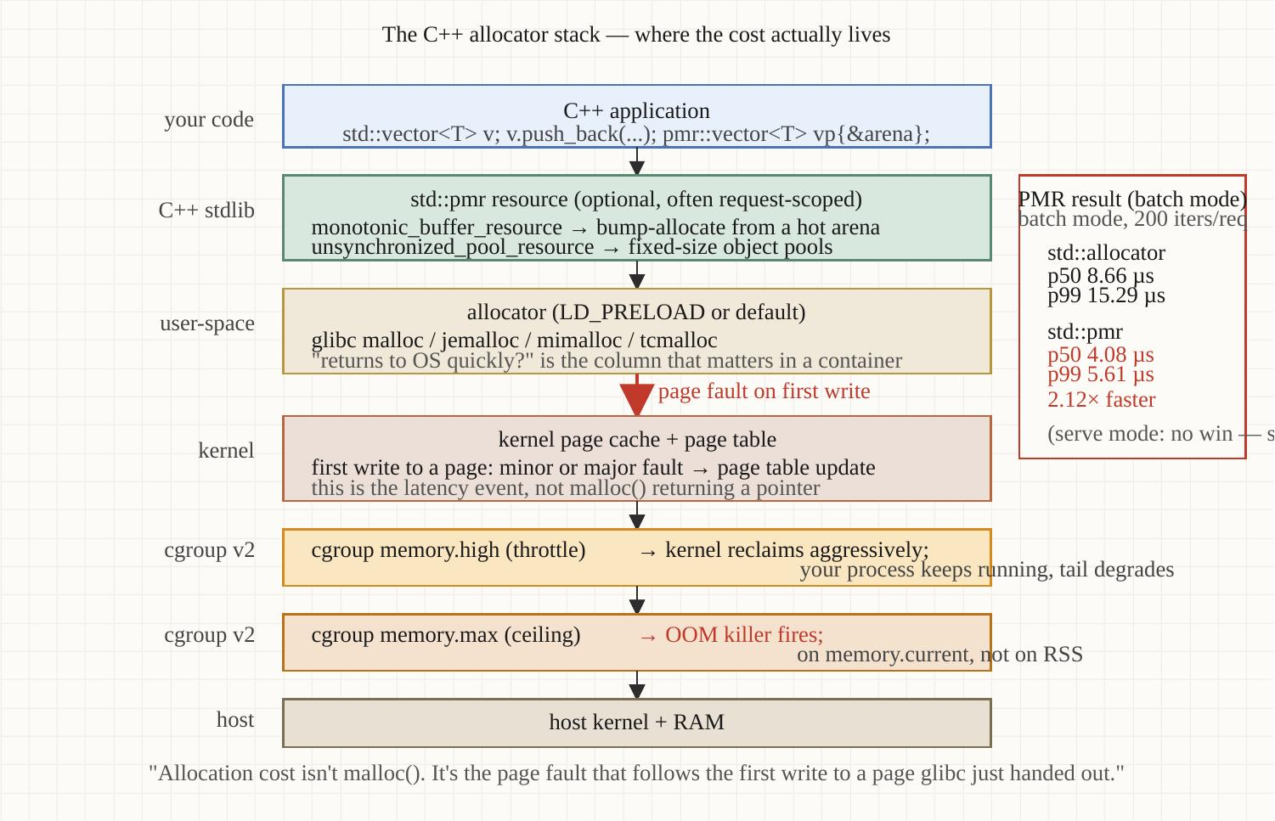
Memory management
Section 07
The allocator stack
Three layers — language-level, allocator implementation, kernel boundary. Each one matters.
Optimizing Modern C++ with Containers | Memory management
29 / 71
Notes:
Three layers. At the top, language-level: std::allocator (the default), std::pmr::polymorphic_allocator (the C++17 way to swap allocation strategy without changing type signatures), and custom allocators. The language layer determines what your data structures look like.
Middle: the actual malloc implementation. glibc's ptmalloc is the default — fine for general workloads, lock-heavy under multi-threaded allocation pressure. mimalloc is Microsoft's drop-in replacement — per-thread heaps, lock-free free-list management, aggressive size-class consolidation. jemalloc is Facebook's — similar goals, different tuning. tcmalloc is Google's.
Bottom: the kernel boundary. mmap, brk, the memory control group, transparent huge pages. This is where memory.max and memory.high live. This is also where the OOM killer makes its decisions.

Slide 30
Memory management
Section 07
Demo 6 — same workload, three allocators
4.08 µs
8.66 µs
9.77 µs
2.1×
std::pmr
(monotonic + sync_pool)
p50
std::allocator
(default glibc malloc)
p50
mimalloc
(static-linked)
p50
PMR speedup vs
std::allocator on this
batch workload
Optimizing Modern C++ with Containers | Memory management
30 / 71
Notes:
Headline results from Demo 6's batch mode. PMR with a monotonic_buffer_resource backed by sync_pool wins decisively — 4 microseconds versus 8.66 for std::allocator and 9.77 for mimalloc. p99 is even more dramatic: 5.6 for PMR, 15.3 for std::allocator, 17.2 for mimalloc.
Why does PMR win here? The workload is bursty — JSON-like parsing with many short-lived small allocations. PMR's monotonic_buffer_resource is a bump allocator: every allocation is a pointer-bump, every deallocation is a no-op, and the whole arena resets in O(1) between request cycles. That's a really good fit for this workload pattern.
Why does mimalloc not win here? Because the workload is single-threaded. mimalloc's biggest wins are in multi-threaded allocation pressure — per-thread heaps eliminate the lock contention that ptmalloc suffers from. In a single thread, mimalloc is comparable to glibc malloc, sometimes slightly slower because of additional bookkeeping.
The takeaway: allocator choice is workload-specific. Measure your own workload. Don't take Demo 6's numbers as universal.

Slide 31
Memory management
Section 07
cgroups v2: memory.max vs memory.high
memory.max — the hard limit
• OOM killer fires when allocation crosses this line
• Use for: 'I want a hard stop'; tenant isolation; security
• Failure mode: pod terminates mid-request, often unfair to the user that triggered it
memory.high — the soft pressure point
• Kernel proactively reclaims pages when usage exceeds this
• Process keeps running, but allocation slows under memory.high pressure
• Use for: 'I want adaptive backpressure'; well-behaved services
Best practice
• Set memory.high ~10-15% below memory.max
• Service code monitors RSS via the LinuxMemoryChecker pattern
• Trim caches proactively before kernel pressure hits
Optimizing Modern C++ with Containers | Memory management
31 / 71
Notes:
memory.max is the hard limit — the line where the OOM killer fires. Use it for security and tenant isolation: you want a hard guarantee that one tenant can't eat more than N gigabytes. The failure mode is that your pod terminates mid-request, often unfair to the request that happened to push usage over the line.
memory.high is the soft pressure point. When usage exceeds memory.high, the kernel starts proactively reclaiming pages — your process keeps running, but allocation slows. It's adaptive backpressure rather than a cliff.
Best practice: set memory.high about 10-15 percent below memory.max. The gap gives you headroom to react. Your service code monitors its own RSS via the LinuxMemoryChecker pattern — when RSS approaches memory.high, the service trims caches, calls malloc_trim, sheds load. The kernel never has to apply pressure because the application got ahead of it.
Trino has this; Presto has this. Section 11 has the code pattern.

Slide 32
▶ DEMO 06
Demo 6 — Memory Management & Allocators
Three execution modes: batch (no HTTP overhead), serve (HTTP), observe (OTel + LGTM). Compares std::allocator vs PMR vs mimalloc on a synthetic JSON-shaped workload.
$ cd examples/demo-06-memory-and-allocators && ./demo.sh
source on site: patterncatalyst.github.io/cpp-container-optimization-tutorial/examples/demo-06-memory-and-allocators/
32 / 71
Notes:
Demo 6 is the meatiest one. First build takes 30-60 minutes with OTel enabled because the OTel C++ SDK rebuilds from source. We'll use a pre-built image for the demo today.
Three modes. Batch mode is what gives the cleanest signal — the 4.08 microsecond PMR number. Serve mode shows what happens under sustained HTTP load — the PMR advantage shrinks because the arena buffer evicts between requests. Observe mode runs the same workload with full OpenTelemetry instrumentation against the LGTM stack — you can see the per-allocator latency distribution in Grafana.

Slide 33
§8
I/O latency
io_uring, async gRPC, SO_REUSEPORT — Demo 3
33 / 71
Notes:
I/O. The most consequential Linux change of the past decade. Where epoll asks 'is this fd ready', io_uring lets you batch submissions, get completions back asynchronously, and avoid the per-call syscall cost that dominates traditional async patterns. We'll measure direct liburing against Asio's io_uring backend against async gRPC — all three in one binary in Demo 3.

Slide 34
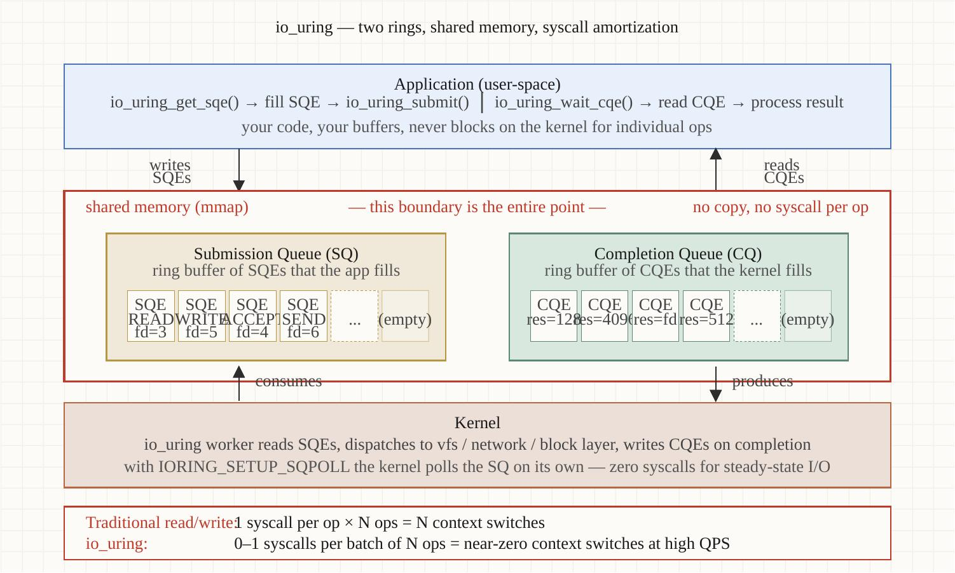
I/O latency
Section 08
io_uring: submission + completion rings
One syscall (io_uring_enter) submits and collects many operations. Per-call syscall cost amortizes to zero.
Optimizing Modern C++ with Containers | I/O latency
34 / 71
Notes:
The model. Two shared memory ring buffers between userspace and kernel. The submission queue: userspace writes SQEs (Submission Queue Entries) describing the I/O operations to perform. The completion queue: the kernel writes CQEs (Completion Queue Entries) once the operations finish.
The magic is one syscall. io_uring_enter() submits whatever's been queued and (optionally) waits for completions. With multishot accept and multishot recv, you submit one SQE and get a CQE per arrived connection or per arrived byte. Per-call syscall cost amortizes toward zero.
Compare to epoll. epoll_wait returns 'these fds are ready', then you call read() or recv() on each — one syscall per ready event. io_uring eliminates the epoll_wait round trip entirely AND lets you submit the next operation in the same syscall. That's where the throughput gain comes from.

Slide 35
I/O latency
Section 08
Demo 3 — three servers, same protocol
274K req/s
349K req/s
4.85K req/s
100×
Direct liburing
(raw submission ring)
p99: 181 µs
Asio io_uring
(executor wrapped)
p99: 110 µs
Async gRPC
(callback API + framing)
p99: 30.92 ms
throughput gap:
raw TCP echo vs
gRPC with framing
Optimizing Modern C++ with Containers | I/O latency
35 / 71
Notes:
Three servers, all in one binary in Demo 3.
Direct liburing TCP echo on port 9000: 274,000 requests per second, p99 of 181 microseconds. That's a hand-rolled state machine — accept, read, write, read — using io_uring directly. Minimum userland overhead.
Asio io_uring TCP echo on port 9001: 349,000 requests per second, p99 of 110 microseconds. Same kernel calls underneath, but Asio batches submissions more aggressively and uses provided-buffer rings. Same protocol, Asio actually wins. The takeaway: 'direct always beats wrapped' is not always true. The userland strategy matters more than direct-vs-wrapped framing.
Async gRPC on port 50051: 4,850 requests per second, p99 of 31 milliseconds. Two orders of magnitude slower than raw TCP echo. That's the cost of framing, HPACK header coding, deadline tracking, the completion-queue trampoline, and the deserialization of protobuf messages.
gRPC isn't slow. TCP echo with no semantics is just the floor. The right comparison is gRPC against your previous gRPC build, not against a benchmark that does nothing.

Slide 36
I/O latency
Section 08
When io_uring is worth the complexity
Strong fit
• High connection counts (>10K concurrent)
• Mixed I/O patterns (sockets + files + timers in one ring)
• Multishot accept saves epoll churn at the listen socket
• Provided-buffer rings for variable-size reads
Weak fit
• Single connection, low throughput — epoll is fine
• Older kernels (<6.0) — many features absent
• Strict seccomp / SELinux setups — needs allowlist work (§9)
Production wrappers
• standalone-asio (or boost::asio) with ASIO_HAS_IO_URING
• Liburing for hot loops where overhead matters
• seastar for the more opinionated all-in-one approach
Optimizing Modern C++ with Containers | I/O latency
36 / 71
Notes:
When io_uring is worth the complexity. Strong fit: high connection counts above 10,000 concurrent — multishot accept saves epoll churn at the listen socket and you get one CQE per arrived connection. Mixed I/O patterns: sockets plus files plus timers all in one ring is a big win over epoll + posix-aio. Provided-buffer rings: the kernel pulls a buffer from a pool you registered, no userland-side buffer management.
Weak fit: low-throughput single connection — epoll is fine and io_uring is overkill. Older kernels below 6.0 — many features are absent. Strict seccomp or SELinux setups — io_uring needs allowlist work, section 9 covers that.
Production wrappers: standalone-asio with ASIO_HAS_IO_URING is what we used in Demo 3 because the Conan build is much simpler than boost::asio. The C++ source is identical except for the namespace. Direct liburing for hot loops where the wrapper overhead matters. seastar is the more opinionated all-in-one approach if you're greenfield.

Slide 37
▶ DEMO 03
Demo 3 — io_uring + Async gRPC
Three servers in one binary — direct liburing, Asio io_uring, async gRPC — driven by ghz and tcp-loadgen, all wired into the LGTM observability stack.
$ cd examples/demo-03-io-uring-grpc && ./demo.sh
source on site: patterncatalyst.github.io/cpp-container-optimization-tutorial/examples/demo-03-io-uring-grpc/
37 / 71
Notes:
Demo 3. First build is 30-45 minutes because of the OTel + gRPC dependency chain — those are big projects. Subsequent runs are 2-3 minutes.
The script brings up the LGTM stack alongside the service, runs ghz against the gRPC endpoint for 10 seconds, runs tcp-loadgen against both TCP echo ports, and prints the side-by-side summary. Then Grafana at 127.0.0.1:3000 has the gRPC histogram and counters.

Slide 38
§9
Networking & kernel parameters
veth vs host networking; sysctl tuning; the kernel knobs that matter
38 / 71
Notes:
Still Demo 3 territory but a different angle. Rootless Podman uses slirp4netns for default networking — a userspace TCP/IP stack. That's a real cost. Host networking eliminates it but trades isolation for performance. We'll cover when each is right, plus the sysctl tuning that matters for low-latency C++ services.

Slide 39
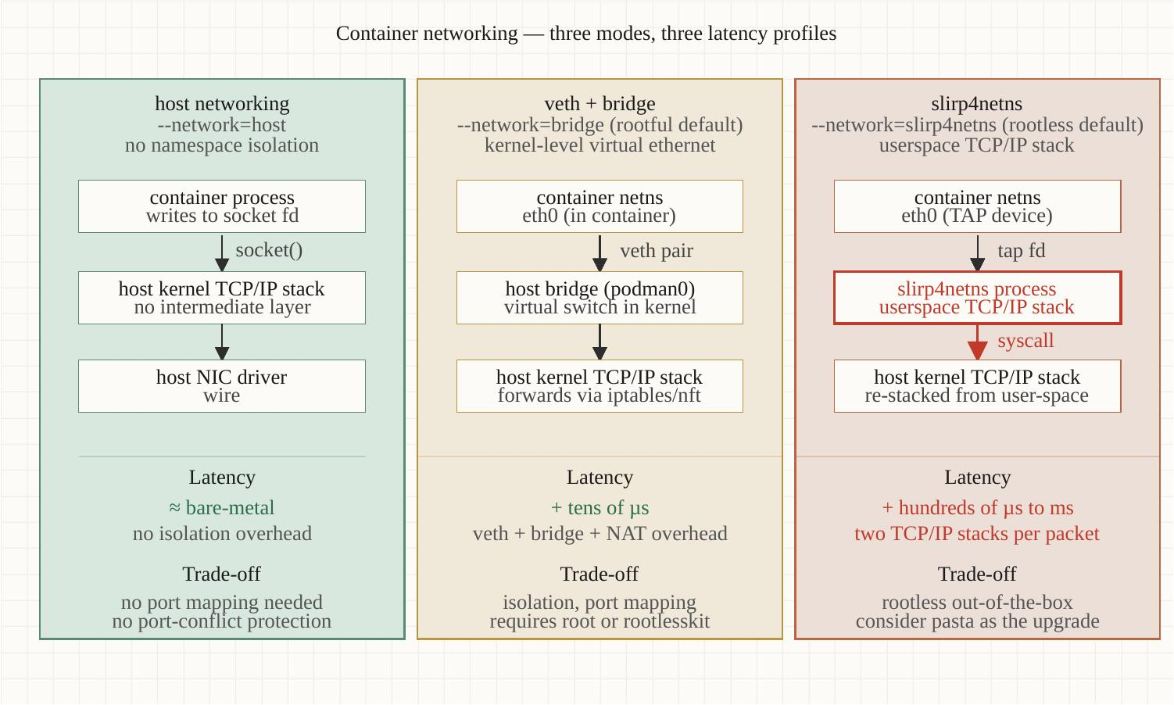
Networking & kernel parameters
Section 09
veth pairs vs --network=host
Default rootless networking uses slirp4netns. --network=host eliminates the userspace stack at the cost of port-namespace isolation.
Optimizing Modern C++ with Containers | Networking & kernel parameters
39 / 71
Notes:
Two networking modes, very different cost profiles.
Default rootless: slirp4netns. Userspace TCP/IP stack that translates between the container's network namespace and the host's. Adds 30-50 microseconds per packet on a typical Fedora 44 host. For high-throughput services that's measurable; for low-rate services it's invisible.
--network=host: the container shares the host's network namespace. No userspace translation, no veth pair. Network performance is identical to running directly on the host. The trade: you lose port-namespace isolation. Two services in two containers can't both bind to port 8080.
For our demos: most use default networking because the loss is in the noise. Demo 3 measures both modes and prints the delta — that's where you can see whether your particular workload cares.

Slide 40
Networking & kernel parameters
Section 09
Sysctls that matter for C++ services
Four kernel parameters that account for most measurable network-side gains:
# Listen queue depth — default 4096 is fine for most;
# bump for high-rate accept workloads:
net.core.somaxconn = 16384
# Connection-tracking table — bump for high concurrent connections:
net.netfilter.nf_conntrack_max = 524288
# Receive/send buffer auto-tuning — defaults are usually OK,
# raise the upper bound for fat-pipe workloads:
net.ipv4.tcp_rmem = 4096 87380 16777216
net.ipv4.tcp_wmem = 4096 65536 16777216
# TCP SACK and timestamps — leave ON (defaults). Some old guides
# said to disable for perf; that advice was wrong.
net.ipv4.tcp_sack = 1
net.ipv4.tcp_timestamps = 1
Optimizing Modern C++ with Containers | Networking & kernel parameters
40 / 71
Notes:
Four sysctls that account for most network-side gains.
net.core.somaxconn — listen queue depth. Default is 4096; for high-rate accept workloads bump to 16384 or 32768. The application also has to pass a backlog value to listen() that's at least this high or it gets clamped.
net.netfilter.nf_conntrack_max — the connection-tracking table. If your service handles many concurrent connections and you're behind a NAT, default 65536 fills up and drops. Bump it.
net.ipv4.tcp_rmem and tcp_wmem — receive and send buffer auto-tuning ranges. Defaults are usually OK; raise the upper bound for high-bandwidth-delay-product links — fat pipes with long RTTs.
TCP SACK and timestamps: leave ON. Some old guides said to disable them for performance. That was wrong advice — they're cheap, they help recovery from packet loss, and modern kernels are tuned for them on.

Slide 41
Networking & kernel parameters
Section 09
SO_REUSEPORT — parallel listeners on one port
What it does
• Multiple processes/threads listen on the same port
• Kernel distributes incoming connections across them
• Distribution is by connection 4-tuple hash — sticky per connection
When it helps
• Single-threaded async services scaling out by process count
• Avoiding accept() contention on the listen socket
• Demo 3's TCP echo servers use it — two listeners share :9000
Caveats
• Connection load distribution is hash-based, not round-robin
• Some flows will land on the same worker (cache friendly, sometimes hot)
• Kernel >= 3.9 required; rootless restrictions on some systems
Optimizing Modern C++ with Containers | Networking & kernel parameters
41 / 71
Notes:
SO_REUSEPORT. Multiple processes or threads bind to the same port; the kernel distributes incoming connections across the listeners by hashing the connection 4-tuple. Same connection always lands on the same listener — cache-friendly, but means load isn't perfectly round-robin.
When it helps: single-threaded async services scaling out by process count. Each worker binds to the same port and the kernel handles distribution. Avoids accept() contention on a single listen socket — that's the thundering herd problem.
Demo 3 uses SO_REUSEPORT on both TCP echo ports. You can run multiple copies of the demo container and they share the listen port; kernel distributes connections.
Caveats: load distribution is hash-based, so some flows will cluster on the same worker. If a particular flow is hot — say, one client sending the bulk of traffic — you'll see that worker take the load. Usually fine; occasionally surprising.

Slide 42
§10
Observability & profiling
OTel + Grafana LGTM stack + perf + eBPF — Demo 4
42 / 71
Notes:
Observability. Three signals — traces, metrics, logs — from OpenTelemetry, all going to the Grafana LGTM stack. Plus host-side observability: perf for CPU sampling, bcc-tools for off-CPU and syscall analysis, bpftrace for ad-hoc kernel probes. The application-layer signals tell you 'what'; the host-layer signals tell you 'why'.

Slide 43
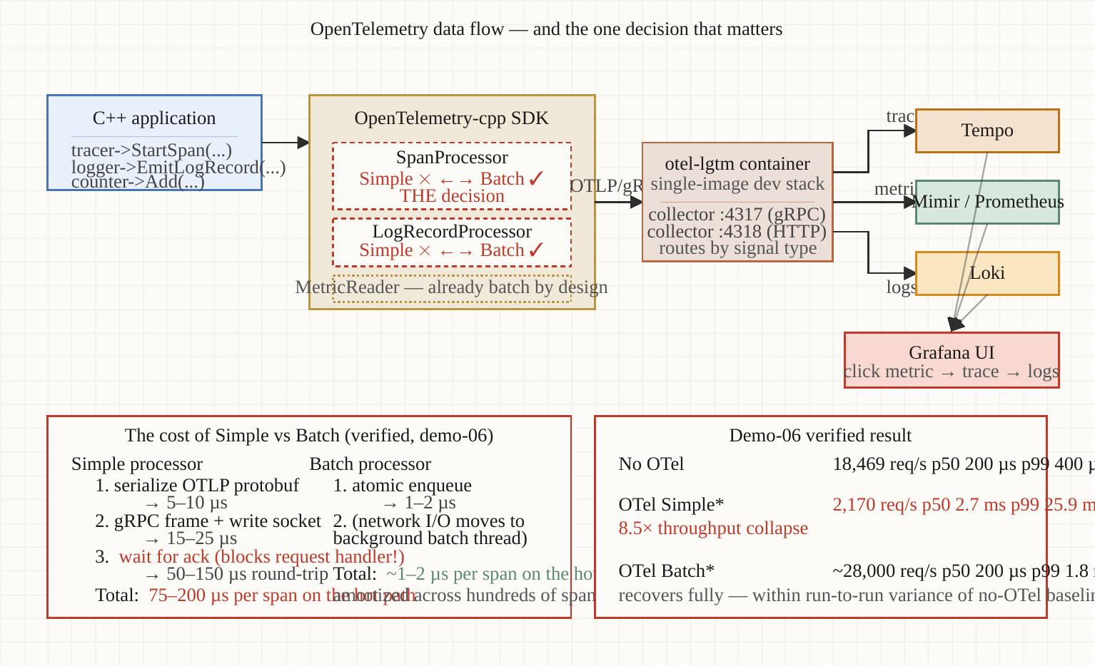
Observability & profiling
Section 10
The OTel + LGTM data flow
Three OTLP signals from the C++ SDK → grafana/otel-lgtm all-in-one → three datasources in Grafana.
Optimizing Modern C++ with Containers | Observability & profiling
43 / 71
Notes:
Three signals, one collector, three backends, one Grafana.
The C++ service uses opentelemetry-cpp SDK. It emits OTLP for all three signals — gRPC by default, HTTP/protobuf as an alternative. All three go to one endpoint: the collector inside grafana/otel-lgtm.
The collector splits the signals: traces go to Tempo, metrics go to Mimir (Prometheus-compatible storage), logs go to Loki. Grafana has all three as datasources and can pivot between them via trace_id — click a span in Tempo, jump to the matching log lines in Loki, see the metric values at that timestamp in Mimir.
The grafana/otel-lgtm image bundles all of this into one container. Production deployments would split these out — separate Tempo cluster, separate Loki cluster, etc. The tutorial setup is the demo-friendly version.

Slide 44
Observability & profiling
Section 10
The OTel Simple→Batch processor decision
8.5×
Per-span
Batched
§14
throughput recovery after switching
from Simple to Batch span processor
Simple processor: one
synchronous export per span
Batch processor: accumulate +
flush every N or every T ms
Pitfall: shipped Simple
in a Helm chart, lost 88% throughput
Optimizing Modern C++ with Containers | Observability & profiling
44 / 71
Notes:
A real production trap. The OpenTelemetry C++ SDK ships with both SimpleSpanProcessor and BatchSpanProcessor. Simple is great for debugging — every span goes out synchronously, you see it in the backend immediately. Batch is what production needs — accumulate spans, flush every N or every T ms.
If you copy a starter Helm chart that uses Simple and ship it to production, you can lose 80-90 percent of your throughput. We've seen this happen. The fix is literally a one-line change in the OTel init code. Section 14 has the runbook entry; Demo 6's observe mode shows the measured recovery: 8.5× throughput improvement going from Simple to Batch on our test workload.

Slide 45
Observability & profiling
Section 10
Three host-side complements
perf — CPU sampling
• perf record -F 99 -g -p $(pidof svc) sleep 30
• Flame graphs via Brendan Gregg's FlameGraph repo
• Tells you which functions burn CPU — application-layer doesn't see this
bcc-tools — off-CPU & syscall analysis
• tcpconnect, tcpaccept, tcpretrans, tcptracer — connection-level events
• opensnoop, execsnoop — file/process activity
• syscount — syscall histograms (great for io_uring perf debugging)
bpftrace — ad-hoc kernel probes
• One-liners against tracepoints, kprobes, uprobes
• `bpftrace -e 'tracepoint:sched:sched_switch /pid==1234/ { @[comm] = count(); }'`
• Catches scheduler-induced p99 spikes that OTel can't see
Optimizing Modern C++ with Containers | Observability & profiling
45 / 71
Notes:
Three host-side tools that complement OTel because they see things the application can't.
perf for CPU sampling. Run perf record at 99 Hz against your service PID for 30 seconds, get a stack-sampling profile. Render as a flame graph using Brendan Gregg's FlameGraph repo. Tells you which functions are eating CPU — your OTel spans see request boundaries, not function-level cost. Perf fills that gap.
bcc-tools for off-CPU and syscall analysis. tcpconnect, tcpaccept, tcpretrans, tcptracer for connection-level events. opensnoop and execsnoop for file and process activity. syscount for syscall histograms — that one's great for debugging io_uring throughput regressions because you can see whether you're actually saving syscalls.
bpftrace for ad-hoc kernel probes. One-liners against tracepoints, kprobes, uprobes. The classic example: catch a noisy neighbor by counting sched_switch events per process. Application metrics won't show that your process is getting preempted; sched_switch shows it directly.

Slide 46
▶ DEMO 04
Demo 4 — OTel Observability Stack
Brings up the LGTM stack, instruments a C++ service with OTel traces/metrics/logs, drives load, opens Grafana with pre-provisioned dashboards. Optional --bpftrace flag.
$ cd examples/demo-04-observability && ./demo.sh
source on site: patterncatalyst.github.io/cpp-container-optimization-tutorial/examples/demo-04-observability/
46 / 71
Notes:
Demo 4 — the observability foundation that the rest of the demos build on. First build is 2-3 minutes; the stack comes up in about 30 seconds.
What to watch: open Grafana at 127.0.0.1:3000, click into the 'Demo overview' dashboard. Three signals visible: traces from Tempo (click a span, see the waterfall), metrics from Prometheus (RPS, p50/p95/p99 histograms), logs from Loki (with trace_id links that let you pivot from a slow span back to the log lines during it).

Slide 47
§11
Noisy-neighbor isolation
cgroups v2, CPU pinning, NUMA — Demo 5
47 / 71
Notes:
Multi-tenant reality. Most production C++ services share hosts with other services. The dominant cost on a busy host is interference, not the CPU work each service performs in isolation. We're going to measure baseline vs unisolated vs weighted vs pinned, side-by-side, in Demo 5.

Slide 48
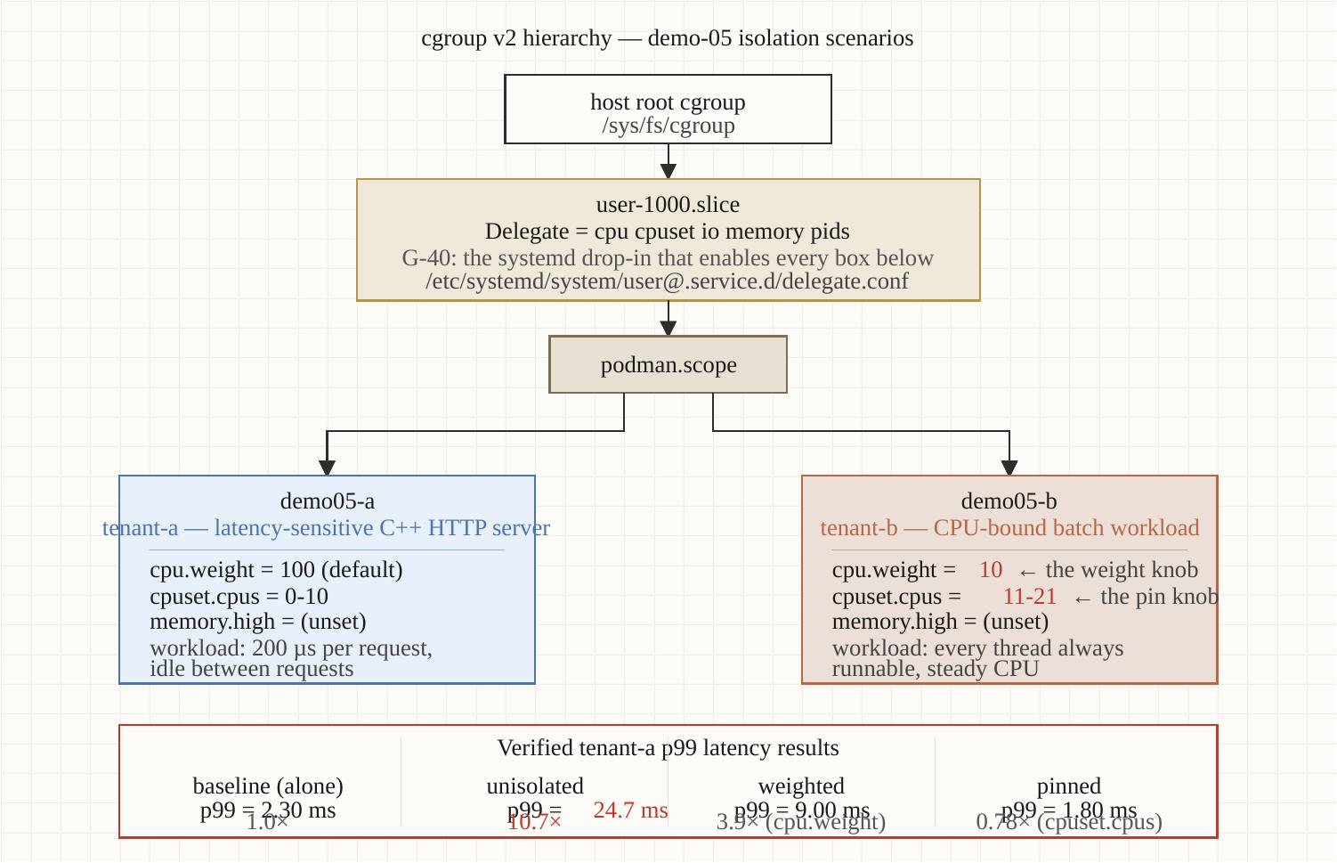
Noisy-neighbor isolation
Section 11
cgroup v2 controller tree
Every process is in a cgroup; every cgroup has weight on every resource; the kernel arbitrates.
Optimizing Modern C++ with Containers | Noisy-neighbor isolation
48 / 71
Notes:
The mental model. Every process lives in a cgroup. cgroups form a tree. Every cgroup has weights on every resource the kernel can arbitrate: CPU, memory, I/O. When resources are constrained, the kernel uses those weights to decide who gets what.
Three controllers we care about for C++ services. cpu.weight: from 1 to 10000, default 100. Higher weight gets more CPU under contention; below contention, weight doesn't matter, processes just run. cpuset.cpus: a specific list of CPUs the cgroup is allowed to use. Eliminates cross-tenant cache eviction. memory.high and memory.max: soft and hard memory pressure points covered in section 7.
Rootless caveat: by default, only memory and pids are delegated to user slices on Fedora. You need to enable cpu and cpuset delegation with a systemd drop-in for the weighted and pinned demos to work. Demo 5's preflight check detects this and points you at the helper script.

Slide 49
Noisy-neighbor isolation
Section 11
Demo 5 — tenant-a p99 under each scenario
2.3 ms
24.7 ms
9.0 ms
1.8 ms
Baseline
(tenant-a alone)
Unisolated
(default scheduler)
10.7× degradation
Weighted
(cpu.weight=10 for neighbor)
3.9× degradation
Pinned
(non-overlapping cpuset)
FASTER than baseline
Optimizing Modern C++ with Containers | Noisy-neighbor isolation
49 / 71
Notes:
Four scenarios, real numbers.
Baseline: tenant-a alone, no neighbor. 2.3 ms p99. That's the calibration point.
Unisolated: tenant-b is a synthetic noisy neighbor that pegs CPU. No scheduler tuning. Tenant-a's p99 climbs to 24.7 ms — more than 10× the baseline. That's the cost of doing nothing.
Weighted: cpu.weight=10 for tenant-b, leaving the default 100 for tenant-a. Same workload. Tenant-a's p99 drops to 9 ms — 3.9× the baseline. Most of the damage is gone, the neighbor still gets some CPU when it's available, the system is sharing reasonably.
Pinned: tenant-a gets cpuset.cpus=0,1; tenant-b gets cpuset.cpus=2,3. They cannot run on each other's CPUs. p99 drops to 1.8 ms — that's *faster than baseline*. Not a typo. When tenant-a gets dedicated CPUs the kernel scheduler doesn't migrate it, cache stays hot, the p99 actually drops below the single-tenant case. This is why latency-sensitive production services often pin.

Slide 50
Noisy-neighbor isolation
Section 11
Pinning vs weighting — when to use which
Use cpu.weight when:
• You want best-effort isolation with elastic CPU sharing
• Maximum throughput matters as much as p99
• Workload is bursty — pinning wastes CPU when nobody's busy
Use cpuset.cpus when:
• p99 is the metric you care about most
• Cache locality matters (databases, ML inference, RT services)
• You have enough cores to dedicate some — typically >= 8
Combine with NUMA when:
• Host has multiple NUMA nodes (most server hosts)
• `numactl --membind` pins memory allocation to the same node as CPU
• Cross-NUMA memory access costs 1.5-3× local
Optimizing Modern C++ with Containers | Noisy-neighbor isolation
50 / 71
Notes:
Pinning vs weighting — the decision.
Use cpu.weight when you want best-effort isolation with elastic sharing. Service A gets more CPU when there's contention, but uses the whole machine when idle. Good for bursty workloads. Bad if your goal is bounded p99 — weighting bounds contention damage but doesn't eliminate it.
Use cpuset.cpus when p99 is what you optimize for. Database engines, ML inference, real-time services. You need enough cores to dedicate some — typically 8 or more so you can give 2-4 to the critical workload and let the rest fight for the others.
Combine with NUMA when your host has multiple sockets. numactl --membind ties memory allocation to the same NUMA node as the CPU set. Cross-NUMA memory access is 1.5 to 3× slower than local — that overhead defeats the locality you got from pinning if you don't pin memory too.

Slide 51
▶ DEMO 05
Demo 5 — Noisy-Neighbor Isolation
Two services side-by-side, four scenarios run sequentially. Prints a comparison table of tenant-a p99 under each. Needs cgroup v2 controller delegation.
$ cd examples/demo-05-isolation && ./demo.sh
source on site: patterncatalyst.github.io/cpp-container-optimization-tutorial/examples/demo-05-isolation/
51 / 71
Notes:
Demo 5. Prereq is cgroup v2 controller delegation. The demo's preflight check will tell you if it's missing and point you at scripts/cgroup-delegation.sh.
Runtime: 3-5 minutes including the four scenario windows. The output is the four-row comparison table. Watch the pinned row — that 1.8 ms beating the 2.3 ms baseline is the result that most surprises engineers the first time they see it.

Slide 52
§12
Static analysis & debugging
cppcheck, clang-tidy, sanitizers, abidiff — Demo 7
52 / 71
Notes:
Engineering hygiene. The tools that catch bugs before production and the patterns that let you debug what slipped through. Demo 7 is the worked pipeline — cppcheck and clang-tidy as build stages, gtest as a separate target, sanitizers as build variants, abidiff as a CI gate, and the ephemeral gdbserver sidecar pattern for attaching to a running container without putting gdb into the runtime image.

Slide 53
Static analysis & debugging
Section 12
Static analysis as build stages
cppcheck — the lightweight catcher
• Catches: uninit vars, memory leaks, null deref, integer overflow
• Runs in seconds; output is XML for CI consumption
• Wire as a Containerfile build stage; fail the build on findings
clang-tidy — the modernization engine
• 100+ checks: modernize-, performance-, bugprone-, cert-
• Pair with .clang-tidy config + 'compile_commands.json'
• Modernizes your codebase incrementally — auto-fix where safe
Demo 7's '--demo-findings' flag
• Production code is clean — empty cppcheck.txt teaches nothing
• Flag temporarily appends a deliberately bad function to channel.cpp
• Runs through analyzer-soft (no gating), shows real findings, restores file
Optimizing Modern C++ with Containers | Static analysis & debugging
53 / 71
Notes:
Three subtopics on static analysis.
cppcheck is the lightweight catcher. Catches the obvious bugs — uninitialized variables, memory leaks, null pointer dereferences, integer overflow. Runs in seconds even on a large codebase. The output is XML so CI can parse it. Wire it as a build stage in your Containerfile; fail the build on any finding.
clang-tidy is heavier and far more powerful. Over a hundred checks across modernize-, performance-, bugprone-, cert- categories. The modernize- checks auto-fix your codebase to current idioms — modernize-use-nullptr replaces NULL with nullptr, modernize-loop-convert replaces index loops with range-for. The performance- checks catch things like unnecessary copies in range-for. Run clang-tidy with a .clang-tidy config file plus compile_commands.json — CMake exports the latter automatically.
Demo 7's --demo-findings flag is a teaching device. Real production code is clean, so the clang-tidy.txt output is empty — which doesn't teach the reader anything. The flag temporarily appends a deliberately bad function to channel.cpp, runs through an analyzer-soft stage that captures findings without gating the build, then restores the file. You see what the tools actually report.

Slide 54
Static analysis & debugging
Section 12
Sanitizers — the slowdown table
Build variants that catch UB at runtime; slowdown determines what you can ship to staging:
# Sanitizer Slowdown Catches
# ========= ========= ===========================================
# ASan 1.5-3x heap/stack OOB, use-after-free, leaks
# UBSan ~1.2x signed overflow, null deref, bad enum casts
# TSan 5-15x data races, deadlocks (mutex order)
# MSan 2-3x uninit memory reads (Clang-only)
# Valgrind 20-50x same as ASan, no rebuild needed
#
# Production approach:
# - ASan + UBSan: ALWAYS in CI for every change
# - TSan: nightly on the multithreaded test suite
# - MSan: rare; only when chasing uninit-read bugs (rebuild deps)
# - Valgrind: when you can't rebuild — last resort
# CMake preset for ASan+UBSan
cmake -B build-asan -DCMAKE_CXX_FLAGS="-fsanitize=address,undefined \
-fno-omit-frame-pointer -g"
cmake --build build-asan && ASAN_OPTIONS=halt_on_error=1 ./build-asan/svc
Optimizing Modern C++ with Containers | Static analysis & debugging
54 / 71
Notes:
Slowdown is what determines what you can practically ship. ASan plus UBSan is the production-friendly combination — 1.5-3× slowdown, catches the majority of memory bugs and undefined behavior. Run on every CI build. Some teams ship ASan in staging environments and live with the slowdown to catch issues earlier.
TSan is 5-15× slower because it's instrumenting every memory access for happens-before tracking. Run TSan nightly against your multithreaded test suite, not on every commit. TSan finds the bugs that ASan can't catch — data races, deadlock potential — but the slowdown means you can't ship it.
MSan needs Clang and you need to rebuild your dependencies with MSan enabled, or the false positives drown you. Use it when you're specifically hunting an uninit-read bug.
Valgrind is the last resort — when you can't rebuild the binary, when you only have the production artifact. 20-50× slowdown, but it just works on any ELF without recompilation. Demo 7 has all five wired up as separate build variants you can select with --variant=asan etc.

Slide 55
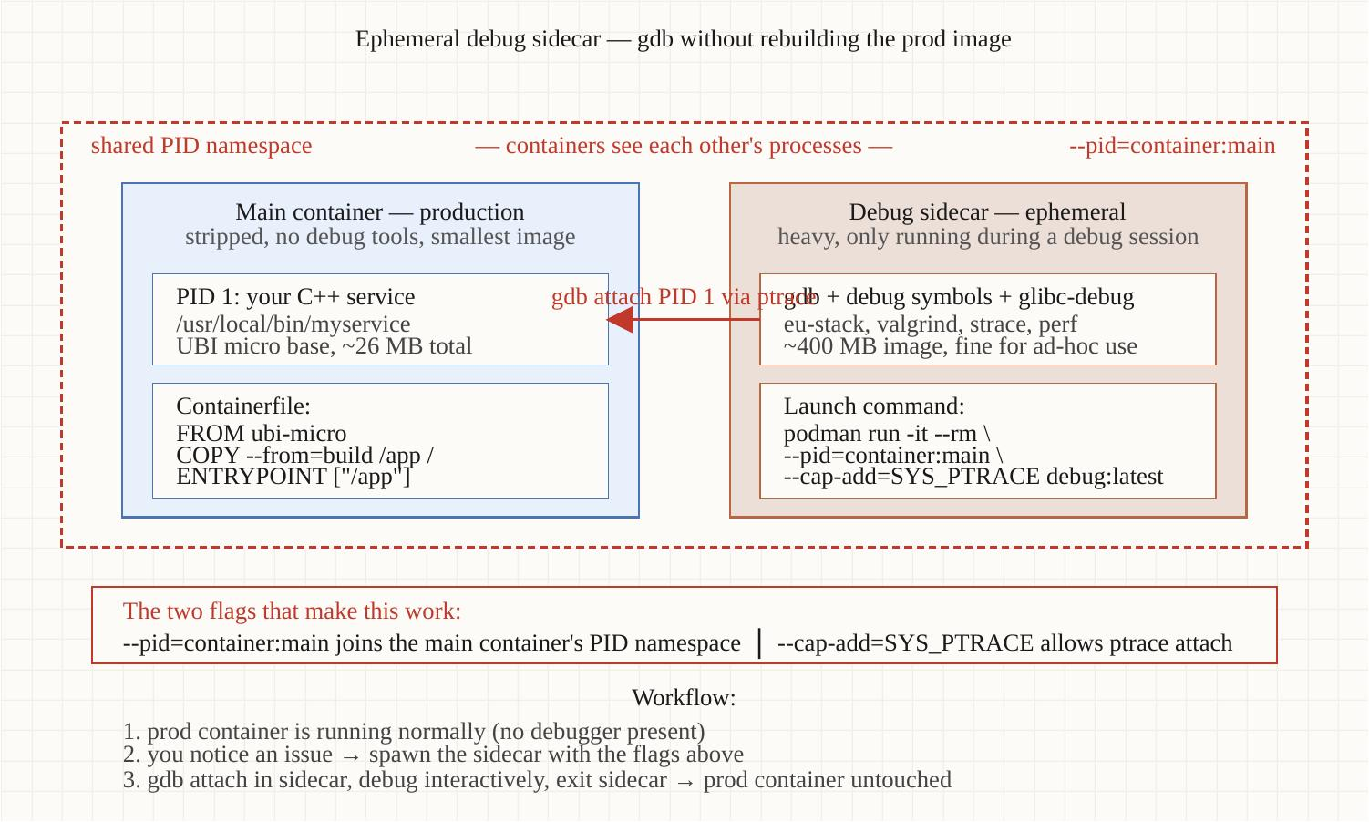
Static analysis & debugging
Section 12
The gdbserver sidecar pattern
Debug a production container without putting gdb in its image. Sidecar shares the PID namespace, attaches, you connect from your workstation.
Optimizing Modern C++ with Containers | Static analysis & debugging
55 / 71
Notes:
The pattern. You have a production C++ service running in ubi-micro — no shell, no debugger, no package manager. Something goes wrong. You can't exec into the container, there's nothing to exec. You don't want to put gdb into the runtime image because it bloats it and adds CVE surface.
Solution: a sidecar container that shares the same PID namespace. Sidecar has gdb, gdbserver, perf, all the tools. Service container has just the binary. Sidecar attaches gdbserver to the service PID, exposes a TCP port. Your workstation runs gdb, connects to that port, debugs the running service. When you're done, kill the sidecar; service is undisturbed.
This is the production pattern. SREs at Stripe, Cloudflare, Google all do some variant of this. Demo 7 has the exact compose snippet — the sidecar shares podman pod, podman pod handles the PID namespace sharing automatically.

Slide 56
▶ DEMO 07
Demo 7 — Quality Pipeline
Full hygiene pipeline in one demo: cppcheck, clang-tidy, gtest, ASan+UBSan, abidiff, hermetic Conan lockfile, and the ephemeral gdbserver sidecar. Use --demo-findings to see what the analyzers actually report.
$ cd examples/demo-07-quality-pipeline && ./demo.sh
source on site: patterncatalyst.github.io/cpp-container-optimization-tutorial/examples/demo-07-quality-pipeline/
56 / 71
Notes:
Demo 7. Five minutes for the full pipeline run. Subsequent runs are quick because Conan caches.
Three things to watch. First, the static-analysis output — with --demo-findings, you'll see real bugs detected and the build report them clearly. Second, the sanitizer build — ASan+UBSan adds a noticeable build-time cost but the runtime cost is bearable. Third, the gdbserver sidecar — we'll attach to the running service and break in main(), prove the production binary is fully debuggable without polluting its image.

Slide 57
§13
Reproducibility & ABI
Conan lockfiles, CMake presets, abidiff — the binary-from-a-commit story
57 / 71
Notes:
Still Demo 7. The reproducibility story. Every binary you ship should be reconstructible byte-for-byte from a commit and a lockfile, six months later. Conan 2's lockfile mechanism is what makes that real. abidiff is what catches the silent ABI breaks that escape from your dependencies and into your production binary.

Slide 58
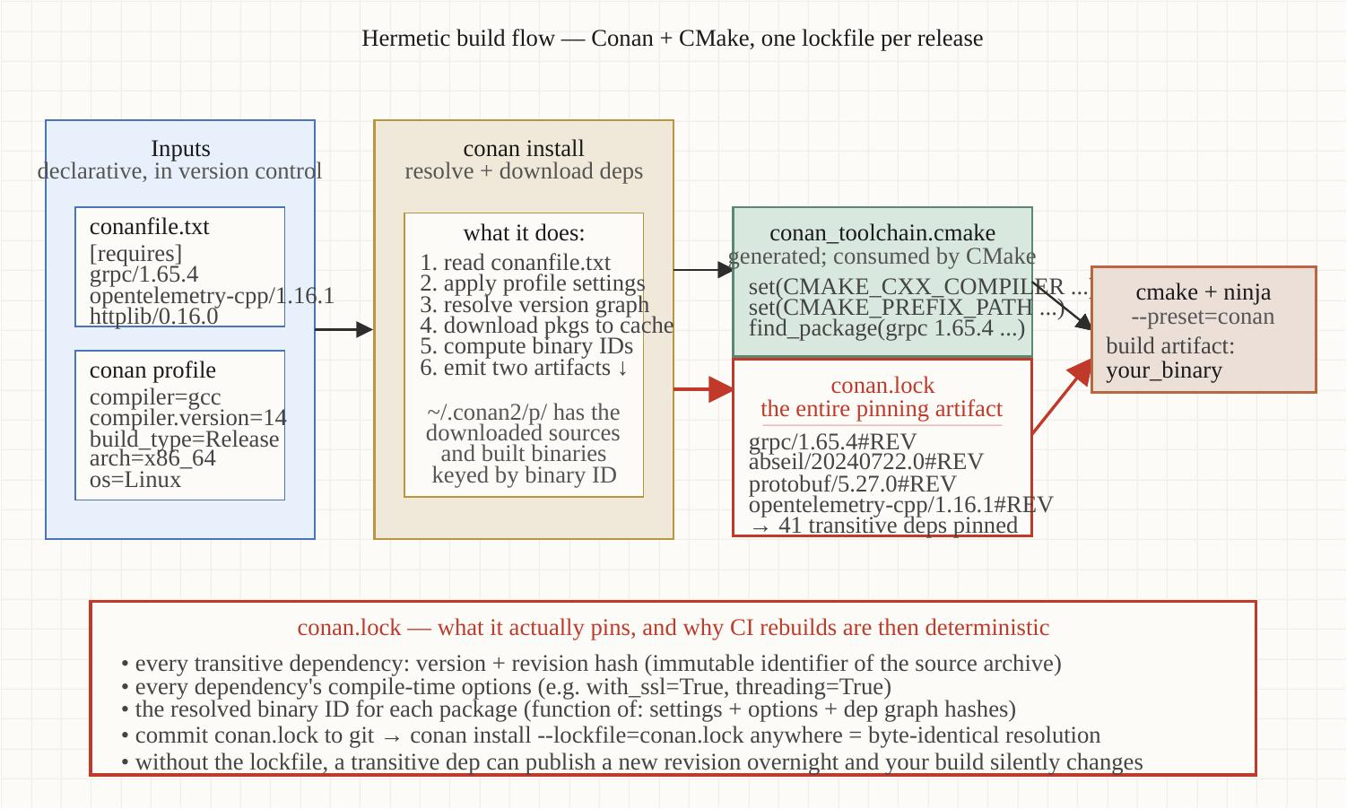
Reproducibility & ABI
Section 13
The Conan + CMake hermetic flow
conan.lock pins exact versions; CMake presets pin compiler flags; the build is reproducible from commit + lockfile.
Optimizing Modern C++ with Containers | Reproducibility & ABI
58 / 71
Notes:
Three pinning points along the build flow.
First, conan.lock pins every transitive dependency to an exact version and recipe revision. If fmt/10.1.0:abc123 is in the lockfile, that exact recipe revision will be resolved next year too, even if the Conan Center package gets updated.
Second, CMakePresets.json pins the toolchain, the build type, compiler flags, and configuration options. Anyone running `cmake --preset release` gets the same build configuration.
Third, the Containerfile pins the base image. UBI 10 with a specific digest hash, not just 'ubi10/ubi:latest'. If Red Hat ships a new ubi10 image, you don't pick it up until you explicitly update the digest.
All three together: given a git commit, you can rebuild bit-identical binaries six months from now. Demo 7 demonstrates this — it builds twice, then compares the binaries with `cmp` and shows they're byte-identical.

Slide 59
Reproducibility & ABI
Section 13
abidiff — the silent ABI break catcher
Catches silently-broken ABI between dependency versions. Wire as CI gate.
# A dependency upgrade looks innocent — but did the ABI change?
# Run abidiff against the before/after .so files:
abidiff old-libfoo.so new-libfoo.so
# Output: 'No changes' or a structured report of:
# - Functions added/removed
# - Function signatures changed (parameter types, return types)
# - Struct members added/removed/reordered
# - Member offsets shifted
# CI integration — fail on incompatible ABI changes:
abidiff --suppressions abi-suppressions.txt \
baseline/libfoo.so new/libfoo.so || exit 1
# Common silent ABI break:
# - Header says: void process(MyConfig& cfg);
# - MyConfig added a field. New code passes 24-byte struct;
# - Old caller (built against old header) passes 16-byte struct.
# - Caller passes garbage; either crash or silent corruption.
Optimizing Modern C++ with Containers | Reproducibility & ABI
59 / 71
Notes:
abidiff from libabigail. The use case: you're upgrading a dependency from version 1.2.0 to 1.3.0. Maintainers say it's a minor version bump, ABI-compatible. abidiff tells you whether that's actually true.
What it catches: function signature changes (return types, parameter types, calling conventions), struct member additions and reorderings, member offset shifts, removal of public symbols that downstream code might use. The structured report tells you exactly what changed.
The classic silent ABI break: a header file adds a field to a public struct. Code that was built against the old header passes a 16-byte struct into a function that now expects 24 bytes. Compiler doesn't catch it because the call site sees the new struct definition in its TU and the linker resolves the function symbol. But the caller built against the old header passes garbage. Either you crash or you silently corrupt data.
Demo 7 has a `--abi-break` flag that intentionally introduces a struct change and shows abidiff catching it. The CI integration is one line — `abidiff old new || exit 1`. Run it on every release branch against the previous release.

Slide 60
Reproducibility & ABI
Section 13
What 'hermetic' actually means
Hermetic = build is a pure function of its inputs
• Same source + same lockfile → byte-identical binary, on any machine
• No network access during build (after lockfile resolution)
• No reliance on /usr/local, /opt, or anything outside the sandbox
Common leaks (what makes a build NOT hermetic)
• Build script does `pip install` without a constraints file
• Compiler reads system headers from /usr/include — host-version-dependent
• Test data downloaded at build time without a hash check
• Timestamps embedded in the binary (use SOURCE_DATE_EPOCH)
Demo 7 demonstrates
• `./demo.sh build && ./demo.sh build && cmp build1.bin build2.bin`
• Byte-identical output. That's the reproducibility test.
Optimizing Modern C++ with Containers | Reproducibility & ABI
60 / 71
Notes:
Hermetic builds. The principle: the build is a pure function of its inputs. Same source plus same lockfile yields a byte-identical binary, regardless of which machine builds it.
What makes a build not hermetic — the leak sources. pip install without constraints — picks up new transitive deps every time. System headers — your binary embeds the layout of structs from the host's /usr/include, which differs between Fedora versions. Network downloads at build time — unless you checksum them, you're trusting a remote server to give you the same bits every time. Timestamps — by default many compilers embed `__DATE__` macros and the build timestamp; set SOURCE_DATE_EPOCH from your git commit timestamp to make this deterministic.
Demo 7's reproducibility test is a one-liner — build twice in a row, `cmp` the binaries. They should be byte-identical. If they're not, something in your build is non-hermetic, find it and fix it. The diff-strings output tells you what differs — often it's the timestamp.

Slide 61
§14
Pitfalls
Symptom → root cause → fix. The runbook section.
61 / 71
Notes:
Pitfalls. The traps that catch experienced people. Every entry is structured as symptom-cause-fix because that's how the bug actually arrives in your inbox. Not 'I read about a class of bugs' — instead, 'my service is crashing with SIGILL on the new fleet, what changed'.

Slide 62
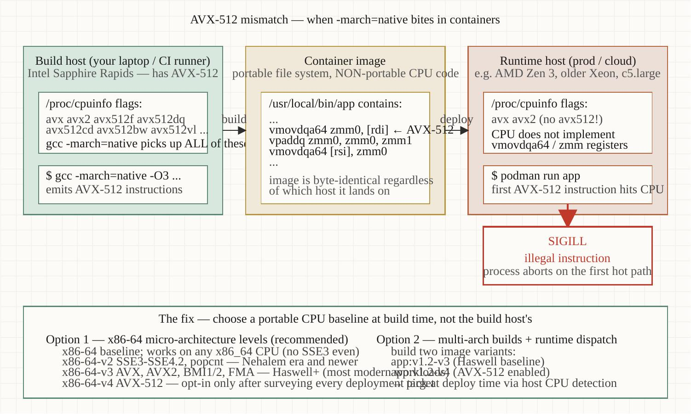
Pitfalls
Section 14
Pitfall 1: AVX-512 instruction-set mismatch
-march=native at build time + heterogeneous fleet at runtime = SIGILL on the older silicon.
Optimizing Modern C++ with Containers | Pitfalls
62 / 71
Notes:
The most common production C++ container failure that I see misdiagnosed.
Symptom: service runs fine in dev. Promoted to staging fleet, runs fine. Promoted to production fleet, immediately crashes with SIGILL — illegal instruction. Engineers blame the container runtime, the OS upgrade, something exotic. The actual cause is the build host.
Cause: the build host had a newer CPU than some production hosts. -march=native at compile time told GCC to use whatever instructions the build host had — which included AVX-512. Some production hosts are older silicon that doesn't have AVX-512. The first AVX-512 instruction the binary tries to execute, the CPU raises SIGILL.
Fix: never use -march=native for binaries that will be promoted across hosts. Use -march=x86-64-v3 (which is Haswell-era — AVX2 but not AVX-512) as a conservative baseline, or -march=x86-64-v4 if you know your entire fleet is Skylake-X or newer. The tutorial's Containerfile pins -march=x86-64-v3 explicitly for exactly this reason.

Slide 63
Pitfalls
Section 14
Pitfalls 2-4: silent overhead, build delays, OTel processor
2. The 25%-of-host malloc trap
• Symptom: pod gets OOMKilled even though service appears to use minimal memory
• Cause: glibc malloc reads host RAM via /proc/meminfo, ignores cgroup
• Fix: set MALLOC_ARENA_MAX=2, or switch to mimalloc/jemalloc
3. Abstraction overhead from misjudged virtuals
• Symptom: 15-30% throughput regression after a 'clean refactor'
• Cause: virtual functions on tight inner loops defeat inlining
• Fix: profile first; templates or CRTP for hot paths; virtuals only for true polymorphism
4. OTel Simple vs Batch span processor
• Symptom: shipped OTel to prod, throughput dropped 80%+
• Cause: SimpleSpanProcessor does synchronous export per span
• Fix: switch to BatchSpanProcessor; one-line change in init code
Optimizing Modern C++ with Containers | Pitfalls
63 / 71
Notes:
Three more pitfalls.
Number two: the 25%-of-host malloc trap. Symptom is your pod gets OOMKilled but your service appears to be using almost no memory. What's happening is glibc malloc reads /proc/meminfo, sees the host has 256 GB, decides it can claim 25% — 64 GB — of arena space without bothering the kernel. Your pod's cgroup limit is 2 GB. First time glibc tries to actually touch some of that arena, you cross the cgroup limit, kernel OOM kills you. Fix: MALLOC_ARENA_MAX=2 caps the arena count, or switch allocators entirely.
Number three: abstraction overhead. After a code-cleanup refactor that introduced an interface hierarchy in your hot path, throughput drops 15-30%. Cause: every virtual call is an indirect jump, defeats inlining, defeats branch prediction at the call site. Fix is profile-driven — figure out which call sites actually matter, and use templates or CRTP (curiously-recurring template pattern) to get polymorphism without virtual dispatch.
Number four: OTel Simple vs Batch — we covered this in section 10. SimpleSpanProcessor is great for debugging, fatal for production. The fix is one line.

Slide 64
Pitfalls
Section 14
The 'symptom → cause → fix' template
Why this format works for runbooks:
• The bug arrives as a SYMPTOM. The on-call has logs, dashboards, a paging alert.
• The on-call has zero context on the cause space.
• Runbook entries indexed by symptom let the on-call find their bug fast.
• Entries indexed by cause assume knowledge that's exactly what the on-call lacks.
Pattern for your own team's runbook:
• Symptom: paste the alert text or error message verbatim
• Cause: one paragraph, plain English, no jargon
• Fix: literal commands. Not 'check the X' but 'run $ kubectl describe ...'
• Verify: how do you know the fix worked
• Prevent: what to change so it doesn't recur
Optimizing Modern C++ with Containers | Pitfalls
64 / 71
Notes:
Why I keep coming back to symptom-cause-fix as the runbook format. When a bug arrives at 3am, the on-call has the symptom — they're looking at the alert, the stack trace, the error message. They don't have context on the cause; that's exactly what they need to figure out. A runbook indexed by cause assumes the very knowledge the reader is searching for.
So index by symptom. Paste the alert or error message literally. Make it grep-able. When the same bug appears six months later and a different engineer is on-call, they grep the runbook for the error string and find the entry.
Cause goes in one plain-English paragraph — what's actually broken under the hood. Fix is literal commands, not abstract guidance. 'Check the cgroup' is useless; '$ cat /sys/fs/cgroup/...memory.max' is actionable.
Verify section: how do you know it worked. Prevent section: what to change in code or config so it doesn't recur. This last section is what turns incidents into permanent improvements.

Slide 65
§15
Where to go next
Four reference books + the topics this tutorial deliberately doesn't cover
65 / 71
Notes:
Short section. Four books that go deeper on different axes than this tutorial does, plus an honest list of what we deliberately don't cover.

Slide 66
Where to go next
Section 15
Four reference books — pick one based on what you need next
Andrist & Sehr — C++ High Performance, 2e
• The single best book on modern C++ performance. C++20 throughout.
• If you read one, read this one. Chapters 4-5 are the most-cited here.
Iglberger — C++ Software Design
• Patterns + anti-patterns for C++ at scale. The abstraction tax chapter.
• Read after Andrist when you're designing libraries, not just optimizing them.
Enberg — Latency
• Cross-stack latency engineering — application through kernel through hardware.
• Best book on observability-as-measurement. Chapter 8 is the OTel reference.
Ghosh — Building Low Latency Apps with C++
• Trading-systems-grade latency. Lock-free, NUMA, kernel bypass.
• Read when 'reasonably fast' isn't enough — when single-digit microseconds matter.
Full annotated treatment: /bibliography/ on the tutorial site.
Optimizing Modern C++ with Containers | Where to go next
66 / 71
Notes:
Four books, ordered by accessibility plus how often they came up in this tutorial.
Andrist and Sehr's C++ High Performance second edition is the single best book on modern C++ performance. C++20 throughout, real benchmarks, idiomatic code. Chapters 4 and 5 — containers and algorithms — are what informed section 6 of this tutorial.
Iglberger's C++ Software Design is the patterns + anti-patterns book. Read it after Andrist if you're designing libraries, not just optimizing existing code. The abstraction tax chapter is the explicit treatment of pitfall number 3 from section 14.
Enberg's Latency is unusual — it goes vertically through the stack from application through kernel through hardware. Best book on observability as a measurement discipline. Chapter 8's framing on 'measuring perturbs the measurement' is what informs section 10.
Ghosh's Building Low Latency Apps with C++ is trading-systems-grade. Lock-free data structures, NUMA, kernel bypass with DPDK. Read this when single-digit microseconds matter, not 'fast enough'.
The /bibliography/ page on the tutorial site has full annotated treatment — which chapter of which book informs which section of this tutorial, plus a few honorable mentions that didn't make the four-book cut.

Slide 67
Where to go next
Section 15
What this tutorial doesn't cover
Deliberately out of scope
• C++ language fundamentals — assumed knowledge
• Kubernetes operator/Helm/cluster-level concerns (separate tutorial)
• Coroutines (C++20) — major topic, deserves its own treatment
• GPU offload / CUDA / OpenCL — different problem space
• Distributed tracing patterns — touched in §10, not deep
• Mobile / embedded C++ — different OS constraints
If you want more on these
• Coroutines: Lewis Baker's lewissbaker.github.io posts, cppcoro library
• Kubernetes for ops: hummingbird-tutorial (companion project)
• GPU offload: NVIDIA's HPC SDK docs, Bryce Adelstein Lelbach's talks
This tutorial is opinionated about its scope. We do containerized C++ services well; for other axes, the right answer is a different tutorial.
Optimizing Modern C++ with Containers | Where to go next
67 / 71
Notes:
Honest scope statement. We deliberately don't cover several things that get asked about.
C++ language fundamentals: assumed. We expect knowledge of templates, RAII, move semantics, and the STL. If you're newer to C++, cppreference and Andrist & Sehr are the right starting points.
Kubernetes operator concerns, Helm charts, cluster-level scheduling: cgroups v2 and Podman pods are the deployment mental model here. Translating to k8s is mechanical but k8s-specific work deserves its own tutorial. The hummingbird-tutorial covers podman-to-Kubernetes for completeness.
Coroutines: C++20 coroutines are a major topic. They deserve their own tutorial; this one would balloon if we added them. Lewis Baker's blog at lewissbaker.github.io is the canonical introduction. cppcoro is the reference library.
GPU offload, CUDA, OpenCL: different problem space. Different observability stack, different optimization concerns. NVIDIA's HPC SDK documentation is where to start.
Mobile and embedded: different OS constraints, no cgroups in the same form, different allocator trade-offs. The mental-model section here is partially transferable; the specific knobs are not.

Slide 68
§16
Appendix A — Conan, autotools, UBI's minimal perl
The survival guide for from-source dependency builds on UBI
68 / 71
Notes:
Brief appendix. Read this one before you attempt your own Conan + UBI + autotools-using-dep build. The tutorial's demo-04 took six rounds of build failures to converge. That war story played out on UBI 9; the tutorial now targets UBI 10 and the recipe below is updated to match — but the trap is a property of UBI's deliberate minimalism, not of any one release: UBI's minimal perl is missing modules that autotools' configure scripts assume are present.

Slide 69
Appendix A — Conan, autotools, UBI's minimal perl
Section 16
The fifteen perl modules that autotools wants
UBI's perl-interpreter is the minimal subset. Any autotools-based Conan build (libcurl, c-ares, openssl, nghttp2, etc.) will fail until these are installed:
Core (always needed)
• perl-Carp perl-Data-Dumper perl-Errno perl-Getopt-Long
• perl-Pod-Simple perl-PathTools perl-File-Path perl-File-Temp
Build-script-specific (commonly needed)
• perl-Digest-MD5 perl-Encode perl-MIME-Base64
• perl-Scalar-List-Utils perl-Storable perl-Text-ParseWords
• perl-Thread-Queue
Simplifying alternatives
• Use ubi10/ubi (not ubi10/ubi-minimal) for the builder stage — includes full perl
• Use a pre-built ConanCenter binary if your platform has one
• Or maintain a 'fat builder' base image with all 15 modules baked in
Optimizing Modern C++ with Containers | Appendix A — Conan, autotools, UBI's minimal perl
69 / 71
Notes:
Fifteen perl modules. I'll spare you the bug history and just give you the list. If you're doing a Conan from-source build on ubi10/ubi-minimal of anything that uses autotools — libcurl, c-ares, openssl, nghttp2, and most C libraries from the 90s — you need these fifteen modules.
Three simplifying alternatives. First and easiest: use the full ubi10/ubi image for the builder stage. The runtime image can still be ubi10/ubi-minimal or ubi10/ubi-micro. Multi-stage means the builder bulk doesn't ship to production. The perl modules are in the builder only.
Second: use a pre-built ConanCenter binary if your platform has one. Conan resolves prebuilt artifacts preferentially; you only fall through to from-source if there's no compatible prebuilt.
Third: maintain a 'fat builder' base image at your organization with all 15 perl modules baked in. Internal teams pull from your builder image; consistency across teams, no per-team rediscovery.

Slide 70
Appendix A — Conan, autotools, UBI's minimal perl
Section 16
Worked example — libcurl from source on UBI 10
The Containerfile fragment that actually works:
# Builder stage — full UBI 10 with the 15 perl modules.
# gcc/gcc-c++ (14.3.1) come straight from the base appstream —
# no software collection, no `scl enable`; CRB is on by default.
FROM registry.access.redhat.com/ubi10/ubi:10.2 AS builder
RUN dnf install -y perl-Carp perl-Data-Dumper perl-Errno \
perl-Getopt-Long perl-Pod-Simple perl-PathTools \
perl-File-Path perl-File-Temp perl-Digest-MD5 \
perl-Encode perl-MIME-Base64 perl-Scalar-List-Utils \
perl-Storable perl-Text-ParseWords perl-Thread-Queue \
gcc gcc-c++ cmake ninja-build python3-pip && \
pip install conan==2.* && dnf clean all
WORKDIR /src
COPY . .
# `conan install` works now: perl modules are present
RUN conan install . --build=missing && \
cmake --preset release && \
cmake --build --preset release
# Runtime: minimal, no perl, no compiler — just the binary
FROM registry.access.redhat.com/ubi10/ubi-micro:10.2
COPY --from=builder /src/build/release/svc /usr/local/bin/svc
ENTRYPOINT ["/usr/local/bin/svc"]
Optimizing Modern C++ with Containers | Appendix A — Conan, autotools, UBI's minimal perl
70 / 71
Notes:
The Containerfile fragment that actually works for libcurl-from-source on UBI 10. Builder stage installs the fifteen perl modules, plus the toolchain and Conan 2. On UBI 10 the compiler is just base gcc/gcc-c++ 14.3.1 — no gcc-toolset software collection to enable. Then `conan install --build=missing` works because the dependency's configure script can find all the perl modules it needs.
Runtime stage is ubi10/ubi-micro, no perl at all, no compiler. Just the binary we copy from the builder. Final image is tens of megabytes, not hundreds. Builder image is large but only exists in your build cache, not in production registries.
This appendix exists because every team that goes from Ubuntu to UBI hits this. The Ubuntu base images include a fuller perl by default; UBI is more aggressive about minimization. The first time your Conan build fails on a missing perl-Errno module is when you realize what's going on. Save yourself the rounds.

Slide 71
Thank you.
Every claim has a runnable demo on the repo.
Tutorial site
All 7 demos
Bibliography
patterncatalyst.github.io/cpp-container-optimization-tutorial
github.com/.../examples
/bibliography/ — Andrist & Sehr, Iglberger,
Enberg, Ghosh
Notes:
We covered seventeen sections, seven demos, the bibliography, and the reproducibility story. Three places to go from here:
The tutorial site at patterncatalyst.github.io is the long-form reference. Every code listing, every metric, every diagram — and the reconciliation plan, which is the truth source for what's verified versus what's claimed.
The GitHub repo has all seven demos. Each one is a self-contained Podman project; cd in, run ./demo.sh, and you have the numbers. Fork it, run the demos against your own workload, file an issue if a measurement doesn't match what your machine does.
The bibliography page consolidates the four reference books — Andrist & Sehr, Iglberger, Enberg, Ghosh — with annotations on what each is strongest at and which sections of this tutorial draw on each. If you want one to read next, that page tells you which one and in what order.
Questions?

