Slide 1
STATELESSNESS COMPENDIUM
Stateless C++ Services
Under Container Orchestration
Request / process / deploy-time scope • RAII • PMR • pools • health & shutdown • the gRPC capstone
Companion deck to “Optimizing Modern C++ with Containers” — Docs 01–11
Every pattern has a runnable Podman demo — 02–11 host-verified
github.com/patterncatalyst/cpp-statelessness
Notes:
This is the statelessness compendium deck — the architectural companion to the performance talk. Where the main deck is about making C++ fast under container constraints, this one is about making C++ services correct as stateless workloads under an orchestrator.
The spine is a single idea developed across eleven documents: statelessness is a deployment posture, not a code property, and the C++ techniques that satisfy it — RAII for request scope, PMR for request memory, explicit process-scoped ownership, externalized authoritative state, health checks and graceful shutdown — compose into one realistic gRPC service by the end.
Every pattern here has a runnable Podman demo, and examples 2 through 11 are host-verified end to end on Fedora 44. We'll cue each demo at the point its pattern is introduced.

Slide 2
Agenda — the eleven documents
Overview
1
Statelessness as deployment posture
7
State externalization
2
RAII as the foundation
8
The ephemeral filesystem
3
PMR: request brings its own memory
9
Health checks & graceful shutdown
4
Process-scoped state, owned in main()
10
The gRPC end-to-end example
5
Threading under a CPU quota
11
Build tooling & vendored helpers
6
12-Factor adapted to C++
Optimizing Modern C++ with Containers | Agenda
2 / 67
Notes:
Eleven documents, three movements. Documents 1 through 3 establish the foundations — the scope vocabulary, RAII, and PMR. Documents 4 through 8 cover the operational concerns — process-scoped ownership, threading, 12-factor, state externalization, the ephemeral filesystem. Documents 9 through 11 land it — health checks and shutdown, the gRPC capstone that composes everything, and the build tooling appendix with the vendored helpers.
Each section ends or pauses on a demo cue where the pattern has a runnable companion.

Slide 3
§1
Statelessness as deployment posture
Statelessness is not a code property — it's what the orchestrator can assume.
3 / 67
Notes:
This compendium is the architectural spine under the performance talk. The thesis here sets the vocabulary for everything that follows: statelessness isn't something you can read off a source file. The same C++ binary can be stateless or stateful depending on what state it holds and where. What makes a service 'stateless' is a property the orchestrator relies on — that it can kill, restart, and scale a replica without coordination.

Slide 4
Statelessness as deployment posture
§1
Why statelessness is the property everything depends on
3
0
02–11
1
scopes of state — request, process, deploy-time —
and only one of them may hold authoritative data
coordination needed to kill or restart a replica
when nothing authoritative lives in-process
compendium examples, each a runnable Podman
demo, host-verified end to end on Fedora 44
binary — stateless or stateful depending only on
where it keeps state, not on its code
Optimizing Modern C++ with Containers | Statelessness as deployment posture
4 / 67
Notes:
Four numbers to frame the whole deck. Three scopes of state, and the discipline is that only deploy-time scope holds authoritative data. Zero coordination to kill a replica — that's the operational payoff. The whole compendium is runnable, not just described. And the punchline: it's one binary; statelessness is about where state lives, not how the code is written.

Slide 5
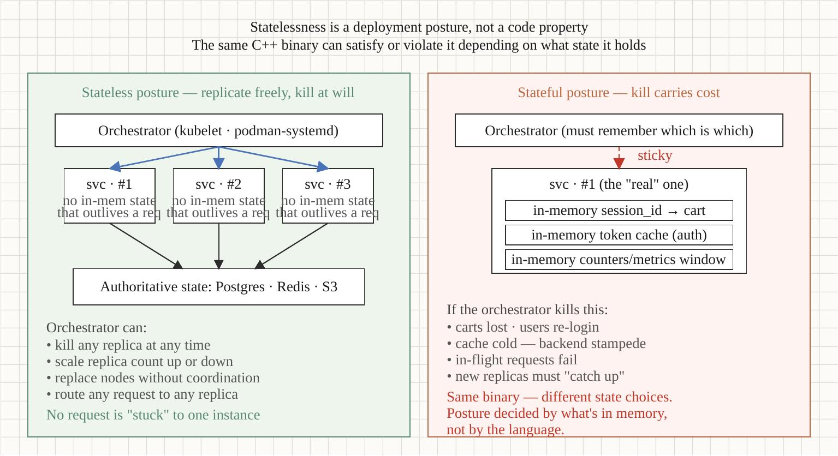
Statelessness as deployment posture
§1
Three scopes of state
The same binary, three kinds of state
• Request scope — lives for one RPC; born and dies inside the handler
• Process scope — lives for the process; pools, caches, channels, config
• Deploy-time scope — lives outside the process; the database, the queue, the cache tier
Statelessness means: nothing the orchestrator can't recreate lives in process scope. Kill a replica and nothing authoritative is lost.
Optimizing Modern C++ with Containers | Statelessness as deployment posture
5 / 67
Notes:
The three-scope vocabulary is used in every later document, so it's worth fixing now. Request scope is the per-RPC lifetime — RAII makes this concrete (the RAII section). Process scope is the process lifetime — pools, channels, parsed config, owned in main() (process scope). Deploy-time scope is everything outside the process — the externalized authoritative state (state externalization).
The litmus test for statelessness: if you SIGKILL a replica, is anything authoritative lost? If the answer is no, the service is stateless regardless of how much process-scoped state it holds for performance.

Slide 6
Statelessness as deployment posture
§1
Six monolith intuitions that mislead
What bare-metal habits get wrong under containers
• "The box has N cores" — the cgroup quota does not equal nproc
• "Memory is the machine's RAM" — memory.max is the real ceiling
• "The filesystem persists" — the rootfs is ephemeral (ephemeral filesystem)
• "My thread pool should match the CPU count" — it should match the cgroup (threading)
• "Local cache is free" — it desyncs across replicas (state externalization)
• "Restart is exceptional" — under orchestration it's routine (health & shutdown)
Optimizing Modern C++ with Containers | Statelessness as deployment posture
6 / 67
Notes:
Each of these intuitions is correct on a dedicated box and wrong under an orchestrator. The thread-pool one is the most expensive: hardware_concurrency() reports the host's core count, not the cgroup quota, so a naive pool oversubscribes and the CFS scheduler throttles it — wrecking tail latency. Demo 11 makes that gap visible. We'll return to each of these as we go.

Slide 7
Statelessness as deployment posture
§1
The State Architecture Table
Decide, per piece of state, where it lives
• Session / auth context → externalized (cache tier), never in-process
• Counters, sequences → the database, atomic; not a process-local int
• Durable workflow → the database or a workflow engine
• Connection pools, channels, parsed config → process scope, owned in main()
• Per-request scratch → request scope, the PMR arena
The table is the design exercise: enumerate every piece of state and assign it a scope.
Optimizing Modern C++ with Containers | Statelessness as deployment posture
7 / 67
Notes:
The State Architecture Table is the practical heart of the process-scope section, introduced here. The exercise is mechanical and clarifying: list every piece of state your service touches, and for each one decide its scope. Anything authoritative goes to deploy-time scope. Anything that's pure performance infrastructure — pools, caches, channels — is process scope, bounded and owned in main(). Anything per-request is request scope. Get this table right and statelessness falls out.

Slide 8
§2
RAII as the foundation
Bind resource lifetime to scope; the destructor is the contract.
8 / 67
Notes:
RAII is the mechanism that makes request scope concrete. If request scope is the idea, RAII is the C++ feature that enforces it: resource lifetime bound to object lifetime, cleanup guaranteed at scope exit on every path — normal return, early return, or exception.

Slide 9
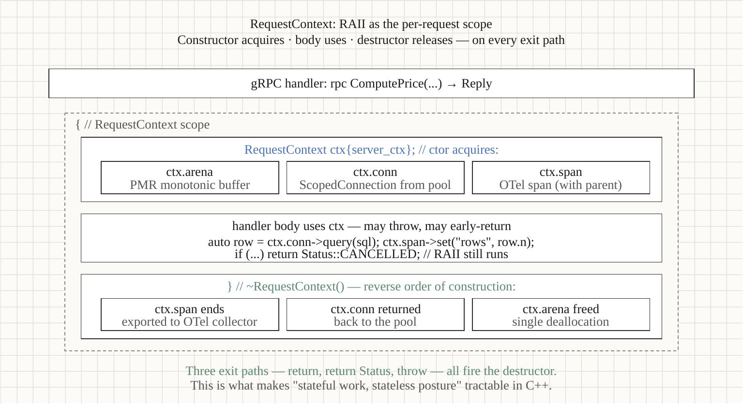
RAII as the foundation
§2
The RequestContext pattern
One RAII type bundles per-request state
• Constructed at the top of the handler; destroyed on return
• Bundles the deadline, correlation id, a per-request arena, the span scope
• Members destruct in reverse declaration order — cleanup ordering built in
• The three exception-safety guarantees: basic, strong, nothrow
All cleanup is RAII; the handler's try/catch is for error-to-status translation, not resource management.
Optimizing Modern C++ with Containers | RAII as the foundation
9 / 67
Notes:
The RequestContext is the single most reused pattern in the compendium — it shows up again in the PMR doc (the arena lives in it), the threading doc (the span scope is TLS-bound to it), and the end-to-end example (the handler builds one per call). The key discipline: the destructor is the contract. You never write cleanup code in the handler body; you let scope exit run it.

Slide 10
RAII as the foundation
§2
Common RAII mistakes
What breaks the guarantee
• Throwing destructors — terminate() during stack unwind
• Raw owning pointers — leak on the exception path
• Manual try/catch cleanup — misses paths RAII wouldn't
• Missing noexcept moves — silent pessimization or UB
• Locks held across co_await — UB after suspension (the threading section)
// The shape that always cleans up:
grpc::Status Handler(ServerContext* ctx,
const Req* req, Resp* resp) {
try {
RequestContext rc{*ctx, req->correlation_id()};
// ... work; may throw grpc::Status or std::exception
return grpc::Status::OK; // rc destructs here
} catch (const grpc::Status& s) { // ...and here
return s; // ...and here
}
} // destructor runs on EVERY path
Optimizing Modern C++ with Containers | RAII as the foundation
10 / 67
Notes:
The throwing-destructor one is the killer: if a destructor throws during stack unwinding from another exception, the runtime calls terminate(). Destructors are noexcept by default in C++11 onward for exactly this reason — don't fight it. The locks-across-co_await trap is subtle and gets its own treatment in the threading doc.

Slide 11
RAII as the foundation
§2
The three exception-safety guarantees
What a function promises when it throws
• Nothrow — never throws (destructors, swap, moves); the strongest
• Strong — throws → state unchanged, as if the call never happened
• Basic — throws → invariants hold, no leaks, but state may have moved
RAII gives you the basic guarantee automatically; the strong guarantee is a design choice (copy-and-swap, build-then-commit).
Optimizing Modern C++ with Containers | RAII as the foundation
11 / 67
Notes:
These three guarantees are the vocabulary for reasoning about what happens on the throw path. RAII hands you the basic guarantee automatically — destructors run, nothing leaks, invariants survive. The strong guarantee — state rolls back as if nothing happened — is a deliberate design, usually copy-and-swap or build-the-new-state-then-commit. Nothrow is what destructors and move operations must be; mark your moves noexcept or the standard library silently falls back to copies.

Slide 12
RAII as the foundation
§2
Construction cost on the hot path
RAII is free; what you put in it may not be
• The RequestContext itself is near-zero — members init in place
• A std::string member under 15 bytes (libstdc++ SBO) costs no allocation
• A std::map member allocates a node per insert; prefer flat/pmr
• Measure the constructor: it runs on every request, in the latency path
Optimizing Modern C++ with Containers | RAII as the foundation
12 / 67
Notes:
RAII has no inherent cost — it's just scope-bound destruction. But the per-request object runs its constructor on every request, so what you put in it matters. A short std::string member fits in the small-string buffer and costs nothing; a std::map member allocates per node. This is where the PMR arena (next section) pays off — the per-request containers allocate from a buffer that's already there.

Slide 13
▶ DEMO 02
Demo — RequestContext RAII
A gRPC handler builds a RequestContext on entry, then takes one of three exit paths — normal return, early return, and throw. Logging in the destructor proves it fires on all three. RAII cleanup made visible.
$ cd examples/statelessness/02-raii && ./demo.sh
source on site: patterncatalyst.github.io/cpp-statelessness/examples/statelessness-02-raii/
13 / 67
Notes:
Watch the destructor log line appear once per request regardless of which exit path the handler took. The point isn't that RAII is clever — it's that the cleanup is path-independent, which is exactly the property a request-scoped resource needs.

Slide 14
§3
PMR: request brings its own memory
monotonic_buffer_resource as architectural statelessness.
14 / 67
Notes:
PMR — polymorphic memory resources — is the in-language realization of 'the request brings its own memory and releases it all together.' It's request scope expressed in the allocator.

Slide 15
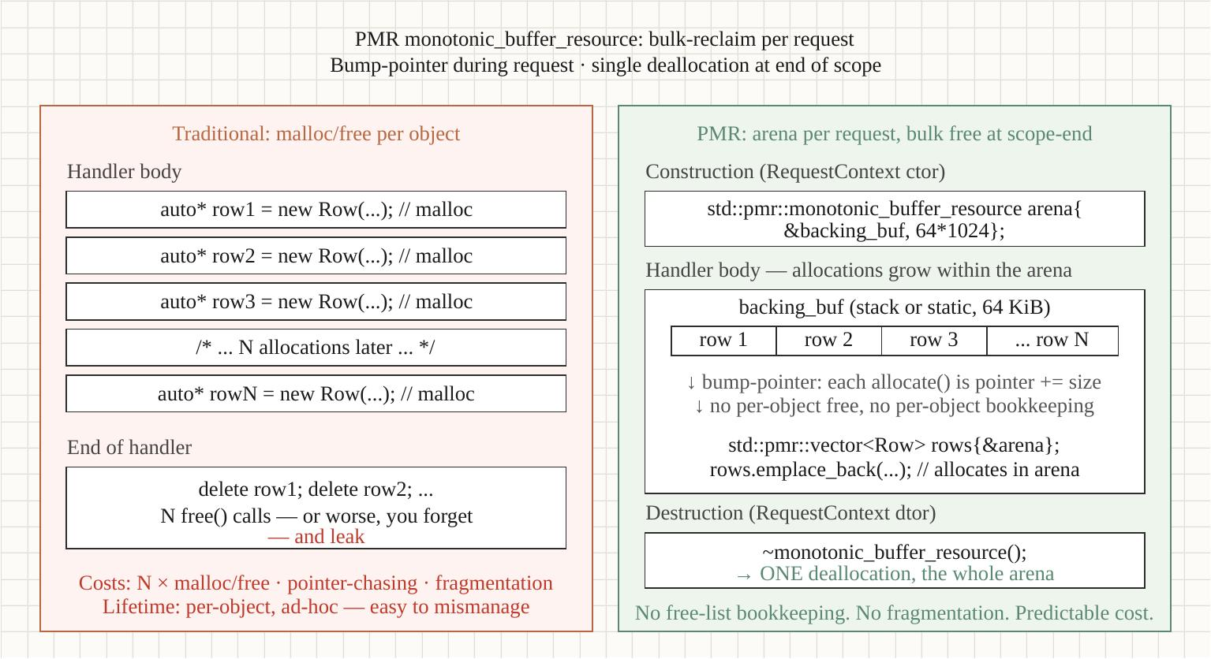
PMR: request brings its own memory
§3
The layered arena recipe
monotonic buffer + pool resource
• A fixed on-stack/in-object buffer fronts a monotonic_buffer_resource
• An unsynchronized_pool_resource layers on top for varied block sizes
• Per-request pmr::vector / pmr::string allocate from the arena
• Destruction asymmetry: individual frees are no-ops; the whole arena is reclaimed at once
Optimizing Modern C++ with Containers | PMR: request brings its own memory
15 / 67
Notes:
The recipe is canonical: monotonic_buffer_resource for the bump-allocation, unsynchronized_pool_resource on top so differently-sized allocations don't waste the buffer. The win is the destruction asymmetry — destroying a pmr::vector built in the arena is essentially free because do_deallocate is a no-op; only the arena's own destruction reclaims memory, and that's a single pointer reset.

Slide 16
PMR: request brings its own memory
§3
The lifetime trap
The one rule PMR makes easy to break
• A pmr container must not outlive its memory_resource
• Return a pmr::string built in a request arena → dangling after the arena dies
• Caught immediately under AddressSanitizer (the dev profile)
Fix: return owning std:: types across the scope boundary, or keep the value inside the arena's lifetime.
Optimizing Modern C++ with Containers | PMR: request brings its own memory
16 / 67
Notes:
This is the counterexample the doc dwells on because it's the one mistake PMR makes easy. The arena is on the stack or in the RequestContext; if you hand a pmr::string built in it back to a caller that outlives the request, you've got a use-after-free. ASan catches it on the first run — which is why the dev profile wires ASan in by default.

Slide 17
PMR: request brings its own memory
§3
Which container, on PMR?
std:: containers that take a memory_resource
• pmr::vector — the workhorse; contiguous, arena-allocated
• pmr::string — short ids and scratch text without the global allocator
• pmr::unordered_map — per-request lookups; nodes in the arena
• pmr::flat_map (C++23) — sorted, cache-friendly, fewer allocations
Same familiar std:: types; the allocator is just plumbed to the request arena via the polymorphic resource.
Optimizing Modern C++ with Containers | PMR: request brings its own memory
17 / 67
Notes:
PMR isn't a separate container library — it's the same std:: containers with a runtime-polymorphic allocator. You pass the arena's memory_resource to the container's constructor and every allocation it makes comes from the arena. pmr::vector is the one you'll reach for most; pmr::flat_map in C++23 gives you a sorted, contiguous map that allocates rarely — ideal for the small per-request maps a handler builds.

Slide 18
PMR: request brings its own memory
§3
Why the asymmetry is the whole point
Allocation vs. deallocation cost
• Allocation: a pointer bump in the monotonic buffer — a few instructions
• Per-object deallocation: a NO-OP (monotonic do_deallocate does nothing)
• Reclamation: one buffer reset when the RequestContext destructs
• Net: thousands of tiny per-request frees collapse into a single reset
Optimizing Modern C++ with Containers | PMR: request brings its own memory
18 / 67
Notes:
This is the performance argument for the arena. In a general-purpose allocator, every allocation has a matching free, and frees are not cheap — they touch free lists, coalesce, lock. In a monotonic arena, allocation is a pointer bump and individual deallocation does literally nothing; the memory comes back all at once when the arena dies. For a request that builds and tears down many small objects, that asymmetry is a real latency win on the destruction side.

Slide 19
▶ DEMO 03
Demo — PMR request arena
The layered monotonic + pool arena in action: per-request allocation freed in bulk, the release-cost asymmetry measured, and the lifetime trap caught live by AddressSanitizer.
$ cd examples/statelessness/03-pmr && ./demo.sh
source on site: patterncatalyst.github.io/cpp-statelessness/examples/statelessness-03-pmr/
19 / 67
Notes:
Two things to watch: the timing difference between per-element free and bulk arena reclamation, and then the deliberate lifetime bug — the demo builds it, runs under ASan, and ASan prints the use-after-free with a stack trace. That's the safety net the dev profile gives you automatically.

Slide 20
§4
Process-scoped state, owned in main()
Some state legitimately lives for the process — own it explicitly.
20 / 67
Notes:
Not all state is request-scoped. Connection pools, gRPC channels, parsed config, in-process caches — these legitimately live for the process lifetime. The discipline is to own them explicitly in main() and inject them by reference, not reach for them as singletons.

Slide 21
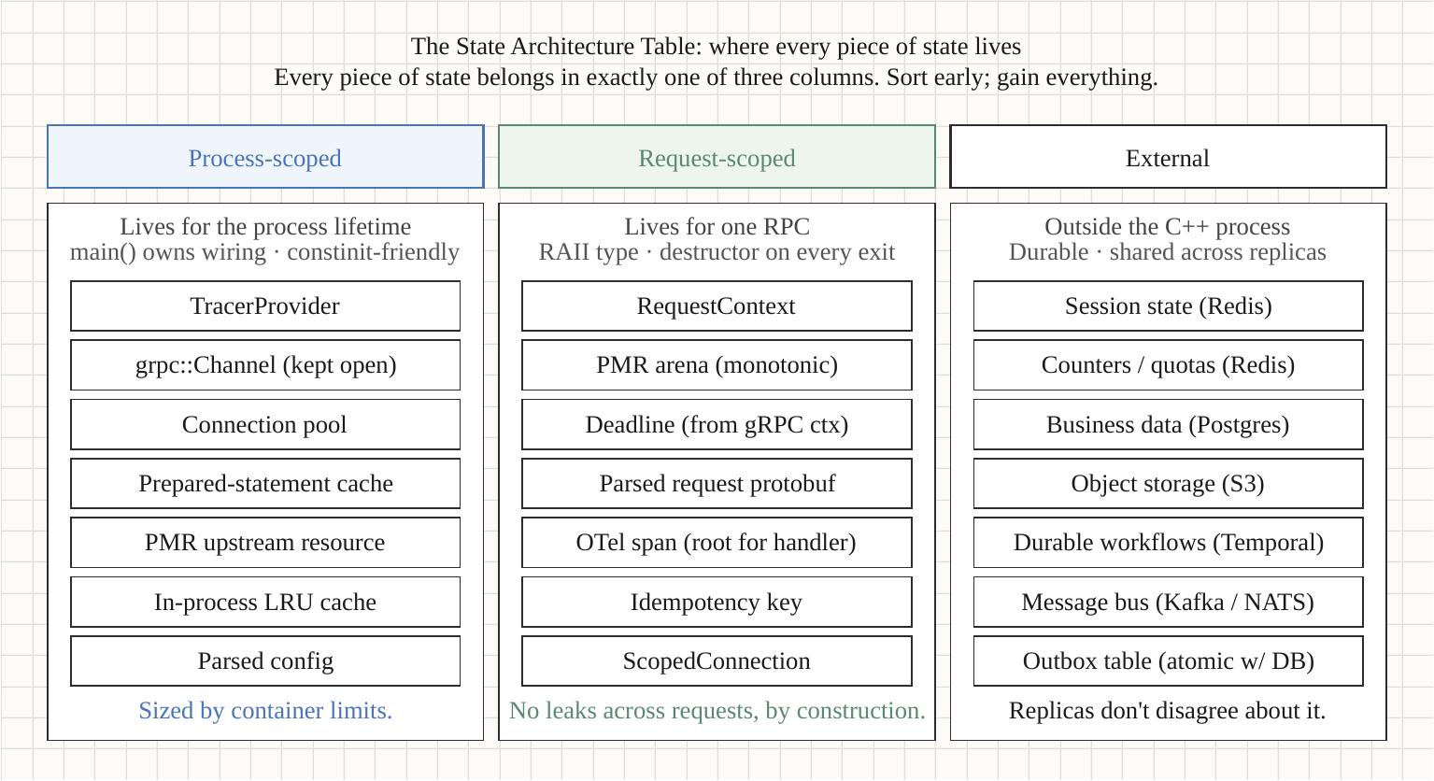
Process-scoped state, owned in main()
§4
The composition root
main() constructs everything by name
• Parsed config, pools, channel cache, caches — built once, in order
• Injected into services by reference; no global singletons
• Reverse-order destruction at scope exit — automatic teardown from RAII
• The State Architecture Table: what's process-scoped vs externalized
Optimizing Modern C++ with Containers | Process-scoped state, owned in main()
21 / 67
Notes:
The composition-root pattern (Iglberger's dependency-injection chapter is the underpinning) keeps ownership legible: you can read main() top to bottom and see the entire lifetime graph. Reverse-order destruction falls out of declaration order, so the teardown sequence is correct without any explicit shutdown code — the channels close after the services that use them, the pools after the channels, and so on.

Slide 22
Process-scoped state, owned in main()
§4
Size process-scoped state from the budget
The cgroup is the budget
• Bounded caches sized against memory.max, not host RAM
• An unbounded cache is a slow OOM under a memory cgroup
• Pool sizes and arena counts scale from the CPU quota (threading)
• Bounded structures everywhere: LRU caps, pool maxima, queue limits
Optimizing Modern C++ with Containers | Process-scoped state, owned in main()
22 / 67
Notes:
The recurring theme: the container's resource limits are the sizing budget for process-scoped state. An unbounded in-process cache that's fine on a 256 GB box becomes a slow OOMKill under a 512 MB memory cgroup. Everything process-scoped should be bounded and sized against the cgroup, which means reading the cgroup — the helper we ship in the build-tooling section.

Slide 23
Process-scoped state, owned in main()
§4
Dependency injection over singletons
Inject by reference; don't reach for a singleton
• The Meyers singleton hides ownership and lifetime
• Pass collaborators in by const& or &; the service owns nothing global
• Testable: substitute a fake pool or channel at the seam
• Iglberger's DI chapter is the architectural underpinning
int main() {
const Config cfg = parse_config();
PgPool pg{cfg.pg_conninfo, cfg.pg_pool_size};
ChannelCache channels{};
// dependencies injected by reference, owned here:
PricingService svc{cfg, pg, channels};
// ... serve ...
} // svc, channels, pg, cfg destruct in REVERSE order
Optimizing Modern C++ with Containers | Process-scoped state, owned in main()
23 / 67
Notes:
The composition root constructs everything and injects it by reference. No service reaches for a global; each takes its collaborators as constructor arguments. That's what makes the lifetime graph legible and the service testable — at the seam you can hand it a fake pool. And because the objects are locals in main(), they destruct in reverse construction order automatically, which is exactly the teardown order you want.

Slide 24
Process-scoped state, owned in main()
§4
Bounded by construction
Every process-scoped structure has a ceiling
• LRU caches: a max entry count sized from memory.max
• Connection pools: a hard maximum, with a checkout timeout
• Queues: bounded, with a backpressure policy when full
• Prepared-statement caches: capped, evicting least-recently-used
Unbounded + a memory cgroup = a slow, surprising OOMKill under load. Bound everything.
Optimizing Modern C++ with Containers | Process-scoped state, owned in main()
24 / 67
Notes:
The discipline that prevents the most common container OOM: every process-scoped structure that can grow must have a ceiling, and the ceiling should be derived from the cgroup memory budget. An unbounded cache doesn't fail fast — it grows until the cgroup OOMKiller reaps the process, usually under peak load, which is the worst time. Bounding by construction turns that into a predictable eviction instead.

Slide 25
§5
Threading under a CPU quota
hardware_concurrency() lies; the cgroup tells the truth.
25 / 67
Notes:
Threading is the cross-cutting concern that interacts with statelessness in the least obvious way. The headline: under a CPU cgroup quota, hardware_concurrency() reports the host's cores, not your budget — and sizing a pool to it throttles you.

Slide 26
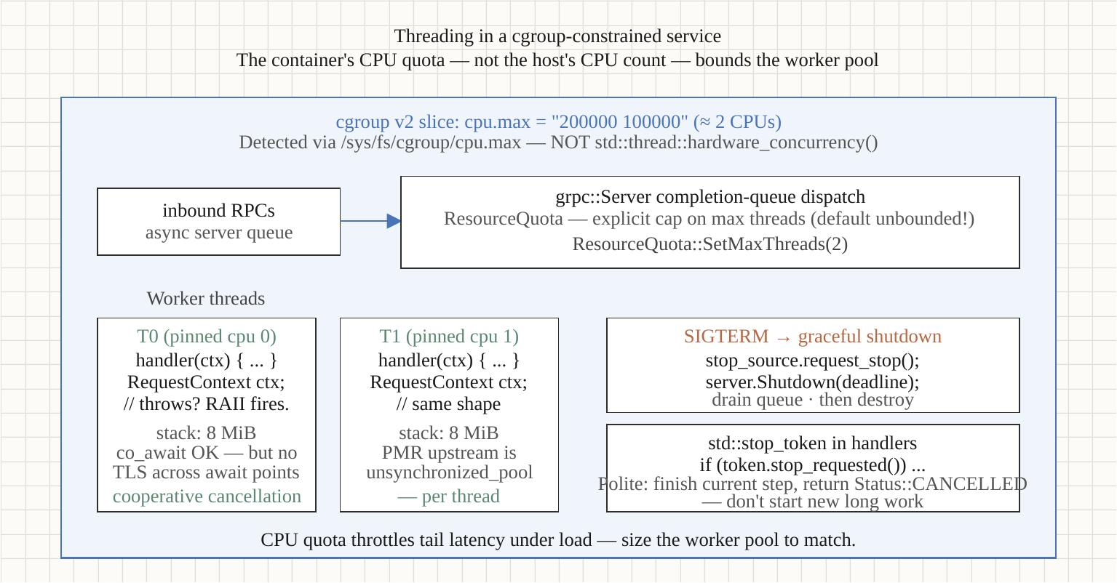
Threading under a CPU quota
§5
CFS quota and the throttling trap
Oversubscription buys nothing and costs tail latency
• CFS gives the cgroup quota microseconds per period
• A pool sized to nproc under --cpus=2 runs out of quota and is throttled
• Throttling shows up as p99 latency spikes, not lower throughput
• Fix: size pools to the cgroup quota; read it with the cgroup helper
Optimizing Modern C++ with Containers | Threading under a CPU quota
26 / 67
Notes:
CFS — the completely fair scheduler — enforces the cgroup CPU quota by handing the cgroup a slice of microseconds per period. If your thread pool has more runnable threads than the quota allows, the kernel throttles the whole cgroup: it stops scheduling your threads until the next period. The symptom isn't lower average throughput — it's vicious p99 spikes as requests stall waiting for the next quota refill.

Slide 27
Threading under a CPU quota
§5
TLS, coroutines, and the co_await gotcha
Concurrency models and where state hides
• TLS is process-scoped, per-thread — the CorrelationGuard pattern
• OS threads, C++20 stackless coroutines, Boost.Fiber stackful
• The trap: a value relied on via TLS after co_await may resume on another thread
• Capture request context into the coroutine frame, not TLS
Optimizing Modern C++ with Containers | Threading under a CPU quota
27 / 67
Notes:
Thread-local storage is process-scoped but per-thread, which makes it a natural home for things like the active span — until coroutines. After a co_await, the coroutine may resume on a different thread, so anything you stashed in TLS before the suspension is gone. The fix is to capture request-scoped context into the coroutine frame. This is why the end-to-end example's RequestContext holds the span scope as a member rather than relying on TLS.

Slide 28
Threading under a CPU quota
§5
The gRPC sync-server ResourceQuota trap
Thread count is not request concurrency
• Sync gRPC server: each in-flight RPC holds a thread for its duration
• Set NUM_CQS, MIN/MAX_POLLERS, and a ResourceQuota max-threads from the budget
• A blocking handler under-provisioned on threads serializes silently
• Size the server thread pool from the cgroup quota, with headroom
Optimizing Modern C++ with Containers | Threading under a CPU quota
28 / 67
Notes:
The gRPC sync server is convenient but has a configuration trap: a blocking handler occupies a thread for its whole duration, so the server's thread pool size caps your concurrency. The ResourceQuota max-threads and the poller settings need to be sized from the CPU budget — too few and you serialize, too many and you throttle. The end-to-end example shows the configuration; this is the knob people miss.

Slide 29
Threading under a CPU quota
§5
Allocator arenas under a quota
Even malloc cares about the CPU count
• jemalloc / tcmalloc shard arenas per-CPU to reduce contention
• Default arena count keys off the host cores, not the cgroup
• Over-arena'd under a small quota wastes memory; size from the budget
• MALLOC_CONF narenas (jemalloc) tuned from cpu_limit_cores()
Optimizing Modern C++ with Containers | Threading under a CPU quota
29 / 67
Notes:
The cgroup-vs-host-count problem isn't only about thread pools — it reaches into the allocator. jemalloc and tcmalloc create per-CPU arenas to cut lock contention, and they size that count from the host's core count by default. Under a small CPU quota that's wasted memory. If you tune it, derive the arena count from the same cgroup reading the thread pool uses.

Slide 30
Threading under a CPU quota
§5
Cooperative cancellation with stop_token
std::jthread + std::stop_token (C++20)
• Background workers take a stop_token; loop while !stop_requested()
• std::jthread joins on destruction — no detached threads outliving main()
• Shutdown requests stop, the worker drains, the jthread joins cleanly
• Ties directly into the graceful-shutdown sequence (health & shutdown)
Optimizing Modern C++ with Containers | Threading under a CPU quota
30 / 67
Notes:
std::jthread and std::stop_token are the C++20 tools for clean worker lifecycle. A jthread joins automatically when it goes out of scope, so you can't accidentally leak a thread past main(); and the stop_token gives cooperative cancellation — the worker checks stop_requested() and exits its loop. The the health-and-shutdown sequence uses exactly this to drain the outbox relay and other background work.

Slide 31
▶ DEMO 05
Demo — Threading & CPU budget
A cgroup-aware probe and a pool-size sweep under --cpus=2 show that oversubscription buys no throughput and wrecks tail latency through CFS throttling.
$ cd examples/statelessness/05-threading && ./demo.sh
source on site: patterncatalyst.github.io/cpp-statelessness/examples/statelessness-05-threading/
31 / 67
Notes:
The sweep runs the same workload with progressively larger pools under a 2-core quota. Watch throughput plateau while p99 climbs — that's throttling, not contention. The cgroup-aware pool size is the knee of that curve.

Slide 32
§6
12-Factor adapted to C++
Most factors map directly; three collide with C++ idioms.
32 / 67
Notes:
The twelve-factor app methodology was written for interpreted, garbage-collected services. Most factors map onto C++ cleanly; three collide with C++ idioms: Config, Processes, and Disposability.

Slide 33
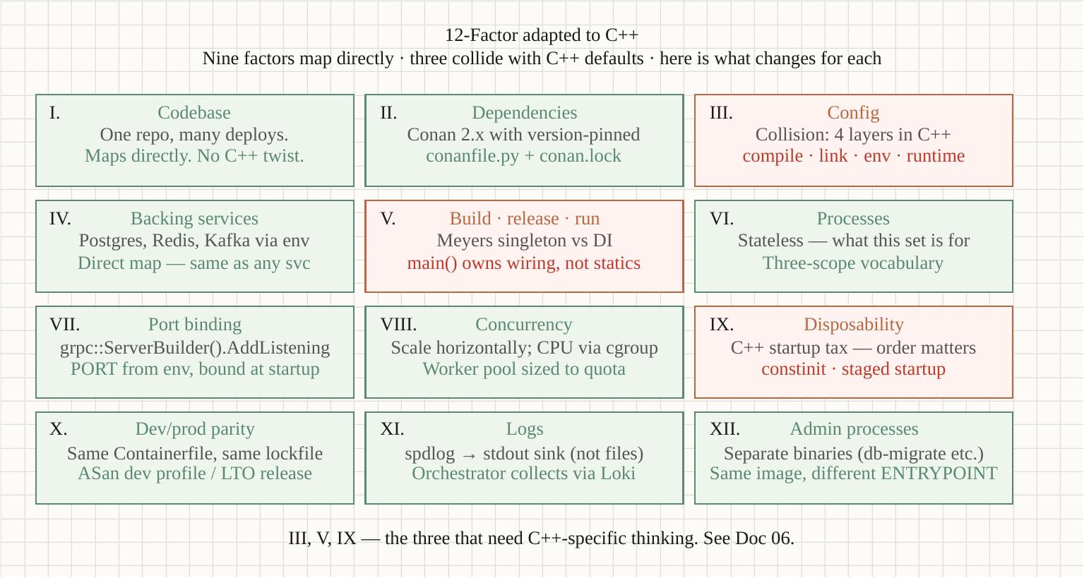
12-Factor adapted to C++
§6
Config: four binding times
Where a value gets fixed matters
• Compile-time — constexpr, template params; zero runtime cost, needs a rebuild
• Link-time — which libraries, which ABI
• Env-time — parsed once in main() from the environment (12-factor's Config)
• Runtime — reloadable policy; rare, and the most expensive
Parse env-time config once into an immutable struct; pass it by const reference. No getenv scattered around.
Optimizing Modern C++ with Containers | 12-Factor adapted to C++
33 / 67
Notes:
C++ has a richer set of binding times than the languages 12-factor assumed, and choosing the right one is a design decision. A feature flag that never changes after deploy should be compile-time (constexpr) — free at runtime. The 12-factor 'Config' factor is specifically env-time: read once in main(), into an immutable Config struct, passed by const reference everywhere. The Config struct shows up in every service in the compendium.

Slide 34
12-Factor adapted to C++
§6
Processes & Disposability
Singletons and the startup tax
• Processes: the Meyers singleton hides ownership — inject instead
• Disposability: fast startup and clean shutdown are features under orchestration
• The C++ startup tax — static initialization order, constinit to tame it
• Staged startup: NOT_SERVING → warm → SERVING (health & shutdown)
Optimizing Modern C++ with Containers | 12-Factor adapted to C++
34 / 67
Notes:
The Processes factor collides with the Meyers singleton — the function-local-static pattern so common in C++. It works, but it hides ownership and lifetime, which is exactly what the composition root makes explicit. Disposability is where the C++ startup tax bites: static initialization runs before main(), and a slow cold start hurts under an orchestrator that restarts replicas routinely. constinit moves what it can to compile time.

Slide 35
12-Factor adapted to C++
§6
Taming the startup tax with constinit
Static init order is a latency and correctness risk
• Non-trivial globals run constructors before main() — the startup tax
• The static initialization order fiasco: cross-TU ordering is undefined
• constinit forces compile-time init — no runtime constructor, defined order
• Prefer locals in main() over globals; constinit for the unavoidable ones
// Forced to be initialized at compile time — zero startup cost,
// no ordering fiasco:
constinit std::string_view kBuildVersion = "1.4.2";
// Better still: own it in main() and inject it.
// Worst: a non-trivial global that runs a constructor
// before main() in an undefined cross-TU order.
Optimizing Modern C++ with Containers | 12-Factor adapted to C++
35 / 67
Notes:
The startup tax is real under orchestration: every non-trivial global runs its constructor before main(), adding to cold-start latency, and the cross-translation-unit ordering is undefined — the classic static initialization order fiasco. constinit fixes the subset that can be initialized at compile time: it's a guarantee, checked by the compiler, that there's no runtime constructor. The better fix for most state is to not make it global at all — own it in main().

Slide 36
12-Factor adapted to C++
§6
The other factors, briefly
Most of 12-factor maps cleanly
• Logs → stdout, the collector owns persistence (ephemeral filesystem)
• Backing services → attached resources, swappable by config (state externalization)
• Build/release/run → the multi-stage Containerfile + a lockfile (build tooling)
• Port binding, concurrency, dev/prod parity → natural fits for a C++ service
Optimizing Modern C++ with Containers | 12-Factor adapted to C++
36 / 67
Notes:
The remaining factors map onto a C++ service without friction. Logs to stdout is the one that bites people because of the spdlog file-default trap, which gets its own doc. Backing services as attached resources is the externalization story. Build/release/run separation is the hermetic Conan build plus the multi-stage image. The rest — port binding, concurrency, parity — are things a well-structured service does anyway.

Slide 37
§7
State externalization
What goes outside the process, and how to reach it safely.
37 / 67
Notes:
If process scope can't hold authoritative state, it has to live outside — the database, the cache tier, the queue. This document is about reaching that external state safely: connection pools as process-scoped infrastructure, idempotency, deadline propagation, and the outbox pattern for atomic write-plus-emit.

Slide 38
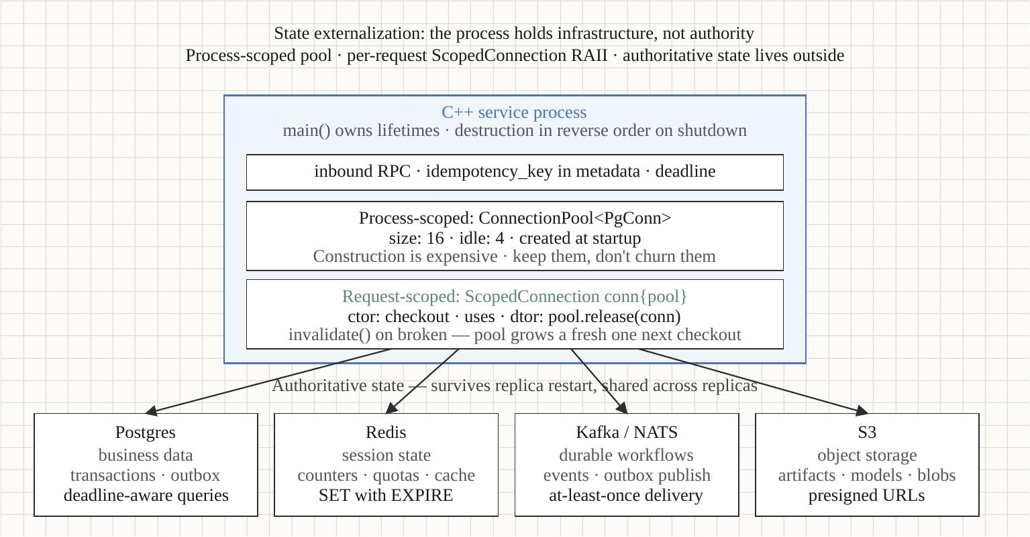
State externalization
§7
Pools, RAII checkout, idempotency
Backing services done right
• Connection pool = process-scoped infra; per-handler RAII checkout
• ScopedConnection returns the connection on scope exit; invalidate() on broken
• Idempotency keys + ON CONFLICT DO NOTHING = DB-authoritative dedup
• Deadlines propagate to the backing service (statement_timeout from the budget)
Optimizing Modern C++ with Containers | State externalization
38 / 67
Notes:
The pool is process-scoped (built in main()); the checkout is request-scoped (RAII, returned on scope exit). That pairing is the whole pattern. Idempotency is enforced at the database with a unique key and ON CONFLICT DO NOTHING, so a client retry is safe even across replicas — there's no in-process state to desync. Deadlines propagate all the way to the database via statement_timeout computed from the remaining request budget.

Slide 39
State externalization
§7
The outbox pattern
Atomic DB write + event emission
• Write the row and an outbox event in ONE transaction
• A relay polls the outbox with FOR UPDATE SKIP LOCKED, publishes to Kafka
• An idempotent consumer applies events with ON CONFLICT DO NOTHING
• At-least-once delivery + idempotent apply = exactly-once effect
Optimizing Modern C++ with Containers | State externalization
39 / 67
Notes:
The outbox solves the dual-write problem: you can't atomically write to the database AND publish to Kafka, so instead you write the event into the same database transaction as the business row. A separate relay then publishes it. Because the relay re-publishes after a crash (at-least-once) and the consumer applies idempotently, the end-to-end effect is exactly-once — without distributed transactions.

Slide 40
State externalization
§7
Deadlines propagate all the way down
One budget, enforced at every hop
• The request deadline comes from the gRPC ServerContext
• Compute remaining budget; set it as the DB statement_timeout
• Pass the same deadline to outbound gRPC ClientContext
• A blown budget surfaces as DEADLINE_EXCEEDED, not a hung handler
auto remaining = deadline - now();
if (remaining <= 0ms)
throw grpc::Status{DEADLINE_EXCEEDED, "..."};
// DB: SET statement_timeout = <remaining ms>
// gRPC: client_ctx.set_deadline(rc.deadline());
Optimizing Modern C++ with Containers | State externalization
40 / 67
Notes:
Deadline propagation is what keeps a slow dependency from turning into a pile-up. The request arrives with a deadline; every downstream call budgets against the same clock. The database gets a statement_timeout computed from the remaining time; the outbound gRPC call gets the same absolute deadline. If the budget is already blown, you fail fast with DEADLINE_EXCEEDED instead of starting work that can't finish in time.

Slide 41
State externalization
§7
Retry-with-backoff vs. fail-fast
When to retry and when to give up
• Idempotent + transient failure → retry with capped exponential backoff + jitter
• Non-idempotent without a key → do NOT blindly retry
• Budget-aware: never retry past the request deadline
• invalidate() a broken pooled connection so it isn't reused
Optimizing Modern C++ with Containers | State externalization
41 / 67
Notes:
Retry policy is where idempotency pays off. If an operation is idempotent — guaranteed by the client key and ON CONFLICT — a transient failure can be retried safely with backoff and jitter to avoid thundering herds. Without idempotency, a blind retry can double-apply. And every retry must respect the remaining deadline; retrying past the budget just wastes work. Broken connections get invalidated so the pool doesn't hand them out again.

Slide 42
State externalization
§7
The cache counterexample, fixed
Why the local-cache counterexample was the bug
• An in-process cache of authoritative data desyncs across replicas
• Replica A updates; replica B serves a stale read — non-deterministic
• Fix: the cache tier is deploy-time scope, shared and authoritative
• In-process caches are fine ONLY for derived/immutable data
Optimizing Modern C++ with Containers | State externalization
42 / 67
Notes:
This closes the loop on the earlier cache counterexample. A local in-process cache of authoritative data is the classic statelessness violation: two replicas hold divergent views, and which answer you get depends on which replica you hit. The fix is to move the cache to deploy-time scope — a shared cache tier — so it's authoritative and consistent across replicas. In-process caching is only safe for data that's immutable or purely derived and cheap to rebuild.

Slide 43
▶ DEMO 07
Demo — State externalization + outbox
An order and its event written in one transaction; a relay publishes the outbox to Kafka with FOR UPDATE SKIP LOCKED; an idempotent consumer applies it. A crash mid-publish still yields an exactly-once effect.
$ cd examples/statelessness/07-outbox-pattern && ./demo.sh
source on site: patterncatalyst.github.io/cpp-statelessness/examples/statelessness-07-outbox-pattern/
43 / 67
Notes:
The companion uses libpq (not libpqxx — its bundled CMake breaks the toolchain), librdkafka's C API, and a single-node Strimzi Kafka. Watch the relay pick up the outbox row, publish it, and the consumer dedupe a replayed event. There's a sibling demo, 07-state-externalization, for the pool and idempotency pieces in isolation.

Slide 44
§8
The ephemeral filesystem
The container rootfs is scratch space — treat it that way.
44 / 67
Notes:
The container filesystem is ephemeral: the writable overlay layer is discarded when the container dies. read_only: true turns that implicit truth into an enforced one, and surfaces every place your code assumed it could write.

Slide 45
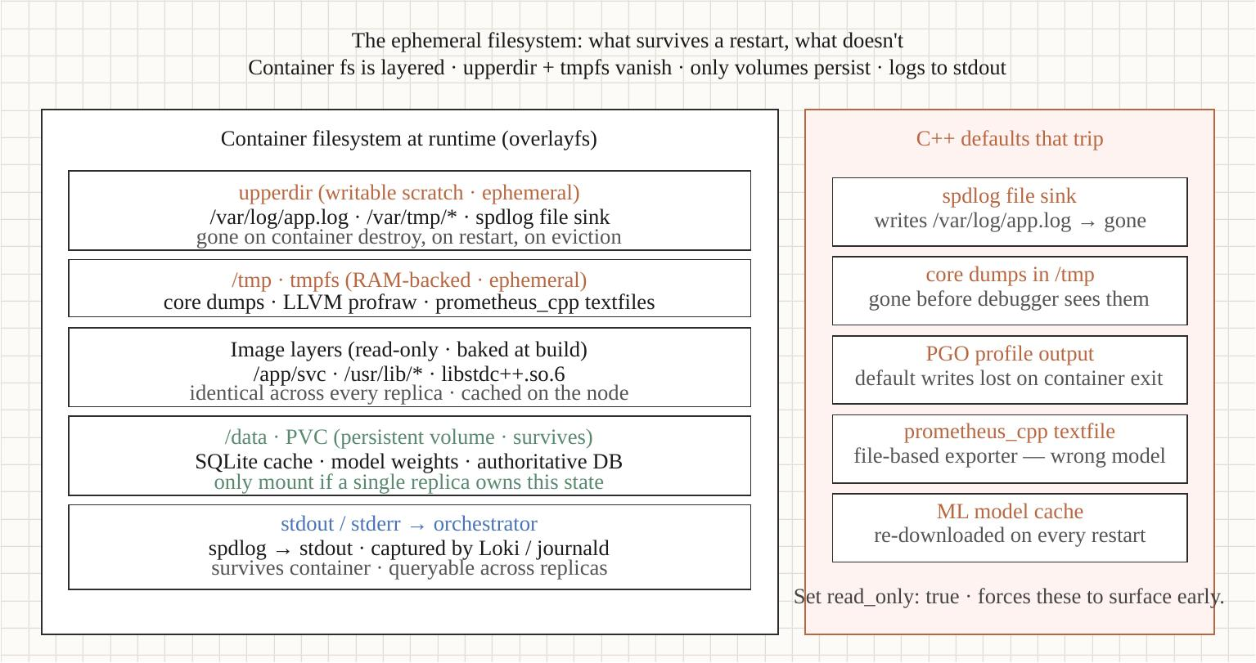
The ephemeral filesystem
§8
read_only: true as a forcing function
Make ephemerality explicit
• rootfs read-only; /tmp on an explicit tmpfs; volumes for what must survive
• Logs go to stdout — the collector owns persistence, not the container
• C++ traps: spdlog's basic_logger_mt opens a file → EROFS on a read-only rootfs
• Fix: the stdout sink; never the default file logger in a container
Optimizing Modern C++ with Containers | The ephemeral filesystem
45 / 67
Notes:
read_only: true is a forcing function — it converts 'the filesystem is ephemeral' from a fact you might forget into an error you can't ignore. The classic C++ trap is spdlog: the convenient basic_logger_mt opens a log file, which fails with EROFS on a read-only rootfs. The fix is to log to stdout and let the platform's collector handle persistence — which is also what 12-factor's Logs factor wants. Other traps: crash dumps, ML model caches, coverage data, prometheus textfiles.

Slide 46
The ephemeral filesystem
§8
What goes where
A place for every write
• rootfs → read-only; the binary, libs, certs, nothing writable
• /tmp → an explicit tmpfs with a size cap; scratch only
• Persistent data → a volume (PVC), and only what must truly survive
• Config → env vars / mounted configmap, read-only
• Logs → stdout; never a file the container owns
Optimizing Modern C++ with Containers | The ephemeral filesystem
46 / 67
Notes:
The mental model is a place for every kind of write. The rootfs is read-only and holds only immutable artifacts. Scratch goes to an explicit, size-capped tmpfs at /tmp — explicit so you've thought about the size, because a tmpfs counts against memory. Anything that must survive a restart goes to a real volume, and you should be able to count those things on one hand. Config is mounted read-only; logs go to stdout.

Slide 47
The ephemeral filesystem
§8
Restart semantics as a feature
Ephemerality is the point, not a limitation
• A crash + restart returns a known-clean filesystem state
• No accreted local state to corrupt, fill the disk, or drift
• rootless Podman's UID mapping: writes you DID allow land correctly
• Kubernetes ephemeral-storage budgets cap the tmpfs + writable layers
Optimizing Modern C++ with Containers | The ephemeral filesystem
47 / 67
Notes:
The flip side of the ephemeral-filesystem constraint is that it's a feature. Because nothing local accretes, a restart always returns you to a known-clean state — no half-written files, no disk slowly filling with logs, no drift between replicas. Rootless Podman adds a UID-mapping wrinkle for the writes you do allow, and Kubernetes lets you budget ephemeral-storage so a runaway tmpfs can't take the node down.

Slide 48
▶ DEMO 08
Demo — Ephemeral filesystem
A read-only rootfs as the forcing function: the spdlog EROFS trap and the stdout-sink fix, ephemerality demonstrated across container restarts, and why scratch belongs on an explicit tmpfs.
$ cd examples/statelessness/08-ephemeral-filesystem && ./demo.sh
source on site: patterncatalyst.github.io/cpp-statelessness/examples/statelessness-08-ephemeral-filesystem/
48 / 67
Notes:
The demo first shows the EROFS failure with the default file logger, then the same service logging cleanly to stdout. Then it writes to /tmp, restarts the container, and shows the file is gone — ephemerality as a feature, not a surprise.

Slide 49
§9
Health checks & graceful shutdown
Three probes, the gRPC health protocol, graceful shutdown.
49 / 67
Notes:
Health checks are the orchestrator's API into your service — how it decides whether to route traffic, restart, or wait. Three probes, each answering a different question, plus the graceful-shutdown sequence that ties together everything we've built.

Slide 50
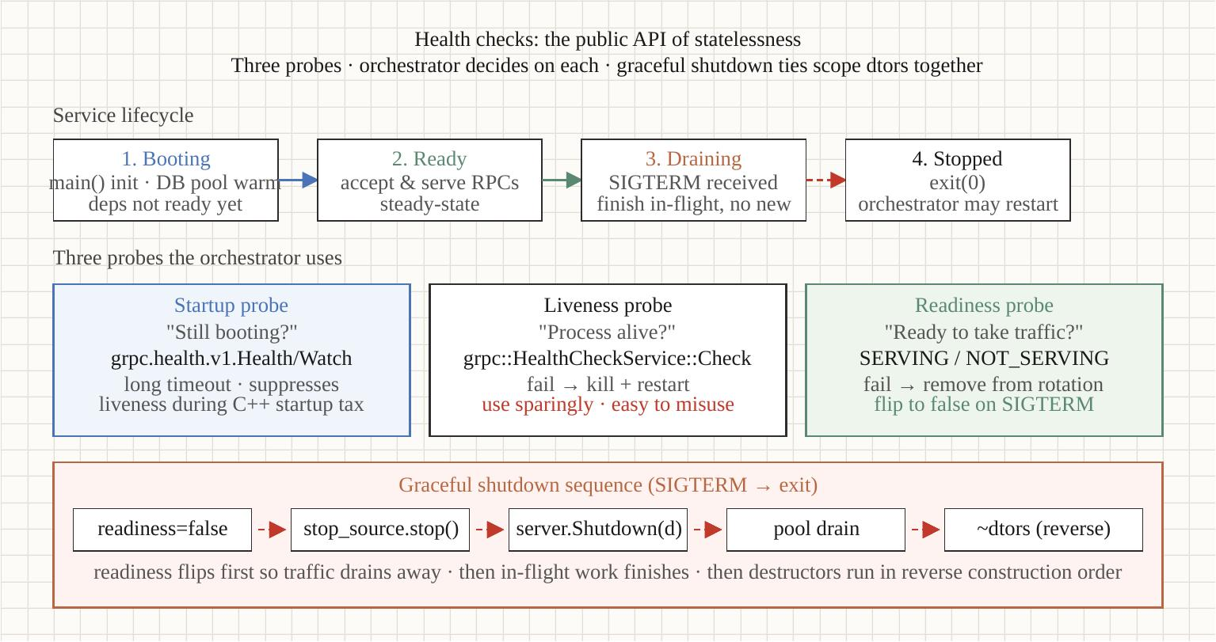
Health checks & graceful shutdown
§9
Startup, liveness, readiness
Three probes, three questions
• Startup — "has it finished initializing?" (permissive, gates the others)
• Liveness — "is it deadlocked?" (narrow; failure means restart)
• Readiness — "should it get traffic?" (fine-grained; failure means drain)
• gRPC standard health protocol via HealthCheckServiceInterface
Optimizing Modern C++ with Containers | Health checks & graceful shutdown
50 / 67
Notes:
The three probes are not interchangeable. Liveness failing means 'restart me' — make it narrow, because a flaky liveness probe causes restart storms. Readiness failing means 'stop sending traffic but don't kill me' — that's the one that handles transient dependency outages and graceful drain. Startup is permissive and covers the cold-start window so liveness doesn't fire during initialization.

Slide 51
Health checks & graceful shutdown
§9
The graceful-shutdown sequence
SIGTERM to clean exit, in order
• Signal handler sets a flag only (async-signal-safe)
• A control thread flips readiness NOT_SERVING — the LB drains us
• server->Shutdown(deadline) lets in-flight RPCs finish
• Reverse-order destruction in main() — pools, channels, config
• std::stop_token cancels background workers cleanly (the threading section)
Optimizing Modern C++ with Containers | Health checks & graceful shutdown
51 / 67
Notes:
The shutdown sequence ties together stop_token from the threading doc, pool draining from the externalization doc, and reverse-order destruction from the process-scope doc. The signal-safety detail matters: a SIGTERM handler must only set a flag — it can't call into gRPC or take a lock, because almost nothing is async-signal-safe. A dedicated control thread watches the flag and does the real work.

Slide 52
Health checks & graceful shutdown
§9
Separate port vs. same port
Where the probes listen
• Same port: the gRPC health service rides the main port — simplest
• Separate port: an HTTP /healthz for liveness, isolated from app load
• Hybrid (the 09 companion): HTTP liveness, gRPC readiness
• Separate-port liveness keeps answering even when the app pool is saturated
Optimizing Modern C++ with Containers | Health checks & graceful shutdown
52 / 67
Notes:
The trade-off between probe placement: same-port is simplest and the gRPC standard health service makes it trivial, but if the application thread pool saturates, the probe can't answer and you get spurious restarts. A separate, lightweight HTTP liveness endpoint keeps answering independently of app load. The 09 companion uses the hybrid: HTTP for liveness, the gRPC health service for readiness.

Slide 53
Health checks & graceful shutdown
§9
Health-check anti-patterns
How probes cause the outages they should prevent
• Liveness that checks dependencies → a DB blip restarts every replica
• Readiness that's too coarse → flapping in and out of rotation
• A probe heavier than a real request → the probe is the load
• No startup probe → liveness fires during a slow cold start, restart loop
Optimizing Modern C++ with Containers | Health checks & graceful shutdown
53 / 67
Notes:
Health checks cause more outages than they prevent when done wrong. The cardinal sin is a liveness probe that checks downstream dependencies: a transient database blip then trips liveness on every replica simultaneously, and the orchestrator restarts your entire fleet at once — turning a blip into an outage. Liveness should check only 'is this process wedged'; dependency health belongs in readiness, which drains rather than kills.

Slide 54
▶ DEMO 09
Demo — Health checks & shutdown
Staged startup (NOT_SERVING → SERVING), liveness vs readiness on separate ports, a SIGUSR1 readiness toggle, and the signal-safe graceful-shutdown sequence to a clean exit.
$ cd examples/statelessness/09-health-checks && ./demo.sh
source on site: patterncatalyst.github.io/cpp-statelessness/examples/statelessness-09-health-checks/
54 / 67
Notes:
Three acts: staged startup with liveness answering 200 while readiness is still NOT_SERVING during init; a SIGUSR1 toggle flipping readiness while liveness stays green; then a SIGTERM showing the ordered drain and clean exit 0. The companion uses the bool SetServingStatus overload and a signal-flag + control-thread design.

Slide 55
§10
The gRPC end-to-end example
Every pattern composed in one order-pricing service.
55 / 67
Notes:
The integration document. The previous nine established patterns in isolation; this one composes them into a single realistic gRPC service — an order-pricing service that calls a second tax service over gRPC — so the way the pieces fit together is visible end to end.

Slide 56
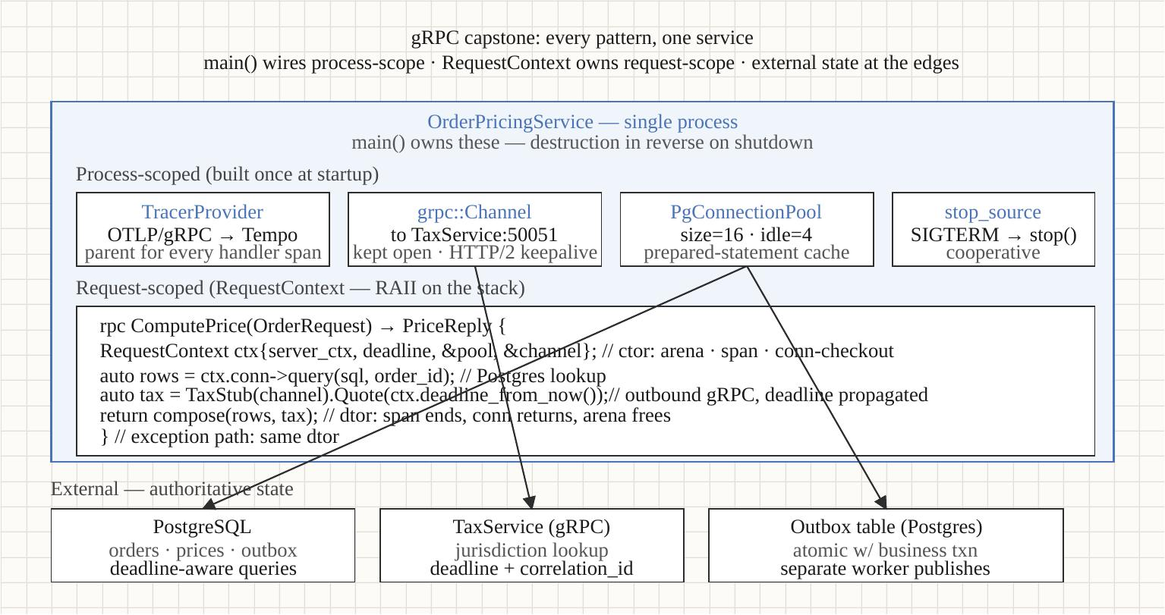
The gRPC end-to-end example
§10
What composes
Every prior section, in one main()
• Config parsed once (12-factor config); process-scoped pool + channel cache (process scope)
• RequestContext with a PMR arena per call (RAII + PMR)
• Handler throws grpc::Status; RAII cleans up; boundary translates (the RAII section)
• Deadline-propagated PostgreSQL + outbound gRPC tax call (threading + externalization)
• Idempotency on the client key; staged health + graceful shutdown (externalization + health)
Optimizing Modern C++ with Containers | The gRPC end-to-end example
56 / 67
Notes:
Twelve numbered steps in main(), every one mapping back to a prior document. The point of this example isn't new ideas — it's showing that the patterns compose without friction. The handler reads a customer and product prices from Postgres, calls the tax service over gRPC with the request deadline propagated, and returns a priced order — idempotent on the client's key.

Slide 57
The gRPC end-to-end example
§10
Faithful in architecture, lean in dependencies
What the runnable companion realizes vs. designs
• PostgreSQL via libpq, not libpqxx (its bundled CMake breaks the toolchain)
• Price lookup straight to PostgreSQL; Redis cache-aside marked as a seam
• OpenTelemetry is a documented seam — the companion emits NO spans
• Sync gRPC API, not callback; composition identical, migration mechanical
The architecture and composition are faithful to the doc; the realized backends stay on the verified stack.
Optimizing Modern C++ with Containers | The gRPC end-to-end example
57 / 67
Notes:
Scope note. The compendium document presents the full design including the OpenTelemetry tracing pipeline. The runnable companion stays on the verified gRPC trio and so represents some of that design as documented seams rather than built dependencies — most importantly, it emits no spans, so nothing reaches Tempo. The composition it DOES prove is the real value: request, process, and external scope fitting together with deadline propagation and idempotency.

Slide 58
The gRPC end-to-end example
§10
main() in twelve numbered steps
The wiring is mechanical and reusable
• Parse config → detect CPU budget → size pools
• Construct process-scoped state: pool, channel cache, service
• Build the server, health NOT_SERVING, warm, flip to SERVING
• Install the signal handler, start workers, Wait(), drain, exit 0
const Config cfg = parse_config(); // 1
const double cpu = cgroup_cpu().value_or( // 2
hardware_concurrency());
PgPool pg{cfg.pg_conninfo, cfg.pool}; // 3
ChannelCache channels{}; // 4
PricingService svc{cfg, pg, channels}; // 5
auto server = build_server(svc, cfg); // 6
health->Set("", NOT_SERVING); warm(pg); // 7-8
health->Set("", SERVING); // 9
install_signal_handler(...); // 10
server->Wait(); // 11
return 0; // reverse-order teardown // 12
Optimizing Modern C++ with Containers | The gRPC end-to-end example
58 / 67
Notes:
This example's main() is twelve steps and every one maps to a prior document — config from 12-factor, CPU budget from threading, pools from externalization, the composition root from process scope, the staged health flip and signal handling from health & shutdown. The shape is the same for any gRPC service in this stack; only the specific subsystems change. That reusability is the payoff of building the patterns in isolation first.

Slide 59
The gRPC end-to-end example
§10
Error translation at the boundary
Helpers throw; the handler translates
• Helpers throw grpc::Status for protocol errors (deadline, unavailable, not-found)
• Helpers throw std::exception for bugs
• The handler's single try/catch maps both to the wire status
• RAII runs all cleanup regardless of which exception propagates
Optimizing Modern C++ with Containers | The gRPC end-to-end example
59 / 67
Notes:
The error model keeps the handler clean: helper functions throw grpc::Status for things the client should see — DEADLINE_EXCEEDED, UNAVAILABLE, NOT_FOUND — and std::exception for programming errors. One try/catch at the handler boundary translates both into the right wire status. Crucially, the try/catch is only for translation; every resource is cleaned up by RAII no matter which path the exception takes.

Slide 60
▶ DEMO 10
Demo — gRPC end-to-end example
An order-pricing service composing every prior pattern, calling a tax service over gRPC. Three acts: a taxable order, a tax-exempt short-circuit, and an idempotent replay returning the identical order id.
$ cd examples/statelessness/10-grpc-microservices && ./demo.sh
source on site: patterncatalyst.github.io/cpp-statelessness/examples/statelessness-10-grpc-microservices/
60 / 67
Notes:
Act 1 prices a taxable order for alice — full path: Postgres lookups plus the outbound tax gRPC call. Act 2 prices for tax-exempt carol, where compute_tax short-circuits and never calls the tax service. Act 3 replays act 1's idempotency key and gets back the IDENTICAL order id — proof the stored result came back, not a recomputation.

Slide 61
§11
Build tooling & vendored helpers
Conan, CMake, the toolchain — and the helpers made runnable.
61 / 67
Notes:
The appendix: the build setup that everything else assumed. Conan 2.x with pinned versions and a lockfile, CMake with Ninja and Conan presets, GCC 14 for C++23 breadth, multi-stage Containerfiles — and full source for the small vendored helpers earlier docs referenced.

Slide 62
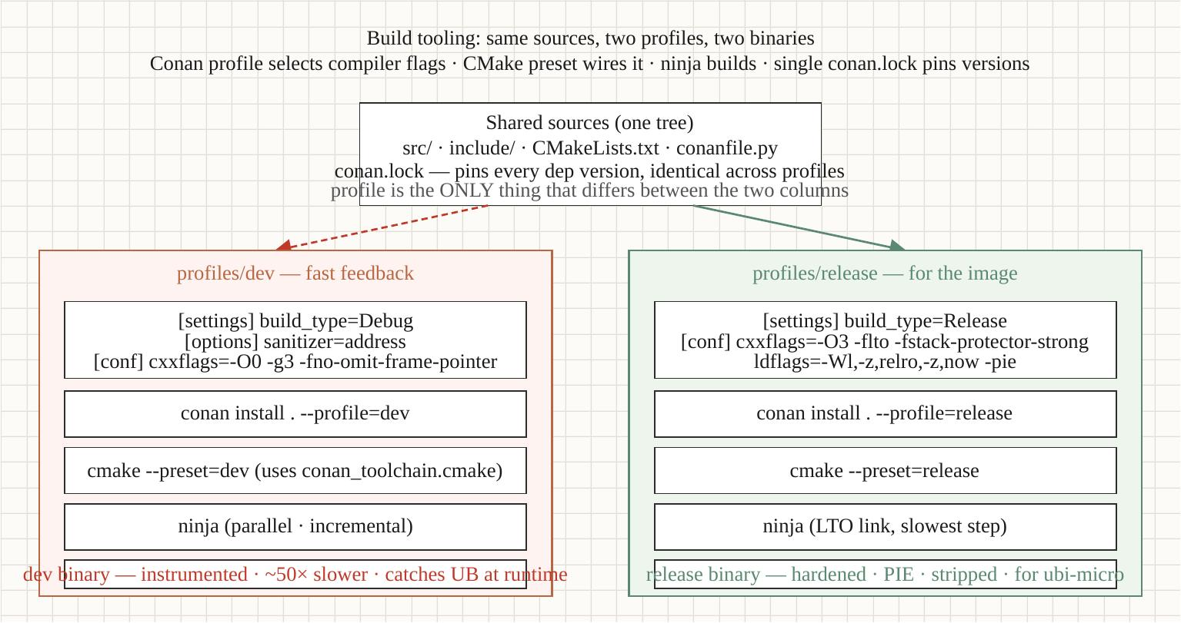
Build tooling & vendored helpers
§11
The build stack
Hermetic, pinned, reproducible
• Conan 2.x — explicit version pins, dev + release profiles, a lockfile
• CMake 3.27+ with Ninja; Conan-generated presets wire the toolchain
• GCC 14 / libstdc++ for C++23 breadth (Clang 18 + libc++ equivalent)
• Multi-stage Containerfile: full toolchain builder, minimal runtime
• Dev profile wires AddressSanitizer — catches the PMR arena trap early
Optimizing Modern C++ with Containers | Build tooling & vendored helpers
62 / 67
Notes:
The build-tooling choices are stable even as the toolchain landscape moves. The one gotcha worth memorizing: protobuf and gRPC versions must match across Conan dependencies, or you get duplicate-symbol linker errors. The dev/release profile split is the high-value habit — ASan and UBSan in dev catch the arena lifetime bugs, the locks-across-co_await UB, and most resource leaks before they reach production.

Slide 63
Build tooling & vendored helpers
§11
The cgroup helper, in one line
Why the vendored helper exists
• hardware_concurrency() reports host cores — wrong under a cgroup
• cpu_limit_cores() reads cgroup v2 cpu.max → the real budget
• Under --cpus=0.5: helper reads 0.5 while hardware_concurrency() still says 22
• That gap is the whole reason to read the cgroup — and Demo 11 makes it visible
Optimizing Modern C++ with Containers | Build tooling & vendored helpers
63 / 67
Notes:
This is the punchline of the whole threading story, made concrete in a 30-line helper. The demo runs the same binary under different --cpus caps; cpu_limit_cores() tracks the cap exactly — 1.5, then 0.5 — while hardware_concurrency() keeps reporting the host's 22 cores. A naive pool would oversubscribe 22-to-1 against half a core and get throttled into the ground. Read the cgroup.

Slide 64
Build tooling & vendored helpers
§11
C++23 feature support is a version question
The toolchain decides what you can use
• std::expected — GCC 12+, Clang 16+
• <stacktrace> — GCC 14+ (link libstdc++_libbacktrace), Clang 18+
• std::flat_map / flat_set — GCC 15+; not in libc++ yet (use absl::btree_map)
• std::print / println — GCC 14+, Clang 18+ (partial)
GCC 14 + libstdc++ on glibc 2.35+ is the recommended 2026 baseline.
Optimizing Modern C++ with Containers | Build tooling & vendored helpers
64 / 67
Notes:
Which C++23 features you can use is a function of the compiler version, and it moves fast. The ones that bite: std::flat_map isn't in libstdc++ until GCC 15, so until then absl::btree_map is the fallback; <stacktrace> on GCC 14 needs an explicit link flag for libstdc++_libbacktrace. The recommended baseline is GCC 14 with libstdc++ on a glibc 2.35-or-newer host, which is what every example in this tutorial builds against.

Slide 65
Build tooling & vendored helpers
§11
Build-tooling gotchas worth memorizing
The traps that cost an afternoon
• protobuf and gRPC versions MUST match across Conan deps → else duplicate symbols
• Always compiler.libcxx=libstdc++11 (the post-GCC-5 ABI); mixing crashes
• Run CMake via the Conan preset/toolchain or find_package can't see deps
• libpqxx's bundled CMake breaks this toolchain → use libpq (G-67)
Optimizing Modern C++ with Containers | Build tooling & vendored helpers
65 / 67
Notes:
A short list of traps from the real build experience of this tutorial. The protobuf/gRPC version match is the most common — two libraries pulling different protobuf versions transitively gives you duplicate-symbol linker errors. The libstdc++11 ABI setting is non-negotiable; mixing the old and new ABI produces crashes that look like memory corruption. And the libpqxx one is ours specifically: its bundled CMake breaks the toolchain, which is why every example here reaches PostgreSQL via libpq.

Slide 66
▶ DEMO 11
Demo — Vendored helpers
cgroup_helper and psi_reader built as static libraries, unit-tested with GoogleTest over their pure parsers, and a binary swept under --cpus / --memory caps so cpu_limit_cores() is shown tracking the cgroup while hardware_concurrency() does not.
$ cd examples/statelessness/11-build-tooling && ./demo.sh
source on site: patterncatalyst.github.io/cpp-statelessness/examples/statelessness-11-build-tooling/
66 / 67
Notes:
Act 1 runs the gtest suite green inside the container. Then the cap sweep: unconstrained, --cpus=1.5, --cpus=0.5 --memory=256m. Watch cpu_limit_cores() report 1.5 then 0.5, memory report 256 MiB, while hardware_concurrency() stays at the host count throughout. That contrast is the entire lesson.

Slide 67
The whole arc, runnable.
Statelessness is a deployment posture; the same binary earns it by where it keeps state.
Request scope → RAII + PMR. Process scope → owned in main(). Authoritative state → externalized.
It all composes in the capstone — and examples 02–11 are host-verified on Fedora 44.
Read the compendium • run the demos • the source is on the repo
github.com/patterncatalyst/cpp-statelessness
Notes:
To close: statelessness isn't a checkbox you tick in code — it's a posture the orchestrator can rely on, and the C++ techniques in this compendium are how a C++ service earns it. Request scope through RAII and PMR, process scope owned explicitly in main(), authoritative state externalized so any replica can die without loss.
And none of it is theory: every pattern has a runnable demo, and the whole arc from RAII to the gRPC capstone is host-verified. Clone the repo, run the demos, read the long-form compendium. Thank you.

