Slide 1


HELM FOR DEVELOPERS · 201
Helm for
Developers 201
Testing, umbrella and library charts, OCI distribution, plugins, GitOps and OpenShift with Helm 4
r1.0
Notes:
What it shows: The second of two decks for the Helm for Developers tutorial. The 101 covered charts, values, templates, hooks and safe releases with Helm 4. This deck covers chapters 13 to 27: testing, multi-service charts, distribution, plugins, delivery and OpenShift. Every example runs against Helm 4.3.0 on minikube profile helm4dev; the OpenShift section is the exception and is covered in that section.
What to show: nothing live on the cover; have a terminal open in the repository root with `source scripts/env.sh` already run.
Fallback: none needed; the deck stands on its own and each section names its examples/NN directory.

Slide 2
201 · SESSION MAP
Agenda
Testing and debugging: the debug ladder, helm-unittest, chart-testing
Multi-service applications: Strimzi, umbrella charts, library charts, starters
Distribution: SemVer, OCI registries, provenance, cosign
Extending Helm: plugin types, Wasm, post-renderer plugins
Delivery: environments, Helmfile, Argo CD, observability
OpenShift: SCCs, Routes and the console (Helm 101 is the prerequisite)
2
Notes:
What it shows: Six sections that follow the order a chart team meets the problems: prove the chart works, compose several charts into a platform, publish it, extend Helm where the chart cannot reach, deliver it across environments, and run it on OpenShift. Helm 101 is assumed: charts, values precedence, templates, hooks, --wait and --rollback-on-failure.
What to show: the repository tree: `ls examples/` and `ls charts/`; the 201 uses examples/13 to 27.
Fallback: the tutorial site lists the same chapters in the same order.

Slide 3
201 · RECAP
Helm 101 recap
Chart and release — a chart is the package, a release is one install of it, stored as a Secret in the release namespace.
Values — chart defaults, then -f files in order, then --set, --set-json and --set-file; a values.schema.json rejects bad input before rendering.
Templates — Go templates plus Sprig; named templates in _helpers.tpl; include over template when the result is piped.
Safe releases — --wait with the kstatus watcher, --rollback-on-failure, server-side apply by default for new releases.
3
Notes:
What it shows: The five ideas from the 101 that the 201 builds on. Nothing new here; it is a checkpoint so the audience can place themselves. Helm 4 renamed the rollback and replace flags; the 101 appendix has the Helm 3 to Helm 4 flag map.
What to show: `helm history shipping -n hfd-12` from examples/12-release-lifecycle if a release is still installed.
Fallback: the 101 deck's closing slide carries the same four points.

Slide 4


01
Testing and Debugging
Find chart faults before they reach a cluster.
Notes:
What it shows: Chapters 13 and 14. Most chart bugs are visible without a cluster: schema errors, template errors, invalid YAML, deprecated APIs, wrong field types. This section orders the checks from cheapest to most expensive and then turns them into tests and a CI pipeline.
What to show: examples/13-debugging and examples/14-chart-testing.
Fallback: the chapters carry recorded output for every failure.

Slide 5
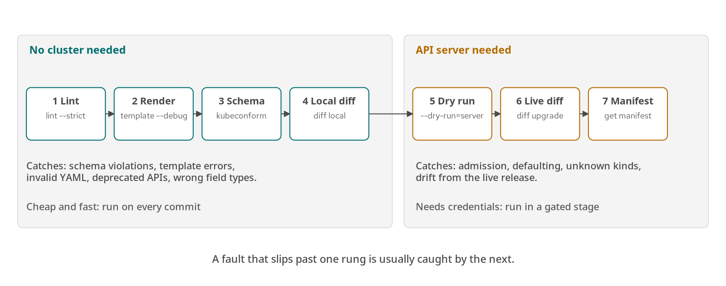
TESTING · DEBUGGING
The debug ladder
Figure: seven checks, four without a cluster, three that need an API server.
5
Notes:
What it shows: Seven rungs from `helm lint --strict` to `helm get manifest`. Rungs one to four need no cluster; five to seven need an API server. The example plants five faults, one per early rung: a values schema violation, a nil pointer in a template, valid template with invalid YAML, a deprecated API that only --strict fails, and a string containerPort that only kubeconform rejects.
What to show: `cd examples/13-debugging && ./demo.sh offline` and read the five fault blocks.
Fallback: the chapter 13 transcript shows the same five error messages.

Slide 6
TESTING · DEBUGGING
Diff and server dry-run
bash · helm 4.3
# Rung 4: compare two chart directories locally (helm-diff plugin)
[host]$ helm diff local charts/shipping-service /tmp/changed
# Rung 5: resolve kinds and run lookup against the API server
[host]$ helm upgrade shipping charts/shipping-service -n hfd-13 \
--dry-run=server
# Rung 6: what an upgrade would change in the live release
[host]$ helm diff upgrade shipping charts/shipping-service -n hfd-13 \
--set replicaCount=2
# Rung 7: the stored manifest, fed back to the schema check
[host]$ helm get manifest shipping -n hfd-13 | kubeconform -strict -summary
From examples/13-debugging. --dry-run=server resolves kinds and runs lookup; it does not schema-validate fields on 4.3.0.
6
Notes:
What it shows: The cluster-facing rungs. `--dry-run=server` connects to the API server, resolves every kind against it and runs `lookup`, which catches unknown kinds. On Helm 4.3.0 it does not schema-validate fields: a string containerPort, an unknown field, negative replicas and a Pod Security violation all pass. For field validation pipe `helm template` into `kubectl apply --server-side --dry-run=server -f -`, which rejects them. `helm diff` is a plugin that compares rendered output against another chart directory or the live release. `helm get manifest` closes the loop by feeding the stored manifest back into kubeconform.
What to show: `cd examples/13-debugging && ./demo.sh` runs the cluster rungs in namespace hfd-13.
Fallback: the chapter 13 transcript for rungs five to seven.

Slide 7
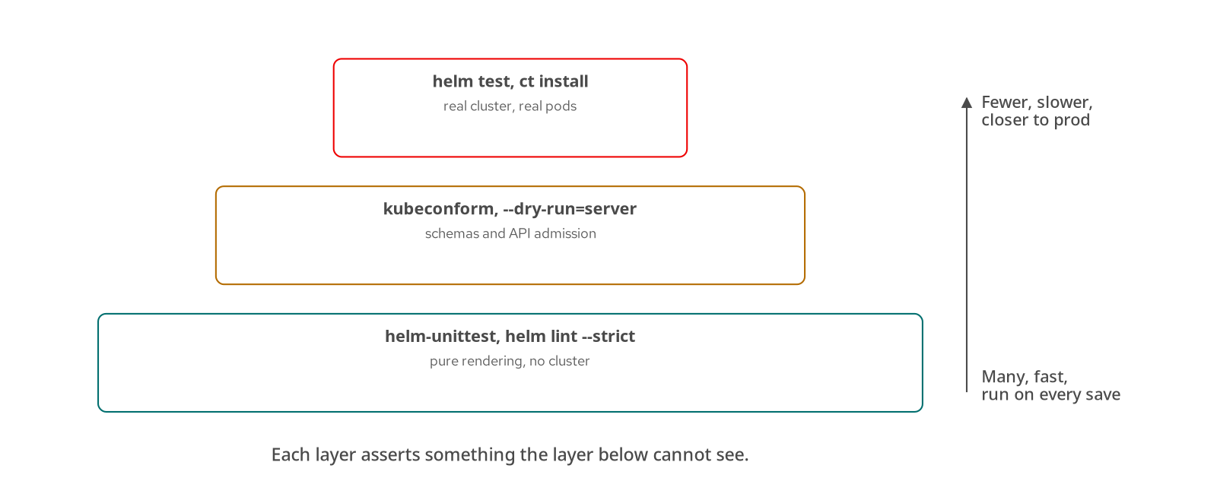
TESTING · DEBUGGING
Chart test pyramid
Figure: pure rendering tests at the base, cluster tests at the top.
7
Notes:
What it shows: Three layers. The base is many fast tests that only render: helm-unittest and lint. The middle validates rendered output against schemas and the API server. The top installs the chart into a real cluster and runs helm test. Each layer asserts something the layer below cannot see.
What to show: `helm unittest charts/shipping-service` (30 tests across 6 suites in the reference chart) and then `helm test shipping -n hfd-14`.
Fallback: the chapter 14 transcript lists the passing suites.

Slide 8
TESTING · DEBUGGING
helm-unittest suites
yaml · tests/
suite: shipping-service deployment
templates:
- templates/deployment.yaml
tests:
- it: renders a Deployment with the default image tag from appVersion
asserts:
- equal:
path: spec.template.spec.containers[0].image
value: shipping-service:0.1.0
- it: fails when kafka is enabled without a bootstrap address
set:
kafka.enabled: true
asserts:
- failedTemplate:
errorPattern: kafka.bootstrap is required
Run helm unittest charts/shipping-service; helm unittest -u refreshes snapshot files.
8
Notes:
What it shows: A helm-unittest suite is YAML beside the chart. Each test renders templates with chosen values and asserts on the output. `failedTemplate` asserts that a `required` or `fail` call fires with the expected message, which tests the guard rails and not only the happy path. Snapshot tests store whole rendered documents; a change shows up as a failed snapshot until it is reviewed and refreshed with `-u`.
What to show: `cd examples/14-chart-testing && ./demo.sh offline` for the pass run and the planted snapshot failure.
Fallback: chapter 14 shows 30 passing tests in 6 suites and the snapshot failure text.

Slide 9
TESTING · DEBUGGING
chart-testing and kubeconform
ct lint | Chart metadata | Chart.yaml schema, yamllint, and helm lint for every ci/* -values.yaml.
ct install | Cluster test | Installs into a generated namespace, runs helm test, cleans up.
ct.yaml | Configuration | chart-dirs, schema and lint config, version-increment check on or off.
ci/*-values.yaml | Scenarios | One values file per configuration worth testing; ct runs each.
kubeconform | Schema check | Validates rendered YAML against Kubernetes and CRD schemas, offline.
9
Notes:
What it shows: Two tools that sit between unit tests and a full install. chart-testing (ct) lints chart metadata and runs each ci/ values file through lint and install. kubeconform validates the rendered manifests against the schema of the Kubernetes version you pin, and against CRD schemas when given a catalog. Unknown Chart.yaml keys are rejected by ct lint, which the example plants as a failure.
What to show: `cd examples/14-chart-testing && ./demo.sh offline`, then the no-argument run for `ct install`.
Fallback: chapter 14 cross-check section shows the expected output of each command.

Slide 10
TESTING · DEBUGGING
Chart CI pipeline
bash · ci
# Stage 1: static checks, no cluster, every push
[host]$ helm lint --strict charts/shipping-service
[host]$ helm unittest charts/shipping-service
[host]$ helm template shipping charts/shipping-service \
-f charts/shipping-service/ci/ci-values.yaml \
| kubeconform -strict -summary
[host]$ ct lint --config ct.yaml --all
# Stage 2: install test on a throwaway cluster
[host]$ ct install --charts charts/shipping-service \
--helm-extra-args '--timeout 3m'
# Stage 3: publish on a version tag
[host]$ helm package charts/shipping-service --dependency-update -d dist
[host]$ helm push dist/shipping-service-1.0.0.tgz \
oci://registry.example.com/charts
Run from examples/14-chart-testing. Three stages: static checks on every push, an install test, and publication on a tag.
10
Notes:
What it shows: The pipeline is the chapter 14 commands in order, with publication from chapter 20 appended. Stage one is cheap and runs on every push. Stage two needs a cluster, so it runs in a job that provisions one. Stage three runs only on a version tag. The same script runs locally, which is the point: the pipeline adds no check a developer cannot run.
What to show: `cd examples/14-chart-testing && ./demo.sh` runs stages one and two against minikube.
Fallback: the pipeline slide itself; every command appears in chapters 14 and 20.

Slide 11
02
Multi-Service Applications
Compose charts into a platform and share what they have in common.
Notes:
What it shows: Chapters 15 to 18. A notification service and a Kafka cluster join the shipping service, an umbrella chart composes them, a library chart removes the duplicated templates, and a starter turns the result into a golden path for new services.
What to show: examples/15-kafka-notification, 16-umbrella, 17-library-chart, 18-starters.
Fallback: chapter transcripts for each example.

Slide 12
MULTI-SERVICE
Kafka via Strimzi
yaml · shipping-kafka
# charts/shipping-kafka: the chart declares the Kafka custom resource
spec:
kafka:
listeners:
- name: plain
port: 9092
type: internal
tls: false
# values.yaml: the contract other charts import
exports:
kafka:
bootstrap: shipping-kafka-kafka-bootstrap:9092
The operator runs the brokers; the chart owns the declaration and exports the bootstrap address.
12
Notes:
What it shows: An operator owns the brokers and the chart owns the declaration. Strimzi 0.51.0 is installed once per cluster in the strimzi namespace and watches every namespace. The shipping-kafka chart renders the Kafka, KafkaNodePool and KafkaTopic resources. Its `exports.kafka.bootstrap` value is static so that an umbrella can import it into the services that need a broker address.
What to show: `cd examples/15-kafka-notification && ./demo.sh`, then `kubectl -n hfd-15 get kafka,kafkanodepool,kafkatopic`.
Fallback: chapter 15 transcript; the cross-check section shows the expected resources.

Slide 13
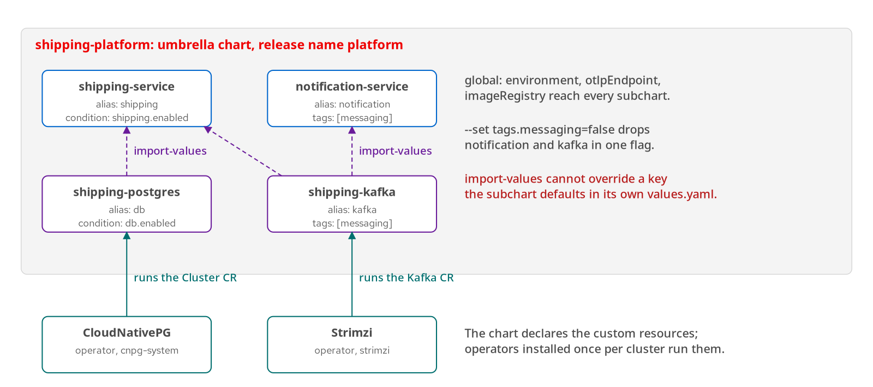
MULTI-SERVICE
Umbrella topology
Figure: one umbrella release, four subcharts, two operators outside the release.
13
Notes:
What it shows: The shipping-platform umbrella declares four dependencies under aliases. Postgres and Kafka values flow into the services through import-values. The operators for Postgres and Kafka are installed once per cluster, outside the release. The umbrella sets the migration hook to post-install because the CloudNativePG Cluster and its credentials Secret are created in the same release, and a pre-install hook would run before they exist.
What to show: `cd examples/16-umbrella && ./demo.sh`, then `helm list -n hfd-16`.
Fallback: chapter 16 shows the rendered release and the rollback-on-failure error text.

Slide 14
MULTI-SERVICE
Conditions, tags, alias
yaml · Chart.yaml
dependencies:
- name: shipping-service
alias: shipping
condition: shipping.enabled
- name: notification-service
alias: notification
tags: [messaging]
- name: shipping-postgres
alias: db
condition: db.enabled
- name: shipping-kafka
alias: kafka
tags: [messaging]
condition switches one subchart; a tag switches a group; alias renames it in values and in rendered names.
14
Notes:
What it shows: Three controls on a dependency. `condition` is a values path that enables or disables one subchart. `tags` group subcharts so one flag, `tags.messaging=false`, removes notification and Kafka together. `alias` lets the same chart appear under a different name in values. When a condition path exists in values it wins over tags. With tags off, also disable the subchart settings that point at Kafka, as `ci/ci-values.yaml` does.
What to show: `helm template platform charts/shipping-platform --set tags.messaging=false` and count the Deployments.
Fallback: chapter 16 transcript shows both renders.

Slide 15
MULTI-SERVICE
Globals and import-values
global — one values subtree every subchart can read: environment, otlpEndpoint, imageRegistry.
import-values — copies a subchart's exports into the parent or a sibling's values at render time.
Static exports — an exports block is a constant, so it must match the Cluster name and Kafka clusterName it describes.
Override trap — a key the subchart defaults in its own values.yaml cannot be overridden by an import; leave it unset.
15
Notes:
What it shows: Global values and imports are the two ways data crosses subchart boundaries. Globals flow downward from the umbrella. Imports flow from a subchart's exports to the parent. The trap is precedence: an imported value cannot replace a key the importing subchart already defaults, which is why postgres.host, postgres.existingSecret and kafka.bootstrap carry no default in the service charts.
What to show: `helm template platform charts/shipping-platform | grep -n KAFKA_BOOTSTRAP` shows the imported address in the notification Deployment.
Fallback: chapter 16 section 'Two traps' shows the stale value that a default would leave behind.

Slide 16
MULTI-SERVICE
CRDs and operators
crds/ directory | Chart-owned CRDs | Applied on first install, skipped on upgrade, never deleted. Inspect with helm show crds.
templates/ | CRD as a template | Upgraded with the release; uninstall deletes the CRD and every custom resource.
Operator chart | Operator-owned CRDs | The operator installs its CRDs; the application chart ships only custom resources.
fail guard | Readable failure | Template stops with a clear message when the required API is not served.
16
Notes:
What it shows: Four ways a chart relates to a CRD. The reference charts use the third and fourth: CloudNativePG and Strimzi own their CRDs, and the application charts ship Cluster and Kafka resources and refuse to render if the API is missing. A CRD placed in templates/ is deleted on uninstall together with every custom resource of that kind, which is rarely intended.
What to show: `cd examples/10-crds-operators && ./demo.sh offline`; the cluster run prints the CRD's managed fields.
Fallback: chapter 10 transcript with the planted guard failure.

Slide 17
MULTI-SERVICE
Capabilities guards
go template
{{- if and .Values.requireOperator
(not (.Capabilities.APIVersions.Has "postgresql.cnpg.io/v1")) }}
{{- fail "shipping-postgres needs the CloudNativePG operator: ..." }}
{{- end }}
# templates/route.yaml renders only where the API exists
{{- if and .Values.route.enabled
(.Capabilities.APIVersions.Has "route.openshift.io/v1") }}
...
{{- end }}
# Offline there is no cluster to ask: supply the API yourself
[host]$ helm template platform charts/shipping-platform -n hfd-ocp \
--api-versions route.openshift.io/v1
[host]$ helm template platform charts/shipping-platform -n hfd-ocp
Has asks the cluster at install time; helm template needs --api-versions (examples/27-openshift-crc).
17
Notes:
What it shows: `.Capabilities.APIVersions.Has` reports which APIs the target cluster serves. The first guard turns a missing operator into a message that names the fix instead of an opaque apply error. The second makes a Route render only on OpenShift, so the same umbrella installs on minikube unchanged. Offline, `helm template` has no cluster, so `--api-versions` supplies the answer; without it the Route is absent, and the example asserts both outcomes.
What to show: `cd examples/27-openshift-crc && ./demo.sh offline` shows the Route with and without the flag.
Fallback: chapters 10 and 27 carry both outputs.

Slide 18
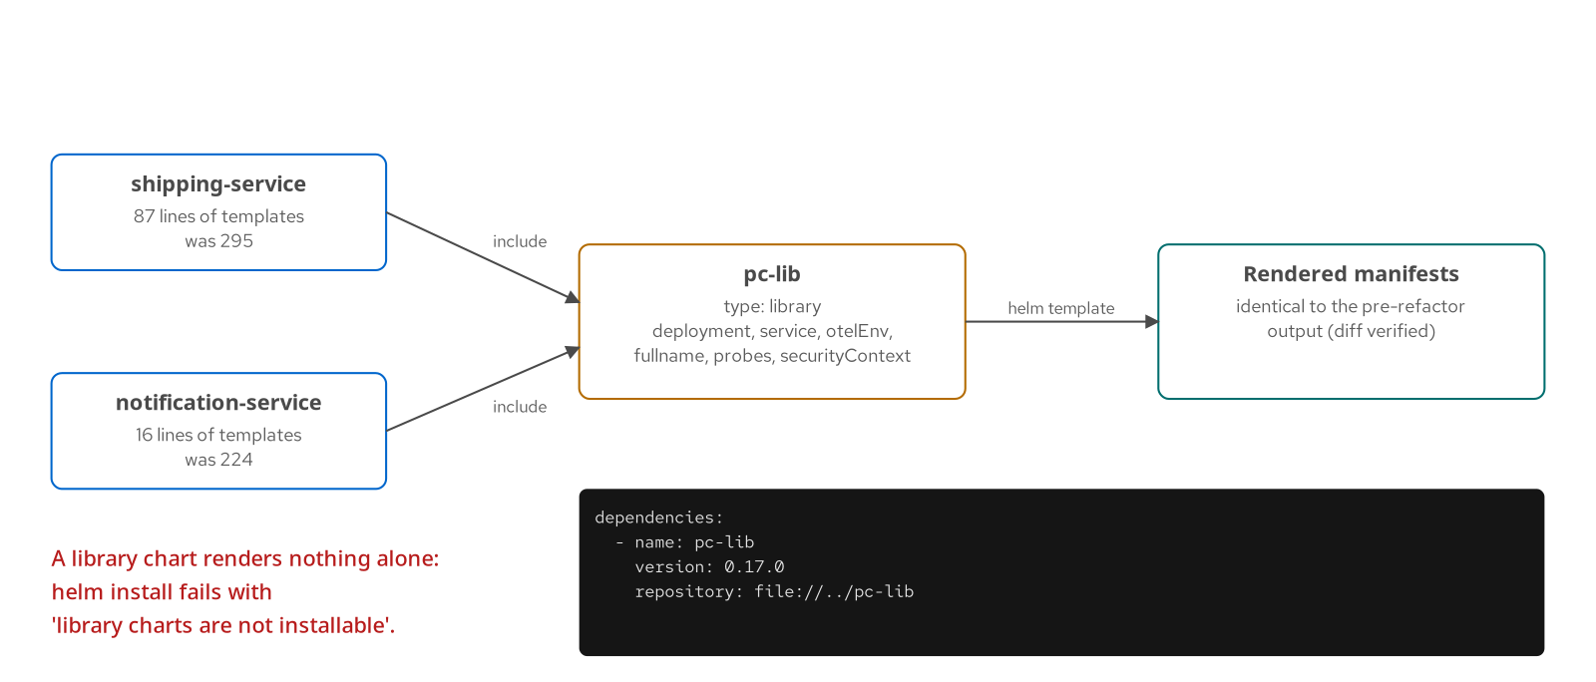
MULTI-SERVICE
Library charts
Figure: two service charts include templates from pc-lib; rendered output stays identical.
18
Notes:
What it shows: pc-lib is a chart with `type: library`. It holds the Deployment, Service, probe, security-context and OpenTelemetry templates as named templates. The service charts include them with a dict of arguments. The refactor reduced notification-service templates from 224 lines to 16 and shipping-service from 295 to 87, and a diff of `helm template` before and after confirms identical manifests. A library chart cannot be installed on its own.
What to show: `cd examples/17-library-chart && ./demo.sh` prints the line counts and the identical-output check.
Fallback: chapter 17 transcript with the line counts.

Slide 19
MULTI-SERVICE
Starters and golden paths
bash · helm create
# A starter is a chart directory; <CHARTNAME> becomes the new name
[host]$ helm create --starter pc-fastapi charts/inventory-service
[host]$ helm dependency build charts/inventory-service
[host]$ helm lint --strict charts/inventory-service
[host]$ helm template inventory charts/inventory-service \
| kubeconform -strict -summary
[host]$ helm upgrade --install inventory charts/inventory-service \
-n hfd-18 --create-namespace
[host]$ helm test inventory -n hfd-18
# Starters live in HELM_DATA_HOME/starters or at an absolute path
Run from examples/18-starters. The starter is the first commit; the library, schema and ci/ values carry the guardrails.
19
Notes:
What it shows: A golden path is the supported route to a working service. The starter supplies the first commit, pc-lib supplies behavior, and the schema and ci/ values supply the guardrails. `helm create --starter` copies the starter and replaces `<CHARTNAME>`; it also rewrites Chart.yaml, so the pc-lib dependency ships as a snippet to append. Version the starter and record which version a service was built from, and measure the path by how many teams stay on it.
What to show: `cd examples/18-starters && ./demo.sh`; it generates a service and runs it through lint, kubeconform, install and helm test.
Fallback: chapter 18 transcript.

Slide 20
03
Distribution
Version, publish, verify and sign charts.
Notes:
What it shows: Chapters 19 to 21. Chart versions have rules, repositories come in two forms, OCI registries are the current default, and there are two independent signature mechanisms.
What to show: examples/19-packaging-repos, 20-oci, 21-signing.
Fallback: chapter transcripts.

Slide 21
DISTRIBUTION
SemVer versus appVersion
yaml · Chart.yaml
version: 1.0.0 # the chart: templates, values keys, dependencies
appVersion: "0.1.0" # the application the chart deploys; default image tag
# CI stamps both without editing the file
[host]$ helm package charts/shipping-service \
--version 1.0.1 --app-version 0.1.1 -d .work/repo
# Pre-releases are valid SemVer and hidden from search until --devel
[host]$ helm package charts/shipping-service --version 1.1.0-rc.1 -d .work/repo
[host]$ helm search repo hfd-local --devel
Bump major for a removed or changed values key, minor for additions, patch for fixes.
21
Notes:
What it shows: Two numbers that move independently. `version` is SemVer for the chart: major when a values key a consumer sets disappears or changes meaning, minor for an added template or optional value, patch for a fix. `appVersion` describes the software inside and is the default image tag. Helm's version parser is lenient and accepts 1.0 or v1.0.2; use three-part numbers without a v so ordering, ranges and tooling behave.
What to show: `cd examples/19-packaging-repos && ./demo.sh`.
Fallback: chapter 19 shows the packaged chart rendering image shipping-service:0.1.1.

Slide 22
DISTRIBUTION
Repos versus OCI
Classic repo | index.yaml over HTTP | helm repo add, update, search repo; helm repo index builds the index; any static host works.
OCI registry | Charts as artifacts | helm push and pull oci://; no helm repo add and no index.yaml; tags carry the version.
Search | Discovery | helm search repo works on classic repos only; registries are browsed with their own tooling.
Digests | Immutability | OCI installs accept @sha256:<digest>; a tag can move, a digest cannot.
Auth | Credentials | helm registry login for OCI; repo credentials flags for classic repos.
22
Notes:
What it shows: Classic repositories are an index.yaml plus tarballs served over HTTP, built with `helm repo index`. OCI registries store the chart as an artifact, so push, pull and install use oci:// references and the tag is the version. OCI adds digest pinning, which is why the promotion workflow later in this deck records digests. The Helm 4 OCI behavior, including install by digest and changes to `helm registry`, is documented on helm.sh/docs.
What to show: `cd examples/19-packaging-repos && ./demo.sh` for a classic repo, then `cd ../20-oci && ./demo.sh`.
Fallback: chapters 19 and 20 transcripts.

Slide 23
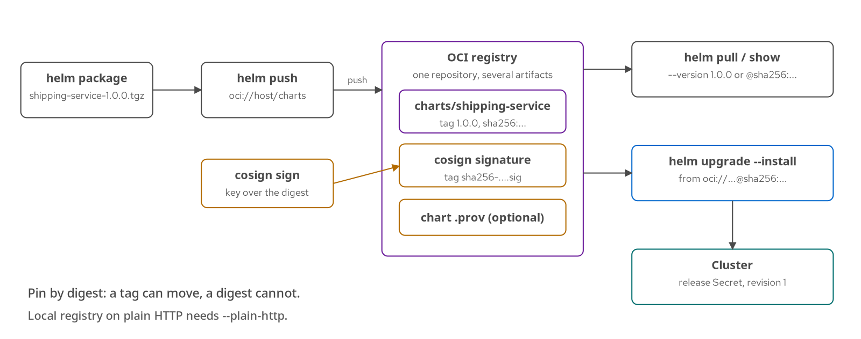
DISTRIBUTION
Push and pull with OCI
Figure: package, push, optionally sign, then pull or install by tag or digest.
23
Notes:
What it shows: The OCI flow end to end. `helm package` builds the tarball, `helm push` sends it to oci://host/charts, and the registry stores the chart under its version tag. Signatures live beside it as separate artifacts. Installs accept a tag or a manifest digest. A local registry on plain HTTP needs `--plain-http`, which the example uses with a registry container on 127.0.0.1:5001.
What to show: `cd examples/20-oci && ./demo.sh` and `curl -s http://127.0.0.1:5001/v2/charts/shipping-service/tags/list`.
Fallback: chapter 20 transcript; it shows the HTTP-to-HTTPS error that --plain-http removes.

Slide 24
DISTRIBUTION
Provenance files
bash · helm package --sign
# Sign at package time; the key must come from a secret keyring file
[host]$ helm package charts/shipping-service --dependency-update --sign \
--key "HFD Throwaway Signer" --keyring .work/keys/secring.gpg \
-d .work/signed
# Verify the tarball against its .prov file
[host]$ helm verify .work/signed/shipping-service-1.0.0.tgz
# Verify while pulling from an OCI registry
[host]$ helm pull oci://127.0.0.1:5001/signed/shipping-service \
--version 1.0.0 --plain-http --verify -d .work/pull
From examples/21-signing. A .prov file holds a PGP signature over the chart's hash; tampering fails verification.
24
Notes:
What it shows: Helm's native provenance is a PGP signature. `helm package --sign` writes a .prov file next to the tarball containing the chart metadata and its sha256, signed with the key. `helm verify` recomputes the hash and checks the signature. In the example a modified tarball fails with a sha256 mismatch. Keys here are throwaway keys in a project-local GNUPGHOME; production keys belong in a managed keyring or hardware token.
What to show: `cd examples/21-signing && ./demo.sh`, which also shows the tamper failure.
Fallback: chapter 21 transcript with the 'Chart Hash Verified' output and the mismatch error.

Slide 25
DISTRIBUTION
Cosign for OCI charts
bash · cosign
# A second mechanism: sign the OCI manifest digest, not the tarball
[host]$ cosign sign --key .work/cosign/cosign.key --yes --allow-http-registry \
--use-signing-config=false --tlog-upload=false \
127.0.0.1:5001/signed/shipping-service@sha256:<digest>
[host]$ cosign verify --key .work/cosign/cosign.pub --allow-http-registry \
--insecure-ignore-tlog \
127.0.0.1:5001/signed/shipping-service@sha256:<digest>
# Keyless signing and the transparency log are the default in production:
# omit --key, --use-signing-config=false and --tlog-upload=false
The flags that disable the transparency log exist for a local HTTP registry only.
25
Notes:
What it shows: Two signatures cover two things. The .prov file covers the chart tarball as a PGP signature that Helm verifies. cosign signs the OCI manifest digest in the registry, so it covers whatever the registry serves under that digest. They are independent and can be used together. cosign 3.1.3 needs extra flags for an HTTP registry and no transparency log; those flags are scaffolding for the local example and are dropped in a real registry with keyless signing.
What to show: `cd examples/21-signing && ./demo.sh`; the last block runs cosign sign and verify, then the missing-signature failure.
Fallback: chapter 21 transcript with the 'no signatures found' error.

Slide 26
04
Extending Helm
Plugins in Helm 4: types, runtimes and post-renderers.
Notes:
What it shows: Chapters 22 and 23. Helm 4 redesigned the plugin system around typed plugins and a sandboxed Wasm runtime, and made post-renderers plugins. Both are Helm-4-changed topics; the authoritative sources are helm.sh/docs and HIP-0026.
What to show: examples/22-plugins and 23-post-renderers.
Fallback: chapter transcripts; the plugins directory holds the sources.

Slide 27
EXTENDING HELM
Helm 4 plugin types
cli/v1 | Command plugin | Adds a subcommand: helm shipping-env, helm wasm-hello.
getter/v1 | Download plugin | Fetches charts from a new kind of location.
postrenderer/v1 | Post-renderer | Rewrites rendered manifests; selected with --post-renderer NAME.
subprocess | Runtime | Helm runs runtimeConfig.platformCommand with the user's permissions.
extism/v1 | Runtime | Helm runs plugin.wasm in a sandbox with memory and time limits.
27
Notes:
What it shows: A plugin has a type, which says what Helm uses it for, and a runtime, which says how Helm runs it. The plugin.yaml uses apiVersion v1. `helm plugin install` verifies provenance by default; installing from a git URL needs `--verify=false`, and installing from a local directory is a development install. Design reference: HIP-0026 and the plugins overview on helm.sh/docs.
What to show: `cd examples/22-plugins && ./demo.sh`; it runs `helm plugin list` showing TYPE and APIVERSION columns.
Fallback: chapter 22 transcript.

Slide 28
EXTENDING HELM
Wasm plugin manifest
yaml · plugin.yaml
apiVersion: v1
type: cli/v1
name: wasm-hello
version: 0.1.0
runtime: extism/v1
runtimeConfig:
memory:
maxPages: 256
timeout: 5000
The runtime field selects the sandbox; memory and time limits live in the plugin's own configuration.
28
Notes:
What it shows: The Wasm runtime is the reason for the redesign. The module is sandboxed, with memory and time limits set in the plugin's own configuration, so it holds fewer permissions than a subprocess plugin. `runtime: extism/v1` tells Helm to load plugin.wasm into the Extism runtime instead of running a platform command.
What to show: `cd examples/22-plugins && ./demo.sh` runs `helm wasm-hello Helm4`; the committed plugin.wasm means no Go toolchain is needed.
Fallback: chapter 22 transcript with the greeting output.

Slide 29
EXTENDING HELM
Wasm plugin entry point
go and bash
// main.go: the exported entry point
//go:wasmexport helm_plugin_main
func helmPluginMain() uint32 { ...; return 0 }
# build the module Helm loads as plugin.wasm
[host]$ GOOS=wasip1 GOARCH=wasm go build \
-buildmode=c-shared -o plugin.wasm .
# run it: helm wasm-hello Helm4
Output: Hello, Helm4! (from a Wasm Helm plugin). The module runs inside Helm's Extism runtime.
29
Notes:
What it shows: The entry point is the exported `helm_plugin_main`; input and output are JSON through the Extism PDK, and the plugin returns an empty JSON object on success. The example builds with Go targeting wasip1 and the resulting plugin.wasm sits beside plugin.yaml.
What to show: `cd examples/22-plugins && ./demo.sh` prints the greeting.
Fallback: chapter 22 transcript with the greeting output.

Slide 30
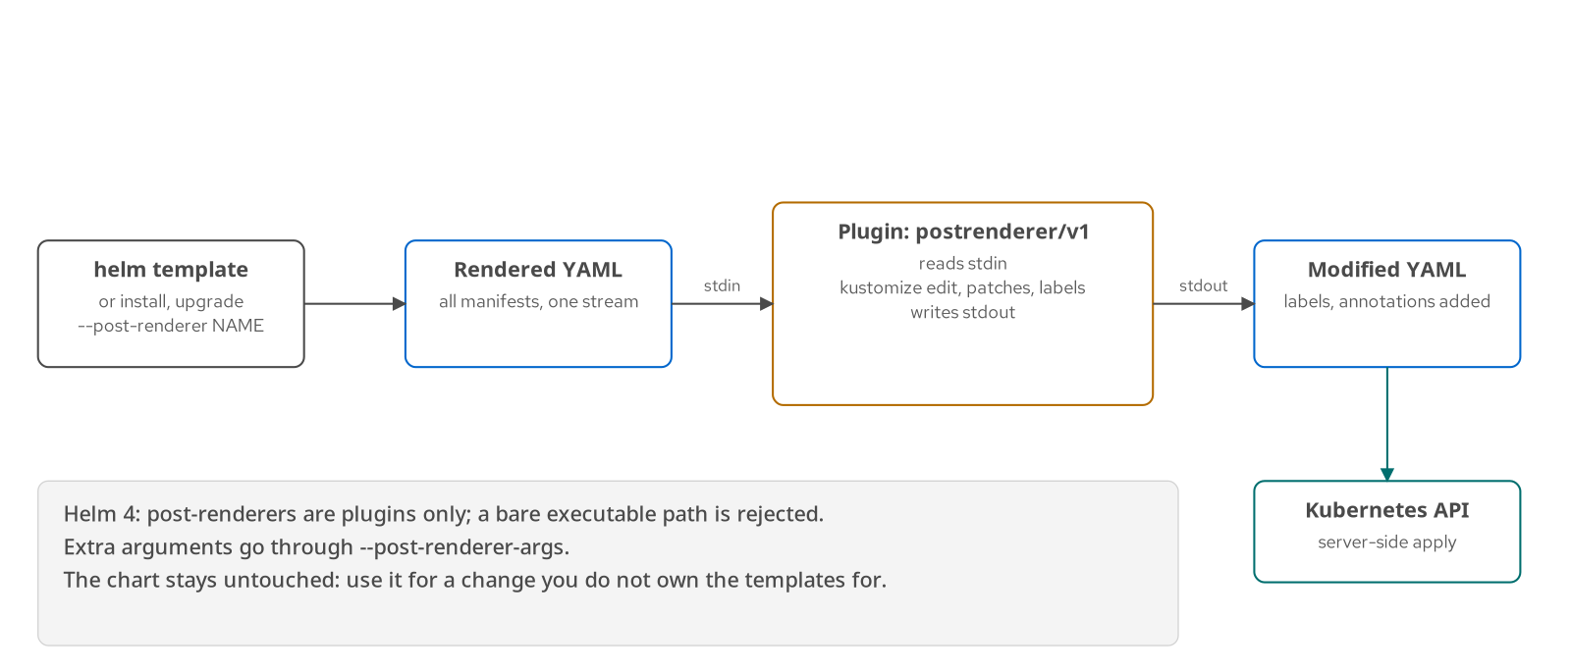
EXTENDING HELM
Post-renderer plugins
Figure: rendered YAML goes to a plugin on stdin and comes back modified on stdout.
30
Notes:
What it shows: A post-renderer receives the rendered manifests on stdin and writes the modified manifests to stdout before Helm applies them. In Helm 4 a post-renderer is a plugin of type postrenderer/v1, selected by name; a path to an executable is rejected. The example plugin runs kustomize to add a label to every object and an annotation to Deployments. Use one when you need a change the chart's templates do not expose and you do not own the chart.
What to show: `cd examples/23-post-renderers && ./demo.sh`; it runs `helm template ... --post-renderer kustomize-postrender`.
Fallback: chapter 23 transcript with the labeled output and the path-rejection error.

Slide 31
05
Delivery
Promote across environments, drive releases from Git, and observe them.
Notes:
What it shows: Chapters 24 to 26. Environments are values layers plus pins, Helmfile is optional glue, Argo CD changes who runs the release, and the library chart carries telemetry configuration to every service.
What to show: examples/24-environments, 25-gitops-argocd, 26-observability.
Fallback: chapter transcripts.

Slide 32
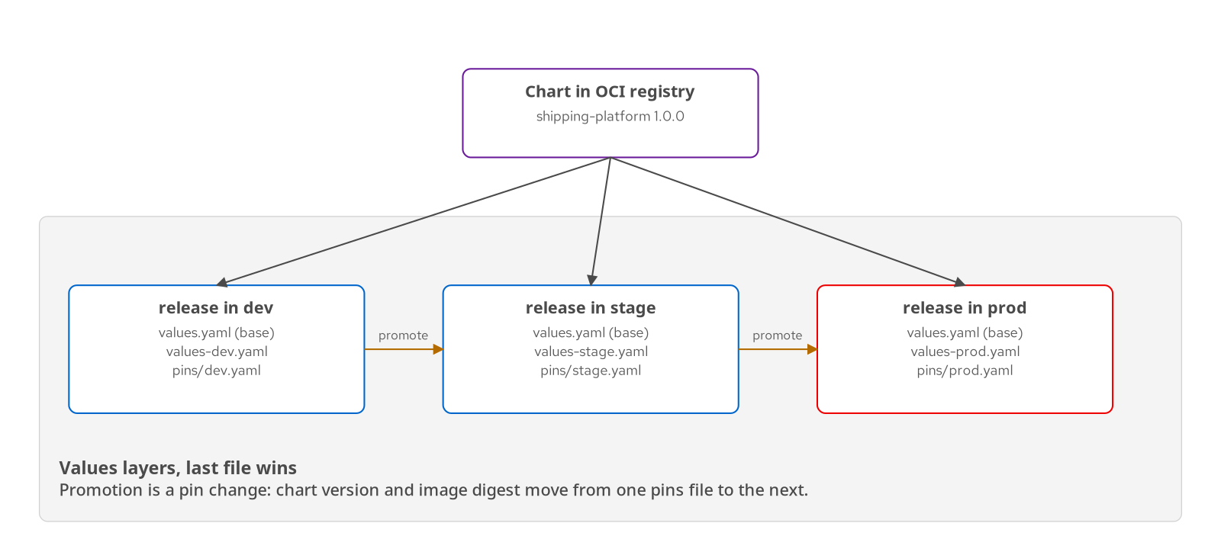
DELIVERY
Environment promotion
Figure: one chart build, three environments, each a values layer plus a pins file.
32
Notes:
What it shows: An environment is a set of values files, not a copy of the chart. The base values.yaml is shared; values-dev, values-stage and values-prod hold the differences; a pins file per environment records the chart version and image tag or digest. Promotion is a reviewed change to the next environment's pins file. The same chart build moves through every environment.
What to show: `cd examples/24-environments && ./demo.sh offline` renders all three environments; `./demo.sh` installs one.
Fallback: chapter 24 transcript with the rendered diffs between environments.

Slide 33
DELIVERY
Helmfile, optional
yaml · helmfile.yaml
helmDefaults:
wait: true
timeout: 600
createNamespace: true
rollbackOnFailure: true # Helm 4 flag
releases:
- name: platform
namespace: hfd-24-prod
chart: ./charts/shipping-platform
version: 1.0.0 # the chart pin: one reviewed line per environment
labels:
env: prod
values:
- charts/shipping-platform/values-prod.yaml
- pins/prod.yaml
helmfile -l env=prod template --skip-deps renders one environment; Helmfile adds no new Helm flags.
33
Notes:
What it shows: Helmfile declares the releases for every environment in one file. Its `rollbackOnFailure` maps to Helm 4's `--rollback-on-failure`, and Helmfile refuses it on Helm 3. It is optional: the same promotion works with plain helm commands and a script. The `version:` line is enforced only for charts from a repository or OCI registry; for a local path it is documentation.
What to show: `cd examples/24-environments && ./demo.sh offline`, which also runs `helmfile -l env=prod template --skip-deps`.
Fallback: the equivalent `helm template platform charts/shipping-platform -f values-prod.yaml -f pins/prod.yaml` from chapter 24.

Slide 34
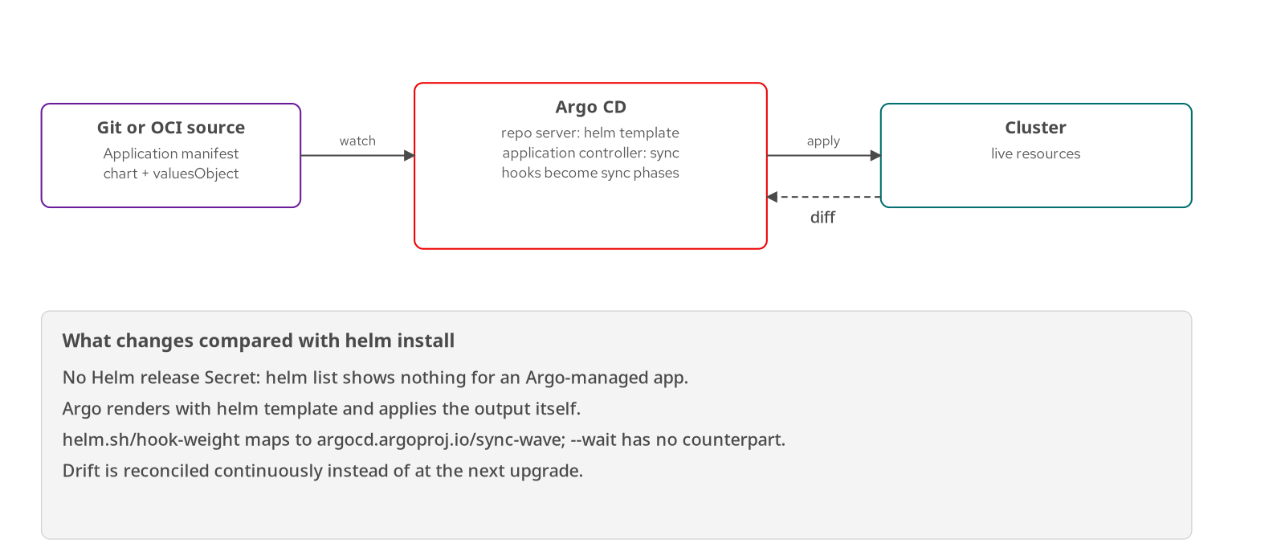
DELIVERY
GitOps with Argo CD
Figure: Argo CD renders the chart with helm template and applies the result itself.
34
Notes:
What it shows: Argo CD does not run `helm install`. Its repo server renders the chart with `helm template` and its controller applies and reconciles the output. The consequences: no release Secret, so `helm list` shows nothing; Helm hooks are mapped to Argo sync phases; and `--wait` has no counterpart, so health comes from Argo's own checks. The Application points at the chart, a version and a valuesObject. Argo CD is installed from its Helm chart with Dex and notifications disabled for the demo.
What to show: `cd examples/25-gitops-argocd && ./demo.sh offline`; the cluster run installs Argo CD in namespace argocd and syncs the chart from the registry addon.
Fallback: chapter 25 transcript with the sync status.

Slide 35
DELIVERY
Hooks versus sync waves
post-install hook | PostSync phase | The migration Job runs after every non-hook resource is Healthy.
hook-weight | sync-wave on hooks | helm.sh/hook-weight becomes argocd.argoproj.io/sync-wave; lower runs first.
no weight | Wave 0 default | Regular resources carry wave 0; annotate them to order them.
Scope | Weights versus waves | Hook weights order hooks within one phase; waves order everything across the sync.
--wait | No equivalent | Readiness probes decide Healthy; the PostSync hook waits on them.
35
Notes:
What it shows: How Helm's ordering maps onto Argo CD. The umbrella's migration Job is post-install and post-upgrade, which Argo treats as PostSync: it runs after every regular resource is Healthy, so the shipping pods must become Ready first. That is the same ordering `--wait` enforced under Helm. Within a phase, order comes from weights and waves; the two mechanisms look alike but differ in scope.
What to show: `cd examples/25-gitops-argocd && ./demo.sh` and `kubectl -n hfd-25 get deploy,job,svc`.
Fallback: chapter 25 section 'Sync waves and hook weights'.

Slide 36
DELIVERY
Observability via pc-lib
go template · _otel.tpl
{{- define "pc-lib.otelEnv" -}}
{{- $global := default (dict) .Values.global -}}
{{- $endpoint := default (default "" $global.otlpEndpoint) .Values.otel.endpoint -}}
- name: OTEL_SDK_DISABLED
value: {{ if $endpoint }}"false"{{ else }}"true"{{ end }}
{{- if $endpoint }}
- name: OTEL_EXPORTER_OTLP_ENDPOINT
value: {{ $endpoint | quote }}
{{- end }}
# umbrella values.yaml
global:
otlpEndpoint: http://otel-collector.observability.svc.cluster.local:4318
One endpoint on the umbrella; an empty endpoint disables the SDK so the chart runs without a collector.
36
Notes:
What it shows: The library chart turns telemetry configuration into one helper. Every service includes `pc-lib.otelEnv`, which reads `global.otlpEndpoint` and renders the OTEL_* environment variables, including service name and resource attributes. An empty endpoint renders OTEL_SDK_DISABLED=true, so the same chart works with no collector. The umbrella also ships the Grafana dashboard as a ConfigMap that the Grafana sidecar loads.
What to show: `cd examples/26-observability && ./demo.sh offline`, then `kubectl -n hfd-26 exec deploy/platform-shipping -- env`.
Fallback: chapter 26 transcript with the rendered env block.

Slide 37
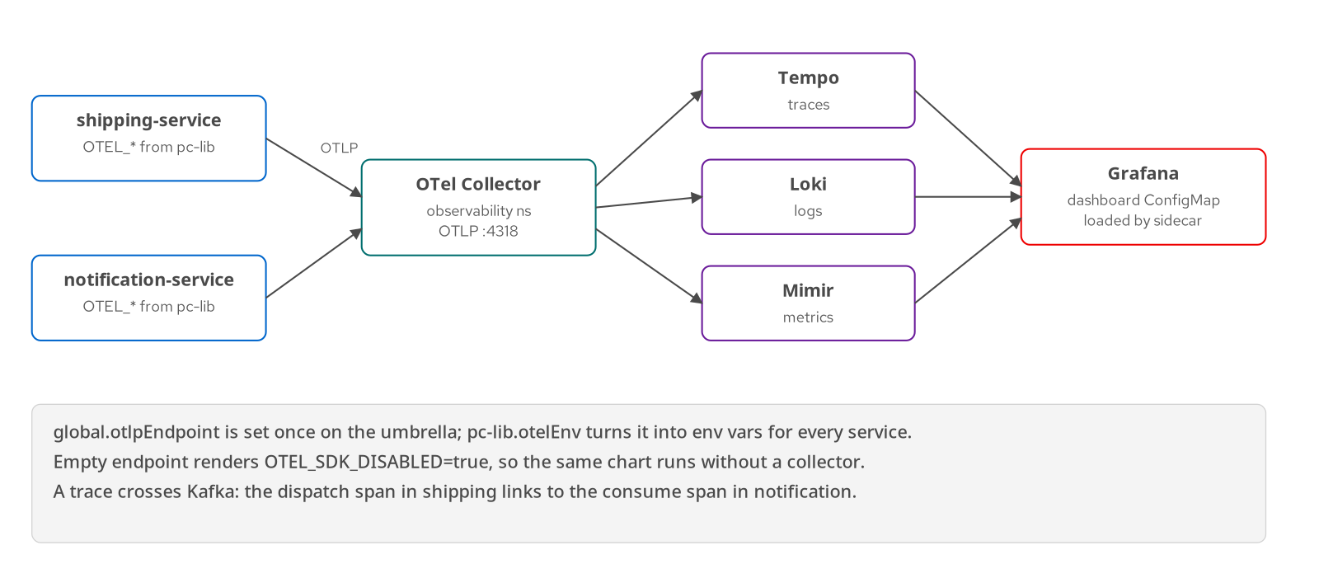
DELIVERY
Telemetry path to LGTM
Figure: services export OTLP to the collector; Tempo, Loki and Mimir feed Grafana.
37
Notes:
What it shows: The path a request's telemetry takes. Both services export OTLP to the OpenTelemetry Collector in the observability namespace, which fans out traces to Tempo, logs to Loki and metrics to Mimir. Grafana reads all three and loads the chart's dashboard from a labeled ConfigMap. A trace crosses Kafka: the dispatch span in shipping links to the consume span in notification. A TraceQL query on `resource.service.name = "platform-shipping"` finds it.
What to show: Grafana at 127.0.0.1:3000 after `scripts/tunnel.sh`; run the TraceQL query from chapter 26 and open the dispatch trace.
Fallback: chapter 26 transcript lists the spans of one dispatch trace.

Slide 38
06
OpenShift
Run the same umbrella chart on OpenShift Local.
Notes:
What it shows: Chapter 27. The same umbrella chart installs on OpenShift Local (CRC) with an override values file. The appendix was verified on OpenShift Local 2.64.0 (OpenShift 4.22.14) on 2026-10-08: the full profile with CloudNativePG and either Strimzi 1.2.0 or Streams for Apache Kafka 3.2.1 from OperatorHub, and the minimal profile, all passing verify-crc.sh. The two Kafka operators own the same CRDs, so a cluster runs one of them. The Developer console Helm view was set up against the published repository; the console's own catalog listing was not opened.
What to show: `cd examples/27-openshift-crc && ./demo.sh offline` anywhere; `PROFILE=full ./verify-crc.sh` on a CRC host.
Fallback: the offline render plus the chapter text; the verify-crc.sh PASS lines from the 2026-10-08 CRC run in the chapter.

Slide 39
OPENSHIFT
SCCs and arbitrary UIDs
restricted-v2 — the default Security Context Constraint assigns each pod a UID from the project's range and sets the group to 0.
runAsUser fails — a manifest that asks for a specific UID, such as 1001, is rejected at admission.
pc-lib avoids it — renders runAsNonRoot, no privilege escalation, dropped capabilities and RuntimeDefault seccomp, and never emits runAsUser or fsGroup.
Group-0 files — the image makes its files group-0 readable, so the assigned UID, near 1000650000, still runs the container.
39
Notes:
What it shows: The one place a chart written for minikube can fail on OpenShift without a template error. The reference charts avoid it by construction: no runAsUser, no fsGroup. The Containerfile's USER 1001:0 is only a default, replaced by the project's assigned UID. On CRC every pod, the operator-managed ones included, carried `openshift.io/scc: restricted-v2`, and `id` inside the services showed uid=1000650000 gid=0, not 1001; the root filesystem stayed read-only and the app ran. verify-crc.sh checks both.
What to show: `./verify-crc.sh` on a CRC host prints PASS or FAIL for the SCC annotation and the UID check; `oc exec deploy/platform-shipping -- id` shows it directly.
Fallback: the rendered Deployment from `helm template` shows no runAsUser; the `id` output from the CRC run in the chapter.

Slide 40
OPENSHIFT
OpenShift overrides
bash and yaml · helm
# Same chart as minikube, with the OpenShift overrides
[crc-host]$ helm upgrade --install platform charts/shipping-platform -n hfd-ocp \
-f values-openshift.yaml -f values-openshift-minimal.yaml \
--wait --rollback-on-failure
# values-openshift.yaml
global:
environment: openshift
imageRegistry: image-registry.openshift-image-registry.svc:5000/hfd-ocp
shipping:
service:
type: ClusterIP
From examples/27-openshift-crc. Routes replace NodePorts; images come from the internal registry.
40
Notes:
What it shows: The OpenShift overrides switch Services to ClusterIP, point images at the internal registry and enable the Route template gated on `route.openshift.io/v1`. A Route is OpenShift's native entry point, served by the cluster router with edge TLS termination and a redirect from HTTP. On OpenShift Local 2.64.0 (OpenShift 4.22.14) the Route host was generated as platform-shipping-hfd-ocp.apps-crc.testing, `/api/info` returned 200 and plain HTTP redirected with 302.
What to show: `cd examples/27-openshift-crc && ./demo.sh offline` for the Route render; on CRC, `./verify-crc.sh`.
Fallback: the offline render; the OpenShift Container Platform documentation for Routes.

Slide 41
OPENSHIFT
Console chart repository
yaml · console
# Developer console: expose a chart repository to one project
apiVersion: helm.openshift.io/v1beta1
kind: ProjectHelmChartRepository
metadata:
name: hfd-charts
namespace: hfd-ocp
spec:
connectionConfig:
url: https://patterncatalyst.github.io/helm-for-developers/charts
The console installs charts from a repository registered per project; the URL is this site's published chart repository, a classic index.yaml plus packaged archives.
41
Notes:
What it shows: A `ProjectHelmChartRepository` makes a chart repository visible in the Developer console's Helm catalog for one project. On OpenShift Local 2.64.0 the resource was accepted with the published URL, the console pod read the index (HTTP 200) and `helm search repo` listed all six charts. The console's catalog listing needs a browser login and was not opened.
What to show: `oc get projecthelmchartrepository -n hfd-ocp` on a CRC host; open Developer, Helm, Create to see the catalog.
Fallback: the YAML on this slide and the chapter 27 section on the Developer console.

Slide 42
201 · SUMMARY
Takeaways
Test in layers — lint and unit tests on every push, kubeconform and server dry-run next, ct install on a real cluster last.
Compose with intent — an umbrella for the platform, a library chart for shared templates, a starter for the golden path.
Ship by digest — OCI registries, SemVer with appVersion kept separate, .prov or cosign signatures.
Extend through plugins — typed plugins and Wasm in Helm 4; post-renderers are plugins only.
Choose who runs the release — helm directly, Helmfile, or Argo CD, each with different hook and wait semantics.
42
Notes:
What it shows: Five points. If the audience keeps one: every check in this deck can run from the command line before CI, and every release step has a Helm-native form even when a GitOps tool drives it. Next steps are the chapter exercises, the cheat sheet that follows, and the reading list.
What to show: return to the tutorial site's chapter list.
Fallback: the cheat sheet slide.

Slide 43
APPENDIX · REFERENCE
Cheat sheet
helm lint --strict | Static check | Schema, YAML and deprecated-API failures without a cluster.
helm unittest CHART | Unit tests | Render-only tests; -u refreshes snapshots.
helm diff upgrade | Change preview | Compare a pending upgrade with the live release.
helm package --sign | Package and sign | Writes the .tgz and a .prov file; helm verify checks it.
helm push / pull | OCI transport | oci:// references; add --plain-http for a local HTTP registry.
helm plugin install | Plugins | Verifies provenance by default; helm plugin list shows TYPE.
--post-renderer NAME | Post-render | Names a postrenderer/v1 plugin; arguments via --post-renderer-args.
--api-versions | Offline capabilities | Supplies APIs to helm template, for example route.openshift.io/v1.
43
Notes:
What it shows: A reference page to keep open in another window. It lists the commands that matter most from chapters 13 to 27; the full cheat sheet is chapter 29 on the tutorial site, including the Helm 3 to Helm 4 flag map in chapter 28.
What to show: `helm <command> --help` from .tools/bin after `source scripts/env.sh` for any flag in doubt.
Fallback: chapter 29.

Slide 44
APPENDIX · REFERENCE
Reading list
Books
Butcher, Farina, Dolitsky, Learning Helm (O'Reilly, 2021)
Block, Dewey, Managing Kubernetes Resources Using Helm (Packt, 2022)
Ibryam, Huss, Kubernetes Patterns (O'Reilly, 2023)
Burns et al., Kubernetes: Up and Running (O'Reilly, 2022)
Muschko, Certified Kubernetes Application Developer (CKAD) Study Guide (O'Reilly, 2024)
Denniss, Kubernetes for Developers (Manning, 2024)
Yuen et al., GitOps and Kubernetes (Manning, 2021)
Salatino, Platform Engineering on Kubernetes (Manning, 2024)
Oliver et al., Effective Platform Engineering (Manning, 2025)
Official sources
helm.sh/docs, Helm 4 overview, changelog and release notes
Helm Improvement Proposals, including HIP-0026 for plugins
OpenShift Local and OpenShift documentation
44
Notes:
What it shows: The nine books the tutorial cites, and the official sources. Books are cited for concepts Helm 4 left unchanged: chart anatomy, templating, Kubernetes objects, GitOps and platform ideas. Anything Helm 4 changed, including flags, plugins, post-renderers, OCI and server-side apply, comes from helm.sh/docs, the release notes and the HIPs, because the two Helm books were written for Helm 3.
What to show: chapter 30 on the tutorial site, which gives each book's scope and ISBN.
Fallback: chapter 30.

