Slide 1


KUBERNETES PATTERNS · CKAD COMPANION
Kubernetes
patterns,
worked live
Thirty-two cloud-native patterns on one minikube cluster, each tagged to the CKAD exam.
r01.0
Notes:
This deck works the Kubernetes design patterns one at a time against the shipping services from the data-mesh project, and runs every one on a single minikube profile on Fedora. It doubles as CKAD revision: each pattern is tagged to its exam domain and a closing crosswalk maps the whole set to the five domains. What to show: the title, then jump to the overview. Fallback: the whole set also reads as a reference site at the project's Pages URL.

Slide 2
OVERVIEW
A pattern per chapter, on a real system
Thirty-two patterns, each worked against the same order, inventory, payment, shipping, and notification services the data-mesh project runs.
Every pattern runs on one minikube profile, mof-patterns, on Fedora: docker driver, containerd runtime, no managed cloud.
Each pattern is tagged to its CKAD exam domain; a closing crosswalk maps the set to all five domains with a timed self-test.
Six pattern families plus three chapters for the CKAD topics the patterns don't already cover.
2
Notes:
The appendix grounds every pattern in a system you can place an order against, rather than a throwaway nginx demo. What to show: name the five shipping services and the single profile. The point is that the same cluster carries all thirty-two patterns. Fallback: the reference site has the same chapters if the deck runs long.

Slide 3
OVERVIEW
The six families
Foundational: the contracts every container honors to be scheduled and run well.
Structural: how containers compose inside one Pod.
Behavioral: how workloads behave over time, from Jobs to StatefulSets.
Configuration: how configuration reaches the application.
Advanced: extending the platform with controllers and an operator.
Security: running with least privilege at the Pod and network layers.
Three closing chapters cover the CKAD topics the patterns leave out: observability, packaging, and namespace governance.
3
Notes:
This is the map. Read a family at a time; within a family the patterns stand alone. What to show: point out that the families run from least to most involved, foundational first because everything else assumes it. Fallback: the crosswalk at the end lists every pattern by family and exam domain.

Slide 4
OVERVIEW
How each pattern is worked
The problem: what breaks without the pattern, stated against the shipping services.
The manifest: the Kubernetes objects that express the pattern, shown as the YAML that matters.
Run it: what you apply, what you observe on the cluster, and how failure looks when a dependency is missing.
The CKAD lens: the exam domain, the competency, and a one-line drill you can run from memory.
4
Notes:
Every pattern chapter follows the same shape, so the deck stays predictable once the audience sees the first one. What to show: tell the audience the CKAD drill on each pattern slide is runnable as-is against mof-patterns. Fallback: skip the drills on a first pass and return to them for exam prep.

Slide 5


01
Foundational Patterns
The contracts every container honors to be scheduled and run well.
Notes:
The foundational family comes first because every later pattern assumes it. A rolling update assumes the scheduler can place a replacement; autoscaling assumes a replica's footprint is known; a health check assumes the container declared what alive and ready mean. What to show: these five patterns are the price of admission for a container to behave on a shared cluster. Fallback: if time is tight, the requests-and-limits and health-probe patterns are the two that matter most to cover live.

Slide 6
FOUNDATIONAL · PREDICTABLE DEMANDS
Predictable Demands
A container with no resource declarations is one the scheduler guesses about. Pack enough guesses onto a node and either the OOM killer picks a victim or CPU contention makes every Pod slow at once.
Requests are what the scheduler reserves against a node's allocatable capacity. Limits are what the kernel enforces once the container runs.
A PriorityClass decides which Pods get first claim on a node, and who the kubelet evicts last under pressure.
ConfigMaps and PersistentVolumeClaims are hard requirements: the Pod refuses to start without them instead of papering over the gap with a silent default.
6
Notes:
shipping-service ships as a plain FastAPI container with no resource declarations of its own; the manifest adds them. A request reserves capacity the scheduler subtracts from a node whether or not the container ever uses it. A limit is enforced by the kernel's cgroup controller: exceed memory and the process is OOMKilled, exceed CPU and it is throttled, not killed. What to show: the two numbers also set the Pod's Quality of Service class, which governs eviction order. Fallback: the runnable example applies the manifests in the wrong order first to surface each failure.

Slide 7
FOUNDATIONAL · PREDICTABLE DEMANDS
Requests and limits
yaml · deployment
resources:
requests:
cpu: 100m # scheduler reserves this
memory: 192Mi
limits:
memory: 512Mi # kernel kills above this (OOMKilled)
# no CPU limit: a CPU limit throttles even on idle cores,
# because CFS accounting is per-container, not per-node
Requests size scheduling, the memory limit guards the node, and the pair sets the Pod's QoS class.
7
Notes:
Requests close to real need, a memory limit for safety, and no CPU limit is a common, well-reasoned production default, not a shortcut. A CPU limit throttles a container even when the node has idle cores sitting next to it. A memory limit protects the node from one leaking process without that downside. What to show: requests below limits earns the Burstable QoS class, evicted after BestEffort but before Guaranteed. Fallback: kubectl get pod -o jsonpath on status.qosClass reads the class directly off a running Pod.

Slide 8
FOUNDATIONAL · PREDICTABLE DEMANDS
Priority and hard requirements
PriorityClass patterns-high-priority (value 1000000) schedules shipping confirmations ahead of batch reports, and the kubelet checks priority before QoS when choosing what to evict.
Apply the Deployment before its ConfigMap exists and the Pod sits in CreateContainerConfigError: the kubelet schedules it but cannot start a container whose env it can't populate.
Apply it before the PVC exists and the Pod stays Pending: a claim is checked during scheduling, earlier than a ConfigMap key.
Both failures surface in kubectl describe pod events. A hard requirement is a state the Pod correctly refuses to hide.
8
Notes:
Priority decides first claim on a node independent of QoS: a Guaranteed Pod at default priority can be evicted before a Burstable Pod at high priority. The ConfigMap and PVC failure modes differ because they are checked at different stages, container start versus scheduling. What to show: the alternative to a hard requirement is a container that falls back to a hardcoded default when its ConfigMap is missing, which hides the misconfiguration until it causes a data problem downstream. Fallback: create the missing object after the fact and the next scheduling or start attempt succeeds without touching the Deployment.

Slide 9
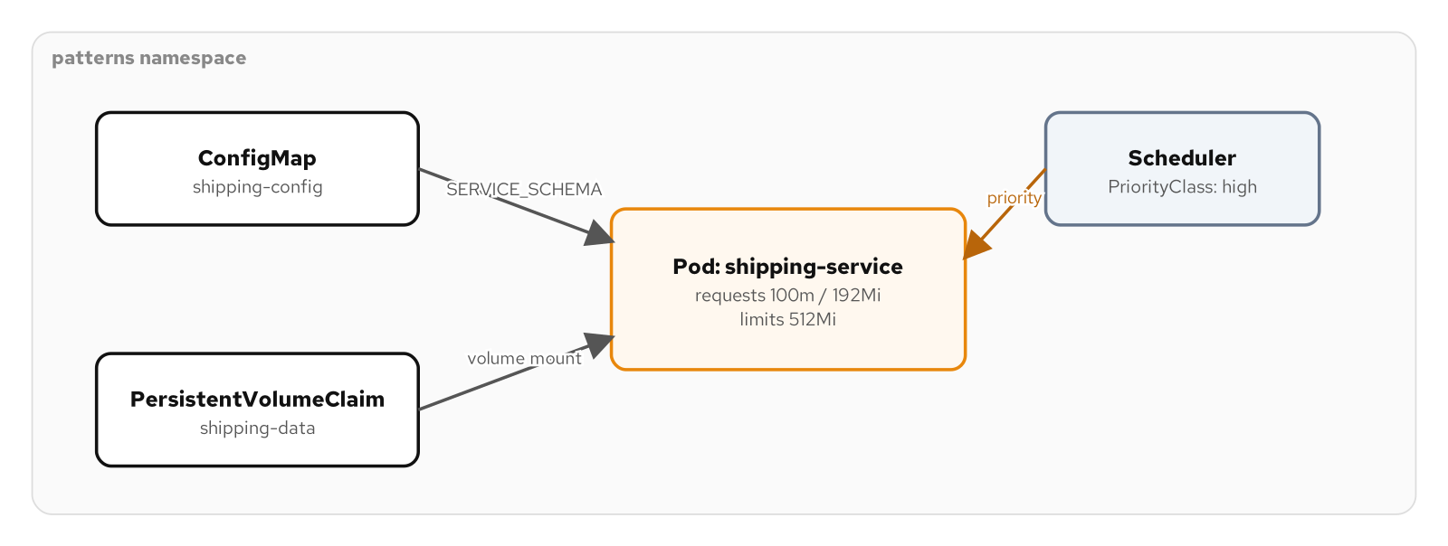
FOUNDATIONAL · PREDICTABLE DEMANDS
The dependency gates
Figure: a Pod with declared requests and limits, gated on a ConfigMap and a PVC, scheduled under a PriorityClass.
9
Notes:
The figure shows the three parts of the pattern in one picture: the ConfigMap and PersistentVolumeClaim feeding the Pod as hard requirements, and the scheduler applying the PriorityClass. What to show: trace the two gates, the PVC checked at scheduling and the ConfigMap at container start. Fallback: the same figure is on the reference site with its editable source.

Slide 10
FOUNDATIONAL · PREDICTABLE DEMANDS
Run it and the exam
Run: apply the manifests in the wrong order first to surface both the CreateContainerConfigError and the Pending scheduling failure, then add the PVC and ConfigMap and watch the Pod reach Ready.
Observe: kubectl top pod compares declared requests against real usage; a memory limit set too low shows as OOMKilled in describe pod.
CKAD domain: Application Environment, Configuration & Security (25%).
Drill: kubectl set resources deployment/shipping-service -n patterns --requests=cpu=150m,memory=256Mi --limits=memory=768Mi
10
Notes:
A LimitRange sets namespace defaults and bounds; a ResourceQuota caps the namespace total. Neither replaces per-container requests and limits, and both belong to the namespace-governance chapter later in the set. What to show: run the drill live, it edits the Deployment and triggers a rollout. Fallback: the full kubectl sequence and cleanup are in the example's README.

Slide 11
FOUNDATIONAL · DECLARATIVE DEPLOYMENT
Declarative Deployment
A Deployment is a declaration, not a one-time instruction. You state that three Pods matching a template should always exist, and a controller reconciles reality toward that statement for the life of the object.
Change anything in spec.template and the controller treats the difference between old and new as work to do. That reconciliation loop is what makes a rollout safe to automate.
RollingUpdate replaces Pods with no gap in service. Recreate tears every replica down before any replacement starts.
kubectl rollout status, history, and undo drive and reverse a release with no extra tooling.
11
Notes:
kubectl set image does not restart Pods directly; it edits desired state and the controller works out how to get there. Which strategy it uses is the whole subject. What to show: the choice between a release nobody notices and one that pages someone at two in the morning. Fallback: the example rolls shipping-service from one image tag to another under each strategy while a curl loop records the result.

Slide 12
FOUNDATIONAL · DECLARATIVE DEPLOYMENT
Deployment, ReplicaSet, Pod
A Deployment never manages Pods directly. It manages a ReplicaSet, and the ReplicaSet owns the Pods.
Every distinct Pod template gets its own ReplicaSet. The previous one is scaled to zero and kept, not deleted.
rollout undo is exactly that retention at work: scale the old ReplicaSet up, the current one down, using the same strategy logic as the forward rollout.
spec.selector is immutable after creation, because it is how the Deployment finds its own ReplicaSets and their Pods.
12
Notes:
revisionHistoryLimit, ten by default, caps how many retired ReplicaSets stick around for undo and history to reference. Set it low on a Deployment that rolls out often and undo eventually has nothing further back to return to. What to show: kubectl get rs exposes the layer the Deployment status usually summarizes away. Fallback: undo --to-revision=N targets a specific revision, since two bare undo calls just alternate between the two most recent.

Slide 13
FOUNDATIONAL · DECLARATIVE DEPLOYMENT
RollingUpdate without a gap
yaml · deployment
spec:
replicas: 3
strategy:
type: RollingUpdate
rollingUpdate:
maxSurge: 1 # at most one extra Pod
maxUnavailable: 0 # never fewer than three
With maxUnavailable 0 the controller waits on each new Pod's readiness probe before terminating an old one.
13
Notes:
maxSurge caps Pods above the replica count; maxUnavailable caps how many may be missing. Three replicas can briefly run four, never fewer than three. The guarantee rests on the readiness probe: without one the controller has no signal to wait on and routes traffic to a Pod still initializing. What to show: a curl loop during the image bump returns 200 throughout. Fallback: rollout status blocks until the rollout finishes, which is what a CI pipeline calls after a deploy.

Slide 14
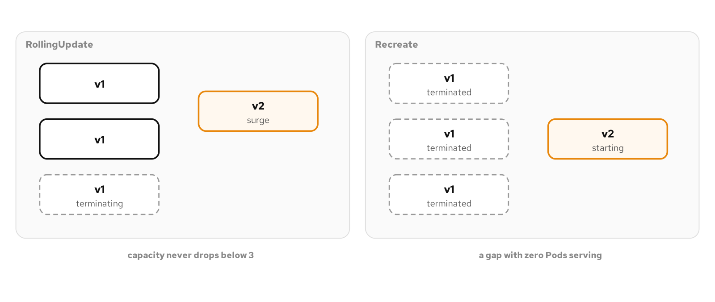
FOUNDATIONAL · DECLARATIVE DEPLOYMENT
Rolling versus recreate
Figure: RollingUpdate overlaps old and new Pods to avoid a gap; Recreate drops to zero before any replacement starts.
14
Notes:
RollingUpdate assumes old and new Pods can coexist, which most stateless HTTP services satisfy trivially. Recreate is correct where two versions would corrupt something: an exclusive lock, a shared non-replicated volume, an incompatible wire protocol. What to show: under Recreate the same curl loop records a stretch of failures while zero Pods back the Service, exactly as promised. Fallback: the decision is made by the workload's constraint, not by preference.

Slide 15
FOUNDATIONAL · DECLARATIVE DEPLOYMENT
Run it and the exam
Run: roll from v1 to v2 under RollingUpdate with a curl loop recording zero failures, then switch to Recreate and repeat to see the gap appear.
Observe: the Progressing and Available conditions on the Deployment are the signal rollout status reads; ProgressDeadlineExceeded surfaces a stuck ImagePullBackOff on its own.
CKAD domain: Application Deployment (20%).
Drill: kubectl rollout history deployment/shipping-service -n patterns --revision=2
15
Notes:
rollout pause freezes a RollingUpdate mid-flight to watch one new Pod's metrics before committing; resume picks up where it stopped. A flaky readiness probe resets the minReadySeconds clock on the Available condition, which is why a strict probe that takes longer beats one that flaps. What to show: run the history drill against a Deployment that has rolled at least twice. Fallback: the example README has the full sequence.

Slide 16
FOUNDATIONAL · HEALTH PROBE
Health Probe
Kubernetes asks two different questions. Is this container alive, which governs restart, and is it ready for traffic, which governs routing.
A container can be alive and not ready: still loading, or its database is unreachable. The correct response to each failure is different, so the checks are separate.
inventory-service exposes /health, 200 while the process can respond, and /healthz, 200 only when it can reach Postgres.
A startupProbe holds both checks back during a slow boot so a liveness probe can't kill the container mid-startup.
16
Notes:
Conflating liveness and readiness is one of the most common ways a cluster misbehaves. Restarting a process that works fine but cannot reach a downed database accomplishes nothing except noise. The two endpoints make the split concrete: one answers is the process up, the other answers can it do its job right now. What to show: the naming is deliberate, /health for liveness and /healthz for readiness. Fallback: the example scales Postgres to zero to drive the two apart live.

Slide 17
FOUNDATIONAL · HEALTH PROBE
Liveness, readiness, startup
yaml · deployment
livenessProbe: # fail -> kubelet restarts the container
httpGet: { path: /health, port: http }
periodSeconds: 10
readinessProbe: # fail -> removed from Service endpoints
httpGet: { path: /healthz, port: http }
periodSeconds: 5
startupProbe: # suppresses both until first success
httpGet: { path: /health, port: http }
failureThreshold: 30
periodSeconds: 2 # up to 60s to boot before liveness runs
The kubelet runs the three probes independently; startup steps aside permanently once the container first answers.
17
Notes:
inventory-service does not boot instantly: it creates its schema, seeds demo stock, and binds a gRPC server before /health answers. A liveness probe starting five seconds in would restart it repeatedly on a slow node, a crash loop that is actually impatience. Thirty attempts at two seconds gives sixty seconds of grace. What to show: describe pod shows the startup probe's events stop the instant the container reports healthy. Fallback: scale Postgres to zero and /health stays 200 while /healthz returns 503, with the restart count never moving.

Slide 18
FOUNDATIONAL · HEALTH PROBE
Readiness gates and probe mechanisms
A readinessGate adds a named condition that must be True before the Pod is Ready, on top of the readiness probe. A Pod can read 1/1 containers yet 0/1 gates.
It gates traffic on a signal no in-container probe can see: a sidecar finishing setup, a migration confirmed, an operator's sign-off.
Three mechanisms: httpGet for a service with a health endpoint, exec for a process with no network listener, tcpSocket for a bare port, and grpc for the gRPC health protocol.
successThreshold must be 1 for a liveness probe; a low failureThreshold on liveness restarts over one slow response, while on readiness it just parks a flaky Pod for a beat.
18
Notes:
A readiness gate lets a condition no HTTP endpoint inside the container could check gate traffic the same way a failed /healthz would. Patch the condition to True and the Pod joins the Service endpoints for the first time, with nothing about the container changed. What to show: the mechanism (how the check runs) and the role (what the result controls) are independent choices. Fallback: describe pod records each probe failure as an Unhealthy event with the status or exit code, the fastest way to tell a misconfigured probe from an unhealthy app.

Slide 19
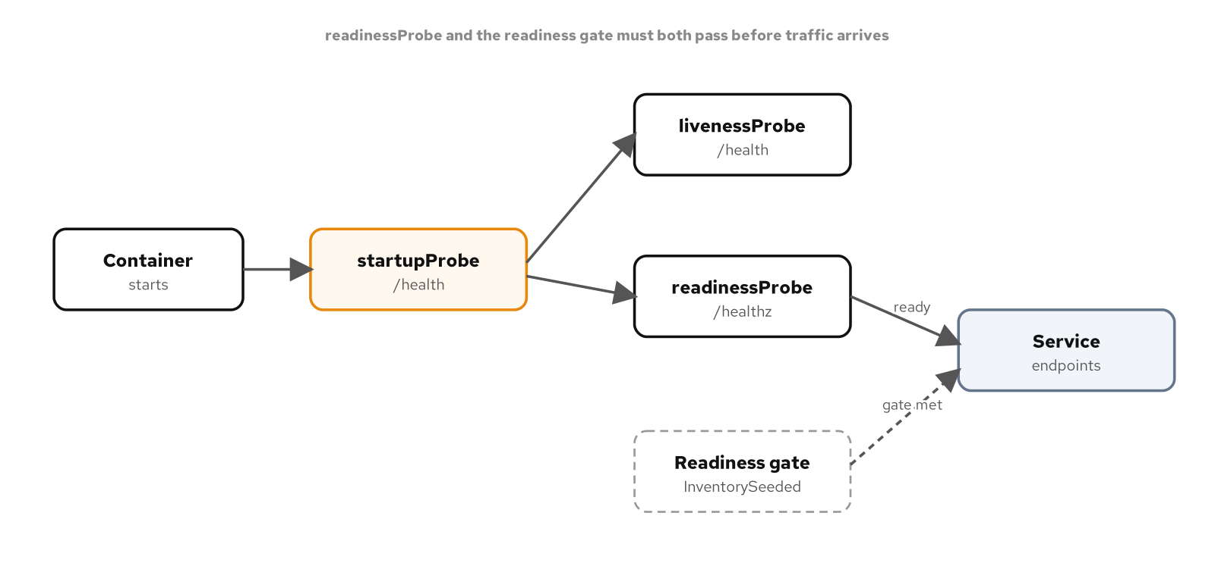
FOUNDATIONAL · HEALTH PROBE
What gates traffic
Figure: the startup probe holds liveness and readiness back during boot; both the readiness probe and any gate must clear before routing.
19
Notes:
The figure shows the ordering: startup first, then readiness and the gate both have to clear before the Service routes traffic. What to show: readiness alone is not enough to join the endpoints when a gate is also set. Fallback: the exam drill reads the Pod's conditions array, which shows each gate and the overall Ready condition.

Slide 20
FOUNDATIONAL · MANAGED LIFECYCLE
Managed Lifecycle
A container does not decide when it starts receiving traffic or when it stops existing. Kubernetes decides both, on a schedule the container can't opt out of.
postStart runs right after the main process starts; the kubelet does not report the container Running until it finishes.
preStop runs before SIGTERM, covering the gap while the Service still propagates the Pod's removal from its endpoints.
terminationGracePeriodSeconds has to cover preStop plus the app's own shutdown, or SIGKILL cuts the graceful path off.
20
Notes:
Get startup wrong and a Pod serves traffic before it can, producing errors that are pure timing. Get shutdown wrong and a Pod is killed with requests in flight. Both are infrastructure problems disguised as application bugs, and both have a declarative fix that never touches the source. What to show: the hooks let a container participate in its own transitions instead of being surprised by them. Fallback: the example times a Pod deletion while tailing logs.

Slide 21
FOUNDATIONAL · MANAGED LIFECYCLE
The shutdown sequence
yaml · deployment
lifecycle:
postStart:
exec: { command: [sh, -c, 'date > /tmp/ready'] }
preStop:
exec: { command: [sh, -c, 'sleep 10'] } # drain window
spec:
terminationGracePeriodSeconds: 30 # covers preStop + exit
Delete removes the Pod from endpoints, runs preStop, then sends SIGTERM; SIGKILL follows if the grace period elapses.
21
Notes:
Endpoint removal across a cluster is not instant: kube-proxy and mesh sidecars need a moment, and without a pause a Pod can get SIGTERM while a load balancer still has a connection open. A fixed sleep is blunt but workable when a service has no finer drain signal. What to show: in the logs the ten-second silence is the preStop sleep, then the app's own shutdown finishes in under a second. Fallback: an httpGet preStop against a /shutdown endpoint is the cleaner upgrade where a service can expose one.

Slide 22
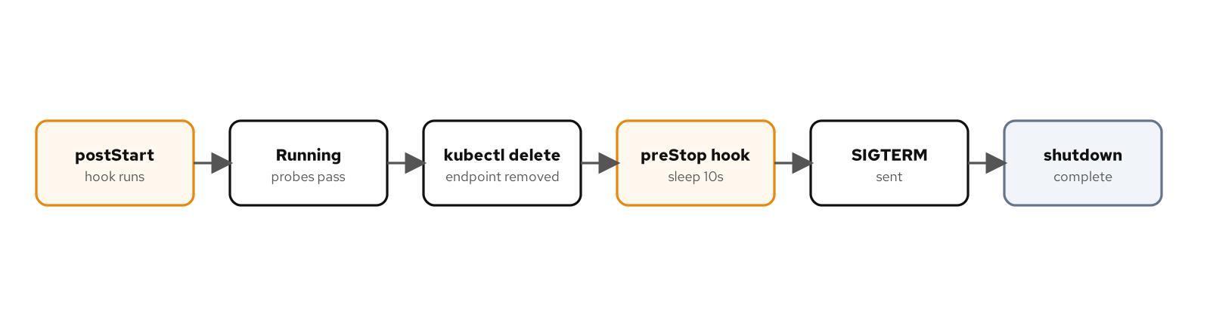
FOUNDATIONAL · MANAGED LIFECYCLE
Start and stop hooks
Figure: postStart gates the start of a container's life; preStop delays SIGTERM long enough for the Service to stop routing first.
22
Notes:
SIGTERM reaches only PID 1. notification-service runs uvicorn as the exec-form entrypoint, so uvicorn is PID 1 and receives the signal directly; wrap it in a shell and the shell swallows SIGTERM unless it traps and forwards it. What to show: a graceful handler is only as good as its ability to receive the signal. CKAD domain: Application Design and Build (20%). Fallback: the drill reads terminationGracePeriodSeconds off the Pod spec.

Slide 23
FOUNDATIONAL · AUTOMATED PLACEMENT
Automated Placement
The default scheduler ranks nodes by fit and picks a good one, which is enough for interchangeable replicas on a homogeneous cluster.
nodeSelector and nodeAffinity answer: does this node have what I need, a label, a zone, a hardware feature.
podAntiAffinity answers a different question: should I avoid running next to another copy of myself, the basis of spreading replicas for availability.
Taints and tolerations flip control: a node repels Pods by default, and only a Pod that tolerates the taint may land there.
23
Notes:
Real clusters are rarely homogeneous: some nodes have local SSDs, some sit in a different zone, some are reserved for one tier. These primitives let a Pod spec describe which differences matter instead of leaving placement to chance. What to show: this chapter adds a second node to the profile, since placement is uninteresting with one. Fallback: the example works all four mechanisms in sequence, confirming each Pending-to-Running transition.

Slide 24
FOUNDATIONAL · AUTOMATED PLACEMENT
Required versus preferred, repel versus tolerate
yaml · pod spec
affinity:
podAntiAffinity: # one replica per node
requiredDuringSchedulingIgnoredDuringExecution:
- labelSelector: { matchLabels: { app: shipping-ha } }
topologyKey: kubernetes.io/hostname
tolerations: # allowed onto a tainted node
- { key: dedicated, operator: Equal,
value: fulfillment, effect: NoSchedule }
A required rule leaves a third replica Pending with no third node; a preferred rule would double up instead.
24
Notes:
requiredDuringScheduling blocks the Pod until satisfied; preferredDuringScheduling is a scoring hint that never blocks. IgnoredDuringExecution means neither is re-checked once the Pod runs: relabel a node and Kubernetes will not evict to fix it. A NoSchedule taint repels new Pods; NoExecute also evicts running ones that don't tolerate it. What to show: two identical Pods, only one with the toleration, make the asymmetry concrete. Fallback: topologySpreadConstraints keeps replicas even across zones, which anti-affinity alone can't express.

Slide 25
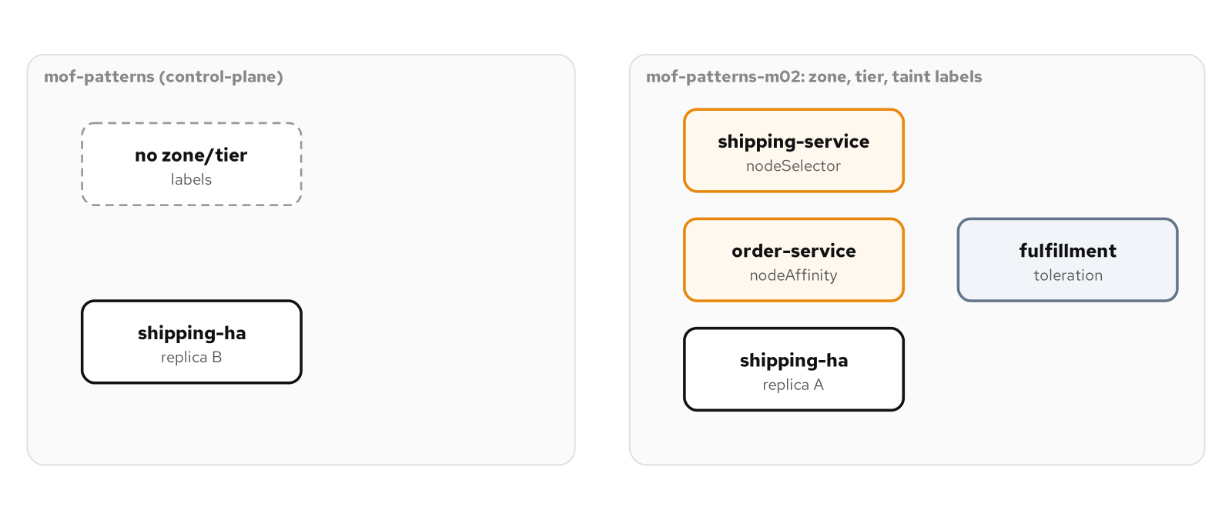
FOUNDATIONAL · AUTOMATED PLACEMENT
Steering the scheduler
Figure: label and taint rules draw fulfillment Pods onto the worker node, while anti-affinity spreads two replicas one per node.
25
Notes:
The figure shows all four mechanisms across the two nodes at once. What to show: a node selector or affinity says what a Pod wants, and many Pods may want the same node; a taint says what the node refuses by default. CKAD domain: Application Design and Build (20%), with affinity and taints leaning toward the CKA exam. Fallback: the drill prints each Pod's node with a custom-columns query.

Slide 26
02
Structural Patterns
How containers inside one Pod compose: gated, alongside, translating, or brokering.
Notes:
The structural family covers four ways a Pod's containers can relate to each other: gated by an init container that must finish first, running alongside as a native sidecar with its own start and stop order, translating a format as a narrower kind of sidecar, or brokering an outbound connection as an ambassador. Each pattern reuses the same two primitives, a shared network namespace and an optional shared volume, for a different purpose. What to show: these patterns answer a different question than the foundational family does, not whether a container behaves well on its own, but how two containers in the same Pod divide responsibility. Fallback: if time is tight, Sidecar and Ambassador are the two most heavily tested on the CKAD exam and worth covering live.

Slide 27
STRUCTURAL · INIT CONTAINER
Init Container
The kubelet runs every init container to completion, in order, before it starts a single main container, a stronger guarantee than retries or health checks inside an app could provide.
`notification-service`'s migrate init container runs `alembic upgrade head` from the same image as the app, so the schema it migrates to is always the one the app's own models declare.
A failed migration shows as Init:Error, then Init:CrashLoopBackOff; the main container sits `Waiting: PodInitializing` the entire time, since it hasn't been created yet.
Alembic's migration is idempotent, so scaling to three replicas or rolling to a new revision reruns it safely: the first Pod to start applies the work, the rest find it already done.
27
Notes:
notification-service graduated off Base.metadata.create_all because its schema needs to change over time, something create_all can't express. What to show: kubectl get pods -w during a missing-Postgres apply, watching Init:Error settle into Init:CrashLoopBackOff while the main container never gets created. Fallback: the runnable example already captures that sequence end to end in its README.

Slide 28
STRUCTURAL · INIT CONTAINER
The migration gate
yaml · deployment
initContainers:
- name: migrate
image: notification-service:v1
imagePullPolicy: Never
command: ["alembic", "upgrade", "head"]
env:
- name: PG_HOST
value: patterns-postgres.patterns.svc.cluster.local
# ...PG_PORT, PG_USER, PG_PASSWORD
Same image, same connection settings as the app container that follows it: no separate migration image to keep in sync.
28
Notes:
The command differs from the app's own uvicorn entrypoint, but the image and database settings are identical, since both come from the same build artifact. Alembic's env.py opens a connection and fails immediately if Postgres isn't reachable, unlike the app's own retrying init_schema(). What to show: the container's own exit code is the only thing that gates the main container, nothing else about its output matters. Fallback: mention splitting a wait-for-dependency init container ahead of the migration when a driver's failure is less legible than Alembic's.

Slide 29
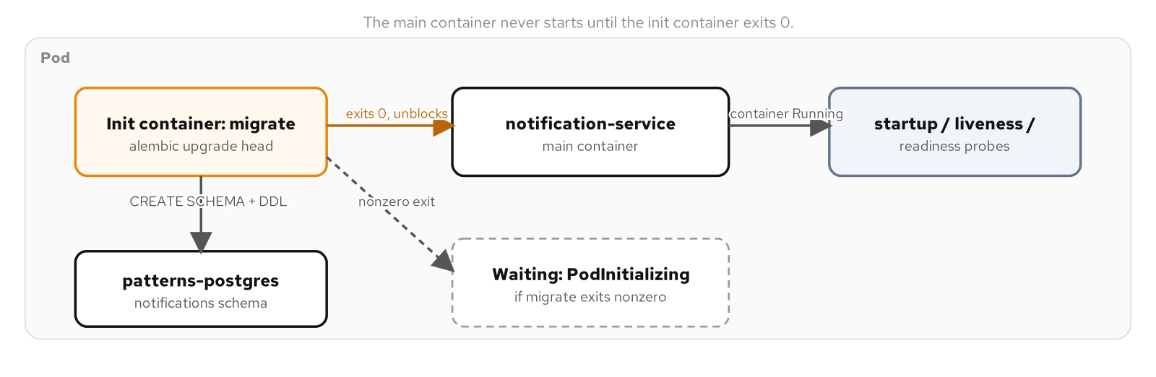
STRUCTURAL · INIT CONTAINER
The exit code gate
Figure: the init container's exit code is the only gate; zero unblocks the main container, nonzero leaves the Pod waiting indefinitely.
29
Notes:
The figure traces one Pod through PodInitializing twice: once while migrate runs, once while the main container is created after it exits zero. What to show: the main container doesn't exist as an object yet during the first PodInitializing, so there's nothing to probe or log until migrate succeeds. Fallback: the same figure and its editable source live on the reference site.

Slide 30
STRUCTURAL · INIT CONTAINER
Run it and the exam
Run: apply notification-service's Deployment before its Postgres exists to surface Init:Error and Init:CrashLoopBackOff, then supply Postgres and watch the Pod reach Ready.
Observe: kubectl get pods -w shows the state transitions live; kubectl describe pod's initContainerStatuses records the last exit code and reason.
CKAD domain: Application Design and Build (20%).
Drill: kubectl get pod -n patterns -l app.kubernetes.io/name=notification-service -o jsonpath='{.status.initContainerStatuses[0].state}'
30
Notes:
The drill reads the same field the live kubectl get pods -w output narrates, just as a single JSON snapshot instead of a stream. What to show: run the drill against both a healthy Pod and one still stuck on Init:CrashLoopBackOff, since the state object's shape changes between the two. Fallback: the example's README has the drill output captured at each stage of the walkthrough.

Slide 31
STRUCTURAL · SIDECAR
Sidecar
Two containers in one Pod share a network namespace by definition: one reaches the other at `localhost`, with no Service, no DNS lookup, and no network policy in between.
`shipping-service`'s probe-tailer polls `/health` and `/healthz` over `127.0.0.1` and appends each result to a shared `emptyDir` volume, with zero changes to the app itself.
The case for a separate container is isolation: a different language, a different release cadence, a bug that can't corrupt the main process's own memory.
An ordinary second container under `containers:` starts and stops with no ordering guarantee relative to the main one, the problem the native sidecar mechanism fixes.
31
Notes:
probe-tailer's payload stays simple so the Pod lifecycle mechanics stay the visible thing; a production sidecar usually tails real logs for Fluent Bit or a vector agent instead. What to show: kubectl exec into probe-tailer and tail the shared log file to confirm it's reading the app over localhost, not through a Service. Fallback: the example's README has the exec command and a sample of the tailed output.

Slide 32
STRUCTURAL · SIDECAR
Native sidecar: restartPolicy Always
yaml · deployment
initContainers:
- name: probe-tailer
restartPolicy: Always # the native sidecar switch
image: registry.../python-minimal:10.2
# starts before the main container,
# never blocks it, never expected to exit
restartPolicy: Always on an initContainers entry starts the sidecar first and stops it last, the reverse of an ordinary second container.
32
Notes:
Native sidecars reached beta in Kubernetes 1.29 and went stable in 1.33; the cluster profile here runs well past that line, so every behavior is available as-is. The kubelet moves on to the main container once the sidecar is considered started, not once it exits, because it isn't supposed to exit. What to show: kubectl get pods -w during startup, watching probe-tailer reach Running while the main container still reads PodInitializing. Fallback: the chapter's figure makes the same point without a live cluster.

Slide 33
STRUCTURAL · SIDECAR
Resource accounting and shutdown order
An ordinary init container's requests are reserved only while it runs. A native sidecar breaks that: restartPolicy: Always keeps its requests reserved for the Pod's whole life.
On shutdown, native sidecars stop last: the main container gets SIGTERM first, the sidecar stays reachable until it's gone, then the kubelet terminates the sidecar too.
That ordering protects two dependencies: a proxy the app needs ready before its first outbound call, and a logging sidecar that needs to still be alive for the app's last burst of output.
A native sidecar still counts toward a Pod's READY column (2/2), but it does not count toward a Job's completion: only the main container finishing matters there.
33
Notes:
probe-tailer's own requests, 20 millicores and 32Mi, stay modest because they're paid for the Pod's whole lifetime rather than just its startup, a cost a heavier sidecar like a full mesh proxy has to size the node pool for explicitly. What to show: delete the Pod while watching both containers' states, confirming probe-tailer terminates after shipping-service, not alongside it. Fallback: the Job-completion distinction applies more directly to the Behavioral family's BatchJob pattern, worth a forward pointer if asked.

Slide 34
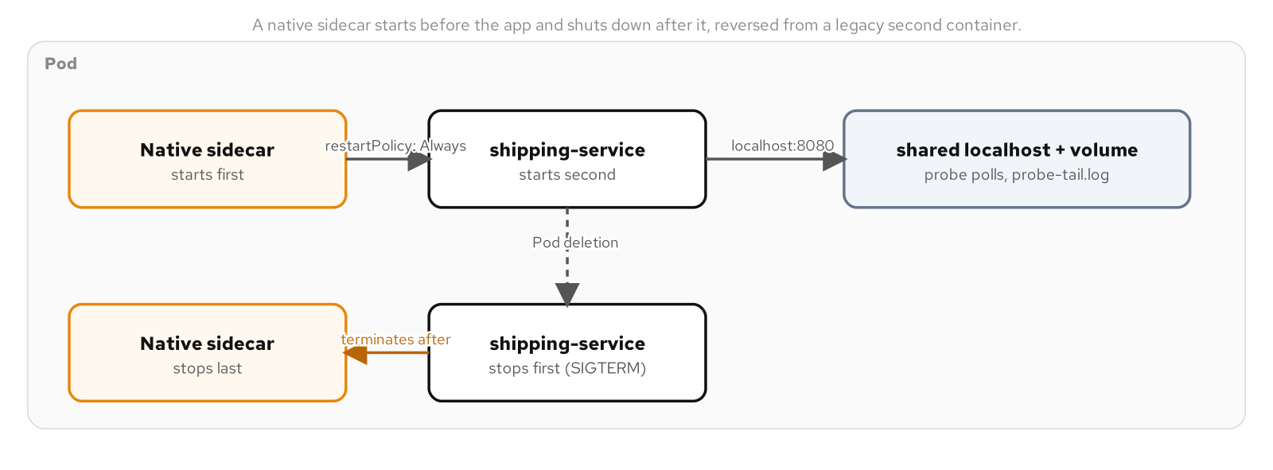
STRUCTURAL · SIDECAR
Brackets the app's lifetime
Figure: restartPolicy: Always inverts the usual race, bracketing the app's whole lifetime instead of merely running alongside it.
34
Notes:
The figure lines up both containers' timelines: the sidecar's Running state starts before the app's and ends after it. What to show: point at the two SIGTERM arrows landing at different moments, the detail that distinguishes a native sidecar from an ordinary second container. Fallback: the reference site hosts the same figure with its editable Excalidraw source.

Slide 35
STRUCTURAL · SIDECAR
Run it and the exam
Run: deploy shipping-service with probe-tailer as a native sidecar, confirm it reaches Running before the main container, then delete the Pod while watching both containers' states.
Observe: kubectl exec into probe-tailer and tail the shared log file; the sidecar keeps answering after the main container has already received SIGTERM.
CKAD domain: Application Design and Build (20%).
Drill: kubectl get pod -n patterns -l app.kubernetes.io/name=shipping-service -o jsonpath='{.spec.initContainers[0].restartPolicy}'
35
Notes:
The drill confirms the switch that makes the whole pattern work; an empty result means the field was never set and the container is an ordinary init container instead. What to show: run the drill, then remove restartPolicy from the manifest and rerun it to see the field disappear. Fallback: the chapter's agent prompt walks through exactly that removal and its effect on the rollout.

Slide 36
STRUCTURAL · ADAPTER
Adapter
Adapter is narrower than Sidecar: every adapter is a sidecar, but the defining trait is a format obligation, reading what the main container already produces and re-emitting the same fact in a required shape.
`shipping-service` reports health as JSON, fine for curl, jq, and kubectl's own probe, but not something a Prometheus scraper can ingest: it expects line-based exposition text, not a status field.
The metrics-adapter sidecar polls `/healthz` over localhost and re-emits the same readiness fact as a Prometheus gauge, `shipping_service_up`, on its own `:9100/metrics` port.
The adapter invents nothing and changes no behavior. It only changes the wire format, which is why the translation belongs in its own container instead of inside the app.
36
Notes:
Teaching shipping-service to speak Prometheus natively would mean adding a metrics library and a new endpoint to every service needing the same translation, for a concern unrelated to shipping logic. What to show: curl both /healthz and :9100/metrics side by side to see the same underlying fact in two different wire formats. Fallback: the example's README has both responses captured together.

Slide 37
STRUCTURAL · ADAPTER
Translating JSON into exposition text
python · adapter
APP_URL = "http://127.0.0.1:8080/healthz"
def do_GET(self):
up = 1 if poll(APP_URL) == 200 else 0
# HELP shipping_service_up ready flag
# TYPE shipping_service_up gauge
print(f"shipping_service_up {up}")
Every scrape triggers a fresh poll of /healthz; the adapter hardcodes one upstream and one metric by design, not as a shortcut.
37
Notes:
A Content-Type of text/plain; version=0.0.4 matters as much as the body itself: a scraper strict about content negotiation can reject a correct-looking response missing that header. What to show: curl -s http://127.0.0.1:9100/metrics next to curl -s http://127.0.0.1:8080/healthz to see the same readiness fact in both formats. Fallback: the chapter's prometheus.io/scrape annotations are the convention a Prometheus Operator setup would use to discover this port.

Slide 38
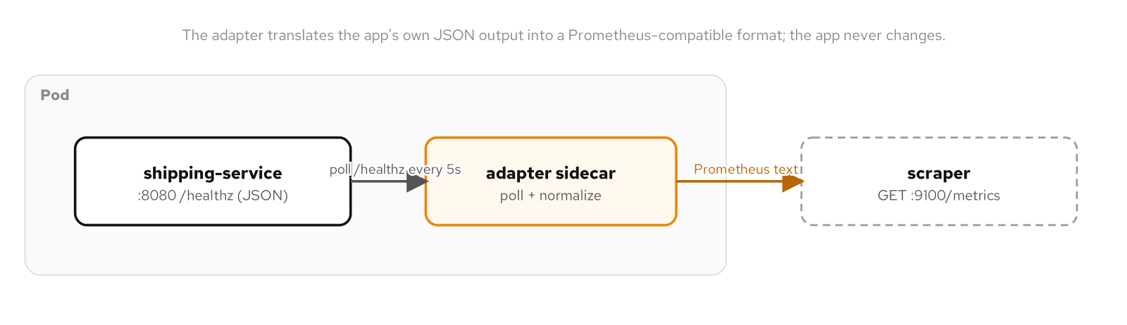
STRUCTURAL · ADAPTER
Same fact, new syntax
Figure: an adapter sidecar translates shipping-service's JSON health body into Prometheus exposition text for an external scraper.
38
Notes:
The figure shows the scraper reading only the adapter's translated port, never touching the app's own /healthz directly. What to show: the adapter never changes what's true about shipping-service, only the syntax a scraper needs to read it in. Fallback: scale Postgres to zero and watch shipping_service_up follow /healthz down, without the adapter itself failing.

Slide 39
STRUCTURAL · ADAPTER
Run it and the exam
Run: deploy shipping-service with metrics-adapter as a second container, compare /healthz's JSON against /metrics's Prometheus text for the same readiness fact.
Observe: scale Postgres to zero and watch shipping_service_up follow the app's real state down to 0, without the adapter container crashing or restarting.
CKAD domain: Application Observability and Maintenance (15%).
Drill: kubectl exec -n patterns deploy/shipping-service -c metrics-adapter -- curl -s localhost:9100/metrics
39
Notes:
The drill execs into the adapter container directly, the same way a troubleshooter would check a sidecar's own output without going through the Service at all. What to show: run the drill before and after scaling Postgres to zero, since the metric's value is the whole demonstration. Fallback: the example's README has both outputs captured together for comparison.

Slide 40
STRUCTURAL · AMBASSADOR
Ambassador
An ambassador sidecar hides where a dependency lives, not whether it exists: the main container always talks to a fixed `localhost` address, and the ambassador decides what's really on the other end.
`shipping-service`'s own config defaults already point at `127.0.0.1:5432`, written for local development; the example's Deployment sets zero Postgres environment variables and the app still connects.
postgres-ambassador is a plain TCP relay with no Postgres protocol awareness: it opens a second connection to the real `patterns-postgres` Service and copies bytes in both directions.
Moving the target is a one-container edit: kubectl set env on the ambassador's UPSTREAM_HOST changes where the connection goes, with zero changes to the application's own manifest.
40
Notes:
The pattern decouples the app's configuration from the cluster's real topology, the same slot a connection pooler, a credential-rotation proxy, or an Istio sidecar fills. What to show: kubectl set env against only the ambassador container, then watch /healthz fail within one probe interval while the application container itself shows nothing wrong. Fallback: the example's README has the before-and-after kubectl describe pod output.

Slide 41
STRUCTURAL · AMBASSADOR
A protocol-blind byte pipe
python · ambassador
async def handle(client_reader, client_writer):
server_reader, server_writer = await (
asyncio.open_connection(
UPSTREAM_HOST, UPSTREAM_PORT))
await asyncio.gather(
pipe(client_reader, server_writer),
pipe(server_reader, client_writer),
)
The ambassador never parses or stores shipping-service's credentials; they travel end to end inside the relayed TCP stream.
41
Notes:
Bound to 127.0.0.1 rather than 0.0.0.0 by design: a Pod IP is routable from anywhere in the cluster network, so binding every interface would turn a scoped convenience into an open relay onto patterns-postgres. What to show: the listener's loopback bind is the one line that makes the whole pattern safe to run. Fallback: a more capable ambassador could terminate TLS or inject rotated credentials on top of this same shape.

Slide 42
STRUCTURAL · AMBASSADOR
Failing fast, and the mesh parallel
If the ambassador's own connection to the upstream fails, it closes the client connection immediately: asyncpg on the app side sees a connection actively refused, not a hang.
That fast, visible failure is exactly what shipping-service's own readiness check is built to catch within one probe interval, with no retry logic required on the ambassador's own part.
`order-service`'s Istio-injected Pod fills the same slot, automated: `istio-proxy` intercepts outbound connections via iptables rather than a hand-dialed localhost address.
A hand-rolled ambassador makes that slot inspectable: one Python script, one upstream address, every rule visible directly in the Pod spec, unlike an automatically injected mesh proxy.
42
Notes:
pool_pre_ping=True on shipping-service's own SQLAlchemy engine guards against a connection going stale while idle in the pool, a separate concern from what the ambassador changes on a first connection attempt. What to show: repoint UPSTREAM_HOST at a Service that doesn't exist and read /healthz failing while kubectl describe pod for the application container shows nothing wrong. Fallback: point at the Istio parallel as the generalized, automated version of the same mechanism.

Slide 43
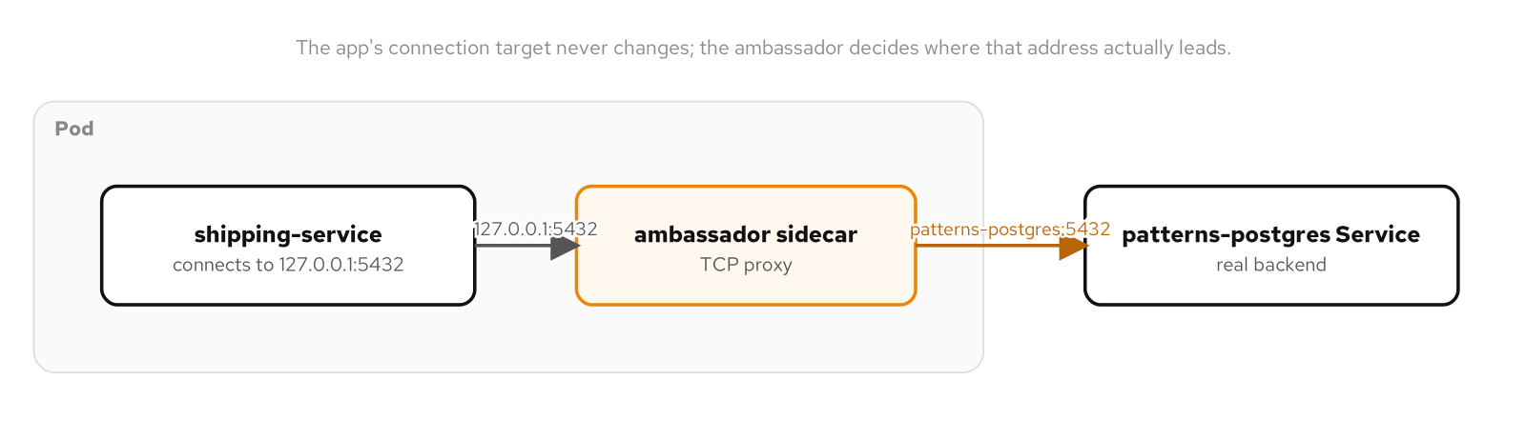
STRUCTURAL · AMBASSADOR
One fixed address, one movable target
Figure: shipping-service always connects to 127.0.0.1:5432; only the ambassador's upstream, not the app's configuration, ever changes.
43
Notes:
The figure separates the app's fixed local target from the ambassador's configurable real one, the whole value of the decoupling in one picture. What to show: trace the credentials flowing through the ambassador unmodified, since it relays bytes without ever parsing the protocol. Fallback: the same figure and its editable source are on the reference site.

Slide 44
STRUCTURAL · AMBASSADOR
Run it and the exam
Run: deploy shipping-service with zero Postgres environment variables and a postgres-ambassador sidecar, confirm /healthz succeeds, then repoint only the ambassador's upstream.
Observe: /healthz fails within one probe interval after the repoint, while kubectl describe pod shows the application container itself untouched and correct.
CKAD domain: Application Design and Build (20%).
Drill: kubectl get deployment shipping-service -n patterns -o jsonpath='{.spec.template.spec.containers[0].env}' (confirm it's empty)
44
Notes:
An empty result from the drill is the whole point: the application container carries no Postgres-aware configuration at all, because the ambassador owns that decision entirely. What to show: run the drill before and after the UPSTREAM_HOST change, since the application's own env array never moves. Fallback: the example's README has the full repoint-and-recover sequence.

Slide 45
03
Behavioral Patterns
How workloads run to completion, hold identity, and find each other across a changing set of Pods.
Notes:
The behavioral family covers what a workload does with its lifetime: finish and stop, run forever as interchangeable replicas, hold a sticky identity, or sit on exactly one node. A Job and a CronJob answer run to completion and run on a schedule; a DaemonSet answers one per node; a PodDisruptionBudget protects the one Pod a singleton can't survive losing; Stateless and Stateful Service name the two shapes most other workloads take; Service Discovery and Self Awareness close the loop, how a workload is reached by name and what it can know about itself. What to show: eight patterns, each one built against a distinct, purpose-built shipping-domain service rather than one service doing everything. Fallback: if time is tight, Stateless Service and Service Discovery are the two most workloads lean on daily.

Slide 46
BEHAVIORAL · BATCH JOB
Batch Job
A Job's success condition is a count of completed Pods, not currently-running ones; a Deployment has no vocabulary for "run this until it's done, then stop."
completions and parallelism are independent numbers: completions is how many Pods must exit 0, parallelism is how many run at once.
completionMode: Indexed injects a JOB_COMPLETION_INDEX into every Pod, letting each one partition a shared dataset with no coordination service.
backoffLimit bounds retries with exponential backoff, and ttlSecondsAfterFinished cleans up the whole Job once it reaches a terminal state.
46
Notes:
shipping-report is a net-new, tiny CLI that reads rows from its own shipment_events demo table and writes a CSV to a PersistentVolumeClaim. A Deployment that crash-loops is an incident; a Job's Pod exiting non-zero is an expected outcome the controller is built to retry, up to a bound. What to show: completions and parallelism are two independent numbers, not one knob wearing two names, since a bounded worker pool tracks pool size and total work separately. Fallback: the example applies a seed Job first, since both the plain and indexed Jobs depend on the table already having rows.

Slide 47
BEHAVIORAL · BATCH JOB
Indexed partitioning
yaml · job
spec:
completions: 3
parallelism: 3
completionMode: Indexed
backoffLimit: 2
ttlSecondsAfterFinished: 300
# kubelet injects JOB_COMPLETION_INDEX: 0..completions-1
# partitions shipment_events by id % partition_count
Indexed mode gives each Pod a unique index; completions and parallelism alone only say how many and how concurrent.
47
Notes:
The plain Job tags each Pod's report with its own Pod name through the Downward API, since three Pods running the same command would otherwise collide on one output filename. completionMode: Indexed is what actually divides the data: the index itself is the coordination mechanism, assigned by Kubernetes and guaranteed not to repeat within the Job. What to show: three disjoint slices of the same table land in report-0.csv, report-1.csv, and report-2.csv with no Pod ever talking to another Pod. Fallback: restartPolicy: Never leaves a failed Pod in place for inspection while the Job controller creates a fresh Pod carrying the same index to retry.

Slide 48
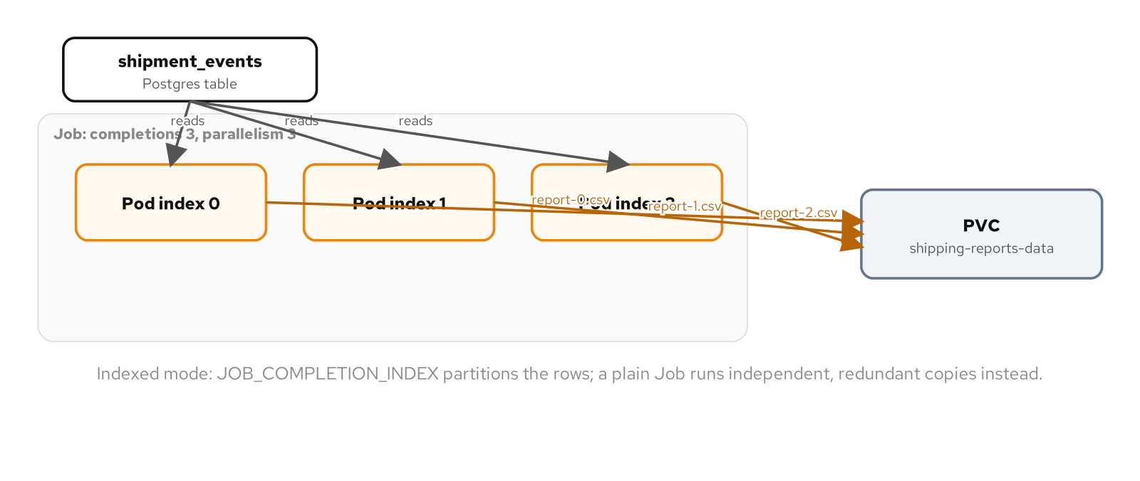
BEHAVIORAL · BATCH JOB
Partitioning by index
Figure: a Job partitions shipment_events across three Pods by completion index, each writing its own CSV to a shared PVC.
48
Notes:
The figure shows three Pods reading disjoint partitions of shipment_events by completion index and writing to one shared PVC. What to show: completions and parallelism control how many Pods run and how many succeed, but completionMode: Indexed is what actually divides the data between them. Fallback: the same figure is on the reference site with its editable source.

Slide 49
BEHAVIORAL · BATCH JOB
Run it and the exam
Run: apply a seed Job first, then run both a plain Job (three redundant full reports) and an Indexed Job (three disjoint partitions) against the same PVC.
Observe: a Job that exhausts backoffLimit reports BackoffLimitExceeded and stops retrying; check minikube image ls before chasing ErrImageNeverPull into application logs.
CKAD domain: Application Design & Build (20%).
Drill: kubectl get job -n patterns -l app.kubernetes.io/name=shipping-report-indexed -o jsonpath='{.items[0].spec.completionMode}'
49
Notes:
backoffLimit bounds retry count; activeDeadlineSeconds bounds total wall-clock time instead, and a Job that needs both sets both fields, since neither one substitutes for the other. ttlSecondsAfterFinished only starts counting once a Job is already done, which is distinct from backoffLimit governing retries before that terminal state. What to show: run the drill against the indexed Job to read its completionMode straight off the live spec. Fallback: the full kubectl sequence, including the seed Job and cleanup, is in the example's README.

Slide 50
BEHAVIORAL · PERIODIC JOB
Periodic Job
A CronJob manages a template for Jobs, not a Job itself: at each tick the controller creates a new Job from jobTemplate and otherwise stays out of the way.
schedule uses standard five-field crontab syntax, evaluated in the cluster's configured time zone unless a per-CronJob timeZone field overrides it.
concurrencyPolicy decides what happens when a firing overlaps a still-running previous one: Forbid skips it, Allow runs both, Replace cancels the old one.
kubectl create job --from=cronjob bypasses concurrencyPolicy entirely, since it talks to the Job API directly rather than through the controller's scheduling loop.
50
Notes:
PeriodicJob isn't a different mechanism from BatchJob, it's BatchJob with a scheduler in front of it, generating a fresh shipping-report Job on a timer instead of a human running kubectl create -f by hand. Every guarantee from that earlier pattern, completions, backoffLimit, ttlSecondsAfterFinished, applies unchanged to the Job template a CronJob wraps. What to show: kubectl get cronjob shows the schedule and last firing time, while kubectl get jobs shows each Job it created separately with its own Pods and lifecycle. Fallback: kubectl create job --from=cronjob/shipping-report clones the current jobTemplate into a brand-new Job without waiting for the next tick.

Slide 51
BEHAVIORAL · PERIODIC JOB
Schedule and overlap policy
yaml · cronjob
spec:
schedule: "*/5 * * * *"
concurrencyPolicy: Forbid
startingDeadlineSeconds: 60
successfulJobsHistoryLimit: 3
failedJobsHistoryLimit: 1
jobTemplate:
spec:
template: { ... } # the Job from the batch-job chapter
Forbid skips an overlapping firing outright; startingDeadlineSeconds bounds how late a missed tick may still start.
51
Notes:
shipping-report's plain-Job path writes to a shared PVC tagged by Pod name, so concurrent firings wouldn't collide on a filename but would duplicate work against the same data, which is why Forbid is deliberate here rather than an oversight. successfulJobsHistoryLimit keeps the last three runs around as a record; failedJobsHistoryLimit keeps only one, on the assumption a single recent failure is usually enough to start debugging. What to show: a per-CronJob timeZone field, stable since Kubernetes 1.27, overrides the cluster default for one schedule without touching the whole control plane. Fallback: kubectl patch cronjob with suspend: true pauses the schedule without deleting the CronJob or its run history.

Slide 52
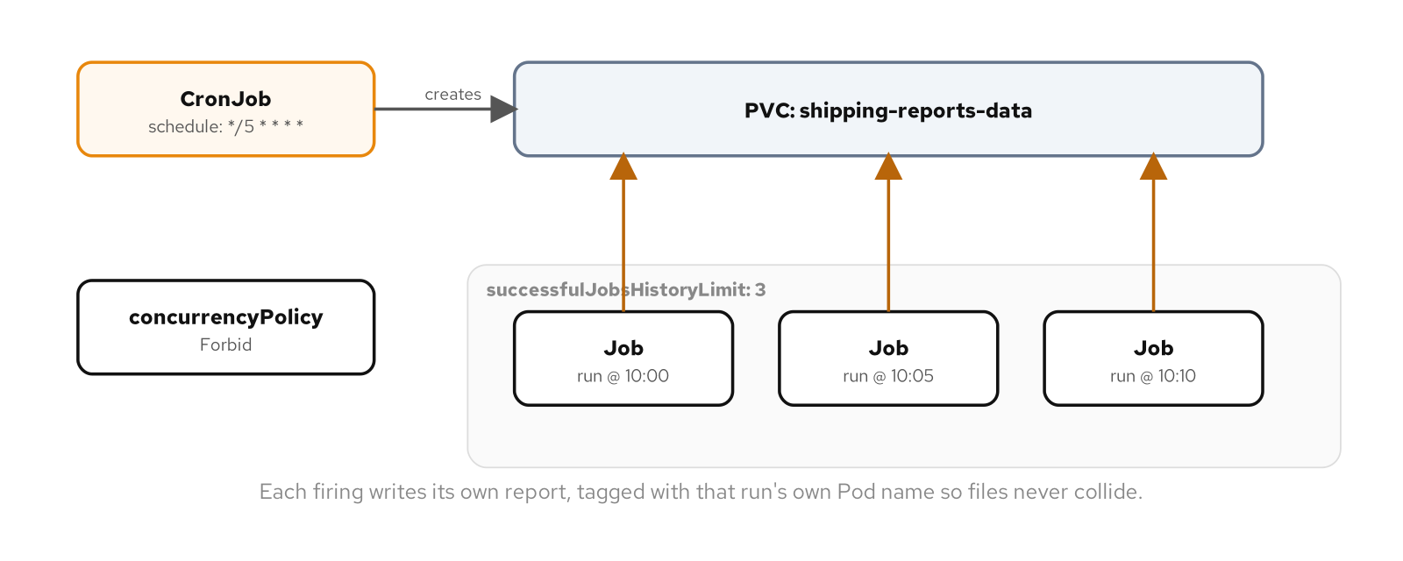
BEHAVIORAL · PERIODIC JOB
One Job per tick
Figure: a CronJob firing on schedule to create successive Jobs, each writing its own report, with history limited to the most recent few.
52
Notes:
The figure shows one Job created per scheduled tick, with successfulJobsHistoryLimit bounding how many completed ones stick around afterward. What to show: every Job guarantee from the batch-job pattern, completions, parallelism, retries, carries over unchanged into the Job a CronJob wraps. Fallback: a Job's auto-generated name carries an encoded scheduled timestamp, which is what guarantees two ticks never produce colliding names even if the controller falls behind.

Slide 53
BEHAVIORAL · PERIODIC JOB
Run it and the exam
Run: trigger two on-demand Jobs with kubectl create job --from=cronjob back to back and watch Forbid refuse the second while the first is still running.
Observe: a missed tick past startingDeadlineSeconds surfaces as a MissedSchedule event; the controller never tries to catch up on ticks it missed.
CKAD domain: Application Design & Build (20%).
Drill: kubectl create job --from=cronjob/shipping-report -n patterns shipping-report-drill-1
53
Notes:
A manually created Job needs an explicit name supplied on the command line, since it has no scheduled time to derive one from the way a real firing does, which is one more small but real distinction beyond the concurrencyPolicy difference. What to show: this on-demand path bypasses concurrencyPolicy entirely, so a manually created Job can run alongside a scheduled one even under Forbid. Fallback: the example's README has the exact kubectl sequence and cleanup.

Slide 54
BEHAVIORAL · DAEMON SERVICE
Daemon Service
A DaemonSet has no replicas field, because the answer is always "one Pod per schedulable node," reconciled automatically as nodes join or leave.
hostPath bind-mounts a path that already exists on whichever node a Pod lands on, with no portability and no cluster-level tracking, exactly what a node-level collector needs.
A toleration for the control-plane's NoSchedule taint is required explicitly; a DaemonSet isn't automatically exempt from a taint that would otherwise skip that node.
RollingUpdate replaces one node's Pod at a time and waits for readiness; OnDelete does nothing until an operator deletes that node's Pod manually.
54
Notes:
node-collector mounts the node's own /var/log read-only, which is what lets it read every container's logs on that node regardless of namespace. A Deployment could in principle be scaled to match the node count by hand, but that number changes every time a node joins or leaves, and a Deployment has no concept of one-per-node as a placement rule the way a DaemonSet encodes it directly. What to show: adding a second node with minikube node add produces a second node-collector Pod within one reconciliation pass, zero manifest changes and zero kubectl scale calls. Fallback: kubectl get daemonset -o wide reports DESIRED, CURRENT, and READY tracking the schedulable node count automatically.

Slide 55
BEHAVIORAL · DAEMON SERVICE
Toleration and hostPath
yaml · daemonset
spec:
selector:
matchLabels: { app.kubernetes.io/name: node-collector }
template:
spec:
tolerations:
- key: node-role.kubernetes.io/control-plane
operator: Exists
effect: NoSchedule
volumes:
- name: varlog
hostPath: { path: /var/log, type: Directory }
operator: Exists tolerates the control-plane taint regardless of value; type: Directory fails Pod creation if the path doesn't exist.
55
Notes:
Without the toleration shown here, node-collector would run on every worker node but skip the control plane entirely, leaving that node's own logs uncollected, the same way the automated-placement chapter's custom taint repelled Pods without a matching toleration. type: Directory tells the kubelet to fail Pod creation if the path doesn't already exist, instead of silently creating an empty one a collector would read nothing from. What to show: a hostPath volume has no equivalent of a PersistentVolumeClaim's cluster-level tracking, which is a liability for an ordinary application and exactly the right tool for a Pod whose entire job is to see this node's state specifically. Fallback: kubectl get daemonset -n patterns node-collector -o wide reports NODE SELECTOR directly when a DaemonSet is restricted to a subset of nodes.

Slide 56
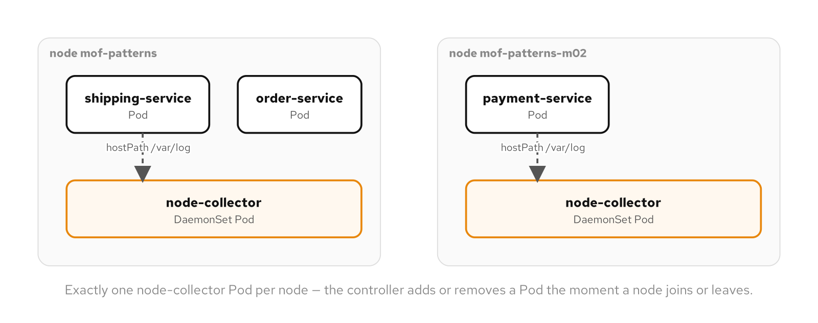
BEHAVIORAL · DAEMON SERVICE
One Pod per node
Figure: two nodes, each running its own shipping service Pods beside a node-collector DaemonSet Pod reading that node's hostPath logs.
56
Notes:
The figure shows one node-collector Pod per node, each reading only its own node's log directory rather than some cluster-wide abstraction of it. What to show: a DaemonSet's resource requests still compete for the same node capacity every other Pod draws from, on every node it runs on, so under-provisioning it is a worse operational surprise than an ordinary Deployment's single Pod failing. Fallback: a static Pod placed directly in a kubelet's manifest directory is the niche alternative, used for bootstrapping control-plane components before an API server exists to schedule anything through.

Slide 57
BEHAVIORAL · DAEMON SERVICE
Run it and the exam
Run: deploy node-collector, confirm one Pod per node, then add and remove a node with minikube node add/node delete and watch the Pod count follow automatically.
Observe: kubectl get daemonset -o wide reports NODE SELECTOR directly, the fastest way to confirm a missing Pod is by design rather than mistake.
CKAD domain: Application Design & Build (20%); DaemonSet node-level operations lean toward the CKA exam.
Drill: kubectl get daemonset node-collector -n patterns -o jsonpath='{.status.desiredNumberScheduled}{" "}{.status.numberReady}'
57
Notes:
There's no maxSurge equivalent for a DaemonSet's RollingUpdate the way there is for a Deployment's, since a DaemonSet can never run more than one Pod per node by definition, so the old Pod has to go before the new one can exist in its place. What to show: nodeSelector and node affinity restrict a DaemonSet's reach the same way they restrict any other workload's, the right shape for a GPU driver or a storage agent relevant to only a subset of nodes. Fallback: the example's README walks the node add/delete sequence end to end.

Slide 58
BEHAVIORAL · SINGLETON SERVICE
Singleton Service
Some workloads can't be made redundant: a process holding an exclusive lock, a leader-elected controller, a legacy component never built to run more than one copy. replicas: 1 is the correct design, not a gap to fix.
A PodDisruptionBudget protects that one Pod from voluntary disruption: a node drain, an autoscaler shrinking the node pool, a descheduler rebalancing load.
minAvailable states a floor and maxUnavailable states a ceiling; for a single-replica singleton the two are functionally identical.
The budget is a live constraint the API server checks at the moment of each disruption request, not evaluated once at creation and left static.
58
Notes:
order-service runs at replicas: 1 behind this PDB in the runnable example, which also depends on reaching a real Kafka broker to answer requests, same as the pattern would protect any other single-replica workload regardless of what it's waiting on. kubectl drain, a cluster autoscaler, and a descheduler all go through the same Eviction API path the PDB checks; none of them are malicious and none are bugs, yet every one is capable of removing the one Pod a singleton can't survive losing. What to show: ALLOWED DISRUPTIONS recalculates continuously as Pods come and go, so it's never a one-time evaluation. Fallback: kubectl get pdb order-service-pdb -n patterns reads that number straight off the live object.

Slide 59
BEHAVIORAL · SINGLETON SERVICE
Protecting the one replica
yaml · poddisruptionbudget
apiVersion: policy/v1
kind: PodDisruptionBudget
metadata:
name: order-service-pdb
spec:
minAvailable: 1
selector:
matchLabels:
app.kubernetes.io/name: order-service
# ALLOWED DISRUPTIONS: 0 with one healthy replica
With one healthy Pod and minAvailable: 1, the Eviction API refuses with 429 until the budget changes.
59
Notes:
kubectl drain and the raw Eviction API both check this budget before honoring a removal; kubectl delete pod bypasses it entirely, since plain delete calls the ordinary delete endpoint rather than the eviction subresource a PDB was ever wired into. What to show: the 429 response names the budget directly, Cannot evict pod as it would violate the pod's disruption budget, rather than failing silently. Fallback: drain --force falls back to a direct delete for any Pod the Eviction API refuses, the explicit override for a planned maintenance window.

Slide 60
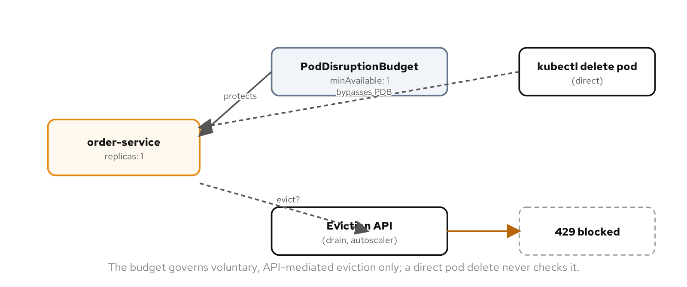
BEHAVIORAL · SINGLETON SERVICE
Eviction versus delete
Figure: an Eviction API request against order-service's single replica blocked by its PodDisruptionBudget, contrasted with a direct pod delete that bypasses it entirely.
60
Notes:
The figure traces the two paths side by side: eviction checked against the budget and refused, direct delete succeeding immediately with no check at all. What to show: a PDB's domain is automated, voluntary, API-mediated removal specifically, not a node crashing outright, which never goes through the eviction path and takes the Pod down regardless. Fallback: a PDB's selector matches on labels the same way a Service does, so it applies to any matching Pod set, a Deployment, a StatefulSet, or unmanaged Pods alike.

Slide 61
BEHAVIORAL · SINGLETON SERVICE
Run it and the exam
Run: confirm the Eviction API refuses with 429 against the single replica, then run a direct kubectl delete pod against the same Pod and watch it succeed immediately.
Observe: a PDB never mentions the Deployment it protects by name, since from its own perspective there's only a selector and a count.
CKAD domain: Application Deployment (20%); PodDisruptionBudget leans toward the CKA exam.
Drill: kubectl get pdb order-service-pdb -n patterns -o jsonpath='{.status.disruptionsAllowed}'
61
Notes:
A workload where even an involuntary outage of a few minutes is too costly usually needs leader election instead, multiple replicas with only one active and the others standing by, a materially larger undertaking than a PDB's narrower guarantee. What to show: recognizing which of the two a workload needs, and not reaching for leader election's added complexity when a PDB already covers the case, is itself part of applying the pattern correctly. Fallback: the example's README has the full sequence including the direct-delete contrast.

Slide 62
BEHAVIORAL · STATELESS SERVICE
Stateless Service
Statelessness isn't enforced by Kubernetes; it's a property of the application code, and a manifest can look identical to a stateless one while still writing to local disk or holding a session in memory.
Three properties earn the label together: no per-Pod storage, no stable network identity, no in-memory state a client depends on.
Deleting a replica proves all three at once: the ReplicaSet creates a replacement with a brand-new name and IP, and nothing about the old Pod's identity transfers.
Horizontal scale needs nothing but a replica count, no data migration and no rebalancing, which is the whole reason statelessness is the default shape to reach for.
62
Notes:
payment-service persists to Postgres, a dependency external to every replica rather than local to any one of them, and every replica answers to the same label selector with nothing addressing a specific one by name. What to show: a service that would break if sessionAffinity were turned off was never stateless to begin with, it was relying on affinity to paper over state that should live somewhere shared. Fallback: the example runs with sessionAffinity: None specifically so the delete-and-replace demonstration proves the claim rather than assuming it.

Slide 63
BEHAVIORAL · STATELESS SERVICE
Interchangeable replicas
yaml · deployment
spec:
replicas: 3
template:
spec:
containers:
- name: payment-service
image: payment-service:v1
# no volumeClaimTemplates, no Pod-specific volumeMounts
# sessionAffinity: ClientIP is an escape hatch, not
# evidence the service needs stateful treatment
No per-Pod storage and the Service's default load balancing are what make delete-and-replace a non-event.
63
Notes:
sessionAffinity: ClientIP routes all traffic from the same client IP to the same backend Pod for a configurable window, usually reached for to smooth an in-process cache's warm/cold inconsistency, not because the application structurally requires it. What to show: nothing in YAML distinguishes a replica that honors statelessness from one that only looks that way until two clients hit two different Pods and get two different answers. Fallback: delete a running Pod and watch kubectl get pods -w assign the replacement a brand-new generated name and IP.

Slide 64
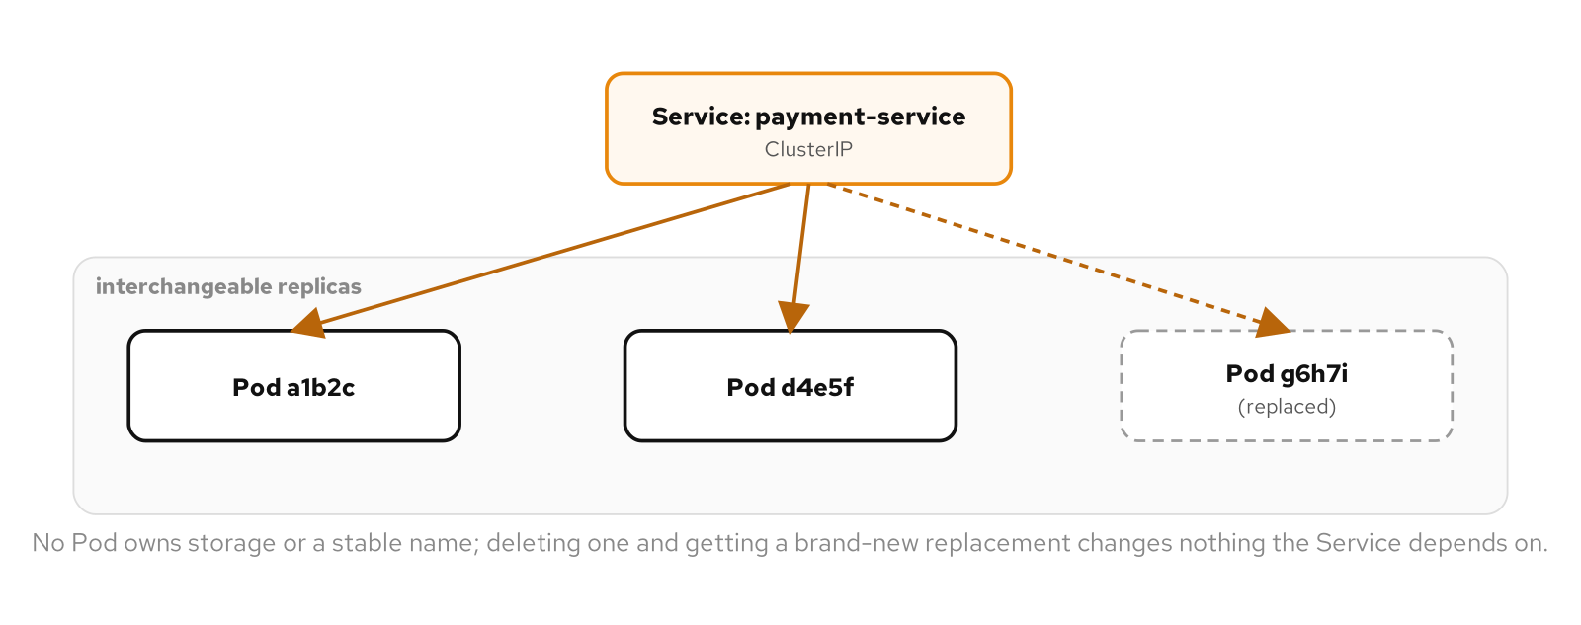
BEHAVIORAL · STATELESS SERVICE
Delete and replace
Figure: payment-service's Service fronting three interchangeable Pods; one is deleted and replaced with a new identity while the Service keeps answering throughout.
64
Notes:
The figure shows the Service continuing to answer through a delete-and-replace cycle, since no Pod owns storage or a name the Service depends on. What to show: readiness probes matter more here than almost anywhere else, since a probe that returns 200 before the application has finished its own startup work breaks the any-replica-can-serve-any-request promise the whole pattern depends on. Fallback: a startupProbe is the specific tool for separating one-time startup cost from ongoing readiness.

Slide 65
BEHAVIORAL · STATELESS SERVICE
Run it and the exam
Run: delete one of three running replicas, confirm the Service keeps answering throughout, then scale to five and back to three with no manifest change beyond the count.
Observe: compare the Pod name set before and after a delete; a stateless workload's replacement always gets an entirely new generated name.
CKAD domain: Application Design & Build (20%).
Drill: kubectl get pod -n patterns -l app.kubernetes.io/name=payment-service -o jsonpath='{.items[*].metadata.name}'
65
Notes:
The converse holds too: a workload needing per-replica storage or a stable identity isn't a design failure for reaching StatefulSet instead, the two patterns divide a real distinction and neither is strictly better than the other. What to show: scaling a stateless Deployment is a one-line operation precisely because there's no question of which existing replica owns which slice of anything. Fallback: the example's README has the delete-and-scale sequence end to end.

Slide 66
BEHAVIORAL · STATEFUL SERVICE
Stateful Service
A stateful workload needs something a stateless Deployment structurally can't provide: a stable identity a specific piece of storage stays tied to, reattached after every restart.
A headless Service (clusterIP: None) trades one load-balanced address for a DNS A record per backing Pod, each individually addressable.
A StatefulSet assigns strictly ordinal names, shipment-archive-0 through -2, and creates and deletes Pods in that order rather than all at once.
volumeClaimTemplates gives each ordinal its own PVC, created once and reattached to that same ordinal's replacement on every restart.
66
Notes:
shipment-archive runs three independent, non-replicating postgres:17-alpine instances, standing in for a per-zone archive rather than a real multi-node database. What to show: deleting shipment-archive-0 and watching its replacement come back proves data written before the delete is still there, because the new Pod mounted the exact same PVC rather than a fresh empty volume. Fallback: a real replicated Postgres on Kubernetes almost always delegates to an operator such as CloudNativePG or Patroni, layered on top of these same StatefulSet mechanics rather than replacing them.

Slide 67
BEHAVIORAL · STATEFUL SERVICE
Ordinal identity and storage
yaml · statefulset
spec:
serviceName: shipment-archive
replicas: 3
selector:
matchLabels: { app.kubernetes.io/name: shipment-archive }
volumeClaimTemplates:
- metadata: { name: archive-data }
spec:
accessModes: ["ReadWriteOnce"]
resources: { requests: { storage: 128Mi } }
serviceName ties the ordinals to their DNS identity; each ordinal's PVC is created once and reused across restarts.
67
Notes:
serviceName ties the StatefulSet to the headless Service that provides its Pods' DNS identity, a field a Deployment has no equivalent of, because a Deployment's Pods were never meant to be individually addressable at all. What to show: shipment-archive-0 must reach Ready before shipment-archive-1 is even created, a strict order rather than a preference, because many real stateful workloads depend on it even though these three independent Postgres instances don't. Fallback: podManagementPolicy: Parallel relaxes that strict ordering for replicas that don't depend on each other's startup order.

Slide 68
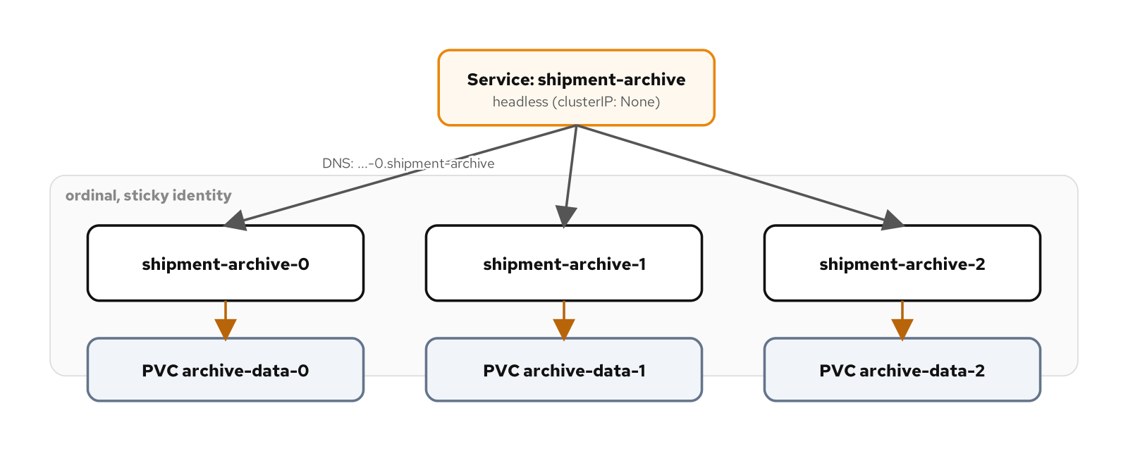
BEHAVIORAL · STATEFUL SERVICE
Headless DNS and sticky storage
Figure: a headless Service providing per-Pod DNS names for three ordinal StatefulSet Pods, each bound to its own PersistentVolumeClaim.
68
Notes:
The figure contrasts directly with the stateless pattern's own delete-and-replace demonstration: there, a new identity meant nothing carried forward by design; here, the identical ordinal identity is exactly what guarantees the storage carries forward too. What to show: deleting the StatefulSet object itself does not delete its PVCs, so recreating it with the same name and volumeClaimTemplates reattaches every ordinal to its pre-existing data. Fallback: raising partition above zero on a RollingUpdate holds lower ordinals on the old template, a built-in canary with no separate traffic-splitting infrastructure.

Slide 69
BEHAVIORAL · STATEFUL SERVICE
Run it and the exam
Run: bring up three ordinals, confirm ordered creation and per-ordinal DNS names, write a row to one, delete that Pod, and confirm both its name and data return intact.
Observe: each ordinal's PVC survives even after the StatefulSet itself is deleted; removing the data entirely needs a separate, explicit PVC delete.
CKAD domain: Application Design & Build (20%), storage.
Drill: kubectl get pvc -n patterns -l app.kubernetes.io/name=shipment-archive -o custom-columns=NAME:.metadata.name,STATUS:.status.phase
69
Notes:
A rolling update on a StatefulSet applies the same ordinal discipline to changes that it applies to creation, by default rolling from the highest ordinal down to zero, the reverse of initial creation order. What to show: a headless Service's per-Pod DNS record, shipment-archive-0.shipment-archive.patterns.svc.cluster.local, is resolvable the same way any other Service name is, with no extra discovery layer required. Fallback: the example's README has the full write-delete-confirm sequence.

Slide 70
BEHAVIORAL · SERVICE DISCOVERY
Service Discovery
Every other pattern's "any replica can serve any request" claim holds up because a Service sits between the caller and the Pods, giving the cluster a name that survives individual Pods coming and going.
ClusterIP is the default, reachable only inside the cluster; NodePort opens the same port on every node's IP; LoadBalancer triggers a cloud's own provisioning, simulated locally with minikube tunnel.
kube-dns resolves a Service name to its virtual IP fresh on every call, so a Pod restart on either end never requires touching configuration.
An Ingress routes multiple backends through one external address by HTTP path, something an L4 Service has no concept of at all.
70
Notes:
order-service, inventory-service, and graphql-gateway are reached by name throughout this pattern's example, through ClusterIP, NodePort, and LoadBalancer respectively, never by Pod IP. order-service's own readiness depends on reaching a real Kafka broker elsewhere in this environment, which the ClusterIP Service in front of it addresses by name the same way regardless of that Pod's own readiness state. What to show: an EndpointSlice is what a Service's selector actually produces, and an empty one on a correct-looking Service almost always means the selector's labels don't match the Pod template's. Fallback: ExternalName is the fourth Service type, a CNAME to an arbitrary external name with no ClusterIP and no selector at all.

Slide 71
BEHAVIORAL · SERVICE DISCOVERY
Routing by path
yaml · ingress
spec:
ingressClassName: nginx
rules:
- http:
paths:
- path: /graphql
pathType: Prefix
backend:
service:
name: graphql-gateway
port: { number: 80 }
pathType: Prefix matches /graphql and anything below it; pathType: Exact is reserved for literal paths like /health.
71
Notes:
ingressClassName: nginx tells the cluster which controller, here the ingress addon's bundled ingress-nginx, watches this object and programs itself accordingly; an Ingress with no rewrite-target annotation forwards the matched path unchanged. What to show: a rule routing to a path that doesn't really exist on that backend is precisely the kind of mistake a rewrite annotation can mask and a plain one can't, so each rule here points at a path the backend actually answers. Fallback: pathType: Exact is reserved for a literal endpoint like /health, so an unrelated path like /health-check can't accidentally match a prefix rule meant to catch only that one route.

Slide 72
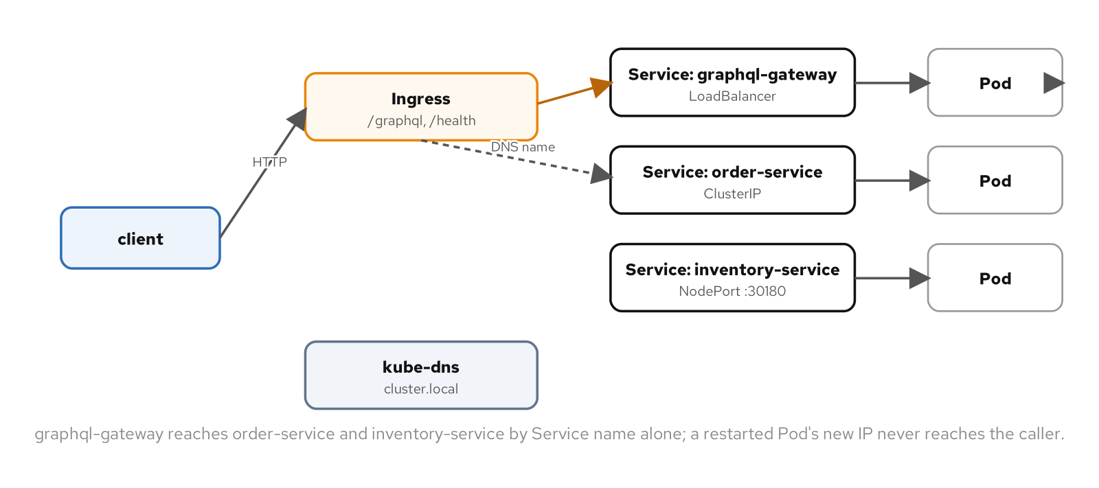
BEHAVIORAL · SERVICE DISCOVERY
Three Service types, one Ingress
Figure: Services of three types in front of order-service, inventory-service, and graphql-gateway, with an Ingress routing by path through a single address.
72
Notes:
The figure traces a caller always reaching a Service name or virtual address, never a Pod IP directly, with kube-dns and kube-proxy making that substitution invisible. What to show: within the same namespace the short Service name is enough, since kube-dns's search path tries the caller's own namespace first; reaching across namespaces needs the fuller name. Fallback: minikube tunnel is what fills the gap a cloud's own load-balancer controller would otherwise fill for a LoadBalancer type.

Slide 73
BEHAVIORAL · SERVICE DISCOVERY
Run it and the exam
Run: stand up order-service behind ClusterIP, inventory-service behind NodePort, and graphql-gateway behind LoadBalancer, then layer an Ingress on top routing two paths to two backends.
Observe: kubectl get endpointslices -l kubernetes.io/service-name=order-service is the fastest diagnostic when a Service "isn't working" despite healthy-looking Pods.
CKAD domain: Services & Networking (20%).
Drill: kubectl get svc -n patterns order-service inventory-service graphql-gateway -o custom-columns=NAME:.metadata.name,TYPE:.spec.type,CLUSTER-IP:.spec.clusterIP
73
Notes:
curl http://$(minikube ip):30180/health reaches inventory-service with nothing more than a node's address, which is also NodePort's production limitation: a real cluster rarely wants every node's raw IP exposed directly, so it's more often a building block a cloud LoadBalancer routes into. What to show: a Service with no selector at all is also valid, producing no automatic EndpointSlice, the pattern behind pointing a Service at a workload that isn't running as Kubernetes Pods. Fallback: the example's README has the full curl sequence against all three Service types and the Ingress.

Slide 74
BEHAVIORAL · SELF AWARENESS
Self Awareness
A container has no inherent way to know its own Pod's name, node, or declared resources; none of that is baked into the image.
fieldRef injects Pod metadata, status, and spec fields, POD_NAME, POD_IP, NODE_NAME, as environment variables resolved once at container start.
resourceFieldRef reads a container's own requests and limits back out, letting an app size a thread pool to match what the scheduler actually promised.
A downwardAPI volume is the one form that keeps updating after start, which is why labels and annotations are exposed only this way, never as env vars.
74
Notes:
Every prior chapter in this appendix sidestepped this question by passing configuration explicitly through env values and configMapKeyRef/secretKeyRef lookups, which work fine for configuration a human chose. What to show: a Downward API value can never drift out of sync with reality the way a ConfigMap copy can, because it isn't a copy of a fact recorded somewhere else, it's read from the one place the fact lives. Fallback: kubectl exec $POD -n patterns env | grep POD_ shows these sitting beside the application's own configured variables, indistinguishable in form.

Slide 75
BEHAVIORAL · SELF AWARENESS
Reading Pod facts back out
yaml · pod spec
env:
- name: POD_NAME
valueFrom:
fieldRef: { fieldPath: metadata.name }
- name: CPU_REQUEST
valueFrom:
resourceFieldRef:
containerName: shipping-service
resource: requests.cpu
fieldRef resolves Pod fields once at start; resourceFieldRef reads a container's own declared resources back out the same way.
75
Notes:
POD_NAME, POD_IP, and NODE_NAME resolve once at container start, a non-issue for status.podIP since it never changes for the life of a running Pod, but exactly why a field that can change later, a label or an annotation, needs the volume form instead. resourceFieldRef reads the exact number from this container's own resources block, formatted in the resource's natural unit, CPU in whole cores unless a divisor says otherwise. What to show: not every Pod field is a valid fieldRef target, only a documented subset of metadata, spec, and status, and nothing belonging to another object is ever reachable this way. Fallback: a projected volume combines a downwardAPI source with a configMap, secret, or serviceAccountToken source under one mount point instead of four separate ones.

Slide 76
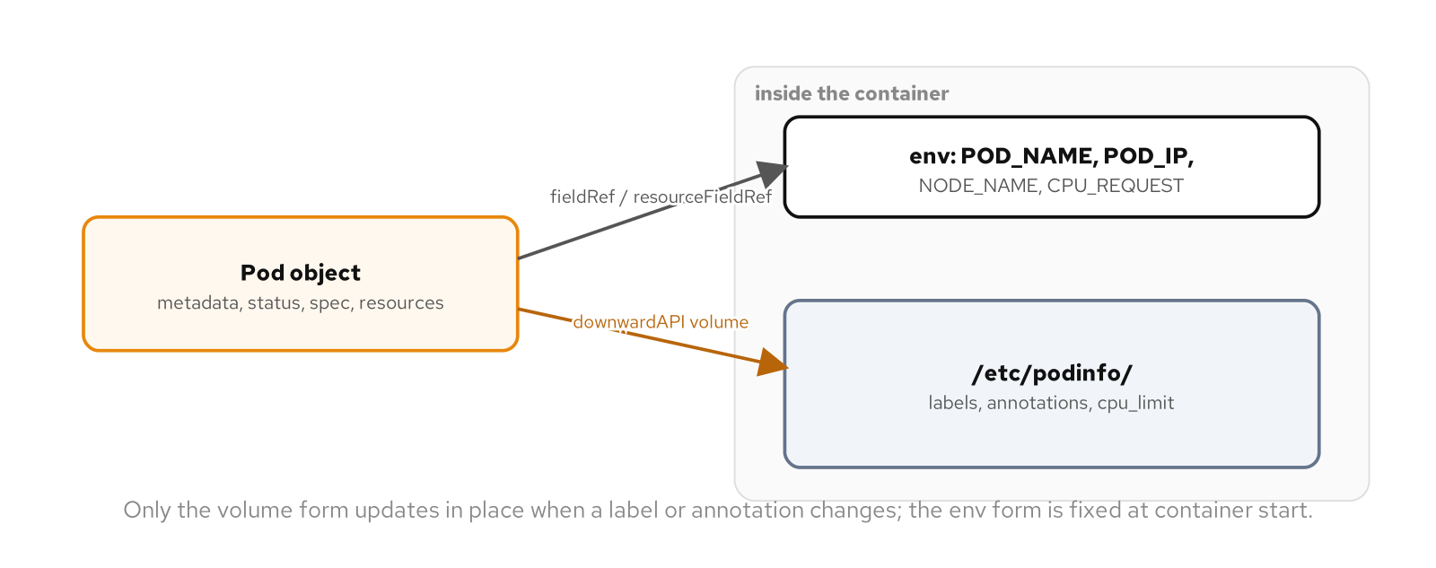
BEHAVIORAL · SELF AWARENESS
Env vars and a live volume
Figure: a Pod's own metadata, status, spec, and resources flowing into a container as Downward API environment variables and a mounted volume.
76
Notes:
The figure separates the two forms: fieldRef and resourceFieldRef resolving once into environment variables, and a downwardAPI volume staying current for the life of the Pod. What to show: patch an annotation with kubectl annotate --overwrite and, within a few seconds, the mounted file reflects the new value with no restart and no new Pod. Fallback: the Downward API grants no ability to call the API server or list other objects, a materially different, higher-privilege mechanism that belongs to the security family instead.

Slide 77
BEHAVIORAL · SELF AWARENESS
Run it and the exam
Run: deploy shipping-service with both forms wired in, confirm every fieldRef/resourceFieldRef value against the manifest that declared it, then patch a running Pod's annotation live.
Observe: /etc/podinfo/annotations updates in place after kubectl annotate --overwrite, the one piece of Downward API behavior that keeps working after the container starts.
CKAD domain: Application Environment, Configuration & Security (25%).
Drill: kubectl exec -n patterns "$POD" cat /etc/podinfo/annotations
77
Notes:
A Downward API value can never drift out of sync with reality the way a stale ConfigMap can, since there's nothing to go stale, the field either reflects the Pod's real IP or the Pod hasn't been assigned one yet. What to show: the mechanism exposes read-only facts about this one Pod and nothing belonging to any other object in the cluster, the smallest, lowest-privilege way to answer "what do I know about myself." Fallback: the example's README has the before-and-after annotate sequence with exact output.

Slide 78
04
Configuration Patterns
Keep settings and credentials out of the image, in forms that update, render, or roll the way each one needs to.
Notes:
The configuration family covers four distinct ways a value reaches a running container: direct env var wiring, a bulk envFrom plus a mounted file, a template rendered by an init container, and a ConfigMap locked against in-place edits entirely. Each chapter builds on the last: Configuration Resource's envFrom replaces Env Var Configuration's per-key wiring at scale, Configuration Template handles the structured config neither flat mechanism can express, and Immutable Configuration closes the hole every earlier chapter's in-place patch quietly left open. What to show: the two axes that matter across all four are resolution timing, once at start, continuously synced, or never again after an init container exits, and whether a change leaves an audit trail. Fallback: if time is tight, Env Var Configuration and Immutable Configuration are the two most exam-relevant to cover live.

Slide 79
CONFIGURATION · ENV VAR CONFIGURATION
Env Var Configuration
Baked-in config forces a new image per environment and leaves a password sitting in a registry forever, readable by anyone who can pull the image.
Three sources feed one env block: a literal string, a ConfigMap key, a Secret key. All three resolve to the same plain variable once the process reads it.
The difference lives in the manifest, not in anything visible once the variable lands inside the container.
notification-service wires a Postgres connection and Kafka bootstrap details through all three sources in one Pod spec.
79
Notes:
notification-service needs a Postgres connection and Kafka connection details, the same kind of configuration every data-mesh service needs. The example wires a literal, a ConfigMap key, and a Secret key into the same env block, each producing an ordinary environment variable the container can't tell apart. What to show: inspect the env block in the manifest, not the running container, since the container gives no hint which source populated which variable. Fallback: kubectl exec into notification-service and run env to print all three with no distinction once resolved.

Slide 80
CONFIGURATION · ENV VAR CONFIGURATION
Literal, ConfigMap, and Secret sources
yaml · deployment
env:
- name: SERVICE_SCHEMA
value: notifications # literal
- name: KAFKA_BOOTSTRAP
valueFrom:
configMapKeyRef:
name: notification-config
key: kafka_bootstrap
- name: PG_PASSWORD
valueFrom:
secretKeyRef:
name: patterns-postgres-app
A literal, a ConfigMap key, and a Secret key land as identical plain env vars once resolved.
80
Notes:
The YAML shape differs by source, but the resolved variable looks the same to a process reading it with getenv(). A literal is checked in with the manifest; a ConfigMap key gives an operator write access to the value without touching the Deployment; a Secret key gates read access through RBAC. What to show: quote numeric-looking literals like PG_PORT, since YAML parses an unquoted 5432 as an integer and the API rejects the type. Fallback: kubectl exec into notification-service and run env to confirm all three variables resolved, indistinguishable from each other.

Slide 81
CONFIGURATION · ENV VAR CONFIGURATION
Resolution happens once
Resolution happens at container start, once. Patch the backing ConfigMap afterward and the running container keeps the old value with no error anywhere.
kubectl rollout restart is the only path to the new value: a fresh container start re-resolves every env var from scratch.
A mounted file behaves the opposite way, synced by the kubelet within about a minute with no restart. Knowing which mechanism a setting uses matters more than knowing which ConfigMap it comes from.
Choosing a source is about the value, not the mechanism: a literal fits a fixed constant, a ConfigMap key fits an environment-shaped setting, a Secret key fits anything that grants access to something else.
81
Notes:
This is the single most important fact in the chapter and the easiest one to miss, because kubectl patch configmap succeeds with no error even though nothing downstream has changed yet. The asymmetry with mounted files, continuously synced versus resolved once, becomes the subject of the next pattern. What to show: patch notification-config's kafka_order_topic key, grep the running Pod's env, and the old value is still there until rollout restart runs. Fallback: the example's README walks the same patch-then-restart sequence end to end.

Slide 82
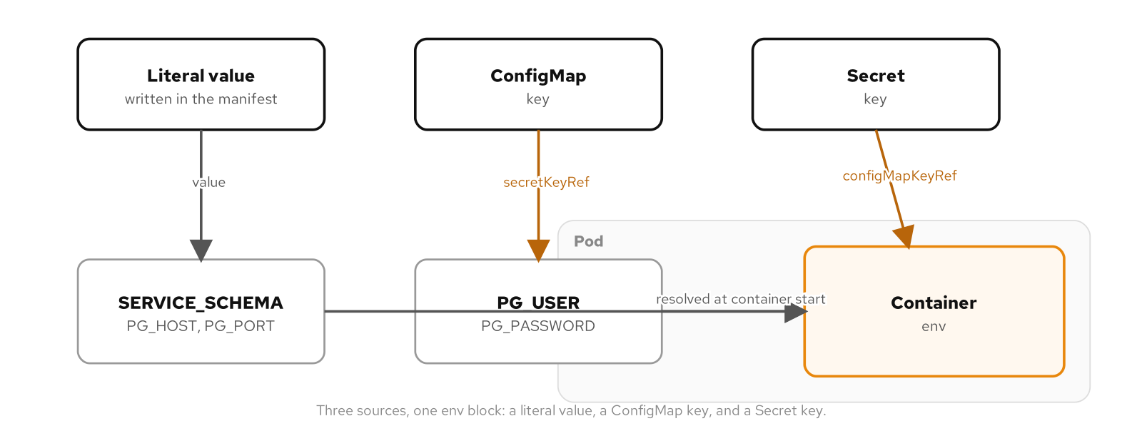
CONFIGURATION · ENV VAR CONFIGURATION
Three sources, one variable
Figure: a literal, a ConfigMap key, and a Secret key all land as ordinary env vars inside the same container.
82
Notes:
The figure traces SERVICE_SCHEMA as a literal, KAFKA_BOOTSTRAP from a ConfigMap key, and PG_USER from a Secret key, all converging on the same container environment. What to show: resolution happens once, at container start, with no ongoing link back to the ConfigMap or Secret afterward. Fallback: patch notification-config live and grep the running container's env to show the old value survives until a rollout restart.

Slide 83
CONFIGURATION · ENV VAR CONFIGURATION
Run it and the exam
Run: wire all three sources into notification-service, confirm each resolved value from inside the running container, then patch notification-config and watch the running Pod ignore it.
Observe: kubectl rollout restart deployment/notification-service is the only thing that makes the new ConfigMap value visible; the patch itself produces no event.
CKAD domain: Application Environment, Configuration & Security (25%).
Drill: kubectl set env deployment/notification-service -n patterns --from=configmap/notification-config KAFKA_GROUP-
83
Notes:
fieldRef, resourceFieldRef, and envFrom round out the valueFrom sources beyond this chapter's three, with envFrom getting its own treatment next. What to show: run the drill live, it removes one ConfigMap-sourced variable and triggers a rollout. Fallback: the full patch-and-restart sequence plus cleanup live in the example's README.

Slide 84
CONFIGURATION · CONFIGURATION RESOURCE
Configuration Resource
Per-key wiring doesn't scale. Env Var Configuration's explicit valueFrom entries work fine for a handful of settings, but every new value means another line in the Deployment.
envFrom bulk-exposes an entire ConfigMap or Secret as environment variables in a single reference, no per-key wiring at all.
A config-file consumer needs a different shape entirely. A process built around an .ini or .properties file needs files on disk, which no amount of env vars substitutes for.
payment-service bulk-exposes a ConfigMap and a Secret as env vars and mounts the same two resources as files, in the same Pod.
84
Notes:
Most applications only need one of the two shapes envFrom and a volume mount deliver, a flat set of variables or a directory of files. payment-service demonstrates the case where a single resource needs to reach the container both ways at once, because different tooling inside the deployment expects different shapes from the same configuration. What to show: envFrom turns adding a setting into editing one resource instead of editing both the resource and the Deployment. Fallback: the example's README has the full manifest set.

Slide 85
CONFIGURATION · CONFIGURATION RESOURCE
envFrom: every key, one line
yaml · deployment
envFrom:
- configMapRef:
name: payment-config
- secretRef:
name: payment-pg-credentials
# keys become env vars verbatim, no prefix
# payment-service.conf has a dot: invalid
# env var name, so the kubelet skips it
Every valid key in both resources becomes an env var named exactly after the key.
85
Notes:
payment-config's three settings keys happen to match payment-service's own configuration loader field names, which is what makes envFrom worth using over per-key wiring. The fourth key, payment-service.conf, contains a dot and can't become a POSIX environment variable name at all. What to show: the kubelet doesn't fail the Pod over the invalid key, it raises a Warning event visible in kubectl describe pod and skips just that one key. Fallback: kubectl exec into payment-service and run env to confirm the three valid keys landed and the fourth never did.

Slide 86
CONFIGURATION · CONFIGURATION RESOURCE
Two update models, same resource
A volume mount delivers the key envFrom skipped. payment-service.conf reaches the container as a file at /config/app, with defaultMode 0400 restricting it to its owning UID.
Patch the file-shaped key and the mounted file updates on its own, within roughly a minute, no restart. Patch a bulk-exposed key and the running environment never changes.
subPath breaks the live update. Mounting a single file into an existing directory pins the container to that file at mount time and never re-resolves it.
A file has no /proc/<pid>/environ exposure and nothing inherits it into a child process automatically, a narrower exposure than an env var for a credential like pg_password.
86
Notes:
The asymmetry is easy to get backward from intuition alone, since both mechanisms read from the same underlying ConfigMap and Secret. A team that assumes env vars sync like a mounted file ships a change that silently never takes effect; a team that assumes a mounted file needs a restart over-engineers a rollout the kubelet was already handling. What to show: patch payment-config's file key live and cat the mounted file inside the running Pod to watch it change with no restart. Fallback: kubectl exec into payment-service and run ls -l to confirm the 0400 mode landed as -r--------.

Slide 87
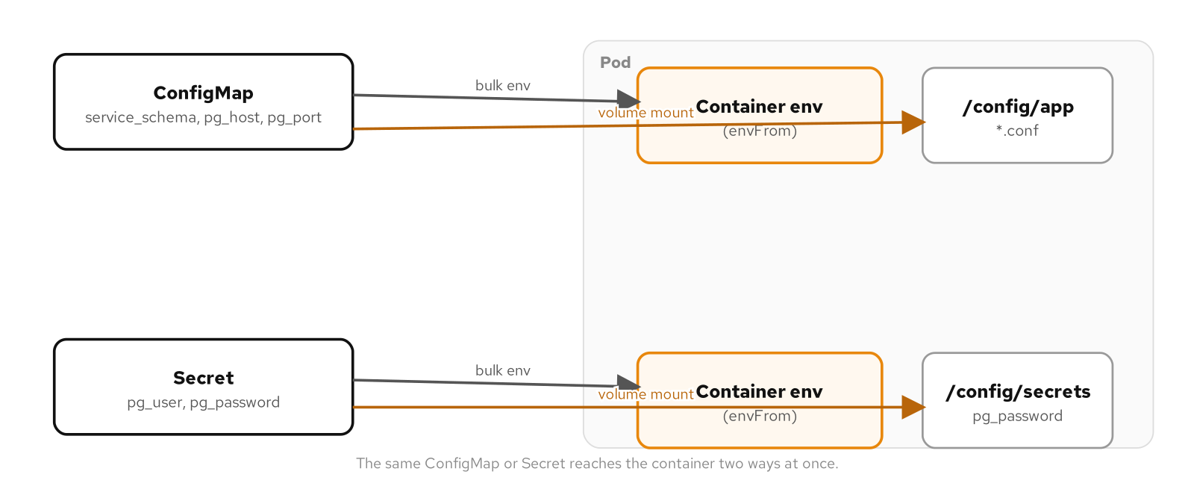
CONFIGURATION · CONFIGURATION RESOURCE
Bulk env vars and mounted files
Figure: the same ConfigMap and Secret reach the container as bulk-exposed env vars and as mounted files at once.
87
Notes:
The figure shows envFrom bulk-exposing every valid key as an env var while a volumeMount delivers the same resource's keys as files, including the key envFrom had to skip. What to show: the fourth, dotted key only reaches the container through the file path, never through envFrom. Fallback: the exam drill counts the bulk-exposed Postgres variables directly from the running container's environment.

Slide 88
CONFIGURATION · CONFIGURATION RESOURCE
Run it and the exam
Run: deploy payment-service with a ConfigMap and a Secret each bulk-exposed via envFrom and mounted as files, then confirm the skipped-key Warning event and the mounted files' permissions.
Observe: patch the file-shaped ConfigMap key and watch the mounted file update live; patch a bulk-exposed key and the running environment stays exactly as it was.
CKAD domain: Application Environment, Configuration & Security (25%).
Drill: kubectl exec -n patterns "$POD" env | grep -c '^pg_'
88
Notes:
etcd's default 1MiB per-object limit rules out a ConfigMap as a place for anything resembling an application artifact or a large certificate bundle; a PersistentVolumeClaim or the container image is the right home for those. What to show: run the drill live, it counts the bulk-exposed Postgres variables and confirms all three landed from envFrom. Fallback: the example's README has the full Warning-event and permission-check sequence.

Slide 89
CONFIGURATION · CONFIGURATION TEMPLATE
Configuration Template
Flat configuration has a ceiling. An XML document, a YAML file with nested lists and maps, any format where shape matters as much as value, breaks the env-var and file-key model entirely.
Splitting template from overlay separates structure that never changes from a handful of values that do, instead of duplicating a whole file per environment.
An init container renders the two together into a shared emptyDir before the main container ever starts, so the application only ever sees a finished, plain file.
inventory-service stands in for a real XML or YAML config consumer, demonstrating the mechanism without touching the service's own code.
89
Notes:
The template this chapter renders is a stand-in: inventory-service's own settings are perfectly well served by flat env vars and stay that way. What to show: by the time the main container starts, there's no template syntax left anywhere, just a plain rendered file. Fallback: the example's README has the full template and both overlay manifests.

Slide 90
CONFIGURATION · CONFIGURATION TEMPLATE
Template, overlay, init container
yaml · init container
initContainers:
- name: render-config
image: ubi10/ubi-minimal:latest
envFrom:
- configMapRef:
name: inventory-dev-overlay
volumeMounts:
- name: template
mountPath: /templates
readOnly: true
- name: rendered
mountPath: /rendered
The overlay arrives via envFrom; the init container renders app.conf into a shared emptyDir before the main container starts.
90
Notes:
The overlay ConfigMap arrives in the init container the same way any ConfigMap arrives anywhere, envFrom, bulk-exposing ENV_LABEL and LOG_LEVEL for the sed command to substitute into the template. The rendered output lands on a second volume, an emptyDir shared with the main container and gone the moment the Pod is deleted. What to show: the main container mounts the same rendered volume read-only and never sees a sed command or template syntax of its own. Fallback: kubectl exec into inventory-service and run cat /config/app/app.conf to show the finished file with every token substituted.

Slide 91
CONFIGURATION · CONFIGURATION TEMPLATE
Switching overlays means a new Pod
An init container runs exactly once per Pod lifetime, at creation, and never again. Editing an overlay ConfigMap's contents while a Pod is running changes nothing already running.
Switching environments means changing which ConfigMap the Deployment names, then rolling: kubectl rollout restart is what actually produces a Pod with the new overlay rendered in.
A sidecar could watch and re-render on the fly, but it costs a long-running process and a main container that has to tolerate its config changing underneath it mid-run.
Deploy-time templating (Helm, Kustomize) is a different layer. Those render the manifest before anything reaches the cluster; this pattern renders at runtime, from resources already applied.
91
Notes:
This is a third, distinct operational model alongside the family's other two: Env Var Configuration resolves once like this does, Configuration Resource's mounted files sync continuously unlike this. What to show: patch the overlay ConfigMap's data and nothing happens until a new Pod is created, exactly because the init container that would render it has already finished and exited. Fallback: the rollout-restart sequence in the example's README switches from the dev overlay to the prod overlay live.

Slide 92
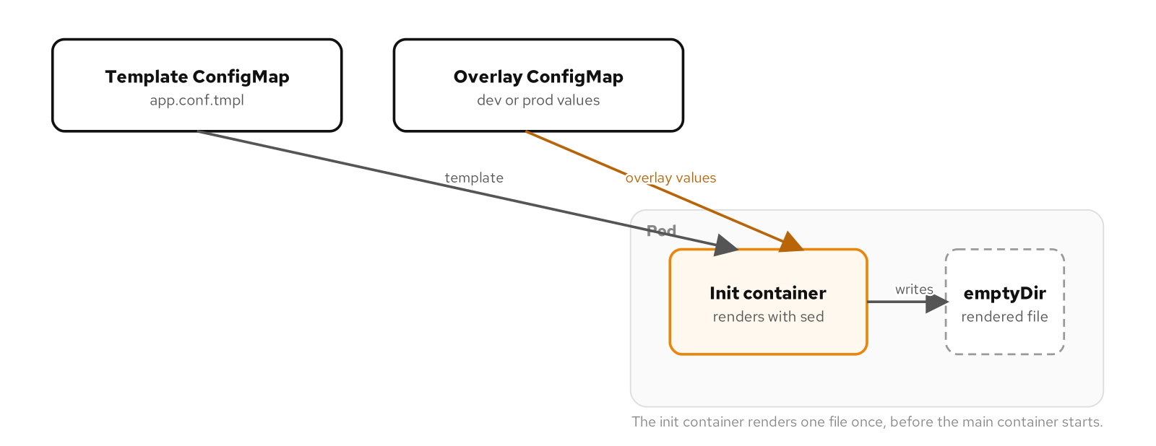
CONFIGURATION · CONFIGURATION TEMPLATE
Rendering before the main container
Figure: a template and an overlay feed an init container, which writes one rendered file into a shared volume before the main container starts.
92
Notes:
The figure shows the init container running to completion, writing app.conf once, and exiting before inventory-service's main container ever starts. What to show: the main container's own volumeMount is read-only against the same emptyDir, confirming it only ever reads the finished result. Fallback: the init container's terminated.reason field is what the exam drill reads to confirm a clean exit.

Slide 93
CONFIGURATION · CONFIGURATION TEMPLATE
Run it and the exam
Run: deploy inventory-service with an init container rendering the template against the dev overlay, confirm the rendered file's content, then switch to the production overlay and recreate the Pod.
Observe: the init container's status shows Completed before the main container ever reports Running; the rendered file only changes after a fresh Pod, never in place.
CKAD domain: Application Environment, Configuration & Security (25%).
Drill: kubectl get pod -n patterns -l app.kubernetes.io/name=inventory-service -o jsonpath='{.items[0].status.initContainerStatuses[0].state.terminated.reason}'
93
Notes:
sed is enough for two tokens and keeps the init container to a stock ubi-minimal image with no custom build; a config complex enough to need this pattern in production usually needs a real templating engine instead. What to show: run the drill live, it confirms the init container exited cleanly before the main container started. Fallback: the example's README has the full dev-to-prod overlay switch end to end.

Slide 94
CONFIGURATION · IMMUTABLE CONFIGURATION
Immutable Configuration
A mutable ConfigMap has no versioning and no audit trail. Patch one behind twenty replicas and every Pod picks up the change on its own invisible schedule, a rollout nobody declared.
immutable: true locks data and binaryData for good. The API server refuses any further write, with no force flag and no admission override short of deleting the resource.
A config change becomes a new resource, referenced by a Deployment update, which routes it through the same rollout machinery, history, and rollback story as any other Pod template change.
graphql-gateway carries no state of its own, so the version-and-roll mechanism this pattern is about doesn't get lost in unrelated setup.
94
Notes:
immutable can only be set at creation; there's no way to mark an existing mutable ConfigMap immutable after the fact without deleting and recreating it. What to show: nothing about consuming an immutable ConfigMap differs from consuming a mutable one, envFrom and volume mounts both work identically until something tries to write to it. Fallback: the example's README has the full gateway-config-v1 and v2 manifests.

Slide 95
CONFIGURATION · IMMUTABLE CONFIGURATION
The rejected patch
yaml · configmap
apiVersion: v1
kind: ConfigMap
metadata:
name: gateway-config-v1
immutable: true
data:
order_rest_url: http://order-service
---
# kubectl patch configmap gateway-config-v1
# --type merge -p '{"data":{...}}'
# error: field is immutable
The API server rejects any write to data or binaryData once immutable is set, with no override.
95
Notes:
There's no force flag and no admission-controller override that makes this patch succeed short of deleting the ConfigMap first, and deleting one a running Deployment still references produces the same CreateContainerConfigError the Predictable Demands pattern covers for a missing ConfigMap. What to show: the rejection names the data field and the ConfigMap's immutability directly as the reason. Fallback: kubectl patch against gateway-config-v1 live reproduces the exact rejection message.

Slide 96
CONFIGURATION · IMMUTABLE CONFIGURATION
Rolling a change forward
The only path to a new value is a new ConfigMap name: gateway-config-v2, created inert and unreferenced until the Deployment's envFrom is updated to name it.
That Deployment update is an ordinary rolling update: a new ReplicaSet, new Pods against the new name, old Pods terminated once the new ones pass readiness.
rollout history and rollout undo both work against it the same way they work against an image change; a config change made this way is a first-class revision, not an untracked edit.
The same field applies to Secret, making a credential rotation structurally impossible to perform as a silent in-place edit of a password every Pod relies on.
96
Notes:
Checking what a Deployment currently references before deleting the ConfigMap it used to point at is the one habit worth building, since deleting one a running Pod still needs produces the same CreateContainerConfigError whether or not it was ever immutable. What to show: kubectl rollout status reports the ConfigMap-name change exactly the way it reports a container image change. Fallback: kubectl exec into graphql-gateway and run env to confirm the new Pod resolved order_rest_url to the v2 value.

Slide 97
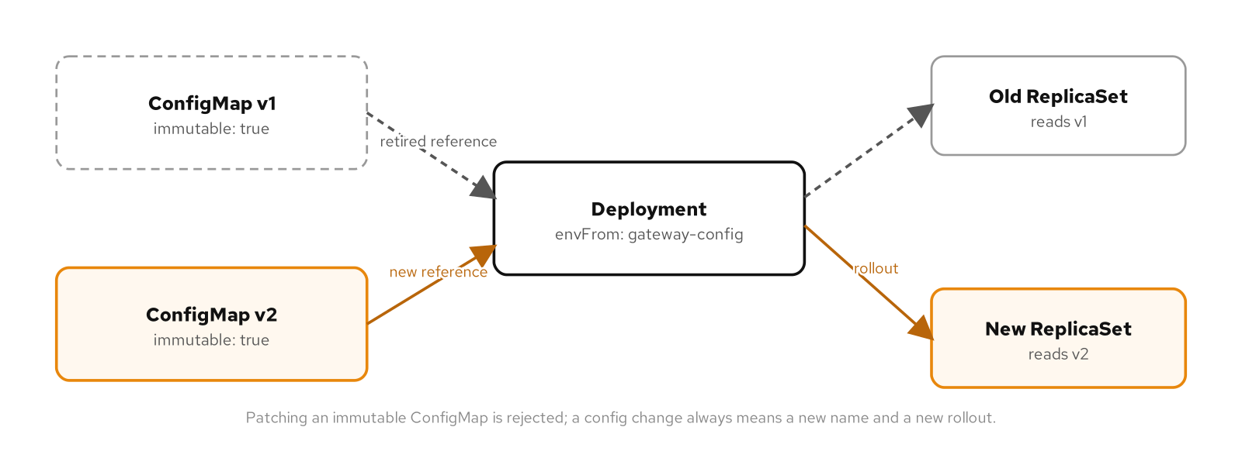
CONFIGURATION · IMMUTABLE CONFIGURATION
Versioned name, not in-place edit
Figure: ConfigMap v1 and v2, both immutable, with a Deployment's reference moving from one to the other and a rollout following it.
97
Notes:
The figure shows the old ConfigMap left untouched while a new one is created and the Deployment's reference moves, triggering an ordinary rolling update rather than an in-place mutation. What to show: v1 stays inert and deletable only once nothing references it anymore. Fallback: the exam drill reads the Deployment's envFrom reference directly to confirm which version is live.

Slide 98
CONFIGURATION · IMMUTABLE CONFIGURATION
Run it and the exam
Run: deploy graphql-gateway against an immutable ConfigMap, confirm the API server rejects an in-place patch, then create a v2 and roll the Deployment onto it.
Observe: kubectl rollout history lists the ConfigMap-name change as a real revision, and rollout undo reverts the Deployment's reference the same way it reverts an image tag.
CKAD domain: Application Environment, Configuration & Security (25%).
Drill: kubectl get deployment graphql-gateway -n patterns -o jsonpath='{.spec.template.spec.containers[0].envFrom[0].configMapRef.name}'
98
Notes:
Kubernetes' own documentation recommends versioned or content-addressed ConfigMap names broadly, since immutable: true also measurably reduces API server watch load at scale, a ConfigMap that can never change again needs no ongoing watch for mutations. What to show: run the drill live, it confirms which version name the Deployment currently references. Fallback: the example's README has the full v1-to-v2 rollout and the matching rollout undo.

Slide 99
05
Advanced Patterns
The reconcile loop, elastic scaling, in-cluster image builds, and a CRD-backed Operator: patterns that extend the cluster's own API instead of just running on top of it.
Notes:
The advanced family assumes everything the foundational patterns taught and adds code that watches and acts on the API itself: a controller's reconcile loop, three ways to change a replica count without a human running kubectl scale, two ways to build a container image without Docker Engine on the host, and a CRD that turns shipping-service's own operational knowledge into a native Kubernetes API. Controller and Operator are really one story told in two chapters, the same observe-diff-act loop, first against a built-in kind and then against a kind this project invented. What to show: controller-runtime is the thread connecting the harder two chapters, name it once up front so the Go snippets later don't feel like a detour. Fallback: if time is short, Elastic Scale and the Operator chapter carry the most exam weight; Image Builder is the one to cut first.

Slide 100
ADVANCED · CONTROLLER
Controller
A controller watches one kind of object and repeatedly closes the gap between its spec and what's actually running, nothing more specific than that.
Level-triggered means the loop never trusts a watch event's payload. It re-reads current state on every reconcile, so a missed event or a crash mid-reconcile still converges on the next pass.
The ReplicaSet controller proves the loop with nothing but kubectl: delete a Pod and the same diff-and-act cycle creates its replacement, no script involved.
ShippingPolicyReconciler runs the identical shape over a custom kind, wired up through controller-runtime's SetupWithManager and Owns calls.
100
Notes:
A controller doesn't care whether the triggering event was a create, an update, a delete, or nothing at all, it only cares about the current difference between desired and observed state. kubectl delete pod against shipping-service proves this live: a new Pod appears with a new generated name, same replica count, and nothing ran a script to notice the gap. What to show: the Deployment and ReplicaSet controllers stack the identical loop on top of each other, two object kinds, one shape, each owning only the objects it's responsible for. Fallback: kubectl get pod -o yaml shows the ownerReferences entry naming the ReplicaSet by UID, confirmed in the object itself rather than inferred from a label match.

Slide 101
ADVANCED · CONTROLLER
Watching owned objects
go · reconciler
func (r *ShippingPolicyReconciler) SetupWithManager(
mgr ctrl.Manager) error {
return ctrl.NewControllerManagedBy(mgr).
For(&shippingv1alpha1.ShippingPolicy{}).
Owns(&appsv1.Deployment{}).
Owns(&corev1.ConfigMap{}).
Named("shippingpolicy").
Complete(r)
}
Owns watches Deployments and ConfigMaps owned by a ShippingPolicy, enqueuing its reconcile on any child edit.
101
Notes:
This is the SetupWithManager wiring from ShippingPolicyReconciler, the custom controller the Operator chapter builds out fully. What to show: For names the primary watched kind, and each Owns call adds a second watch scoped to objects carrying a controller owner reference back to that kind, which is how a direct kubectl scale on the child Deployment still triggers a correction. Fallback: kubectl scale deployment/controller-demo --replicas=5 against the running example and watch the Deployment settle back to the ShippingPolicy's spec.replicas within moments.

Slide 102
ADVANCED · CONTROLLER
Reconcile, read before trusting
go · reconciler
func (r *ShippingPolicyReconciler) Reconcile(
ctx context.Context, req ctrl.Request,
) (ctrl.Result, error) {
var policy shippingv1alpha1.ShippingPolicy
if err := r.Get(ctx, req.NamespacedName,
&policy); err != nil {
if apierrors.IsNotFound(err) {
return ctrl.Result{}, nil
}
return ctrl.Result{}, err
}
// diff policy.Spec against current state, act only
// on what's actually different
}
req carries only a namespace and name, so Reconcile has to re-Get current state on every call.
102
Notes:
req never carries a payload describing what changed, which is the discipline that keeps the loop level-triggered rather than edge-triggered. What to show: a reconciler that trusted fields off the watch event instead would quietly reintroduce the exact failure mode, a missed or stale event leaving the cluster wrong forever, that the whole mechanism exists to prevent. controllerutil.CreateOrUpdate further down applies the same discipline to writes: it issues an update only if the result actually differs from what's there. Fallback: the appendix's own test suite asserts a no-op reconcile leaves the Deployment's generation unchanged, which is the proof this discipline works.

Slide 103
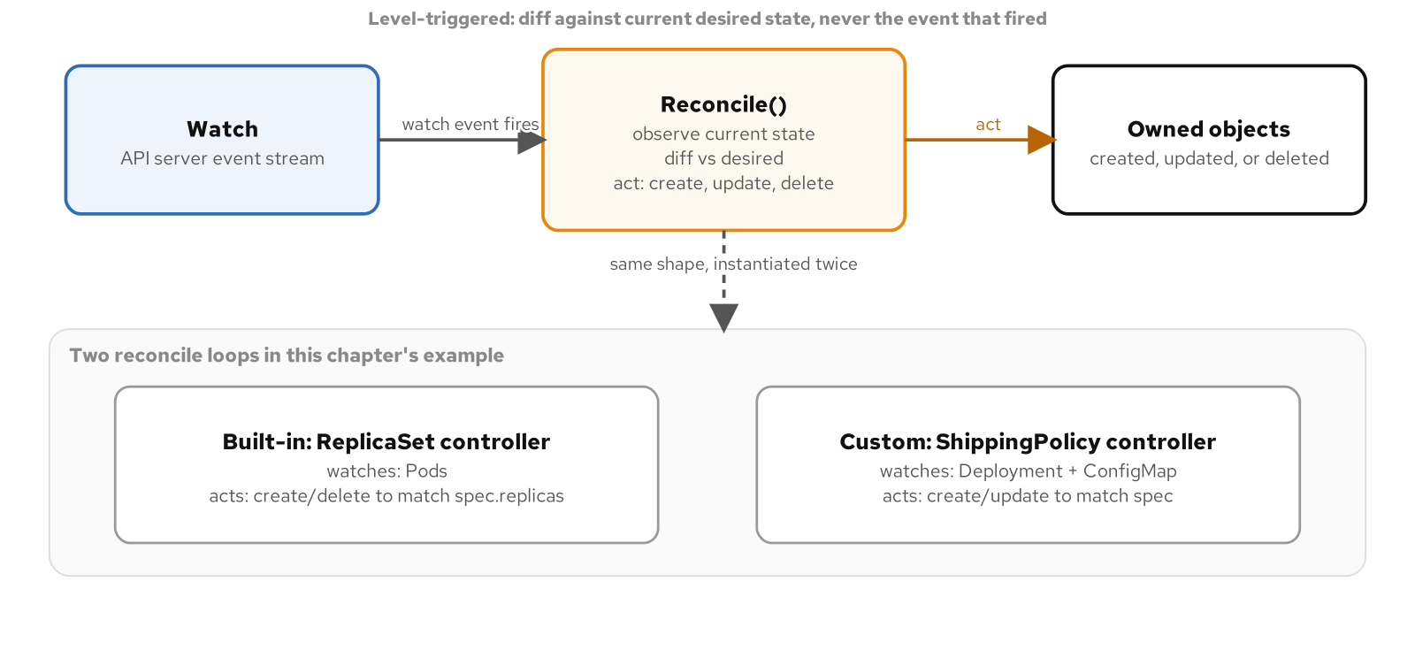
ADVANCED · CONTROLLER
Two loops, one shape
Figure: the same watch-observe-diff-act loop, once as the built-in ReplicaSet controller over Pods and once as ShippingPolicyReconciler over a Deployment and ConfigMap.
103
Notes:
The figure places the built-in and custom controllers side by side to make the point visually: the loop's shape never changes, only the watched kind and the owned objects it acts on do. What to show: trace the arrow from owned objects back to Reconcile, that's the garbage-collection and re-trigger path owner references buy with no extra code. Fallback: the same figure and its editable source live on the reference site.

Slide 104
ADVANCED · CONTROLLER
Run it and the exam
Run: delete a shipping-service Pod directly and watch the ReplicaSet controller replace it, then scale and delete the custom controller's owned Deployment and ConfigMap and watch both come back.
Observe: kubectl get pod -o yaml shows the ownerReferences entry naming the ReplicaSet by UID; the operator's own log lines show which reconcile, scale-driven or delete-driven, ran first.
CKAD domain: Application Environment, Configuration & Security (25%).
Drill: kubectl get pod -n patterns -l app.kubernetes.io/name=shipping-service -o jsonpath='{.items[*].metadata.ownerReferences[0].name}'
104
Notes:
Both halves of the example run against the same cluster profile: a plain Deployment for the built-in loop, then the shipping-policy-operator binary and a ShippingPolicy object for the custom loop. What to show: deleting the ConfigMap is the more convincing half to run live, since nothing in ShippingPolicyReconciler's code mentions ConfigMap deletion as a case to handle, it just falls out of the same reconcile. Fallback: the controller example's README has the exact kubectl sequence and expected output for both halves.

Slide 105
ADVANCED · ELASTIC SCALE
Elastic Scale
HPA and VPA both read the Pods themselves, CPU and memory usage the kubelet already reports, which is a structural reason neither can ever scale a workload to zero.
KEDA answers the same question from outside the Pods: Kafka lag, HTTP concurrency, a queue depth, any signal that still exists when the workload has zero replicas.
An HTTPScaledObject holds the first request at an interceptor, scales the Deployment up from zero, and only forwards once a Pod reports Ready.
KEDA doesn't replace HPA. Every ScaledObject generates an ordinary HPA behind the scenes, wired to an external metric instead of metrics-server.
105
Notes:
Every autoscaler here answers the same question, how many replicas should this workload have right now, but they disagree about where the answer comes from. A metric computed from a running Pod's own usage can't exist until a Pod is running, so HPA and VPA both carry a hard floor of one. What to show: KEDA gets the same scale-to-zero property on top of plain Deployments, with no separate serving runtime to adopt. Fallback: more of this chapter, installing and operating the autoscaling infrastructure itself, sits closer to CKA territory; the CKAD competency is understanding what each one reads and does to a workload.

Slide 106
ADVANCED · ELASTIC SCALE
HPA: replicas from CPU
yaml · hpa
apiVersion: autoscaling/v2
kind: HorizontalPodAutoscaler
metadata:
name: shipping-service
spec:
scaleTargetRef:
kind: Deployment
name: shipping-service
minReplicas: 1 # floor: no % from zero Pods
maxReplicas: 5
metrics:
- type: Resource
resource:
name: cpu
target: { type: Utilization, averageUtilization: 50 }
averageUtilization is a percent of the container's own CPU request, never of a limit or absolute cores.
106
Notes:
This is the HPA from the shipping-service example, trimmed to the fields that matter: a CPU request on the target container is mandatory because utilization is always computed as a percentage of it. What to show: kubectl get hpa -w while a busybox wget loop hammers /health shows the replica count climb from one toward five and settle back down once the load stops, no kubectl scale involved. Fallback: kubectl describe hpa reads TARGETS as unknown/50% when the Deployment has no CPU request at all, the single most common reason an HPA never moves.

Slide 107
ADVANCED · ELASTIC SCALE
VPA off, KEDA from zero
yaml · vpa + keda
# VPA: compute a recommendation, never act on it
apiVersion: autoscaling.k8s.io/v1
kind: VerticalPodAutoscaler
spec:
targetRef: { kind: Deployment, name: shipping-service }
updatePolicy:
updateMode: "Off" # Auto would evict and fight the HPA
---
# KEDA: scale graphql-gateway from zero
apiVersion: http.keda.sh/v1alpha1
kind: HTTPScaledObject
spec:
replicas: { min: 0, max: 3 }
scalingMetric:
concurrency: { targetValue: 5 }
Off keeps VPA's recommendation visible without evicting Pods out from under the HPA's own denominator.
107
Notes:
VPA's Auto mode evicts a Pod to resize it, which rewrites the CPU request the HPA's utilization percentage is computed against, mid-flight, with neither controller aware of the other. Off sidesteps that fight entirely: kubectl describe vpa still shows the recommendation, nothing acts on it automatically. What to show: the HTTPScaledObject below it holds the first request at an interceptor while the Deployment scales up from zero, then forwards it once a Pod reports Ready, paying that extra latency exactly once per idle-to-active transition. Fallback: lower targetValue from 5 to 1 and reapply to show replicas climbing faster under identical load.

Slide 108
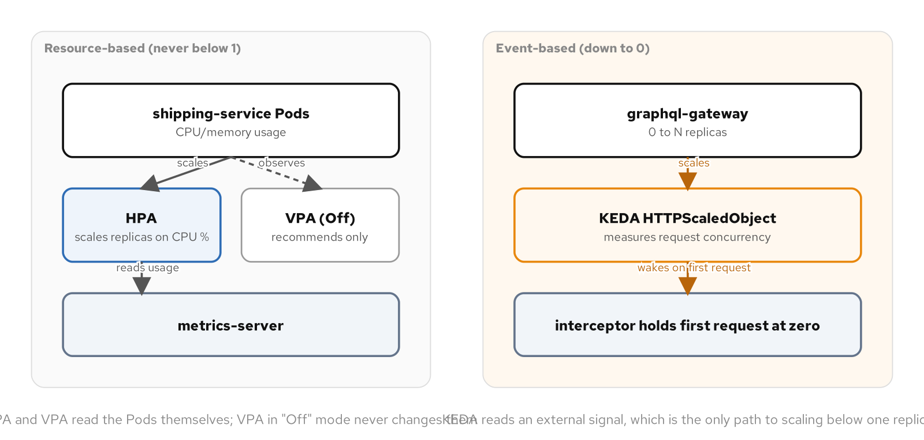
ADVANCED · ELASTIC SCALE
Reading the Pod versus reading the world
Figure: HPA and VPA read CPU and memory off the Pods themselves; KEDA's HTTPScaledObject reads request concurrency from outside the Pod, which is what lets it scale to zero.
108
Notes:
The figure puts the two families side by side on the same cluster: shipping-service under HPA and VPA, graphql-gateway under KEDA. What to show: there's no arrow from a Pod into the KEDA interceptor's measurement, that absence is the entire mechanism behind scale-to-zero. Fallback: the reference site carries the same figure with its editable source.

Slide 109
ADVANCED · ELASTIC SCALE
Run it and the exam
Run: generate load against shipping-service and watch the HPA climb from one replica to five and settle back, then send a request to graphql-gateway at zero replicas and watch the interceptor hold it until a Pod is Ready.
Observe: kubectl describe hpa's AbleToScale condition names a metrics-API failure directly; kubectl describe scaledobject surfaces the same failure for a KEDA trigger that can't resolve.
CKAD domain: Application Deployment (20%).
Drill: kubectl get hpa,scaledobject,httpscaledobject -n patterns
109
Notes:
HPA and VPA installation leans toward the CKA curriculum's cluster-operations territory; the CKAD competency is narrower, understanding what each autoscaler reads and does to a workload, not configuring the autoscaling stack from scratch. What to show: the reference-only Kafka ScaledObject in the example directory matters even though it's never applied live, since shipping-service has no real topic to consume from on this profile. Fallback: the elastic-scale example's README has the exact helm install commands for KEDA and its HTTP add-on.

Slide 110
ADVANCED · IMAGE BUILDER
Image Builder
minikube image build runs the build on the node itself through containerd, with no Docker Engine on the host and no Kubernetes object behind it anywhere.
Kaniko builds inside an ordinary Job's Pod, reimplementing a container build in user space with no privileged container and no Docker socket mounted anywhere.
A Pod and a node don't share a network namespace, so Kaniko pushes to the registry at one address and the kubelet later pulls from a different one.
Kaniko answers to the Kubernetes API: a CI system that can create a Job can trigger the build, watch status.conditions, and read logs the same way as any other workload.
110
Notes:
Every other chapter in this appendix builds shipping-service with docker build on the host and loads the result with minikube image load; in-cluster building removes that host-side dependency entirely. What to show: the two paths differ specifically in how real they are as Kubernetes objects, one bypasses the API, the other is a Job the API can schedule and watch. Fallback: this chapter also drops the Knative build lane the underlying pattern literature covers, Kaniko alone covers the in-cluster-build half of that story without the heavier serving framework.

Slide 111
ADVANCED · IMAGE BUILDER
minikube image build
bash
minikube -p mof-patterns image build \
-f Containerfile \
-t shipping-service:v1 \
../17-capstone/services/shipping-service
# lands directly in containerd's local image store
minikube -p mof-patterns image ls
The -f flag is a basename resolved against the build context, not a path from the host's current directory.
111
Notes:
No docker build runs on the host at all here; the build context ships straight to the node and runs there against the same containerd runtime already running every Pod. What to show: minikube image ls shows shipping-service:v1 present immediately, with no separate load step, because imagePullPolicy: Never looks at the exact same local store the build just wrote into. Fallback: kubectl get pods and kubectl get jobs during the build show nothing related to it, the real limit of this path, no Kubernetes object, nothing the API can watch or trigger.

Slide 112
ADVANCED · IMAGE BUILDER
Two addresses, one registry
yaml · registry
# Kaniko pushes from inside a Pod: cluster DNS
--destination=registry.kube-system.svc.cluster.local/shipping:v1
# the Deployment later pulls from the node's own proxy
image: localhost:5000/shipping:v1
imagePullPolicy: Always # there's a real registry now
The same registry answers to two addresses because a Pod's network namespace and a node's are never the same thing.
112
Notes:
A Pod and a node never share a network namespace, which is why Kaniko's push and the kubelet's later pull use two different addresses for the identical registry. What to show: the registry addon's per-node registry-proxy DaemonSet is what makes localhost:5000 resolve correctly from the node's own vantage point, not a Pod's; using that same address from inside the Kaniko Pod fails with connection refused. Fallback: kubectl describe pod on the Deployment's Pod shows Pulling image followed by Successfully pulled in its Events, confirming the kubelet actually contacted the proxy rather than reusing a stale local image.

Slide 113
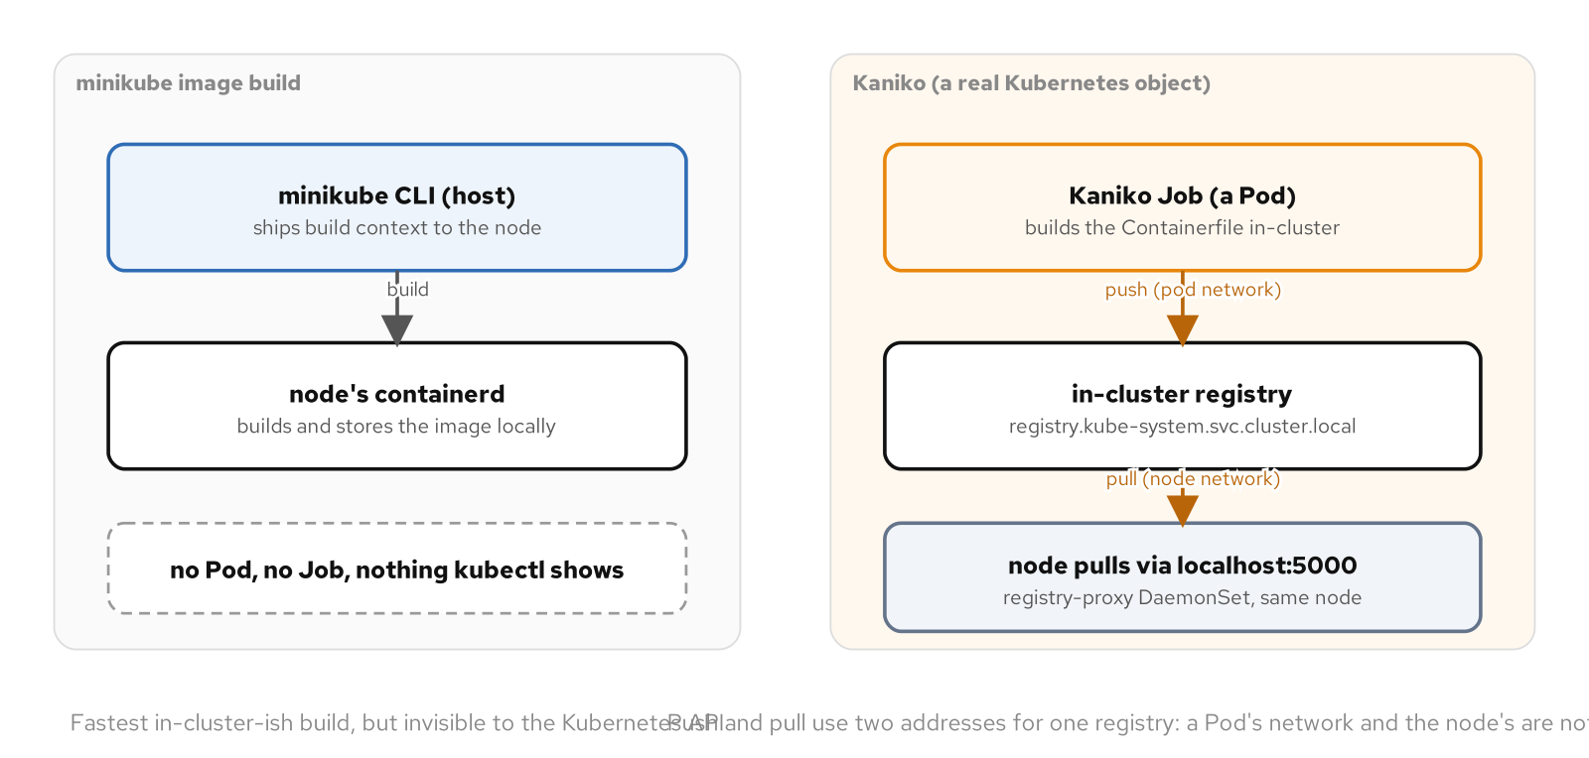
ADVANCED · IMAGE BUILDER
Visible to the API, or not
Figure: minikube image build runs on the node with no Kubernetes object behind it, while a Kaniko Job builds and pushes inside a Pod to a registry the Deployment pulls from through a second, node-local address.
113
Notes:
The figure separates the two build paths by how visible each one is to the Kubernetes API: one leaves no trace, the other is a real Job a CI system could trigger and watch. What to show: follow the two arrows out of the registry box, one to the Kaniko Pod's push, one to the node's pull proxy, they never cross. Fallback: the same figure with its editable source lives on the reference site.

Slide 114
ADVANCED · IMAGE BUILDER
Run it and the exam
Run: build shipping-service once with minikube image build directly on the node, then a second time with a Kaniko Job that builds from a git context and pushes to the registry addon.
Observe: kubectl get job's status.conditions confirms Kaniko exited zero; describe pod's Pulling image and Successfully pulled events confirm the Deployment actually fetched the fresh push.
CKAD domain: Application Design and Build (20%).
Drill: kubectl get job shipping-service-kaniko-build -n patterns -o jsonpath='{.status.conditions[?(@.type=="Complete")].status}'
114
Notes:
A Job completing successfully only proves Kaniko's own process exited zero; it doesn't by itself prove the Deployment referencing the built image is actually running it. What to show: with imagePullPolicy: Always in play, a stale local image under the same tag would otherwise be indistinguishable from a freshly pulled one without checking the pull event directly. Fallback: the image-builder example's README has the full build, load, and verify sequence for both paths.

Slide 115
ADVANCED · OPERATOR
Operator
A controller needs something to watch. An Operator is a controller plus a CRD that gives it a kind that didn't exist in Kubernetes before this project defined it.
ShippingPolicy registers a new API group, a validated schema, and a status subresource, reachable by kubectl get, describe, and RBAC like any built-in kind.
+kubebuilder markers on the Go struct become real OpenAPI v3 validation the apiserver enforces on every create and update, before the reconciler ever sees the object.
Splitting spec and status into separate subresources means a client with write access to one can never forge the other, the same separation RBAC already relies on for a Deployment.
115
Notes:
ShippingPolicyReconciler's loop is identical in shape to the ReplicaSet controller's; what makes the whole system an Operator rather than just a controller is ShippingPolicy itself, a first-class API object with its own schema and validation. What to show: a fulfillment team's own domain concept, a shipping policy for one carrier lane, gets a real, typed, validated place in the cluster's own API the moment the CRD registers it. Fallback: kubectl get shippingpolicy works exactly like kubectl get deployment, no special tooling required to read it.

Slide 116
ADVANCED · OPERATOR
CRD: typed and validated
go · crd spec
type ShippingPolicySpec struct {
// +kubebuilder:validation:Required
// +kubebuilder:validation:MinLength=1
Carrier string `json:"carrier"`
// +kubebuilder:validation:Minimum=1
MaxTransitDays int `json:"maxTransitDays"`
// +kubebuilder:validation:Minimum=0
Replicas int32 `json:"replicas"`
}
MinLength, Minimum, and Required become real OpenAPI v3 constraints in the generated CRD manifest.
116
Notes:
controller-gen turns these kubebuilder markers into a full OpenAPI v3 schema on the generated CustomResourceDefinition: carrier becomes a required string with minLength 1, maxTransitDays a required integer with minimum 1. What to show: apply a ShippingPolicy with an empty carrier and the apiserver rejects it outright, naming the exact field, before Reconcile is ever called. Fallback: the operator's envtest-backed test proves this rejection against a real apiserver, the one guarantee a fake client's in-memory object tracker structurally cannot make.

Slide 117
ADVANCED · OPERATOR
Owning the children
go · reconciler
deploy := &appsv1.Deployment{ObjectMeta: metav1.ObjectMeta{
Name: policy.Name, Namespace: policy.Namespace,
}}
controllerutil.CreateOrUpdate(ctx, r.Client, deploy,
func() error {
deploy.Spec.Replicas = &policy.Spec.Replicas
deploy.Spec.Template.Spec.PriorityClassName =
policy.Spec.PriorityClassName
return controllerutil.SetControllerReference(
policy, deploy, r.Scheme)
})
SetControllerReference on both children is what makes ShippingPolicy the garbage-collection root for everything it owns.
117
Notes:
CreateOrUpdate is a small generic version of the same observe-diff-act loop: it fetches the object if it exists, applies the mutation, and issues an update only if the result actually differs, or creates it from scratch if missing. What to show: SetControllerReference does double duty, it's both the predicate a watch checks and the field the apiserver's own garbage collector reads to cascade a delete with no finalizer anywhere in this operator. Fallback: delete the ShippingPolicy sample and watch its Deployment and ConfigMap disappear with it, no cleanup code involved.

Slide 118
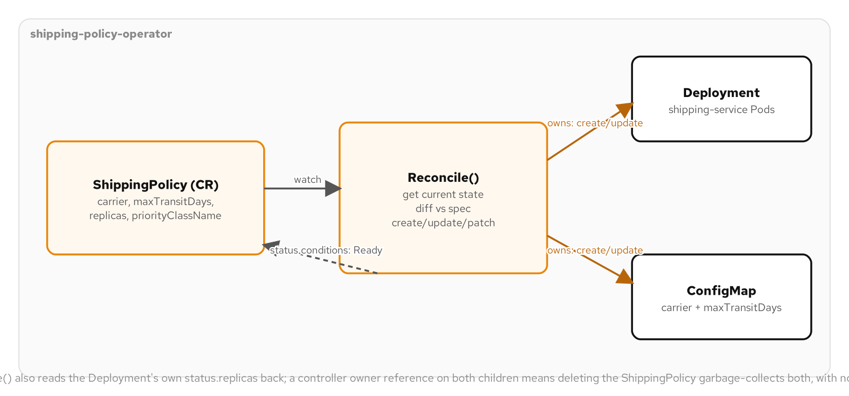
ADVANCED · OPERATOR
CRD plus controller
Figure: a ShippingPolicy custom resource watched by the operator's Reconcile loop, which owns a child Deployment and ConfigMap and reads their status back into its own conditions.
118
Notes:
The figure shows the full Operator shape in one picture: spec in, Deployment and ConfigMap out, status.replicas read back into ShippingPolicy's own Ready condition. What to show: that return arrow from status back into Reconcile is the observe-before-trusting discipline that keeps Ready accurate instead of flipping True the instant a write is issued. Fallback: the reference site carries the same figure with its editable source.

Slide 119
ADVANCED · OPERATOR
Run it and the exam
Run: apply the generated CRD, RBAC, and operator Deployment, then a sample ShippingPolicy, and watch its Ready condition flip True once the child Deployment's observed replicas match spec.
Observe: go test ./... runs the fake-client suite and an envtest-backed suite in milliseconds, entirely offline, proving both the reconcile logic and the CRD's own apiserver-enforced schema validation.
CKAD domain: Application Environment, Configuration & Security (25%).
Drill: kubectl get shippingpolicy ground-standard -n patterns -o jsonpath='{.status.conditions[?(@.type=="Ready")].status}'
119
Notes:
OLM and OperatorHub are a separate packaging layer this chapter doesn't build: this operator deploys the plainer way, a CRD and RBAC and a Deployment, applied directly with kubectl apply -f install.yaml. What to show: status.observedReplicas staying behind spec.replicas for a beat after apply is the normal gap while the Deployment and ReplicaSet controllers underneath still have to run their own reconciles first. Fallback: the operator example's README has the full build, load, deploy, and try sequence.

Slide 120
06
Security Patterns
The controls that bound what a compromised container can reach, read, and do.
Notes:
The security family narrows what a Pod can do once something inside it goes wrong: Access Control bounds its API permissions, Network Segmentation bounds its network reach, Process Containment bounds its Linux-level privilege, and Secure Configuration bounds what a leaked credential hands over. None of these patterns assume an attacker gets in; each one assumes that eventually happens and asks what is left to take once it does. What to show: the four patterns are additive and composable, a real workload layers all of them rather than picking one. Fallback: if time is tight, Access Control and Process Containment are the two the CKAD exam leans on hardest.

Slide 121
SECURITY · ACCESS CONTROL
Access Control
Every Pod authenticates to the API server as something. Skip serviceAccountName and Kubernetes fills in `default`, the one account every Pod in the namespace shares unless it asks for its own.
A ServiceAccount grants nothing by itself. It is an identity string, `system:serviceaccount:patterns:payment-service`, that RBAC rules key on once something binds a Role to it.
A Role lists resources, verbs, and optionally `resourceNames` to name individual objects instead of every object of a kind. `payment-service-reader` grants `get` on exactly one ConfigMap and one Secret.
A RoleBinding connects the Role to the ServiceAccount, both scoped to the same namespace. Leaving `default` with nothing bound closes the gap a shared account otherwise opens.
121
Notes:
payment-service is the worked example: a dedicated ServiceAccount bound to a Role that names exactly one ConfigMap and one Secret by resourceNames, with nothing else in the patterns namespace reachable. The default ServiceAccount every namespace already has starts with no RBAC grants, but it is shared by every Pod that doesn't ask for its own, so a Role accidentally bound to default grants its permissions to everything running there. What to show: creating an identity and granting it permissions are two separate steps by design, so a ServiceAccount with zero attached permissions is the safe state while scoping gets worked out. Fallback: the example also turns off the ServiceAccount's token automount, since a FastAPI service that never calls the Kubernetes API has no reason to hold a live token at all.

Slide 122
SECURITY · ACCESS CONTROL
A Role scoped by resourceNames
yaml · role
apiVersion: rbac.authorization.k8s.io/v1
kind: Role
metadata:
name: payment-service-reader
namespace: patterns
rules:
- apiGroups: [""]
resources: ["configmaps"]
resourceNames: ["payment-config"]
verbs: ["get"] # list/watch ignore resourceNames
resourceNames scopes get to one ConfigMap; granting list or watch here would reopen the whole namespace.
122
Notes:
Without resourceNames, a rule granting get on configmaps lets the bound identity read every ConfigMap in the namespace by name; with it, a request for anything but payment-config is denied exactly as if the rule didn't exist. The restriction only covers verbs that name a single object: get, update, patch, delete. list and watch return a collection with no object name in the request, so resourceNames has no effect on them at all, and adding those verbs widens the grant to the entire namespace the moment it stops mattering. What to show: payment-service-reader grants only get for exactly this reason. Fallback: a ClusterRole bound through a namespaced RoleBinding instead of a ClusterRoleBinding reuses a rule set like the built-in view role without ever granting it cluster-wide.

Slide 123
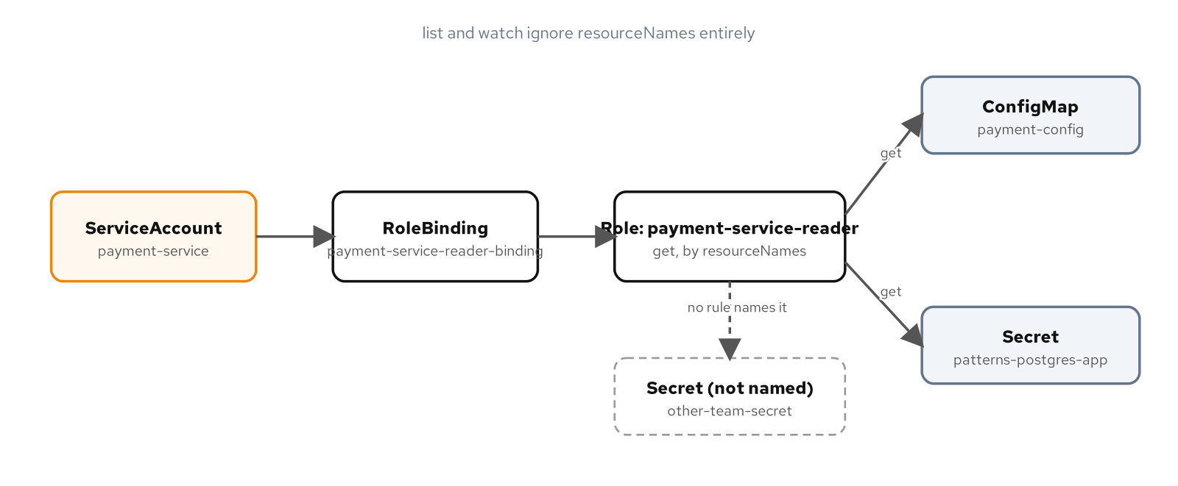
SECURITY · ACCESS CONTROL
Identity, Role, grant
Figure: payment-service's ServiceAccount reaches payment-config and its own Secret by name through its Role; an unnamed Secret is never granted.
123
Notes:
The figure traces payment-service's ServiceAccount through a RoleBinding to a Role naming two specific resources, with other-team-secret left outside the grant entirely. What to show: follow the path from identity to RoleBinding to Role to the two named objects, then point at the Secret with no line reaching it at all. Fallback: the same figure is on the reference site with its editable source.

Slide 124
SECURITY · ACCESS CONTROL
Run it and the exam
Run: auth can-i checks against payment-service's identity: an allowed get on payment-config and its own Secret, a denied get on a decoy ConfigMap, and a denied list across the namespace.
Observe: a Forbidden response names the identity, verb, resource, and namespace; `kubectl auth can-i --list --as=<identity> -n patterns` audits every allowed combination in one call.
CKAD domain: Application Environment, Configuration & Security (25%).
Drill: kubectl auth can-i get configmap/other-team-config --as=system:serviceaccount:patterns:payment-service -n patterns (expect no, since the Role never names it)
124
Notes:
kubectl auth can-i tests one rule at a time; --list prints every resource and verb combination an identity currently holds, the faster path to a broader audit after writing a new Role. A Forbidden error's identity string also catches the failure that looks like a missing permission but isn't: a Pod running under the wrong serviceAccountName, or a typo in --as. What to show: run the drill live against payment-service's identity and watch the no come back. Fallback: the example's README has the full can-i sequence, including the ClusterRole-via-RoleBinding check.

Slide 125
SECURITY · NETWORK SEGMENTATION
Network Segmentation
A fresh cluster has no network segmentation at all. Any Pod reaches any other Pod's IP and port across every namespace, with nothing in the network layer checking whether the connection should be allowed.
A NetworkPolicy is additive and Pod-scoped, not a cluster-wide switch. A Pod untouched by any policy stays fully open; a Pod selected by even one policy flips to deny-by-default for whichever direction it names.
Calico is a prerequisite here: minikube's default CNI stores the NetworkPolicy object but enforces nothing against it, a quiet way to fail every check in this chapter.
inventory-service, payment-service, and graphql-gateway are the worked example. The gateway is the one legitimate caller; payment-service has none yet and stays fully isolated.
125
Notes:
payment-service and inventory-service each get their own default-deny policy scoped by podSelector, rather than one sweeping policy with an empty selector that would deny-by-default for the whole patterns namespace, including Postgres and every other chapter's leftover Pods. graphql-gateway's allow rule protects a connection its own resolver code actually makes over gRPC, not a synthetic stand-in. What to show: confirm the CNI first with kubectl get pods -n kube-system | grep calico, since a policy that silently does nothing is the most confusing failure mode here. Fallback: a disposable curl Pod proves the open baseline before any policy exists, then proves the block once one does.

Slide 126
SECURITY · NETWORK SEGMENTATION
Default-deny, scoped to one workload
yaml · networkpolicy
apiVersion: networking.k8s.io/v1
kind: NetworkPolicy
metadata:
name: deny-all-inventory
spec:
podSelector:
matchLabels:
app.kubernetes.io/name: inventory-service
policyTypes: [Ingress] # empty rules, deny all
podSelector keeps the deny scoped: only inventory-service's own Pods flip to deny-by-default.
126
Notes:
An empty ingress list with Ingress named in policyTypes denies every inbound connection to the Pods this policy selects; Postgres, payment-service, and graphql-gateway are untouched because none of them carry this label. payment-service gets the identical treatment under its own policy and its own label, and because nothing grants it an allow rule afterward, that one policy is the entire story for it. What to show: two policies both selecting the same Pods combine additively, so a later allow rule is an exception layered on top, not a contradiction of this one. Fallback: kubectl get networkpolicy -n patterns lists what exists before diagnosing why a connection is or isn't getting through.

Slide 127
SECURITY · NETWORK SEGMENTATION
Punching one hole for one caller
yaml · networkpolicy
ingress:
- from:
- podSelector:
matchLabels:
app.kubernetes.io/name: graphql-gateway
ports:
- protocol: TCP
port: 50051 # gRPC only, not REST 8080
The rule narrows on both selector and port: only graphql-gateway, only the gRPC path it actually dials.
127
Notes:
podSelector matches a Pod's labels and nothing more: it says nothing about what process is running inside, or which ServiceAccount it uses, so a differently built Pod carrying the same label satisfies this rule just as well. That is exactly how the example verifies the rule fired, a short-lived curl Pod labeled to match the gateway's selector, without needing the gateway's own container to make the test connection. What to show: the same label also makes this probe Pod a brief endpoint of the gateway's Service, since NetworkPolicy and Service selectors are evaluated completely independently. Fallback: a separate egress policy restricts inventory-service's outbound traffic to DNS and its own Postgres Pod, closing the direction a compromised dependency is more likely to use.

Slide 128
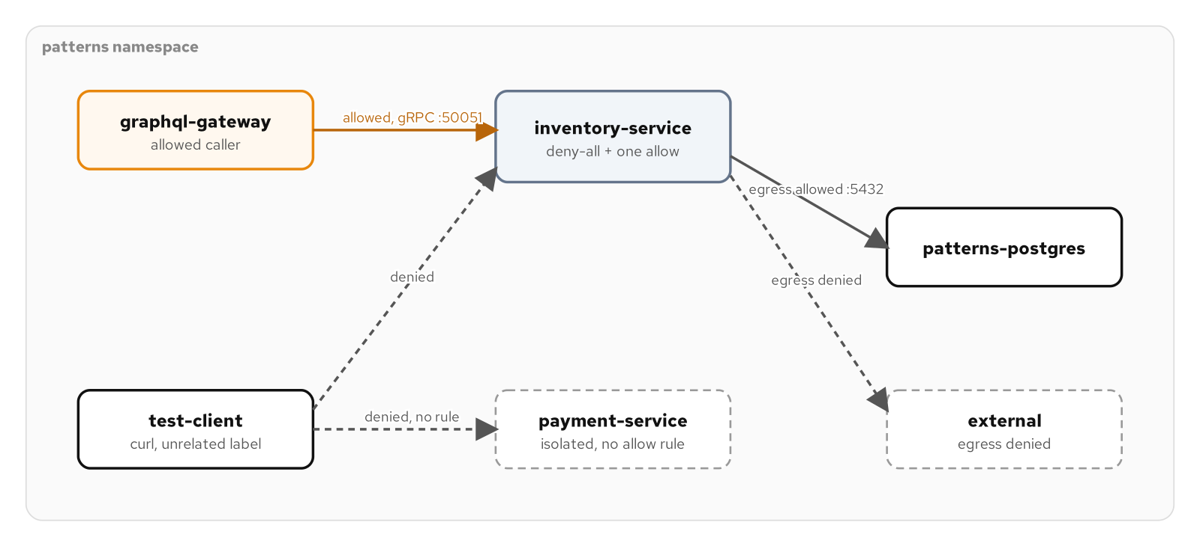
SECURITY · NETWORK SEGMENTATION
Deny by default, one exception
Figure: inventory-service denies all ingress except graphql-gateway's gRPC call; payment-service has no allow rule and stays fully isolated.
128
Notes:
The figure shows a test client denied against both protected services, with graphql-gateway's one explicit allow rule as the sole path through. What to show: point out that the rule matches a label, not a verified identity, which is why a mesh's AuthorizationPolicy is the layer that closes the selector-isn't-identity gap once a mesh is already part of the picture. Fallback: the same figure is on the reference site with its editable source.

Slide 129
SECURITY · NETWORK SEGMENTATION
Run it and the exam
Run: a curl test client reaches both services before any policy exists, is denied after the default-deny policies apply, then succeeds against inventory-service once the gateway's allow rule and matching label are in place.
Observe: a denied connection and a Pod that isn't ready yet look identical, a timeout; `kubectl get networkpolicy` and `kubectl get pods --show-labels` confirm the selectors actually match what the policy assumes.
CKAD domain: Services & Networking (20%).
Drill: kubectl exec -n patterns netseg-test-client -- curl -m 3 payment-service:80 (expect a timeout, confirming payment-service has no allow rule)
129
Notes:
A NetworkPolicy that applies without error can still be a complete no-op if its selector doesn't match what the author pictured; a typo'd label value silently selects zero Pods and changes nothing about traffic. A from entry combines a podSelector and namespaceSelector with AND, not OR, so listing them as separate array items instead of fields on one item turns a narrow rule into a much broader one by accident. What to show: run the drill against payment-service and confirm the timeout, then repeat it against inventory-service with the gateway's label for the contrast. Fallback: the example's README walks the full sequence, including the Calico setup step.

Slide 130
SECURITY · PROCESS CONTAINMENT
Process Containment
A container is a Linux process on the same kernel as every other container on the node, isolated by namespaces and cgroups rather than a hypervisor boundary. Every control here narrows that isolation further.
runAsNonRoot and runAsUser pin the UID the kubelet actually checks, independent of whatever a rebuilt image or a deploy-time override might do to it later.
capabilities.drop: [ALL] removes the container runtime's entire default privilege set; a workload adds back only the one capability it actually needs.
readOnlyRootFilesystem blocks writing a second-stage payload to disk at all; a Pod Security Standard labeled on the namespace enforces the floor even when a Deployment's author forgets.
130
Notes:
review-service's own image already runs as a non-root user, but that is a property of its Containerfile, not something a Pod's manifest can verify or rely on continuing to be true; Process Containment moves the requirement into the Pod spec where the kubelet enforces it independently. What to show: the hardening is cheap to verify from inside the running container, id for the UID, /proc/1/status for the capability mask, a touch against the read-only root for the denial. Fallback: a namespace labeled with the baseline Pod Security Standard backstops any Deployment that skips this securityContext entirely.

Slide 131
SECURITY · PROCESS CONTAINMENT
Pod-level identity and syscalls
yaml · securitycontext
spec:
securityContext:
runAsNonRoot: true
runAsUser: 1001
runAsGroup: 0 # matches UBI's USER 1001:0
fsGroup: 0 # ownership for mounted volumes
seccompProfile:
type: RuntimeDefault # blocks rarely-needed syscalls
runAsNonRoot checks the UID the kubelet resolves; the seccomp filter blocks syscalls no capability governs.
131
Notes:
runAsNonRoot doesn't choose a UID by itself; it's a check the kubelet runs against whatever UID the container would otherwise run as, refusing to start it if that UID resolves to 0. Pairing it with an explicit runAsUser makes the required UID visible in the manifest and gives the check something concrete to verify even against an image never written with a non-root default in mind. What to show: RuntimeDefault turns on the runtime's default seccomp filter, blocking kernel module loading, raw socket creation, and dozens of other rarely-needed syscalls regardless of what the container's capabilities allow. Fallback: fsGroup matters most once a PersistentVolumeClaim is involved, an emptyDir volume usually works without it.

Slide 132
SECURITY · PROCESS CONTAINMENT
Drop everything, add nothing back
yaml · securitycontext
containers:
- name: review-service
securityContext:
allowPrivilegeEscalation: false
capabilities:
drop: ["ALL"]
readOnlyRootFilesystem: true
volumeMounts:
- {name: tmp, mountPath: /tmp} # one writable path
The read-only root filesystem leaves /tmp as the one writable exception, picked because it is the one path that needs it.
132
Notes:
capabilities.drop: [ALL] removes the double-digit default set the container runtime grants whether the process uses any of it or not; allowPrivilegeEscalation: false closes a separate door, since a setuid binary can still gain more privilege through exec regardless of what capabilities were dropped. readOnlyRootFilesystem means a process handed arbitrary code execution still can't write a payload to disk or modify a binary already in the image. What to show: Python's standard library assumes a writable temp directory exists even when the application never calls tempfile directly, which is the whole reason /tmp gets an emptyDir mount instead of leaving the entire root writable. Fallback: a namespace labeled enforce: baseline rejects a Pod setting privileged: true before it is ever created, naming the violating field in the response.

Slide 133
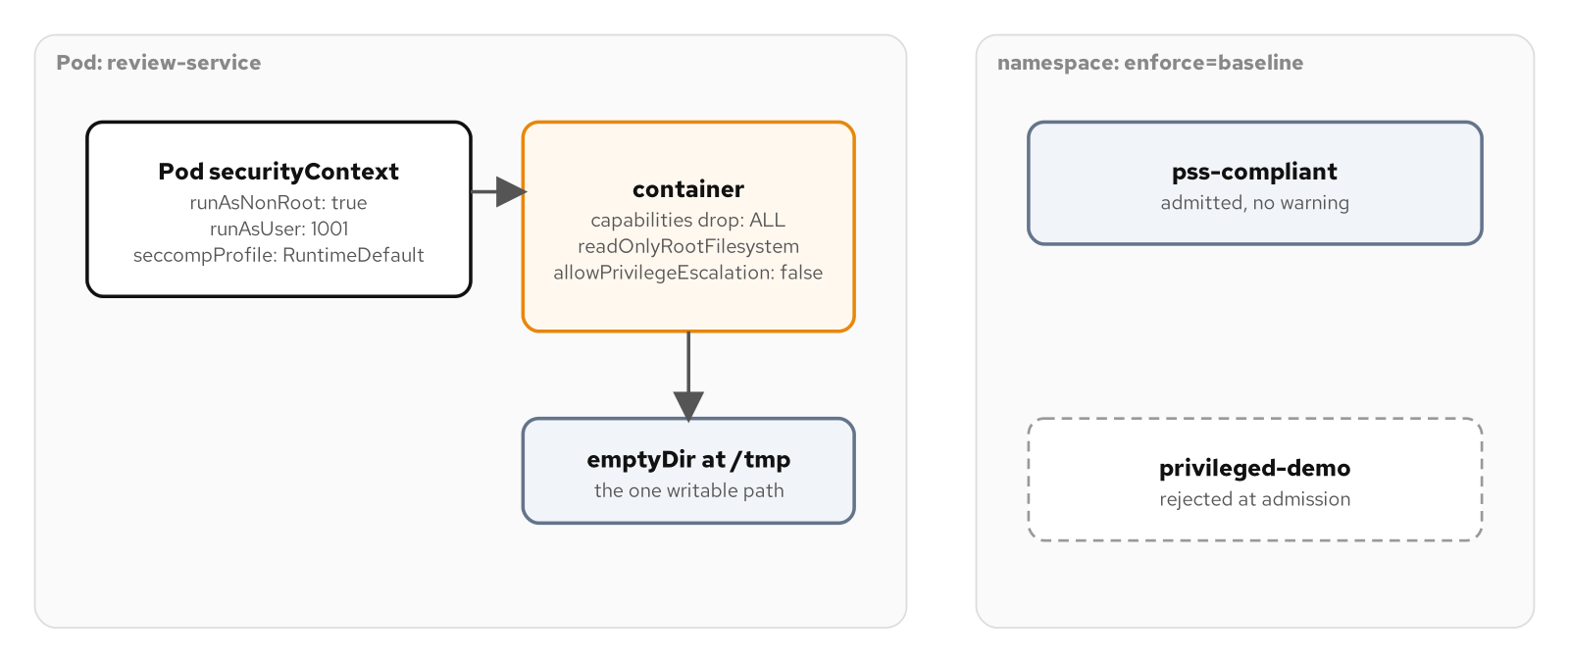
SECURITY · PROCESS CONTAINMENT
Hardened Pod, enforced floor
Figure: review-service runs with a non-root UID, dropped capabilities, and a read-only root filesystem; a Pod Security Standard rejects a privileged Pod outright.
133
Notes:
The figure pairs review-service's full securityContext against a disposable namespace enforcing the baseline Pod Security Standard, admitting a compliant Pod while rejecting a privileged one. What to show: the rejection happens at admission time, before the scheduler or kubelet ever sees the Pod, independent of a reviewer catching a dangerous manifest first. Fallback: the same figure is on the reference site with its editable source.

Slide 134
SECURITY · PROCESS CONTAINMENT
Run it and the exam
Run: deploy the hardened review-service, then check its UID, its effective capability mask, and attempt a write against the read-only root filesystem and against the /tmp mount.
Observe: /proc/1/status's CapEff reads all zeros once the drop takes effect at the kernel level; a privileged Pod applied against the baseline-labeled namespace is rejected before it is ever created.
CKAD domain: Application Environment, Configuration & Security (25%).
Drill: kubectl label namespace patterns-pss-demo pod-security.kubernetes.io/enforce=restricted --overwrite, then reapply the compliant Pod and confirm it is still admitted.
134
Notes:
PodSecurityPolicy was deprecated in Kubernetes 1.21 and removed in 1.25; Pod Security Admission, three fixed standards applied with plain namespace labels, replaced it on any currently supported cluster. enforce, audit, and warn can each name a different standard, a common pattern for hard-blocking the clearly dangerous settings namespace-wide while surfacing, without blocking, anything that falls short of the fully restricted bar. What to show: run the drill live and watch the compliant Pod stay admitted under the stricter label. Fallback: the example's README has the full exec sequence for the UID, capability, and filesystem checks.

Slide 135
SECURITY · SECURE CONFIGURATION
Secure Configuration
A Secret and a ConfigMap share the same API shape and the same data field. A schema name leaking into a log line is an inconvenience; a Postgres password leaking the same way is an incident.
base64 is a reversible encoding, not encryption. Decoding it is a one-line command available to anyone with `get` on the object, not a specialized attack.
A Secret's actual protection comes from RBAC, who can get it by name, and etcd encryption-at-rest, a cluster-level setting this appendix's minikube profile doesn't enable.
A credential read from a mounted file at 0400 is harder to exfiltrate by accident than one in an env var: no inheritance into child processes, no /proc/<pid>/environ exposure.
135
Notes:
inventory-service's Postgres credentials live in their own inventory-db-credentials Secret rather than the shared credential this appendix's other examples use, so revoking or rotating one service's credential never touches another. kubectl describe secret redacts values as a convenience in one tool; kubectl get -o yaml and anything with get on the object see the full decodable value. What to show: decode the password live with base64 -d to make the point concrete rather than asserted. Fallback: the example also consumes the same Secret two ways, an env var and a 0400 mounted file, to compare the two exposure surfaces directly.

Slide 136
SECURITY · SECURE CONFIGURATION
stringData in, base64 out
yaml · secret
apiVersion: v1
kind: Secret
metadata:
name: inventory-db-credentials
stringData: # plain text in, base64 stored
username: capstone_app
password: changeme
dbname: capstone_db
kubectl get -o yaml still shows the same base64 value anyone with get on the object can decode in one line.
136
Notes:
stringData takes plain text at creation time and lets the API server do the base64 encoding, so the manifest reads password: changeme directly instead of a pre-encoded string nobody can review by eye; both end up in the same place at rest. A Secret's real type matters too: kubernetes.io/basic-auth, kubernetes.io/tls, and kubernetes.io/dockerconfigjson each validate a required shape, where Opaque validates nothing. What to show: kubectl get secret ... -o jsonpath='{.data.password}' | base64 -d returns changeme instantly, which is the whole point to make live. Fallback: immutable: true on a Secret stops anyone from silently swapping a password every Pod referencing it is relying on.

Slide 137
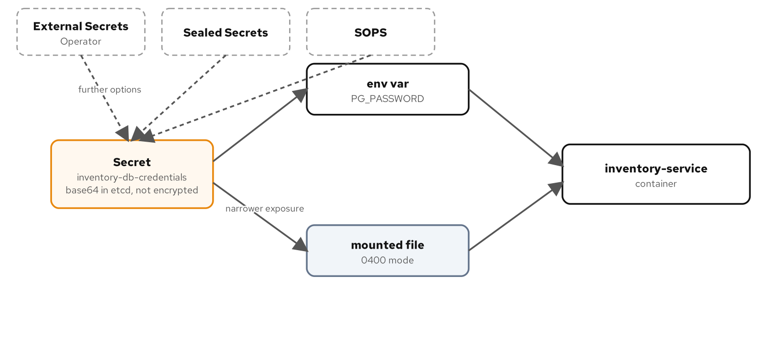
SECURITY · SECURE CONFIGURATION
One Secret, two paths
Figure: inventory-service reads the same Secret as an env var and as a 0400-mode file; neither path changes what the Secret looks like at rest.
137
Notes:
The figure traces both consumption paths from one Secret into inventory-service, with the Secret's own object flagged as base64, not encrypted, in etcd. What to show: the file path's permission bits are a restriction an env var has no equivalent for; point to that directly on the figure. Fallback: the same figure is on the reference site with its editable source.

Slide 138
SECURITY · SECURE CONFIGURATION
Run it and the exam
Run: create inventory-db-credentials with stringData, decode the password back with base64 -d, then confirm the deployment reads it both as an env var and from the 0400 mounted file.
Observe: kubectl describe secret redacts values as a terminal convenience; kubectl get -o yaml or jsonpath shows the full decodable value to anyone with get on the object.
CKAD domain: Application Environment, Configuration & Security (25%).
Drill: kubectl get secret inventory-db-credentials -n patterns -o jsonpath='{.data.username}' | base64 -d (confirms the value is a one-line decode away, not encrypted).
138
Notes:
The two places a credential leaks in practice are the image, an ARG or ENV baking it into a layer that persists after rotation, and the logs, a connection string or stack trace with the password embedded; inventory-service's multi-stage build never gives a credential a build argument to leak through. External Secrets Operator, Sealed Secrets, and SOPS each answer where encryption happens for a credential that needs to live outside the cluster or be safe to commit to Git, worth knowing even though this example installs none of them. What to show: run the drill live and watch the plain password fall out of a one-line pipe. Fallback: the example's README has the full env-vs-file comparison from inside the running container.

Slide 139
07
CKAD Gap Chapters
The exam topics the patterns don't already cover.
Notes:
These three chapters round out the exam material ahead of the appendix's governance and access-control content: a deck built on the patterns the manifests already encode doesn't automatically cover troubleshooting a pod that misbehaves at runtime, choosing between Helm and Kustomize, or capping what a namespace as a whole can consume. CKAD tests all three directly, and together they account for a meaningful share of exam weight that sits outside the patterns themselves. What to show: these are the gaps a candidate who only studied the patterns would walk into the exam without covering. Fallback: each chapter's runnable example stands alone, so under time pressure, pick one chapter to run live rather than skimming all three.

Slide 140
CKAD GAP · OBSERVABILITY AND DEBUGGING
Observability and Debugging
A correctly built pattern still misbehaves in production: a probe that passes locally and fails on the cluster, a process that logs one stack trace and goes quiet. Observability is the separate skill of diagnosing that, not building it.
Almost every Kubernetes debugging problem reduces to five questions: what did a container print, what does its filesystem and process table look like right now, can you reach its port directly, what did the control plane decide and when, and how do you get a tool into a pod without rebuilding it.
kubectl logs, exec, port-forward, describe/get events, and kubectl debug answer those five questions in that order.
CKAD weights Application Observability and Maintenance at 15% of the exam, on its own, separate from the patterns that build the workload in the first place.
140
Notes:
shipping-service gains a trivial second container named heartbeat in this chapter, solely so kubectl logs -c and kubectl exec -c have a real second container to choose between. The five tools map one-to-one onto the five debugging questions a candidate actually faces: print, inspect, reach, reconstruct, and tool up. What to show: none of the five requires changing the pod's own image, which is the point of the whole chapter. Fallback: walk the five questions out loud even without running a single command, since the mapping itself is the exam-relevant structure.

Slide 141
CKAD GAP · OBSERVABILITY AND DEBUGGING
Logs: plain, by container, after a crash
bash
# plain stream: stdout/stderr since container start
kubectl logs -n patterns $POD -c shipping-service
# -c is required once a pod has more than one container
kubectl logs -n patterns $POD -c heartbeat
# -f follows; --since caps how far back it backfills first
kubectl logs -n patterns $POD -c heartbeat -f --since=20s
# -p reads the instance that just died, not the current one
kubectl exec -n patterns $POD -c shipping-service -- kill 1
kubectl logs -n patterns $POD -c shipping-service --previous
The -c flag becomes mandatory the moment a pod has two containers; -p only ever has the one instance before the current.
141
Notes:
Kubernetes never reads a container's log files, only the stdout/stderr stream the container runtime captures, which is why killing PID 1 and waiting for a restart is the fastest way to generate a --previous example live. The kubelet keeps exactly one previous instance's logs, not a history, so a second restart loses the first crash's output for good. What to show: kubectl get pod's RESTARTS column climbing to 1 right before the --previous read. Fallback: --since on a -f stream avoids dumping an hours-old buffer before it starts following, a useful note even without running it.

Slide 142
CKAD GAP · OBSERVABILITY AND DEBUGGING
exec, port-forward, and an ephemeral probe
bash
kubectl exec -n patterns $POD -c shipping-service -- \
env | grep SERVICE_SCHEMA
kubectl port-forward -n patterns $POD 8080:8080 &
curl -s http://127.0.0.1:8080/healthz | jq .
kill %1
# ephemeral container: shares the pod's network namespace
kubectl debug -n patterns $POD -c probe-net \
--image=registry.access.redhat.com/ubi10/ubi:10.2 \
-- curl -s http://localhost:8080/health
exec only runs tools the image already shipped; kubectl debug attaches a throwaway container with its own.
142
Notes:
port-forward tunnels through the kubelet straight to one named pod, bypassing kube-proxy and any Service's virtual IP entirely, which is the only way to be certain which of three replicas you're actually talking to. shipping-service's runtime image carries no curl or ps by design, a smaller attack surface, so kubectl debug's ephemeral container is what closes that gap without rebuilding anything. What to show: --target additionally shares the named container's process namespace, which is what lets a debug probe see the real application's PIDs. Fallback: exec permission on a pod grants a lot more than read access, worth a one-line callout even if the access-control chapter covers it in full.

Slide 143
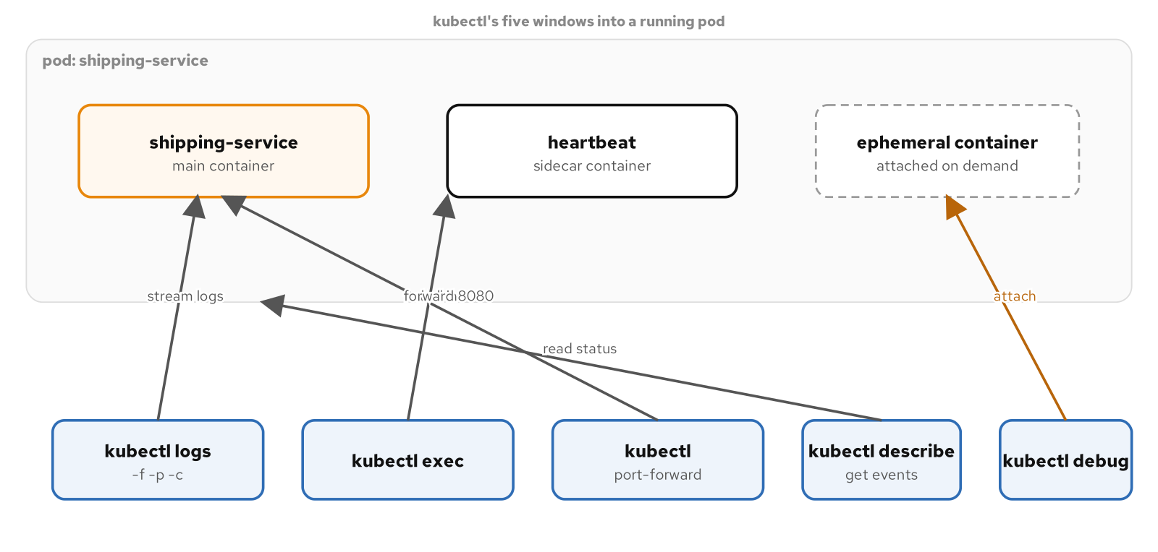
CKAD GAP · OBSERVABILITY AND DEBUGGING
Five windows into one pod
Figure: kubectl's five windows into a running pod: logs, exec, port-forward, describe/events, and an ephemeral container attached on demand.
143
Notes:
The figure lines up all five tools against the single running pod they all interrogate, with none of them touching the pod's own image. What to show: trace describe pod's Events section back to the same CreateContainerConfigError and Pending failures the earlier patterns chapters already produced, now read through a different lens. Fallback: the same figure and its editable source live on the reference site.

Slide 144
CKAD GAP · OBSERVABILITY AND DEBUGGING
Run it and the exam
Run: kill PID 1 inside shipping-service to force a restart, read the dead instance's logs with --previous, exec a one-off env check, port-forward straight to the pod, then attach both debug probes (shared network, shared process namespace).
Observe: a RESTARTS count above zero in kubectl get pod is the signal to reach for --previous; kubectl describe pod's Events section says what failed in plain text instead of a generic failed-state name.
CKAD domain: Application Observability and Maintenance (15%).
Drill: kubectl exec -n patterns "$POD" -c shipping-service -- kill 1 && kubectl logs -n patterns "$POD" -c shipping-service --previous
144
Notes:
An ephemeral container can't be removed individually: once attached, it stays listed in the pod's ephemeralContainerStatuses for the rest of that pod's life, which is why the chapter's two debug probes use distinct container names. What to show: run the drill live against a pod that hasn't restarted yet, so the RESTARTS column visibly moves from 0 to 1. Fallback: the full sequence, including the heartbeat sidecar setup, is in the example's README.

Slide 145
CKAD GAP · HELM AND KUSTOMIZE
Helm and Kustomize
Helm treats a set of manifests as a template: values.yaml supplies inputs, Go template syntax computes the output, and helm install tracks the result as a numbered release you can upgrade and roll back as a unit.
Kustomize treats a set of manifests as data: a base of ordinary YAML plus a chain of overlays that patch specific fields, with no templating language and no release object at all.
CKAD's Application Deployment domain, 20% of the exam, expects comfort with both, because real clusters run both at once for different reasons on the same team.
The exam tests the command surface a chart consumer uses day to day, not chart authoring: install, upgrade, rollback, history, and --set.
145
Notes:
A chart distributed to other teams is a Helm problem; a service your own team owns, deployed with small per-environment differences, is very often a Kustomize problem, and this chapter works the same shipping-service Deployment through both so the contrast is concrete. kubectl has shipped Kustomize built in since 1.14, so no separate binary is required for any of it. What to show: Helm earns its templating language exactly where Kustomize gives it up, a bounded set of fields that vary by environment versus a chart meant to hide structure from a consumer who shouldn't need to know it. Fallback: the main tutorial already covers chart authoring in full; this chapter assumes that and focuses on the consumer-facing commands.

Slide 146
CKAD GAP · HELM AND KUSTOMIZE
The Helm command surface
bash
helm install shipping-helm ./chart --namespace patterns
helm list -n patterns
helm upgrade shipping-helm ./chart -n patterns \
--set replicaCount=2
helm history shipping-helm -n patterns
helm rollback shipping-helm 1 -n patterns
helm history tracks every revision the release touches as a unit; rollback reverts to a release revision, not a Deployment revision.
146
Notes:
A changed value moves the release to revision 2, and because the chart's Deployment template carries a checksum/configmap annotation, Pods roll even when nothing in the Deployment template itself literally changed. helm history is the exam-relevant command for what changed and when, independent of whatever kubectl rollout history would show for the Deployment alone. What to show: helm template and helm lint both catch a malformed chart before it reaches the API server, worth running before any upgrade that changes something non-trivial. Fallback: helm uninstall closes the loop if time allows for the full lifecycle.

Slide 147
CKAD GAP · HELM AND KUSTOMIZE
Base, overlay, patch
yaml · kustomize
# base/kustomization.yaml: lists manifests, no templates
resources:
- deployment.yaml
# overlay/kustomization.yaml: patches the base by name
resources:
- ../../base
patches:
- path: deployment-patch.yaml
# deployment-patch.yaml: a strategic merge patch
spec:
replicas: 2
A patch names only what changes; Kubernetes merges container list entries by name, not by array index.
147
Notes:
The base is a complete, valid Deployment you could kubectl apply -f directly; the namespace field in each kustomization.yaml is a transformer, stamping every listed resource at build time instead of repeating it in every manifest. Each overlay's patch is matched by apiVersion, kind, and metadata.name, so it only has to say what changes, not repeat every sibling field on the object. What to show: kubectl diff -k matters more for Kustomize than for Helm, since there's no release object recording what the previous apply looked like. Fallback: configMapGenerator and JSON 6902 patches are fair game on the exam even though this chapter's two overlays only need a strategic merge patch.

Slide 148
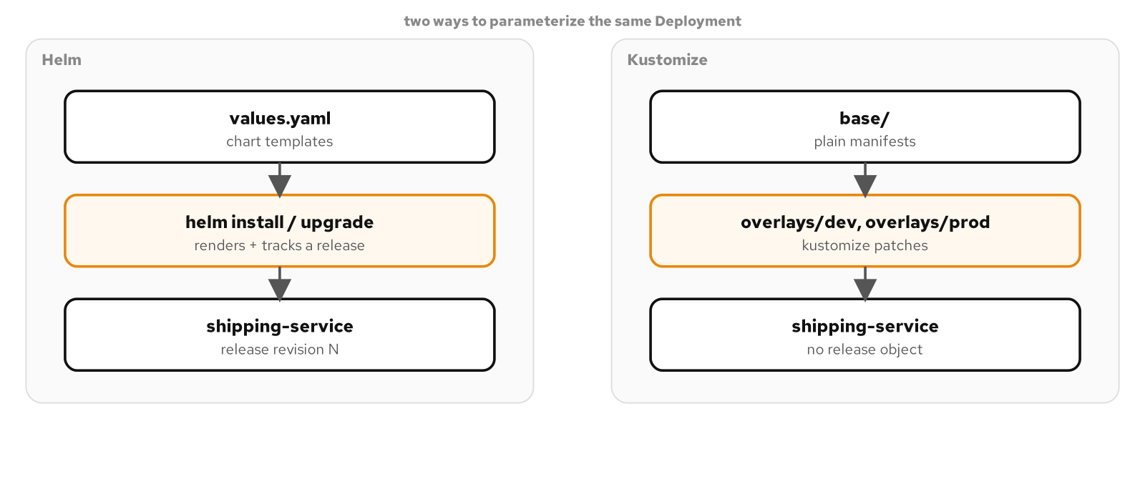
CKAD GAP · HELM AND KUSTOMIZE
Two paths to the same Deployment
Figure: two ways to parameterize the same Deployment: a Helm chart rendering values into a tracked release, and a Kustomize base patched by dev and prod overlays with no release object at all.
148
Notes:
The figure places both mechanisms side by side against the identical shipping-service image and namespace, neither aware the other exists. What to show: Helm's release object is the thing Kustomize has none of by design, which is also why kubectl diff -k matters more on that side. Fallback: the same figure and its editable source live on the reference site.

Slide 149
CKAD GAP · HELM AND KUSTOMIZE
Run it and the exam
Run: install the Helm chart, upgrade it with --set, roll back to revision 1, then apply the Kustomize dev overlay, diff against prod, and switch deployments.
Observe: helm history lists every revision across every object the release manages; kubectl diff -k shows exactly what an apply would change, since Kustomize keeps no release object of its own to compare against.
CKAD domain: Application Deployment (20%).
Drill: kubectl kustomize kustomize/overlays/prod | kubectl apply -n patterns -f -
149
Notes:
Applying a rendered overlay with plain -f instead of -k is exactly the pattern a CI pipeline that pins a rendered manifest would use, so the drill doubles as a real-world shortcut worth knowing beyond the exam. What to show: run both the Helm rollback and the Kustomize dev-to-prod switch back to back, since the exam distinguishes a release revision from a Deployment revision. Fallback: the example's README has the full install-upgrade-rollback-then-overlay sequence with cleanup.

Slide 150
CKAD GAP · NAMESPACE GOVERNANCE
Namespace Governance
ResourceQuota caps what a namespace can consume in total; LimitRange bounds and defaults what any single container inside it can ask for. Neither lives at the level of one Pod's own manifest.
Nothing stops every team sharing a cluster from each declaring individually reasonable requests that together exceed what the cluster actually has, or one manifest from omitting resource declarations and quietly consuming whatever's left.
Application Environment, Configuration and Security is CKAD's largest single domain at 25%, and this is where ResourceQuota and LimitRange sit.
LimitRange is mutating admission, ResourceQuota is validating, and Kubernetes always runs mutating ahead of validating for the same request, which is why a limits.cpu quota is compatible with a container that sets no CPU limit of its own.
150
Notes:
The example reuses shipping-service's own requests and limits and the patterns-high-priority PriorityClass from Predictable Demands, specifically so the same numbers get admitted or rejected now against rules nobody wrote directly into the Deployment. What to show: this is a cluster-operator problem layered on top of a workload-author problem, not a replacement for it. Fallback: if time is tight, the ResourceQuota pod-count rejection is the single most exam-relevant demo in the chapter.

Slide 151
CKAD GAP · NAMESPACE GOVERNANCE
ResourceQuota caps the total
yaml · resourcequota
apiVersion: v1
kind: ResourceQuota
metadata: { name: patterns-quota, namespace: patterns }
spec:
hard:
pods: "3"
requests.cpu: "1"
limits.cpu: "2"
limits.memory: "2Gi"
pods counts every pod regardless of its own numbers; a rejected third replica never creates a Pod object at all.
151
Notes:
A tight pods: "3" is the failure mode that actually bites in the worked example, simpler than a resource-total breach, a choice suited to a first exam scenario. A quota violation on a Deployment's third replica shows up as a FailedCreate event on the ReplicaSet, not on any pod, because the ReplicaSet controller's attempt to create one is rejected outright and no pod object ever exists to attach an event to. What to show: kubectl describe resourcequota reads Used against Hard for every tracked dimension, the only trail left when there's no pod to describe. Fallback: kubectl get events --field-selector reason=FailedCreate isolates the rejection from the rest of the namespace's event stream.

Slide 152
CKAD GAP · NAMESPACE GOVERNANCE
LimitRange defaults and bounds
yaml · limitrange
apiVersion: v1
kind: LimitRange
spec:
limits:
- type: Container
defaultRequest: { cpu: 50m, memory: 128Mi }
default: { cpu: 200m, memory: 256Mi }
max: { cpu: 500m, memory: 512Mi }
default.cpu supplies the limit shipping-service omits, stamped in before ResourceQuota ever counts it.
152
Notes:
defaultRequest and default are the mutating half, stamping missing values into a container's resources block at admission time before the object is ever stored; min and max are the validating half, rejecting a value outside the band regardless of whether it arrived as an author's choice or a LimitRange default. A pod over max is rejected synchronously as part of the kubectl apply call itself, with no controller retry loop and no object left behind, the same way a quota rejection creates nothing. What to show: a pod applied with no resources block at all comes back from the API server with a full resources section already populated. Fallback: the admission order, mutating before validating, matters even without demoing it live, since it's the detail the drill is built to test.

Slide 153
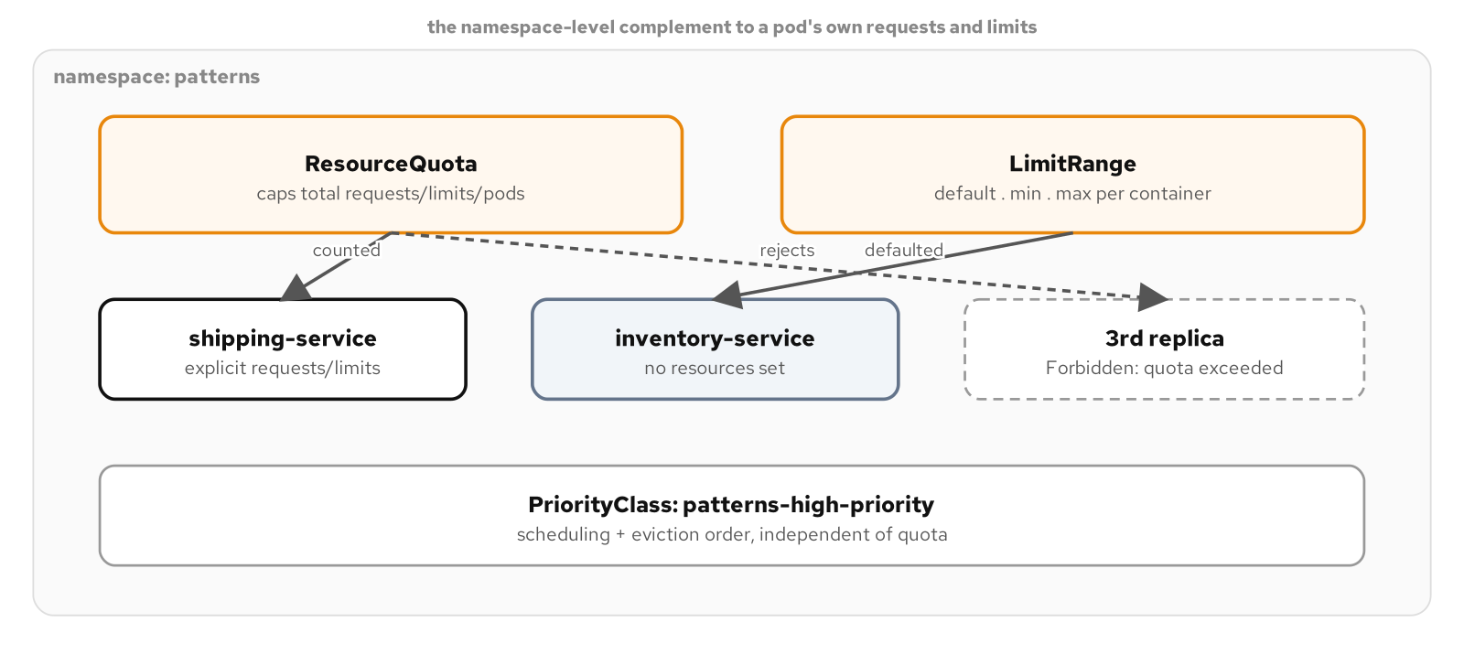
CKAD GAP · NAMESPACE GOVERNANCE
Quota, range, and priority together
Figure: a namespace with a ResourceQuota capping totals and a LimitRange defaulting and bounding each container, alongside the PriorityClass that governs scheduling and eviction order underneath both.
153
Notes:
The figure stacks all three mechanisms against the same namespace: ResourceQuota counting and capping, LimitRange defaulting and bounding each container, PriorityClass deciding who wins when either one runs out of room. What to show: quota and limits both only ever answer yes or no to a new pod; priority is the only one of the three that answers which existing pod should go. Fallback: a ResourceQuota's scopeSelector field, which ties a quota to a specific PriorityClass, is real and exam-fair even though the runnable example leaves it unbuilt.

Slide 154
CKAD GAP · NAMESPACE GOVERNANCE
Run it and the exam
Run: apply the quota and limit range before any workload, scale shipping-service to a third replica and watch it rejected, then apply one pod with no resources and one over the LimitRange's max.
Observe: the quota rejection is a FailedCreate event on the ReplicaSet, not the pod, since no Pod object is ever created; kubectl describe resourcequota reads Used against Hard for every tracked dimension.
CKAD domain: Application Environment, Configuration and Security (25%).
Drill: kubectl describe resourcequota patterns-quota -n patterns (read Used against Hard for every tracked dimension, then predict whether the next kubectl apply in this chapter succeeds before running it)
154
Notes:
The pod-count quota is exactly full by design once Postgres and two shipping-service replicas are running, so the third-replica rejection and the PriorityClass recap both land on the same exact-capacity scenario. What to show: run the over-max pod apply right after the no-resources pod, since the contrast between a stamped-in default and an outright rejection is the clearest two minutes in the chapter. Fallback: the full apply order and cleanup sequence are in the example's README.

Slide 155
08
CKAD Crosswalk
Every pattern mapped to the five exam domains.
Notes:
This closing section is pure reference: no new manifests, no runnable example of its own. It maps every chapter in the appendix back to the CKAD domain and competency it reconciles against, then turns the whole set into a timed self-test. What to show: the appendix doesn't weight its chapters evenly across domains; name the imbalance up front, Environment, Configuration and Security pulls far more chapters than Services and Networking, before the domain table appears. Fallback: if time is short, the five-domain figure and the self-test slide carry the section on their own.

Slide 156
CKAD CROSSWALK · OVERVIEW
Using the crosswalk
This chapter ships no new manifests. It maps every pattern chapter in the appendix back to the exam domain and competency it tests, so the set doubles as a revision tool once you've read the patterns themselves.
A few patterns lean toward CKA's cluster-operations scope rather than CKAD's application-developer territory: scheduling, DaemonSets, PodDisruptionBudgets, and autoscaling. Their rows say so.
Custom controllers and operators, by contrast, sit squarely inside CKAD's own competency for discovering and using resources that extend Kubernetes.
The self-test at the end turns the appendix into fifteen timed tasks against the shipping services, each naming the chapter that teaches the skill it checks.
156
Notes:
This chapter is reference only: it reuses a prior chapter's deployment for every self-test task rather than shipping a new example. What to show: the opening names four patterns that lean toward CKA instead of CKAD; call that out before the domain table so the later rows aren't a surprise. Fallback: skip straight to the self-test section and walk through its first task live against a running mof-patterns profile.

Slide 157
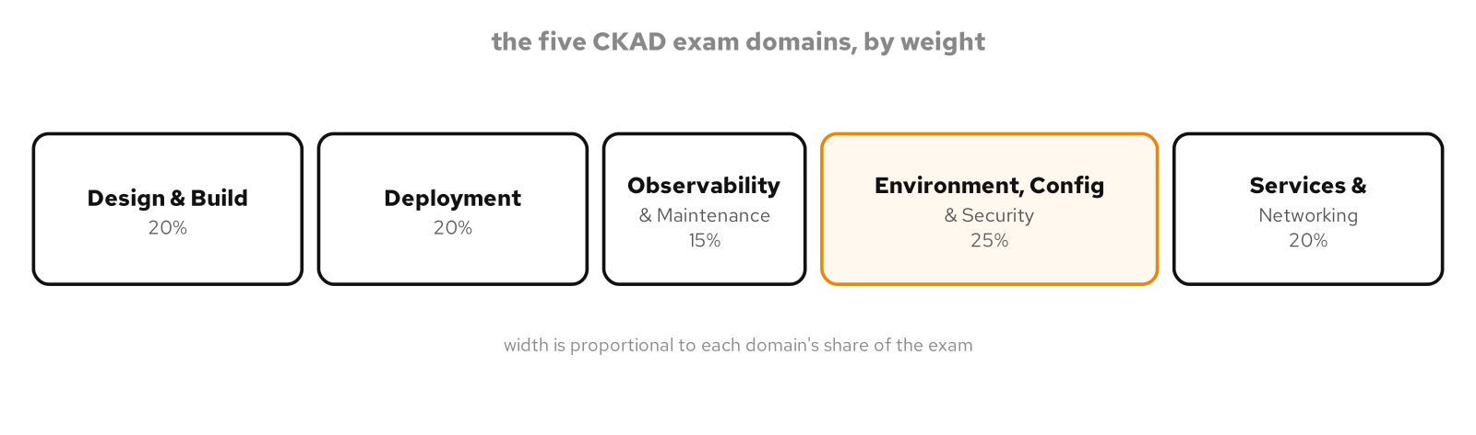
CKAD CROSSWALK · EXAM WEIGHTS
The five domains
Figure: the five CKAD exam domains sized by their share of the exam, from Observability and Maintenance at 15% up to Environment, Configuration and Security at 25%.
157
Notes:
The figure sizes each of the five CKAD domains by its official exam weight. Environment, Configuration and Security carries the single largest share at 25%, and the largest cluster of chapters in this appendix too. What to show: compare the five bars against the chapter counts in the tables that follow; the two track closely but not exactly. Fallback: the same figure is on the reference site with its editable source if the PNG doesn't render.

Slide 158
CKAD CROSSWALK · DOMAINS
Domains by weight
20% | Application Design and Build | Multi-container Pod design (init containers, sidecars, adapters, ambassadors), scheduling, and most of the Behavioral family.
20% | Application Deployment | Rolling and non-rolling update strategies, PodDisruptionBudgets, autoscaling, and Helm/Kustomize packaging.
15% | Application Observability and Maintenance | Liveness, readiness, and startup probes, a metrics-adapter sidecar, and kubectl's own debugging toolchain.
25% | Application Environment, Configuration and Security | Resource requests and limits, every Configuration-family pattern, RBAC, SecurityContext, Secrets, and namespace governance.
20% | Services and Networking | Service types, DNS resolution, Ingress routing, and NetworkPolicy-based segmentation.
158
Notes:
This table lists the five CKAD domains in the order the official curriculum publishes them, each row naming the chapter families that cover it. Environment, Configuration and Security draws from the Foundational, Configuration, Advanced, and Security families at once, which is why it is the appendix's busiest domain. What to show: Services and Networking carries a full 20% weight yet rests on the fewest dedicated chapters, Service Discovery and Network Segmentation account for most of it. Fallback: the appendix's own coverage-by-domain table has the exact chapter counts.

Slide 159
CKAD CROSSWALK · PATTERN MAP
Foundational and structural
Predictable Demands | Foundational | Environment, Configuration & Security (25%): resource requests/limits and ConfigMap/PVC hard requirements.
Declarative Deployment | Foundational | Application Deployment (20%): rolling and non-rolling update strategies, kubectl rollout.
Health Probe | Foundational | Observability & Maintenance (15%): liveness, readiness, and startup probes.
Managed Lifecycle | Foundational | Application Design & Build (20%): multi-container Pod design and lifecycle hooks.
Automated Placement | Foundational | Application Design & Build (20%), leans CKA: scheduler, node affinity, taints and tolerations.
Init Container | Structural | Application Design & Build (20%): an init container that completes before the main container starts.
Sidecar | Structural | Application Design & Build (20%): a sidecar's startup and shutdown ordering.
Adapter | Structural | Observability & Maintenance (15%): a sidecar re-emitting metrics in a standard format.
Ambassador | Structural | Application Design & Build (20%): a proxy sidecar brokering an outbound connection.
159
Notes:
The first nine patterns, Foundational and Structural, in reading order. Most land in Application Design and Build or Environment, Configuration and Security. What to show: Health Probe and Adapter are the odd ones out, both in Observability and Maintenance. Fallback: the full table with working links to every chapter is on the site version of this chapter.

Slide 160
CKAD CROSSWALK · PATTERN MAP
Behavioral
Batch Job | Behavioral | Application Design & Build (20%): a Job partitioning work across parallel Pods by completion index.
Periodic Job | Behavioral | Application Design & Build (20%): a CronJob scheduling successive Jobs, with a concurrency policy.
Daemon Service | Behavioral | Application Design & Build (20%), leans CKA: a DaemonSet running one Pod per node.
Singleton Service | Behavioral | Application Deployment (20%), leans CKA: a PodDisruptionBudget protecting a single replica.
Stateless Service | Behavioral | Application Design & Build (20%): interchangeable replicas behind one Service.
Stateful Service | Behavioral | Application Design & Build (20%), storage: a StatefulSet's stable identity and per-Pod volumes.
Service Discovery | Behavioral | Services & Networking (20%): Service types, DNS, and Ingress routing.
Self Awareness | Behavioral | Environment, Configuration & Security (25%): the Downward API feeding Pod metadata into a container.
160
Notes:
The eight Behavioral patterns, the appendix's largest family. Most sit in Application Design and Build, with Service Discovery carrying the Services and Networking weight and Self Awareness the configuration weight. What to show: Daemon Service and Singleton Service both lean toward CKA, as their rows note. Fallback: the coverage-by-domain table gives the exact counts.

Slide 161
CKAD CROSSWALK · PATTERN MAP
Configuration and advanced
Env Var Configuration | Configuration | Environment, Configuration & Security (25%): literals, ConfigMap keys, Secret keys, and resolution timing.
Configuration Resource | Configuration | Environment, Configuration & Security (25%): envFrom bulk exposure versus a volume mount, and live updates.
Configuration Template | Configuration | Environment, Configuration & Security (25%): an init container rendering config from a template.
Immutable Configuration | Configuration | Environment, Configuration & Security (25%): an immutable ConfigMap and rolling a config change.
Controller | Advanced | Environment, Configuration & Security (25%): a custom controller's watch-and-reconcile loop (CRDs).
Elastic Scale | Advanced | Application Deployment (20%), leans CKA: HPA, VPA, and KEDA scale-to-zero.
Image Builder | Advanced | Application Design & Build (20%): building and referencing an image produced in-cluster.
Operator | Advanced | Environment, Configuration & Security (25%): a CRD-based operator packaging operational knowledge.
161
Notes:
The four Configuration patterns and the four Advanced patterns. Environment, Configuration and Security dominates this slice, with six of eight rows. What to show: Controller and Operator are CKAD's own extend-Kubernetes competency, not a CKA lean, unlike Elastic Scale. Fallback: the coverage-by-domain table has the precise numbers.

Slide 162
CKAD CROSSWALK · PATTERN MAP
Security and the gap chapters
Access Control | Security | Environment, Configuration & Security (25%): ServiceAccount, Role, and RoleBinding scoped to named resources.
Network Segmentation | Security | Services & Networking (20%): default-deny NetworkPolicy and a single narrow allow rule (needs Calico).
Process Containment | Security | Environment, Configuration & Security (25%): SecurityContext and Pod Security Standards.
Secure Configuration | Security | Environment, Configuration & Security (25%): Secrets as env vars and files, and what etcd actually stores.
Observability and Debugging | CKAD gaps | Observability & Maintenance (15%): logs, exec, port-forward, describe, and debug ephemeral containers.
Packaging: Helm and Kustomize | CKAD gaps | Application Deployment (20%): Helm install/upgrade/rollback and Kustomize bases and overlays.
Namespace Governance | CKAD gaps | Environment, Configuration & Security (25%): ResourceQuota and LimitRange over a namespace.
162
Notes:
The four Security patterns and the three CKAD-gap chapters that close the appendix. Network Segmentation is the second pattern carrying Services and Networking directly, and it is the one pattern with a CNI prerequisite. What to show: the gap chapters exist precisely to cover exam topics the pattern catalog leaves out, Helm and Kustomize most of all. Fallback: every row links to its chapter on the site.

Slide 163
CKAD CROSSWALK · REVISION
A timed self-test
Fifteen tasks run against the shipping services in the `patterns` namespace, each naming the chapter that teaches the skill it checks.
Five minutes per task matches CKAD's own pacing. Attempt each one cold against a live `mof-patterns` profile before reading the answer chapter.
Every domain gets at least one task, from setting a resource request with a single kubectl command to capping a namespace at three Pods before a fourth replica gets a Pod object.
An agent prompt at the end generates five more practice tasks, weighted toward whichever domain in the coverage table has the fewest chapters.
163
Notes:
The self-test is this chapter's own verification: there's no separate runnable example, because every task reuses a deployment from an earlier chapter. What to show: run the first task live, a single kubectl command that sets shipping-service's CPU request and memory limit with no YAML edit, since it makes the format concrete in under a minute. Fallback: read three or four tasks aloud and point out how each names its answer chapter; that's the revision mechanic even without a live cluster.

Slide 164
CLOSING
From reference to workshop
Every pattern here is runnable: the manifests, the build scripts, and the exact kubectl sequence ship in the project's examples directory.
The CKAD crosswalk turns the set into timed revision against the five exam domains.
The same content extends into a hands-on workshop: one cluster, one pattern per lab, building on the shipping services already deployed.
Chapters, runnable examples, and the editable diagrams live on the project's Pages site and GitHub repository.
164
Notes:
Close by pointing people at the runnable examples and the crosswalk. What to show: the examples directory layout, one folder per pattern, each with its own README and manifests. Fallback: if time is short, end on the crosswalk slide and leave the workshop framing for the follow-up.

