Slide 1


MODERNIZING ENTERPRISE APPLICATIONS (PYTHON) · 101
Django to FastAPI,
one seam at a time
The case for modernizing a Django monolith into async FastAPI services, and the strangler-fig method that gets there without a rewrite.
r1.0
Notes:
This is the 101 — the ideas deck. It makes the conceptual case for modernizing a Django monolith into FastAPI services and explains the strangler-fig method that drives the migration, without going into async implementation detail; the full pattern set is the 201, and the async/FastAPI code deep dive is the 201-FastAPI. STUB: expand this script in the content-authoring wave.

Slide 2
101 · THE IDEAS
The whole argument, in one sitting
TODO W2 — why modernize, and when to leave it alone
TODO W2 — the strangler fig — grow the new around the old
TODO W2 — finding the seams in the domain
TODO W2 — data, ownership, and coordination as ideas
TODO W2 — communication and contracts across the seam
TODO W2 — operating the result: mesh, observability, supply chain
TODO W2 — the modernization, made measurable
TODO W2 — where to stop — and where to go next
2
Notes:
STUB speaker notes. The agenda runs the three-act arc: Why & How, The Migration, Operating & Reflection. Expand with the full roadmap framing in the content-authoring wave.

Slide 3


A
Why, and How
The case for change, and the method that makes it safe.
Notes:
STUB divider. Opens the why-modernize argument and introduces the strangler-fig method as the thing that makes changing a live system safe. Expand with the full arc in the content-authoring wave.

Slide 4
WHY MODERNIZE · THE CASE
Modernize because change got expensive
TODO W2 — the monolith holds the business value; every change is coupled to everything else.
TODO W2 — the target is independent deployability, not a service count — lead with the advantage of shipping on an independent schedule.
4
Notes:
STUB speaker notes. This slide opens the why-modernize case; fill in during the content-authoring wave with the advantage-framed argument sourced from the authored chapters.

Slide 5
WHY MODERNIZE · RESTRAINT
And when not to modernize at all
TODO W2 — stable and low-value systems are cheapest left exactly as they are; encapsulate before you extract.
TODO W2 — modernization is a means, not a virtue — the test is whether a real change gets safer or cheaper.
5
Notes:
STUB speaker notes. This slide makes the restraint case; fill in during the content-authoring wave.

Slide 6
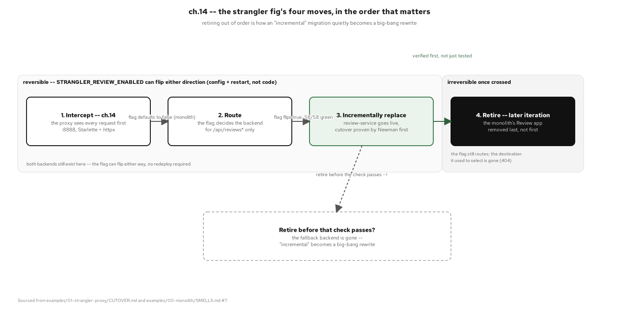
THE STRANGLER FIG · THE METHOD
Grow the new system around the old
TODO W2 caption — the four strangler moves, advantage-framed against a big-bang rewrite.
6
Notes:
STUB speaker notes. Introduces the strangler-fig method as the safe alternative to a rewrite; fill in during the content-authoring wave.

Slide 7
B
The Migration
Grow the new system around the old, one seam at a time.
Notes:
STUB divider. Walks the migration as a set of ideas: proxy routing, finding seams, owning data, and coordinating across services. Expand with the full condensed arc in the content-authoring wave.

Slide 8
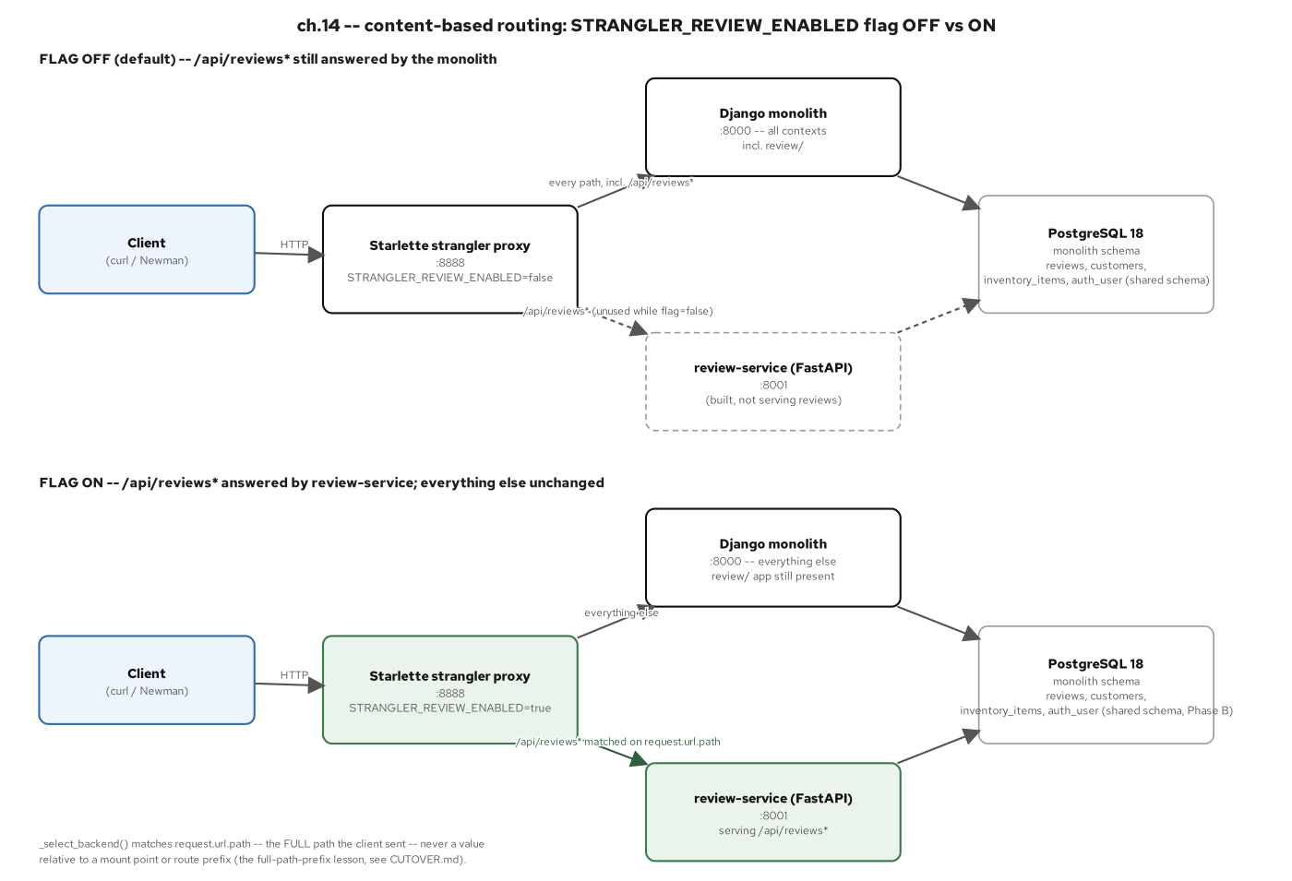
THE STRANGLER FIG · PROXY ROUTING
A proxy in front, one seam out at a time
TODO W2 caption — the edge proxy routes by flag; every cutover is reversible.
8
Notes:
STUB speaker notes. Explains the proxy-routing mechanics at altitude, no code; fill in during the content-authoring wave.

Slide 9
FINDING THE SEAMS
Seams are discovered, not invented
TODO W2 — event storming and DDD bounded contexts are how a seam is named before it is cut.
TODO W2 — the service count follows the domain — six real bounded contexts, not a target number.
9
Notes:
STUB speaker notes. Introduces domain-driven seam-finding; fill in during the content-authoring wave.

Slide 10
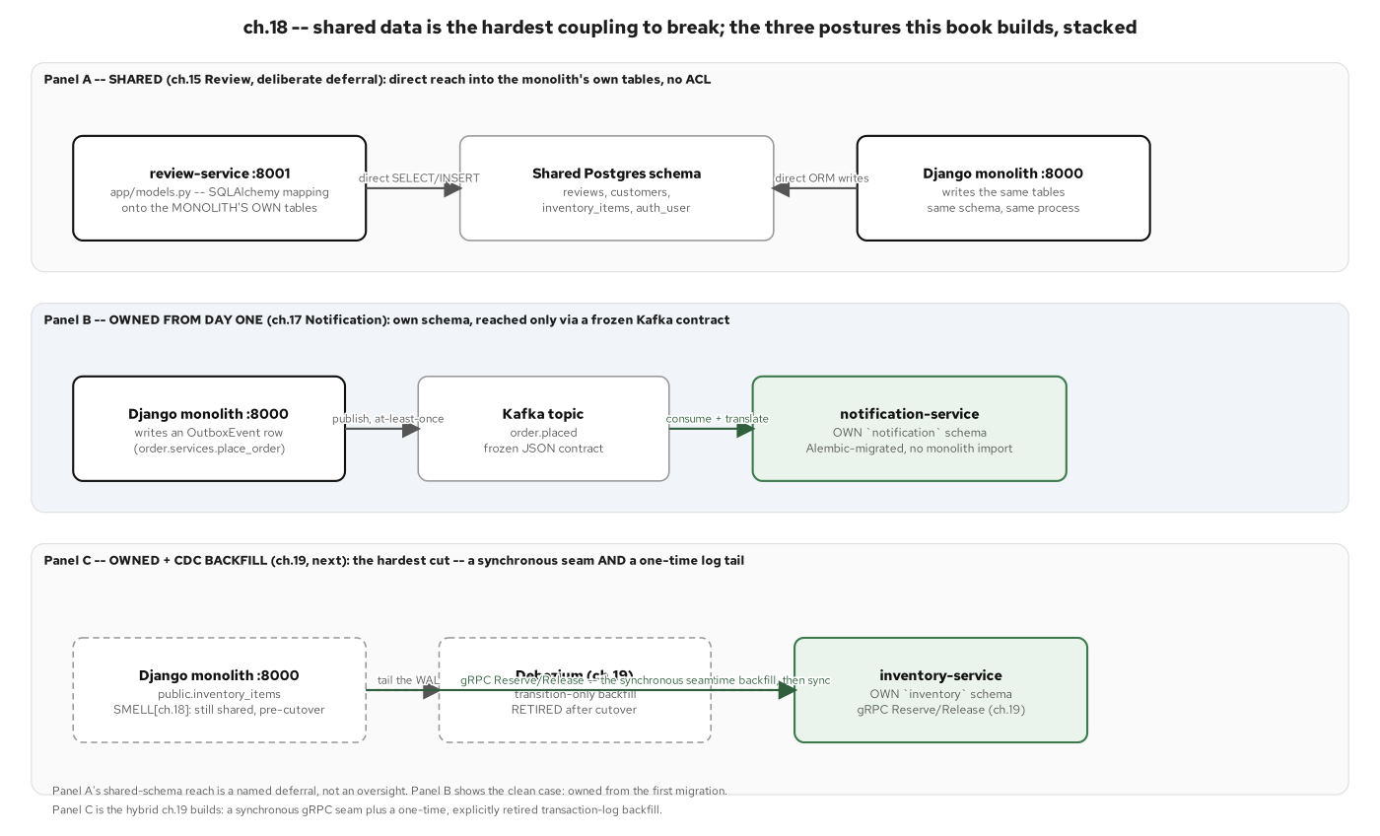
DATA ACROSS THE SEAM
Lead with owned data, not the shared schema
TODO W2 caption — lead-new-thing-left: each FastAPI service owns its Postgres schema versus the monolith's shared tables.
10
Notes:
STUB speaker notes. Introduces database-per-service as the hard part of decomposition; fill in during the content-authoring wave.

Slide 11
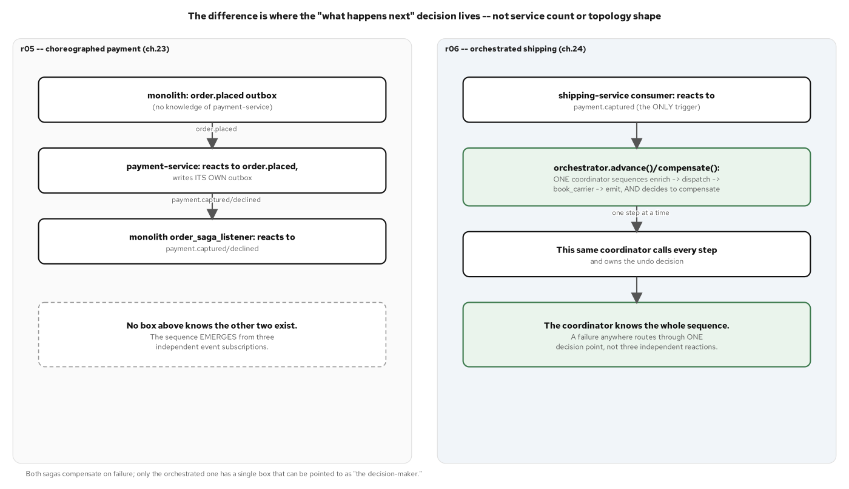
COORDINATING
Two ways to run a workflow across services
TODO W2 caption — choreography and orchestration, same checkout; compensation, not rollback.
11
Notes:
STUB speaker notes. Introduces the two coordination styles at altitude; fill in during the content-authoring wave.

Slide 12
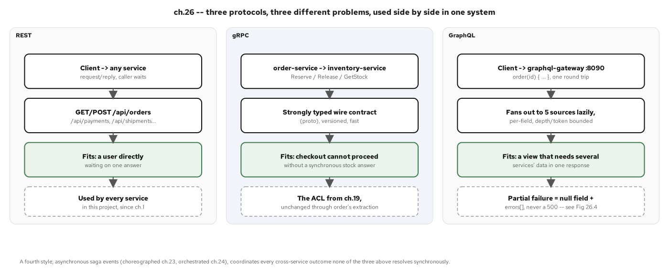
COMMUNICATION · PROTOCOL FIT
REST, gRPC, and GraphQL each earn their seam
TODO W2 caption — pick the protocol by the shape of the call, not by habit.
12
Notes:
STUB speaker notes. Introduces protocol fit across the service boundary; fill in during the content-authoring wave.

Slide 13
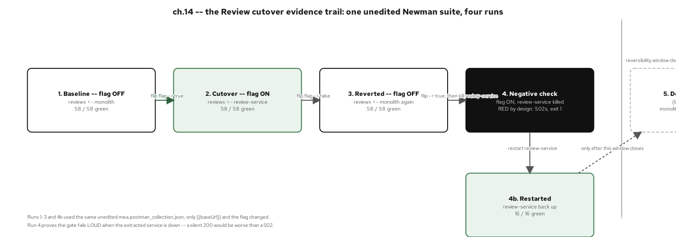
THE CUTOVER TIMELINE
Six seams, in dependency order
TODO W2 caption — each cutover stays behind the equivalence gate until the old module is retired.
13
Notes:
STUB speaker notes. Walks the cutover order and the reversibility guarantee; fill in during the content-authoring wave.

Slide 14
C
Operating & Reflection
Run the result, measure the win, and know when to stop.
Notes:
STUB divider. Covers the chassis, mesh, observability, the measurable supply-chain win, and the pattern-language retrospective. Expand with the full arc in the content-authoring wave.

Slide 15
THE CHASSIS AS CONVENTION
The chassis is a convention, not a framework
TODO W2 — config, health, logging, and OTel as a shared FastAPI convention across services, not a shared library to maintain.
TODO W2 — the platform answers the operational questions — identity, traffic, discovery — from Kubernetes and the mesh.
15
Notes:
STUB speaker notes. Introduces the chassis-as-convention idea; fill in during the content-authoring wave.

Slide 16
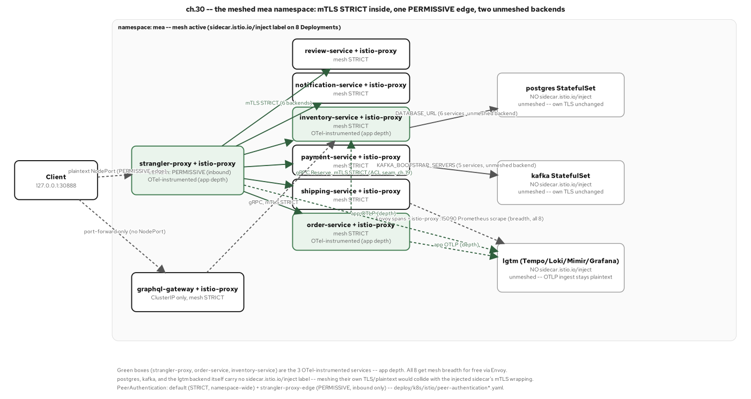
OPERATING · THE MESH
mTLS and traffic identity, once services own their data
TODO W2 caption — the mesh gives every service an identity and encrypted traffic without application code.
16
Notes:
STUB speaker notes. Introduces the service mesh as an operating-model idea; fill in during the content-authoring wave.

Slide 17
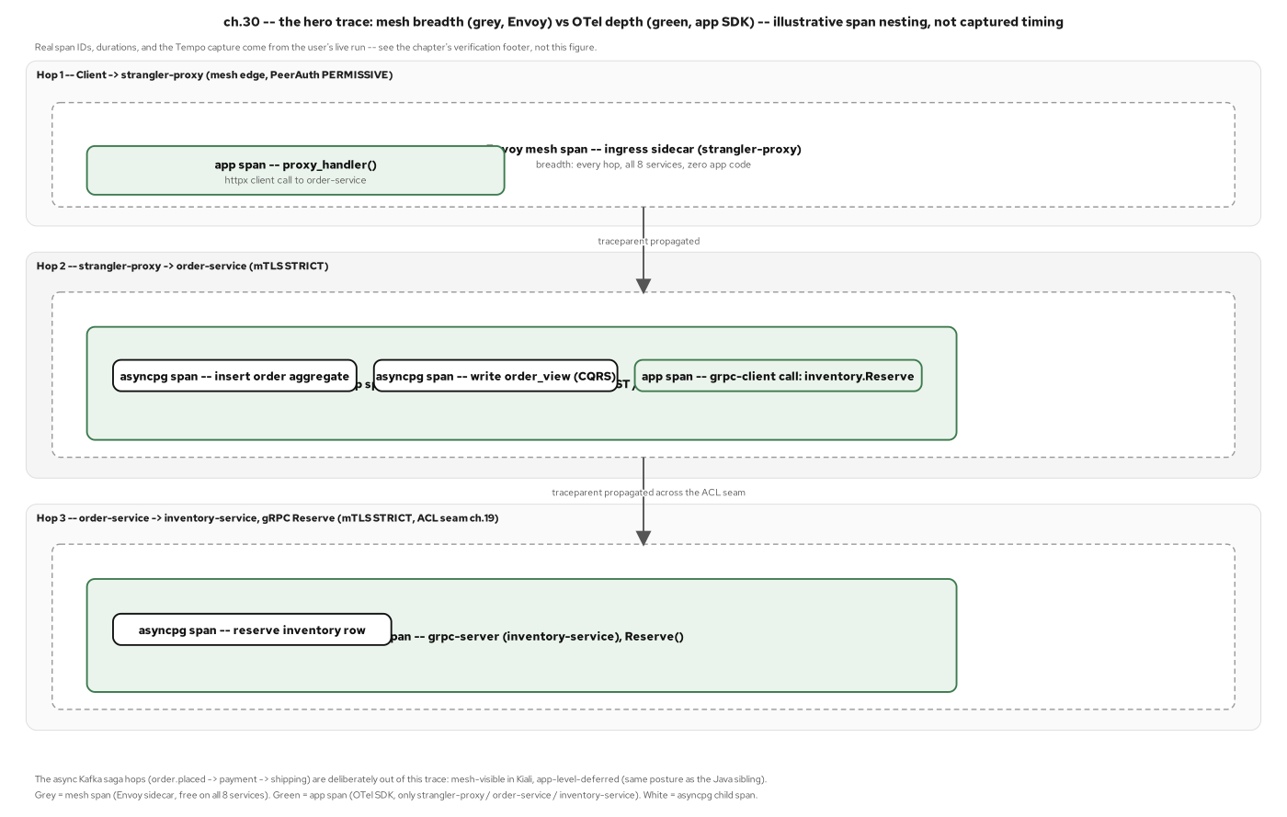
OPERATING · THE TRACE
One request, traced end to end
TODO W2 caption — the migration did not lose observability; it gained a trace across six services.
17
Notes:
STUB speaker notes. Shows the hero trace waterfall as proof of operability; fill in during the content-authoring wave.

Slide 18
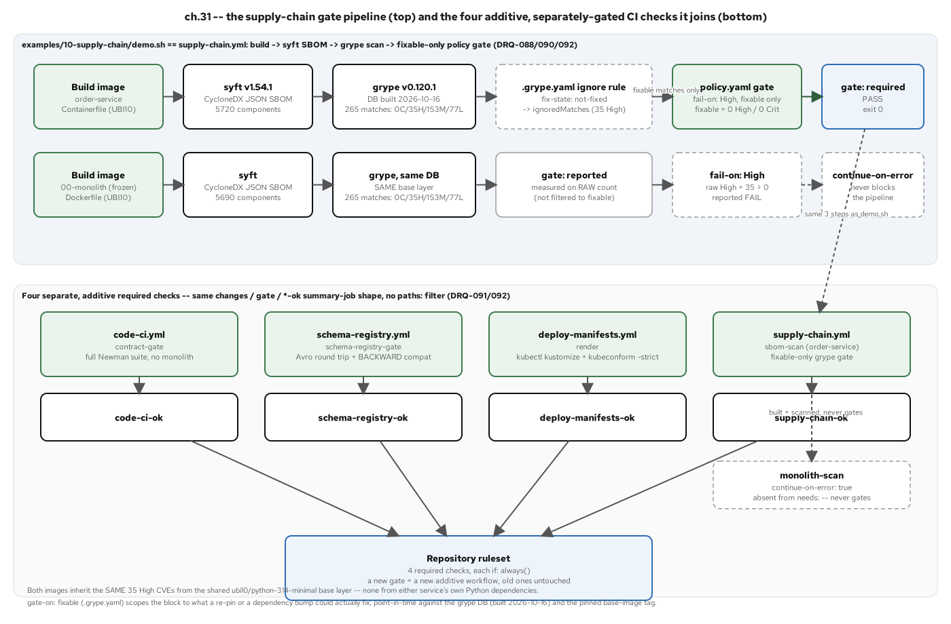
THE MEASURABLE WIN
The modernization, made measurable
TODO W2 caption — SBOM, scan, gate — the monolith fails it; the modernized service passes clean.
18
Notes:
STUB speaker notes. Makes the supply-chain case quantitatively; fill in during the content-authoring wave.

Slide 19
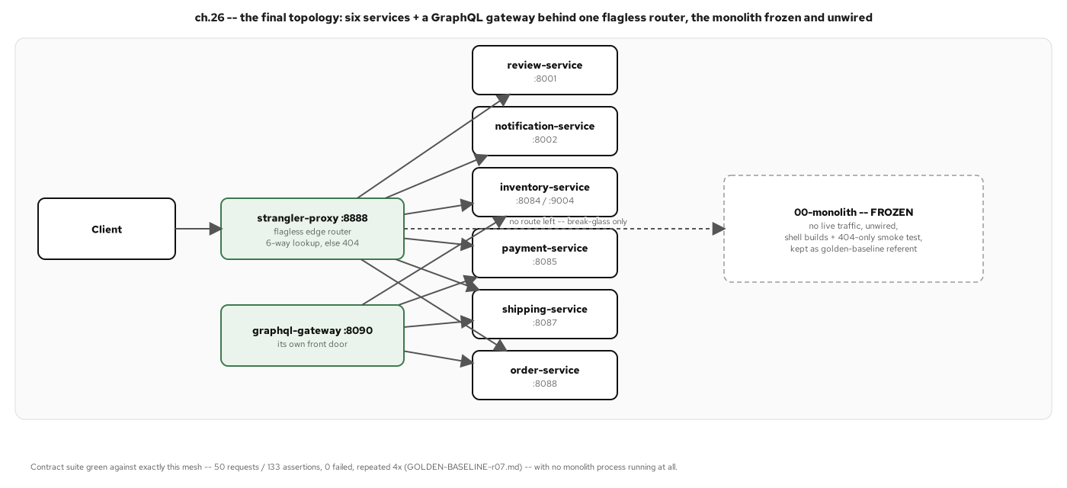
THE RESULT
One monolith, six independent services
TODO W2 caption — the final topology: the monolith is gone; each service owns its data.
19
Notes:
STUB speaker notes. Shows the end-state topology; fill in during the content-authoring wave.

Slide 20
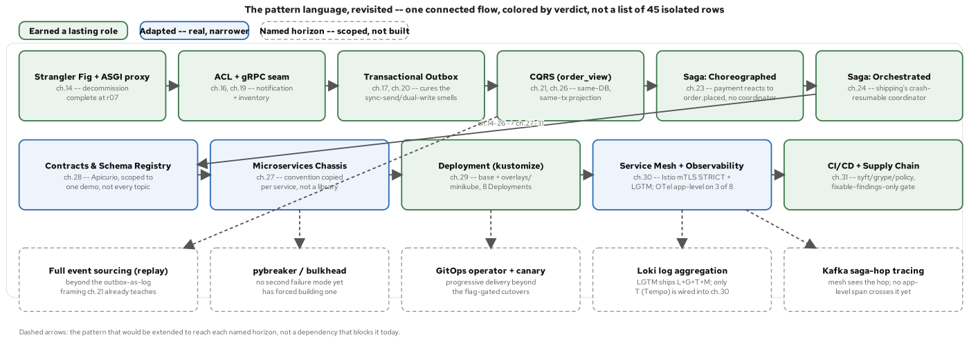
REFLECTION · THE PATTERN MAP
Where each pattern lives in the language
TODO W2 caption — cross-reference by concept to the 201's deep sections.
20
Notes:
STUB speaker notes. Introduces the pattern-language map as a navigation aid; fill in during the content-authoring wave.

Slide 21
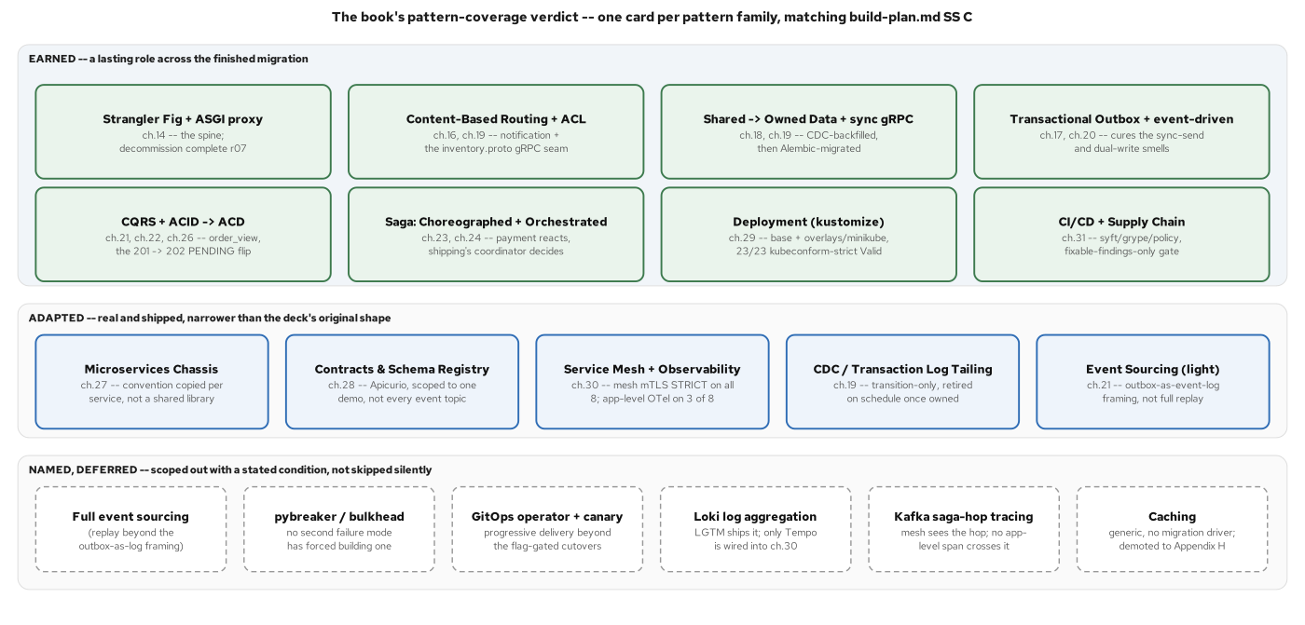
REFLECTION · THE SCORECARD
A pattern belongs when it cures a pain you have
TODO W2 caption — used versus deferred; deferred is a verdict too.
21
Notes:
STUB speaker notes. Walks the pattern scorecard at altitude; fill in during the content-authoring wave.

Slide 22
REFLECTION · WHERE TO STOP
Over-decomposition is the seductive failure
TODO W2 — the tell is a coordinated release; stop at context-aligned services.
TODO W2 — nanoservice sprawl is a distributed monolith — all the coupling, plus a network.
22
Notes:
STUB speaker notes. Closes the reflection on service-count discipline; fill in during the content-authoring wave.

Slide 23
101 · CLOSE
One monolith, six services, a method that verifies itself
TODO W2 — the claim held: a coupled Django monolith became six FastAPI services that own their data and coordinate without a conductor.
TODO W2 — for the running system and the full pattern set, see the 201; for the async code deep dive, see the 201-FastAPI.
23
Notes:
STUB speaker notes. Closing summary and hand-off to the 201 and 201-FastAPI; fill in during the content-authoring wave.

