Slide 1


OBSERVABILITY · PYTHON · OPENTELEMETRY
Make a Python
service observable
OpenTelemetry and the self-hosted Grafana LGTM stack — traces, metrics, and logs from one SDK, correlated across one request as it crosses REST, gRPC, Kafka, and Postgres.
r2.0
Notes:
Welcome. This is a hands-on talk about making a real Python service observable — not a survey of vendors. By the end you will have taken one small FastAPI service and grown traces, metrics, and logs out of it with a single OpenTelemetry SDK, and seen all three correlated in a self-hosted Grafana stack. Everything runs locally under Podman; nothing here needs a cloud account or a credit card. Two ways to run it: a 90-minute core talk, or a half-day workshop where every demo runs live. Set expectations now for which one this session is.

Slide 2


00
Foundations
The stack, the signals, and the services we will instrument.
Notes:
This first part lays the groundwork: what the talk covers and how it is delivered, the tools and the running backend, the conceptual model of the three signals, and a close read of the example services. No instrumentation yet — we earn that by first understanding the system we are about to make transparent.

Slide 3
FOUNDATIONS · OUTLINE
A few small services, made fully observable
The running example is a small set of services — order, inventory, payment, shipping, notification, review — where one POST /orders fans out across REST at the edge, gRPC between services, an asynchronous Kafka event, Postgres underneath, and a GraphQL read path.
Over the talk that system grows traces, metrics, and logs from a single OpenTelemetry SDK, all correlated in Grafana, with a Collector in the path making the sampling and routing decisions.
The backend is the open-source Grafana LGTM stack — Loki for logs, Grafana to view, Tempo for traces, Mimir for metrics — running locally under Podman. No paid accounts, no managed cloud on the path.
3
Notes:
Frame the whole arc here. The system is deliberately a realistic shape — one request that crosses several services and protocols, not a single process. That fan-out is the reason the demo earns its keep: context has to survive gRPC calls and a Kafka message, not just an in-process call, which is exactly where correlation usually breaks. LGTM is the mnemonic: Loki, Grafana, Tempo, Mimir. Stress that everything is self-hosted and vendor-neutral — mapping it to a managed service later is the audience's to do, not ours.

Slide 4
FOUNDATIONS · OUTLINE
The arc, in three parts
Foundations | the stack, the signals, the services | Outline · Prerequisites · Fundamentals · The services
The three signals | traces, metrics, logs — and correlation | Auto-instr · Metrics · Logs · Custom spans across Kafka · Auto/custom/hybrid · Reading it in Grafana
The pipeline | the Collector and what to keep | Sampling · Profiling
Foundations is this part; the three signals and the pipeline are the two halves that follow.
4
Notes:
Walk the three parts left to right. Part one (today's foundation iteration) is conceptual and structural. Part two adds each signal in turn and ends on carrying trace context across the Kafka hop — the hard, interesting bit. Part three moves the costly sampling and routing decisions into the Collector and adds continuous profiling. Refer to parts by name, never by slide number.

Slide 5
FOUNDATIONS · OUTLINE
Two ways to deliver it — and what it is not
Core (~90 min): foundations, the four headline demos — auto-instrumentation, logs-to-traces, custom spans across the Kafka hop, the correlated view — and the sampling discussion.
Workshop (~half day): every demo live, including metrics, the hybrid pattern, and continuous profiling, with one break in the middle.
Not a Python, FastAPI, Kafka, or Postgres tutorial.
Not a Kubernetes deployment.
Not a commercial-vendor comparison — the backend is self-hosted and vendor-neutral.
5
Notes:
Pick the profile out loud and tell the room which one they are in. The core path is demo-driven and keeps moving; the workshop pauses to run everything live. The right column manages expectations: assume working knowledge of the four technologies. If the audience is shaky on Kafka, flag the producer/consumer hop as the one thing to watch and move on. The duration numbers are targets to confirm in a timed rehearsal — they are marked unverified in the materials.

Slide 6
FOUNDATIONS · PREREQUISITES
What you need installed
Python 3.14 with Poetry for dependency management. Each service's range stays open to 3.12+ so the images build on whatever supported CPython the current Red Hat UBI base ships while the 3.14 tag is confirmed.
Podman with podman compose — not Docker. Podman is rootless by default and is the engine on the platforms this talk targets (current Fedora, current macOS via the Podman machine).
On macOS, give the Podman machine at least 4 GB; the full stack uses roughly 3 GB across all its services.
6
Notes:
The single biggest readiness risk in this whole talk lives on this slide: whether the OpenTelemetry auto-instrumentation wheels are published for a brand-new CPython 3.14. Confirm that against upstream right before delivery. The dependency range is deliberately open to 3.12+ precisely so the demo still installs if 3.14 wheels are not ready yet. Podman-first is a real constraint, not a preference — the compose file, the rootless build, and the UBI base images all assume it. If someone only has Docker, the compose file will mostly work, but do not promise it.

Slide 7
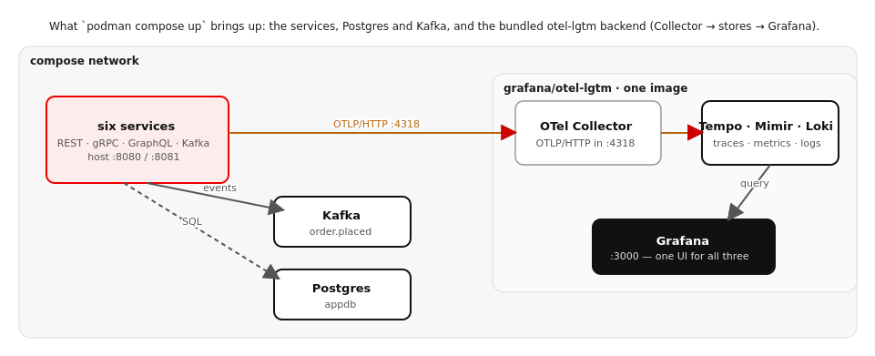
FOUNDATIONS · PREREQUISITES
What one `podman compose up` brings up
Figure 1.1 — Services send OTLP/HTTP :4318 to the bundled otel-lgtm Collector → Tempo/Mimir/Loki → Grafana; Kafka and Postgres sit alongside.
7
Notes:
Show the shape before the ports table. Everything runs in one compose network. The services emit OTLP/HTTP on 4318 to the Collector bundled inside the grafana/otel-lgtm image; the Collector fans each signal to Tempo, Mimir, and Loki, and Grafana reads all three. Kafka and Postgres are shared infra the services talk to directly. Nothing here is installed by hand except the container engine — the backend arrives as images on the first compose up.

Slide 8
FOUNDATIONS · PREREQUISITES
One image, the whole backend
Grafana | localhost:3000 | the one UI for all three signals
OTLP/HTTP | localhost:4318 | where telemetry is sent (this talk's default)
OTLP/gRPC | localhost:4317 | the gRPC alternative — a one-line switch
Tempo | localhost:3200 | trace storage and query
Mimir | localhost:9090 | metric storage and query (Prometheus-compatible)
Loki | localhost:3100 | log storage and query
Order | localhost:8080 | external REST edge — place/read orders
Review | localhost:8081 | external GraphQL read edge
From the host: localhost + port. Inside the compose network: service name (lgtm:4318) — the two are not interchangeable.
8
Notes:
The backend is one image — grafana/otel-lgtm — that bundles Grafana, Tempo, Mimir, Loki, AND an OpenTelemetry Collector. Bundling keeps the demo to a single podman compose up, but the architecture it stands for is the real one: apps send to a Collector, the Collector routes each signal to its backend. We mount our own Collector config in so sampling and routing stay first-class. Hammer the host-vs-network distinction — it is the most common 'can't reach the Collector' bug. From your laptop it's localhost:4318; from inside a container it's lgtm:4318.

Slide 9
FOUNDATIONS · PREREQUISITES
A house-style choice: OTLP over HTTP
Telemetry can leave the SDK over OTLP/gRPC (4317) or OTLP/HTTP (4318). This talk defaults to HTTP on 4318.
It is easier to debug — a plain curl can post to it — more firewall-friendly, and for a development workload the performance difference is negligible.
The gRPC endpoint stays exposed, so switching is a one-line change to OTEL_EXPORTER_OTLP_PROTOCOL and the port. Endpoints in later chapters use the path-less form http://lgtm:4318, which the SDK completes per signal.
9
Notes:
This is a deliberate, stated choice so nobody wonders later why the endpoints look the way they do. HTTP wins on debuggability for a teaching context — you can curl the receiver to prove it is listening. In production with high telemetry volume you might prefer gRPC for throughput; say so, and point out it is genuinely a one-line switch because both receivers are live. The path-less endpoint detail matters: the SDK appends /v1/traces, /v1/metrics, /v1/logs itself, so you configure the base once.

Slide 10
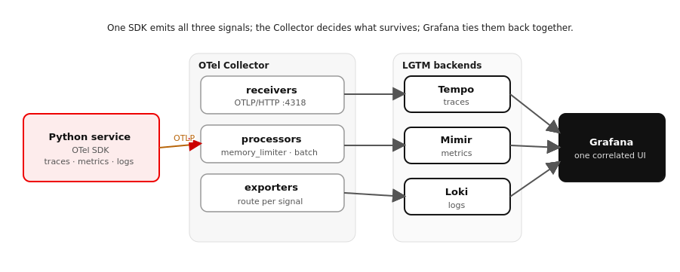
FOUNDATIONS · FUNDAMENTALS
One SDK, one Collector, three backends, one UI
Figure 2.1 — A service's SDK exports OTLP to the Collector, which routes traces → Tempo, metrics → Mimir, logs → Loki, all viewed in Grafana.
10
Notes:
This is the spine of the whole talk; the same SVG appears in the tutorial as Figure 2.1. Trace the left-to-right flow: in-process SDK produces all three signals, exports once over OTLP to the Collector. The Collector has three internal stages — receivers accept OTLP, processors act on the stream in order (memory_limiter, batch, later a sampler), exporters fan out to the three backends. Grafana reads all three and links them because they share identifiers. The key teaching point: the application emits everything; the Collector decides what survives. That separation is why sampling and routing can change without touching application code.

Slide 11
FOUNDATIONS · FUNDAMENTALS
Three signals, three questions
A trace answers where did the time go, and what happened along the way — a tree of spans sharing one trace_id, each with a duration, attributes, and a parent. One trace should span the REST request, both gRPC calls, the Postgres writes, the Kafka publish, and the shipping and notification consumers.
A metric answers how much, how often, how slow — in aggregate. Cheap numbers over time: request rate, error rate, duration percentiles. Small enough to keep for everything, always — which is what alerts fire on.
A log answers what exactly happened at this instant — a timestamped, ideally structured record carrying the detail a metric averages away and a span has no room for.
The trap is treating them as three products; their strength is the hand-off between them.
11
Notes:
Give the canonical hand-off story: the metric tells you error rate just spiked, the trace shows which hop is failing, the log line gives the exact exception. That chain only works if all three carry the same identifiers — which is the entire reason to use one OpenTelemetry SDK rather than three unrelated libraries. Emphasize the trace_id as the thread running through all of it. Keep this conceptual; the wiring comes next.

Slide 12
FOUNDATIONS · FUNDAMENTALS
The OpenTelemetry data path
OpenTelemetry splits producing telemetry from shipping it. In your process the SDK creates spans, records measurements, and emits logs, all stamped with a shared resource — the service.name, version, and environment that say who produced this.
The SDK exports over OTLP to the Collector — the decision point. Receivers accept OTLP; processors act in order (a memory_limiter so a flood can't take the Collector down, a batch processor, later a sampler); exporters route traces → Tempo, metrics → Mimir, logs → Loki.
Putting the Collector in the path lets sampling, batching, redaction, and routing be configured in one place, owned by whoever runs the platform, without touching application code.
12
Notes:
This slide narrates Figure 2.1 in words. The resource is easy to skip but important — it is the identity stamped on every signal, the thing that lets Grafana group everything from one service. Processor ORDER matters: memory_limiter first so you protect the Collector before doing anything expensive, batch to ship efficiently, sampler later once we get there. Land the punchline: the application emits everything; the Collector decides what survives. That is the whole argument for a Collector instead of exporting straight to each backend.

Slide 13
FOUNDATIONS · FUNDAMENTALS
Why the shared context is the point
Context propagation is what makes this one system, not three. When a span is active the SDK can stamp its trace_id and span_id onto log records emitted in the same breath, and attach an exemplar — a pointer back to a representative trace — onto a metric.
The hard part, and the part most material skips: keeping that context alive across a boundary that is not a function call. When the order service publishes order.placed to Kafka, the shipping and notification consumers are different processes with no shared call stack.
Unless the trace context travels with the message, each consumer starts a brand-new trace and the chain breaks in the middle. Carrying it across that hop is the job of the custom-instrumentation chapter.
13
Notes:
This is the thesis statement for the second half of the talk. Make the audience feel the problem before we solve it: an in-process call shares context for free through the call stack, and gRPC carries it in a header automatically, but a Kafka message is just bytes — the trace context is not in those bytes unless you put it there. Plant the flag now: the single trace_id flowing through every hop is the foundation everything else is built on, and the Kafka hop is where it is easiest to lose. We will fix it explicitly later with a propagator that writes context into message headers.

Slide 14
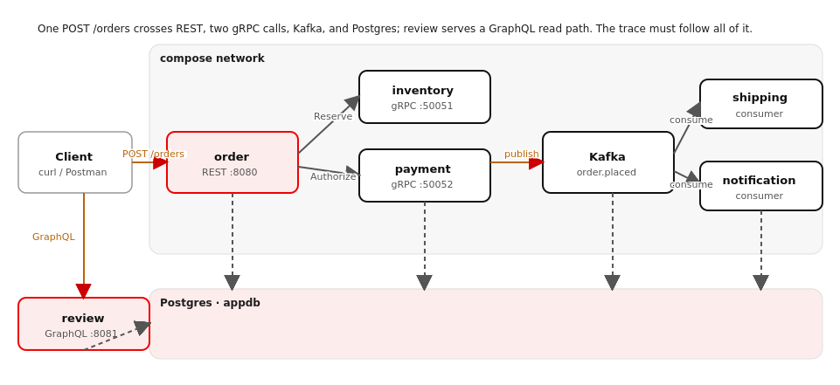
FOUNDATIONS · THE EXAMPLE SERVICES
One order, five protocols, six services
Figure 3.1 — POST /orders fans out: gRPC to inventory + payment, Postgres, Kafka order.placed → shipping + notification; review serves GraphQL.
14
Notes:
Same SVG as Figure 3.1 in the tutorial. Walk the fan-out with your finger: a client POSTs to the order service; order calls inventory and payment over gRPC, writes Postgres, and publishes order.placed to Kafka; shipping and notification each consume that event; review answers a GraphQL read. The cast is a small set of familiar e-commerce services — order, inventory, payment, shipping, notification, review — run on Podman compose, not Kubernetes, because this is an OpenTelemetry talk. The teaching point: five protocols means five places a trace can continue or break. Auto-instrumentation will carry it across REST and gRPC for free; the Kafka hop is the one we wire by hand later.

Slide 15
FOUNDATIONS · THE EXAMPLE SERVICES
The one request the whole talk follows
POST /orders on the order service is the action everything hangs off. In sequence: reserve stock (gRPC → inventory), authorize payment (gRPC → payment), persist the order (Postgres), publish order.placed (Kafka), return the confirmed order.
Two services react asynchronously: shipping consumes the event and writes a shipment; notification consumes the same event and sends a message. A separate review service exposes a GraphQL read API over orders and reviews.
That is REST at the edge, gRPC between services, Kafka for the async fan-out, Postgres underneath, and GraphQL on the read side — one workflow, five protocols, all of which a single trace must stay whole across.
Reserve before you charge, charge before you promise, promise before you announce.
15
Notes:
Set up the order of operations as deliberate, not arbitrary: you reserve stock before charging, charge before confirming, confirm before announcing — so a failure at any step leaves the system consistent and the customer correctly informed. The order service short-circuits with a 409 if stock can't be reserved and a 402 if payment declines, writing a row with the reason either way so failures are visible. This is the spine the next slides instrument.

Slide 16
FOUNDATIONS · THE EXAMPLE SERVICES
One shared library carries all the telemetry
Every service depends on a small package, obs (services/common/), so the instrumentation story is identical everywhere and lives in one reviewable place — application code stays clean.
obs.otel.setup(name) builds the resource, the OTLP/HTTP exporters for all three signals, the W3C propagator, and turns on auto-instrumentation for FastAPI, gRPC, and asyncpg.
obs.kafka / obs.kafka_propagation publish JSON events and carry trace context across Kafka; obs.db is one asyncpg pool; obs.logging emits trace-stamped JSON. In Foundations none of it is switched on yet (OTEL_SDK_DISABLED=true).
16
Notes:
The point of a shared obs package is that the talk can show the SAME setup() call in every service rather than six slightly different bootstraps. It is also what makes the no-telemetry baseline a one-variable change: setup() checks OTEL_SDK_DISABLED first and returns no-op providers when it is true. Name the four submodules so the audience has a map for the chapters that follow: otel (the bootstrap), kafka/kafka_propagation (the async hop), db (the pool), logging (correlated logs).

Slide 17
FOUNDATIONS · THE EXAMPLE SERVICES
The order handler — the spine
python · FastAPI
@app.post("/orders") async def create_order(body: CreateOrder) -> dict: order_id = str(uuid.uuid4()) amount_cents = UNIT_PRICE_CENTS * body.quantity # 1. reserve stock (gRPC → inventory; auto-traced) reservation = await app.state.clients.reserve(order_id, body.sku, body.quantity) if not reservation.reserved: raise HTTPException(409, "insufficient stock") # 2. authorize payment (gRPC → payment; auto-traced) auth = await app.state.clients.authorize(order_id, body.customer_id, amount_cents) if not auth.authorized: raise HTTPException(402, f"payment declined: {auth.decline_reason}") # 3. persist (Postgres) 4. announce (Kafka, context in headers) await repo.insert_order(order_id, ..., status="confirmed") await obskafka.publish_event(app.state.producer, ORDER_PLACED_TOPIC, key=order_id, value={...}) return {"order_id": order_id, "status": "confirmed"}
Two gRPC calls, a Postgres write, a Kafka publish — and not one line of tracing code.
17
Notes:
The thing to point at is what is NOT here: no spans, no trace ids, no propagation. The handler reads as plain business logic — reserve, authorize, persist, announce — and yet by the next part it produces a full trace across two processes. That is the payoff of auto-instrumentation plus the obs library: the gRPC client calls and the Postgres queries instrument themselves; the only deliberately-instrumented hop is the Kafka publish, and even that is hidden inside obskafka.publish_event. Stress the short-circuits: 409 on stock, 402 on payment — those give us repeatable error traces later.

Slide 18
FOUNDATIONS · THE EXAMPLE SERVICES
A gRPC service — inventory.Reserve
python · grpc.aio + asyncpg
class InventoryServicer(inventory_pb2_grpc.InventoryServiceServicer): async def Reserve(self, request, context): pool = await db.get_pool() # atomic check-and-decrement: only succeeds if enough on hand remaining = await pool.fetchval( "UPDATE stock SET on_hand = on_hand - $2 " "WHERE sku = $1 AND on_hand >= $2 RETURNING on_hand", request.sku, request.quantity) if remaining is None: return inventory_pb2.ReserveResponse(reserved=False) reservation_id = str(uuid.uuid4()) await pool.execute("INSERT INTO reservations ...", reservation_id, ...) return inventory_pb2.ReserveResponse(reserved=True, reservation_id=reservation_id, remaining=remaining)
Contracts are shared protos at proto/shop/…; the gRPC server instrumentation continues the order's trace.
18
Notes:
Two things to land. First, the single conditional UPDATE … WHERE on_hand >= qty RETURNING on_hand both checks and decrements stock atomically — no read-then-write race — and returns NULL when there isn't enough, which is how Reserve signals failure. A reservation row keyed by order_id makes a retry idempotent. Second: this runs in a DIFFERENT process from the order service, yet because the gRPC server is auto-instrumented and the order service injected context on the wire, these spans and their Postgres children land under the order's trace. The proto that defines this service lives once at the repo top level and is compiled into the image.

Slide 19
FOUNDATIONS · THE EXAMPLE SERVICES
The fragile bits, named not hidden
Every domain shares one Postgres database (appdb) for laptop simplicity; a production system might isolate a store per domain. The observability story — a Postgres span per service under one trace — is identical either way.
The payment ceiling and the catalog unit price are hardcoded so demos are deterministic: a fixed amount authorizes, a large quantity declines, on demand.
Kafka auto-creates the order.placed topic; production would create topics explicitly with chosen partition counts. None of these change the spans or metrics — they are scope cuts, stated out loud.
19
Notes:
Naming the simplifications buys credibility and heads off the 'but what about…' questions. The one most likely to be challenged is the shared database — be ready to say that per-domain stores are the production ideal but co-locating them changes nothing about the telemetry, which is what this talk is about. Keep the focus on observability.

Slide 20
FOUNDATIONS · THE EXAMPLE SERVICES
It works — and it is completely opaque
cd examples/01-no-telemetry && ./demo.sh — brings the whole stack up in Podman with telemetry disabled and places one order.
Expect a confirmed order in the response, a shipment row, and a notification log — proof the request travelled the full chain across REST, gRPC, Kafka, and Postgres.
Then open Grafana and look for it. There is nothing there. Six services just collaborated to fulfil that order and you cannot see any of it — exactly the opacity the rest of the talk removes.
This is the baseline: no telemetry. Every later demo is measured against this opacity.
20
Notes:
The emotional pivot of the foundation: the system works perfectly and tells you nothing. Run it, show the confirmed response, then pull up an empty Grafana and let the silence land. Demo 1 ships with OTEL_SDK_DISABLED=true on purpose; the next part flips one variable and the same request lights up.

Slide 21
THE THREE SIGNALS
Three signals, one thread
Auto-instrumentation · Metrics · Logs · Custom spans across Kafka
Notes:
This part turns the SDK on and adds one signal at a time to the exact same code, ending by carrying trace context across the Kafka hop so the async work rejoins the trace.

Slide 22
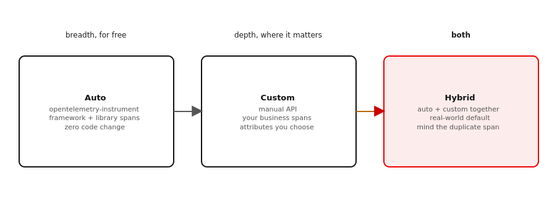
THE THREE SIGNALS · AUTO-INSTRUMENTATION
Auto, custom, and the hybrid you actually ship
Figure 4.1 — Auto-instrumentation gives breadth for free; custom spans give depth where it matters; real systems run both.
22
Notes:
Frame the three columns. Auto-instrumentation is breadth for free: turn it on and FastAPI, gRPC, and asyncpg emit spans with no code change. Custom instrumentation is depth where it matters: you open spans for the work the libraries can't see. The hybrid is what every real service is — and the one gotcha is the occasional duplicate span when auto and custom overlap. This part starts with the free breadth, then earns the depth in the Kafka chapter.

Slide 23
THE THREE SIGNALS · AUTO-INSTRUMENTATION
Turn it on once, in the shared library
python · obs.otel.setup
resource = Resource.create({ "service.name": cfg.service_name, # the most important attribute "service.version": cfg.service_version, "deployment.environment": cfg.environment}) tracer_provider = TracerProvider(resource=resource) tracer_provider.add_span_processor( BatchSpanProcessor(OTLPSpanExporter(f"{cfg.endpoint}/v1/traces"))) trace.set_tracer_provider(tracer_provider) # … MeterProvider + LoggerProvider wired the same way … AsyncPGInstrumentor().instrument() # every query → a span GrpcAioInstrumentorClient().instrument() # inject context on the wire GrpcAioInstrumentorServer().instrument() # extract it on arrival
service.name is what lets Grafana say 'this span happened in payment'; BatchSpanProcessor keeps export off the critical path.
23
Notes:
Three beats. The resource is the identity stamped on every signal — service.name is the single most important attribute in the whole system, which is why we pass it explicitly rather than trust a default. The Batch processor ships spans on a background thread, so observing the service never slows the request. And the three instrument() calls are the whole of 'auto': each patches its library process-wide, so the order handler we saw earlier — with no tracing in it — now produces gRPC and Postgres spans automatically. FastAPI is the exception, instrumented against the app object via instrument_fastapi(app).

Slide 24
THE THREE SIGNALS · AUTO-INSTRUMENTATION
One trace for free — until Kafka
Place an order, open Tempo: one trace spans the POST /orders server span, the inventory and payment gRPC client+server spans, and every asyncpg query — none of it written by hand.
Context crosses HTTP and gRPC because the instrumented client writes a traceparent header and the server reads it — the W3C Trace Context standard, propagated automatically.
But the shipping and notification work shows up as separate, parentless traces. A Kafka message has no one filling in a traceparent for you, so the chain breaks at the broker. Demo 2 runs with propagation off to make that visible; Chapter 7 fixes it.
24
Notes:
This is the honest edge of auto-instrumentation and the hook for the rest of the part. Show the beautiful free trace first, then deliberately point at what's missing: the consumers are off on their own. Resist the urge to hand-wave — name why (no instrumented client owns the Kafka publish header) so the fix in Chapter 7 feels inevitable rather than magic.

Slide 25
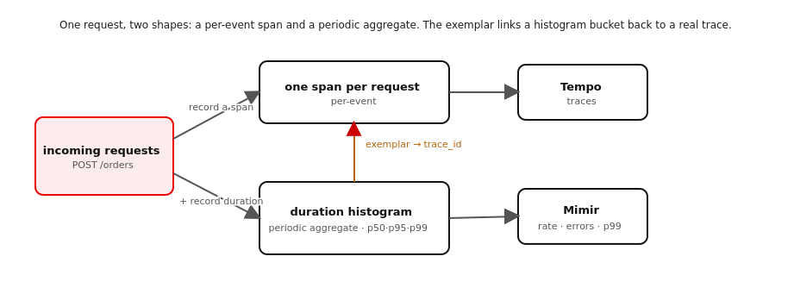
THE THREE SIGNALS · METRICS
One request, two shapes
Figure 5.1 — The same request becomes a per-event span and a periodic histogram; the exemplar links a bucket back to a real trace.
25
Notes:
Set up the RED slide with the mechanic: a span is one event, a metric is a running aggregate sampled on an interval — two shapes of the same traffic. The exemplar is the thread between them, which is exactly why the next slide's 'click the dot to open the slow trace' works.

Slide 26
THE THREE SIGNALS · METRICS
RED, mostly for free — and exemplars back to traces
RED — Rate, Errors, Duration — is the default question set for a request-driven service: is it busy, is it broken, is it slow? The HTTP and gRPC auto-instrumentation emits most of it already, labelled by route, method, and status.
Metrics are periodic aggregates, not per-event records: a MeterProvider with a PeriodicExportingMetricReader samples in-memory aggregations and exports them on an interval — the fundamental difference from a span.
Exemplars are the payoff: a sample trace_id attached to a histogram bucket when the measurement was taken inside a span. Grafana renders them as dots on the latency graph; click one to open the actual slow trace in Tempo.
Cross-check: the request count per minute should match the number of order traces for the same window.
26
Notes:
The single most valuable idea on this slide is exemplars — they turn 'p99 spiked at 14:32' from a dead end into 'here is a request that was actually slow.' That only works because the same SDK with the same resource emits both signals, so the ids line up. Mention that domain questions ('how many orders declined for payment?') need a custom Counter you define with obs.otel.meter(); the transport metrics cover RED but not the business.

Slide 27
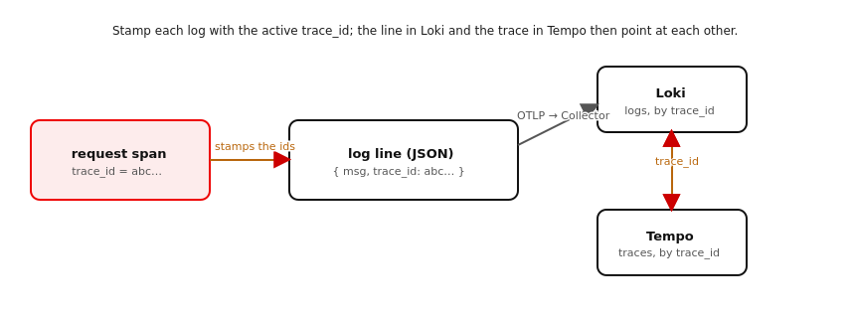
THE THREE SIGNALS · LOGS
The ids are the join key
Figure 6.1 — Stamp the active trace_id onto every JSON log line; Loki and Tempo then point at each other.
27
Notes:
Lead the logs section with the why before the code: a log line alone tells you what happened, not which request it belonged to. Stamp the trace_id and a line in Loki links to its trace in Tempo, and a span links back to its logs. The next slide is the filter that does the stamping.

Slide 28
THE THREE SIGNALS · LOGS
Stamp every line with the active trace
python · obs.logging
class TraceContextFilter(logging.Filter): def filter(self, record): span = trace.get_current_span() ctx = span.get_span_context() if span else None if ctx and ctx.is_valid: record.trace_id = format(ctx.trace_id, "032x") record.span_id = format(ctx.span_id, "016x") else: record.trace_id = record.span_id = "-" return True # a JsonFormatter then renders these as fields
JSON + the trace_id on every record = a log in Loki links to its trace in Tempo, and back. The ids are the join key.
28
Notes:
Two decisions make logs correlatable: structure (JSON, so trace_id is a queryable field, not buried in a string) and the trace context on every record. A logging Filter is the right hook because it runs at log time, so inside a request the ids are the request's ids and outside one they're '-'. The hex formatting (032x / 016x) is the canonical form Tempo expects, so the value in Loki matches the trace exactly. Services log to stdout; the collector routes it to Loki, so the service stays ignorant of the backend.

Slide 29
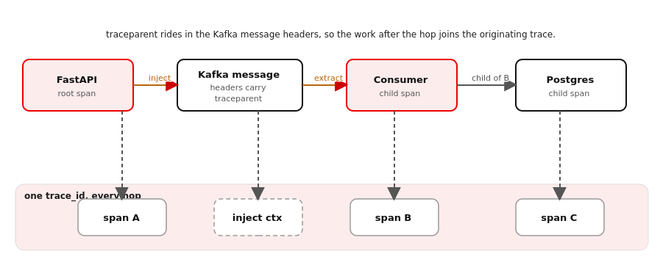
THE THREE SIGNALS · CUSTOM SPANS
Carrying the trace across the Kafka boundary
Figure 7.1 — gRPC propagates context for you; across Kafka you inject it into the message headers and extract it in the consumer.
29
Notes:
This is the climax of the talk and the technique that generalises: anywhere context doesn't propagate automatically — a queue, a batch job, a custom protocol — you do exactly this. Walk the figure: the producer injects the active context into the Kafka message headers; the consumer extracts it and opens its processing span with that context as the parent. The same traceparent the gRPC hop used, just placed and read by hand because no library does it for a Kafka message.

Slide 30
THE THREE SIGNALS · CUSTOM SPANS
Inject on publish, extract on consume
python · obs.kafka_propagation
# producer side — inject the active context into Kafka headers def inject_headers(existing=None): carrier = {}; propagate.inject(carrier) # writes 'traceparent' return [(k, v.encode()) for k, v in carrier.items()] # consumer side — rebuild the context, then parent the span to it ctx = extract_context(msg.headers) with otel.tracer().start_as_current_span( "shipping.handle_order_placed", context=ctx): await create_shipment(order) # this span is now a child of the order
context=ctx is the entire trick: without it the consumer starts a new trace; with it, it joins the order's.
30
Notes:
Slow down on context=ctx — it is the whole chapter in one argument. propagate.inject is the same call the HTTP and gRPC instrumentors make internally; we do it explicitly only because no library will do it for a Kafka message. extract_context returns a context value, not an active one; passing it as context= to start_as_current_span is what makes the consumer's span a child of the order service's publish span, in a different process, reached asynchronously. The asyncpg span for create_shipment then nests under that automatically. Two lines per consumer — extract, then pass context= — and the async hop is whole.

Slide 31
THE THREE SIGNALS · CUSTOM SPANS
Same API, a second use: GraphQL shape
The review service uses the same start_as_current_span call for a different reason — not to cross a boundary, but to make one opaque POST /graphql legible.
Each resolver opens a span (review.resolve_order, review.resolve_reviews), so a GraphQL query shows up as a resolver tree with its Postgres children — not a single span you can't see inside.
Once you can open a span deliberately, you can give any custom work — resolvers, batch steps, scheduled jobs — the structure it deserves. That is the general lesson under the specific Kafka fix.
Run examples/05-spans-across-kafka and compare the trace to Demo 2: the consumers are now on it.
31
Notes:
Close the part by generalising: start_as_current_span is not a Kafka tool, it is THE tool for making invisible work visible — the Kafka consumers and the GraphQL resolvers are two faces of the same move. End on the side-by-side: Demo 2's trace stopped at the broker; Demo 5's runs all the way through shipping and notification. Same code, one env var, the whole picture.

Slide 32
THE THREE SIGNALS · HYBRID
Auto, custom, hybrid — and what each costs
Auto-instrumentation is breadth for free: every request, RPC, and query becomes a span with no code. The cost is volume you pay to export, store, and read, and blind spots — it sees nothing no instrumented library owns (the Kafka hop, a GraphQL resolver, the business meaning).
Custom spans are depth where you decide: your names, your attributes (order_id, decline reason), wrapping work no instrumentor sees. The cost is code you maintain — so you spend it on the message boundary and the resolver, not on HTTP.
Hybrid — auto everywhere, custom in the gaps — is the production default, and it is what this repo already runs. Two rules keep it cheap: instrument any one boundary once (two near-identical spans = double-instrumentation), and keep high-cardinality ids on spans, never on metric labels.
Demo 6 shows both layers in one trace; compare it to Demo 2 with the custom layer off.
32
Notes:
This is the slide the senior engineers in the room are waiting for: the honest cost/benefit. Auto is not free — it is volume and it is library-shaped. Custom is not noble — it is maintenance you ration. The hybrid is the only realistic answer, and the two failure modes worth naming out loud are double-instrumenting one boundary (the duplicate-span smell) and shoving an unbounded id like order_id into a metric label, which is how an observability bill becomes a horror story. Identifiers belong on spans, where one-per-request is already the shape; metrics get bounded labels — route, method, status.

Slide 33
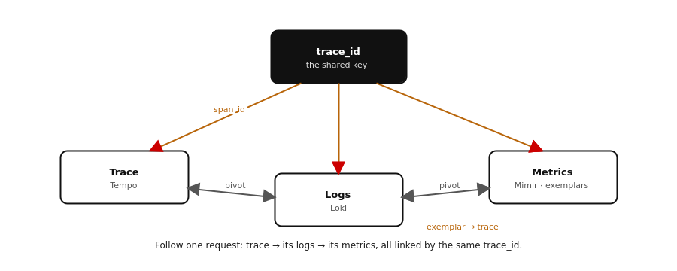
THE THREE SIGNALS · CORRELATED VIEW
Read one request across all three signals
Figure 9.1 — One trace_id links a trace in Tempo to its logs in Loki and its metrics in Mimir; the pivots are one click.
33
Notes:
This is the payoff slide — open Grafana and actually use the correlation. Walk the four moves live if you can. (1) In Tempo, a trace read top-down IS the distributed business flow — the path across services with a duration on each hop, and on a failed order the error sits on the Authorize span with the decline reason as an attribute. (2) From a span, 'Logs for this span' jumps by trace_id to exactly that service's lines in Loki — no grep, no window-guessing. (3) From a p99 bump in Mimir, an exemplar dot opens the slow trace behind it. (4) The gap between a gRPC client span and its server span is wire + serialization time, with message sizes on the spans — the serde cost read straight off the trace. All four pivot on one trace_id flowing through every hop. That movement between signals is the whole point; it is what a wall of disconnected logs can never give you.

Slide 34
THE PIPELINE
Decide in the Collector
Sampling · Continuous profiling
Notes:
The app emits everything; the Collector decides what survives and at what cost. This part keeps telemetry affordable at volume with tail sampling, then adds the fourth signal — profiling — that shows where the time goes inside a slow span.

Slide 35
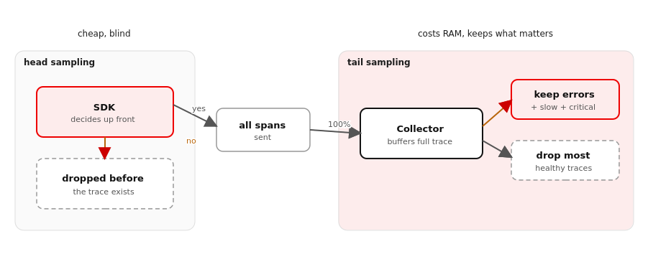
THE PIPELINE · SAMPLING
Where you decide what to keep
Figure 10.1 — Head sampling decides at the SDK, cheap and blind; tail sampling buffers the whole trace in the Collector, then keeps errors, slow, and critical routes.
35
Notes:
Set up head-vs-tail visually before the policy slide. The cost of intelligence is memory: tail sampling must hold each in-flight trace until it knows how the trace turned out, then decide.

Slide 36
THE PIPELINE · SAMPLING
Keep errors, slow, and critical — sample the rest
Head sampling decides in the SDK before the request runs: cheap, but blind — a 5% head sampler keeps 5% of your errors too. Tail sampling decides in the Collector once the trace is complete, so it can keep a trace because it errored, was slow, or hit a route you care about.
The policy is OR-evaluated in stack/otelcol/config.tail-sampling.yaml: keep every ERROR, every request over 1s, every /orders, plus a 5% probabilistic baseline of the healthy rest.
The services export 100% and own no sampling — what you keep is a Collector config change, not a redeploy. The cost is Collector RAM: roughly 10–50 KB per in-flight trace held for the decision window (here 30s), capped by num_traces.
36
Notes:
The headline trade: you pay in Collector memory for the ability to keep a trace based on how it turned out. decision_wait holds traces until trailing spans arrive; num_traces caps the buffer so the Collector drops new traces rather than running out of memory. Stress that the app is deliberately not in the sampling business — that separation is why the policy changes without a redeploy.

Slide 37
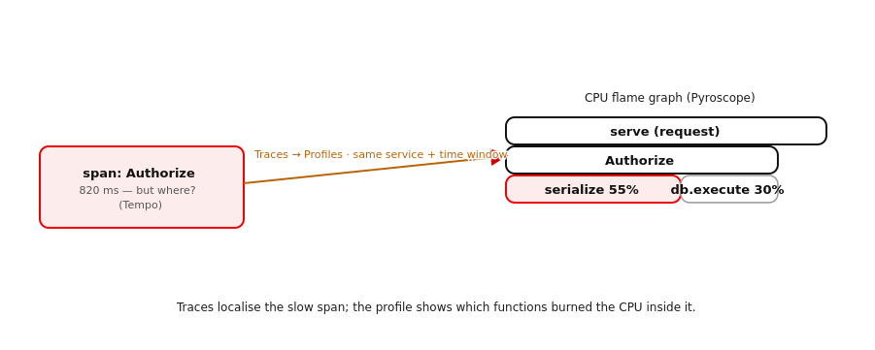
THE PIPELINE · PROFILING
The fourth signal: inside the slow span
Figure 11.1 — A slow span in Tempo links by service + time window to a CPU flame graph in Pyroscope, showing which functions inside it spent the time.
37
Notes:
Traces localise the slow span across services; the profile localises what was slow inside one. The link is service + time window, not a shared id — the same correlation pattern as trace→logs, one signal over.

Slide 38
THE PIPELINE · PROFILING
Bundled backend, unsettled client side
Continuous profiling samples the call stack a few times a second at low overhead, always on, and aggregates it into a flame graph — the view traces, metrics, and logs cannot give, because they stop at the process boundary.
The backend is already here: the otel-lgtm image bundles Pyroscope with a Collector profiles pipeline. The span→flame-graph link is Grafana's tracesToProfiles, matched on service + time.
Honest caveats: the 0.8.1 image pin may predate Pyroscope (bump it); the mounted Collector config must add a profiles pipeline back; and the Python OTLP-profiles signal is still experimental, so the Pyroscope SDK is the pragmatic path today. This is the least-settled signal in the stack.
38
Notes:
Be candid that this chapter is a sketch to validate, not a settled recipe. The good news is the backend ships in the same image; the friction is all on the Python client side and the version-sensitive wiring. obs.profiling is an optional, gated hook that no-ops unless PYROSCOPE_ADDRESS is set.

Slide 39
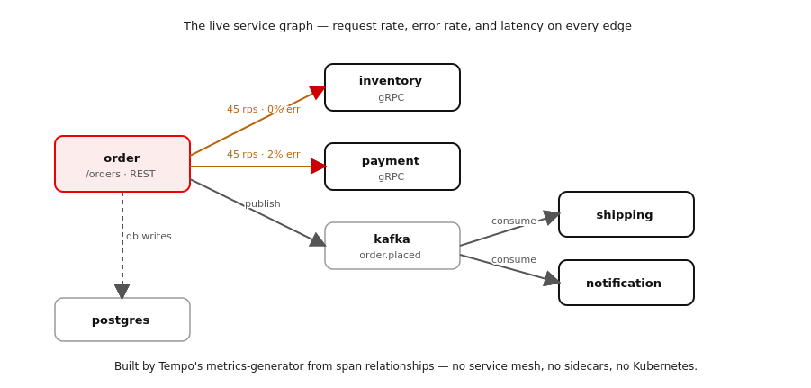
THE PIPELINE · LIVE SERVICE GRAPH
What's going on right now
Figure 12.1 — The topology with live request, error, and latency on every edge — built from traces by Tempo's metrics-generator, no mesh required.
39
Notes:
The operational, all-requests-at-once view — same correlation idea one level up: instead of one trace, the shape of all of them. Stress that it's trace-derived: the edges come from client/server and producer/consumer span kinds and db.* attributes, which is exactly why it needs no service mesh or sidecars.

Slide 40
THE PIPELINE · LIVE SERVICE GRAPH
The Kiali view, without the mesh
Tempo's metrics-generator reads span relationships — client/server calls, producer/consumer hops, db.* attributes — and emits service-graph and span metrics; Grafana renders them as a node graph with live RED on every node and edge.
That's exactly this system's shape: REST/gRPC give the inventory and payment edges, the Kafka hop gives shipping and notification (because §7 set the producer/consumer span kinds), and asyncpg gives the Postgres edge.
So you get the Kiali-style live map — request rate, error rate, latency, animated — with no service mesh, no sidecars, and no Kubernetes. Enabling it is two bits of config: the generator's processors plus remote-write, and Grafana's service map pointing at the metrics store.
40
Notes:
This is the answer to 'can we see what's happening live?' without adopting Istio. The Kafka edge only appears if propagation is on (Demo 2) — a missing shipping/notification edge is the broken async link from §7, seen from above. The Grafana service map is provisioned; the Tempo generator enablement is the version-sensitive bit to confirm.

Slide 41
WRAP-UP
One request, four signals, end to end
The full correlation story across the services: traces across REST and gRPC for free, metrics with exemplars, logs stamped with the trace_id, custom spans that carry the trace across Kafka, the honest auto/custom/hybrid trade-off, and a Grafana walkthrough that pivots trace → logs → metrics on one click.
The pipeline part moved the costly decisions into the Collector: tail sampling that keeps errors, slow, and critical routes at volume while the app stays out of the sampling business, continuous profiling as the fourth signal, and a live service graph built from the traces — the whole system, at a glance.
The tutorial mirrors these slides chapter for chapter (§0–§11), with six example services, the shared protos and obs library, and a runnable demo per chapter. It is authored against the target versions but not yet run end to end — it ships marked unverified, and a live rehearsal against the real stack is the next milestone.
41
Notes:
Re-walk the whole arc so the audience knows what they hold. Foundations gave them the services and the model; the three signals gave them the correlated signals, their cost, and the one-click view; the pipeline kept it affordable at volume and added the fourth signal. Be honest about iteration state: this is authored against the target versions but not yet run end-to-end here, so it ships marked unverified, and a live rehearsal is the next milestone. Point people at the repo — the tutorial mirrors these slides chapter for chapter, and every example has a runnable demo.sh.

