Slide 1
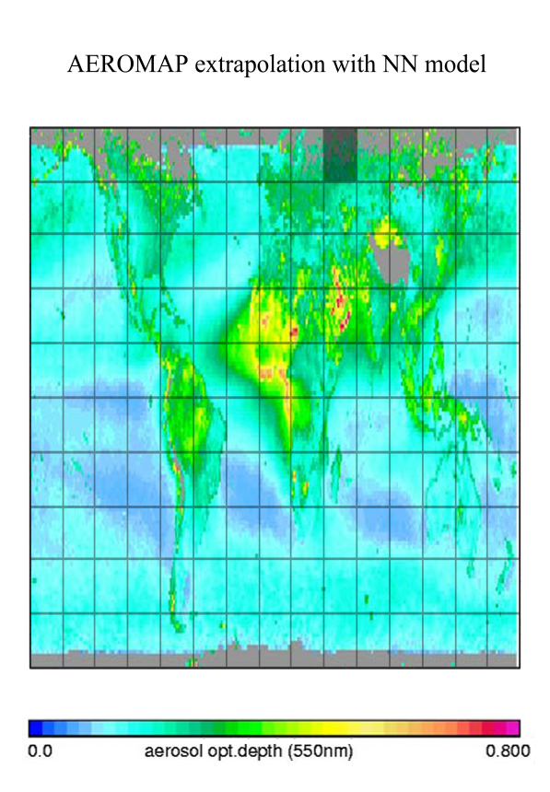
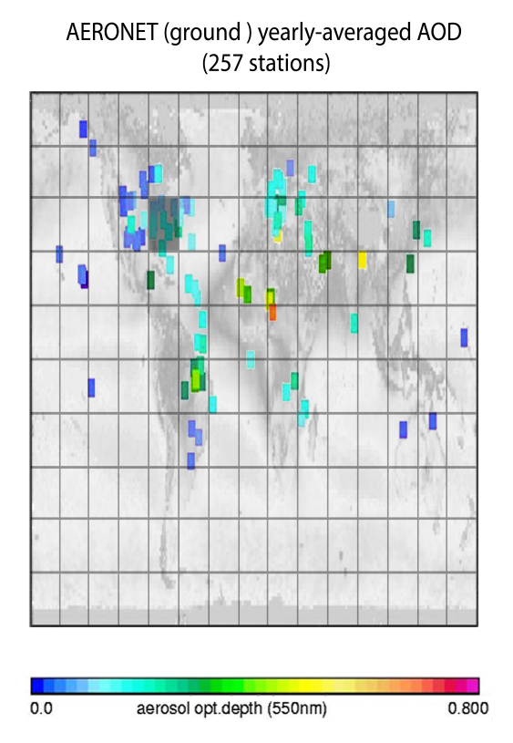
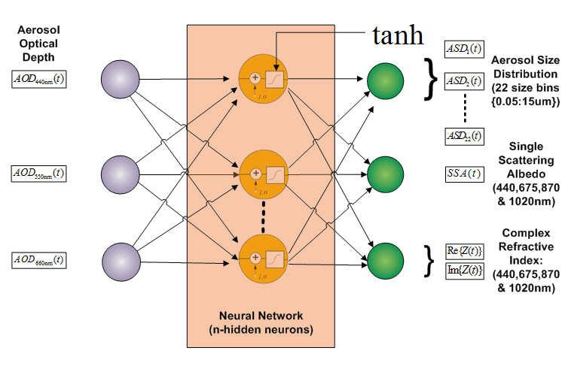
AEROMAP - Global mapping of aerosol properties using neural network inversions of ground and satellite based data
Neural networks are being trained on AERONET data so as to produce moderate resolution global retrievals of aerosol optical and microphysical properties
Other facets of the AEROMAP project include:
1) A global site variability study
2) A global aerosol classification based on hierarchical clustering and permutation analysis
3) The construction of neural network forecast models for aerosol parameters
Michael Taylor APCG-IERSD-NOA: patternizer@gmail.com

