Slide 1
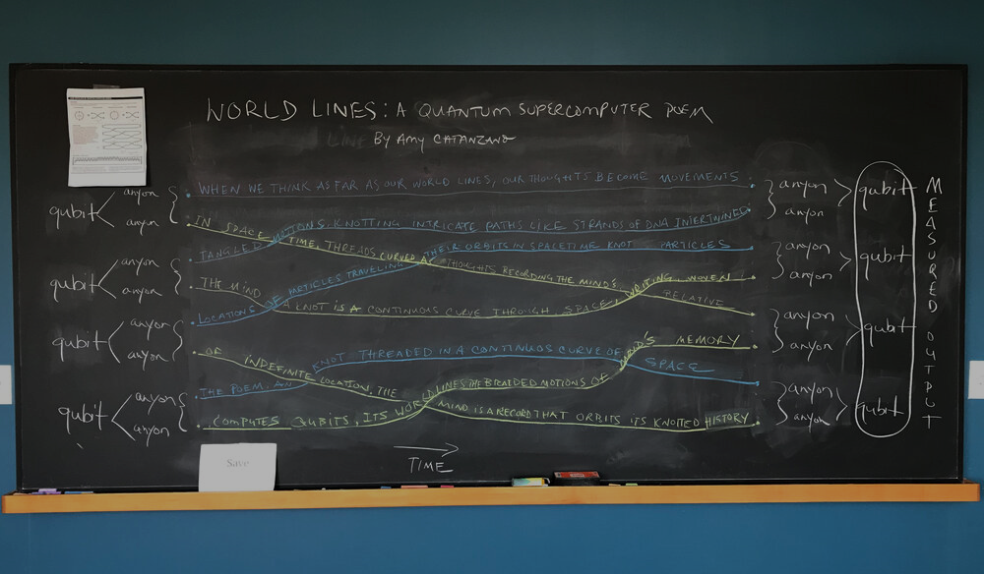



Amy Catanzano
https://www.amycatanzano.com/world-lines
NETWORK-X
NLP
ANYON-AI
Michael Taylor
https://github.com/patternizer

Slide 2


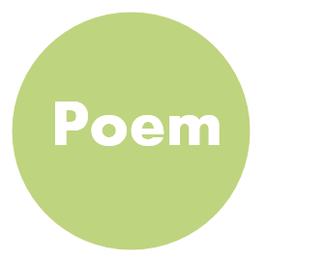

NLP

Slide 3

Lost at the junction of life and consciousness,
being aware of complexity seems to be a beautiful predicament.
Colors and sounds create a mosaic trompe l'oeil,
as now euphoria is deciphered as a play of endorphins in the mighty brain.
My mind searches for eternal tranquility,
while my brain reasons the crude reality.
The warmth of life is presently reduced to being a string of photons,
and all human intricate feelings just to the chaotic firing of the limbic masters in our control center.
I wonder at the simplex complexity and the Tao of life,
as I know all that awaits is a dance of fractals.
They dance to varying frequencies in an energy field,
as there is no color no sound only pure awareness dipped in illusion.
Solidity and vanity are fueled by atomic vibrations,
while the serene colors of the sky are an amalgamation of diverse wavelengths.
Life seems to be a maze, while my companion coffee causes positive ionotropic effects,
and my sweet tooth spells the chant for my sweet dreams.
Well, I realize I live in a holographic universe,
with innumerable possibilities like the Schrodinger's cat.
Infinite things such as placebo still haunt our reasoning,
as we are akin to a robot in a Chinese room as what we know is an iota in the sea of reality.
Poem
Text basis – for testing / code dev
‘Theory of Everything’ by Nitya819:
https://allpoetry.com/Nitya819

Slide 4
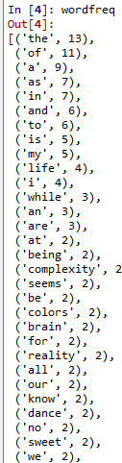
TEXT STATS: N (words) = 222, N (lines) = 20, N (sentences) = 10
UNIQUE WORDS = 134
[ 'lost', 'at', 'the', 'junction', 'of', 'life', 'and', 'consciousness', 'being', 'aware', 'complexity', 'seems', 'to', 'be', 'a', 'beautiful', 'predicament', 'colors', 'sounds', 'create', 'mosaic', 'trompe', "l'oeil", 'as', 'now', 'euphoria', 'is', 'deciphered', 'play', 'endorphins', 'in', 'mighty', 'brain', 'my', 'mind', 'searches', 'for', 'eternal', 'tranquility', 'while', 'reasons', 'crude', 'reality', 'warmth', 'presently', 'reduced', 'string', 'photons', 'all', 'human', 'intricate', 'feelings', 'just', 'chaotic', 'firing', 'limbic', 'masters', 'our', 'control', 'center', 'i', 'wonder', 'simplex', 'tao', 'know', 'that', 'awaits', 'dance', 'fractals', 'they', 'varying', 'frequencies', 'an', 'energy', 'field', 'there', 'no', 'color', 'sound', 'only', 'pure', 'awareness', 'dipped', 'illusion', 'solidity', 'vanity', 'are', 'fueled', 'by', 'atomic', 'vibrations', 'serene', 'sky', 'amalgamation', 'diverse', 'wavelengths', 'maze', 'companion', 'coffee', 'causes', 'positive', 'ionotropic', 'effects', 'sweet', 'tooth', 'spells', 'chant', 'dreams', 'well', 'realize', 'live', 'holographic', 'universe', 'with', 'innumerable', 'possibilities', 'like', "schrodinger's", 'cat', 'infinite', 'things', 'such', 'placebo', 'still', 'haunt', 'reasoning', 'we', 'akin', 'robot', 'chinese', 'room', 'what', 'iota', 'sea’ ]
KNOTS (>1 connection) = 30
[ 'the', 'of', 'a', 'as', 'in', 'and', 'to', 'is', 'my', 'life', 'i', 'while', 'an', 'are', 'at', 'being', 'complexity', 'seems', 'be', 'colors', 'brain', 'for', 'reality', 'all', 'our', 'know', 'dance', 'no', 'sweet', ‘we’ ]
Wordfreq
Anyons basis – for test / dev
NLP parsing at word level.
Q. Can it be made to work multi-lingually?

Slide 5
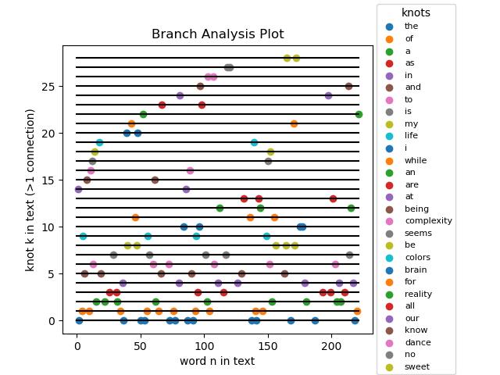
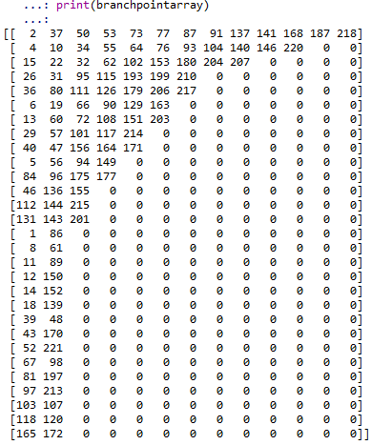
Knots
Knots are the branch points pertubing anyons in braid formation.
Knots are those words with freq > 1
I extract their indices in the wordlist,
Q. Is there a more efficient implementation for scaling up to large text strings?

Slide 6


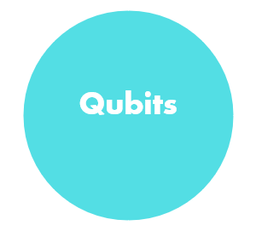

NetworkX

Slide 7
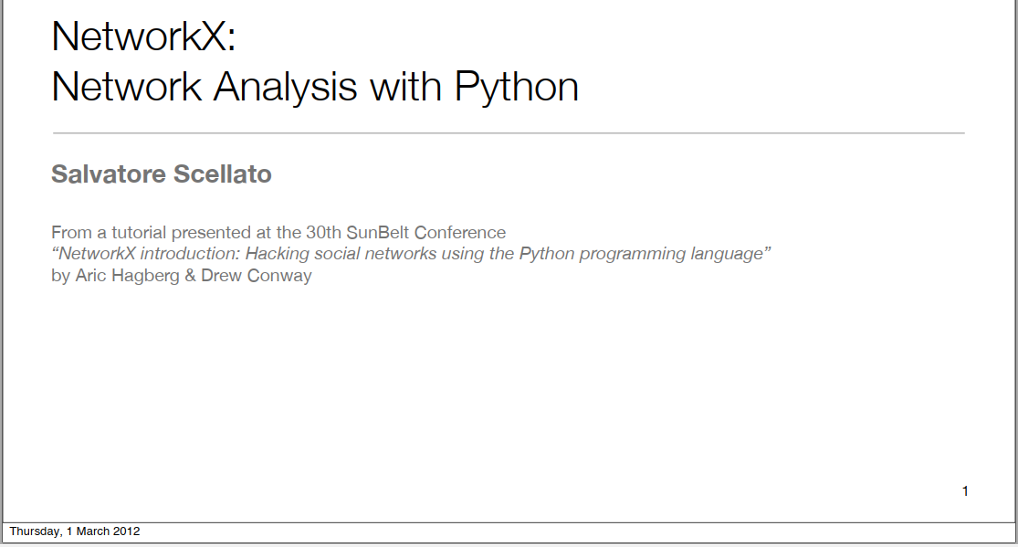
Software
Python for the codebase.
NetworkX for analysis of directed graphs and visualisation of universe of braided qubits.
Q. What is the most appropriate Machine Learning (ML) software / method for assessing qubit entanglement and doing quantum simulation?

Slide 8
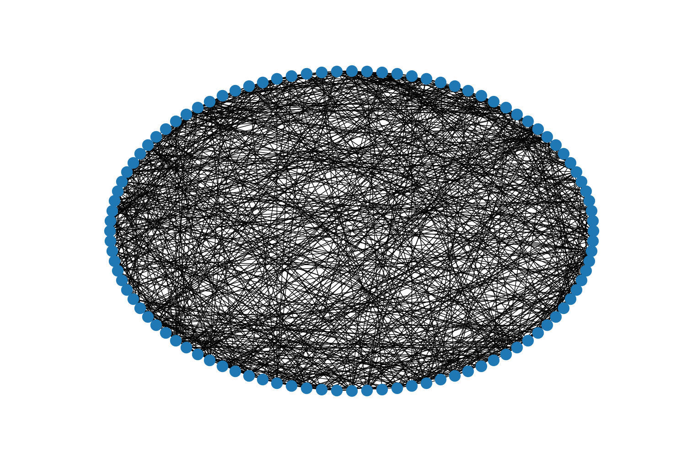
Adjacency
I am learning how to use the adjacency matrix for word connectivity – here is an example of a random fully-connected (Erdos) net.
Q. What’s the best way to visualise many braids corresponding to the different Bell states ?

Slide 9
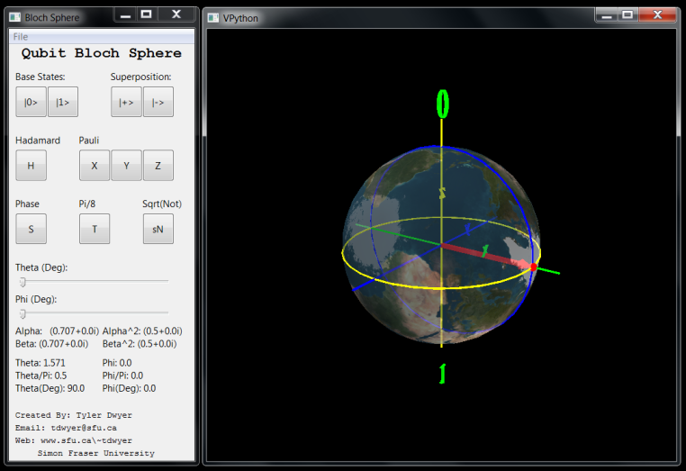
Qubits
Perhaps we need to consider using the Bloch Sphere for qubits when the number of anyons is large.
Q. What is the best way to make use of this in the ML / quantum simulation downstream processing ?

Slide 10

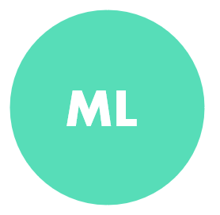


Anyon-AI

Slide 11
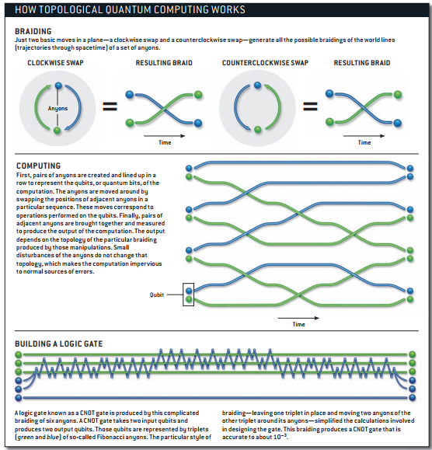
Braiding
After we construct the Qubit Register and identify all braided anyons, we can perhaps think about use of logic gates in the computational part of the processing chain.

Slide 12
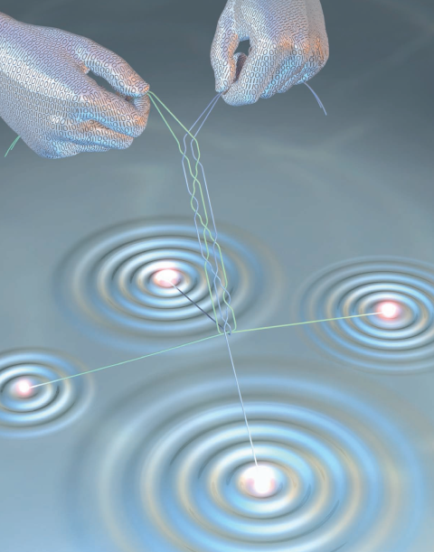
ML
Having generated braids from the Bell States we can begin to apply NLP and machine learning to look at semantic.
We can also begin quantum simulation.
Q. What additional logic do we need to implement here?

Slide 13
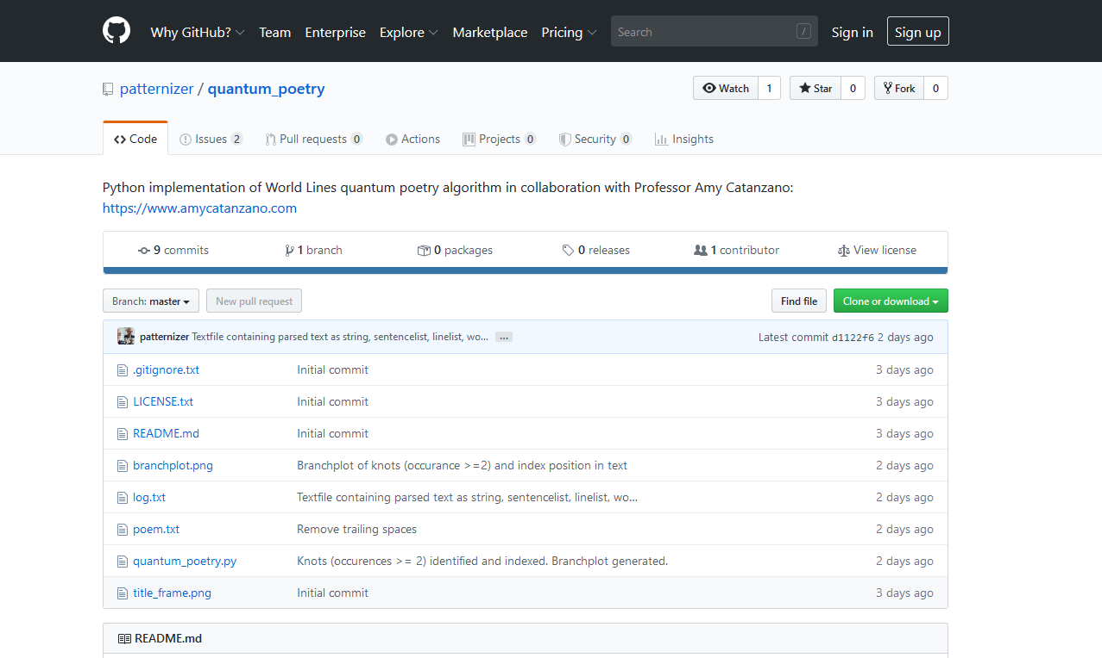
App
Potential online app with e.g. a text upload button or copy-paste box.
Interactive Plotly Reactive Dash for output case selection.
Codebase: Github (open source)

