Slide 1
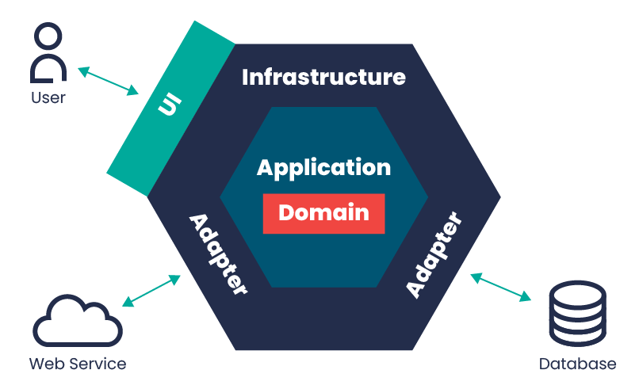
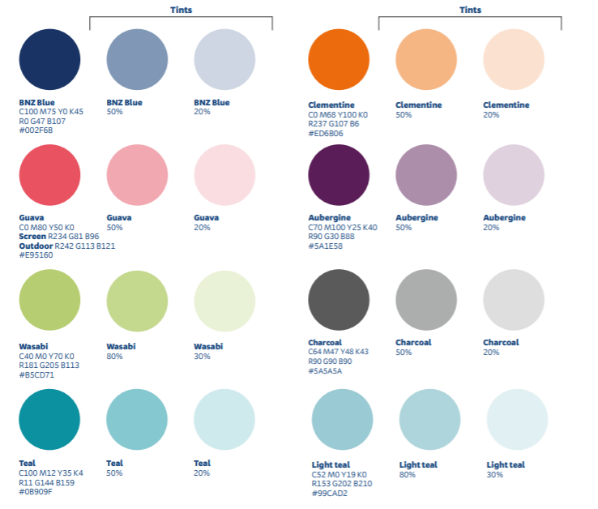



Slide 2
We should integrate our Microservices vs Agent-Based Perspectives
Make choices to maximise our ability to procure or build the agents we will need
Treat agents as a type of service. Align with our choices in other platforms.
Agent purpose
Agent Framework
Agentic Platform
Infrastructure

Slide 3
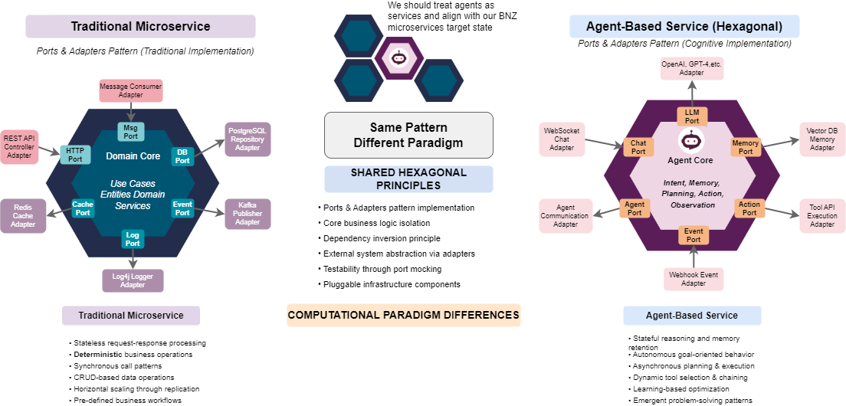
We should integrate our Microservices vs Agent-Based Perspectives
Both architectures follow a similar pattern but serve different computational paradigms

Slide 4
