Slide 1
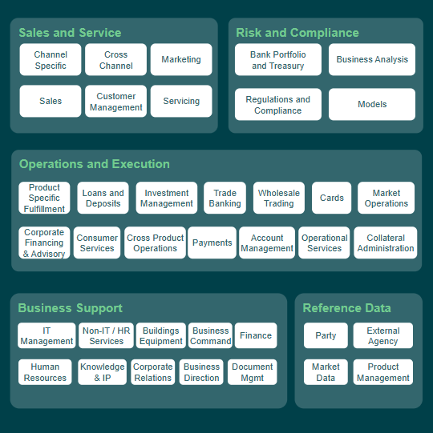

Slide 2
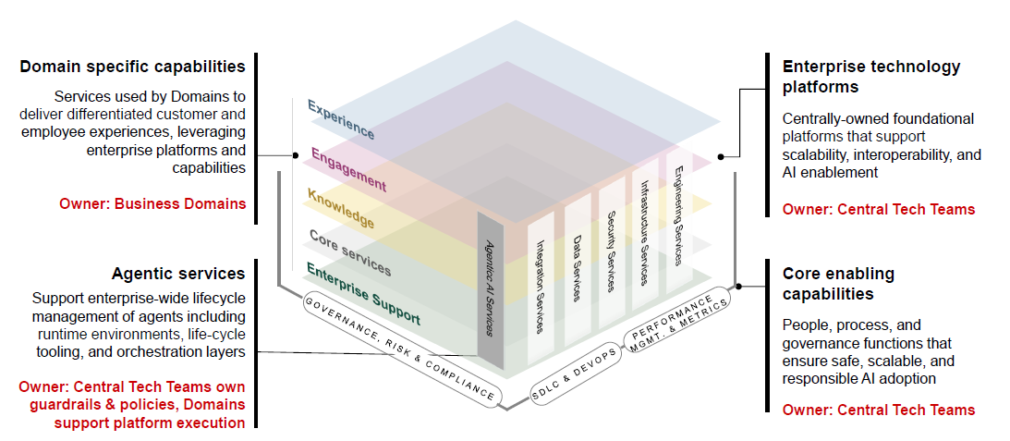
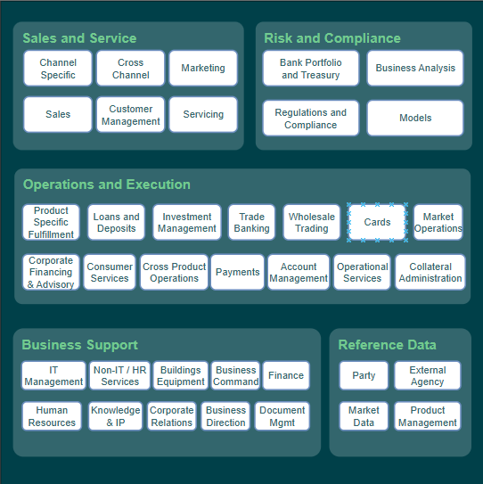
Experience
Engineering Services
Infrastructure Services
Engagement
Security Services
Domain Aligned Platforms
Data Services
Agentic AI Services
Integration Services
Knowledge
Core Services
Enterprise Support
PERFORMANCE MGMT. & METRICS
GOVERNANCE, RISK & COMPLIANCE
SDLC & DEVOPS

Slide 3

Experience
Engagement
Domain Aligned Platforms
Agentic AI Services
Knowledge
Core Services
Enterprise Support

Slide 4
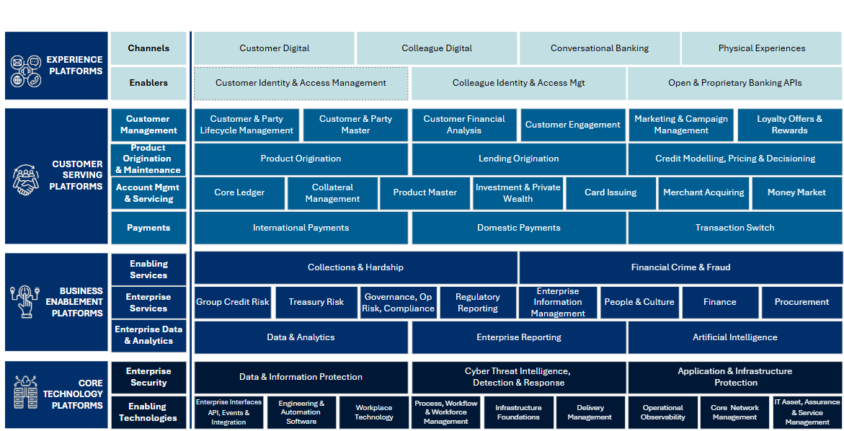
Security Services
AI Platform
Data & Analytics
Agentic AI Services
Enterprise Data & Analytics
Data Services
Cyber Threat Intelligence, Detection & Response
Application & Infrastructure Protection
Data & Information Protection
Enterprise Security
Enterprise Interfaces API, Events & Integration
Infrastructure Foundations
Engineering & Automation Software
Infrastructure Services
Enabling Technologies
Integration Services
Engineering Services

