Slide 1
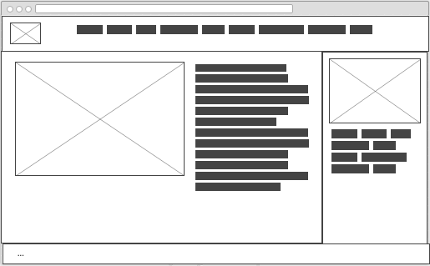
Header –
NAV
Aside –
Map, Address, Tel #
Article –
About us
Footer –
Contact us

