Slide 1
Generative Imaging using Diffusion Models
Marios S. Pattichis, FEAMBES, Senior Member, National Academy of Inventors
Director of online M.Sc. In Computer Engineering in Applied Machine Learning And AI Systems Engineering
Department of Electrical and Computer Engineering
The University of New Mexico

Slide 2
References
The coding examples are adopted from:
A. Géron (2025). Hands-On Machine Learning with Scikit-Learn and PyTorch: Concepts, Tools, and Techniques to Build Intelligent Systems. O'Reilly.
The basic learning models are from:
Torralba, A., Isola, P., & Freeman, W. T. (2024). Foundations of Computer Vision. The MIT Press. https://visionbook.mit.edu/.

Slide 3
The Diffusion Process: Training
Step 1. Build a dataset to train the diffusion process:
Select a dataset to use for generation
Add noise to all the pixels
Repeat until the picture looks like noise
Step 2. Train an auto-encoder neural network to remove noise from an image:
Noisy images dataset
Auto-encoder
Neural Network
Define error in terms of generated and input images

Slide 4
The Diffusion Process: Deployment
Generate Random Noise and input time step t
Use Neural Network to reverse all time steps
Realistic Image

Slide 5
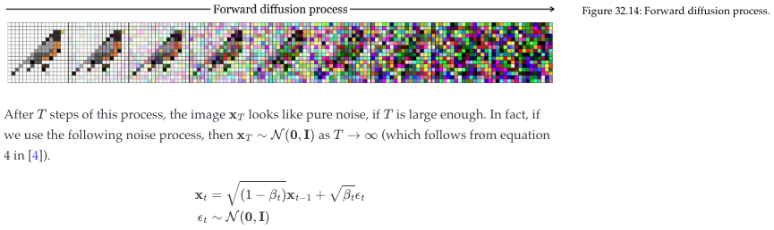
Training dataset: Create a sequence from any input image
https://visionbook.mit.edu/

Slide 6
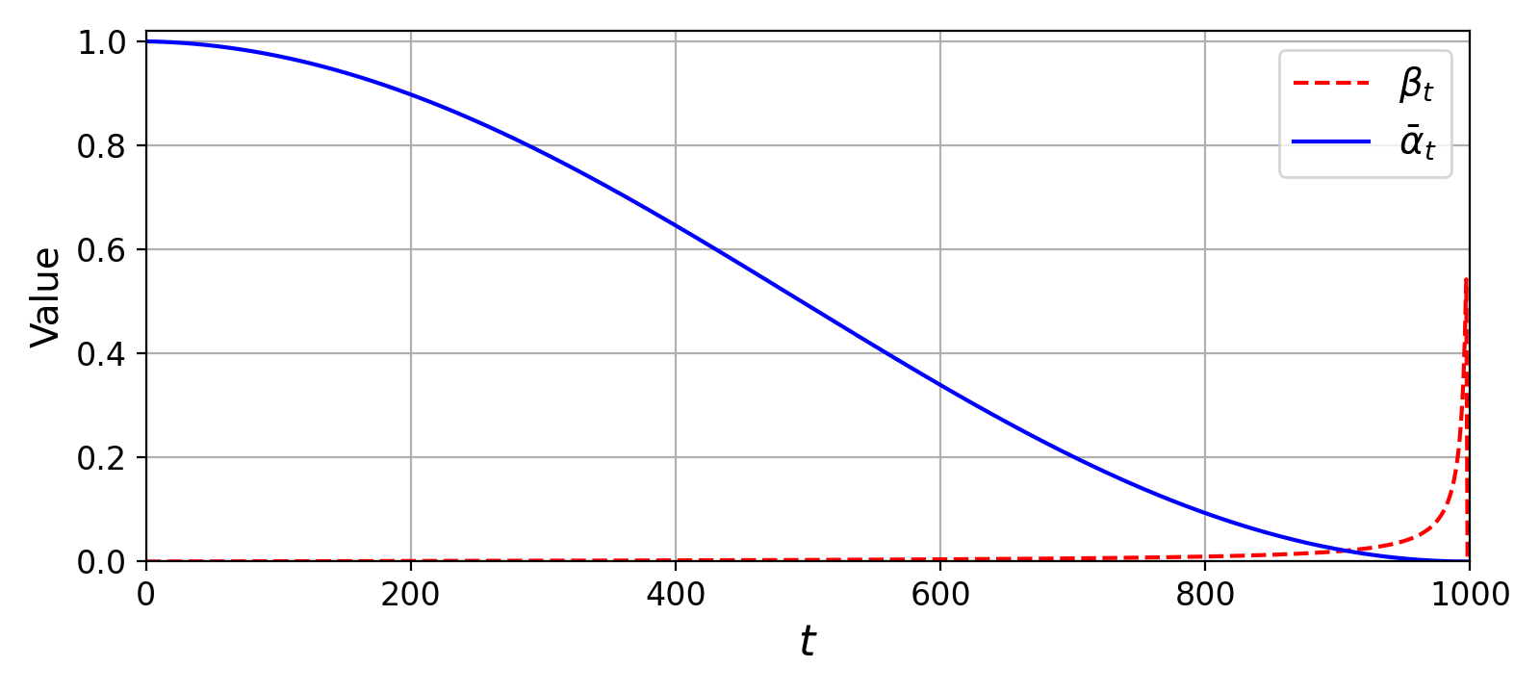
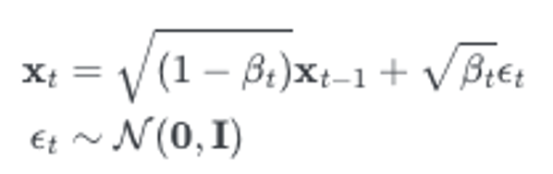
Generate noisy videos
Code uses:
ab = 1 - beta_t.
beta_t = 1 – ab.
Signal coefficient keeps going down.
Noise coefficient picks up at the end.
N_STEPS = 1000 # number of noise levels: t = 0, 1, ..., 999
s = torch.arange(N_STEPS + 1, device=device) / N_STEPS
alpha_bar = (torch.cos((s + 0.008) / 1.008 * math.pi / 2) ** 2) # cosine schedule
alpha_bar = (alpha_bar[1:] / alpha_bar[0]).clamp(1e-5, 1) # 1 = clean ... ~0 = pure noise
def add_noise(x0, t, noise): # x0: clean videos, shape (B, 1, T, H, W)
ab = alpha_bar[t].view(-1, 1, 1, 1, 1) # one alpha_bar per video, shaped to match x0
return ab.sqrt() * x0 + (1 - ab).sqrt() * noise # x_t = sqrt(ab)*x0 + sqrt(1-ab)*noise
# In the training loop:
noise = torch.randn_like(x0) # random Gaussian noise, same shape as the videos
xt = add_noise(x0, t, noise) # noisy videos at random noise levels t

Slide 7
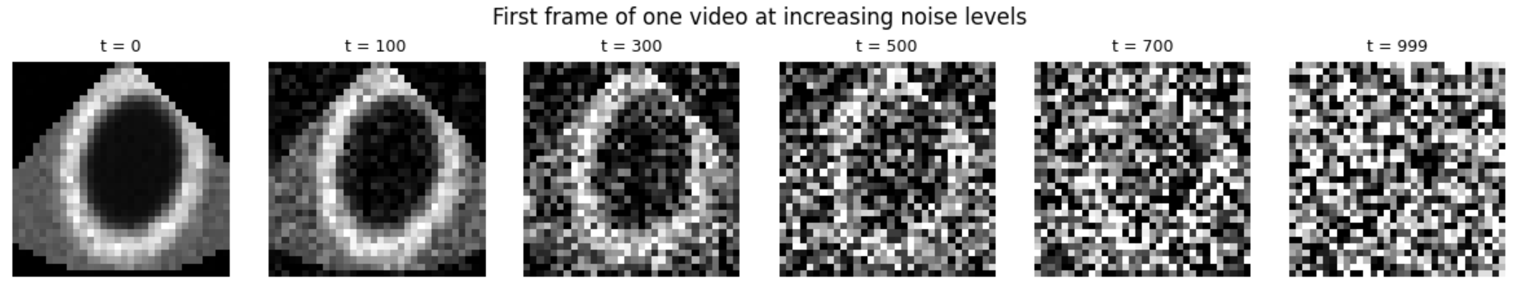
Adding noise until it looks like noise

Slide 8
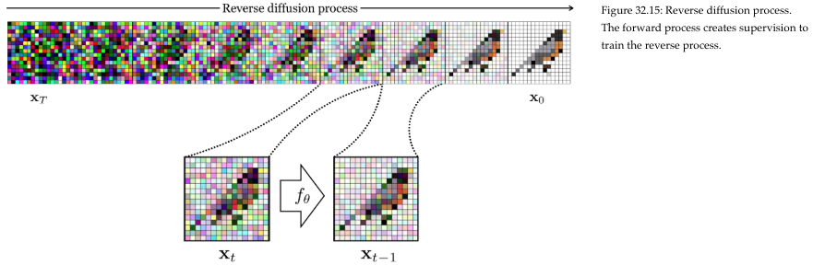
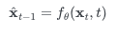
Neural Net Goal: Reverse the sequence
We will look at embedding
the time t and other parameters
into the input.
https://visionbook.mit.edu/

Slide 9
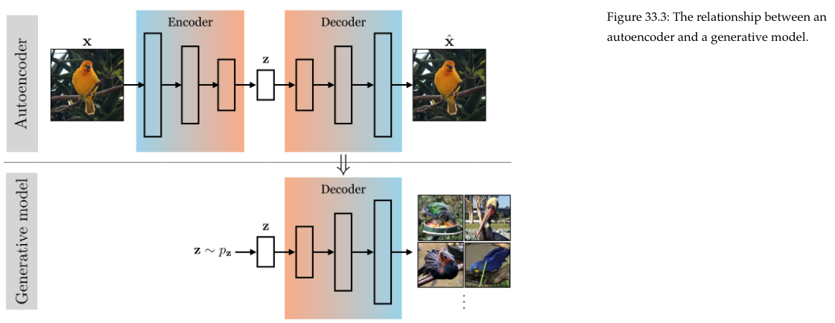
Use an Auto-encoder as a Diffusion Model
https://visionbook.mit.edu/

Slide 10
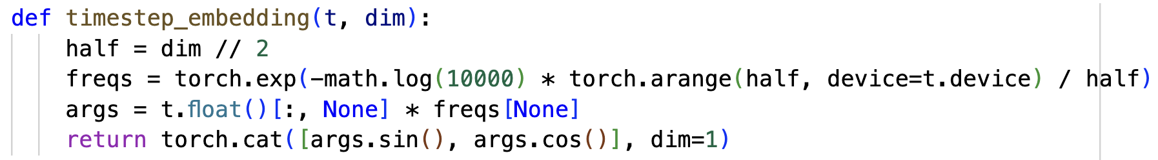
Embedding Time using sinusoids

Slide 11
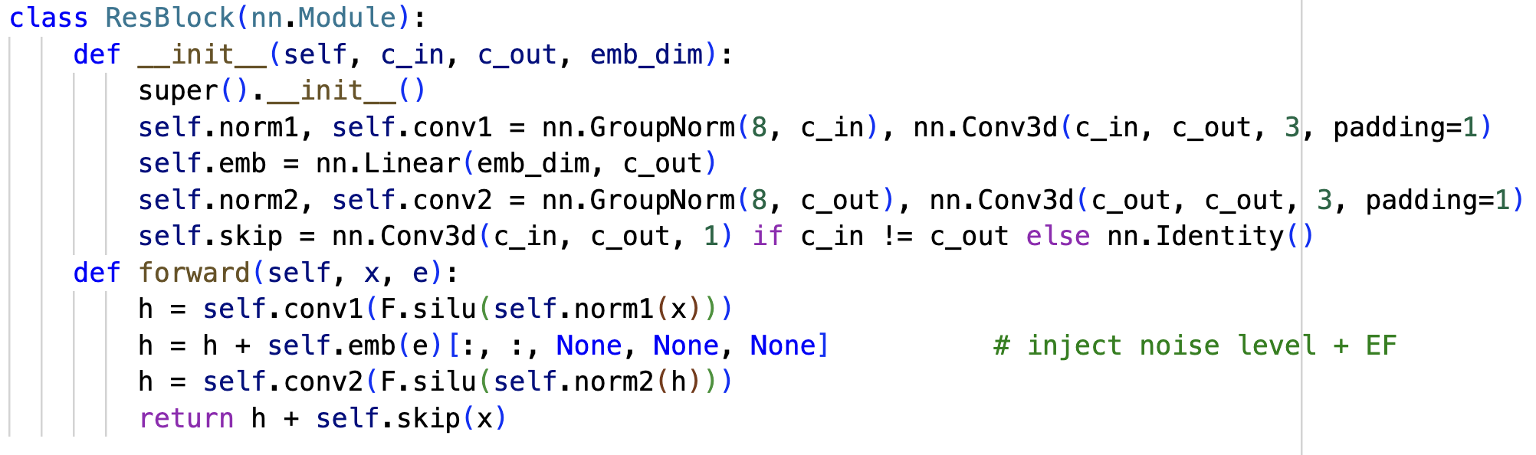
Residual block: from c_in to c_out channels
The skip connection converts from input channels to output channels if needed, enabling a residual connection.
Residual connection.
ejection fraction embedding propagation through linear layer.

Slide 12
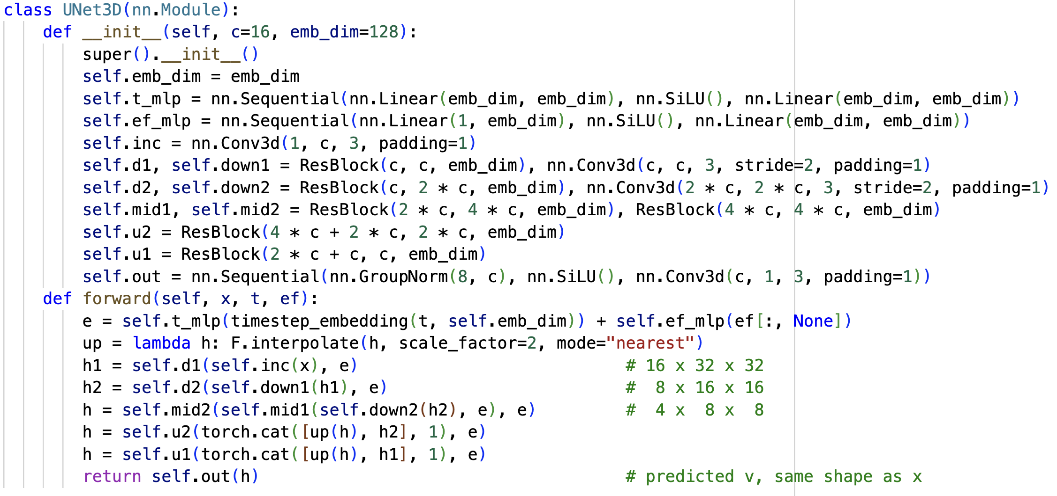
UNet3D: Autoencoder with time and ef embeddings
ejection fraction embedding.

Slide 13
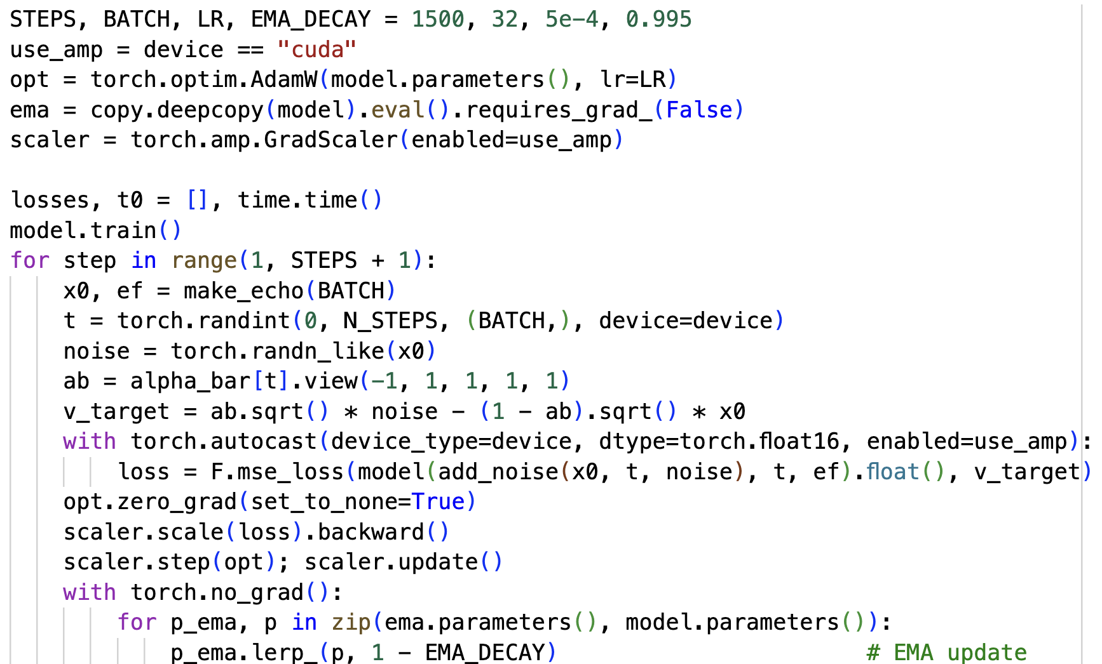
Training EMA using UNet3D
ema model.
Add noise and train UNet3D to reverse.
Train ema model.

Slide 14
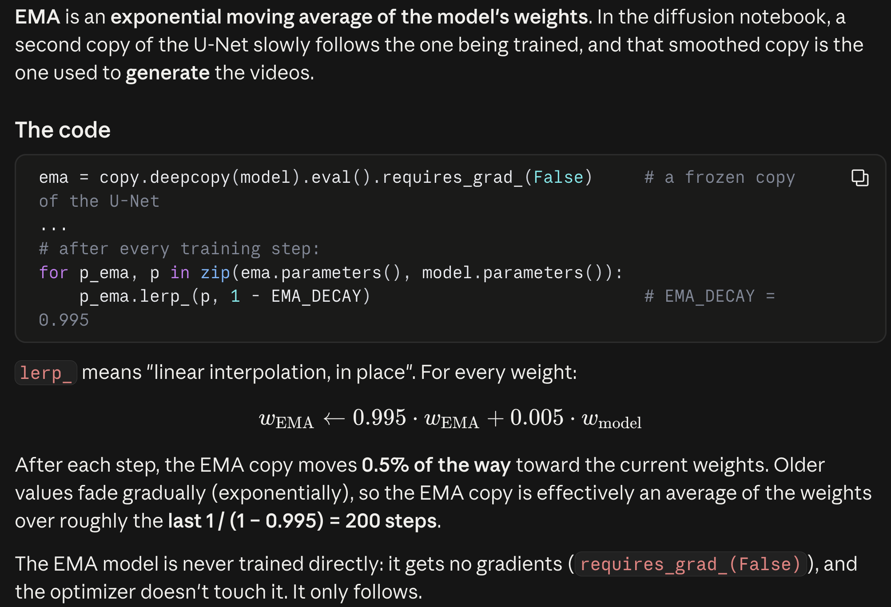

Slide 15
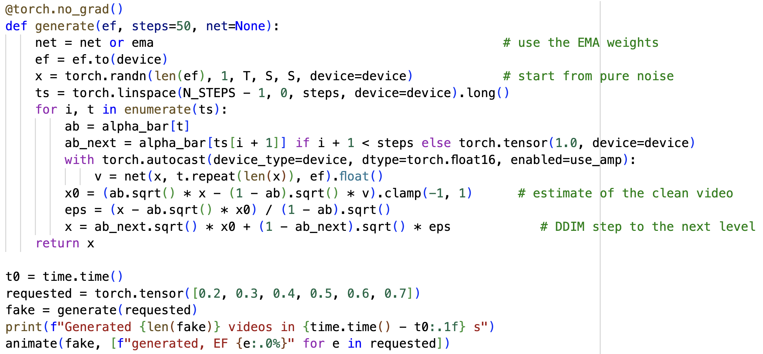
Use ema to generate the target with given ef
Generate these ejection fractions.

Slide 16
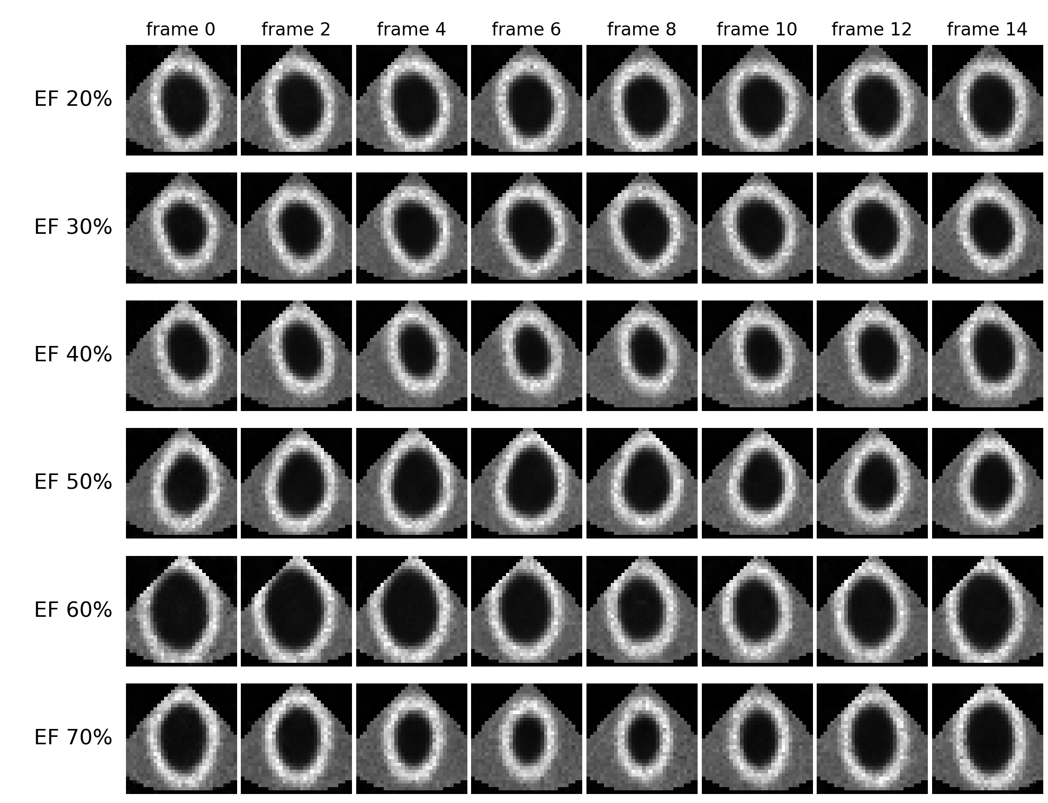
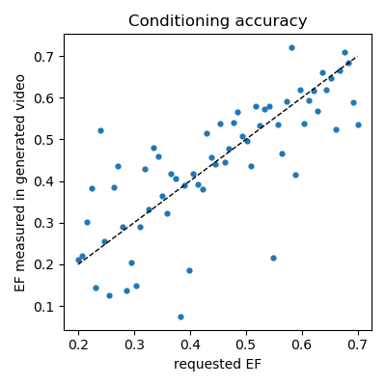
Example Output: Heart Videos
Ejection fraction (EF): the fraction of blood the left ventricle pumps out with each heartbeat.
EF = (EDV − ESV) / EDV EDV, ESV: ventricle volume when most filled / most emptied
Normal: about 55–70%. 40% or less: reduced (heart failure).
In our videos (2D): EF = 1 − smallest cavity area / largest cavity area
Above: requested EF vs. EF measured in 64 generated videos.
Correlation 0.77, mean error 0.07
Do the videos appear realistic? Does each heart pump as requested?

