Slide 1
Adversarial Training
Marios S. Pattichis, FEAMBES, SM NAI
Department of Electrical and Computer Engineering
The University of New Mexico, USA

Slide 2

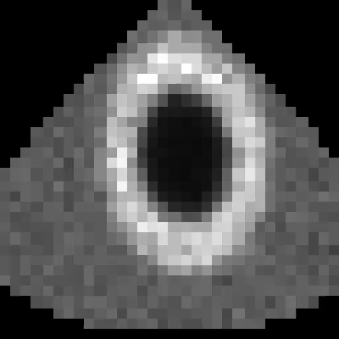
Simulated videos for EF=20 (left), EF=70 (right)
Ejection fraction (EF): the fraction of blood the left ventricle pumps out with each heartbeat.
EF = (EDV − ESV) / EDV EDV, ESV: ventricle volume when most filled / most emptied
Normal: about 55–70%. 40% or less: reduced (heart failure).
In our videos (2D): EF = 1 − smallest cavity area / largest cavity area. A bad approx.

Slide 3
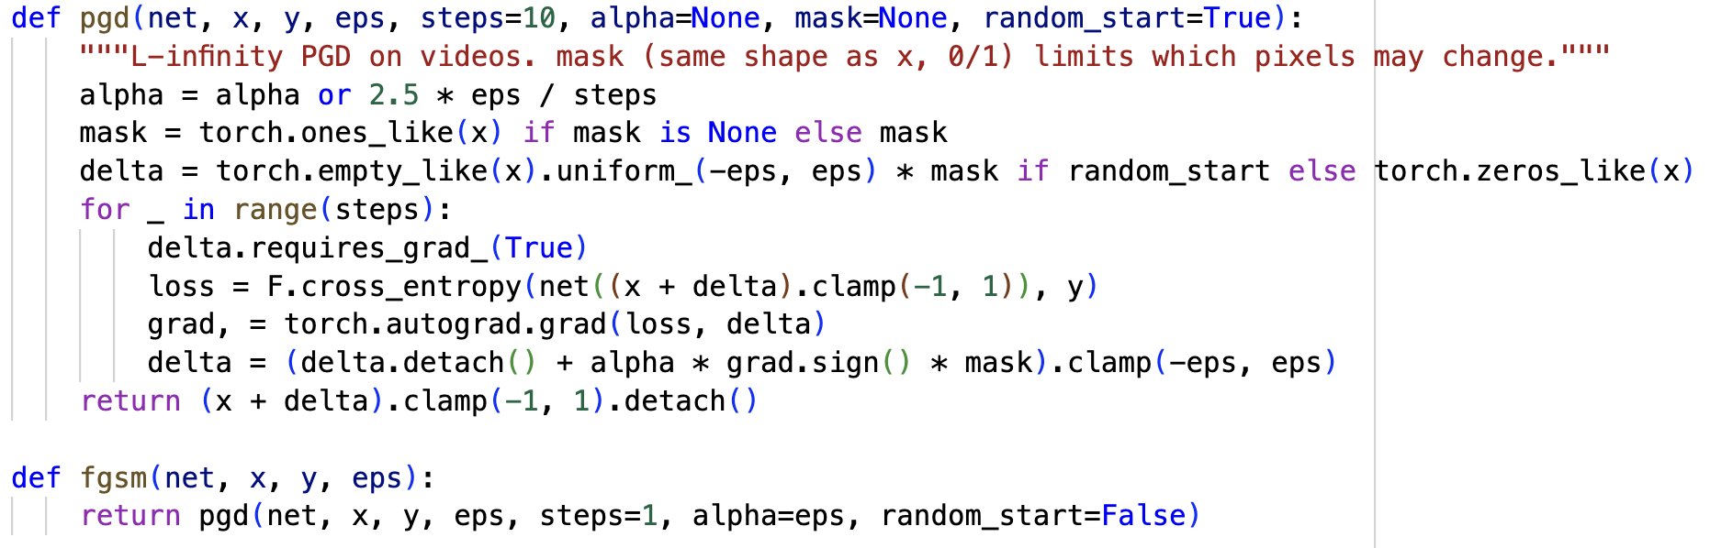
Adversarial attack over mask, random start, and steps
Control the size of the attack using alpha.
mulitple steps
delta = uniform random noise input.
Attack using the sign of the gradient of the added delta.
Original FGSM sets alpha=eps instead of optimizing better over 10 steps.
Original FGSM attack is weaker. Taking 10 gradient steps is more effective and better optimized.

Slide 4
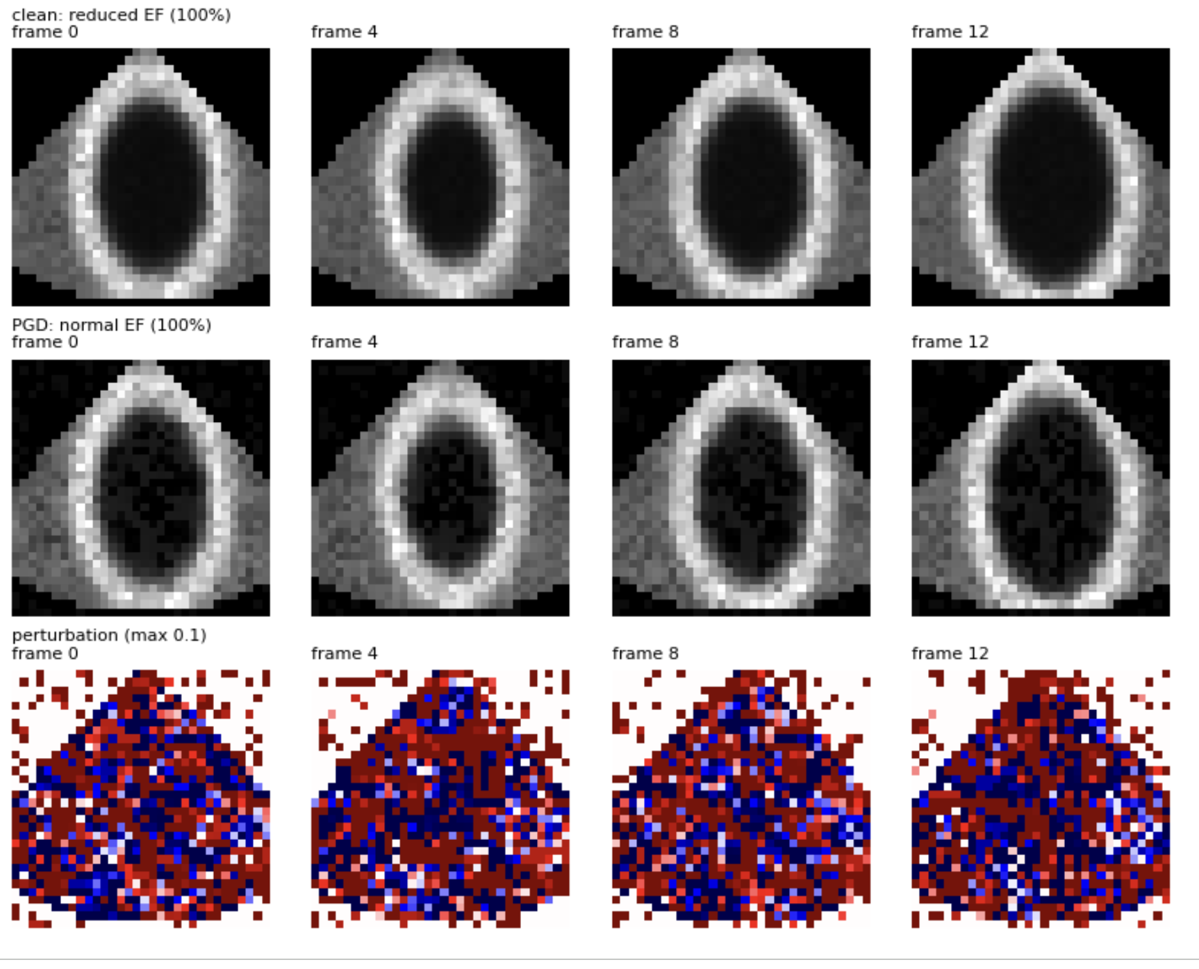
An Example of an Adversarial Attack
Reduced ejection fraction is
correctly classified.
A small attack keeps the same
look but now gets misclassified!
Noise that was added to the
original (=top video).

Slide 5
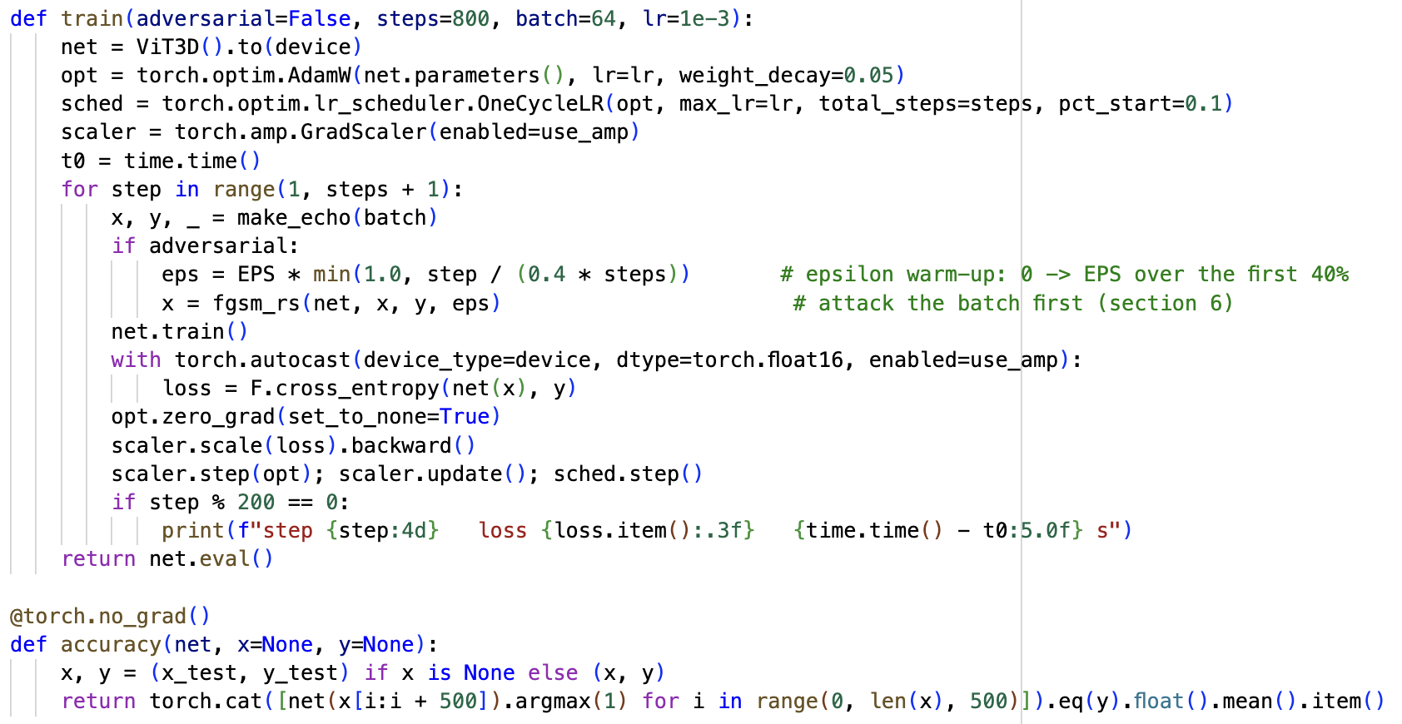
Adversarial Training
Achieve fast convergence by training
scheduling the learning rate.
Prevent zero-gradient components through scaling.
Linearly increase eps and then keep at 1.0.
Attack x but keep the label y the same.

Slide 6
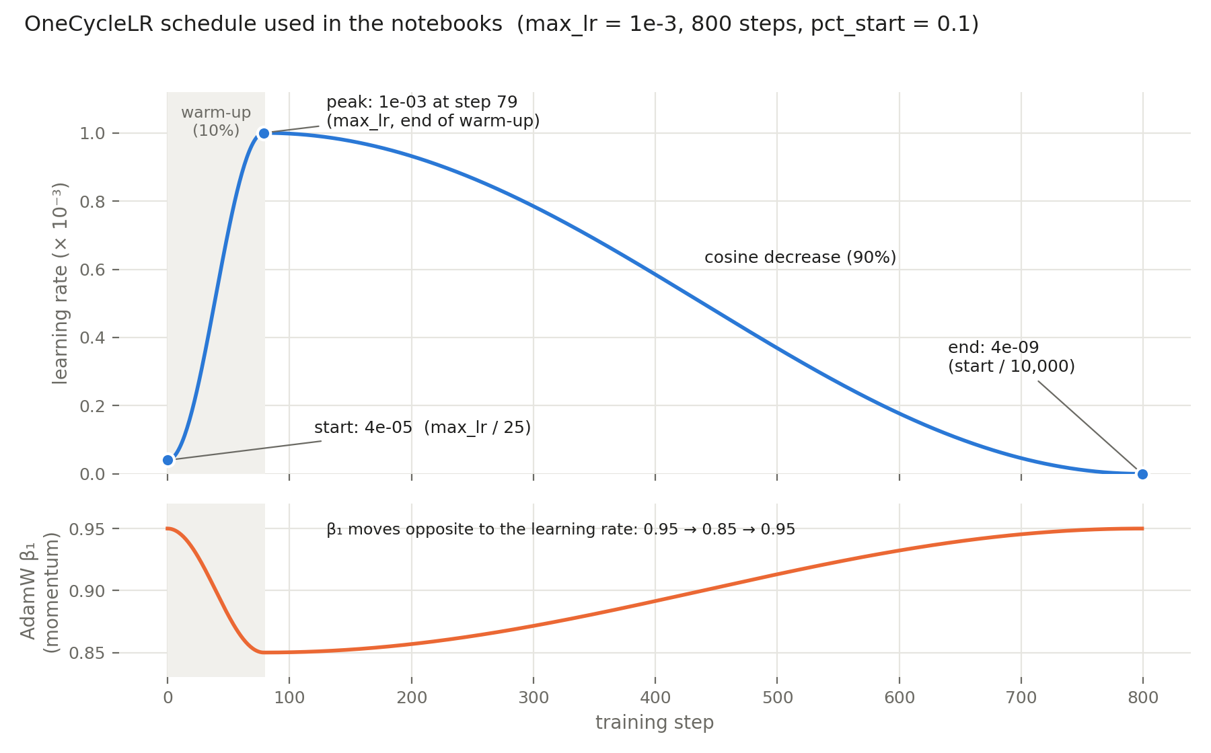
Fast training using learning rate and momentum scheduling

Slide 7
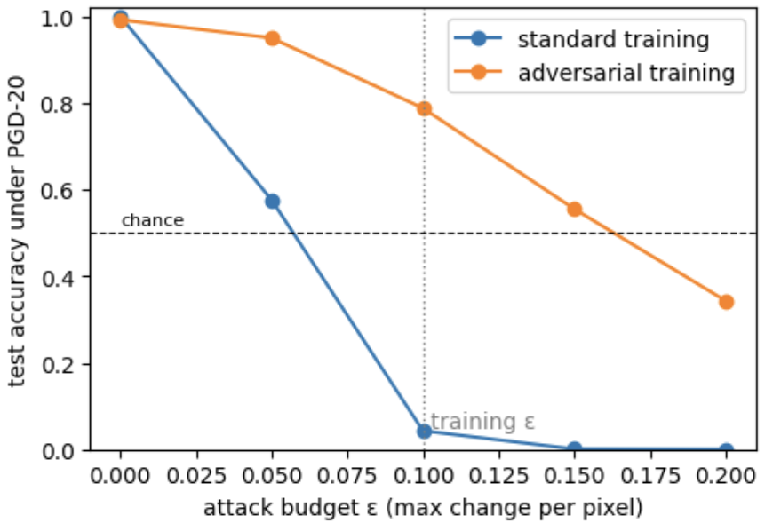
Improved results for reasonable attacks

