Slide 1
A demo of 3D transformers for surgical video guidance
Marios S. Pattichis
Department of Electrical and Computer Engineering
The University of New Mexico, USA

Slide 2
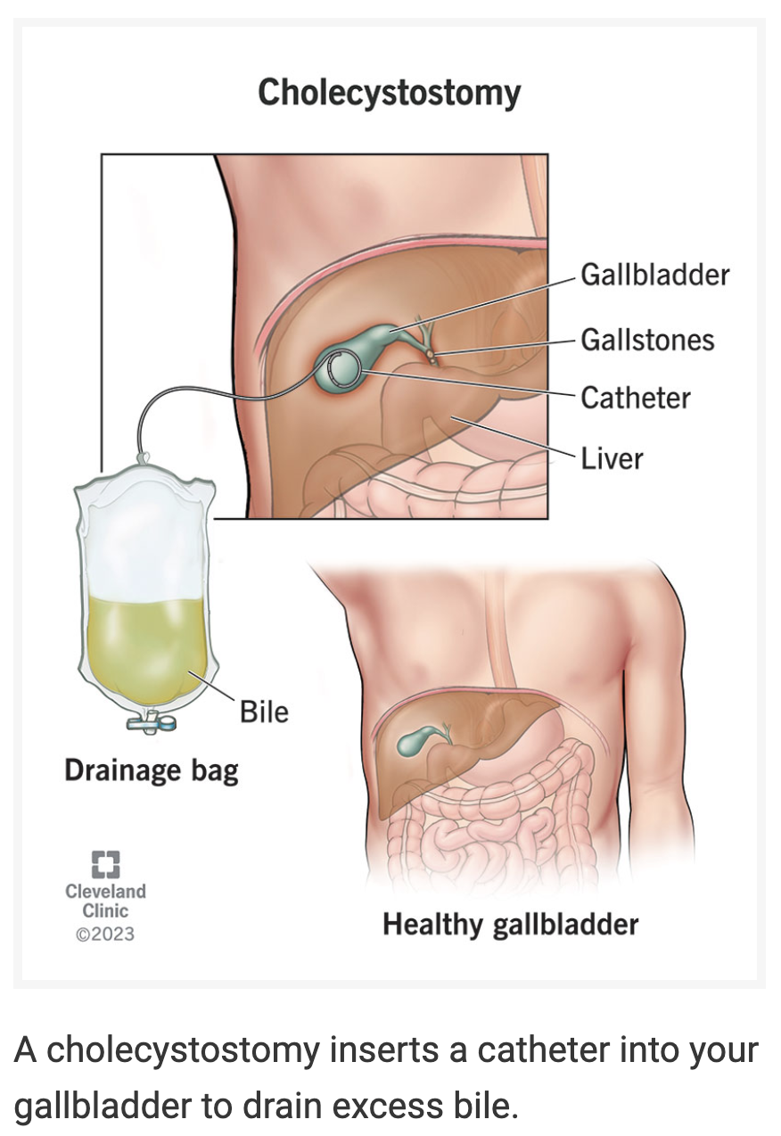
Goal: Guide surgeon to gallbladder
Training Dataset:
Create a simulated video of moving away from the bladder.
Set ground truth to opposite direction that moves us closer.
Testing Dataset:
Full video.
Last frame duplicated.
First frame duplicated.
Random shuffing of frames.
Architecture:
Construct a 3D transformer architecture to process the videos.
Add classification token for last output to select among directions.
Image taken from https://my.clevelandclinic.org/health/procedures/cholecystostomy

Slide 3
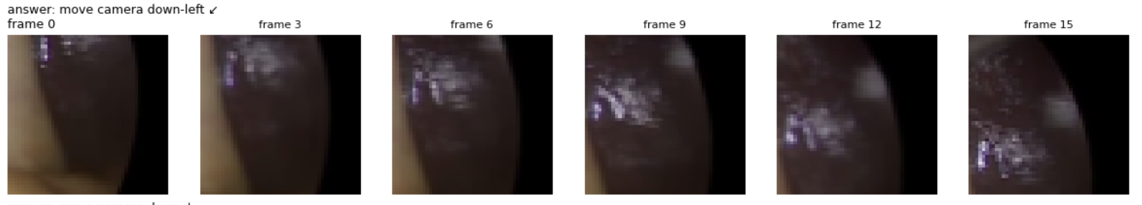
Simulated video example
Input: surgical videos with higher resolution cropped to 48x48 frames.
First-frame: Gallbladder located in the lower-left.
Remaining frames: Moving to the upper-right over the full frame. Crop to 48x48.
Ground truth: Correct upper-right movement by recommending down-left.
Limitation: Only 8 directions considered here.

Slide 4
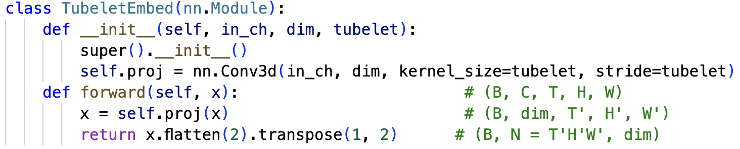
Input video decomposed into segments
Conv3D uses a stride that is the same as the tubelet (=video segment) for non-overlapping segments.
At the end, flattening turns them into vectors.

Slide 5
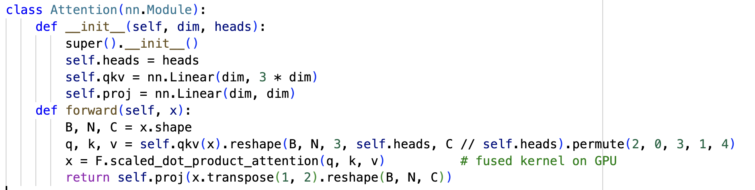
Attention implementation
Dimensions:
B = batch size, N=number of tokens, C=3 for the R, G, B channels.
Single video segment = 2 frames of 8x8 blocks each.
F.scaled_dot_product_attention(.) from PyTorch.

Slide 6
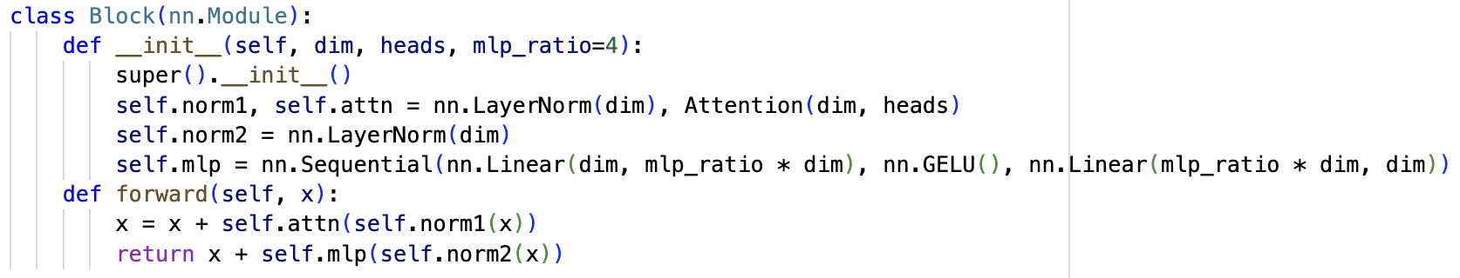
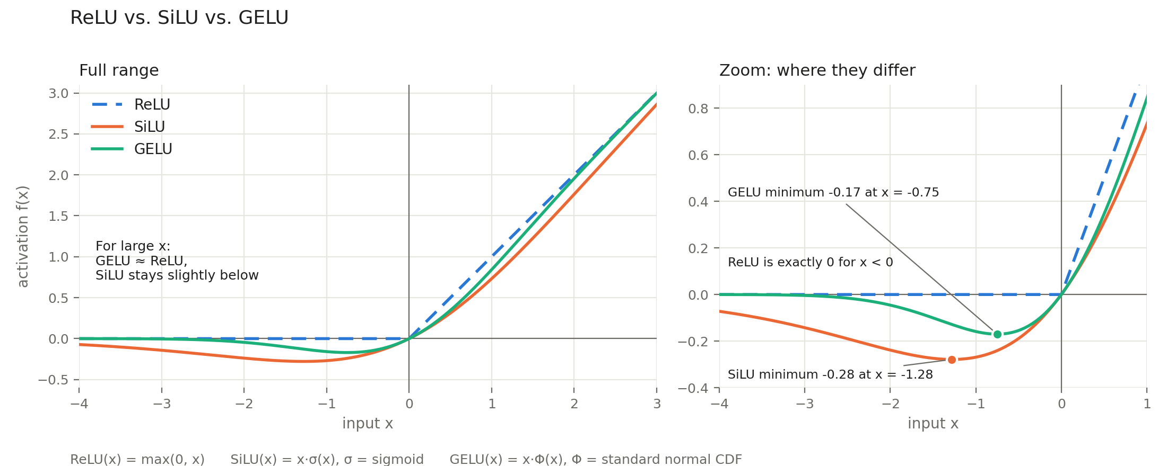
Transformer Block

Slide 7
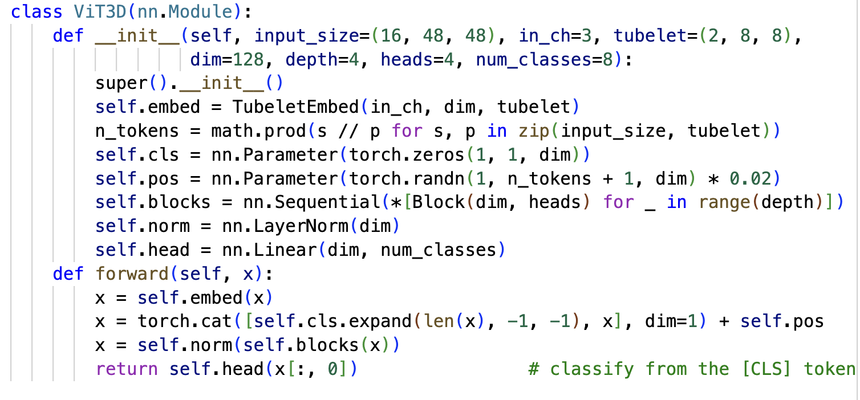
Main Transformer Architecture
Notes:
self.embed(x) implements the video segments.
self.pos implements random vectors for position encoding.
Self.head(x[:, 0]) trains the classification token to accumulate the results.

Slide 8
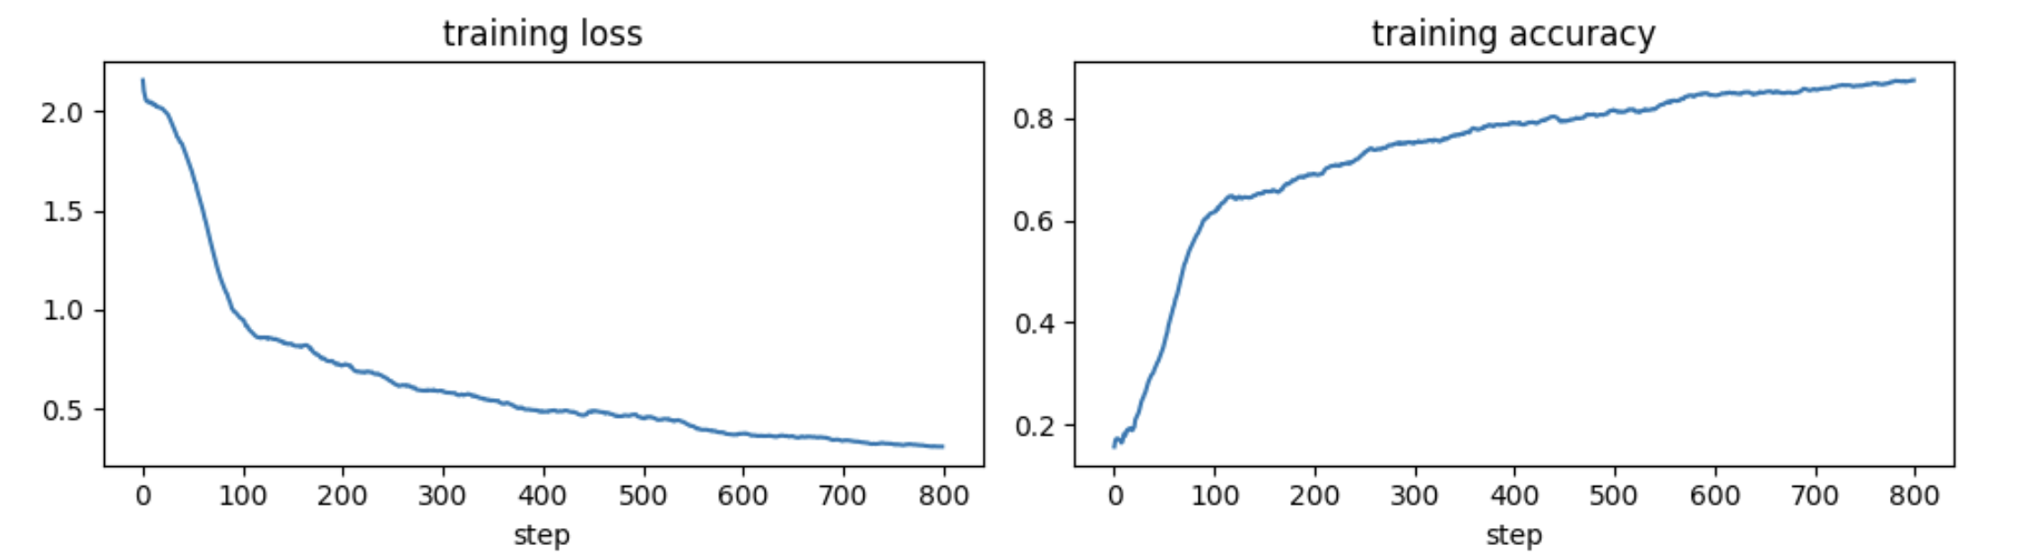
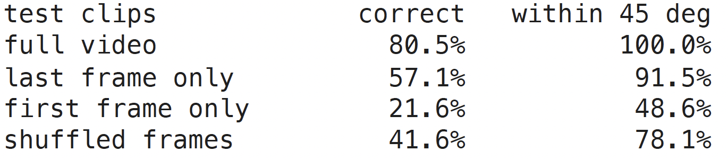
The approach works!

Slide 9
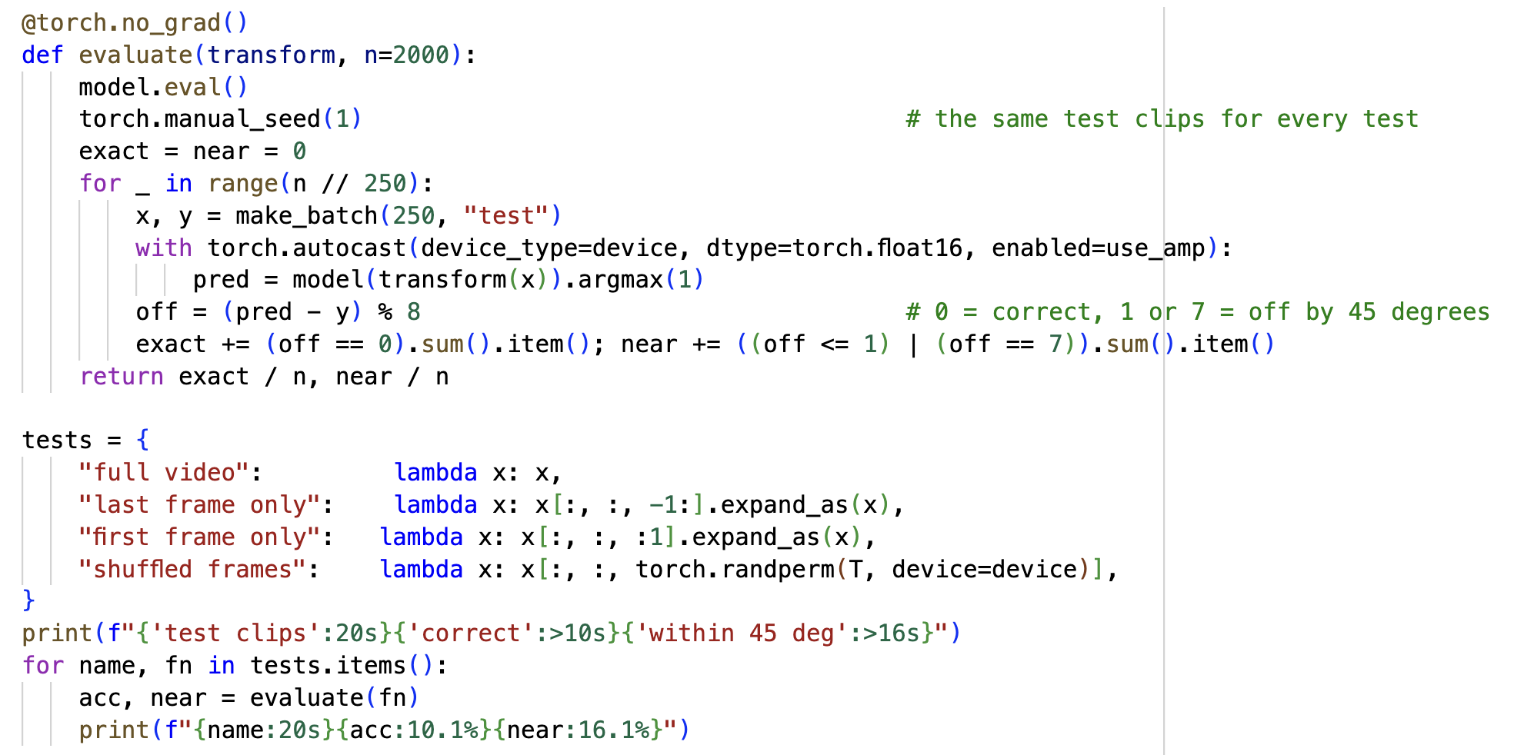
Testing the transformer
Tests resamples the videos and expands to full video length.

Slide 10
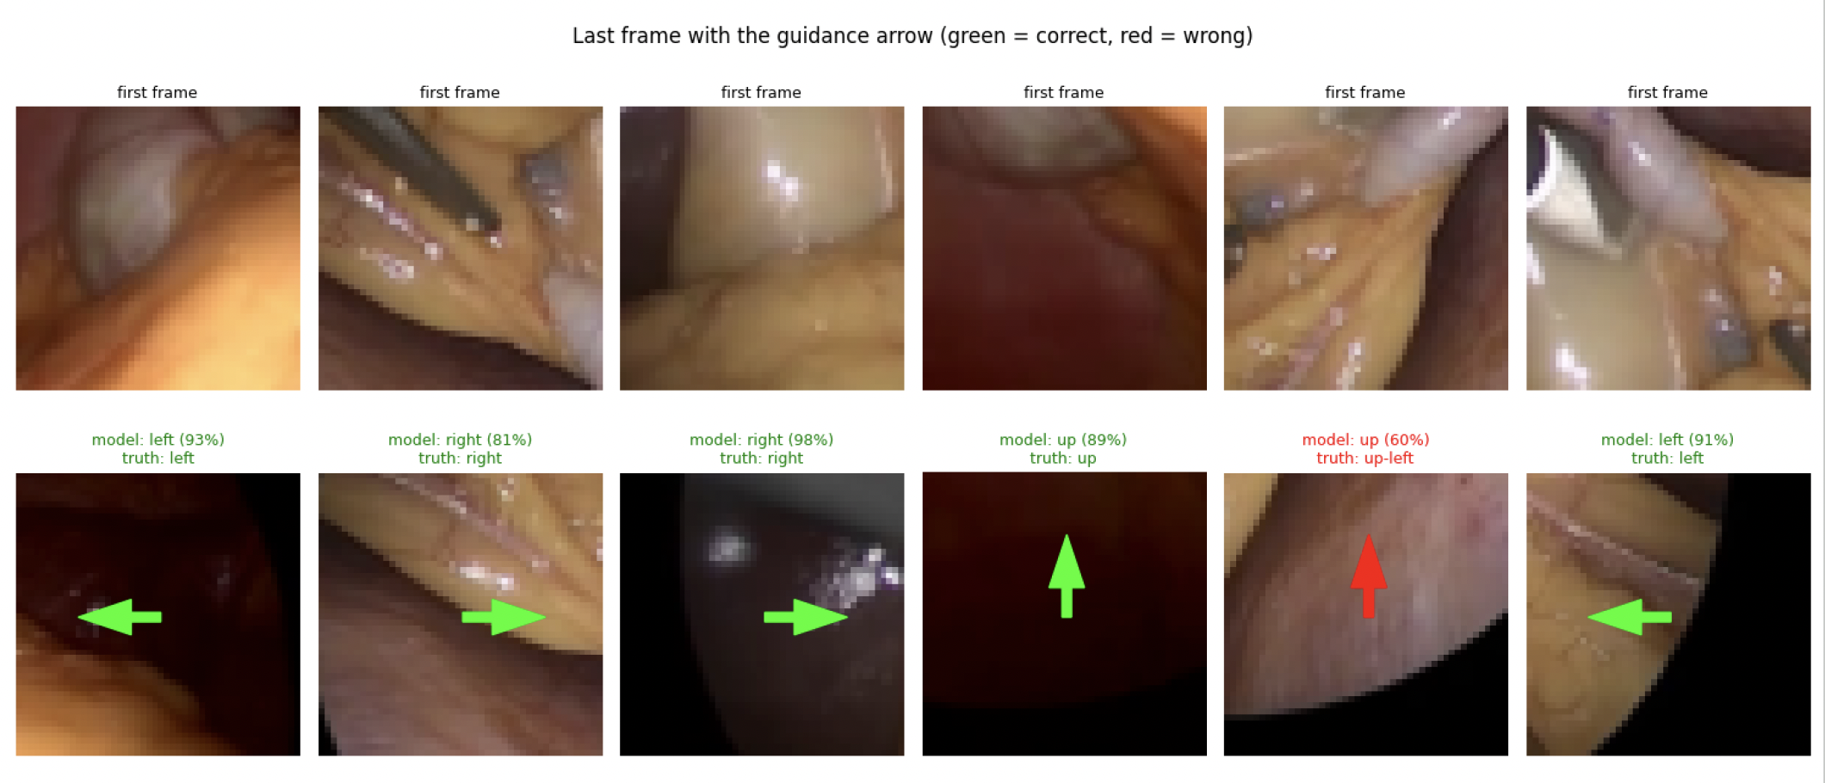
Results: Arrow should point to location in first frame

