Slide 1








Slide 2
Best Mobile in Flip cart

Slide 3
STEPS FOR PROJECT :
1. Importing Required Modules.
2. Web-Scraping.
3. EDA process.
4. Data visualization

Slide 4
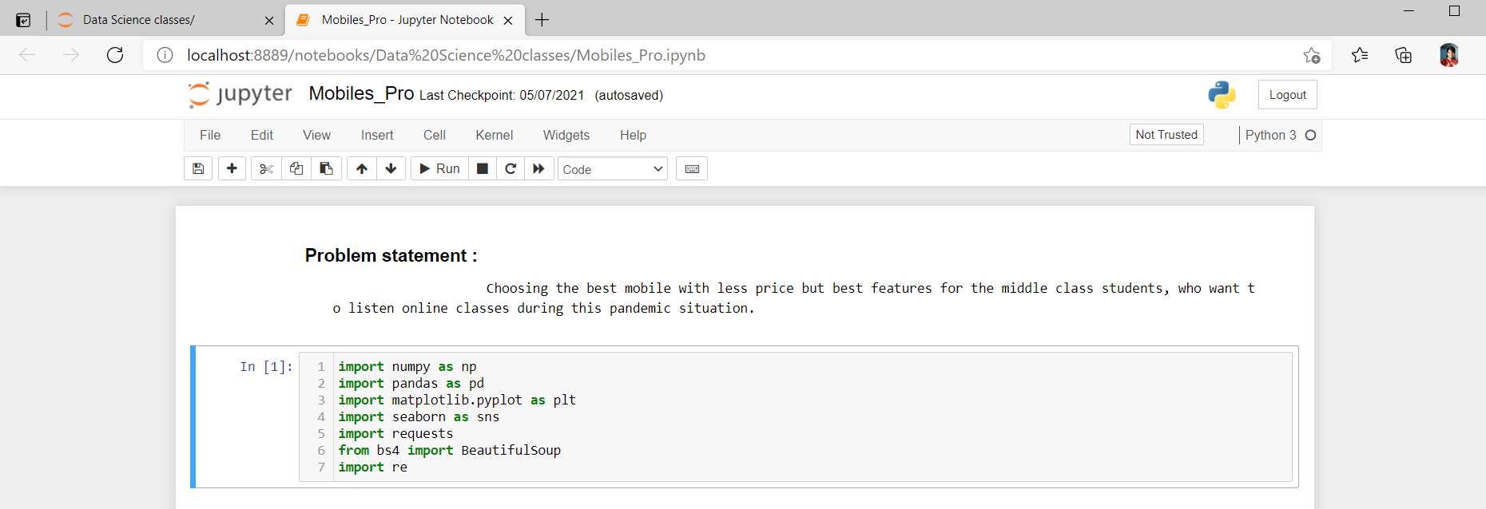
1. Importing Modules :
Figure : Modules

Slide 5
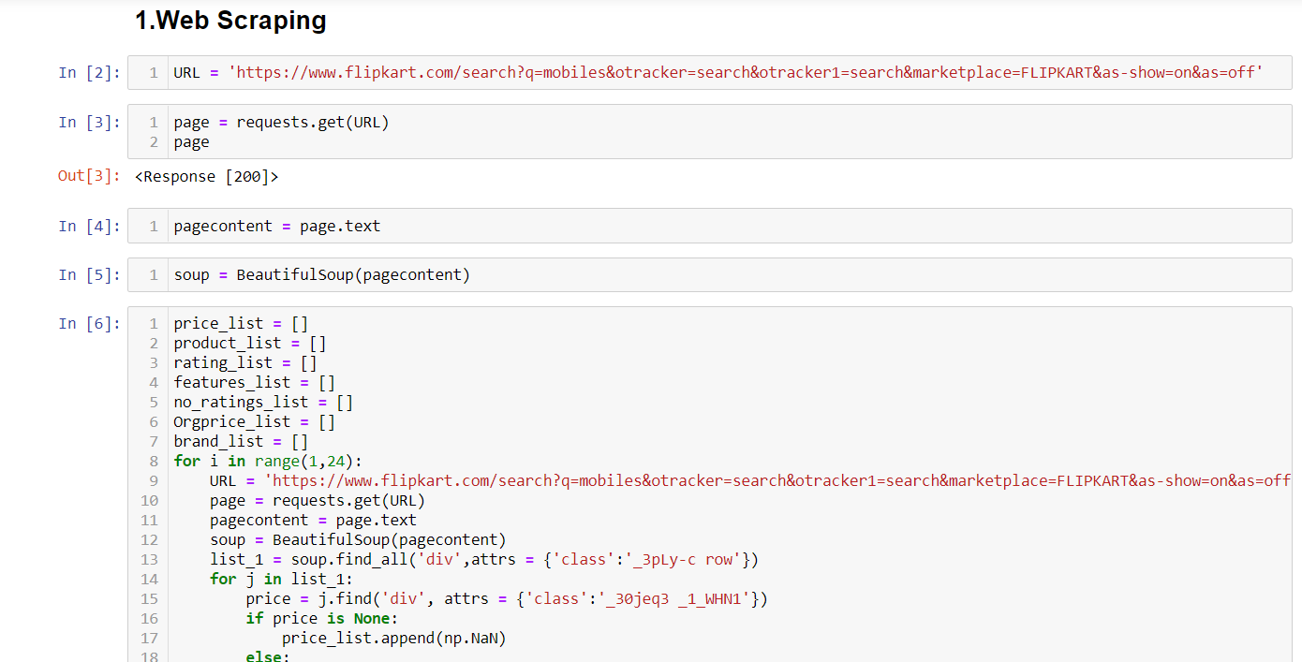
2. Web-Scraping :
Firstly, we have to scrap the data from the related website.
Secondly, we have to load the data by using website’s URL.
Finally, we have to follow the traditional methods to gather the appropriate data and use the REGEX expressions we have to extract more data for data visualization.
Figure : Web Scraping1

Slide 6
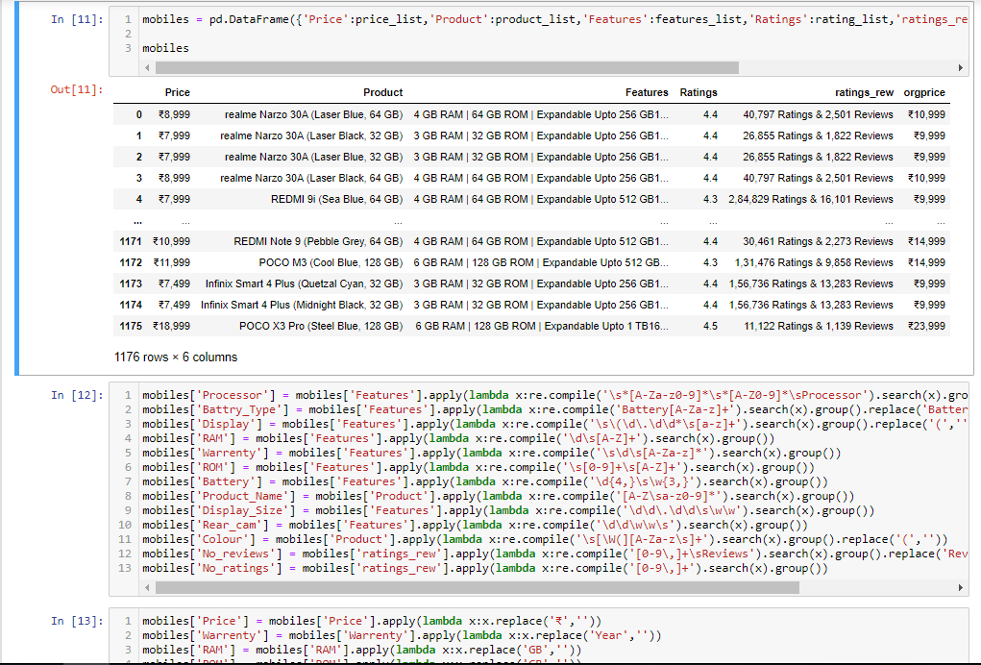
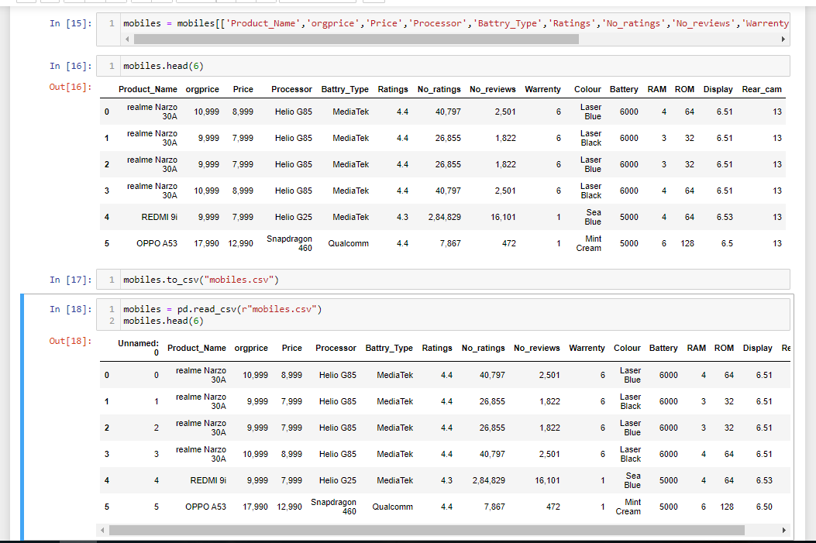
Figure : Web Scraping2
Figure : Web Scraping3

Slide 7
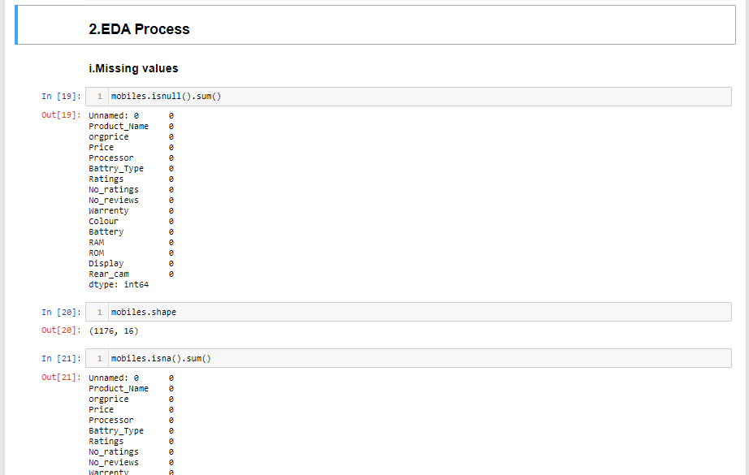
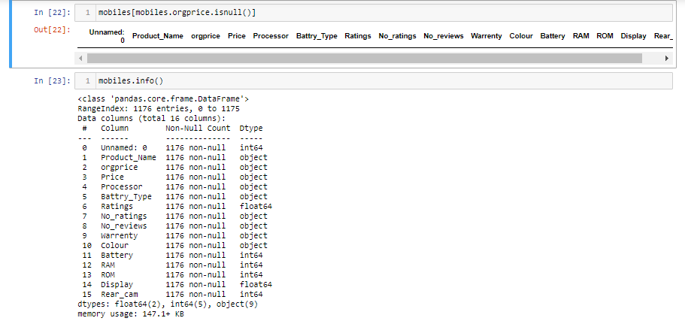
3. EDA Process:
This Process has various steps to detect Null/Missing values ,duplicate values, Invalid values and Outlier detections.
i. Missing Values Detection :
Following figures shows about null values detection.
Figure : Missing Values

Slide 8
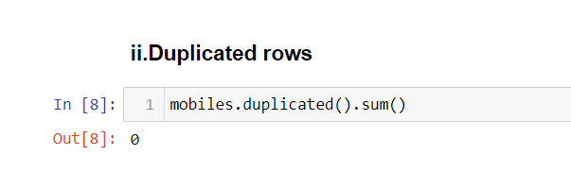
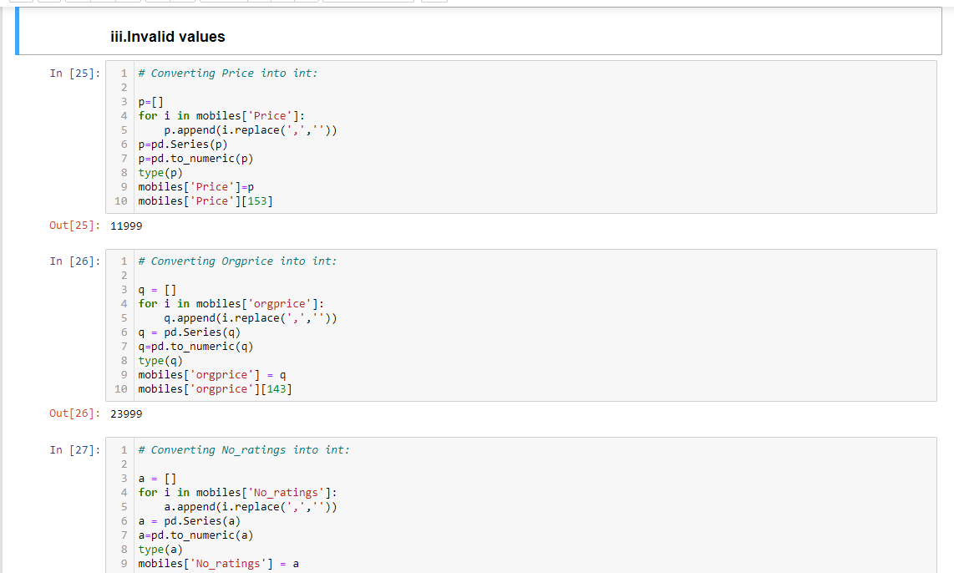
ii . Duplicated Values :
The following figure shows about duplicated values
iii . Invalid Values :
The following figure shows about invalid values
Figure : Duplicated rows
Figure : Invalid values1

Slide 9
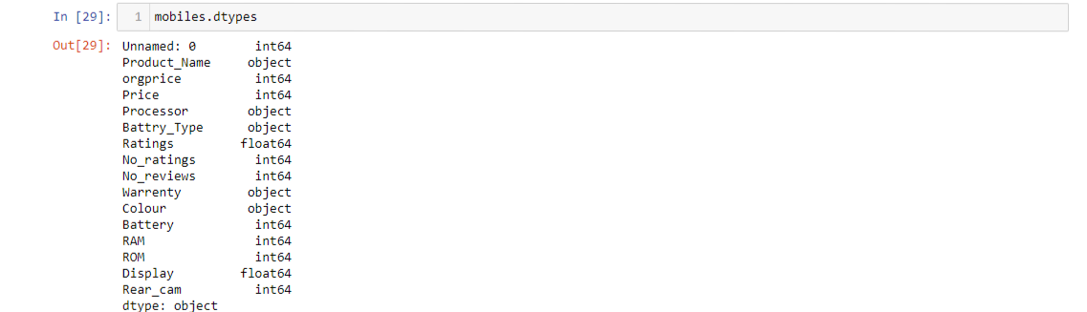
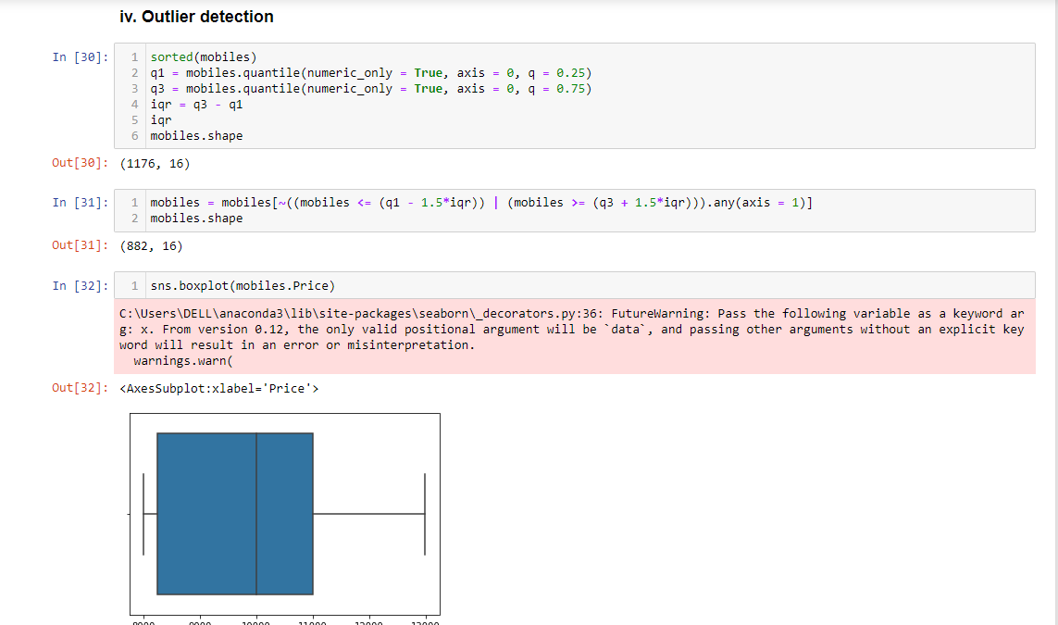
Figure : Invalid values2
Iv . Outlier Detection :
The following figure shows about outlier detection
Figure : Outlier Detection

Slide 10
4 . Data Visualization :
Data Visualization is a tool In which the data can be represented in the form of graphs.
Because human mind can easily understands the image data than the data which in text format.
So, data scientists prefers the various graphs plotting techniques to make people understand the complex to simple thing.
The various graphs plotting techniques are as follows:
Using Matplotlib we have the graph’s like : Bar, Box, Line, Pie, Scatter, Histogram.
Using Seaborn we have the graph’s like : Scatter, Line, Kde, Violin, Histogram, Bar, Box, Count, Heat map, Pair, Distribution, Joint, Relational, Sub.

Slide 11
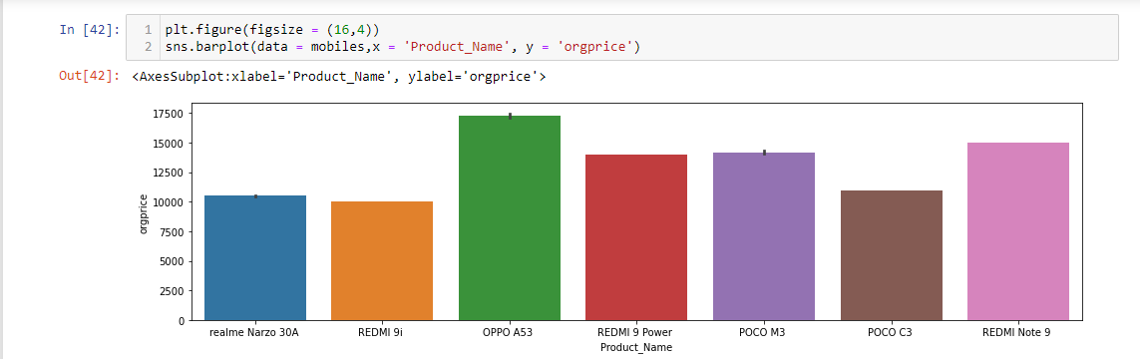
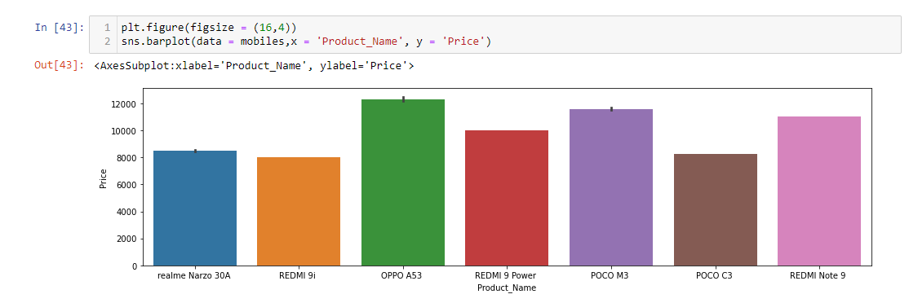
Product Name v/s Features :
Figure : Org price
Figure : Price

Slide 12
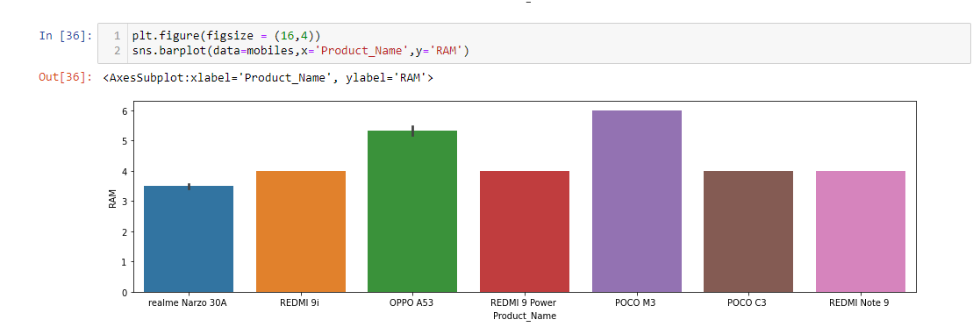
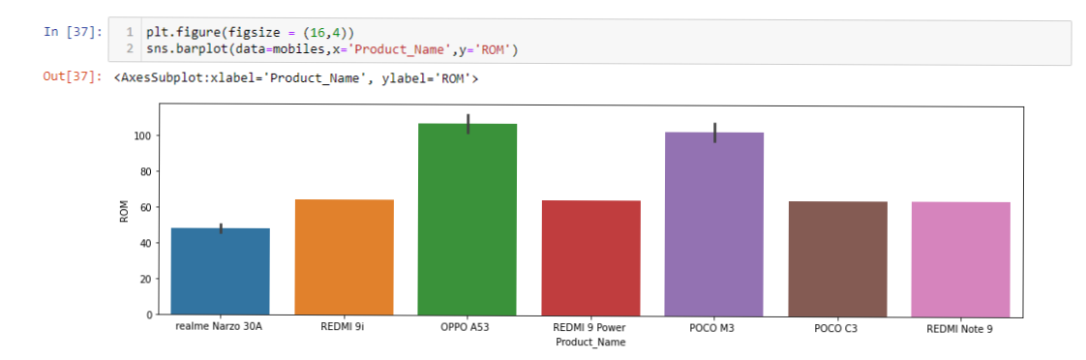
Figure : RAM
Figure : ROM

Slide 13
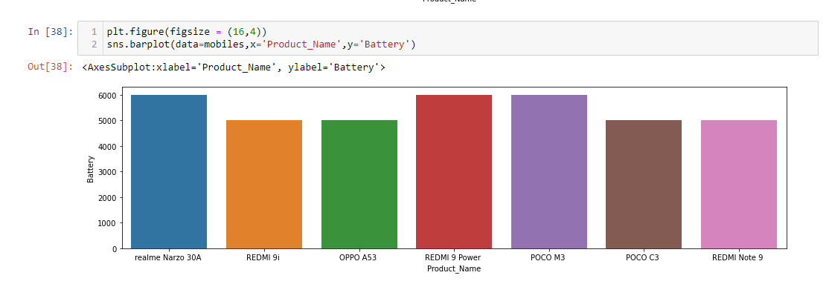
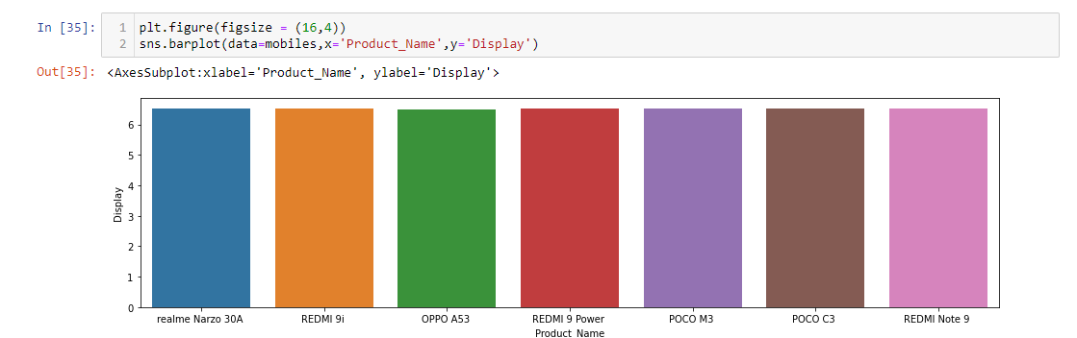
Figure : Battery
Figure : Display

Slide 14
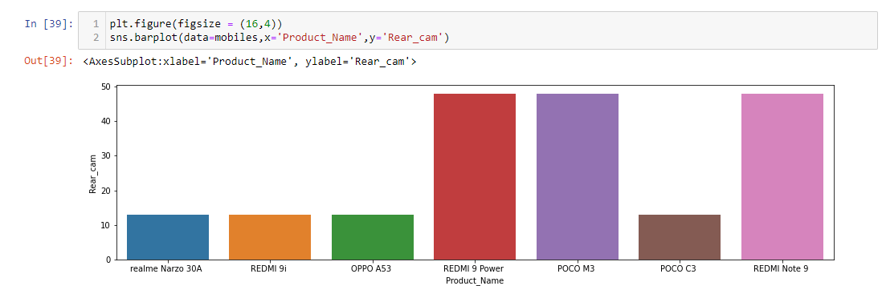
Figure : Rear cam

Slide 15
Conclusion :
We come to know that by observing above graphs the “REDME 9 POWER & POCO M3” is Best when compared to other because it has better features and low price than rest of them.
So, I decided to identify the best mobile with less cost which is affordable to any parents to their children’s future.

Slide 16

THANK YOU

