Slide 1
Sports Buddy Finder
By Sports Buddy Team
Jialin Ding, Linda Namisi, Noor Monam, Pattiya Mahapasuthanon, Sergey Kompaniyets, Wesley Hancock

Slide 2
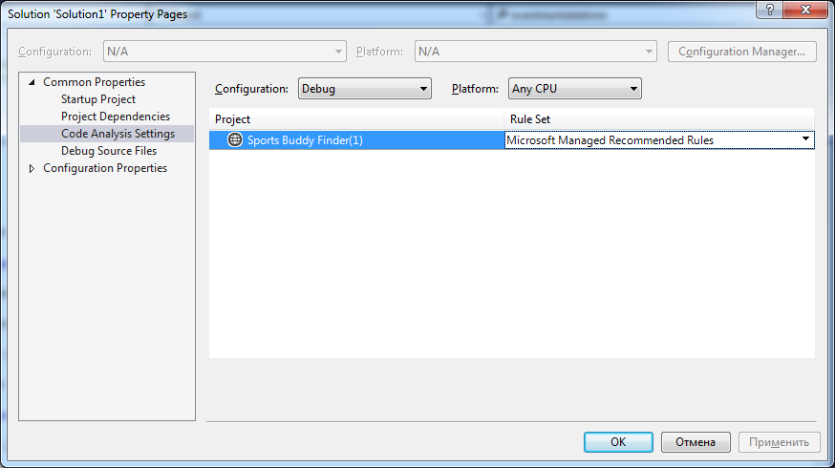
Run Code Analysis Automatically

Slide 3
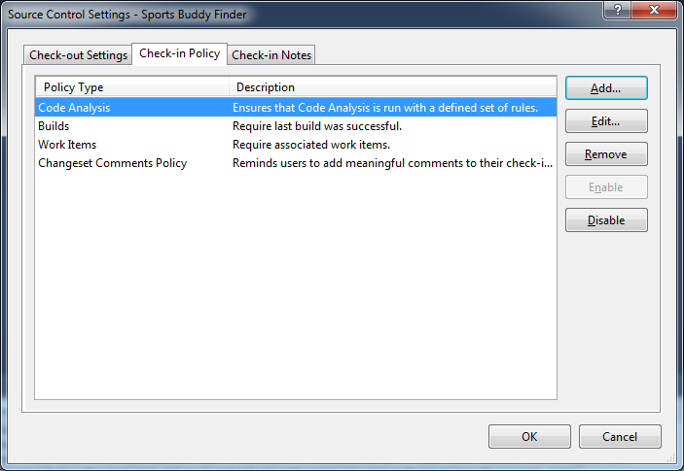
Run Code Analysis while check-in source code to TFS version control (TFSVC)

Slide 4
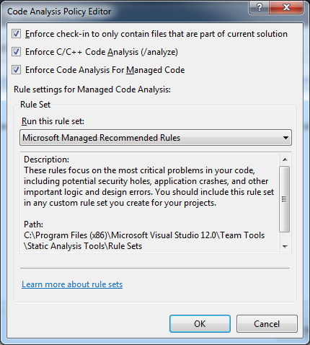
Run Code Analysis while check-in source code to TFS version control (TFSVC)

Slide 5
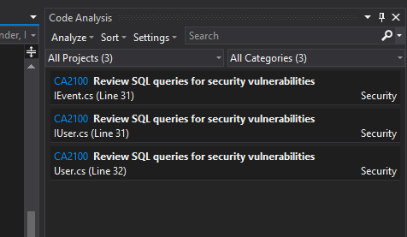
Code analysis in solution

Slide 6
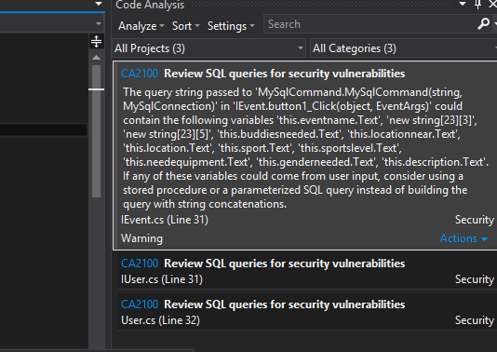
More descriptions on Code Analysis
- MySQL Security Vulnerabilities

Slide 7
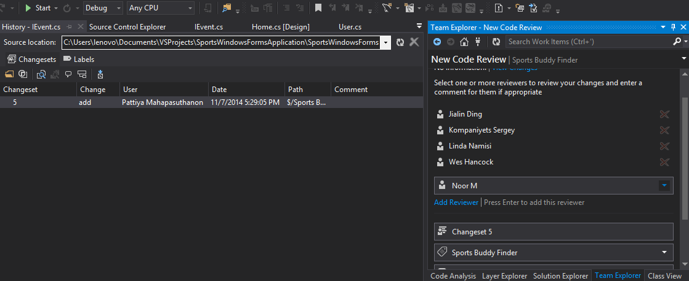
Request a Code Review and Add Reviewers

Slide 8
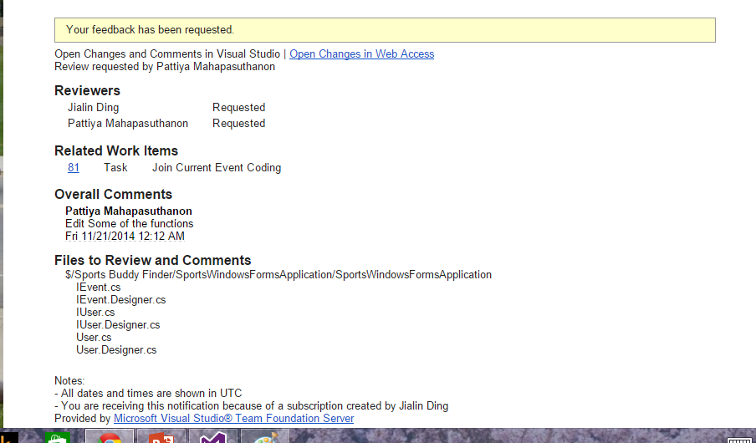
Reviewer Jialin receives an email to inform her files and codes that are waited for her to review

Slide 9
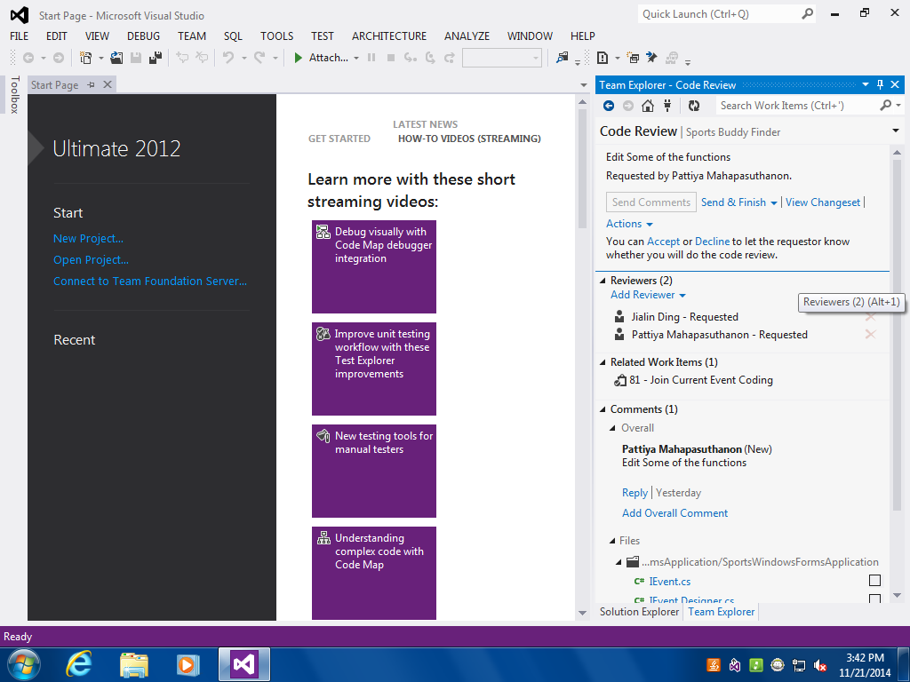
Reviewer accepts the requested code review and starts reviewing

Slide 10
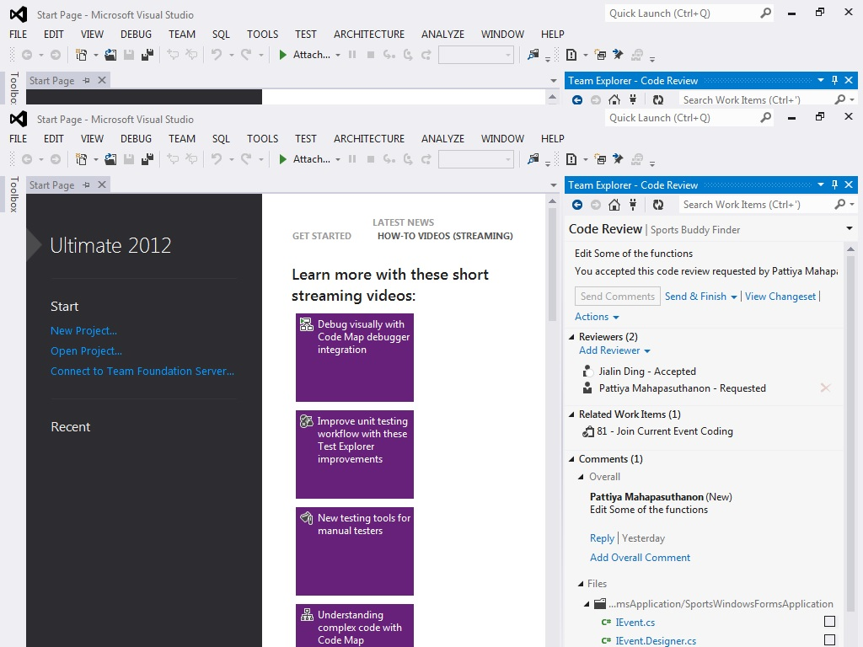

Slide 11
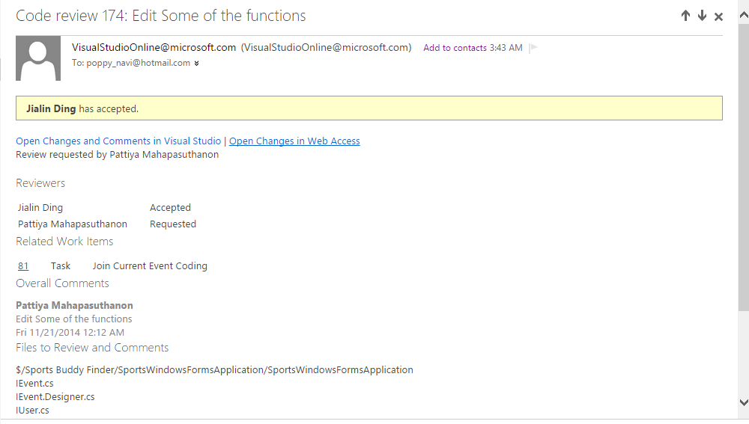
Programmer gets notification when reviewer accepts code review and starts reviewing

Slide 12
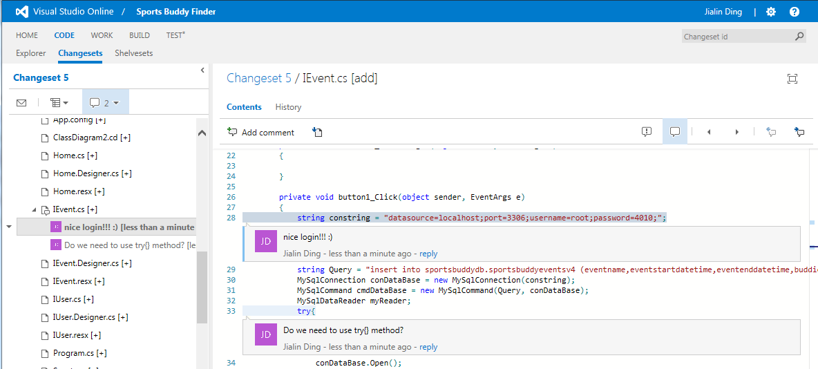
Also Able to Perform a Code Review in VS Online

Slide 13
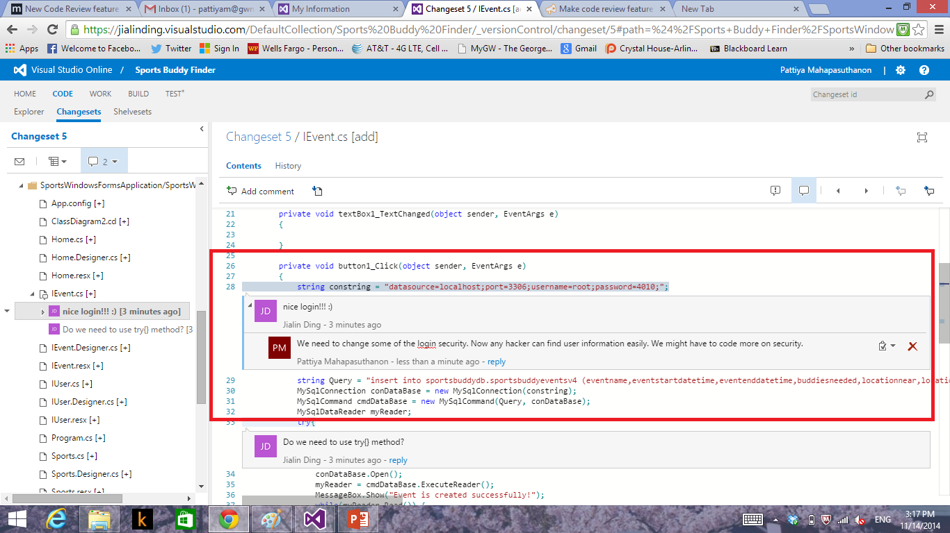
Programmer responds to a comment in VS online

Slide 14
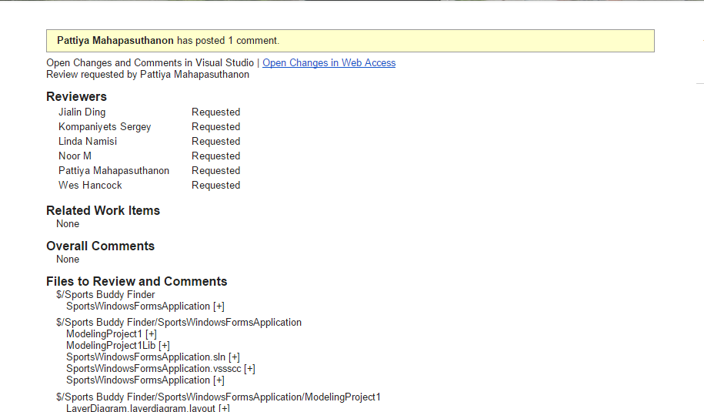
Reviewers get alerts when someone comments and makes a change

Slide 15
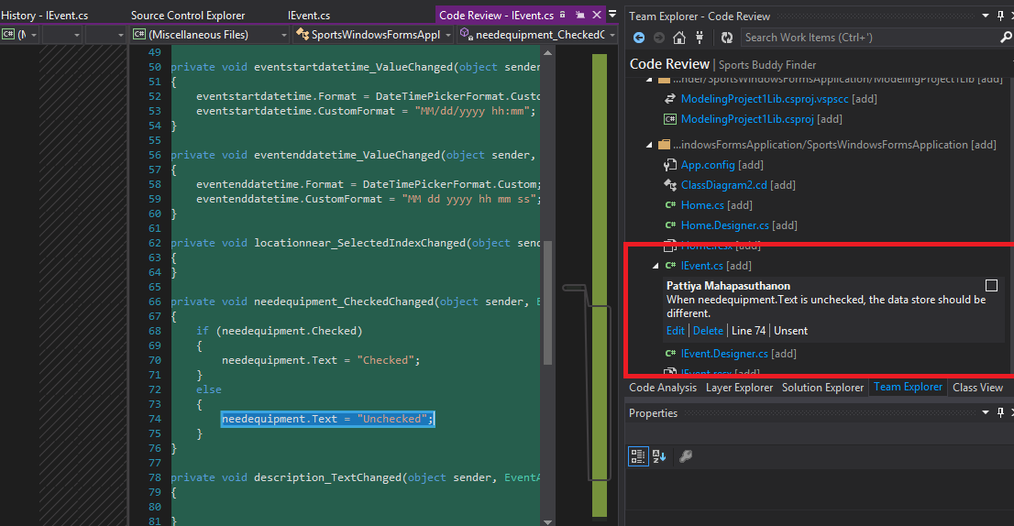
Comment on Particular Code in VS

Slide 16
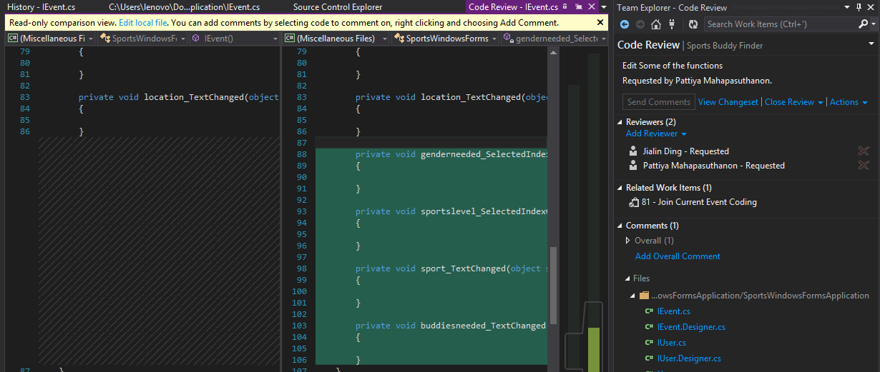
As a reviewer, they can see the changes and review them. More functions are added in the second version

Slide 17
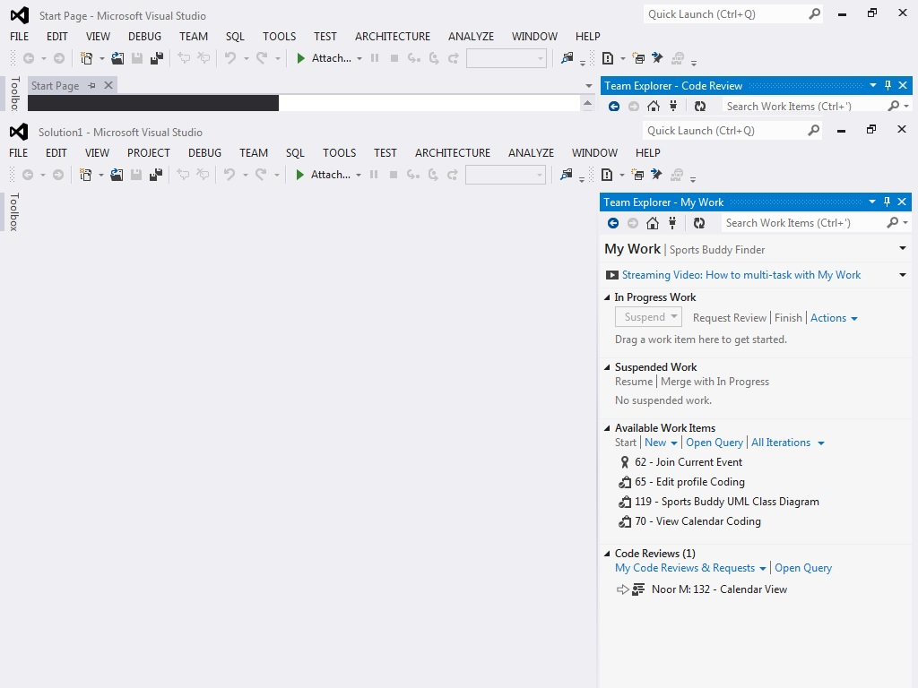
After performing a code review, reviewer sends comment as “look good”

Slide 18
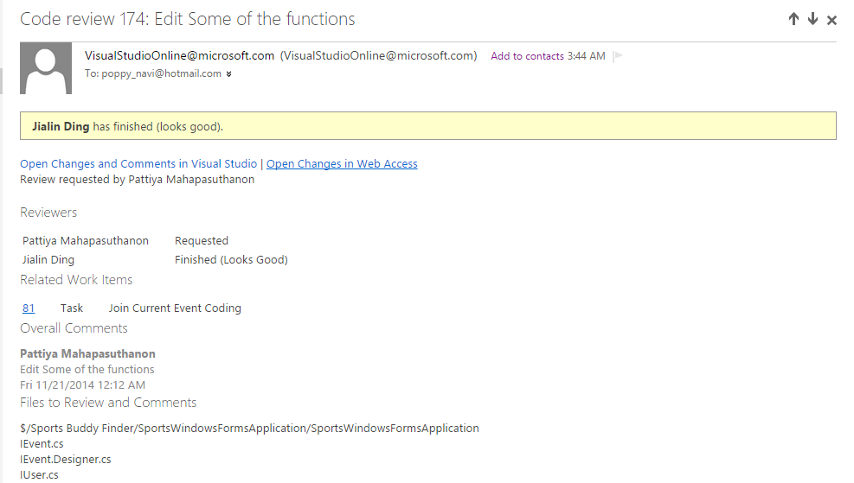
Programmer gets alert as code review is finished

Slide 19
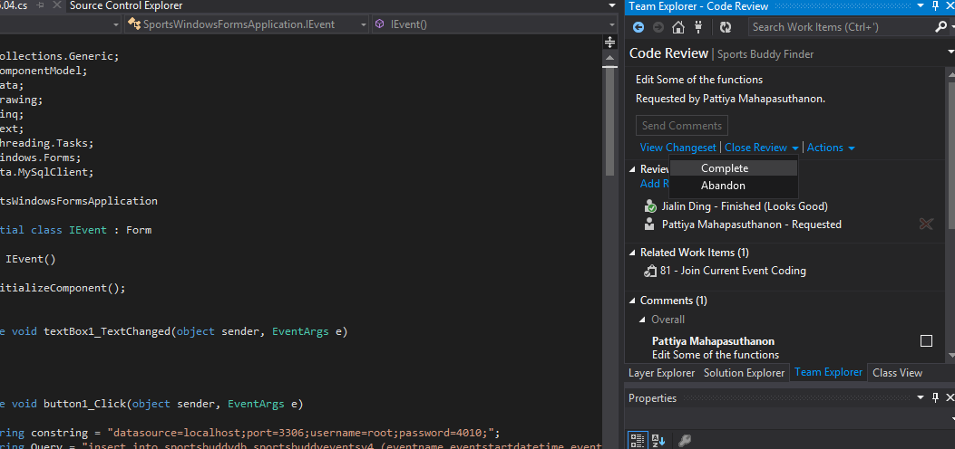
Code Review is closed. Code Reviews are available for references.

Slide 20
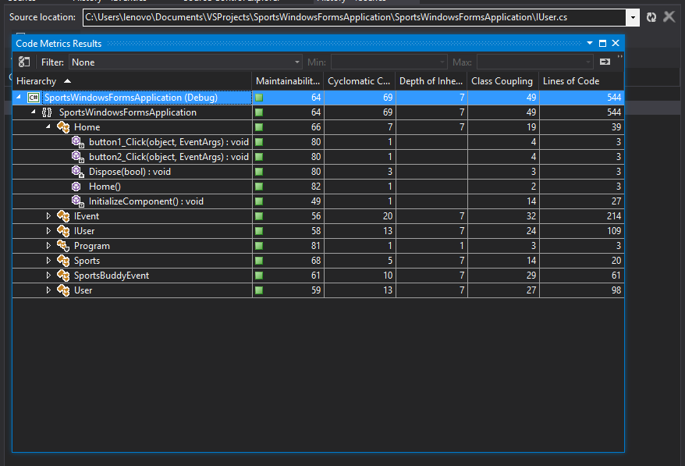
Calculate Code Metrics
Icon | Level | Range
 | High Maintainability | Between 20 and 100 inclusive
 | Moderate Maintainability | Between 10 and 19 inclusive
 | Low Maintainability | Between 0 and 9 inclusive
According to Microsoft,

Slide 21
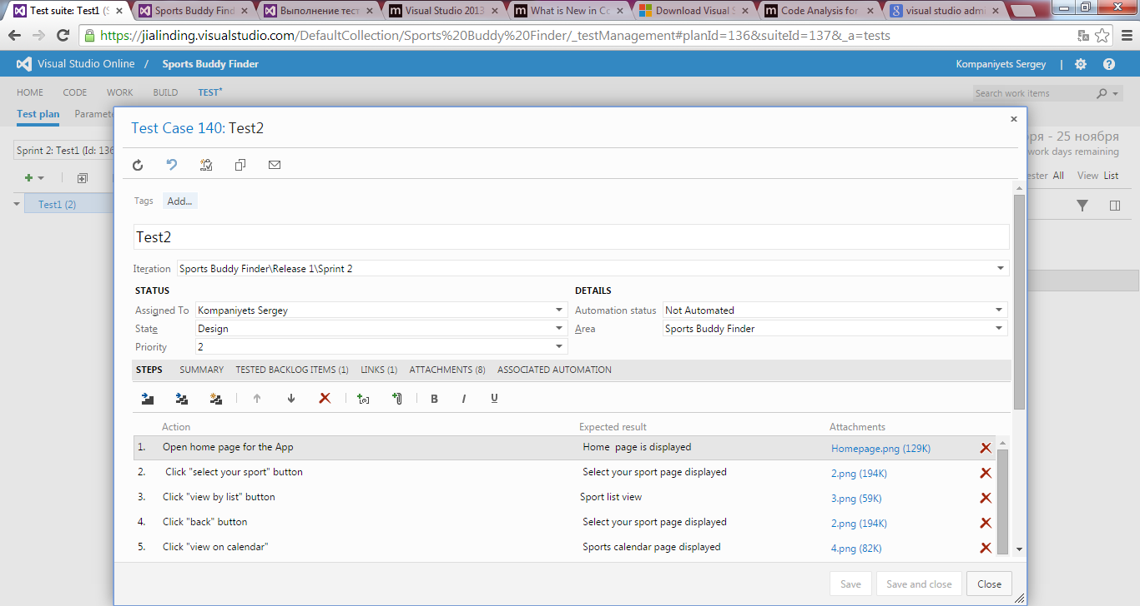
Test Creating

Slide 22
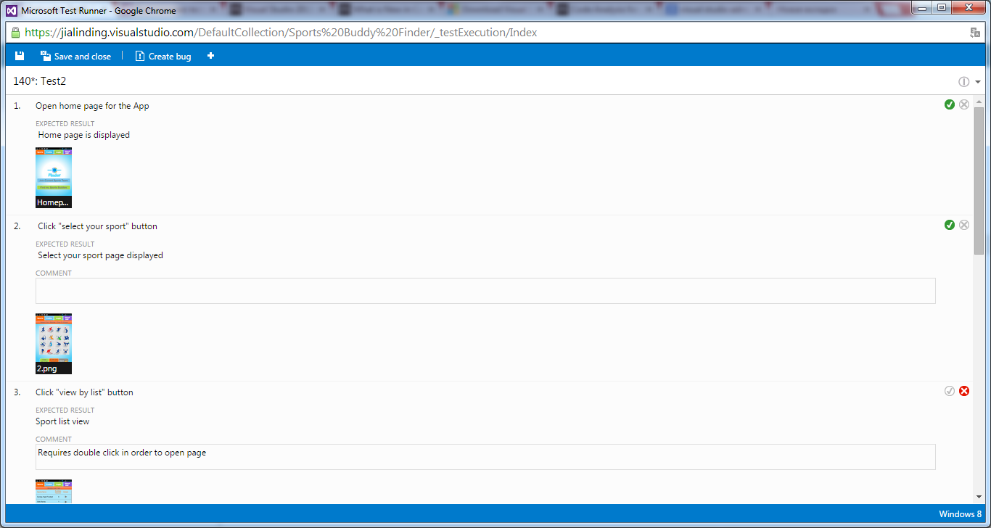
Run Test

Slide 23
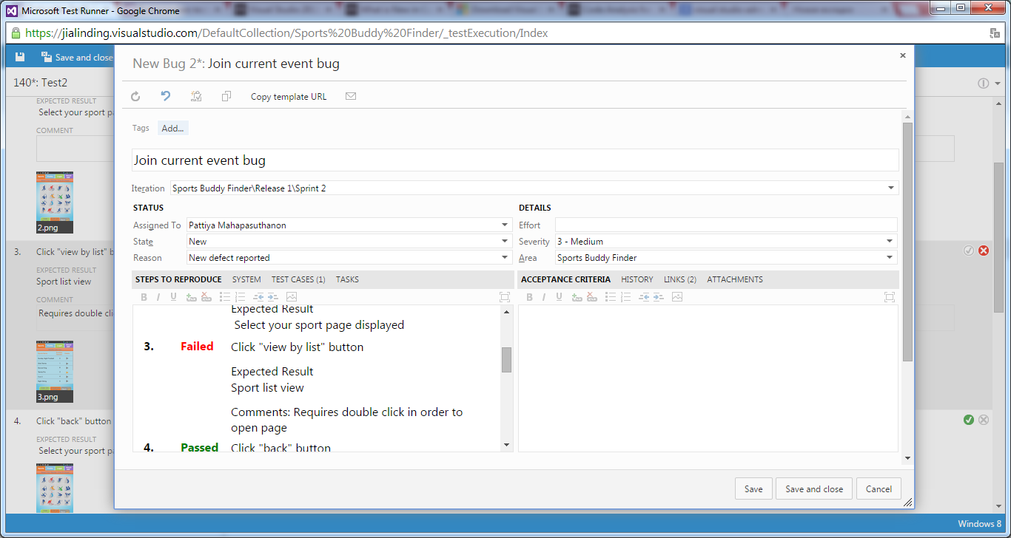
New Bug Creating

Slide 24
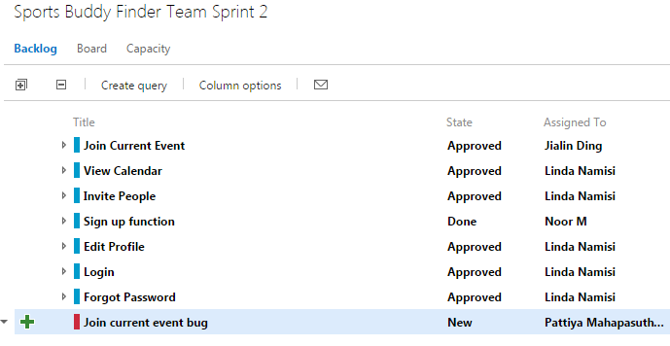
Bug Assigned to Programmer

Slide 25
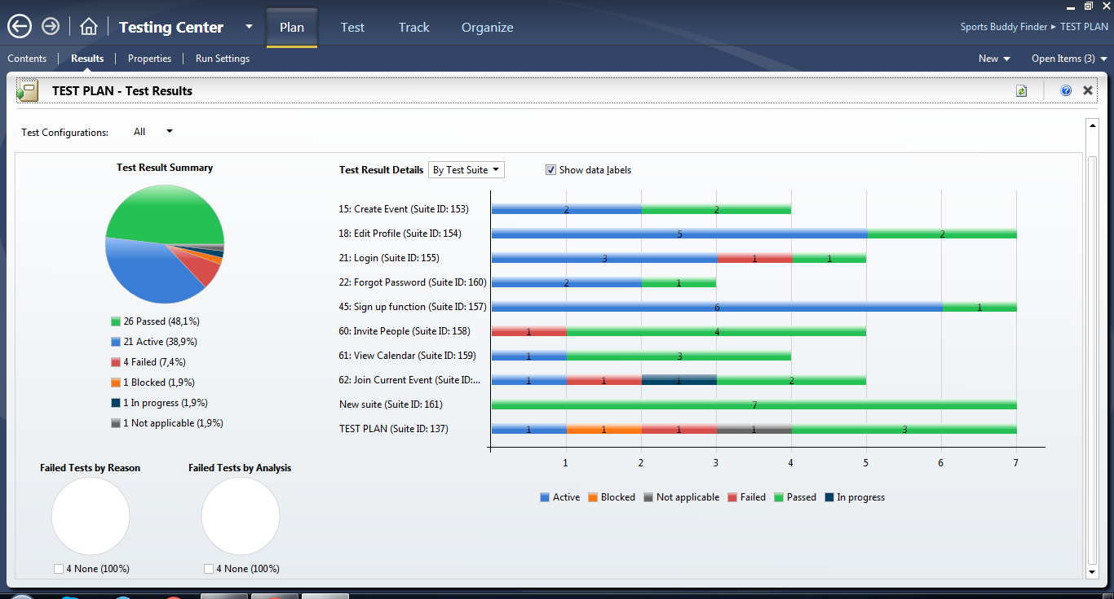
Requirements traceability matrix

Slide 26
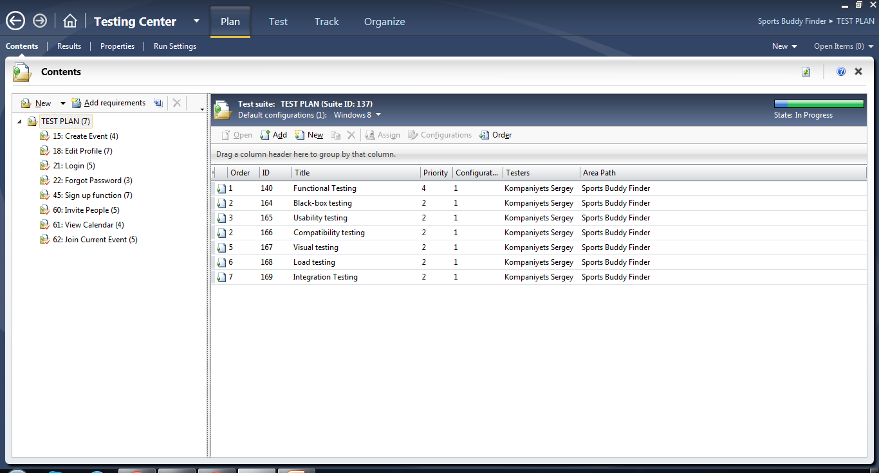
All types of tests included in Test plan

Slide 27
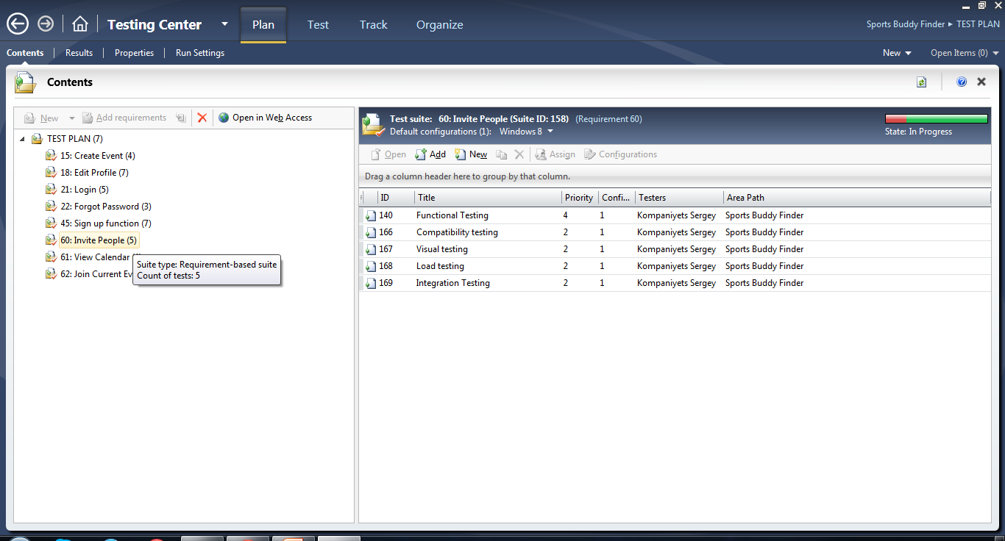
List of tests assigned for Invite People requirement

Slide 28
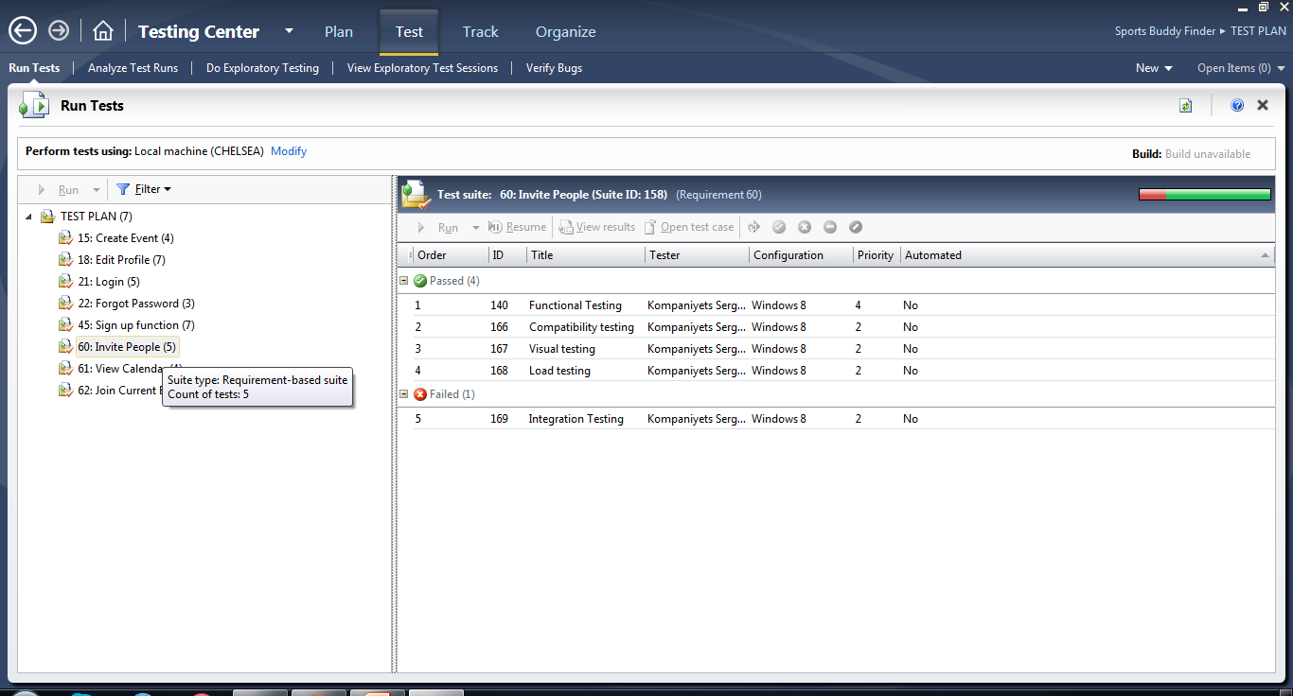
Status of tests assigned for Invite People requirement (Test Center)

Slide 29
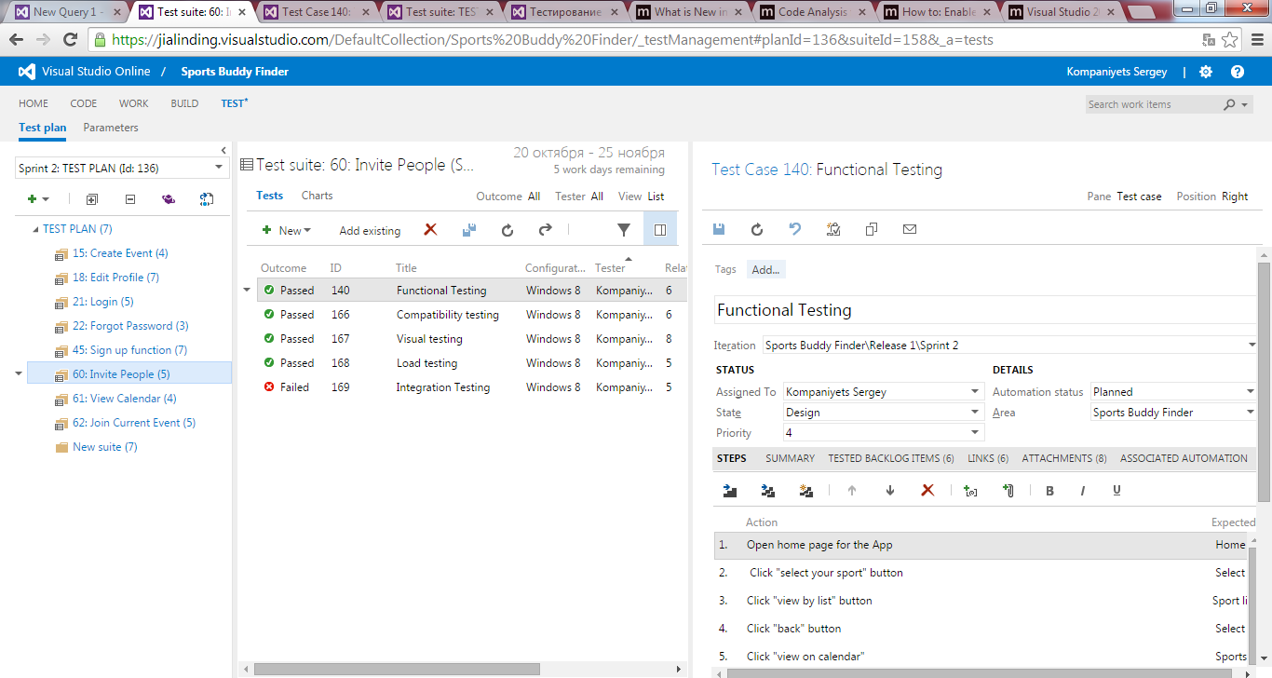
Status of tests assigned for Invite People requirement (TFS)

Slide 30
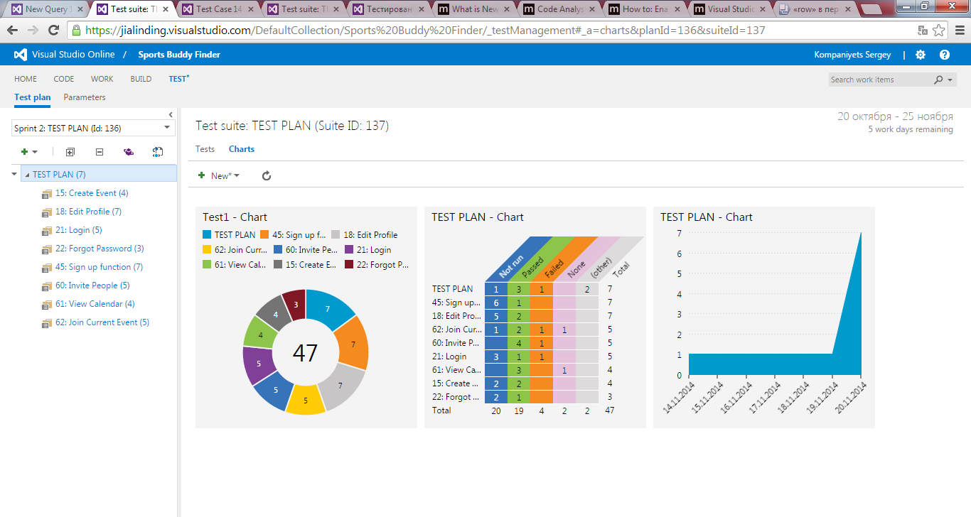
Test Plan in Charts form

Slide 31
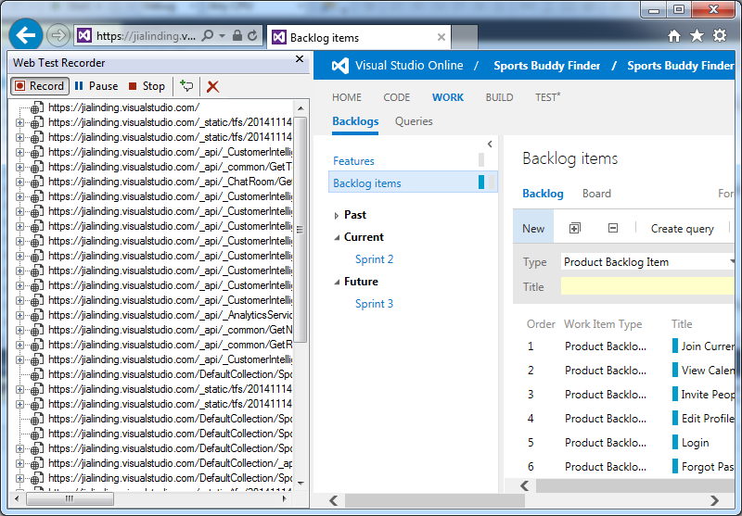
Test load application

Slide 32
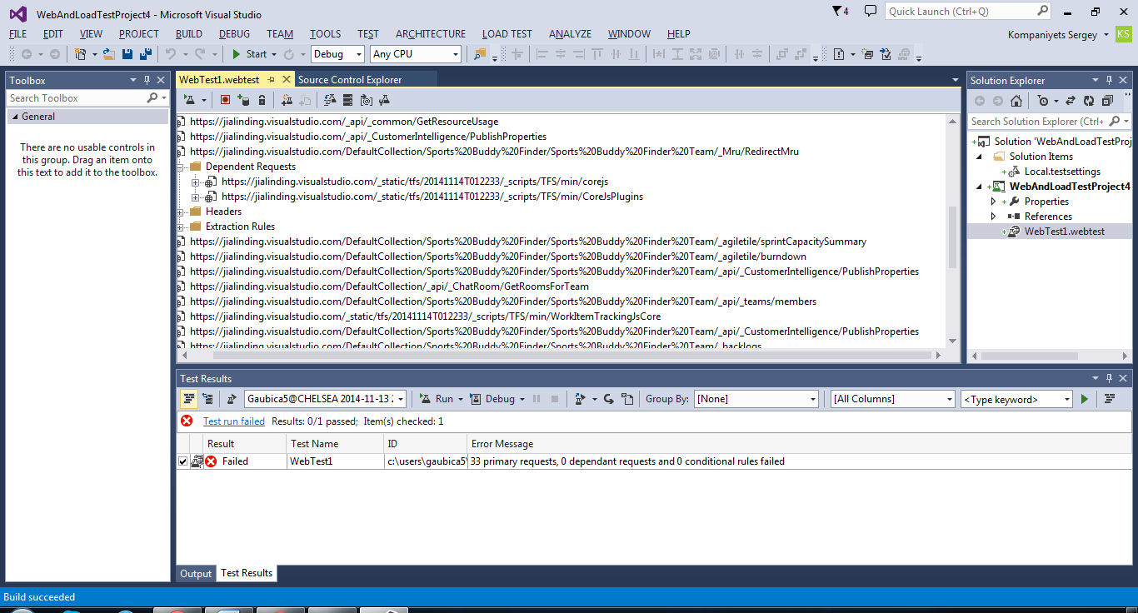
Test load application

Slide 33
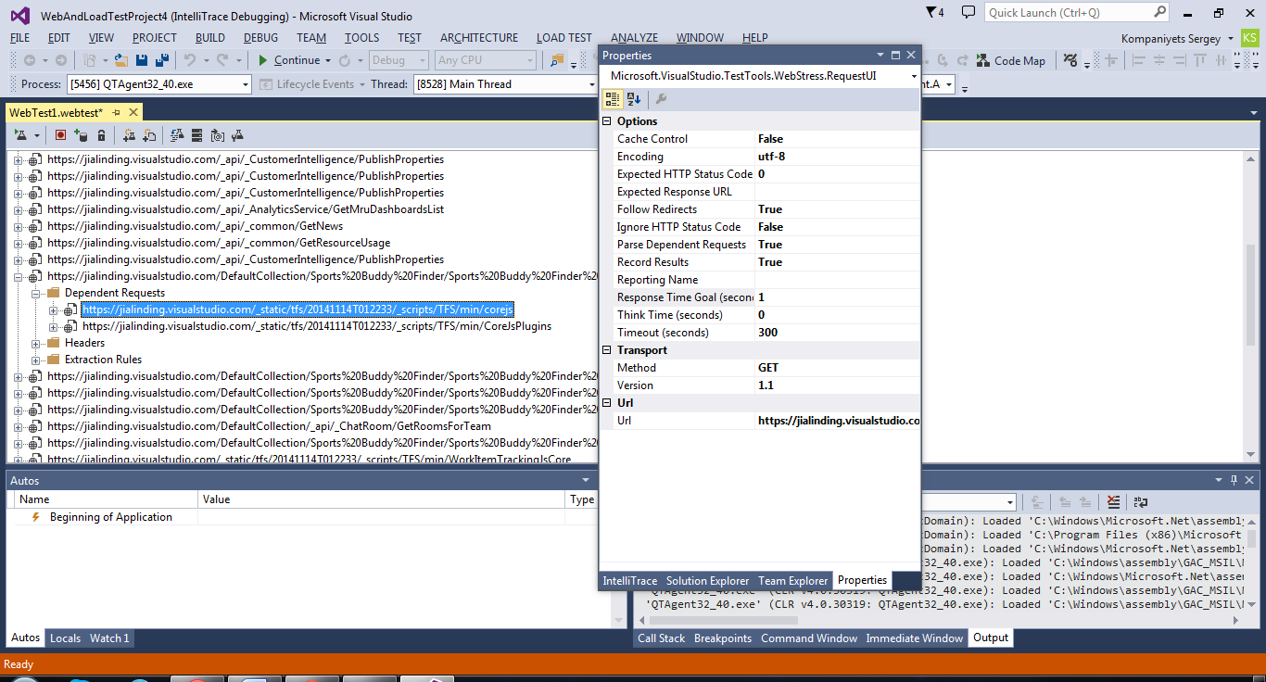
Test load application

Slide 34
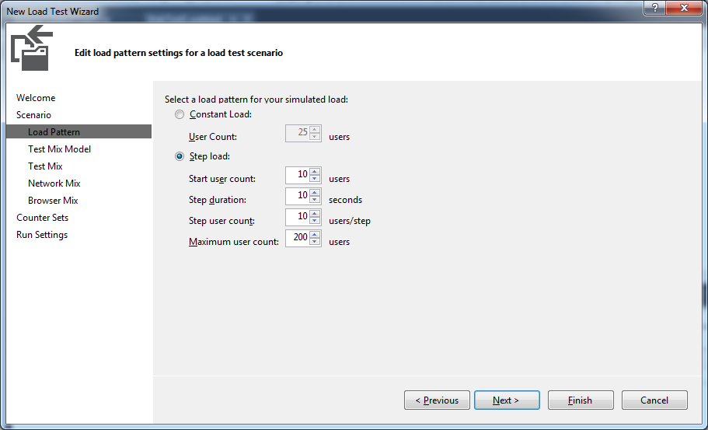
Test load application

Slide 35
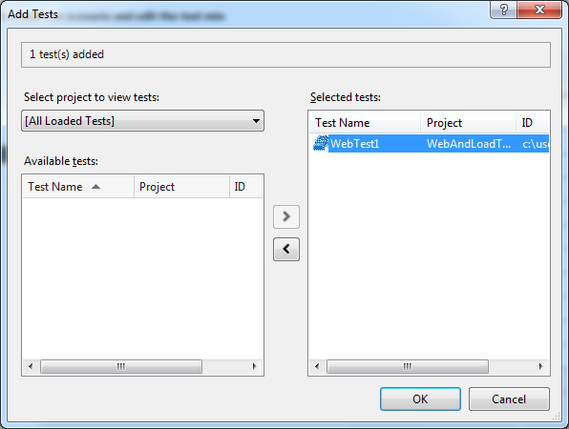
Test load application

Slide 36
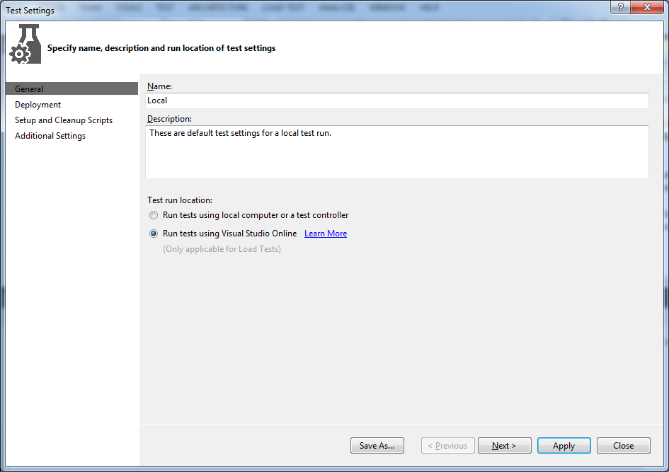
Test load application

Slide 37
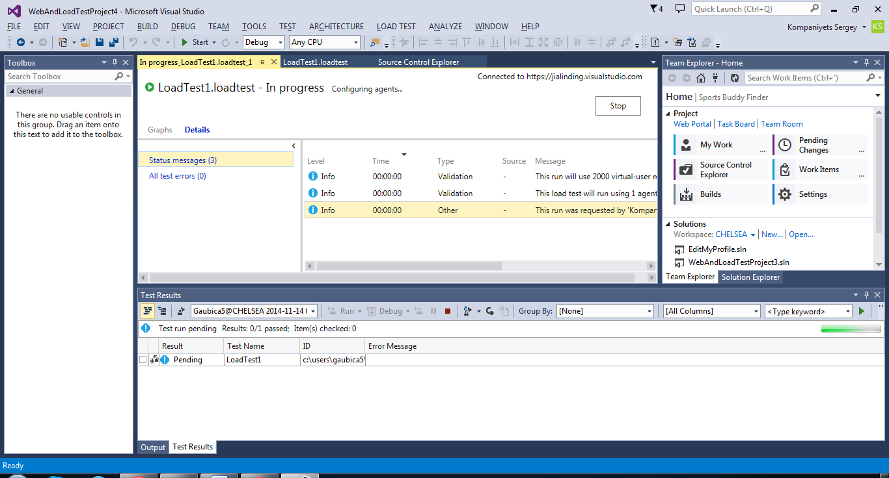
Test load application

Slide 38
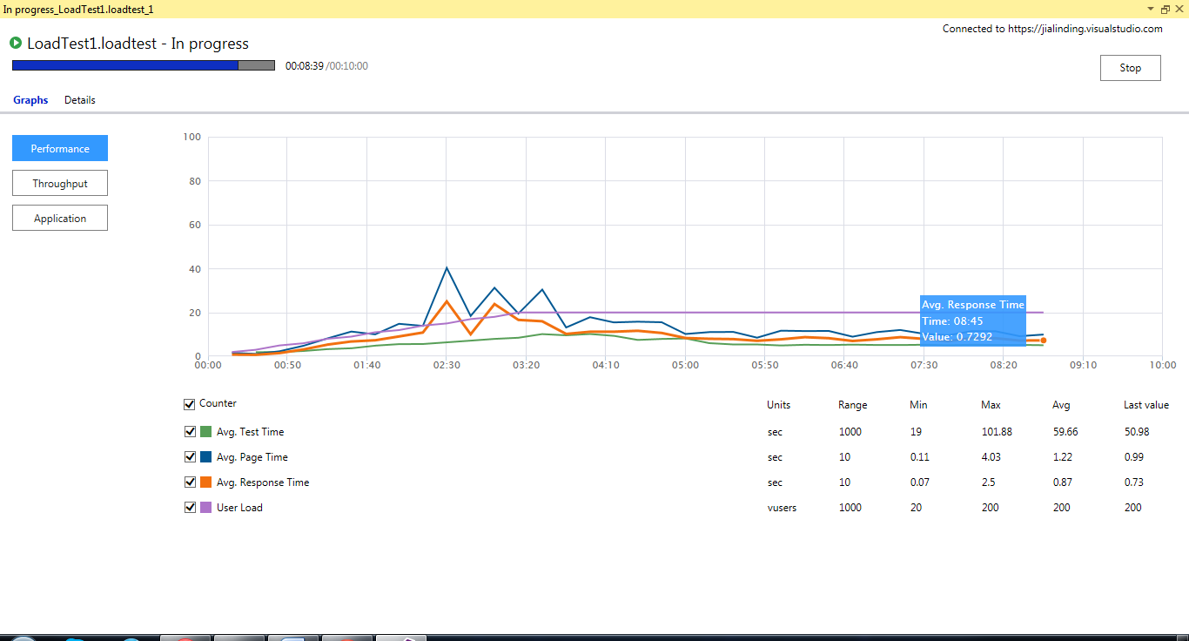
Test load application

Slide 39
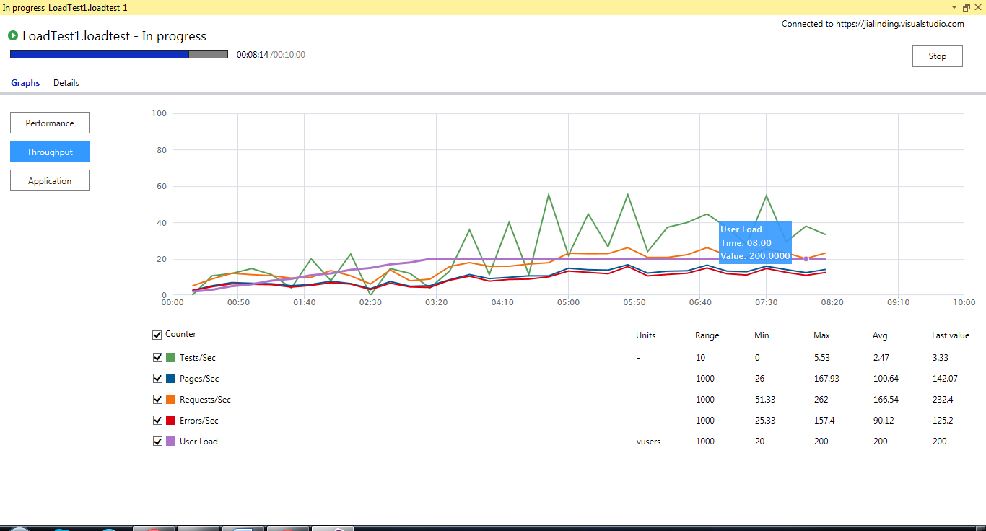
Test load application

Slide 40
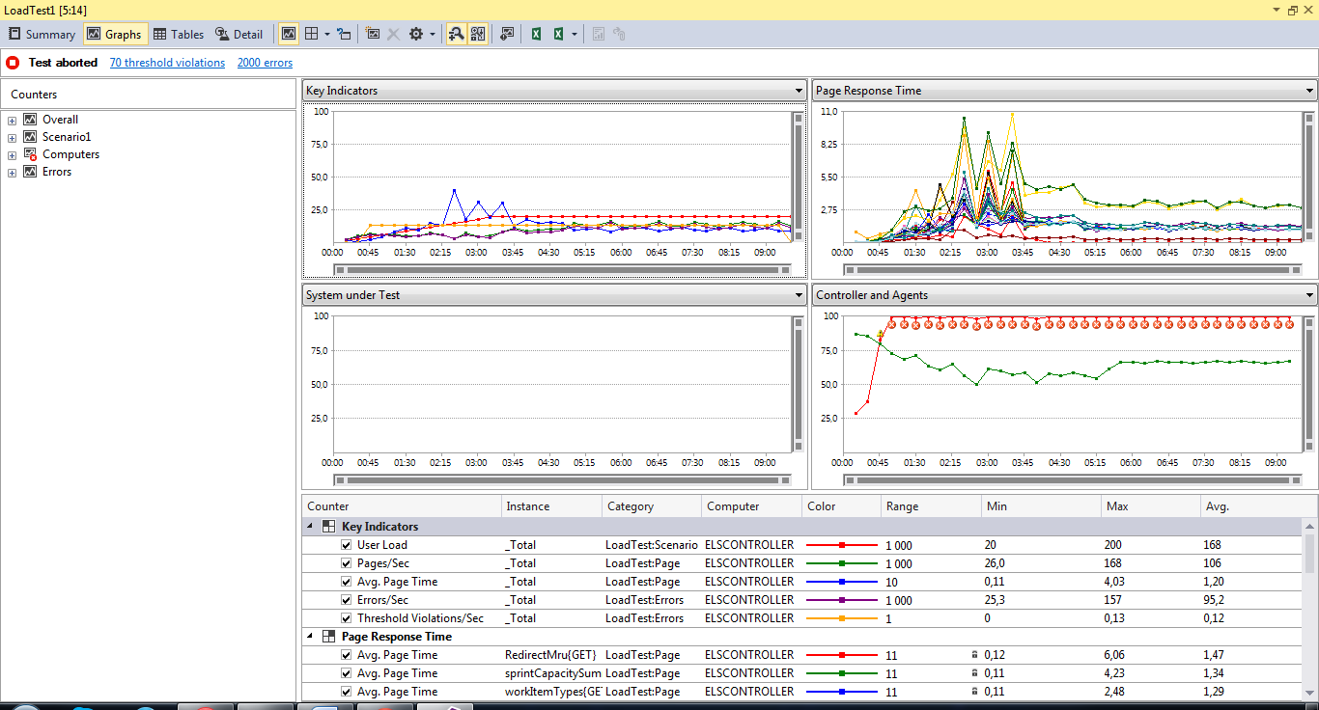
Test load application

Slide 41
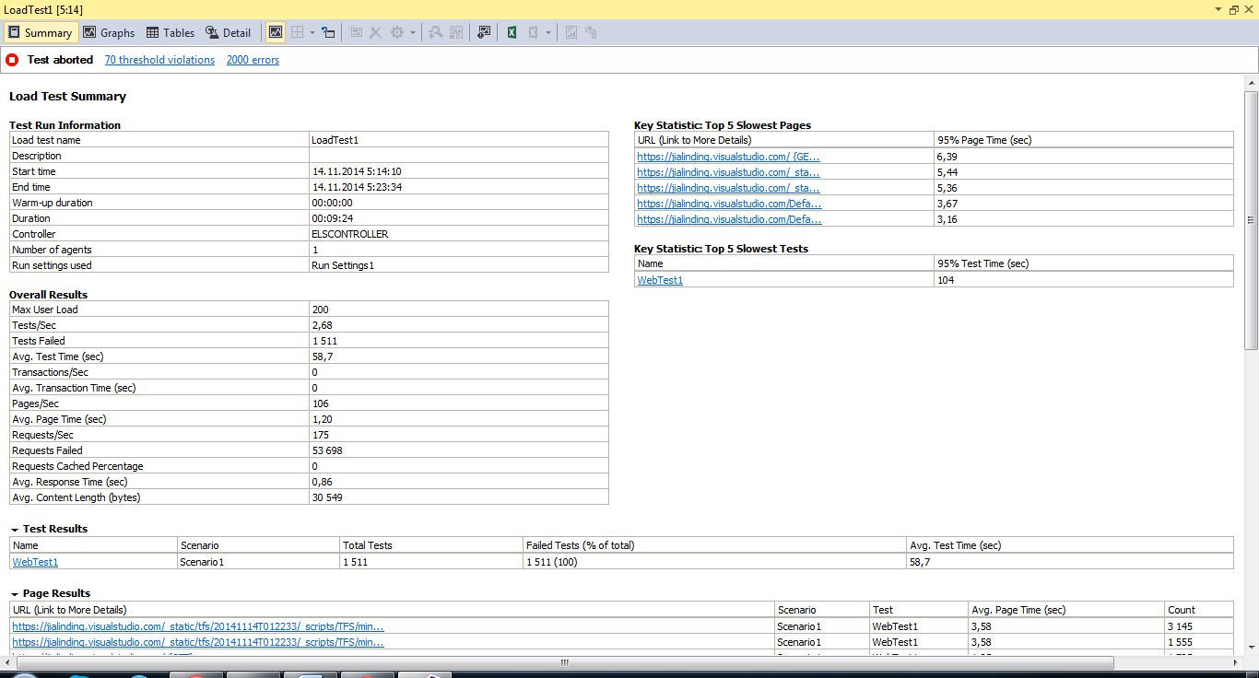
Test load application

