Slide 1


Sentinel Sites Activation
Integrated Service Delivery
A focused 60-minute orientation: activate • assess • improve • learn
UGANDA MINISTRY OF HEALTH • HEALTH SERVICE INTEGRATION
80
16
5
36
sentinel sites
health zones
sites per zone
months of learning
Regional • District • Facility Orientation

Slide 2
SESSION DESIGN
Today's purpose & 60-minute flow
By the end of this session, we should be able to:
60 MINUTES
05
min
Opening & integration context
1
Explain what a sentinel learning site is — and is not.
08
min
Sentinel model & network
2
Use the staging tool to establish a shared baseline and action plan.
08
min
Assessment & staging
07
min
SOPs in practice
3
Use the 17 SOPs as practical job aids at service points.
07
min
QI, roles & reporting
4
Start one focused QI cycle from a priority gap and know when to escalate.
05
min
Activation outputs & follow-up
20
min
Discussion & decisions
The detailed SOP and QI decks remain reference materials; today we focus on what teams must do.
Sentinel Learning & Adaptation Sites • September 2026

Slide 3
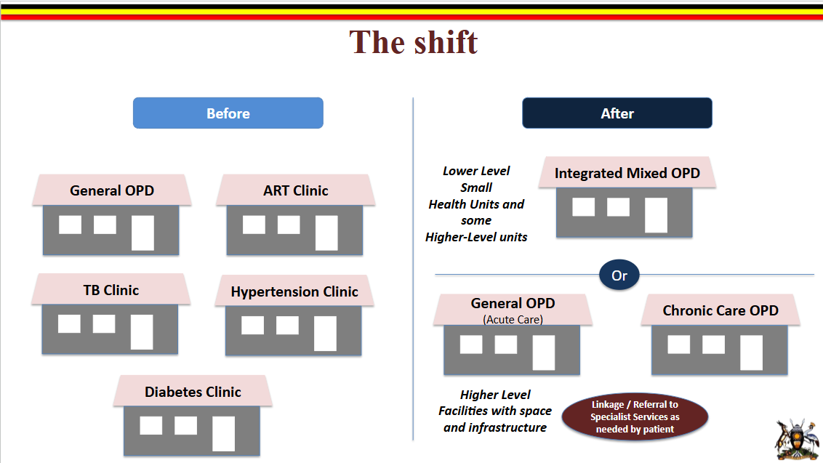
WHY INTEGRATION
The shift: disease clinics → integrated, patient-centred care
BEFORE
AFTER
General OPD
ART clinic
Acute Care
OPD
Integrated
Mixed OPD
OR
TB clinic
Hypertension clinic
Chronic Care
OPD
Diabetes clinic
Shared screening • coordinated care • referral and follow-up
Parallel services • repeated queues • duplicated processes
Core message: Integration is not a separate programme — it is how the health system organises people, platforms, information and resources around the patient.
Sentinel Learning & Adaptation Sites • September 2026

Slide 4
FROM POLICY TO IMPLEMENTATION
Why sentinel learning sites?
01
02
03
Policy direction is clear
Implementation is uneven
We need to know what works
National integration guidance defines the direction for integrated service delivery.
Patient flow, referrals, documentation, commodities and data use vary across facilities and districts.
The system needs a structured way to learn what drives integration — and how successful practice can be adapted and spread.
Sentinel sites are not research sites, surveys or performance awards.
They are structured learning and improvement sites.
Sentinel Learning & Adaptation Sites • September 2026

Slide 5
NETWORK DESIGN
A national learning network
Selection approach
NETWORK AT A GLANCE
1
Stratified random selection
Verified facility frame by health zone.
80
sentinel sites
2
By level of care
RRH/Hospital • HC IV • HC III.
16
health zones
5
3
By ownership
Government and PNFP facilities.
sites per zone
36
4
No eligibility screen
The learning network intentionally captures real-world variation.
months of learning
Each site serves as a CQI engine • demonstration hub • learning generator
Sentinel Learning & Adaptation Sites • September 2026

Slide 6
HOW THE PIECES FIT
The sentinel site cycle — one improvement loop
1
STAGE USING TOOL
2
USE SOPs
3
IDENTIFY ADDITIONAL INPUTS
Assess integration maturity across domains
Put standards into daily practice
Document HRH, tools, commodities, space & data gaps
SHARE LEARNING
TRACK ACTIONS
RUN QI
4
5
6
Document what worked and spread it
Agree owners, dates, support & status
Test small changes through PDSA
Assessment is not the end point — it starts the improvement cycle.
Sentinel Learning & Adaptation Sites • September 2026

Slide 7
ASSESSMENT & LEARNING TOOL
One tool, nine domains, one action plan
The same nine domains carry through staging, indicators and action planning.
D1
Leadership & governance
D2
Service delivery
D3
Commodity management
Each domain includes
A
Staging
Score standards 1–5 using evidence.
D4
Health information
D5
Human resources
D6
Laboratory systems
B
Key indicators
Review measured signals of performance.
D7
Community systems
D8
Health financing
D9
Quality of care
C
Synthesis & action plan
Prioritise up to five gaps with owner and timeline.
D
Shared experiences
One tool. One visit. Action plan before the team leaves.
Capture what changed, what worked and what can spread.
Sentinel Learning & Adaptation Sites • September 2026

Slide 8
A SHARED BASELINE, NOT A SCORECARD
How staging works
Each standard is scored from 1 to 5. Agree the level with the facility team and record the evidence behind it.
1
2
3
4
5
No integration
Minimal alignment
Partial integration
Strong alignment
Full integration
20%
40%
60%
80%
100%
Services remain vertical
Ad hoc steps, not systematic
Some structure; uneven practice
Routine, documented and sustained
Consistent, self-sustaining; can mentor others
Target: Score 4 — Strong alignment
Good staging practice
Integrated protocols in use • CQI active • data reviewed • referrals tracked • routine practice documented
Use evidence • agree the score • record why • compare at the next review
Sentinel Learning & Adaptation Sites • September 2026

Slide 9
FIVE PRACTICAL ACTIONS
What the activation visit must deliver
1
Confirm the integration coordinator and CQI focal person & core team
Clarify who supports staging, QI, records and service-point follow-up.
2
Place SOPs where care happens
Registration • triage • consultation • laboratory • pharmacy • exit • community follow-up.
3
Complete staging & inputs review
Agree the starting point and document missing HRH, tools, commodities, space, data and support.
4
Agree the action tracker before leaving
Convert priority gaps into actions, owners, due dates, support needs and escalation points.
5
Start one QI focus & capture learning
Choose a testable priority problem, start a PDSA and agree how progress will be reviewed.
No visit should end with observations only — leave with actions, owners, a QI focus and a follow-up plan.
Sentinel Learning & Adaptation Sites • September 2026

Slide 10
KEEP ORIENTATION PRACTICAL
SOPs — 17 job aids, not 17 lectures
The SOPs standardise critical steps in integrated care. For this session, understand the three groups and how to use them.
1–6
7–12
13–17
Entry, flow & assessment
Treatment, linkage & community
Systems, data & QI
Registration • appointments • patient education • comprehensive assessment • emergency care • differentiated care
DSD models • prescribing • dispensing • referrals • socioeconomic linkage • community outreach
Patient tracking • CPD • client satisfaction • data/reporting • continuous quality improvement
Why they matter
Standardise patient flow
Reduce missed opportunities
Support frontline staff
Strengthen supervision & QI
Use them where the work happens: visible, accessible, discussed and refined through feedback.
Sentinel Learning & Adaptation Sites • September 2026

Slide 11
FROM POSTER TO PRACTICE
Using SOPs in daily care
Put the right SOP at the right service point — and link feedback to supervision and QI.
01
02
03
04
05
Registration &
appointments
Education, triage
& assessment
Prescribe &
dispense
Referral, community
& follow-up
Feedback, data
& CQI
Who keeps this working?
Facility in-charge
integration Coordinator
Service-point teams
QI & records teams
DHMT / RRH mentors
Accountability, orientation, escalation
Placement, feedback, learning log
Use SOPs; identify barriers
Analyse gaps, review data, run PDSA
Validate, coach and escalate
Feedback loop: use → observe barriers → discuss → adapt practice → feed learning into supervision and QI.
Sentinel Learning & Adaptation Sites • September 2026

Slide 12
FROM ONE GAP TO ONE TESTED CHANGE
QI — keep it practical
QI is how the facility turns priority gaps into measurable improvement.
Four principles
Client focus
Systems thinking
Data use
Teamwork
Four-step CQI process
1
Identify
2
Analyse
3
Develop
4
Test
What is the problem? How do we know?
Why is it happening?
What small change may help?
PDSA: plan • do • study • act
MoH priority QoC areas
Patient safety • IPC • 5S • client satisfaction • integration
QI is not needed for every gap. Use it where a practical change can be tested, measured and refined.
Important:
Sentinel Learning & Adaptation Sites • September 2026

Slide 13
WHO DOES WHAT
Clear ownership, reporting and escalation
FACILITY
DHMT
RRH / REGIONAL ICS
MOH / NACI
Use SOPs • complete staging • run CQI/PDSA • maintain learning logs • review data monthly
Routine supervision • follow up action plans • solve local bottlenecks • spread tested practice
Activation • mentorship • peer learning • data use • escalate system constraints
Stewardship • standard tools/SOPs • national synthesis • policy uptake • unblock decisions
Reporting pathway: Facility → DHMT → RRH / Regional ICS → MoH / NACI
Learning travels both ways; unresolved bottlenecks move upward for action.
Sentinel Learning & Adaptation Sites • September 2026

Slide 14
IMPLEMENTATION TIMELINE & FOLLOW-UP
Activation now; learning continues
Mar–Aug 2026
Sep–Oct 2026
Nov–Dec 2026
2027–2028
FOUNDATION
ACTIVATION
REVIEW & REFINE
SCALE LEARNING
Site selection
Assessment tool finalised
SOPs developed
Teams prepared
Baseline assessments
First mentorship visits
CQI cycles initiated
First learning synthesis
Performance review
Second mentorship/
CQI round
Change packages documented
Repeated learning cycles
National synthesis
Change-package toolkit
Guidance updates
WE ARE HERE
September visit output: baseline + action tracker + first QI focus + clear follow-up date
Sentinel Learning & Adaptation Sites • September 2026

Slide 15
DISCUSSION • 20 MINUTES
What must we agree today?
1
Are the facility focal persons and core teams clear?
2
Completion of the baseline and action tracker during activation — and what evidence is needed?
3
Which SOPs need immediate placement or orientation at service points?
4
What should be the first QI focus, and what gaps need district, regional or national escalation?
End with decisions • owners • dates • escalation points

