Slide 1


Support Supervision Tool for Sentinel Sites on Integration

Slide 2
Tracking Integrated Service Delivery at Facility Level
ASSESS
Where are we now?
From assessment to action
STAGE
How mature is integration?
• Create a common picture of how integrated services are functioning at each facility.
• Identify strengths, gaps and priority areas for improvement.
• Track agreed actions and progress over time.
• Capture practical experiences that can be shared across facilities.
MEASURE
What do the KPIs show?
ACT
What will we improve?
LEARN
What can others use?
Facility-level integrated service delivery tracking | Orientation
1

Slide 3
The Tool: Five Sections That Work as One Improvement Cycle
Each section answers a different question—from “where are we?” to “what will we change?”
3 Key Performance Indicators
1 Facility Identification
Confirm the facility and context before the assessment begins.
Review measurable signals of performance and identify gaps.
2 Staging
4 Action Tracker
Establish the current level of integrated service delivery.
Translate gaps into owned, time-bound improvement actions.
5 Shared Experiences
Document lessons, innovations, challenges and solutions.
Facility-level integrated service delivery tracking | Orientation
2

Slide 4
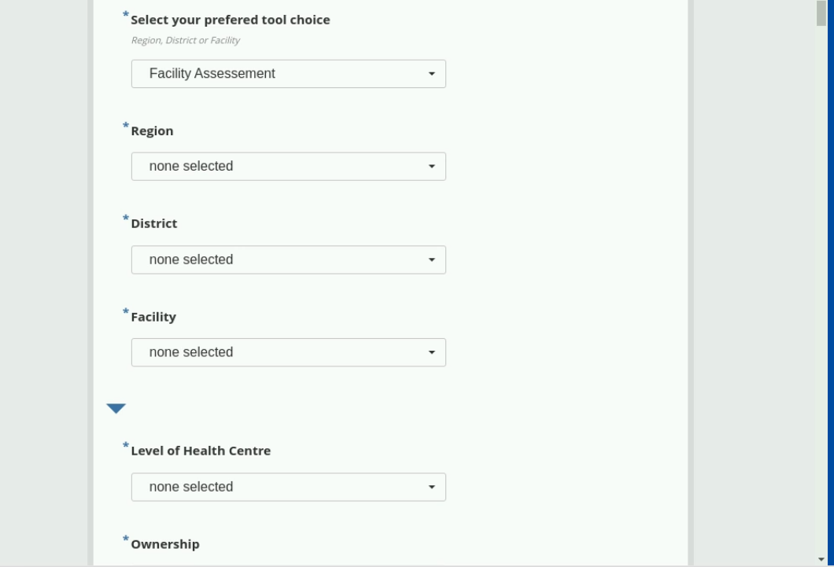
1–2. Facility Identification
Start with the correct facility, then establish a shared baseline for integration
Facility identification — what to enter
Select “Facility Assessment”, then select the correct Region, District and Facility. Confirm the Level of Health Centre and Ownership before proceeding. These fields anchor the assessment to the correct service delivery setting.
Staging — establish the starting point
Use the staging component to determine the facility’s current level of integration. Discuss the evidence with the facility team, agree on the most accurate current state, and use it as the baseline for improvement.
Good practice: verify facility details before starting the assessment.
Why the baseline matters
An incorrect facility or level makes results impossible to compare over time — confirm these entries with the facility team.
The stage agreed today becomes the reference point for the next review. Record the evidence behind it so the facility team and the next supervisor can see why that stage was chosen.
Facility-level integrated service delivery tracking | Orientation
3

Slide 5
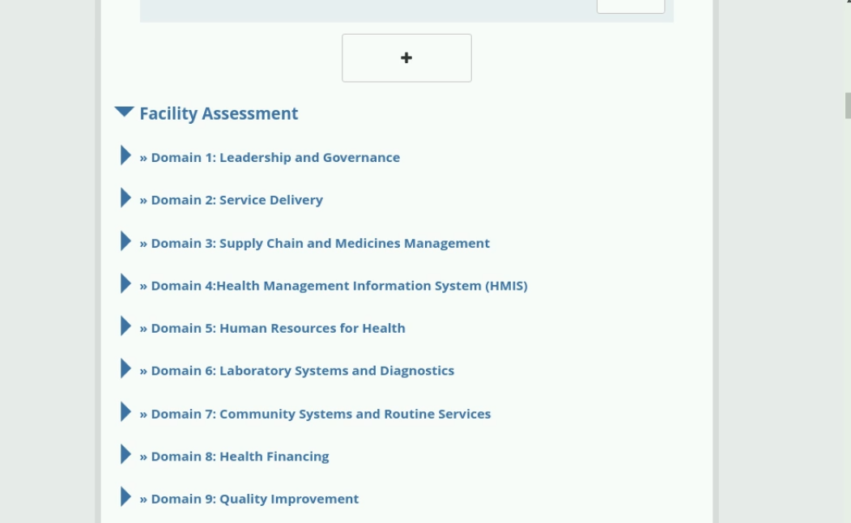
The Facility Staging: Nine Domains
Each domain is assessed with the facility team to build one shared picture of performance
Nine domains, one conversation
The assessment covers leadership and governance, service delivery, supply chain and medicines, HMIS, human resources, laboratory and diagnostics, community systems, health financing and quality improvement.
How to work through each domain
Open one domain at a time and complete it with the facility team using available evidence. Record the response, note the gap in your own words, and carry every priority gap forward into the Synthesis and Action Plan.
Expand a domain to reveal its assessment questions.
The nine domains stay the same across assessment, indicators and action planning — so findings, measures and actions all line up domain by domain.
Before you close a domain
Confirm the facility team agrees with the response recorded, and that any gap is written clearly enough for someone who was not in the room to act on it.
Facility-level integrated service delivery tracking | Orientation
4

Slide 6
3. Key Performance Indicators
Review measured performance against the agreed indicators, then decide what the data is telling you
KEY PERFORMANCE INDICATORS
Use the KPI section to review the facility’s performance against the agreed measures of integrated service delivery.
• Review each indicator using available facility evidence/data.
• Identify areas where performance is strong and where gaps remain.
• Discuss the reasons for the gaps rather than treating the score as the end point.
• Prioritise the indicators that require action.
1
Review
2
Interpret
3
Prioritise
KPI / evidence
Gap & cause
What matters most?
Every priority gap goes forward
Indicators are only the diagnosis. Each gap you prioritise here must be carried into the Synthesis & Action Plan, then into the Action Tracker with an owner and a deadline.
Facility-level integrated service delivery tracking | Orientation
5

Slide 7
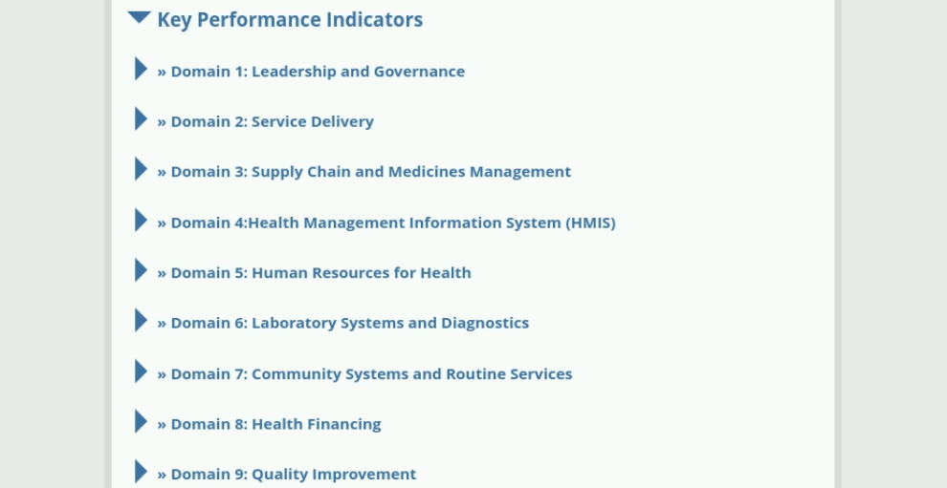
Key Performance Indicators by Domain
The same nine domains, now measured — indicators show whether integration is improving
Mirrors the assessment structure
KPIs are organised under the same nine domains as the assessment, so qualitative findings and measured performance line up directly for each area of the facility.
Using the indicators well
Indicators support the improvement discussion — they are not a scorecard.
Enter the current value for each indicator from facility records rather than recall. Compare it with the previous review to show direction of travel, and discuss the reasons behind any indicator that has not moved.
Because the indicators sit under the same nine domains as the assessment, a weak KPI points straight to the domain — and the gap — that needs attention.
Review indicators with the facility team, not about them.
Facility-level integrated service delivery tracking | Orientation
8

Slide 8
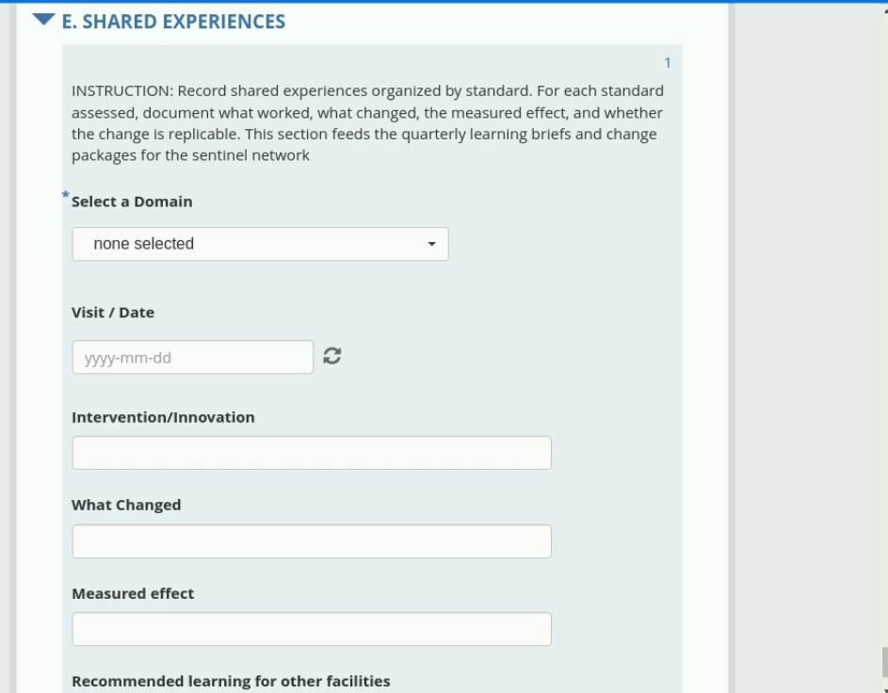
4. Shared Experiences — Turn Facility Learning into System Learning
What to capture
Practical experiences from implementation: innovations, successes, challenges, solutions and lessons that could help another facility.
SUCCESS
CHALLENGE
What improved and why?
What did not work as expected?
SOLUTION
LESSON
What did the team change?
What should others know or try?
Section E is completed once per intervention worth sharing.
Record what was tried, what changed, and the measured effect — then say plainly whether another facility could repeat it. This is what feeds the quarterly learning briefs.
ASSESS → STAGE → MEASURE → ACT → LEARN → IMPROVE
Facility-level integrated service delivery tracking | Orientation
9

Slide 9
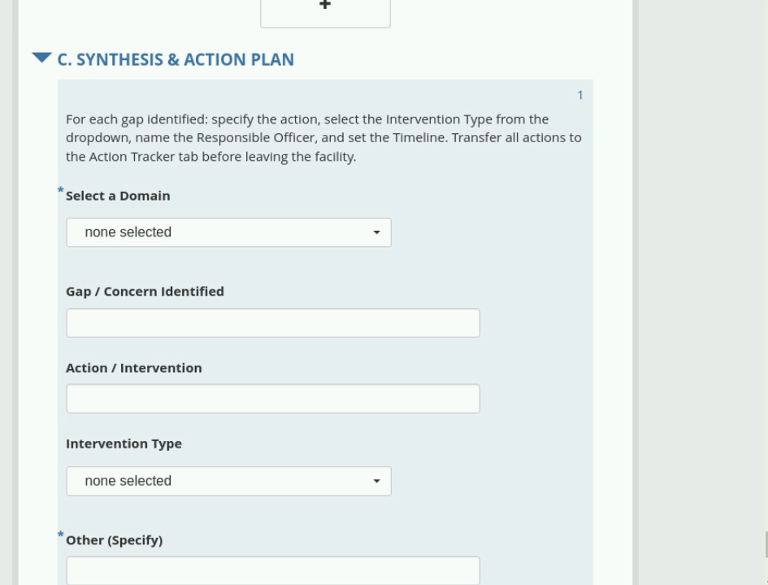
5. Synthesis & Action Plan: From Gap to Owned Action
Section C converts every prioritised gap into a specific action with a named owner and a timeline
What to record for each gap
Select the domain, state the gap in plain language, then define the action. Choose the Intervention Type from the dropdown, name the Responsible Officer, and set a realistic timeline.
One rule before you leave the facility
Every action recorded here must be transferred to the Action Tracker tab before the visit ends. An action that stays in the synthesis section has no owner and no follow-up.
Intervention Type matters
The dropdown groups actions into comparable categories, so the district can see which kinds of intervention facilities are relying on — and which gaps keep recurring across the network.
Repeat section C once for every gap identified.
Use the facility team's own words for the gap — an action written to satisfy the form rarely gets done.
Facility-level integrated service delivery tracking | Orientation
6

Slide 10
5. Action Tracker: Where Actions Get Owned and Closed
The tracker is the accountability record between visits — every action has one owner and one deadline
GAP
ACTION
OWNER
DEADLINE
STATUS
The prioritised
finding
What will
change
One named
person
A realistic
date
Open / in progress
/ closed
Filling the tracker
Using it at the next visit
Transfer every action from the Synthesis & Action Plan before leaving the facility. Write the action so someone who was not in the room could carry it out.
Open the tracker first. Review what was closed, what slipped and why — this becomes the starting point of the next assessment conversation.
One owner, one date, one status
Actions shared between several people tend to stay open. A single named owner with a specific date is what makes the tracker a follow-up tool rather than a list of good intentions.
ASSESS → MEASURE → SYNTHESISE → TRACK → CLOSE
Facility-level integrated service delivery tracking | Orientation
7

