Slide 1

QUALITY OF CARE
Continuous Quality Improvement for Frontline Health Workers
Ministry of Health • Department of Standards, Compliance,
Accreditation & Patient Protection (SCAPP)
September 2026

Slide 2
SESSION OVERVIEW
What we will cover today
01
Quality of Care defined
What quality means and why it matters
02
Key components
Patient safety, IPC, 5S & client satisfaction
03
Principles of QI
Client focus, systems, data, teamwork
04
The QI process
From gap identification to PDSA cycles
05
Governance & learning
Structures, collaboratives, reporting
Ministry of Health | SCAPP | Quality of Care
2 / 30

Slide 3
DEFINING QUALITY
What is Quality of Care?
Quality of Care is the degree to which health services for individuals and populations increase the likelihood of desired health outcomes and are consistent with current professional knowledge.
Safe
Effective
Patient-centred
Avoids harm to patients
Evidence-based care
Respects preferences
Timely
Efficient
Equitable
Reduces harmful delays
Avoids waste
No variation by status
Ministry of Health | SCAPP | Quality of Care
3 / 30

Slide 4




WHY IT MATTERS
Why Continuous Quality Improvement is essential
Better outcomes
Safe, effective care reduces mortality, morbidity and complications.
Client experience
Shorter waits, respectful care and continuity increase trust and utilisation.
System efficiency
Less rework, fewer stock-outs and better use of limited resources.
Accountability
Data-driven improvement creates transparent performance culture.
Ministry of Health | SCAPP | Quality of Care
4 / 30

Slide 5




KEY ELEMENTS
MOH Priority Quality of Care Interventions
Patient Safety
IPC
Prevent avoidable harm through audits, incident reporting and adherence to standards.
Hand hygiene, PPE, waste segregation, cleaning schedules and safe injection practices.
5S
Client Satisfaction
Sort, Set in order, Shine, Standardise, Sustain — organised, safe workspaces.
Collect feedback, act on concerns and close the loop with clients.
Ministry of Health | SCAPP | Quality of Care
5 / 30

Slide 6
PATIENT SAFETY
Every patient has the right to care without avoidable harm
What to prevent
What to strengthen
What leaders do
• Medication errors
• Incident & near-miss reporting
• No-blame learning culture
• Delayed emergency care
• Clinical & mortality audits
• Assign & track actions
• Falls & infections
• Mentorship on standards
• Remove barriers
• Poor referral handover
• Equipment functionality
• Escalate systemic gaps
Ministry of Health | SCAPP | Quality of Care
6 / 30

Slide 7
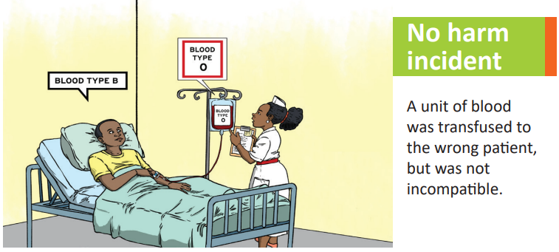
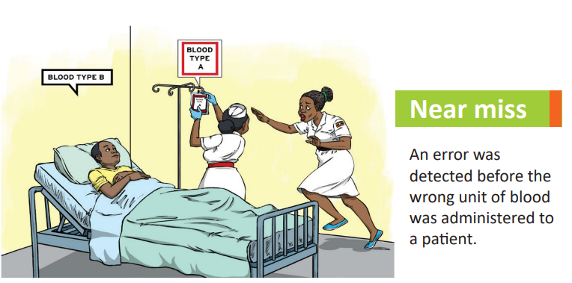
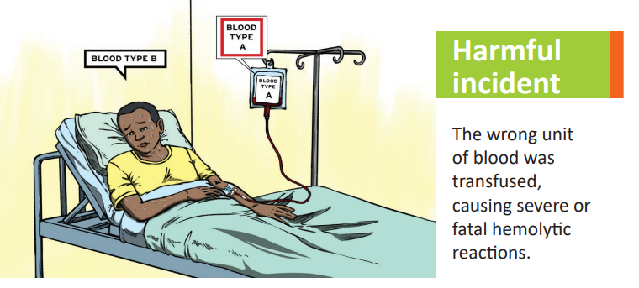
Example of near misses, no harm incident, and harmful incident in blood transfusion

Slide 8
INFECTION PREVENTION & CONTROL
IPC must be routine at every service point
1
2
3
Hand hygiene
PPE use
Waste segregation
5 moments, alcohol-based rub or soap & water
Correct donning/doffing for the procedure risk
Colour-coded bins; sharps safety
4
5
6
Safe injections
Cleaning schedules
IPC standards
One needle, one syringe, one patient
High-touch surfaces and equipment
Adhere to national IPC guidelines daily
Ministry of Health | SCAPP | Quality of Care
7 / 30

Slide 9
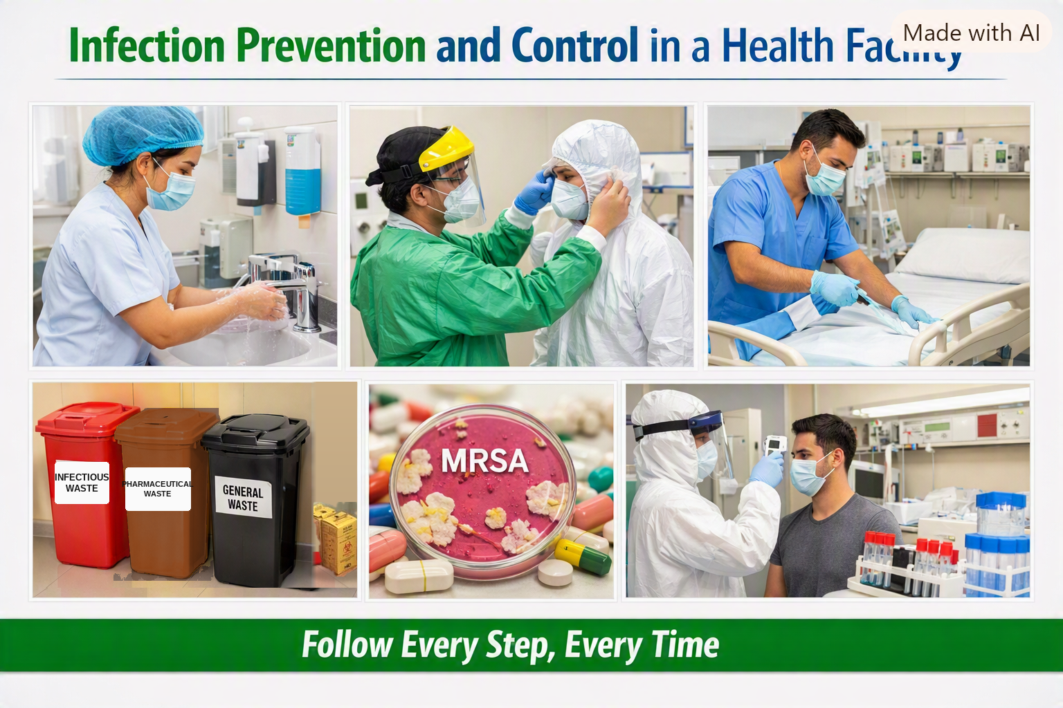
Infection Prevention and Control

Slide 10
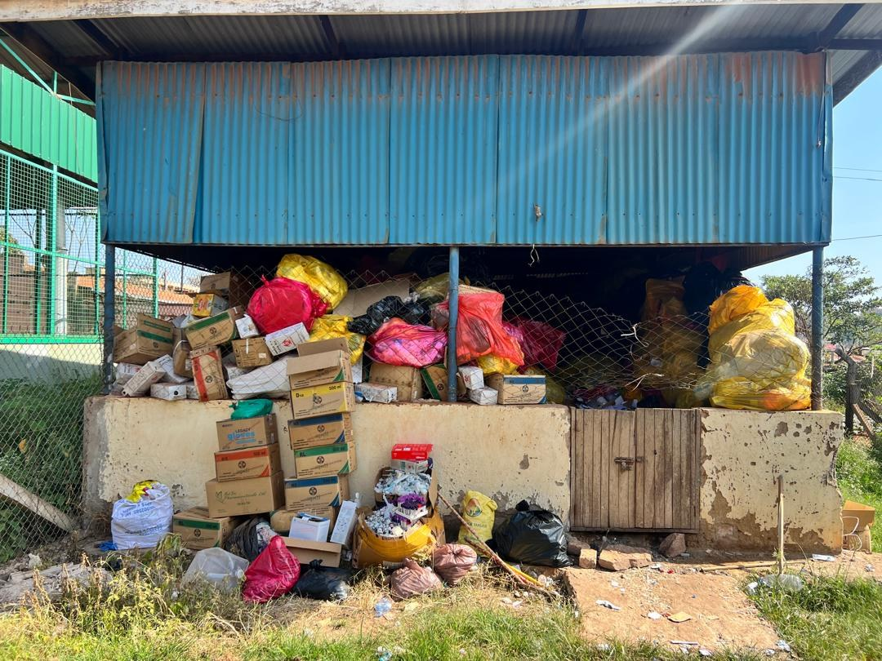
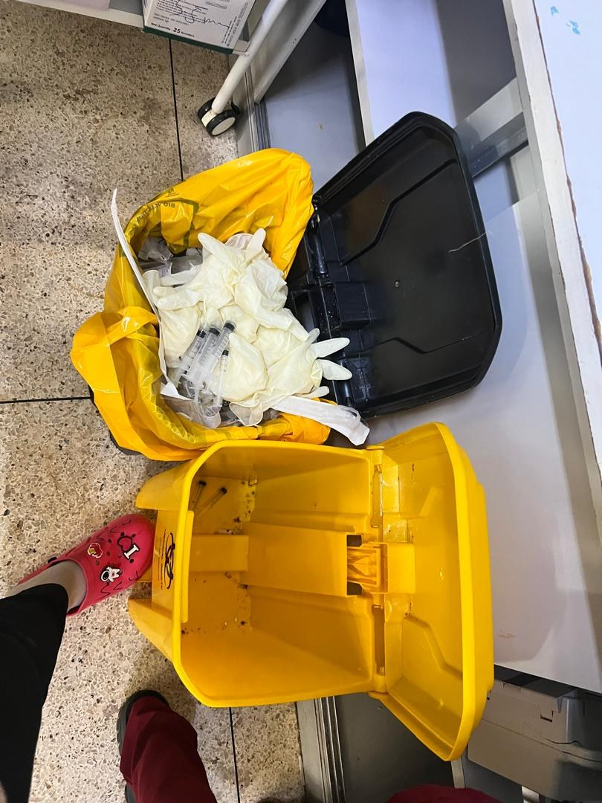
HCWM in our facilities: what must change?
Poor practice: an overflowing waste store, a risk to staff and the community
Poor practice: sharps left loose in a wrong location. Black bins are for non infectious waste. Sharps should only be put in a sharps box

Slide 11
5S FOR THE CARE ENVIRONMENT
Organised workspaces improve flow, safety and dignity
S
Sort
Remove clutter, broken equipment and unnecessary items from service areas.
S
Set in order
Store commodities and tools where staff can find them quickly and safely.
S
Shine
Clean workstations, floors and equipment; assign daily cleaning responsibility.
S
Standardise
Create simple visual standards and checklists so the good order is repeatable.
S
Sustain
Daily walk-throughs, audits and leadership modelling keep 5S alive.
Ministry of Health | SCAPP | Quality of Care
8 / 30

Slide 12
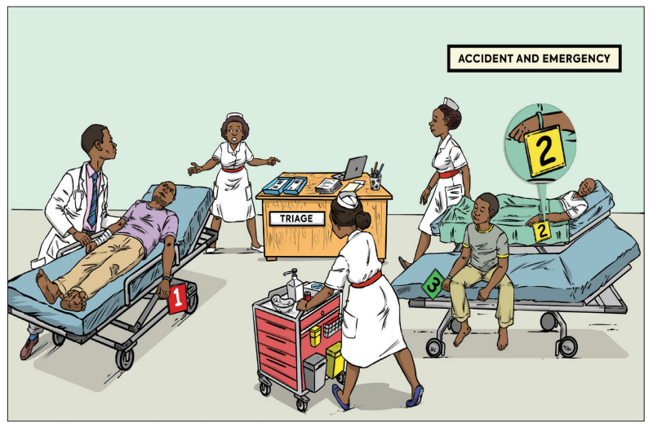
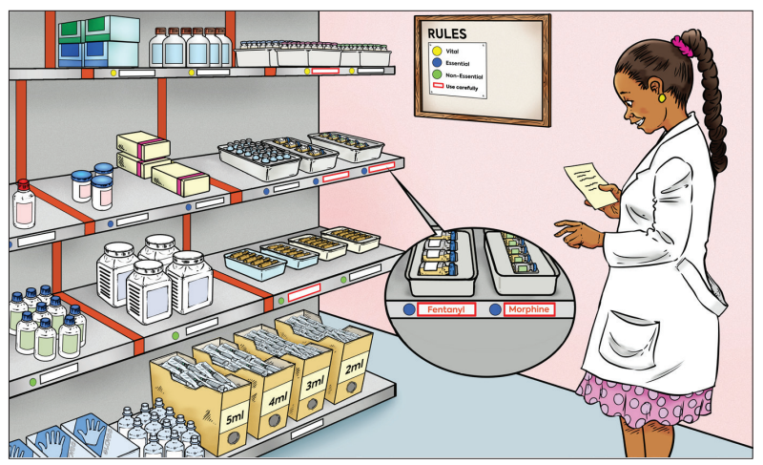
An example of 5S activities color coding and well-designed labelings that contribute to patient safety (Pharmacy)
An example of 5S activities Color codes –that contribute to patient safety (Triage at the Emergency)

Slide 13
CLIENT SATISFACTION
Listen, act and close the loop
1
2
3
4
5
Collect
Review
Act
Track
Tell
QR codes, suggestion boxes, exit interviews, barazas, RCSFI
Identify themes: waiting time, respect, continuity, stock-outs
Agree actions, assign owners and deadlines in the tracker
Monitor completion within 12 weeks; escalate blockers
Inform clients what changed — builds trust and utilisation
Ministry of Health | SCAPP | Quality of Care
9 / 30

Slide 14

The MOH Client Satisfaction Feedback System

Slide 15


QI PRINCIPLES
Four principles that guide quality improvement
Client Focus
Systems & Processes
Understand needs, meet requirements and exceed expectations. Satisfied clients comply better and refer others.
Every system is designed to get the results it gets. Fix the process, not the person.
Data Use
Teamwork
Decide on facts. Measure to identify problems, understand causes and know if a change is an improvement.
Quality faults often occur at hand-overs. Involve every cadre who touches the process.
Ministry of Health | SCAPP | Quality of Care
10 / 30

Slide 16
PRINCIPLE 1
Client Focus — internal and external clients
External clients
Internal clients
Patients, caregivers and the community who receive services. Their needs are defined in standards and guidelines. Feedback mechanisms include surveys, suggestion boxes, barazas and RCSFI.
Health workers, managers, implementing partners and MoH. Satisfied internal clients work better with the system and deliver higher quality to external clients.
Key insight
Key insight
Services that do not meet client needs fail. Satisfied clients refer others.
Treat colleagues as clients. Hand-overs and communication are part of quality.
Ministry of Health | SCAPP | Quality of Care
11 / 30

Slide 17
PRINCIPLE 2
Focus on systems and processes, not blame
“Every system is perfectly designed to achieve exactly the results it achieves.”
If you want different results, redesign the system.
Process
System
Flow chart
Sequence of steps that convert inputs into outputs for the client (e.g. patient flow from registration to exit).
Sum of interrelated processes working together toward a common goal (e.g. integrated chronic care clinic).
Tool to visualise steps, decisions, bottlenecks and missing or redundant work.
Ministry of Health | SCAPP | Quality of Care
12 / 30

Slide 18
PRINCIPLE 3
Use data for decision-making
1
Identify problems
Gaps between actual and expected performance
2
Understand causes
Root-cause analysis guided by facts, not opinion
3
Know improvement
“How will we know a change is an improvement?”
4
Sustain gains
Ongoing monitoring prevents slippage
Ministry of Health | SCAPP | Quality of Care
13 / 30

Slide 19
PRINCIPLE 4
Teamwork — quality is produced by the whole system
Interdependent steps
Staff knowledge
Processes are executed by different people; faults often occur at hand-overs.
Those who do the work often know the real barriers and the practical solutions.
Buy-in
WIT
Participation improves ideas, reduces resistance and builds ownership.
Work Improvement Teams at unit level review data, run PDSA and report to facility management.
Ministry of Health | SCAPP | Quality of Care
14 / 30

Slide 20
MINDSET CHANGE
Quality is how we work every day
✕
CQI is only for the QI team
Every cadre creates quality through daily decisions, documentation and problem-solving.
✕
CQI is extra work
CQI reduces rework, long queues, errors, wastage and repeated complaints.
✕
Data is only for reports
Data is for action at the service point before it becomes a report.
✕
QI is a paid project
QI is an integral part of professional work — it is not optional or remunerated separately.
Ministry of Health | SCAPP | Quality of Care
15 / 30

Slide 21
POLICY DIRECTION
MoH CQI Circular on Quality of Care (July 2025) — key directives
1
Provide leadership, technical oversight and mentorship for CQI
6
Strengthen data use for decision-making at service points
2
Establish or revitalise integrated CQI / Work Improvement Teams
7
Promote patient-centred and integrated service delivery
3
Include CQI indicators and actions in performance reviews and Integrated Care System (ICS) platform meetings
8
Apply 5S and strengthen IPC in all service areas
4
Conduct quarterly quality of care self-assessments (HFQAP, 5S, RCSFI, Integration, IPC and Patient Safety digital tools)
9
Document and report projects in the National QI database/or QI Journals
5
Develop and implement targeted QI projects using PDSA
10
Escalate gaps requiring higher-level action
Ministry of Health | SCAPP | Quality of Care
16 / 30

Slide 22
THE QI PROCESS
Four steps of quality improvement
1
2
3
4
Identify
Analyse
Develop
Test
What is the problem? How do we know? How big is it?
Why is it happening? Root causes, not symptoms.
What changes can we make that will lead to improvement?
PDSA: Plan–Do–Study–Act on a small scale, then scale.
Ministry of Health | SCAPP | Quality of Care
17 / 30

Slide 23
STEP 1
Identify and prioritise the problem
What is the problem?
Gap between actual and desired performance
How do we know?
Data, observation, client feedback, audits
How frequent / how long?
Magnitude and trend over time
What are the effects?
On clients, staff, outcomes and costs
Ministry of Health | SCAPP | Quality of Care
18 / 30

Slide 24
STEP 2
Analyse root causes — dig deeper than symptoms
5 Whys
Fishbone (Ishikawa)
Ask “why” repeatedly until the fundamental cause is reached.
Categorise causes: People, Process, Materials, Environment, Equipment, Management.
Process mapping
Pareto
Flow chart to locate bottlenecks, delays and missing steps.
Focus on the vital few causes that drive most of the problem.
Ministry of Health | SCAPP | Quality of Care
19 / 30

Slide 25
STEP 3
Develop a SMART improvement aim
A good aim answers: How good? By when? For whom? Using what approach?
S
M
A
R
T
Specific
Measurable
Achievable
Relevant
Time-bound
Clear focus (e.g. waiting time in chronic care clinic)
Numerator, denominator, data source, frequency
Realistic with available resources and time
Addresses a priority client or system gap
Clear deadline (e.g. by December 2026)
Ministry of Health | SCAPP | Quality of Care
20 / 30

Slide 26
STEP 4
Test changes with the PDSA cycle
Plan
Do
Study
Act
What will be done, by whom, when, resources needed, baseline data
Execute the plan on a small scale; document observations and data
Compare results with baseline and aim; what did we learn?
Adopt, adapt or abandon; plan the next cycle or scale-up
Ministry of Health | SCAPP | Quality of Care
21 / 30

Slide 27
DOCUMENTATION
QI Journal/National QI Database
What to document
Where to report
• Identified gap and baseline
National QI Database
• Improvement aim & SMART objectives
cqi.health.go.ug
• Root causes and change ideas tested
Update projects routinely. Discuss progress in facility monthly meetings. Use findings for coaching, recognition and cross-learning.
• Results (run charts)
• Challenges and lessons learned
• Actions to sustain gains
Ministry of Health | SCAPP | Quality of Care
22 / 30

Slide 28
Practical Application
Interactive Scenario

Slide 29
SCENARIO
Case: Bwambara HC III
During a support supervision visit the team found:
• Over 50 clients at OPD with only 4 of 10 staff present by midday
• Late arrival / early departure of staff, no duty roster
• Clients complained of long waits, rude staff, no medicines
• Dirty toilets and broken equipment in corridors
• Facility deliveries only 11–29% of target; midwives often absent
• Static immunisation only on Tuesdays; MR2 coverage low
Clients preferred TBA services because “she is kind and does not delay”.
23

Slide 30
APPLY THE STEPS
Apply the 4 CQI Steps + PDSA
Identify
1
What are the main problems? How do we know?
Analyse
2
Root causes? (5 Whys, fishbone, flow chart)
Develop
3
What changes could improve the situation?
Test (PDSA)
4
Plan–Do–Study–Act on a small scale, then act
24

Slide 31
INTERACTIVE
Group Work — Discussion Prompts
1. Prioritise the top 2–3 problems using a simple matrix (gap, feasibility, impact).
2. Write one SMART improvement aim for the highest priority problem.
3. List possible root causes using the 5 Whys or a fishbone diagram.
4. Propose 2–3 change ideas and design a first PDSA cycle to test one idea.
5. Who should be on the Work Improvement Team (WIT) for this problem?
25

Slide 32
GOVERNANCE
QI structures at every level
Facility
District
Region (ICS)
National
• QI teams & WITs
• DHT / QI leads
• ICS platform
• SCAPP / MoH
• Identify gaps, run PDSA
• Mentorship & supervision
• Coordinate coaching
• Standards & database
• Report projects
• Data review
• Action tracker
• Policy & recognition
• Monthly meetings
• Escalate blockers
• Escalate systemic gaps
• National learning
Ministry of Health | SCAPP | Quality of Care
23 / 30

Slide 33
INTEGRATED CARE SYSTEMS
ICS — real-time accountability platform
Regional ICS Committees (chaired by RRH SEC, co-chaired by MoH) provide a monthly virtual platform to identify operational gaps and drive remedial actions.
Purpose
Key issues
Link central leadership to regions, districts and facilities; strengthen governance for quality.
HRH performance, service integration, financing, client feedback, EMR, commodities, equipment.
Action tracker
Learning
Document actions, owners, deadlines; review status monthly; escalate unresolved items.
Share successful change ideas across facilities and regions for scale-up.
Ministry of Health | SCAPP | Quality of Care
24 / 30

Slide 34
COLLABORATIVE LEARNING
Improve together — share what works
1
Within facility
Departments share progress, barriers and successful change ideas in monthly meetings.
2
Across facilities
Mentorship visits, peer exchange and learning sessions between sentinel sites and neighbours.
3
Across regions
ICS platforms and national webinars harvest solutions that can be adapted and scaled.
4
National conference
Annual National QI Conference for cross-learning, recognition and policy feedback.
Ministry of Health | SCAPP | Quality of Care
25 / 30

Slide 35
REPORTING
Key Digital Systems for Tracking Quality of Care Practice
RCSFI Dashboard
Routine Client Satisfaction Feedback. Tracks timeliness, respect, continuity and other experience indicators. Use for waiting-time and dissatisfaction trends.
National QI Database
www.cqi.health.go.ug — register QI projects, update progress, share change packages and enable national coaching and recognition.
ICS Action Tracker
National and Regional view of documented actions, completion status and sites with no active responses to healthcare system gaps
5S Tool and IPC tool
5S tool assesses the organization of workplace environment, while the IPC tool assesses the IPC practices at the health facility
Integration of Health Services
Assesses the level of health care services integration at a facility
Ministry of Health | SCAPP | Quality of Care
26 / 30

Slide 36
STANDARD OPERATING PROCEDURES
National Standard Operating Procedures (SOPs) for Integrated Service Delivery
Entry, Flow & Assessment (1–6)
Registration, appointments, education, assessment, emergency, differentiated care
Treatment, Linkage & Community (7–12)
DSD models, prescribing, dispensing, referrals, socioeconomic support, outreach
Systems, Data & QI (13–17)
Tracking, CPD, client feedback, data reporting, continuous quality improvement
Ministry of Health | SCAPP | Quality of Care
27 / 30

Slide 37
SUMMARY
Key Takeaways
1
Quality of Care can be achieved through continuous quality improvement
2
MOH has prioritized 5S, IPC, Client Satisfaction, Patient safety and Integration as the priority areas to improve quality of care
3
QoC is guided by four principles: client focus, systems thinking, data use and teamwork.
4
CQI can be achieved through the four steps: identify → analyse → develop → test (PDSA).
5
Documentation and reporting of the CQI projects is important to track progress
6
The key documentation tools that have been digitized include: 5S, IPC, Client Satisfaction, Patient Safety, Integration, ICS and HFQAP
7
Quality of Care is everyone’s daily work — not a special project or extra task.
Ministry of Health | SCAPP | Quality of Care
28 / 30

Slide 38
NEXT STEPS
Next Steps for Health workers (WITs)
1
Orient your unit
Share this deck and the CQI circular with your WIT or department.
2
Pick one gap
Use data or client feedback to select one priority problem.
3
Start a PDSA
Write a simple aim, test one change idea on a small scale.
4
Apply 5S & IPC
Walk through your service area and fix one visible problem today.
5
Report & share
Log the project in cqi.health.go.ug and present progress next month.
Ministry of Health | SCAPP | Quality of Care
29 / 30

Slide 39
Thank you
Quality is how we work every day.
Ministry of Health • SCAPP
For guidance: contact your Regional ICS team or SCAPP
cqi.health.go.ug

