Slide 1


Slide 2

DocuAI
Overview

Slide 3
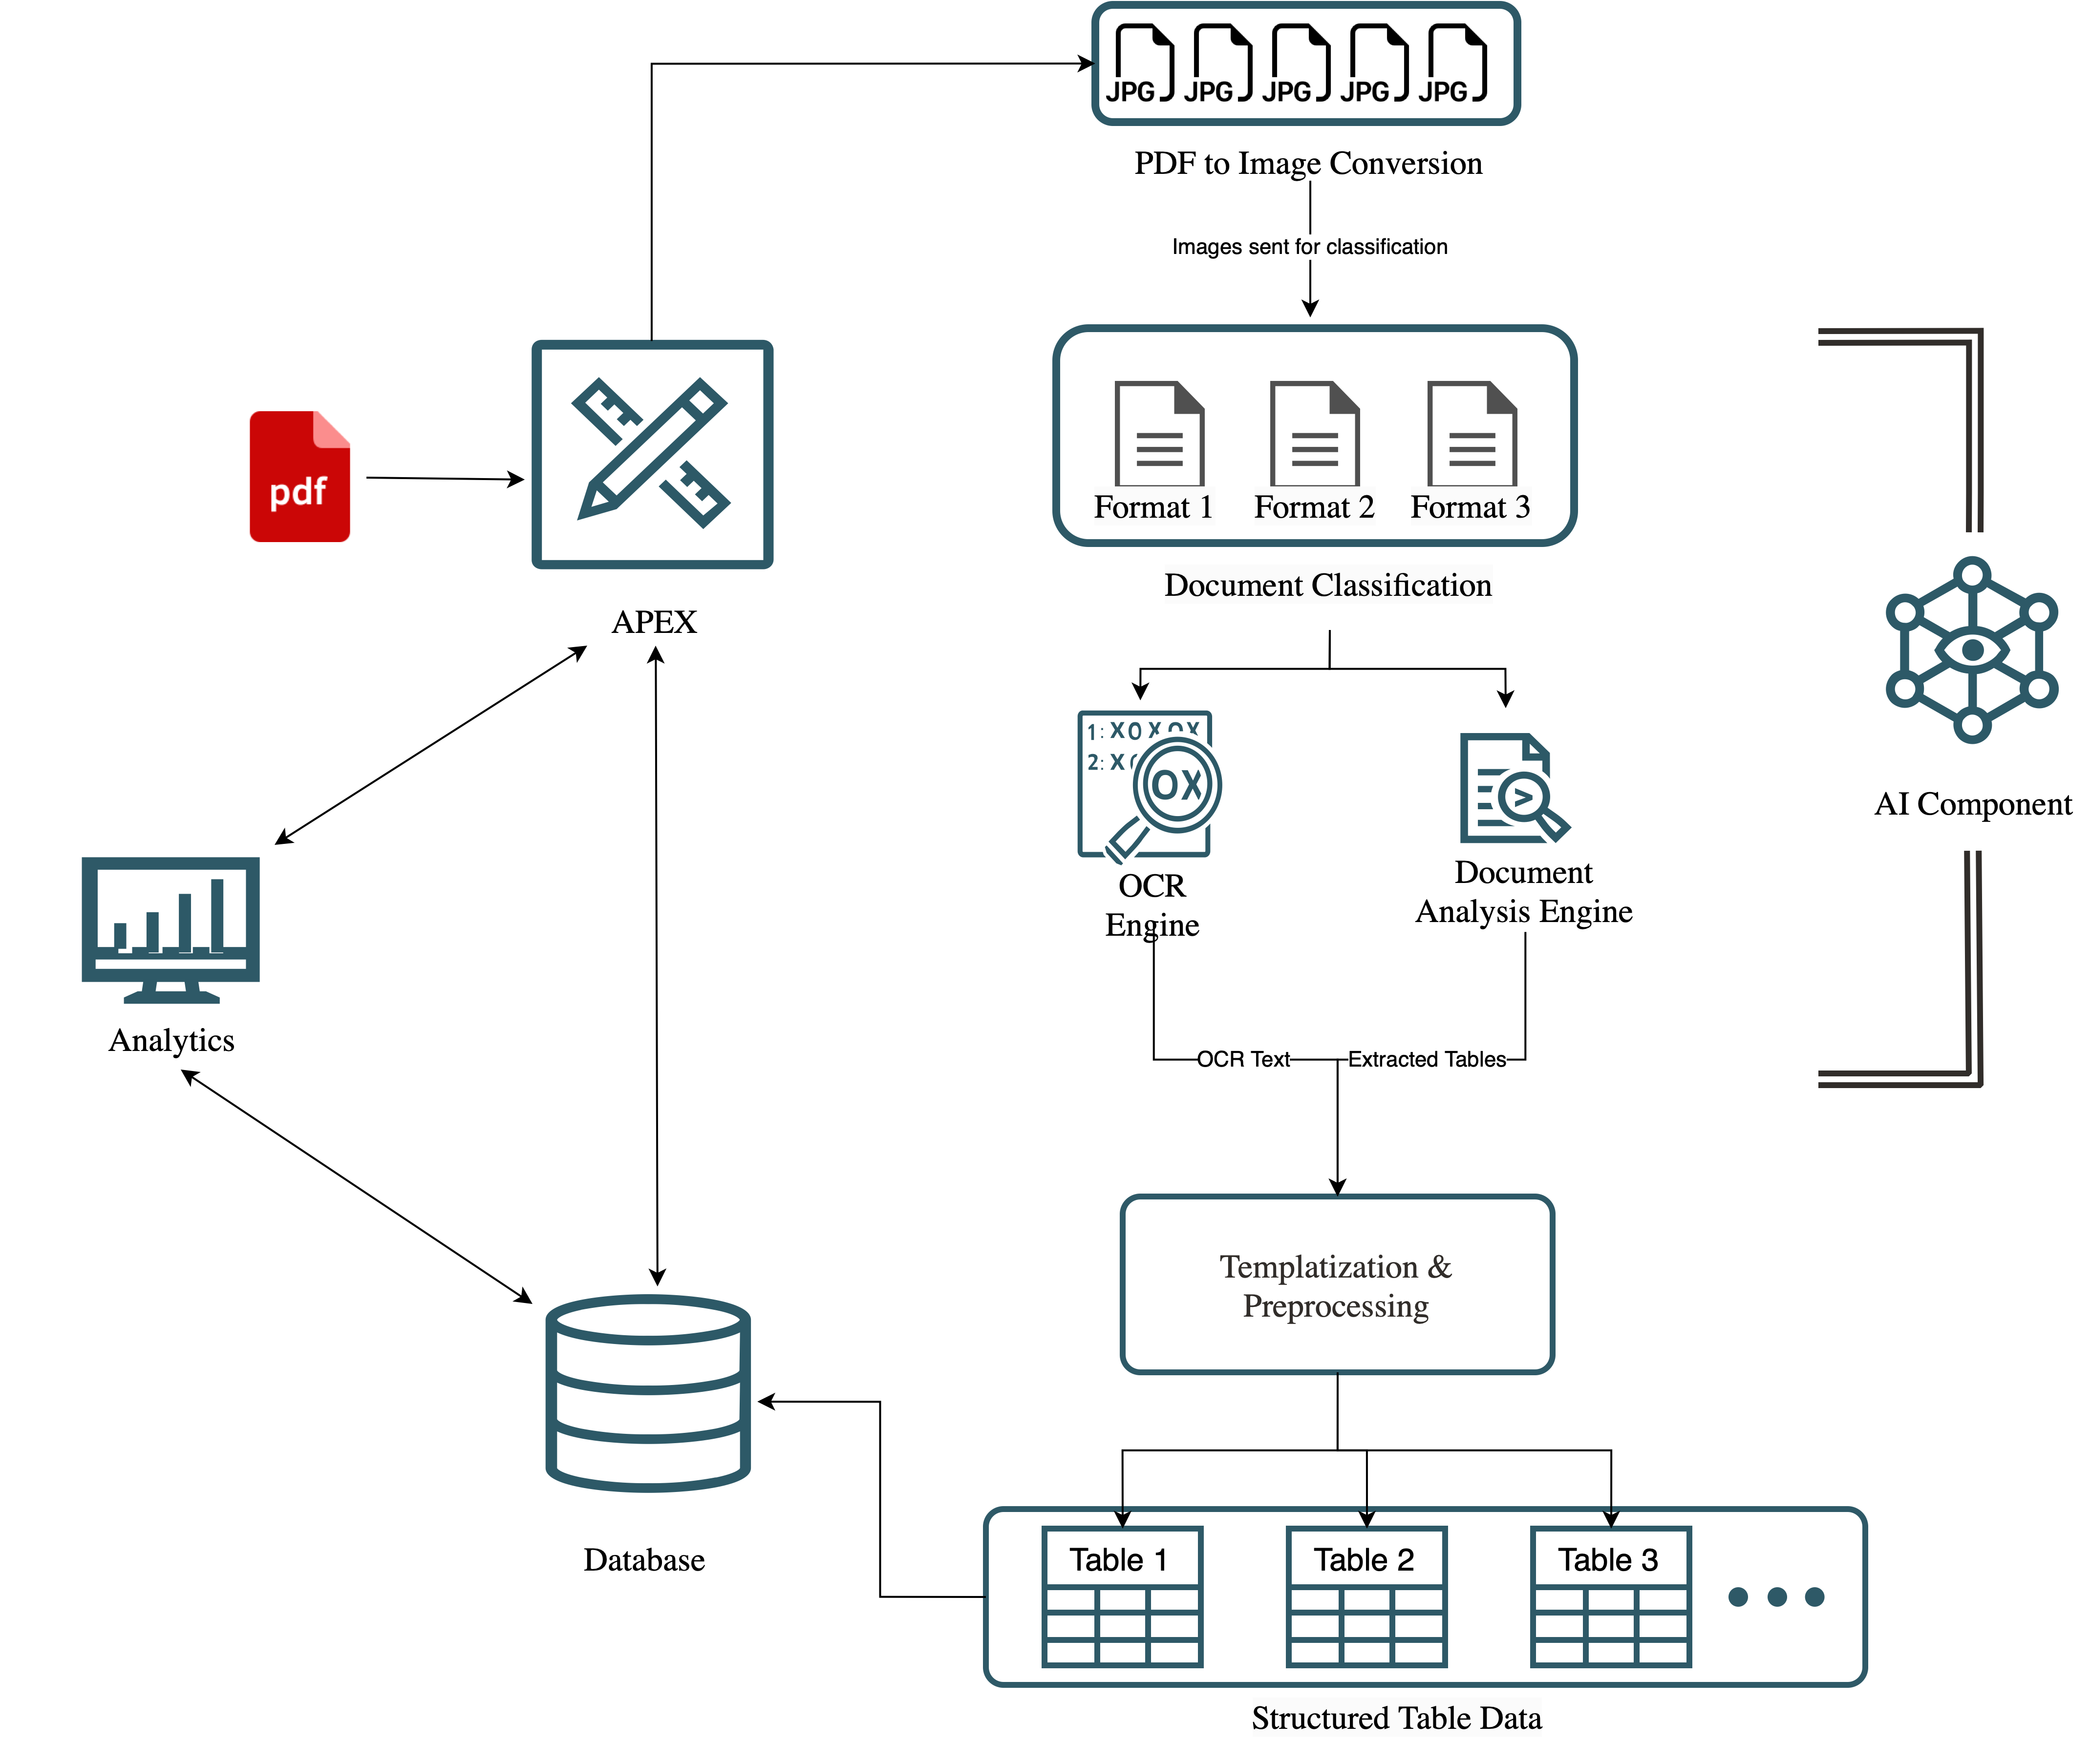
System Architecture

Slide 4


Slide 6

Our mission is to help people see data in new ways, discover insights, unlock endless possibilities.

