Slide 1

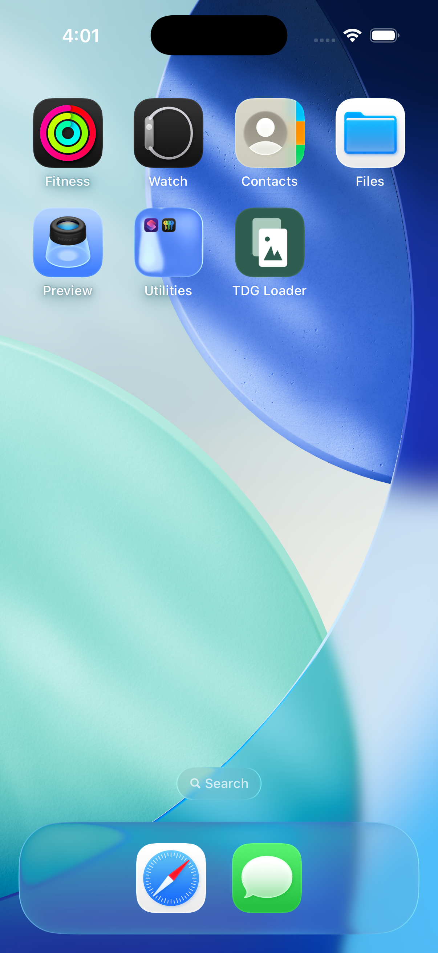
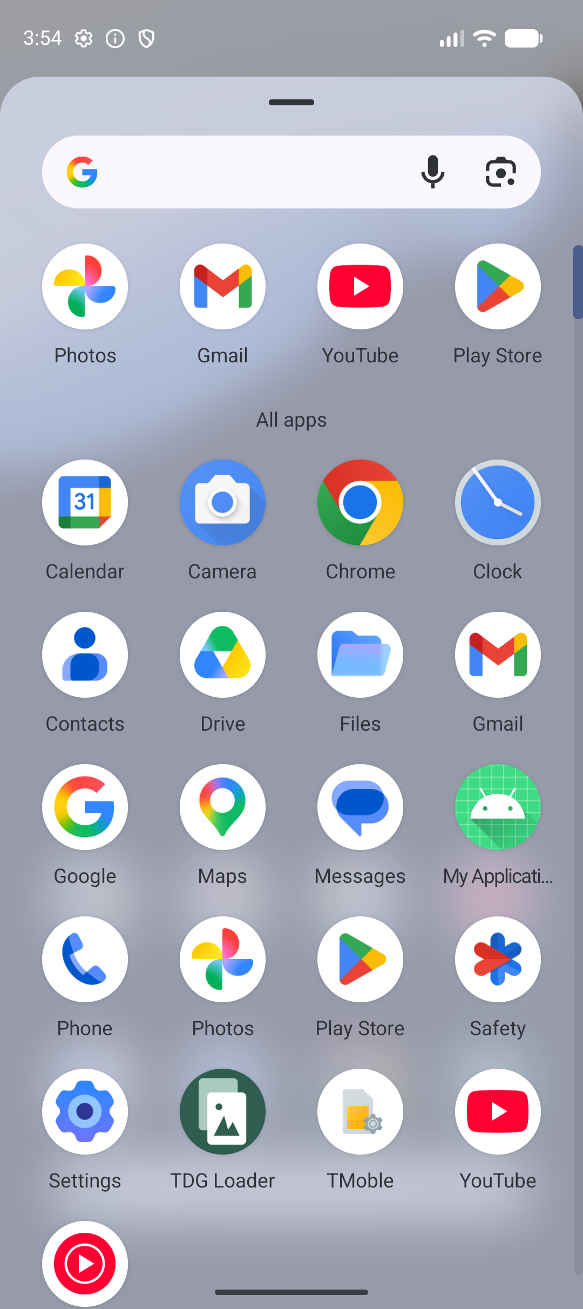
Screen by screen
Every interface TDG puts in front of you
A browser to build packs, a command line to script them, and a small app on each phone to do the one thing only a native app can — write into the camera roll.
Notes:
Four surfaces: web control plane, CLI, Android app, iOS app. The two phones are where the pack actually lands.

Slide 2
WHERE THE WORK HAPPENS
Four surfaces, one pack
Web control plane
Command line
Pick a size, a device persona and a format mix. Watch the build. Hand a phone a six-digit code.
The same generator, scriptable. Build, load, verify and wipe from CI without a browser.
Anyone on the LAN
Automation
Android app
iOS app
Writes into the gallery through MediaStore, keeps a receipt, and removes exactly what it wrote.
Writes into Photos through PHAssetCreationRequest, batched, with the same receipt discipline.
Any Android 11+ device
Any iPhone on iOS 17+
The manifest is the contract between them: every surface reads the same pack, and every loader writes the same receipt.
Notes:
The web plane and the CLI both drive the generator; the two apps are thin loaders.

Slide 3
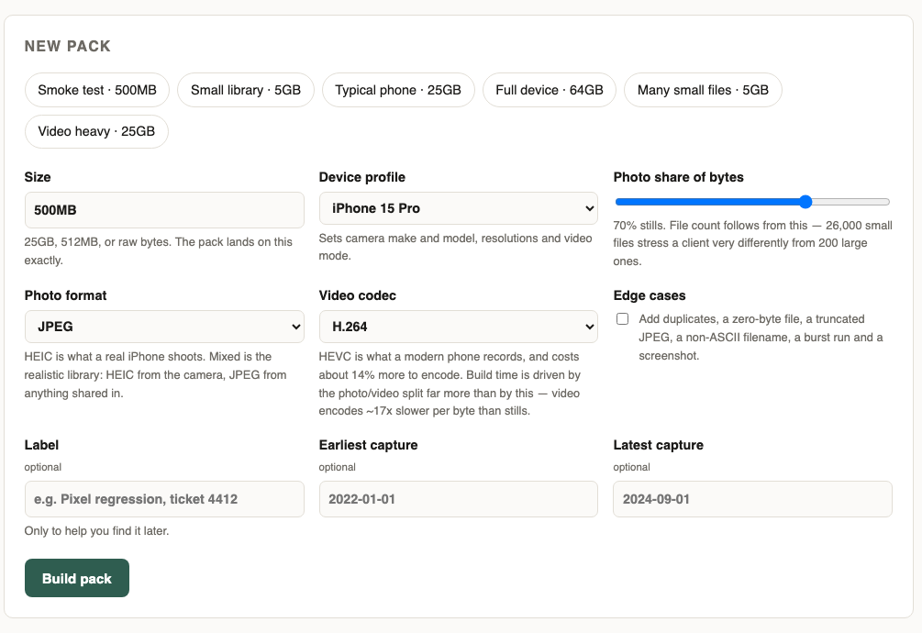
WEB · NEW PACK
Describe the library you want
Size is exact, not approximate — "25GB" lands on 25 GB, delta zero
Device profile sets the camera make, model, resolutions and video mode that end up in the EXIF
Photo share of bytes decides file count: 26,000 small files stress a client very differently from 200 large ones
Photo format and video codec: JPEG, HEIC or a mixed library; H.264 or HEVC
Edge cases adds the awkward files — a zero-byte file, a truncated JPEG, a non-ASCII name, a burst run, a screenshot
Capture dates bound the timeline the gallery will group on
One preset click fills the whole form — Smoke test, Typical phone, Full device, Many small files, Video heavy.
Notes:
This is the only screen most people use. Everything else follows from what is set here.

Slide 4
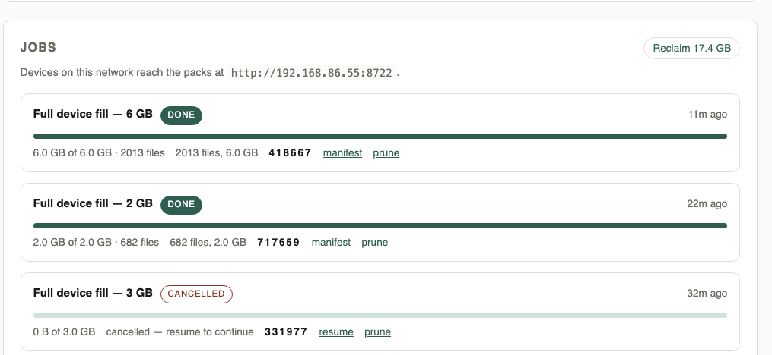
WEB · JOBS
Watch it build, then hand it to a phone
Live progress is read from the build's own checkpoint, so it stays accurate across a resume
The build log streams in as it runs — every photo, every pad, every trim
The six-digit code is what a phone types; nothing else identifies the pack
manifest opens what a loader will actually fetch
Cancel stops a build and keeps what it made; resume continues from the checkpoint rather than starting over
prune deletes a pack's media and keeps the job; Reclaim frees every finished pack at once
Older jobs fold into one line each, so a long history costs no screen
Notes:
The cancelled job in this shot is real — it shows resume being offered.

Slide 5
COMMAND LINE · THE SEED POOL
Fetch the pictures once, then build forever
$ tdg harvest --images 24 --out ./seed-pool
Harvesting up to 24 open-license stills into /tmp/tdg-harvest-demo
! from_openverse failed: HTTP Error 401: Unauthorized
seed pool now holds 24 assets
Every still in a pack is a crop of a seed image, re-encoded with its own EXIF — so run this before the first build
Stock APIs forbid bulk harvesting, so the pool is fetched once and cached; seed-pool/ is gitignored
seeds.json records the licence, author and origin of every file, and a LICENSES.csv ships with each pack
Openverse now wants a key and answers 401; Wikimedia covers the shortfall, which is why the count still lands on 24
bootstrap-seeds synthesises a pool with no network — but a synthetic pool is the smaller one
$ ls seed-pool | wc -l
213
$ python3 -m json.tool seed-pool/seeds.json | head -9
{
"version": 1,
"seeds": [
{
"file": "wm_8898464043.jpg",
"kind": "image",
"source": "wikimedia-commons",
"author": "Ross, Gordon, 1873-1946, artist",
"license": "Public domain",
Twelve synthetic seeds put 268 perceptually identical pairs in a 2,227-photo pack. With 212 harvested seeds, plus per-file variation and a perceptual-hash gate, the same measurement finds none.
Notes:
Pool size is what decides whether two stills in a pack are the same picture. The 401 is real: Openverse changed its terms, and the harvest covers the gap from Wikimedia.

Slide 6
COMMAND LINE · BUILD
The same generator, scriptable
$ tdg build --size 40MB --out ./pack --profile pixel-8 --edge-cases
Building 40.0 MB pack [pixel-8] -> /tmp/clipack
edge cases 10 total 1.6 MB
photos 5 total 16.6 MB / 40.0 MB
photos 8 total 24.9 MB / 40.0 MB
pad photo 8.0 MB deficit 7.1 MB
pad photo 7.1 MB deficit 0 B
job demo01
files 20 (20 photos, 0 videos)
target 40.0 MB
actual 40.0 MB (delta +0 bytes, +0.0000%)
elapsed 2.9s (13.6 MB/s)
manifest /tmp/clipack/manifest.json
Every flag the web form offers, plus a few it does not
The pad and trim lines are the size planner closing the gap: video duration first, then a JPEG comment segment
delta +0 bytes is the point of the whole tool
Same job id and seed rebuild the identical pack, byte for byte
A killed build resumes from its checkpoint
Notes:
40 MB with edge cases, built in under three seconds, landing exactly on target.

Slide 7
COMMAND LINE · DEVICES AND LOAD
Find a device, push a pack
$ tdg devices
booted simulators:
3766D8F3-9DAB-41EA-A904-C40F29B30178 iPhone 17 (iOS-26-5)
adb devices:
emulator-5554 product:sdk_gphone16k_arm64 model:sdk_gphone16k_arm64 device:emu64a16k transport_id:3
What is reachable right now. Simulators and adb devices are probed separately, so one missing toolchain cannot hide the other platform.
$ tdg load --pack ./pack --target emulator --verify
job demo01 -> emulator emulator-5554 /sdcard/DCIM/TDG demo01
20 files, 40.0 MB; 6.6 GB free
pushed 20/20
scanned 20/20
20/20 files in 21.4s (1.9 MB/s)
verified 20/20 files
receipt /Users/pdoran/.tdg/receipts/demo01__emulator__emulator-5554.json
Free space is checked before a byte is written, --verify re-hashes what landed, and the receipt is written outside the pack — which is what makes the fill resumable and the wipe exact.
Notes:
Targets are a folder, an iOS simulator, or an Android device. The receipt lives in ~/.tdg/receipts, never inside the pack.

Slide 8
COMMAND LINE · VERIFY
Ask the device what it actually indexed
$ tdg verify --pack ./pack --target emulator
job demo01 -> emulator emulator-5554
20 files expected (20 photos, 0 videos), 40.0 MB
assets indexed 20/20 [PASS]
capture time preserved 18/18 (worst delta 0.823s) [PASS]
no capture time 2 asset(s) carry no EXIF date (a screenshot or an empty file has none)
album grouping DCIM/TDG demo01 (expected TDG demo01)
fill took 21.4s (1.9 MB/s)
PASSED
Queries the gallery database, not the filesystem — it answers whether the assets were indexed, not merely copied
Capture times are compared against the manifest to sub-second tolerance
Album grouping is checked, and undated assets are reported rather than counted as missing
A failing run exits non-zero, so CI notices — this is the conformance gate
Notes:
PASSED, or the shell fails. The two undated assets are the screenshot and the zero-byte file, both correct.

Slide 9
COMMAND LINE · WIPE AND PRUNE
Undo it, and get the disk back
$ tdg wipe --job demo01
job demo01 emulator emulator-5554 20 files
deleted 20/20
scanned 20/20
receipt cleared /Users/pdoran/.tdg/receipts/demo01__emulator__emulator-5554.json
wipe reads the receipt and deletes only what it records. Nothing else in the gallery is touched, and the folder it empties goes too.
$ python3 -m tdgweb.prune --packs ./packs --dry-run
prune 77b981 done 6.0 GB
prune 65e3f3 done 2.0 GB
prune ce3e59 cancelled 614.9 MB
prune 7a7d81 done 800.1 MB
prune f17cac done 24.0 MB
prune 3404ba done 500.0 MB
…
reclaimable: 17.4 GB
Packs are the only thing that grows without bound — a 64 GB job leaves 64 GB behind
prune deletes the media and keeps the job, so it can be rebuilt byte for byte
A partial build is skipped: pruning it would discard a resume
Receipts are never touched, so a loaded device stays wipeable
Notes:
--dry-run first: it reports exactly what would go and what it would free.

Slide 10
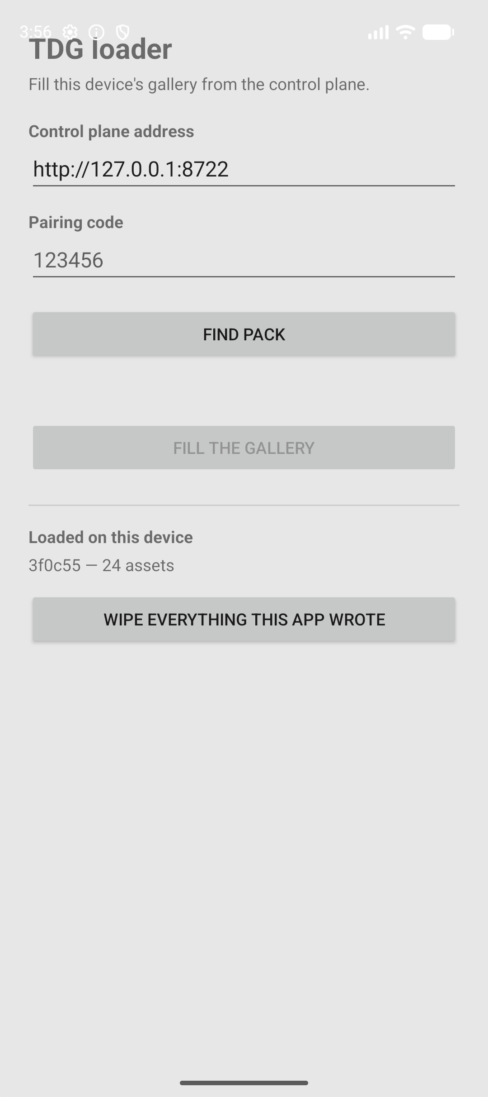
ANDROID · THE APP
Before it is opened
TDG Loader installs like any app — a debug APK today, a signed one when it is distributed
The adaptive icon is the product mark: two sheets, the front one a photo
On first launch it asks only for notification permission, so the fill can show progress
No storage permission is requested, and none is needed — since Android 10 an app may write, read back and delete the media it owns
The address is remembered between runs; only the six-digit code changes
In the app drawer
Ready to pair
Notes:
Captured on a Pixel 9 emulator running Android 17.

Slide 11
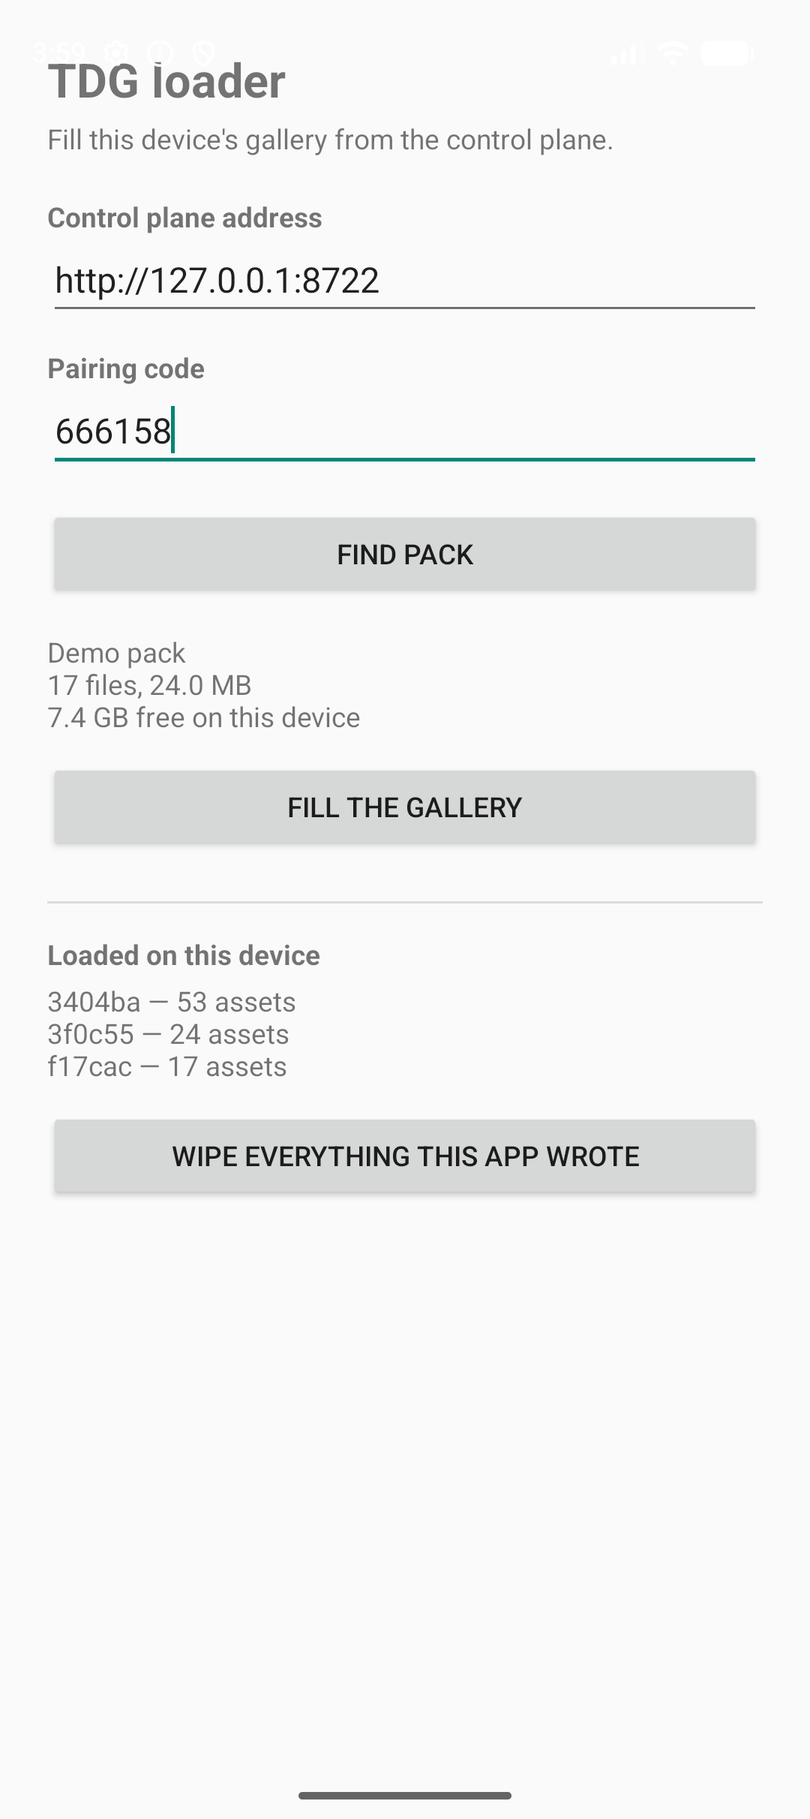
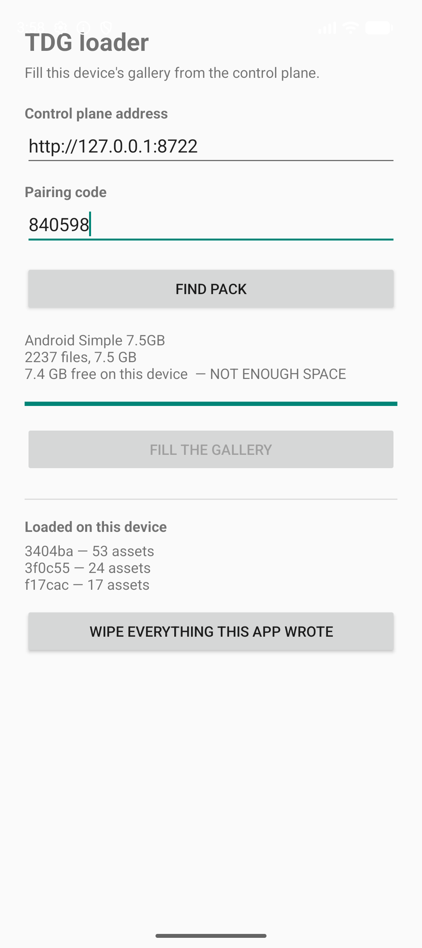
ANDROID · PAIR
Type six digits, see what you are about to get
The code alone resolves to a pack — a phone has a keypad and no way to know a twelve-digit job id
Before anything is written it shows the label, the file count, the total size, and the free space on this device
If the pack will not fit, the fill button stays disabled and says why — filling a device until it wedges is a slow, unhelpful way to fail
A pruned pack, or one still building, says so in words rather than failing halfway
Paired
Refused: not enough space
Notes:
The right-hand shot is a genuine refusal: 7.5 GB pack, 7.4 GB free.

Slide 12
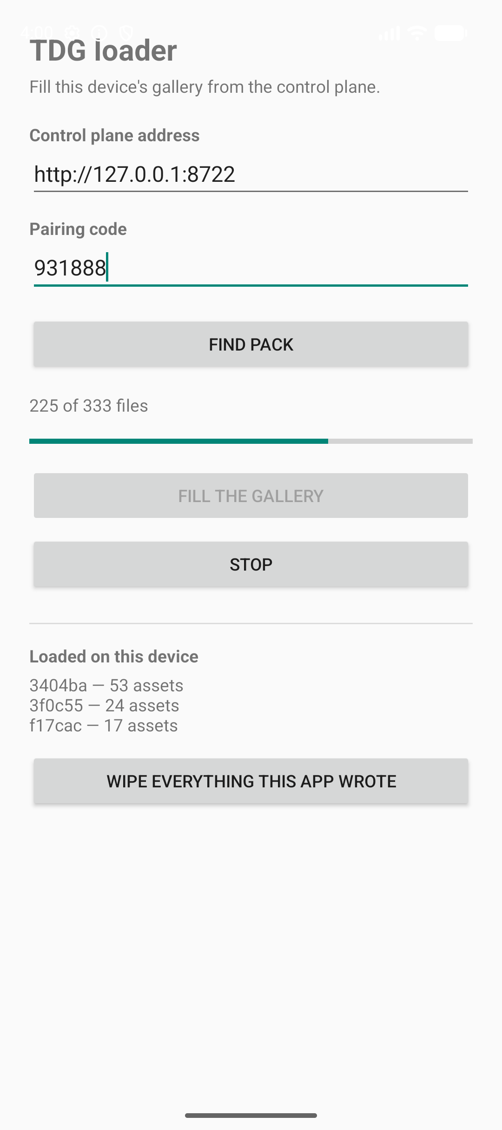
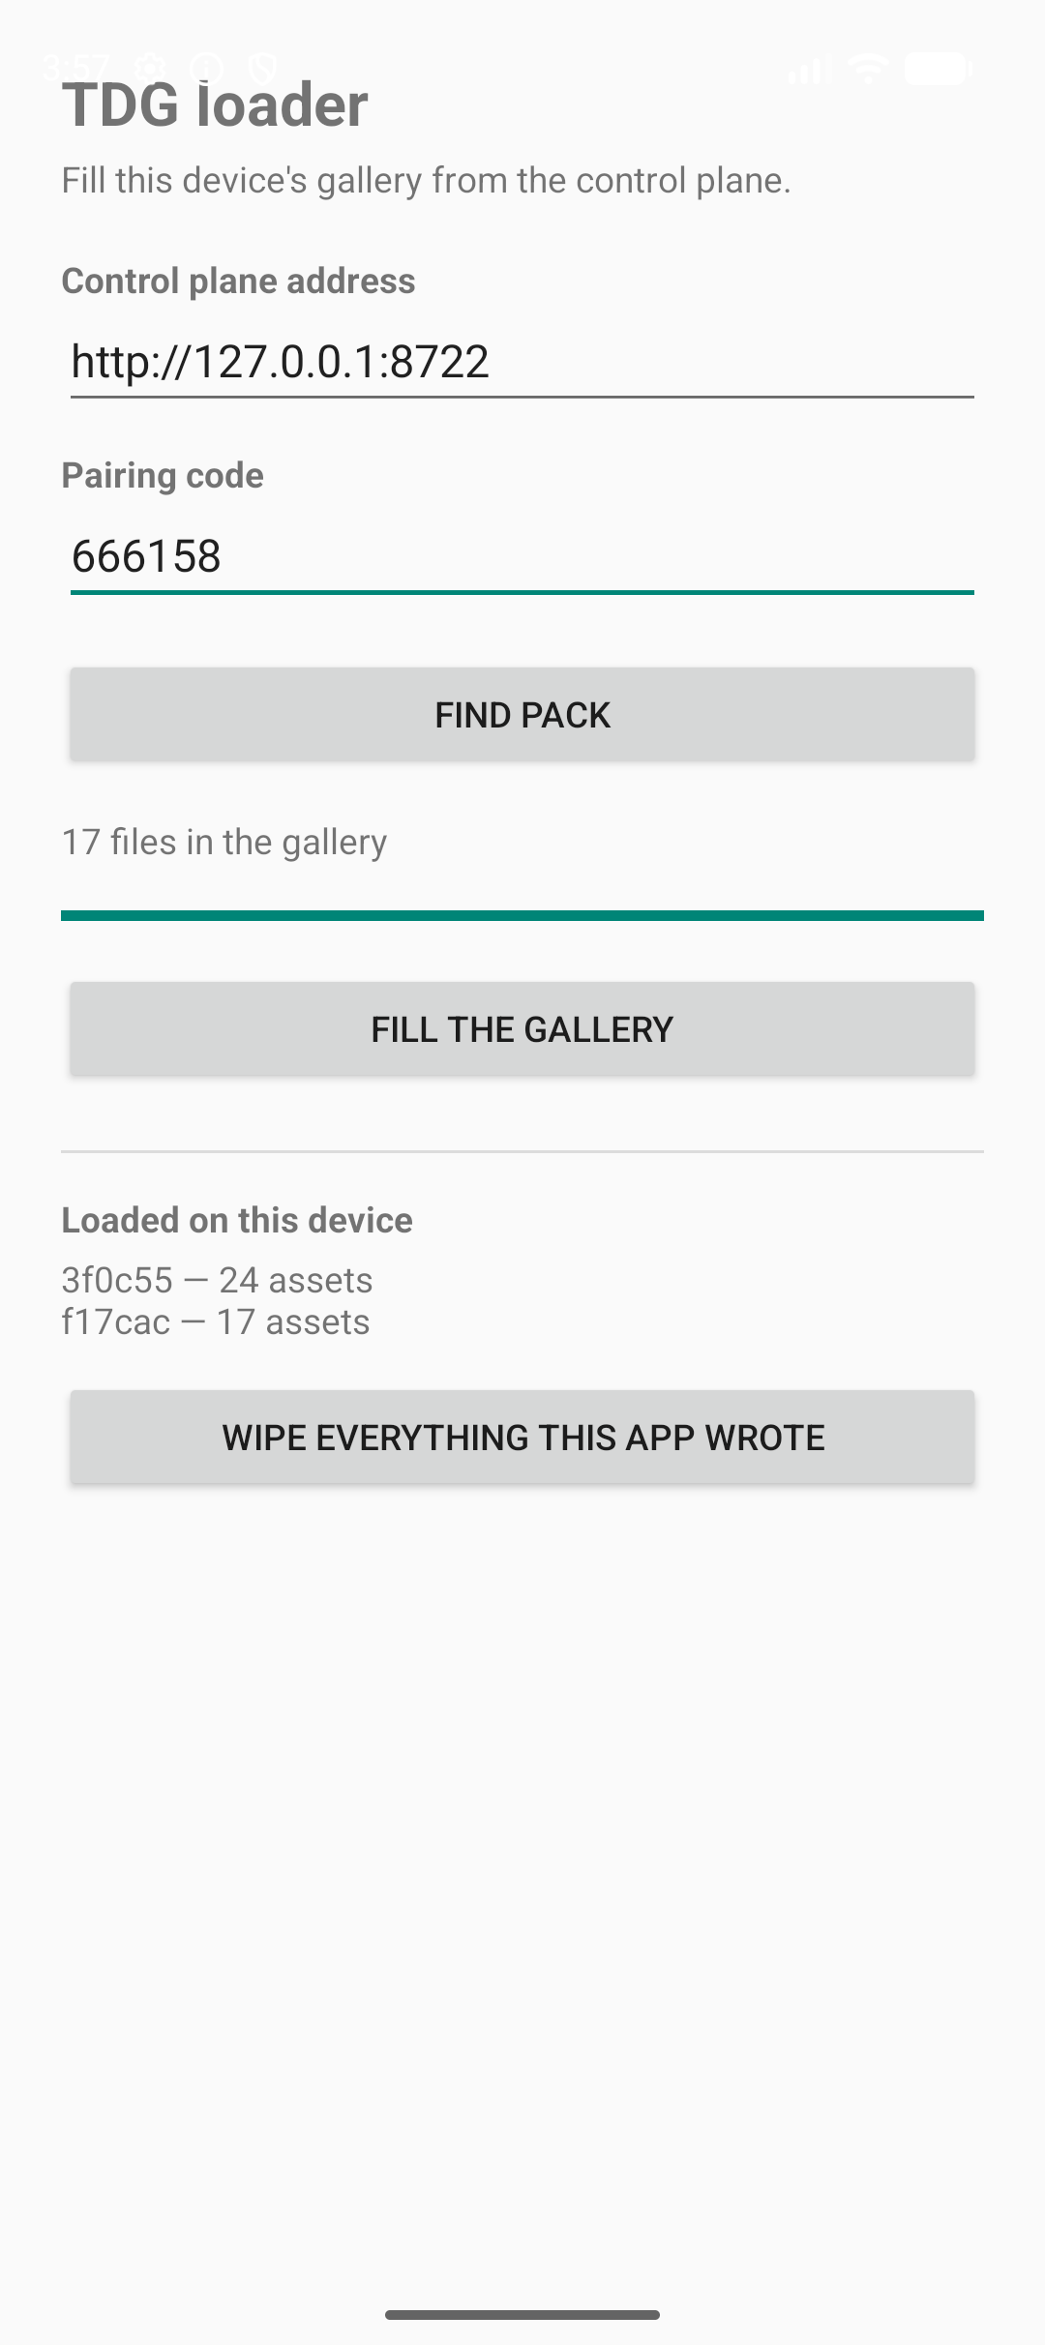
ANDROID · FILL AND WIPE
Fill it, then take it all back
The fill runs in a foreground service, so it survives the screen going off — verified for 15 minutes unplugged on a Galaxy S24
Progress is per file, and Stop leaves what already landed in place
Re-pairing the same pack resumes: files already in the receipt are skipped
Loaded on this device lists every pack this app wrote, with its asset count
Wipe removes exactly those assets, then deletes the folder it emptied — nothing else in the gallery is touched
Filling
Done, with receipts
Notes:
Wipe asks once, naming the number of assets, then deletes without further prompting.

Slide 13
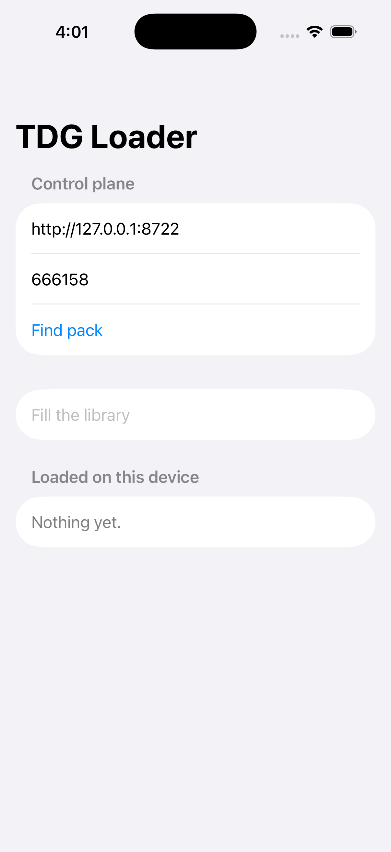
iOS · THE APP
Before it is opened
The same mark, rendered as an iOS app icon
Installed by cable for now — signed with a development team, so no TestFlight is needed to try it
It asks for add-only photo permission, which is all a fill needs; full access is requested only when you wipe
The control-plane address and code are the whole configuration
Launch arguments drive it unattended in CI: -host, -code, -autostart, -autowipe
On the home screen
Ready to pair
Notes:
Captured on an iPhone 17 simulator; the same build runs on the iPhone 15 Pro.

Slide 14
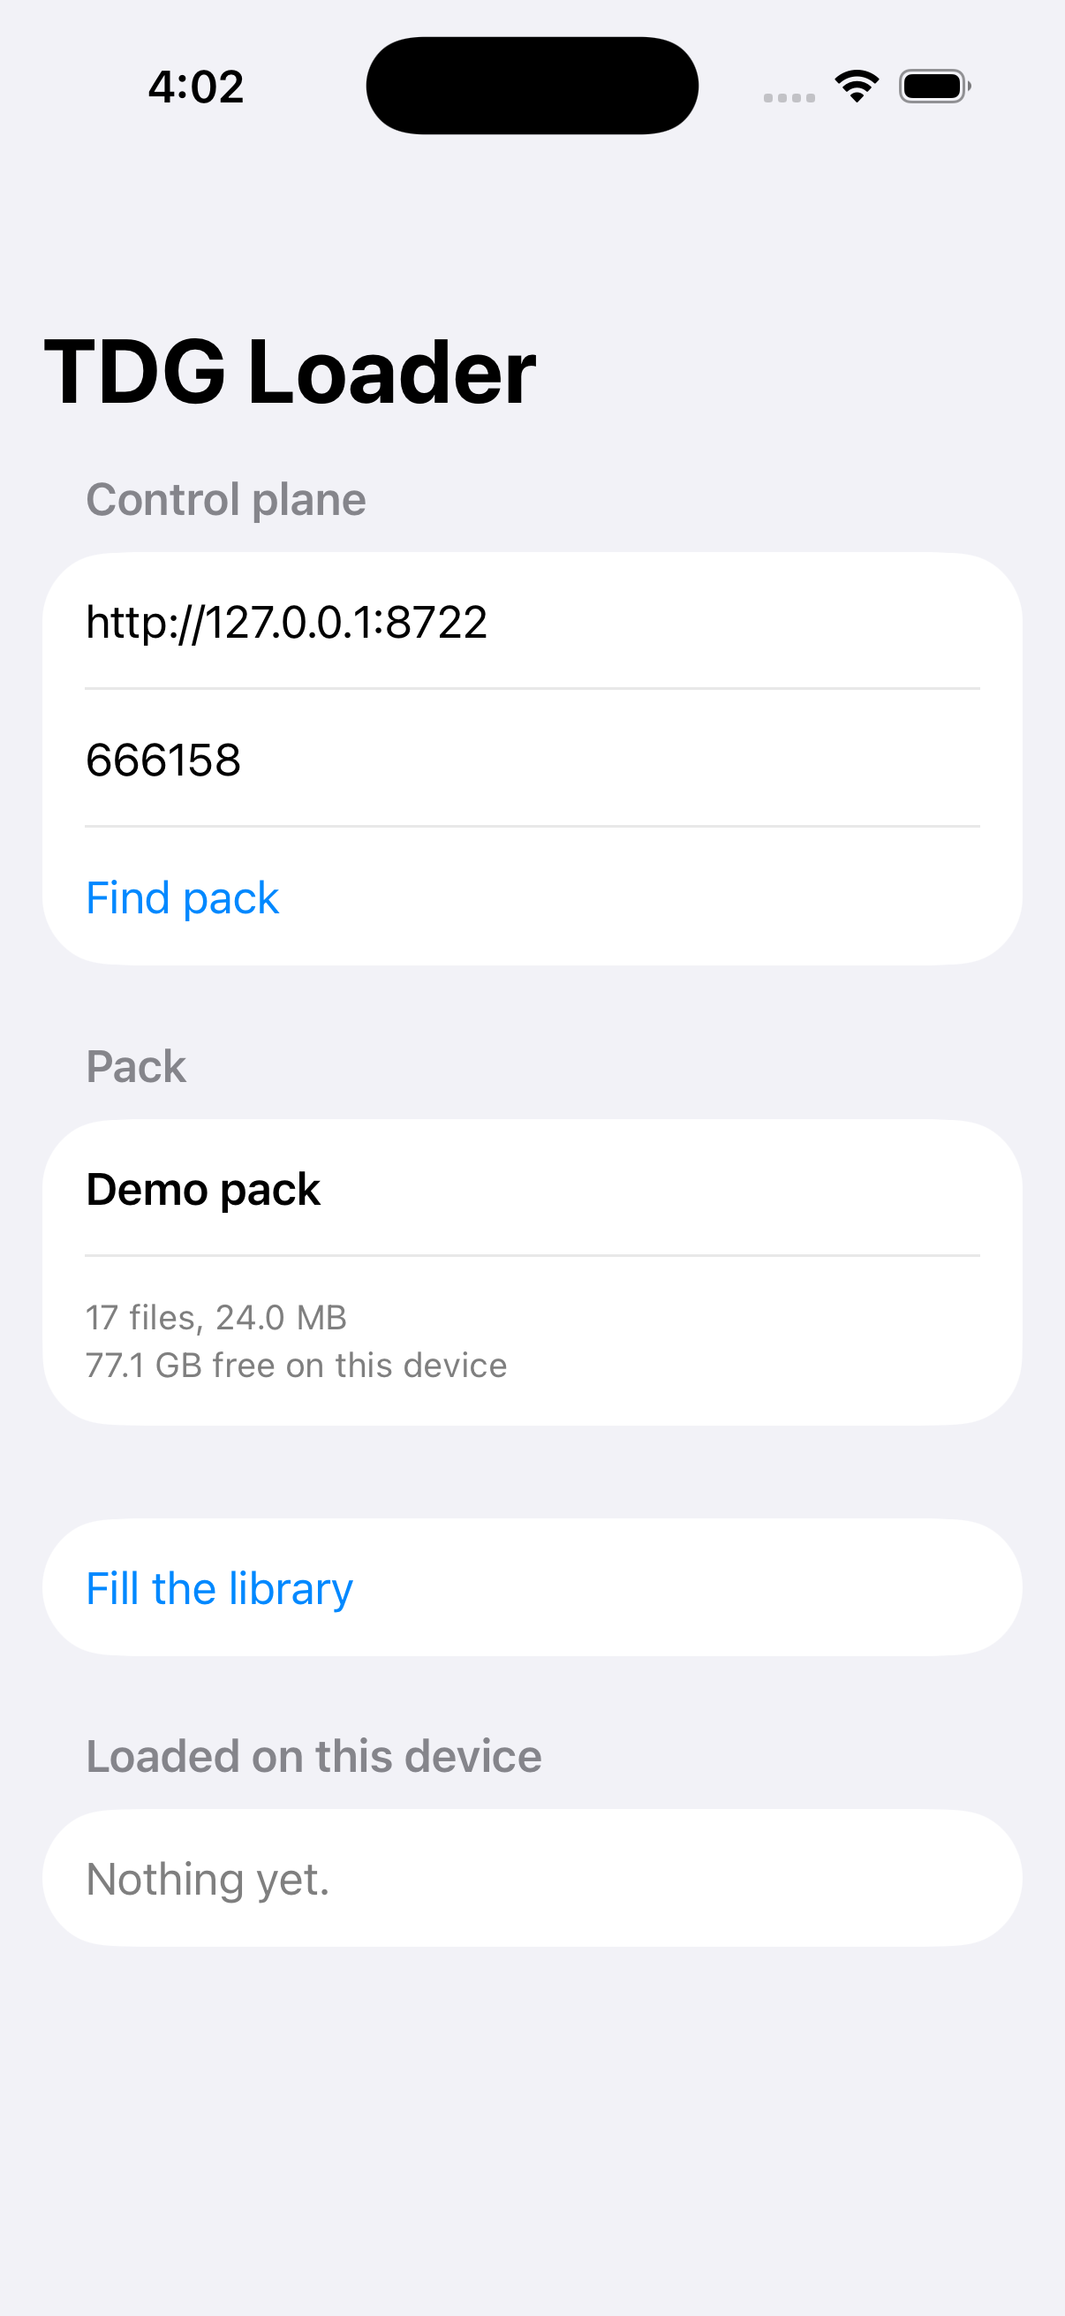
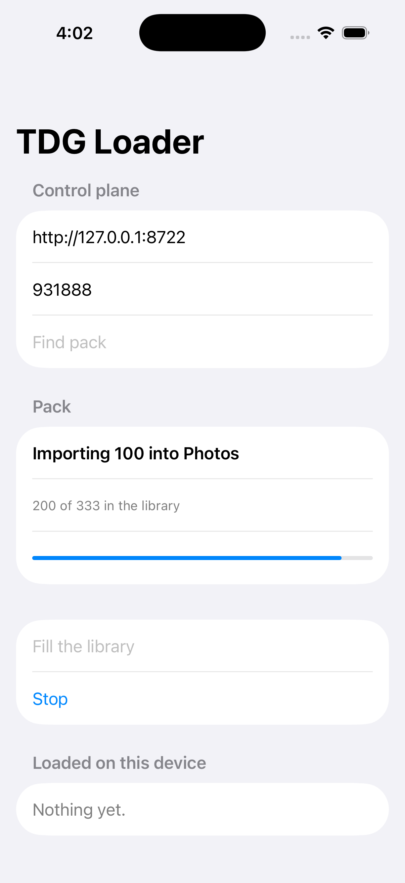
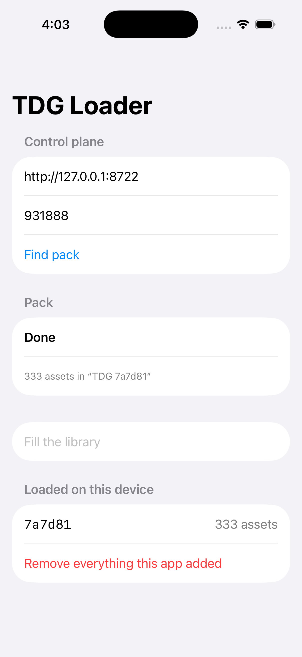
iOS · PAIR AND FILL
Pair, fill, and see what landed
Same six digits, same preflight — file count, total size, free space
Assets are imported to Photos in batches, because one transaction per file is far slower
A batch that Photos refuses falls back to one asset at a time, so a single bad file cannot lose the whole run
The album is named for the job, so the pack is visible as a group
Removing works from the same receipt, and needs full access — which iOS asks for separately
Paired
Importing
Done
Notes:
The zero-byte edge case is correctly refused by Photos; the retry path is what keeps the other 71 of 72.

Slide 15
Web
build and hand off
CLI
One loop, four surfaces
script and verify
Build it in the browser or from a script. Pair a phone with six digits. Watch it fill. Ask the device what it indexed. Take every byte back.
Android
MediaStore
Every screenshot here was taken from the running software, not mocked up.
iOS
Photos
Notes:
Close: the loop is complete on both platforms, on real hardware.

