Slide 1
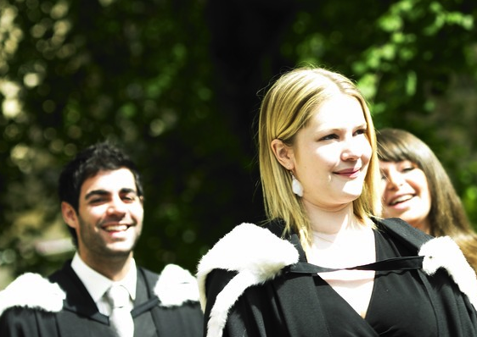
Welcome to
Computer Science
Steven Bradley
Department of Computer Science
Durham University
WWW.BINOCULARITY.ORG

Slide 2
Game of life
Simulation of a biological system
World is a simple grid
Each square is alive or dead
Step-wise simulation: discrete events
Invented by John Conway

Slide 3
Rules of life
Any live cell with fewer than two live neighbours dies
Any live cell with two or three live neighbours lives on
Any live cell with more than three live neighbours dies
Any dead cell with exactly three live neighbours becomes alive

Slide 4
What happens?
Once cell by itself?
Two in a line?
Three in a line?

Slide 5
Can you make?
Other still-life (never changes)
Other oscillators (like three-in-a-row)
Something that travels

