Slide 1
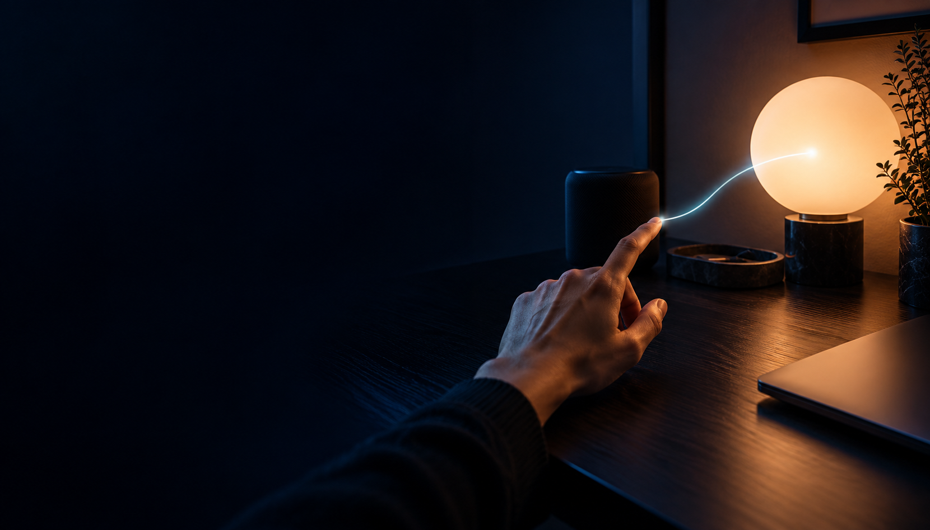
Spellcast
Your room,
within reach.
Gesture control for lights and music
Build Day / Durham / 17 October 2026
Concept illustration
Notes:
10 seconds
Spellcast lets you point at a device in your room and control it with your hands. We are starting with the two things students adjust at their desks: lighting and music.
Sources and qualifications
Visual: AI-generated concept illustration using the built-in image-generation tool. It is not a photo of the prototype.
Research checked 17 October 2026. Commercial figures are proposals, not traction.

Slide 2
SPELLCAST
02
Smart rooms still interrupt us
Students with smart desk setups interrupt study
to adjust lights and music through separate controls.
40%
3 in 5
of UK households had a smart speaker
smart-speaker users have had the wrong
radio station play after a request
Sources: Ofcom, Media Nations 2025 and Audio Listening 2025. Demand for gestures remains a hypothesis.
Notes:
25 seconds
Our first user is a student with a Mac, a smart lamp and Spotify. Adjusting the room still means reaching for an app, finding a switch or speaking a command. The cost we want to reduce is that interruption. Ofcom found smart speakers in 40% of UK households, and three in five smart-speaker users said a request for a radio station had played the wrong thing. That is evidence of control friction, not proof that they will pay for gestures.
Sources and qualifications
https://www.ofcom.org.uk/siteassets/resources/documents/research-and-data/multi-sector/media-nations/2025/media-nations-2025-uk-report.pdf (printed page 92, Q1 2025 smart-speaker ownership)
https://www.ofcom.org.uk/tv-radio-and-on-demand/digital-radio/top-trends-uk-listening-habits-2025 (21 May 2025, wrong radio-station playback). Do not interpret this as 60% of requests failing.
Research checked 17 October 2026. Commercial figures are proposals, not traction.

Slide 3
SPELLCAST
03
Gesture control for lights and music
01
Lighting
Power, brightness and colour
on the paired Zigbee lamp
02
Music
Spotify playback, volume and next track
03
Room scenes
Calm, Study and Party
coordinate light and music
Current scope: macOS, webcam, calibrated targets, paired Zigbee lamp and the Spotify desktop app.
Notes:
20 seconds
Spellcast uses the webcam already on the Mac. We calibrate where the lamp and speaker appear in the camera view. Pointing selects the device, and the other hand controls it. The current code connects the lamp through Zigbee2MQTT and controls the Mac Spotify app. It also includes Calm, Study and Party scenes. This prototype uses two-dimensional camera calibration, not automatic room understanding.
Sources and qualifications
Repository: src/App.tsx, src/tracking/handTracker.ts, src/targeting/useLampTargeting.ts, src/control/*, electron/main.ts, electron/spotify.ts, electron/scenes.ts. The source overview files contain older progress descriptions.
Research checked 17 October 2026. Commercial figures are proposals, not traction.

Slide 4
SPELLCAST
04
Watch the room respond
LIVE DEMO
Lamp
Music
Scene
Point to select.
Open or close your hand.
Raise or lower brightness.
Point at the speaker.
Raise or lower the
Spotify volume.
Tap index fingertips
together twice to change
light and music together.
Webcam perception runs on the Mac. Lamp control needs the local Zigbee setup. Spotify remains its own service.
Notes:
45 seconds. Switch to the running app.
Before pitching, pair the bulb, open and sign into Spotify, permit Automation, enable the camera and calibrate both target boxes. Start with no scene active.
0-15 sec: point at the lamp. Use the other hand open for ON, fist for OFF, then reopen and move it up or down for brightness.
15-30 sec: point directly at the speaker. Move the other hand to adjust Spotify volume.
30-45 sec: touch the two index fingertips together twice, separating them between contacts, to enter Calm. Repeat if time permits to show Study. Keep Party optional. Scene presets override individual lamp gestures.
Say: One camera, two devices, and a room that responds to where you point.
If hardware fails, use the on-screen controls to explain the same interaction and say clearly which connection is unavailable. Do not imply a recorded result.
Sources and qualifications
Gesture evidence: src/control/useTwoHandLampControl.ts, useSpotifyHandControl.ts, useTwoHandSceneControl.ts. Current scene sequence: none, Calm, Study, Party, none.
Research checked 17 October 2026. Commercial figures are proposals, not traction.

Slide 5
SPELLCAST
05
A different way to choose the device
Approach | Device selection | Main requirement
Apps / dashboards | Choose an item on a screen | Phone or desktop interaction
Voice assistants | Speak a device name | Microphone and voice command
Flic Duo | Press or gesture with a controller | Dedicated physical control
Spellcast | Point at a calibrated object | Mac webcam and local device setup
Our bet: pointing feels more direct for visible desk devices.
Product sources: Philips Hue and Flic. Comparison reflects interaction methods, not a usability benchmark.
Notes:
20 seconds
Apps give precise controls. Voice can work across the room. Flic already sells physical controls with gesture support. Spellcast adds a different selection method: point at the actual visible object. We are not claiming that gesture control is new, or that this prototype is universally easier. The hypothesis is that direct pointing is useful in a quiet desk setup.
Sources and qualifications
https://www.philips-hue.com/en-gb/products/smart-light-starter-kits
https://www.mynewsdesk.com/flic/pressreleases/flic-duo-pre-orders-are-open-now-exclusive-offers-and-limited-bundles-available-today-3365357
Spellcast source: src/targeting/* and src/control/*. Assessment compares interaction approaches, not measured task speed. Existing shortcuts and automations can already combine actions.
Research checked 17 October 2026. Commercial figures are proposals, not traction.

Slide 6
SPELLCAST
06
UK market and launch scope
TAM / category proxy
SAM / assumed fit
SOM / year-one target
11.6m
116k
1,000
UK households with
a smart speaker
1% assumed to fit the
initial supported setup
Paying rooms after
a successful beta
£29,000 annual gross revenue at 1,000 paying rooms
TAM is a broad proxy. SAM, SOM and £29/year are planning assumptions. Sources: ONS and Ofcom, 2025 data.
Notes:
20 seconds
Our first audience is students with compatible desk setups. For scale, we use a broad UK smart-speaker household proxy, not a count of compatible Spellcast buyers. Twenty-nine million UK households times 40% gives 11.6 million. Our serviceable scenario assumes just 1% also meets the Mac, webcam, lighting and willingness criteria. Our first-year target is 1,000 paying rooms. We must measure that 1% assumption and demand before relying on this market case.
Sources and qualifications
https://www.ons.gov.uk/peoplepopulationandcommunity/birthsdeathsandmarriages/families/bulletins/familiesandhouseholds/2025 (2025 household estimate, released 17 April 2026)
https://www.ofcom.org.uk/siteassets/resources/documents/research-and-data/multi-sector/media-nations/2025/media-nations-2025-uk-report.pdf (Q1 2025 ownership share)
Calculation: 29,000,000 × 0.40 = 11,600,000. SAM scenario: 11,600,000 × 0.01 = 116,000. SOM target: 1,000 / 116,000 = 0.86%. Price proposal: GBP 29 per year.
Research checked 17 October 2026. Commercial figures are proposals, not traction.

Slide 7
SPELLCAST
07
The first 100 users
100
01 Durham pilot
Recruit 20 compatible testers through
computing and gaming societies.
02 A demo people can share
activated setups
Publish the real interaction with a setup guide.
Reach maker groups and desk-setup creators.
Target funnel: 400 qualified visits × 25% activation = 100 users. Proposed channels and conversion, not traction.
Notes:
15 seconds
We start in Durham with students who already own compatible hardware. Recruit 20 supervised testers through computing and gaming societies. Then share a real demonstration and a compatibility guide with maker communities and desk-setup creators. The planning funnel is 400 qualified visits and 25% activation to reach 100 installed setups. These are targets, not existing users.
Sources and qualifications
Acquisition proposal. No university, society, creator partnership or installed-user count has been verified. Activation means a user completes a gesture command on a real paired device.
Research checked 17 October 2026. Commercial figures are proposals, not traction.

Slide 8
SPELLCAST
08
A software licence for the room
£29
Free beta
Trial with compatible hardware
before a paid launch.
per room / year
Proposed paid offer
Supported lighting and music controls,
with ongoing compatibility updates.
Pricing hypothesis. Hardware and music service costs are separate. No cloud video inference is required.
Notes:
15 seconds
The beta is free. Our paid-launch proposal is 29 pounds per year for one supported room. Enthusiasts would pay for a maintained control layer and compatibility updates. Existing hardware is separate. At 1,000 customers this is 29,000 pounds in annual gross revenue before fees, tax and support. We will test payment after users have tried it. Willingness to pay and renewal are unproven.
Sources and qualifications
Commercial proposal, not an existing subscription. No revenue or customer commitments have been verified. Hardware, Spotify service and integration support costs remain separate.
Research checked 17 October 2026. Commercial figures are proposals, not traction.

Slide 9
Spellcast
Your space,
within reach.
20 students. One room each.
Join the first pilot.
Concept illustration
Notes:
10 seconds
We have built the interaction. The next step is proving it belongs in everyday life. We are looking for 20 students with compatible desk setups to try Spellcast in their own rooms. Your space, within reach.
Sources and qualifications
Pilot recruitment is the proposed next step. This does not claim 20 users already exist. Visual: AI-generated concept illustration.
Research checked 17 October 2026. Commercial figures are proposals, not traction.

Slide 10
SPELLCAST / APPENDIX
10
Prototype scope and boundaries
Implemented in the repo
Current limits
Two-hand tracking and calibrated targeting
Lamp power, brightness and colour
Spotify controls and coordinated scenes
Local model assets and camera processing
Mac must stay awake with camera in view
Targets need manual calibration
Lamp needs Zigbee2MQTT and a coordinator
Spotify needs macOS Automation access
Hardware demo is the evidence for physical performance. Other brands, arbitrary rooms and accessibility remain unvalidated.
Notes:
Q&A
The code is the current source of truth. PRODUCT.md and the earlier README progress list predate many implemented features. We inspected source for the claims in this deck. The deck does not claim a measured end-to-end latency, recognition accuracy or independent physical-device verification from this research session.
Sources and qualifications
src/App.tsx; src/tracking/handTracker.ts; src/targeting/useLampTargeting.ts; electron/main.ts; electron/spotify.ts; electron/scenes.ts; README.md. Checkout observed at commit 23970ca on 17 October 2026.
Research checked 17 October 2026. Commercial figures are proposals, not traction.

Slide 11
SPELLCAST / APPENDIX
11
Market assumptions and sensitivity
Scope | Room / household calculation | Annual gross at £29
TAM proxy | 29m UK households × 40% = 11.6m | £336.4m theoretical
SAM scenario | 11.6m × assumed 1% fit = 116k | £3.364m scenario
SOM target | 1,000 paid rooms in year one | £29k target
At 0.5% fit: 58k rooms. At 2% fit: 232k rooms.
Broad category proxy, assumed compatibility and adoption, then a sales target. None are measured product demand.
Notes:
Q&A
TAM proxy combines two UK datasets for 2025 with slightly different measurement periods. It does not measure ownership of a supported lamp, a Mac, or demand for a webcam interface. The 1% combined-fit rate is a placeholder to replace with actual research. At 0.5% fit the serviceable scenario is 58,000 rooms. At 2% it is 232,000. Market-size revenues are hypothetical annual gross spend at the proposed price, not forecast sales.
Sources and qualifications
https://www.ons.gov.uk/peoplepopulationandcommunity/birthsdeathsandmarriages/families/bulletins/familiesandhouseholds/2025
https://www.ofcom.org.uk/siteassets/resources/documents/research-and-data/multi-sector/media-nations/2025/media-nations-2025-uk-report.pdf
Arithmetic: TAM proxy 11.6m × GBP 29 = GBP 336.4m; SAM scenario 116k × GBP 29 = GBP 3.364m; SOM target 1k × GBP 29 = GBP 29k.
Research checked 17 October 2026. Commercial figures are proposals, not traction.

Slide 12
SPELLCAST / APPENDIX
12
The pilot tests everyday usefulness
Task reliability
At least 90% of prompted actions succeed across pilot tasks
Accidental control
No more than one unintended command per user-hour
Continued use
At least 10 of 20 testers choose to use it after one week
Payment signal
At least 5 of 20 make a paid reservation after the trial
Proposed go / no-go thresholds. Compare with current controls and measure camera comfort, fatigue and setup friction.
Notes:
Q&A
Run a pilot with 20 students who have the supported setup. Compare the same lamp and music tasks using Spellcast and their existing controls, counterbalancing the order. Count completed actions and unintended activations. Test daylight and dim rooms. Follow up after one week and offer a real paid reservation only after a trial. These thresholds are proposed decision rules, not results.
Sources and qualifications
Research design proposal. No customer interviews, usability study, retention test or willingness-to-pay evidence was supplied or conducted for this deck.
Research checked 17 October 2026. Commercial figures are proposals, not traction.

Slide 13
SPELLCAST / APPENDIX
13
Research sources
01
Ofcom / Media Nations 2025
40% UK household smart-speaker ownership. Printed page 92.
02
Ofcom / UK listening habits 2025
Three in five users report incorrect radio-station playback.
03
ONS / Families and households, 2025
29.0 million UK households. Released 17 April 2026.
04
Philips Hue and Flic
Existing app, switch and physical gesture-control alternatives.
05
Spellcast / current source code
Features and current integration boundaries, commit 23970ca.
Full links and source qualifications appear in the relevant speaker notes. Cover visual is a concept illustration.
Notes:
Reference appendix. Primary sources support the problem context and competitor capabilities. Every commercial figure and acquisition funnel is an explicit proposal. Research date: 17 October 2026.
Sources and qualifications
https://www.ofcom.org.uk/siteassets/resources/documents/research-and-data/multi-sector/media-nations/2025/media-nations-2025-uk-report.pdf
https://www.ofcom.org.uk/tv-radio-and-on-demand/digital-radio/top-trends-uk-listening-habits-2025
https://www.ons.gov.uk/peoplepopulationandcommunity/birthsdeathsandmarriages/families/bulletins/familiesandhouseholds/2025
https://www.philips-hue.com/en-gb/products/smart-light-starter-kits
https://www.mynewsdesk.com/flic/pressreleases/flic-duo-pre-orders-are-open-now-exclusive-offers-and-limited-bundles-available-today-3365357
https://ai.google.dev/edge/mediapipe/solutions/vision/hand_landmarker
https://docs.ultraleap.com/TouchFree/touchfree-user-manual/index.html
Research checked 17 October 2026. Commercial figures are proposals, not traction.

