Slide 1

P3: Super Box Crate
Patrick Owens CS 559

Slide 2
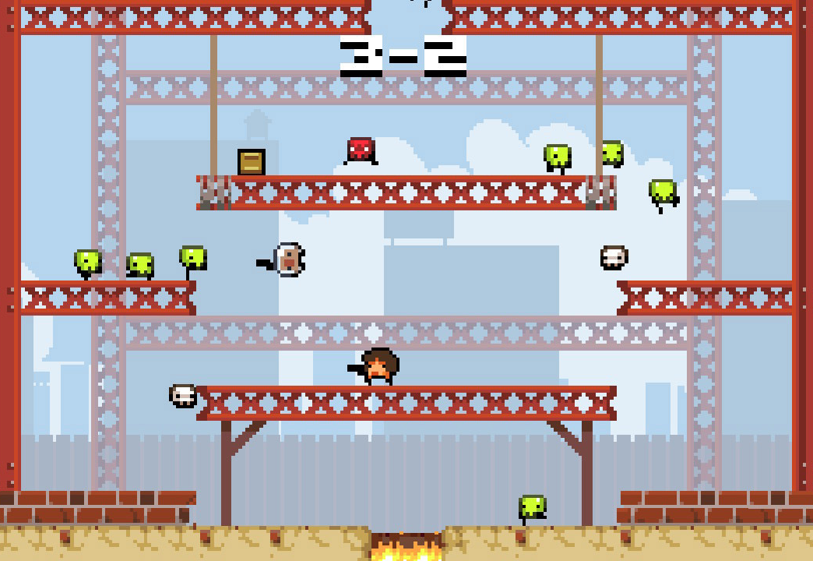
Inspiration
Remake of the 2010 game “Super Crate Box
Drawn only using the HTML Canvas

Slide 3
Implementation Checklist
Map + Background
Reusable Objects
Make platforms a curved surface
Map has style and color (isn’t bland)
Title Screen + Menu
Gameplay doesn’t start on load
Track scores in local session
Playable Character (PC)
Controlled using keyboard input
Can fire weapons
Collectible Crates
Increment the score
Give a random weapon to PC
Enemies (NPC)
Move in random direction
Reuse same object when cycling from bottom → top of map
Different shapes, sizes, and/or speeds
Difficulty scales with Score

Slide 4
Map + Background
boundaries.js
Platform
Wall
Split classes to handle edge case behavior when hitting the side of a platform vs. wall.
Reusable Objects
Make platforms a curved surface
Map has style and color (isn’t bland)

Slide 5
Title Screen + Menu
titleScreen.js
One class object to handle the visibility, drawing, and keyboard event handler
Interact w/ Global variable to control if rest of game runs
main.js
Track local session scores
Gameplay doesn’t start on load
Track scores in local session

Slide 6
Playable Character (PC)
playableCharacter.js
Keyboard event handlers for movement.
Handlers for firing weapon, assigning a random weapon, updating position + collision detection with environment, and drawing the PC
weapons.js
Weapon & Bullet object classes
Keyboard event handlers for firing weapon
Track weapon properties like firerate + name
Each bullet fired is an object, tracking position, speed, and size.
Controlled using keyboard input
Can fire weapons

Slide 7
Collectible Crates
crates.js
Define rows a crate can spawn in
Randomize where in the row it spawns
Handler for updating position + collision with a platform, draw the crate
Main.js
Handler for collision with PC to increment score + invoking PC function to randomize current weapon
Increment the score
Give a random weapon to PC

Slide 8
Enemies
enemies.js
Constructor for speed, size, and color
Randomize direction
Handler for updating position, handling environmental collisions, and drawing
Main.js
Handle the # of enemies that can spawn, the spawn-rate, and difficultly scaling
Move in random direction
Reuse same object when cycling from bottom → top of map
Different shapes, sizes, and/or speeds
Difficulty scales with Score

Slide 9
Code Flow – main.js

Slide 10
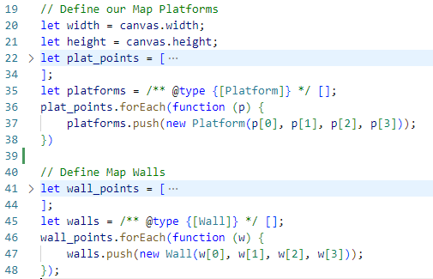
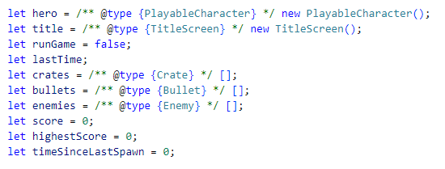
Global Variables, Objects, & Arrays

Slide 11
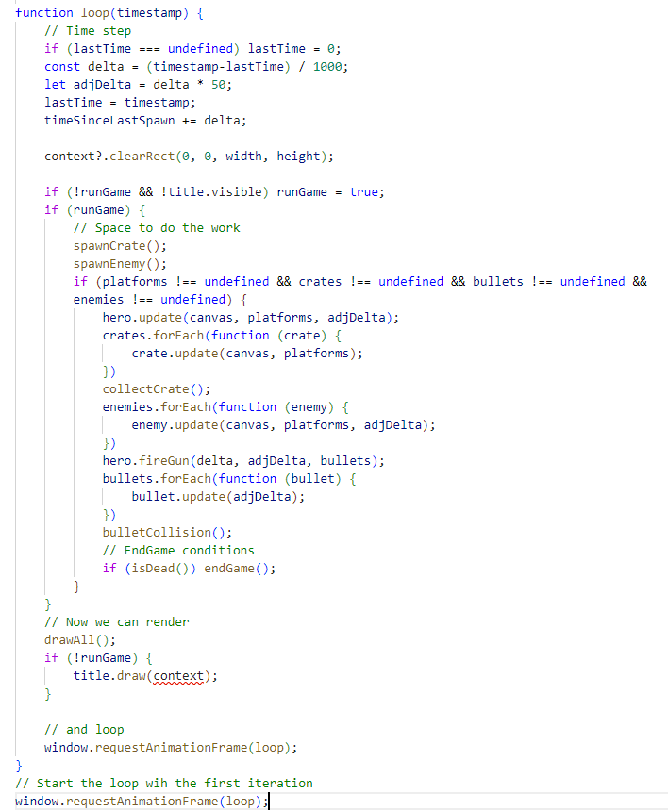
Animation Loop
Handle the time step across animation frames
Clear the Canvas

Slide 12
Animation Loop
Check runGame and Title visibility.
When game isn’t running, don’t update any of the object positions, just draw map and then overlay the Title.

Slide 13
Animation Loop
Spawn new objects as needed

Slide 14
Animation Loop
Positional Updates
Environmental Collisions
Inter-Object interactions
Crate - Hero
Bullet - Enemy
Enemy - Hero
Notes:
First update the Hero’s position. Then update the crate’s position. Check if the Hero is collecting a crate in this frame.
Update enemy position.
Handle firing of the weapon, aka creating new bullet objects. Update position of existing bullets.

