Slide 1

Agenda
Introduction
Descriptive Stats
Approach to Identify good and risky clients
Machine Learning Approach to Handle Imbalanced datasets
Model interpretability and top features
Results and Recommendation

Slide 2

Introduction
Credit card department in a bank is a very important business unit and is responsible for fair assessment and performing due diligence of clients. Without proper assessment it is a huge risk to the bank.
Advanced data driven approaches are significantly being adopted to assist the humans in assessment of the creditworthiness and also Fasttrack the application process.
In this report, we presented the statistics derived from the data source mentioned below.
Data source:
https://www.kaggle.com/datasets/rikdifos/credit-card-approval-prediction

Slide 3

Descriptive statistics
Application
Monthly Credit Report

Slide 4
Monthly Credit Report
Monthly credit report contains – 1048575 samples
11179 – Clients don’t have credit report till the current month on which the data is extracted. (Assuming their services are cancelled, hence no history is provided till the current month)
34806 – Clients have credit report till current month and also the monthly data is continuous, no breaks in between.
From this data, we made an assumption that if a client enters in to any of the status (3, 4 or 5), they are tagged as risky.
In total there are 45654 good clients and 331 risky clients based on the above definition.
Problems in data:
Typically we need to wait at least 150 days to see the risk status as 5. But some of the clients are placed on status 5 on the opening month itself.
Examples of such clients are provided in the notebook and are discarded from the analysis as this could be due to some data problem in extraction logic.

Slide 5
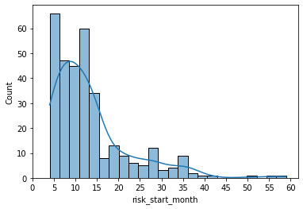
Monthly Credit Report
Most of the risk status related to '3', '4' & ‘5’, occurs within first 15 months only.
90% of the customers are identified in the first 27 months window.
95% of the bad customers are identified in the first 32 months window
We can consider the window for determining good book clients to be something greater than 27 to 32 months.
For this problem, lets say our period of study is 30 months. (2.5 years)
Good book clients criteria:
Get all the instances of IDs where window is greater than 30 months and with no STATUS in credit report being (3, 4, 5). Also, discarded clients where all the months credit report status is X (No loan for that month). May be they are inactive clients since no transaction at all.
Risky clients criteria:
Get all the instances of IDs where window is > 3 and window <= 30 and with Status in credit report contains at least (3,4,5).
Window criteria greater than 3 to discard bad data as we have few examples where clients are placed on status 5 on the starting month of the credit report.
mean | 13.323
std | 9.05
min | 4.0
25% | 7.0
50% | 11.0
75% | 15.0
max | 59.0

Slide 6
Application status report
Combining credit report data with application status report by ID, gave us the following counts.
Risk clients – 278
Good book clients – 8300
Minority class (risky clients) is 3.2%. Highly Imbalanced data
Problems in data:
Joining both the reports have discarded lot of ID’s.
On combined data, following are some of the observations.
2549 samples doesn’t contain occupation type (imputed with missing category)
No variability in FLAG_MOBI, standard deviation is zero. (Excluded this column in analysis)
DAYS_EMPLOYED, max value is 365243 (1388 samples has same value). Based on the data description, positive value signifies unemployment. Hence samples with these values are imputed as zero.
Max count of children is 14 and max count of family members is 15. (outliers)
Detailed charts and EDA is provided in the notebooks.

Slide 7
Machine learning approach to handle imbalanced datasets
Data splits are constructed using stratified sampling in order to preserve the same ratio of labels.
Following are train/valid/test splits.
Following Models are tried:
Gradient Boosted decision tree (catboost) – Multiple variants of the model is tried by adjusting some of the hyper-parameters like class weights, scale_pos_weight which are used to tackle imbalanced datasets.
Gradient Boosted decision tree is also tried by introducing both under sampling techniques on majority class and by creating synthetic minority samples on minority class using SMOTE techniques.
Ensemble of balanced bootstrapped samplers are tried with varying hyperparametres:
BalancedBaggingClassifier
AdaBoostClassifier
BalancedRandomForestClassifier
RUSBoostClassifier.
Split type | Good book | Risky clients
train | 6348 | 225
valid | 706 | 25
test | 784 | 28
Results on test set: As a metric, Balanced accuracy is used to compare.
Two best model variants based on Balanced accuracy (Average recall of two classes) are reported below.
Model variant | Valid result | Test Result
Balanced Random forest classifier | 0.75 | 0.77
Gradient Boosted tree | 0.70 | 0.72
Confusion matrix on test produced using balanced random forest | Ground Truth Risky | Ground Truth Good
Predicted Risky | 18 | 67
Predicted Good | 10 | 717

Slide 8
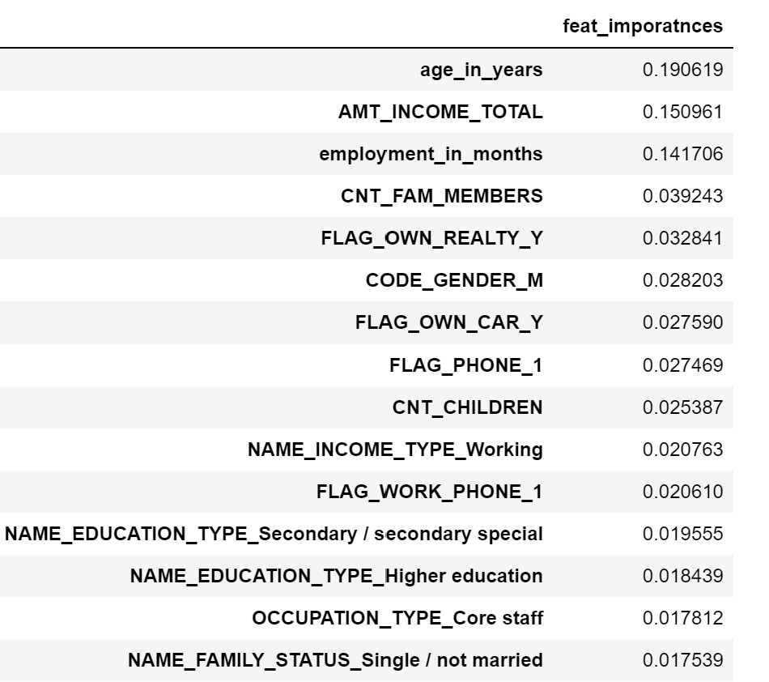
Model Explainabilty and top features
Top features based on the Balanced RF ensemble:
Age, Total Income and employment in months play a significant role. (Contributions from these 3 features are relatively very high)
Below is the list of top 15 features

Slide 9
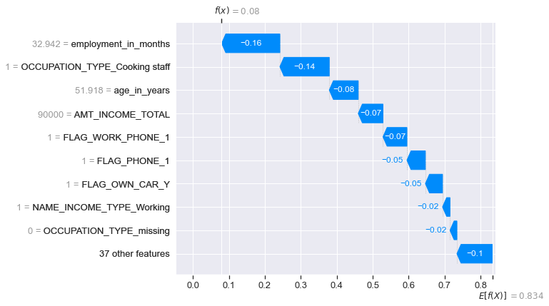
Shap value contributions for random example labelled as risky in test set
Employment in months (32), Occupation type cooking staff (1), Amount income total (90000) and age in years (52 nearly) are driving the prediction to label as risky

Slide 10
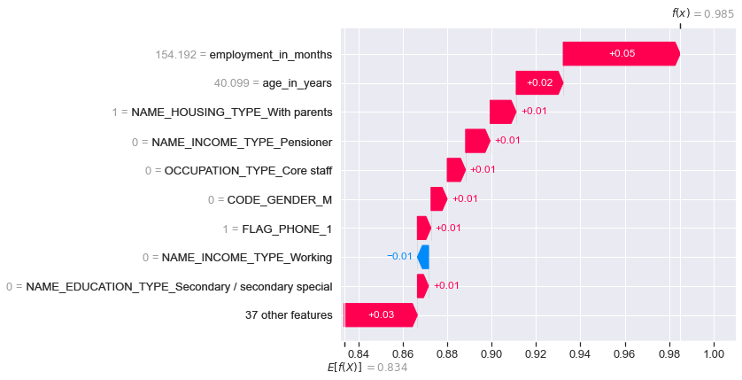
Shap value contributions for random example labelled as good in test set
Employment in months (155 nearly, 12 years), Age (40 years), Name housing type with Parents (1) and income type not pensioner are driving the prediction to be good client.

Slide 11
Improvement & Recommendations
There is a scope to improve the model by doing hyperparameter tuning using bayesian search provided by hyperopt.
Beyond this we need more samples otherwise it can be also prone to overfitting.
Can also perform Survival analysis. Constructed time to event in months (Time to go the status '3', '4', '5') for the samples. The good book clients are right censored since their event is not seen. Since the ask is classification problem, didn’t model the Survival analysis technique.
By careful probability threshold tuning, we can deploy the model to identify the risk related to clients and combine it with human assistance at the early stages.
Can use the feedback to retrain the model and improve the reliability.

Slide 12


Thank you
Bharath Paturi

