Slide 1
INSTRUCTIONS
Use Font size 22 to 28 and Font Style Times New Roman (body)
Do not change the Template: Heading / Title of the slides
Do not change font style or colours
Do not copy paste paragraphs: use only Bullet Points
Maximum slide Limit is 20 only
As per the number of supervisor allotted adopt slide-2 or slide-3
Please display the required meaningful Content or images or tables
Change the footer accordingly using insert tab then click on header & footer tab and edit it
Save the PPT with Register No, Dept and Review no, example: 23xxxxxxxxx_CSE

Slide 2

Title: RESPONSIVE PERSONAL PORTFOLIO IMPLEMENATION OVERVIEW
Student Name: P.MADHULIKA
Student ID: 2520030151)
Cluster:4
Section: 14
Under the Guidance
of
Supervisor Name: SUREKHA
Assistant Professor
Department of CSE

Slide 3
OUTLINE
Abstract
Existing System
Proposed System
System Architecture
Project Modules
Objectives
Co’s Attainments - FWD
Co1
Co2 …….. 5. Co5
Co’s Attainments - DSA
Co1
Co2 …….. 5. Co5
Screen Shots for FWD & DSA
Conclusion
Geo-Tagged Photos

Slide 4
Abstract
Responsive personal portfolio website to showcase skills and projects
Developed using HTML, CSS, JavaScript for frontend development
Provides professional online presence for students or developers
Includes sections like About, Skills, Projects, and Contact
Fully responsive design accessible on mobile, tablet, and desktop

Slide 5
Existing System
Traditional portfolios are static and not responsive
Limited accessibility across different screen sizes
Hard to update or maintain personal achievements
No interactive UI or project showcase features
Lack of online visibility for students and developers

Slide 6
Proposed System
Responsive web-based personal portfolio system
Modern UI using HTML5, CSS3 and JavaScript
Dynamic sections for projects, skills and profile
Mobile-friendly layout using responsive design
Easy to update and deploy on web hosting platforms

Slide 7
System Architecture
User Interface Layer – Portfolio web pages
Frontend Technologies – HTML, CSS, JavaScript
Responsive Design – CSS media queries and flexible layout
Project Section – Displays project details and links
Contact Section – Allows visitors to connect with the developer

Slide 8
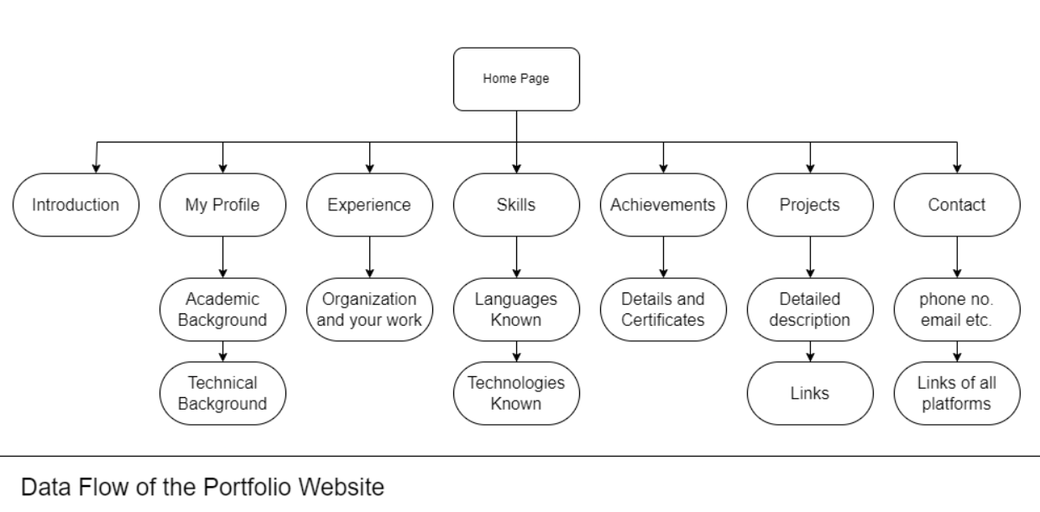

Slide 9
Project Modules
Home Module – Displays introduction and profile
About Module – Shows personal details and background
Skills Module – Lists technical and professional skills
Projects Module – Showcases completed works
Contact Module – Provides email or contact form

Slide 10
Objectives
To design a responsive personal portfolio website
To showcase skills, projects and achievements
To improve frontend development skills
To create mobile-friendly and user-friendly UI
To provide an online professional profile

Slide 11
Co’s Attainments - DSA
CO1: Implemented searching algorithms and analyzed algorithm efficiency.
CO2: Designed and implemented Linked List with basic operations.
CO3: Implemented Stack and Queue data structures in Java.
CO4: Applied Java programs to demonstrate efficient data structure usage.
CO5: Developed practical applications using linear data structures.

Slide 12
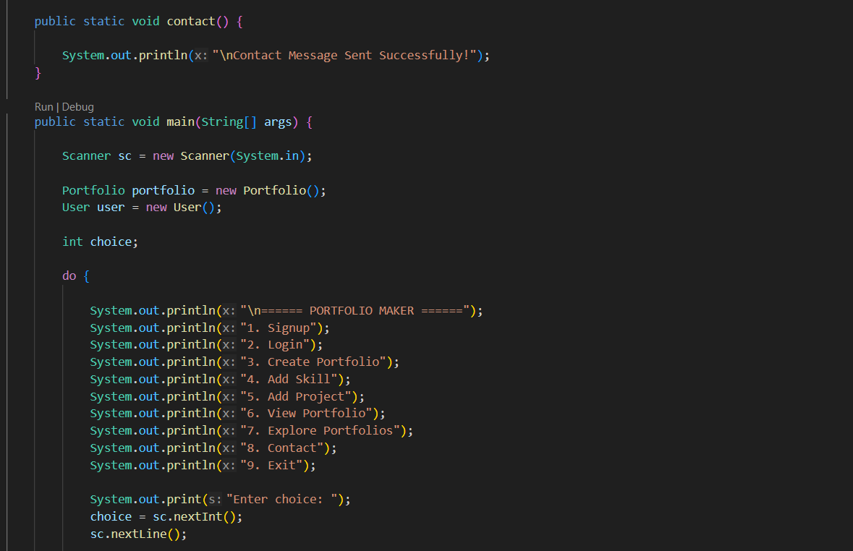
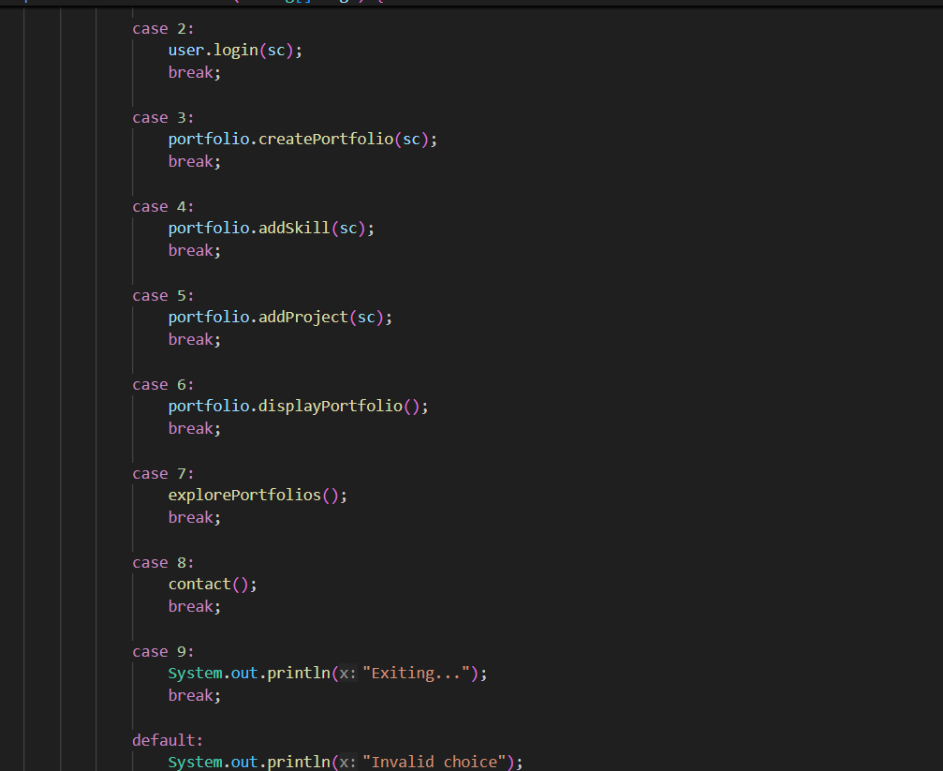

Slide 13
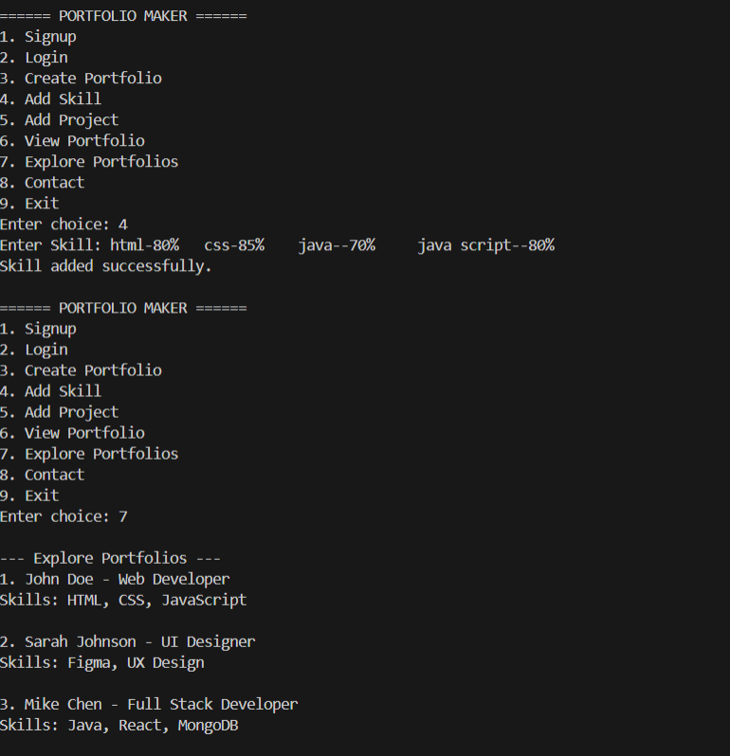
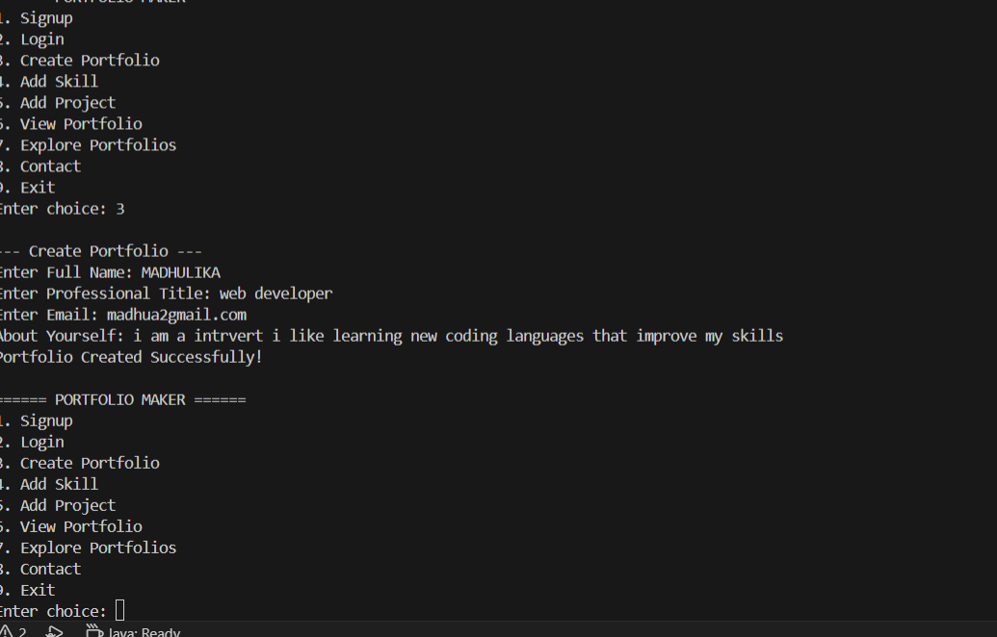
Screenshots of project:

Slide 14
Conclusion
Responsive portfolio website successfully implemented
Provides professional digital profile for developers
Improves accessibility across devices
Demonstrates frontend development knowledge
Useful for showcasing academic and personal projects

Slide 15
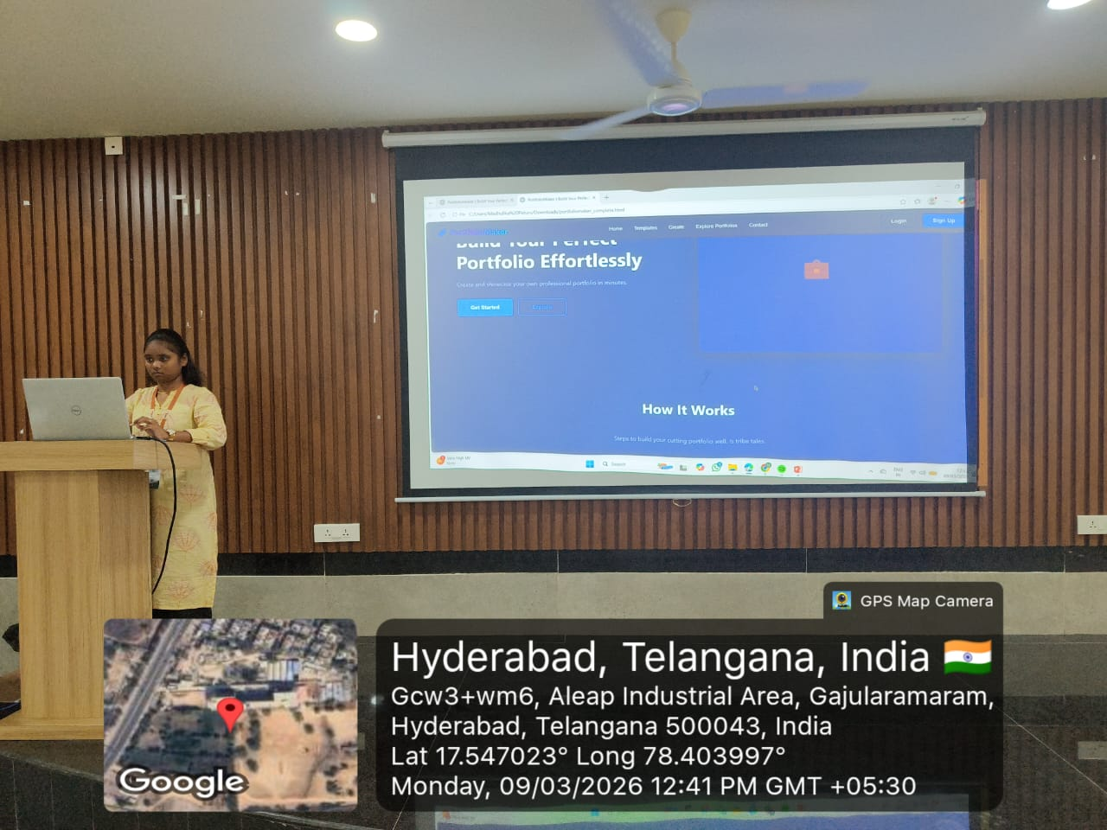
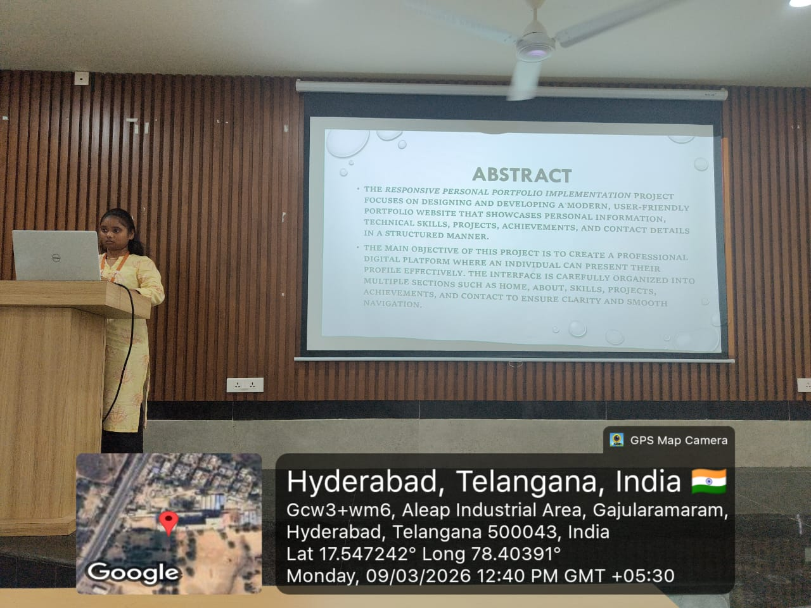
Geo- Tag Photos

Slide 16
THANK YOU

