Slide 1

Team Superheroes - Table #41
Edward Fox
Hamid Jizan
Joe Hillhouse
Rick Hoxie
Vinit Patankar

Slide 2
DESCRIBE YOUR SOLUTION
Solution
LifePillar is a solution providing callers and crisis counselors enhanced safety planning with follow-up capabilities
Value Add Capabilities
Standardize the safety plan intake process for crisis counselors
Capture and retain records in a central repository for all 170 centers
Anonymous personalized safety planning for callers when desired
Provide opt-in functionality for frequent callers to be identified and notified
Leverage IVR to connect callers and crisis counselors for “at-risk” plans
Notes:
Save time so crisis counselors can serve more callers

Slide 3
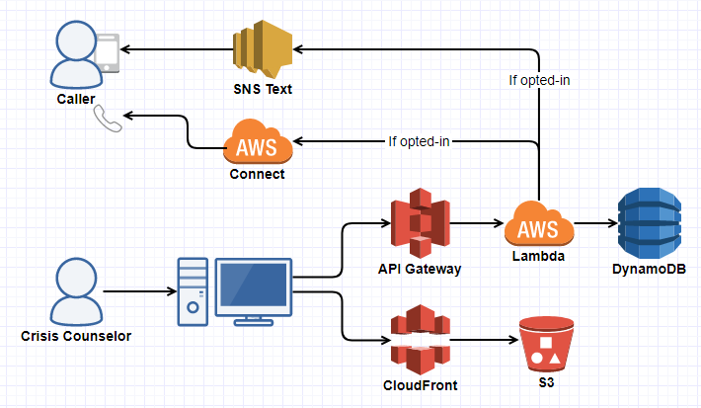
HOW DID YOU CREATE IT?
API Gateway
Lambda
DynamoDB
CloudFront
S3
SNS
Connect
Notes:
Simplistic Approach
Keep Costs Low
Serverless Architecture

Slide 4
THE PATH FORWARD
Future Strategy
Further enhance the base solution with capabilities to help our callers achieve a higher level of emotional well-being
What’s next?
Centralize the risk assessment workflow for all centers
Improve the experience using metrics to track call and safety plan quality
Leverage AI to identify “at-risk” plans based on plan health score
Facilitate omni-channel outreach by leveraging API integration
AI capabilities for action plan recommendation based on effective plans

