Slide 1
MEETING_2&3_1FEB&15FEB
Nitin D. Patwari
Anjul Srivastavs

Slide 2
Work progress
1] An Efficient and High Speed Overlap Free Karatsuba Based Finite Field Multiplier for FGPA Implementation.
2] Cryptographic Accelerators for Digital Signature Based on Ed25519.
Sr. No. | Date | To Do | Done
1) | 1st JAN to 18th JAN | Go through the papers and decide the feasibility to implement them. | Studied both the papers and overviewed the basic concepts required to understand the paper. Decided to implement paper [1] then [2].
2) | 18th JAN to 1st Feb | Implement Karatsuba multiplier. | Implemented Conventional multiplier. Started implementation of Karatsuba multiplier (completed for operands of the form n=2^{m}).
3) | 1st Feb to 15th Feb | Implement Karatsuba multiplier for n={93, 131, 163, 193, 233, 283, 409} | Done implementation of Karatsuba multiplier for n={93, 131, 163, 193, 233, 283, 409}

Slide 3
Sr. No. | Date | To Do | Done
4) | 15th FEB to 1st MAR | Implementation of OKA and OBS.

Slide 4
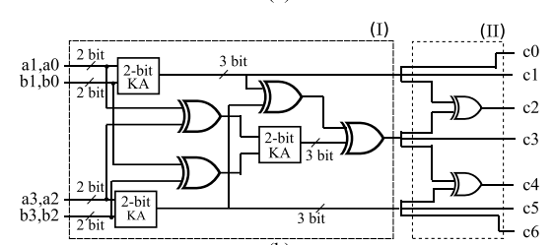
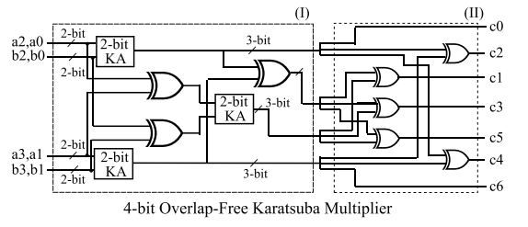
Previous Meeting Questions
Explanation of Karatsuba Multiplier with an example.
How does the number of Xor gates in Karatsuba Multiplier and Overlap-free Karatsuba Multiplier same?
KA 4bit Multiplier
OKA 4bit Multiplier

Slide 5
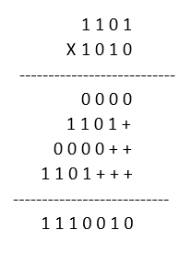
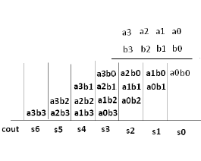
Conventional Multiplier
Conventional Multiplier (CM)
e.g.
Effective polynomial representation
e.g. 10100001=x7+x5+1.
AND gate
XOR gate

Slide 6
Theoretical Area and Delay for CM
CA_{XOR}(n) = (n − 1) ²
CA_{AND} (n) = (n) ²
Number of Gates = CA_{XOR}(n) + CA_{AND} (n)
T_{CA}(n) = T_{a} + log₂(n) T_{x}
n | 2 | 4 | 8 | 16 | 32 | 64 | 93 | 163 | 193 | 233 | 283 | 409
No. of gates | 5 | 25 | 113 | 481 | 1985 | 8065 | 17113 | 52813 | 74113 | 108113 | 159613 | 333745
T_{CA} (Tg) | 2 | 3 | 4 | 5 | 6 | 7 | 7.53916 | 8.34873 | 8.5925 | 8.8642 | 9.1447 | 9.67595

Slide 7
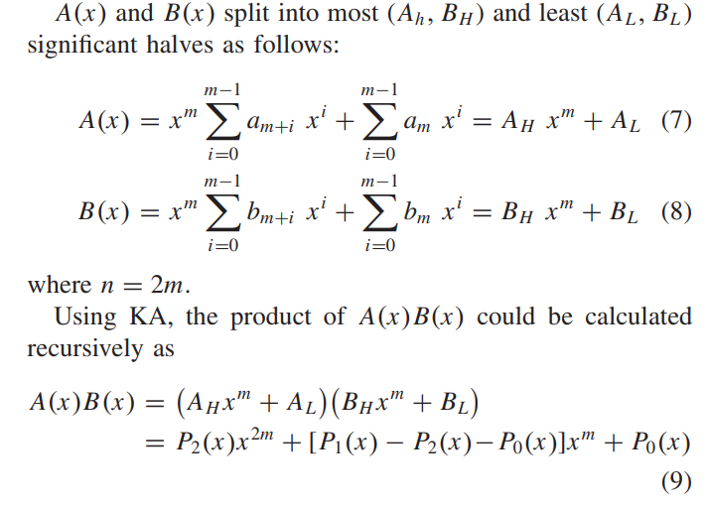
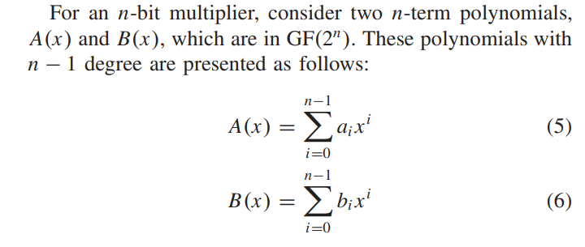
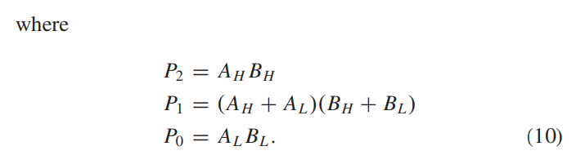
Karatsuba Multiplier (KA)

Slide 8

Karatsuba Multiplier (KA)

Slide 9
Theoretical Area and Delay for KA
KA_{XOR}(n) = 6 n^{log}₂⁽³⁾ − 8n + 2
KA_{AND}(n) = n^{log}₂⁽³⁾
Number of Gates = KA_{XOR}(n) + KA_{AND} (n)
T_{KA}(n) = T_{a} + ( 3 log₂(n) − 1)T_{x} .
n | 2 | 4 | 8 | 16 | 32 | 64 | 93 | 163 | 193 | 233 | 283 | 409
No. of gates | 7 | 33 | 127 | 441 | 1447 | 4593 | 8485 | 21154 | 27809 | 37699 | 51576 | 93242
T_{KA} (Tg) | 3 | 6 | 9 | 12 | 15 | 18 | 19.6 | 22.046 | 22.777 | 23.593 | 24.434 | 26.0279

Slide 10
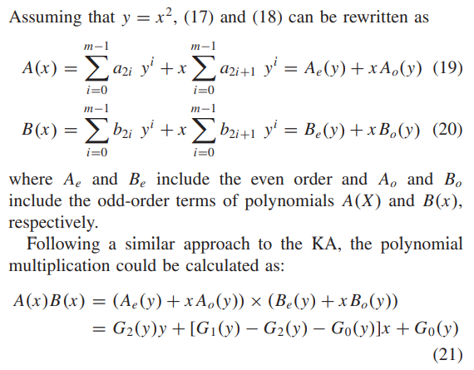
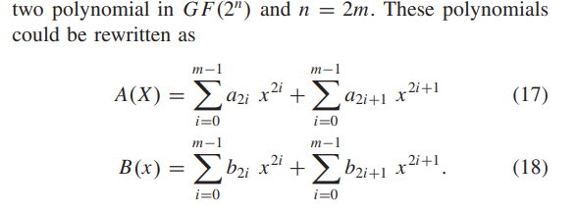
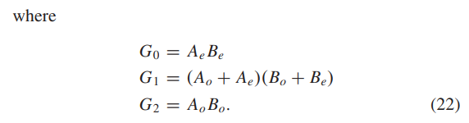
Overlap Free Karatsuba (OKA)

Slide 11
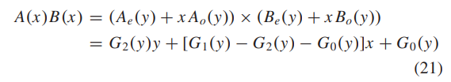
Overlap Free Karatsuba (OKA)

Slide 12
Theoretical Area and Delay for OKA
KA_{XOR}(n) = 6 n^{log}₂⁽³⁾ − 8n + 2
KA_{AND}(n) = n^{log}₂⁽³⁾
Number of Gates = KA_{XOR}(n) + KA_{AND} (n)
T_{KA}(n) = T_{a} + ( 2 log₂(n) − 1)T_{x} .
n | 2 | 4 | 8 | 16 | 32 | 64 | 93 | 163 | 193 | 233 | 283 | 409
No. of gates | 7 | 33 | 127 | 441 | 1447 | 4593 | 8485 | 21154 | 27809 | 37699 | 51576 | 93242
T_{KA} (Tg) | 2 | 4 | 6 | 8 | 10 | 12 | 13.078 | 14.697 | 15.185 | 15.728 | 16.289 | 17.3519

Slide 13
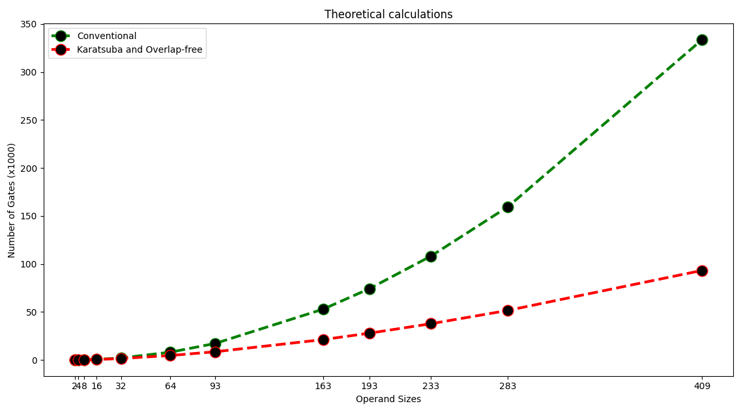
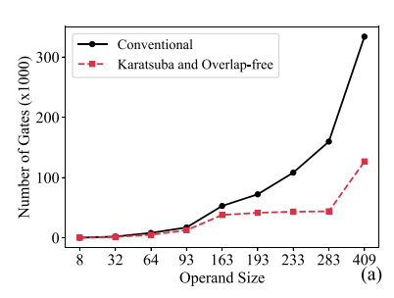
Plot: Number of gates

Slide 14
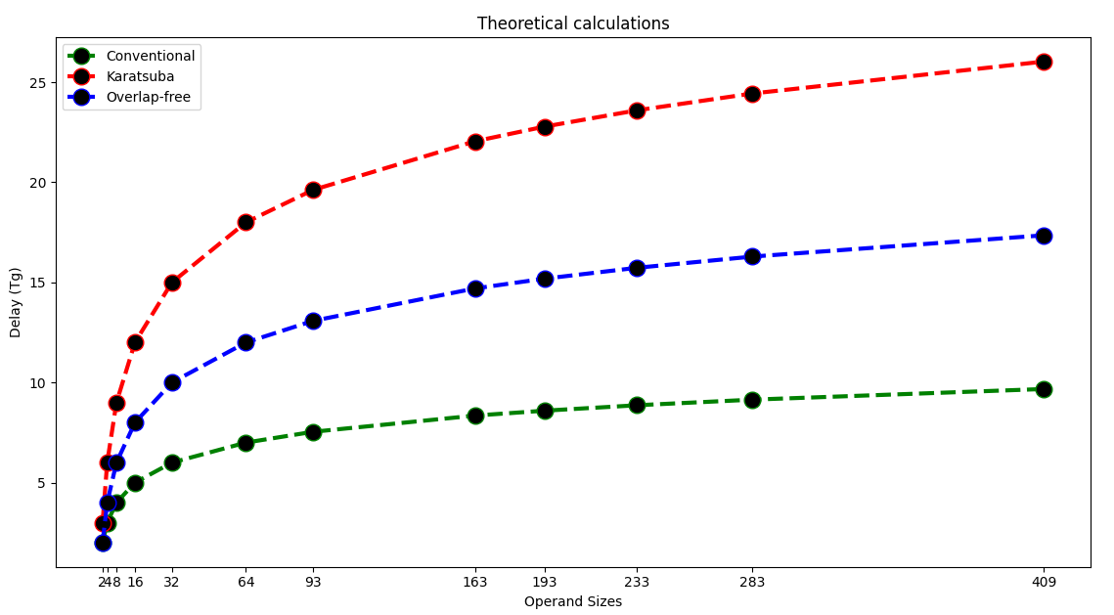
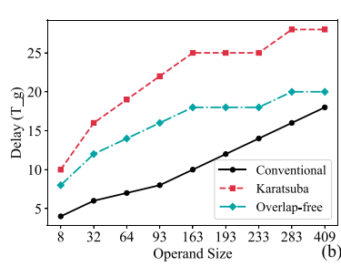
Plot: Number of delay

Slide 15
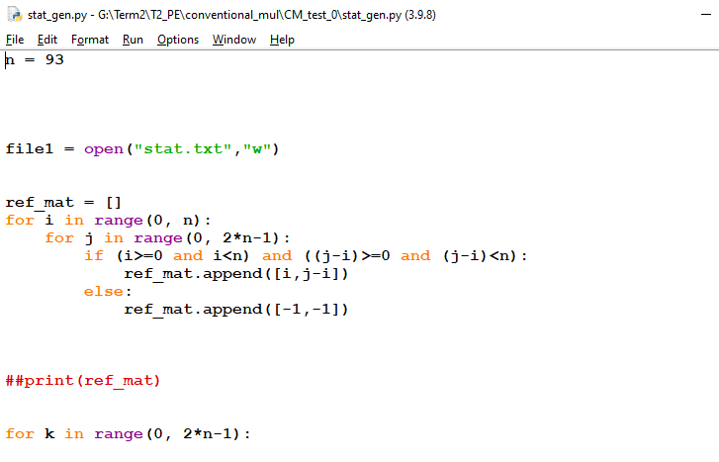
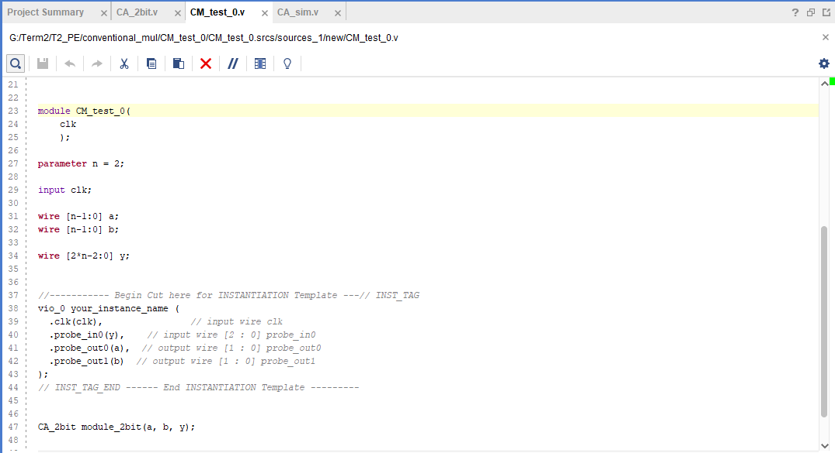
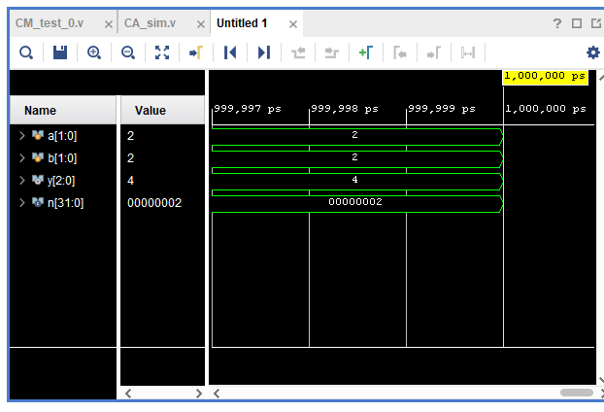
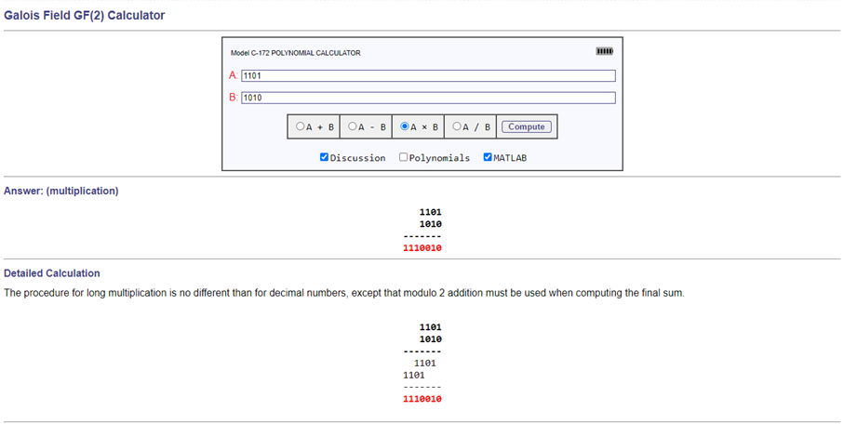
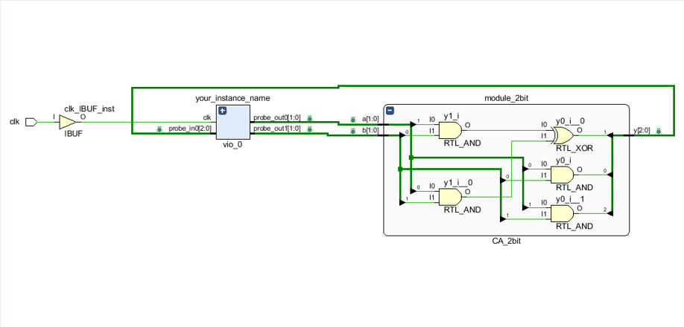
Implementation of CM
1) Wrote python program to generate Verilog code for implementation of n bit CM.
2) wrote test-bench
3) Compared the output with result of online calculator
(http://www.ee.unb.ca/cgi-bin/tervo/calc.pl)

Slide 16
Implementation of KA for n=2^{m}
1) Wrote python program to generate Verilog code for implementation of n=2^{m} bit KA.
2) wrote test-bench
3) Compared the output with result of online calculator
(http://www.ee.unb.ca/cgi-bin/tervo/calc.pl)

Slide 17
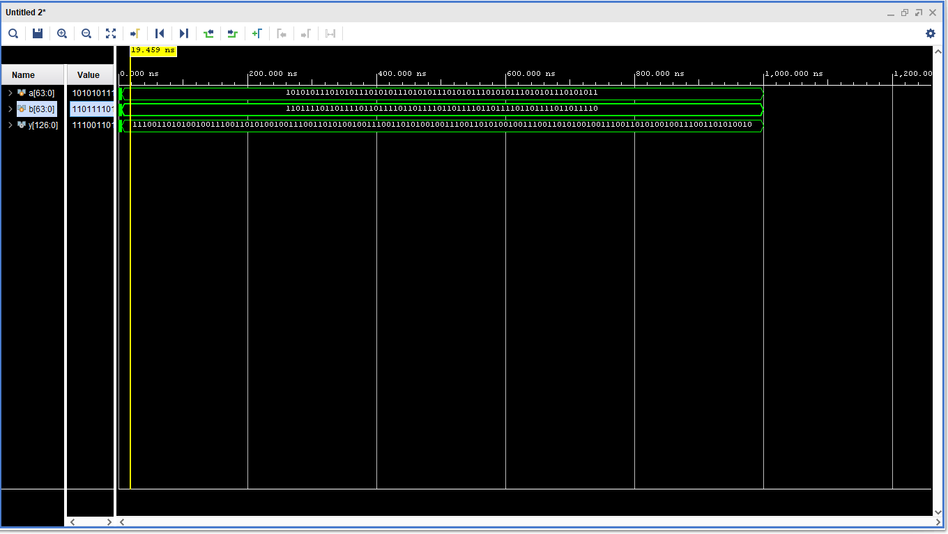
KA for 64 bit

Slide 18
Work done between 1stFEB - 15thFEB

Slide 19
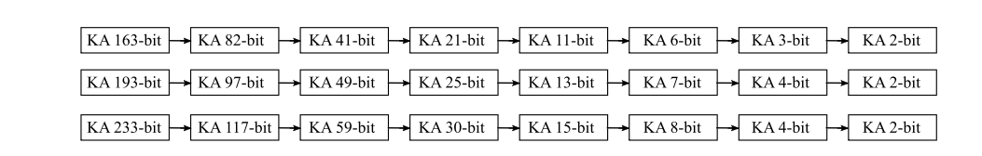
How odd number multiplicand KA implemented !
n={93, 131, 163, 193, 233, 283, 409}

Slide 20
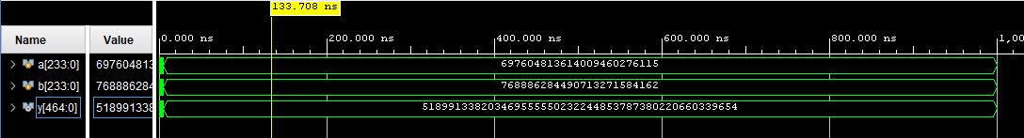
KA for 233 bit

Slide 21
THANK YOU !!

