Slide 1
MEETING_4&5_15MARCH
Nitin D. Patwari
Anjul Srivastavs

Slide 2
Work progress
1] An Efficient and High Speed Overlap Free Karatsuba Based Finite Field Multiplier for FGPA Implementation.
2] Cryptographic Accelerators for Digital Signature Based on Ed25519.
Sr. No. | Date | To Do | Done
1) | 1st JAN to 18th JAN | Go through the papers and decide the feasibility to implement them. | Studied both the papers and overviewed the basic concepts required to understand the paper. Decided to implement paper [1] then [2].
2) | 18th JAN to 1st Feb | Implement Karatsuba multiplier. | Implemented Conventional multiplier. Started implementation of Karatsuba multiplier (completed for operands of the form n=2^{m}).
3) | 1st Feb to 15th Feb | Implement Karatsuba multiplier for n={93, 131, 163, 193, 233, 283, 409} | Done implementation of Karatsuba multiplier for n={93, 131, 163, 193, 233, 283, 409}

Slide 3
Sr. No. | Date | To Do | Done
4) | 15th FEB to 1st MAR | Implementation of OKA and OBS. | Done implementation of OKA and OBS for n={93, 131, 163, 193, 233, 283, 409}
5) | 1st MAR to 15th MAR | Calculate delay and area for implemented algorithms FPGA board | Done implementation and analysis CA, KA, OKA and OBS.

Slide 4
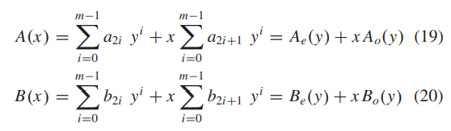
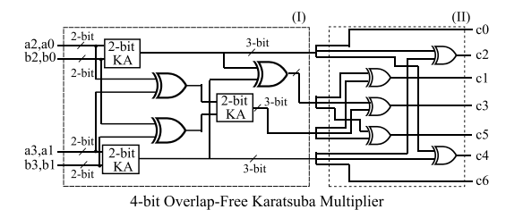
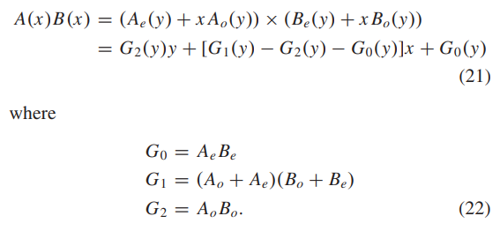
OKA

Slide 5
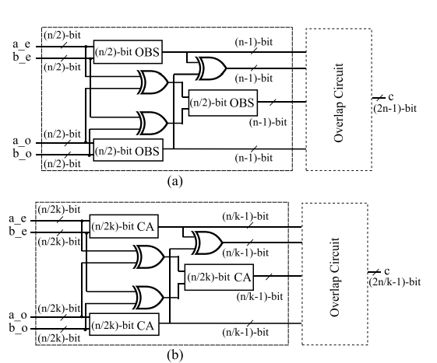
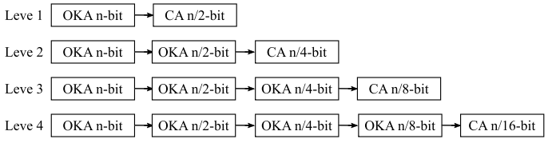
OBS

Slide 6
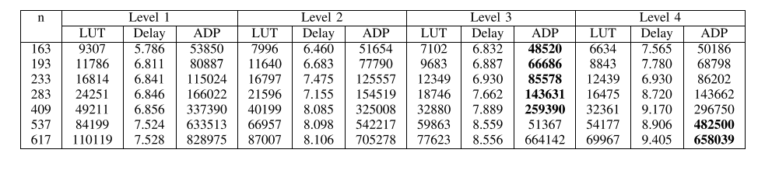
How Levels affect area and delay ?

Slide 7
Work done between 1stMARCH - 15thMARCH

Slide 8
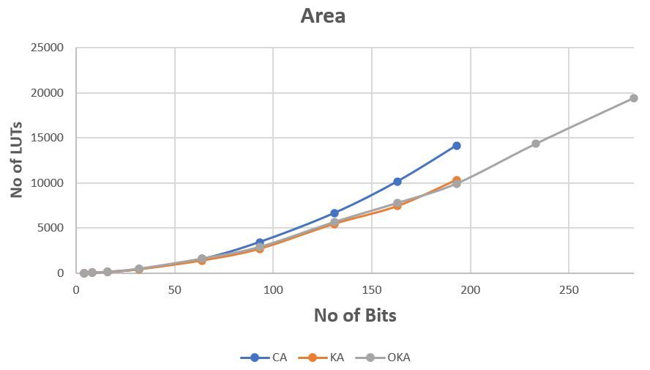
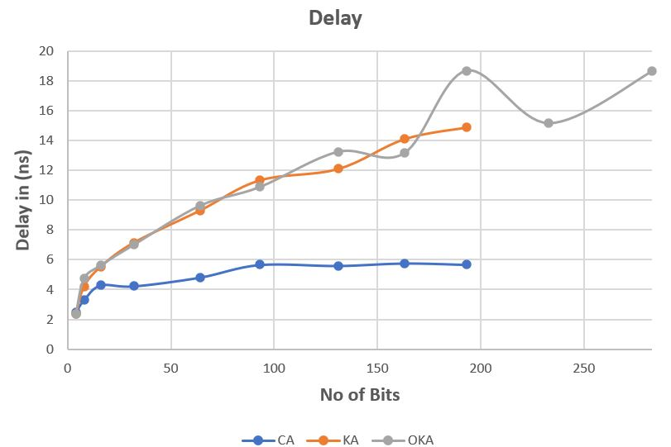
Area and Delay plots (CA,KA,OKA)

Slide 9
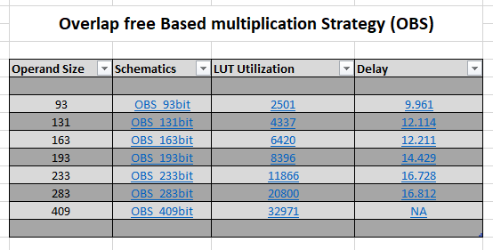
Area and Delay plots (OBS)

Slide 10
THANK YOU !!

