Slide 1

Scraping
Without being banned for life?...
Robert D. West

Slide 2
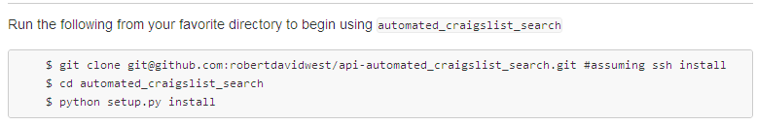
scraping craigslist
Setup:
Packages needed: urllib2, bs4, pandas, email
What does it do?
Automates craigslist searches, stores the results in a pandas.DataFrame, allows you to e-mail results as html

Slide 3
scraping craigslist
Setup:
Packages needed: urllib2, bs4, pandas, email
What does it do?
Automates craigslist searches, stores the results in a pandas.DataFrame, allows you to e-mail results as html

Slide 4
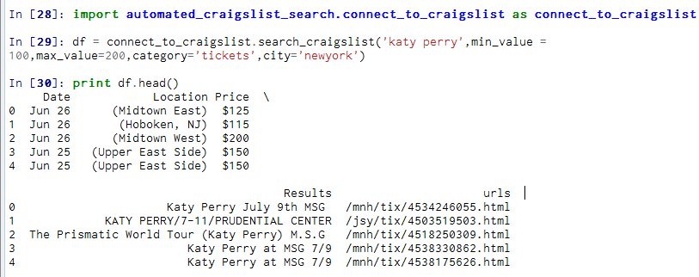
scraping craigslist
Example:

Slide 5
scraping craigslist
Activity Partners

Slide 6
scraping craigslist
Activity Partners
Across 7 major US Cities: Chicago, Houston, Los Angeles, New York, Philadelphia, Phoenix, San Antonio

Slide 7
scraping craigslist
Activity Partners
Across 7 major US Cities: Chicago, Houston, Los Angeles, New York, Philadelphia, Phoenix, San Antonio
Found the top 20 most commonly occurring search words (limit of 1 word per search).

Slide 8
scraping craigslist
Activity Partners
Across 7 major US Cities: Chicago, Houston, Los Angeles, New York, Philadelphia, Phoenix, San Antonio
Found the top 20 most commonly occurring search words (limit of 1 word per search).
Started with a pandas.DataFrame

Slide 9
scraping craigslist
Activity Partners
Across 7 major US Cities: Chicago, Houston, Los Angeles, New York, Philadelphia, Phoenix, San Antonio
Found the top 20 most commonly occurring search words (limit of 1 word per search).
Started with a pandas.DataFrame
Cleaned the data: removed duplicate entries, made lower case, removed punctuation and numbers

Slide 10
scraping craigslist
Activity Partners
Across 7 major US Cities: Chicago, Houston, Los Angeles, New York, Philadelphia, Phoenix, San Antonio
Found the top 20 most commonly occurring search words (limit of 1 word per search).
Started with a pandas.DataFrame
Cleaned the data: removed duplicate entries, made lower case, removed punctuation and numbers
Removed common words

Slide 11
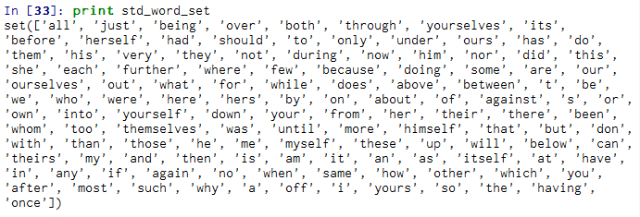
scraping craigslist
Removed common words:

Slide 12

scraping craigslist
Removed common words: The rest by trial and error:

Slide 13
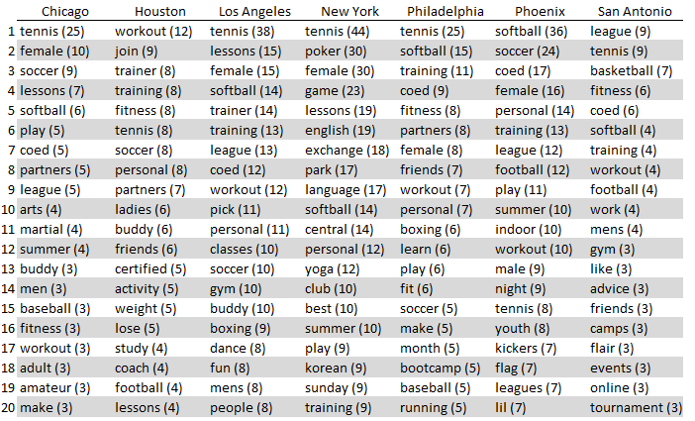
scraping craigslist

Slide 14
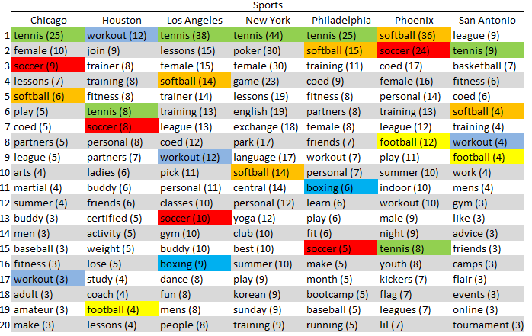
scraping craigslist

Slide 15
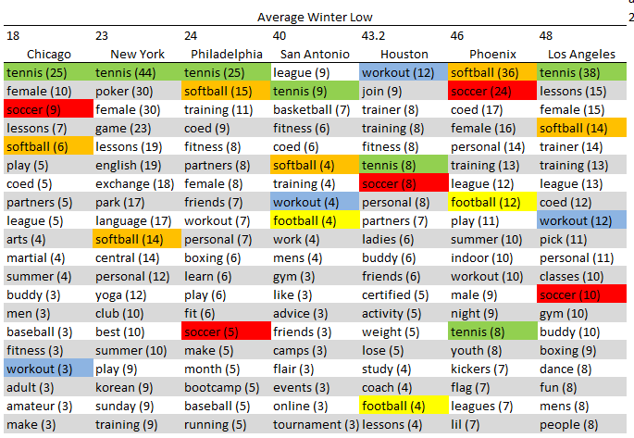
scraping craigslist

Slide 16
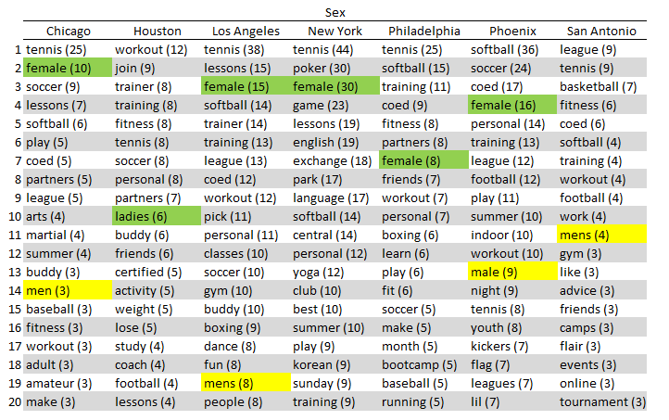
scraping craigslist

Slide 17
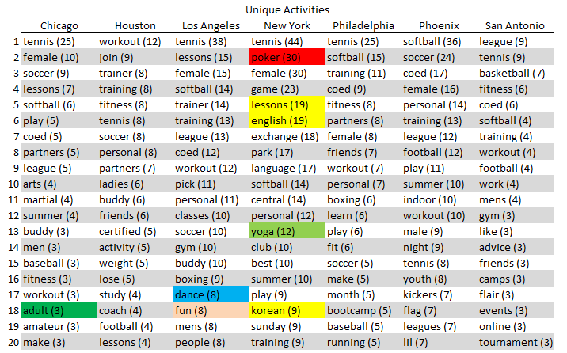
scraping craigslist

