Slide 1
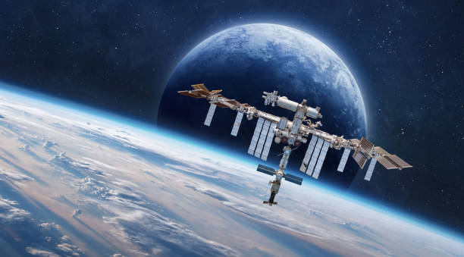
EarthLoc: Automated Localization of Astronaut Photography
A Deep Learning Approach for ISS Image Retrieval

Slide 2
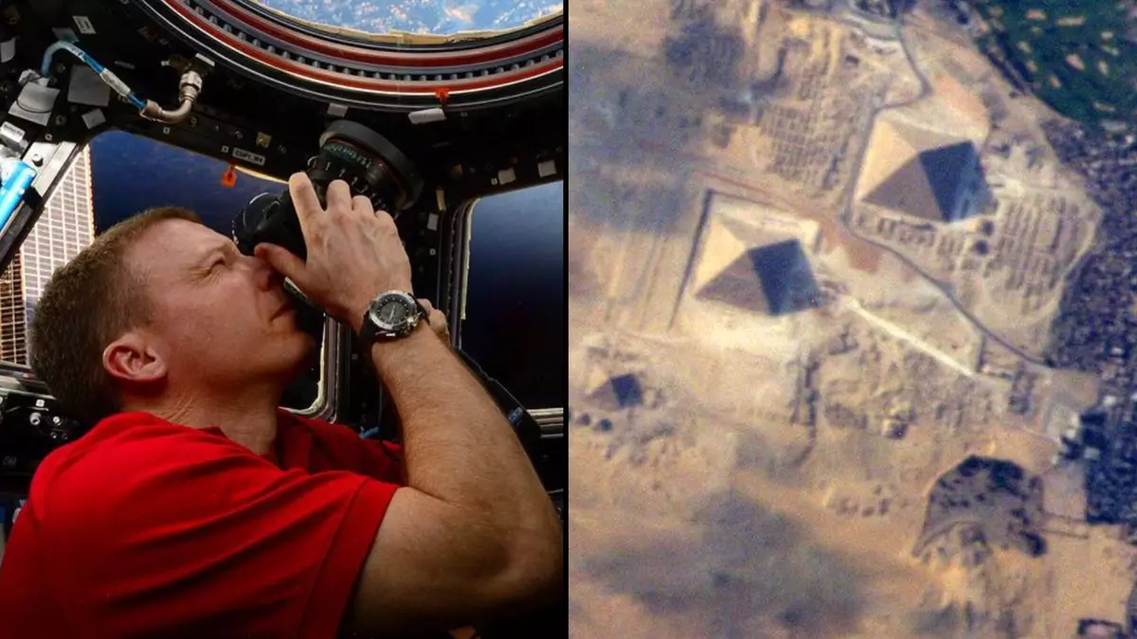
Problem Statement
Traditional manual localization of astronaut photos is time-consuming.
Challenge: Match astronaut photos (queries) to a global database of geo-tagged satellite imagery.
4.5 M photos
300,000 only geo-tagged
2500 km photo wide
#Angles and #resolution
Day and Time shot
Appearance Changes over time

Slide 3
Solution Overview
EarthLoc: Image Retrieval as a Solution
Reformulates localization as an image retrieval problem.
Uses deep metric learning (ResNet50 + MLP-Mixer) for feature extraction.
Create a database of satellite imagery from a 4 year period, cloudless, nadir view, 4 view angles.
Need to filter the database to the ISS point and within a 2500 km wide
[Astronaut Photo] → [Preprocess] → [ResNet50 + MLP-Mixer] → [k-NN Search] → [Matched Satellite Image]

Slide 4
Key Innovations
Clustered batches: Improves discrimination of similar regions.
Year-wise augmentation: Ensures temporal robustness.
Neutral-aware loss: Handles partially overlapping matches.
4x90° TTA: Rotation-invariant inference.
N.B: The EarthLoc is inspired from AnyLoc in where the solution was open – not specific.
To solve the challenges mentioned, key innovations was introduced to the model.

Slide 5
Model Architecture
How EarthLoc Works
Feature Extraction:
Backbone: ResNet50 (pretrained + fine-tuned).
Aggregator: MLP-Mixer → 4096-D descriptor.
Inference:
k-NN retrieval from 700k database entries.

Slide 6
Performance Metrics
57.1% Recall@1 (top-match accuracy).
0.05 seconds per query (efficient for large datasets).
Outperforms prior methods in speed/accuracy.

Slide 7

Advantages
Efficiency: Compact descriptors enable rapid retrieval.
Robustness: Handles scale, rotation, seasons.
Scalability: Works with 700k+ images.

Slide 8
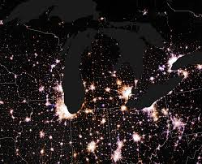
Limitations
Daytime imagery only.
Performance drops for extreme geometries (far from ISS nadir).
Night View

Slide 9
Key Takeaway
Combines classical CNNs (ResNet) + modern techniques (MLP-Mixer, TTA).
Balances accuracy, speed, and robustness.
It was inspired from AnyLoc (VPR model) that fits different environment including UAV, but EarthLoc is specialized on Space – Satellite
Can be adopted to UAV problem with some fine tuning and model adjustment
AnyLoc on the other hand do not need training

Slide 10
Inspiration
I will present it as a scenario case:
If for example someone has a photo taken from Drone and he know or assume that this photo is related to Beirut. In order to geolocalize it.
We can get a similar case such as EarthLoc.
In our case we replace the ISS nadir point by a center point of Beirut Mohafaza,Casa or Cadastral and the other remain the same.
For sure the model has to be adopted for UAV images size.
This approach reduce model changes in the architecture and focus on image scale and area of study range.

Slide 11
Setup Code
Data storage is 65 GB alone, and colab free account allow only 70 GB
The model can not be tested. (https://github.com/gmberton/EarthLoc )
Noting that it is well documented.

