Slide 1
MuSe‑Net: Weather‑Robust Cross‑view Geo‑localisation

Slide 2
Why We Need MuSe-Net
Problem Statement – Drone ↔ satellite geo-localization fails in bad weather (rain, fog) because training and test images come from different environmental “domains.”
Goal – Create a network that adapts to weather variations rather than collapsing when domain shift occurs.
Solution Overview – MuSe-Net:
Two-branch design
  Style-extraction branch learns environment cues.
  Self-adaptive branch uses those cues to correct features on-the-fly.
Claimed Impact – Robust performance proven on three public benchmarks(University-1652, SUES-200, CVUSA)

Slide 3
From Viewpoint Gap to Weather Gap
What is Aerial Geo-localization?
Retrieve a satellite image (GPS-tagged) that matches a given drone snapshot—vital for drone navigation, event detection, aerial photography.
Classic Challenge = Viewpoint Shift
Prior CNN methods (two-branch Siamese, metric learning, part matching) focus on aligning view angles between drone and satellite imagery.
Overlooked Challenge = Environmental Shift
Trained networks “collapse” when test weather differs (rain, fog); real flights encounter rapid weather changes that can hide targets and risk accidents.

Slide 4
From Viewpoint Gap to Weather Gap
Research Goal
Achieve robustness across multiple environments—not higher average accuracy in clear skies.
Domain-Generalization Perspective
Making features universally invariant is hard; instead, emulate humans: filter out weather effects rather than memorize every style.
Two Practical Issues Raised
a) How to reproduce environmental style signals at test time.
b) How to use them to rebalance features and cancel the style gap.
Data Collection Bottleneck
Capturing real drone images in every weather is costly; motivates synthetic augmentation later introduced in MuSe-Net.

Slide 5
Synthetic Weather Styles & Residual SPADE
Fast Data Generation Strategy
2. Automatic Style Labels
.
Disentangling Identity vs. Style
IBN-Net as Backbone
Need Dynamic Adaptation

Slide 6
MuSe-Net Architecture in a Nutshell
Residual SPADE Recap – A conditional normalisation layer that scales & shifts
Two-Branch Framework
Branch 1 – Style Extraction
Encodes environment style and outputs modulation parameters.
Branch 2 – Self-adaptive Feature Extraction
IBN-Net backbone augmented with Residual SPADE after every IN layer.
Uses the style branch’s parameters to dynamically neutralise weather effects.
Shared Inputs – Both branches see the same image, guaranteeing one-to-one
pairing between style codes and content features.
Outcome – The style gap is closed on the fly, preserving place identity while
removing environmental bias.
First Stated Contribution – The paper is the first to pinpoint weather &
illumination variation as a dominant failure mode for aerial geo-localization systems in real deployments.

Slide 7
Prior Cross-view Geo-localization Work
Hand-crafted → CNN Evolution
Early methods relied on SIFT / handcrafted matching [25]; CNNs (AlexNet pre-trained on ImageNet & Places) quickly became dominant [27].
Siamese / Metric-learning Trend
  Siamese networks with contrastive loss [31, 32].
  NetVLAD layer injected for local aggregation [7].
  Modified partitions (square-ring) to handle rotations [2].
Orientation & FoV Solutions
Coordinate encoding [4], orientation-normalization nets [34], Dynamic Similarity Matching (DSM) for limited FoV [6].
Semantic Layout Alignment
Works such as Zhai et al. transfer ground semantics to satellite to reduce spatial misalignment [24].
Observation
All focus on viewpoint gap—none explicitly tackle environmental (weather) domain shift, motivating MuSe-Net’s contribution.

Slide 8
More Viewpoint-Centric Methods vs. Our Weather Focus
Advanced Alignment Techniques
Semantic transfer: ground → aerial semantics [24].
Image synthesis: generate aerial from ground panoramas (GAN) [35].
Optimal-transport matching at feature level [5].
Polar transform for pixel-wise alignment [8].
Key-points & heatmaps for robust region alignment [3, 36].
Improved Loss Functions
Soft-margin triplet (Vo & Hays) [37].
Weighted ranking loss (Hu et al.) [7].
Hard-exemplar re-weighting (Cai et al.) [38].
Instance loss as proxy classification (Zheng et al.) [1].
Transmission-loss to equalise multi-view distributions [41].
Attention Mechanisms
Used to spotlight discriminative areas, boosting retrieval accuracy [38, 8].
Key Gap Remains
All cited works handle viewpoint differences; none tackle the multi-weather domain shift.
MuSe-Net’s Novelty
Explicitly parameterises environment style and adapts features, enabling the drone to localise unseen places under unseen weather.

Slide 9
IBN-Net + Residual SPADE = Adaptive Normalisation
IBN-Net Basics
Combines BatchNorm (BN) — preserves class discrimination.
and InstanceNorm (IN) — removes style statistics.
Good for cross-domain tasks, but IN can over-blur identity when weather styles vary widely.

Slide 10
Problem
Problem:
Drone images are captured in various environments (e.g., rain, snow), unlike
constant satellite images, causing a domain shift and hurting geo-localization
performance.
Solution – MuSe-Net:
A dual-branch architecture that adapts to multiple environments:
🟣 Style Branch: Extracts environmental style using a style encoder
(from ResNet-50) and predicts the style label via a classifier.
Content Branch: Extracts geo-location features using a content encoder
(based on IBN-Net), modulated by style through Residual SPADE.
Residual SPADE:
An improved SPADE module that modulates normalized features based on
environmental style, preserving content identity while adjusting for
environmental shifts
Goal:
Improve drone-to-satellite image retrieval by reducing environmental interference
and enhancing identity preservation across variable styles.

Slide 11
What is SPADE?
SPADE learns how to adjust internal features
based on external style information.

Slide 12
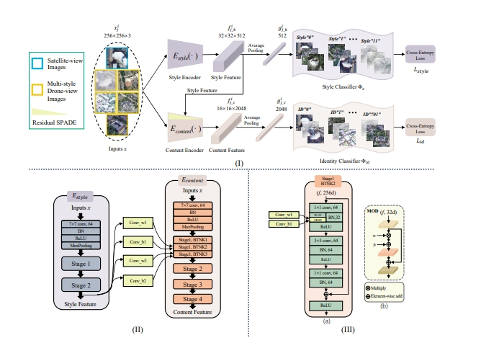
Schematic overview of MuSe-Net

Slide 13
MuSe-Net: Schematic Overview
Input Setting:
Each batch contains an equal number of satellite and drone images.
Satellite image style remains constant.
Network Structure:
Purple Branch – Style Extraction:
Extracts style features using a style encoder.
Groups features from images with similar styles.
Style features are passed to the Residual SPADE module.
Pink Branch – Content Extraction:
Contains a content encoder.
Focuses on self-adaptive feature extraction.
Aims to reduce feature distance between images with the same geo-tag (i.e., same location).

Slide 14
MuSe-Net: Schematic Overview
Feature Interaction via Residual SPADE:
Style features from the purple branch are:
  Convolved via layers (Conv_w1, Conv_b1) → generate modulation parameters w and b.
These parameters modulate intermediate activations in the content encoder (pink branch).
Residual SPADE adjusts features by applying:
Mod(x)=w⋅IN(x)+b
where IN = instance normalization.

Slide 15
Datasets and Evaluation Protocol
The proposed method is trained and evaluated primarily on the University-1652 dataset, with additional validation on SUES-200 and CVUSA datasets:
University-1652
SUES-200
CVUSA

Slide 16
Implementation Details
Backbones:
  Style Encoder: Based on ResNet-50, pre-trained on ImageNet.
  Content Encoder: Initialized from IBN-Net50-a, also pre-trained.
  Architecture adjustments include reducing stride in certain ResNet layers for better resolution.
Image Preprocessing:
  All images are resized to 256×256.
  Satellite images: Augmented via random cropping and flipping.
  Drone images: Augmented using imgaug (e.g., to simulate overexposure).
Example Code for Overexposure Augmentation:
python
import numpy as np # img: PIL image img1 = np.array(img)

Slide 17
Comparisons with Competitive Methods
This section presents a comparative evaluation of the proposed method against seven competitive methods using two tasks on the University-1652 dataset:
Drone → Satellite (drone-view target localization)
Satellite → Drone (drone navigation)

Slide 18
Key Points:
Comparison Methods: All baselines include a content encoder and identity classifier, using backbones like VGG16, ResNet-50, ResNet-101, DenseNet121, Swin-T, IBN-Net50-a, and LPN.
Evaluation Metric: Accuracy is reported as R@1 (Recall at rank 1) and AP (Average Precision) across 10 environmental conditions (e.g., fog, rain, snow, dark)

Slide 19
Results: Drone → Satellite
LPN [2] achieves the best results among the seven re-implemented methods due to its explicit use of local features.
IBN-Net [18] significantly improves geo-localization performance due to its multi-domain adaptability.
Proposed Method:
  Outperforms IBN-Net in all conditions.
  R@1 improves from 62.30% to 65.15% (+2.85%)
  AP improves from 66.46% to 69.16% (+2.70%)
  Also surpasses LPN, indicating strong performance despite not explicitly modeling local information.

Slide 20
Results: Satellite → Drone
This task is considered easier.
Even simpler models like VGG16 outperform the proposed method on Drone → Satellite.
Proposed Method:
  Still outperforms six methods that do not use local features.
  R@1 increases from 82.27% to 84.68% (+2.41%)
  AP increases from 63.36% to 65.75% (+2.39%)
  Remains competitive with LPN.
Insights:
IBN-Net’s strength lies in reducing domain shift across environmental conditions.
Proposed Method enhances IBN-Net with dynamic parameter learning for adaptive style adjustment.
Environmental noise (e.g., fog, darkness) still affects performance, but the method improves robustness by minimizing style-related prediction discrepancies.

Slide 21
Future Directions
Finer disentangled representations.
Real‑world deployment & harsher tests.
Lightweight variants for onboard inference.

