Slide 1
Multiple-environment Self-adaptive Network
for Aerial-view Geo-localization

Slide 2
Aerial-view geo-localization is the process of matching a drone-view image to its corresponding geo-tagged satellite image to determine geographic location. It has many real-world applications like drone navigation and aerial photography. Compared to ground-view images, drone-view images offer clearer visibility but face challenges due to cross-view domain shifts—especially those caused by environmental changes (e.g., rain, fog, snow).
While traditional methods focus on dealing with viewpoint differences, they often fail under diverse or unseen environmental conditions. This is because trained models may collapse when facing unfamiliar weather scenarios. Therefore, the goal of the research is not just to improve accuracy under ideal conditions but to ensure robustness across environments.
Inspired by human cognition—where we recognize places by filtering out environmental distractions—the authors propose a model that dynamically adapts to environmental changes during testing. Their key idea is to extract and use environmental style information to compensate for environmental domain gaps.

Slide 3
To achieve this, the authors:
Generate synthetic environmental styles (fog, rain, snow, wind, etc.) using a lightweight image transformation tool instead of resource-heavy GANs.
Train a model that can separate identity features (location) from environmental styles.
Use a two-branch architecture called MuSe-Net:
One branch extracts environmental style features.
The other uses self-adaptive feature extraction with a custom Residual SPADE module to align feature representations across weather conditions.
Build on IBN-Net, combining Batch Normalization (to keep feature discrimination) and Instance Normalization (to reduce style noise), and enhance it with SPADE for style-aware modulation.

Slide 4
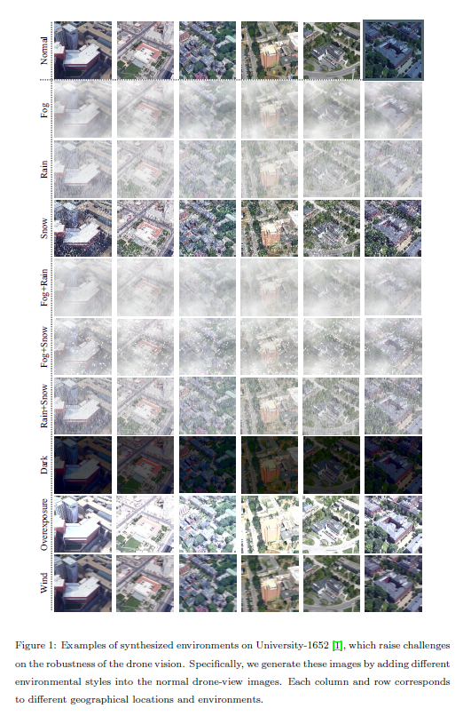

Slide 5
Problem: Current visual geo-localization methods often fail in real-world applications due to weather and illumination changes, which significantly affect image appearance and reduce localization reliability.
Proposed Solution: To tackle this, the authors introduce MuSe-Net (Multiple-environment Self-adaptive Network)—an end-to-end, dual-path CNN framework. It:
Uses simulated multi-weather data.
Dynamically adjusts environmental style information (e.g., rain, fog, lighting).
Integrates a custom Residual SPADE module to help the network learn discriminative and adaptive features under various environmental conditions.
Key Results:
MuSe-Net is tested on three benchmark datasets (University-1652, SUES-200, CVUSA) and outperforms existing methods in multiple environments.
It remains competitive even under unseen extreme weather, such as mixed fog, rain, and snow.

Slide 6
What is Domain Generalization (DG)? Domain generalization addresses the challenge of domain shift—differences in data distributions across environments—without using any target domain data during training.
Unlike domain adaptation, which uses labeled/unlabeled target data, DG focuses only on multi-source training data to learn models that generalize to unseen domains.

Slide 7
DG Techniques
Distribution Alignment
Uses statistical techniques to minimize domain differences (e.g., distribution distances).
Data Augmentation
Increases the diversity of training data using synthetic or perturbed inputs, improving robustness.
Adversarial Learning
Trains models to produce features that confuse a domain classifier, encouraging domain-invariant representations.
Meta-Learning
Trains models to quickly adapt to new environments using few examples.
E.g., MAML (Model-Agnostic Meta-Learning) and its variants.
Disentangled Representation Learning
Separates common (domain-invariant) and specific (domain-dependent) features.
Approaches:
Feature decomposition (e.g., splitting classifier into shared and biased parts).
Learnable masks (e.g., DMG) that dynamically balance feature contributions.
Latent space separation using models like VAE to encode identity and domain information independently.
Some use GANs to synthesize and control latent features related to environment and style.

Slide 8
Relevance to MuSe-Net:
This background supports the idea behind MuSe-Net, which:
Separates style (environment) from identity (location) features.
Uses style-aware modules (like Residual SPADE) to adjust features dynamically.
Follows the domain generalization principle by learning from multi-weather training data to generalize to unseen environmental conditions during deployment.

