Slide 1
Predicting Ski Resort Lift Ticket Prices
IBM Applied Data Science Capstone Project
March 17, 2019

Slide 2
Single-day lift ticket prices
Expensive
Proxy for the ski resort riding experience
Depend on the size of the resort
Might depend on the resort off-mountain infrastructure
Predicting prices is important for dynamic pricing and might guide the future resort infrastructure development
Comparing actual and predicted prices might might help find good deals

Slide 3
Data acquisition
www.skiresort.info [number of ski lifts, vertical drop, price, etc.]
www.onthesnow.com [lift ticket price]
wikipedia.org [number of ski lifts, vertical drop, price, etc.]
www.google.com [ski resort latitude and longitude]
developer.foursquare.com [number of restaurants, hotels, etc.]

Slide 4
Data cleaning
Remove duplicates
Fill missing price values/improve price relevance by merging all datasets and keeping the highest price value (assumption for the most recent price)
Drop irrelevant or mostly unfilled features
Drop 33 ski resorts and areas that still have missing prices
Add information on number of venues within a 5 km radius using Foursquare API
Resulting dataset has 385 entries with price information and 13 additional numerical features

Slide 5
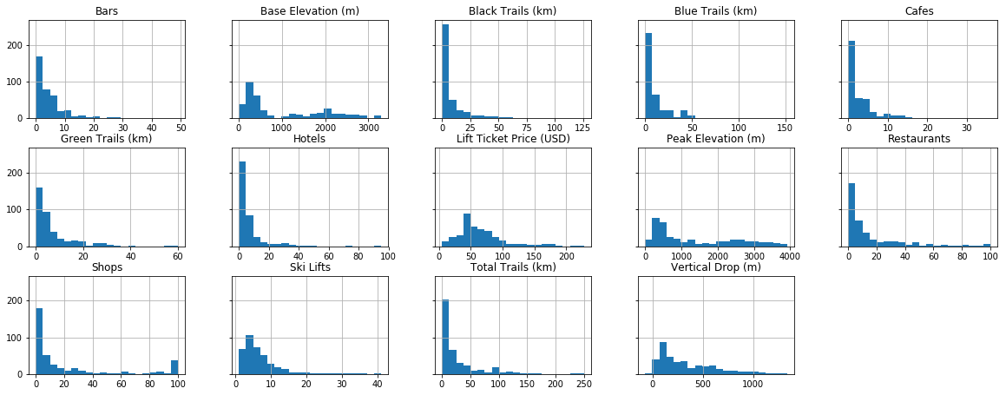
Data exploration: Histograms

Slide 6
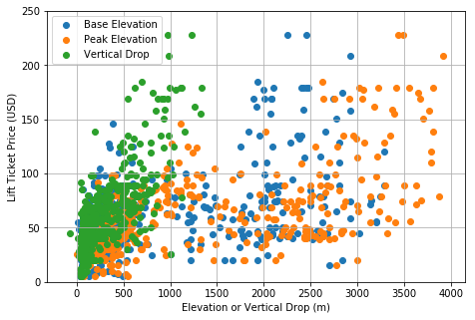
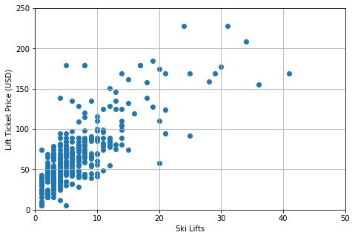
Data exploration: Correlations

Slide 7
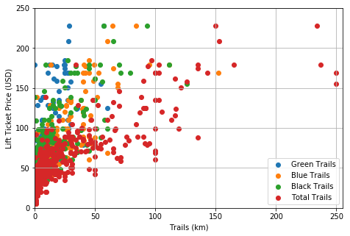
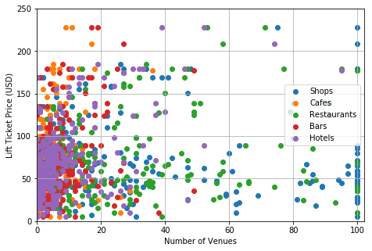
Data exploration: Correlations

Slide 8
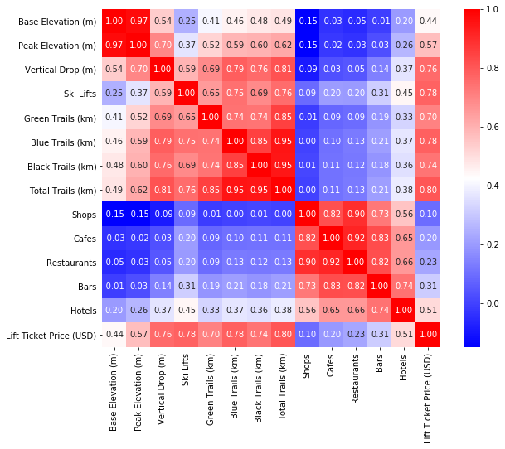
Data exploration: Correlations
Peak Elevation and Total Trails are redundant
Resort stats and number of nearby venues features do not correlate as much as between themselves
Shops and Cafes unlikely to improve the prediction performance

Slide 9
Models: Feature selection
All Stats (naïve, baseline model): base elevation, peak elevation, vertical drop, ski lifts, green trails, blue trails, black trails, total trails
Selected Stats (less-redundant model): base elevation, vertical drop, ski lifts, green trails, blue trails, black trails
Selected Stats & All Venues (model with all venue info): base elevation, vertical drop, ski lifts, green trails, blue trails, black trails, shops, cafes, restaurants, bars, hotels
Selected Stats & Venues (model with the most relevant venue info): base elevation, vertical drop, ski lifts, green trails, blue trails, black trails, restaurants, hotels

Slide 10
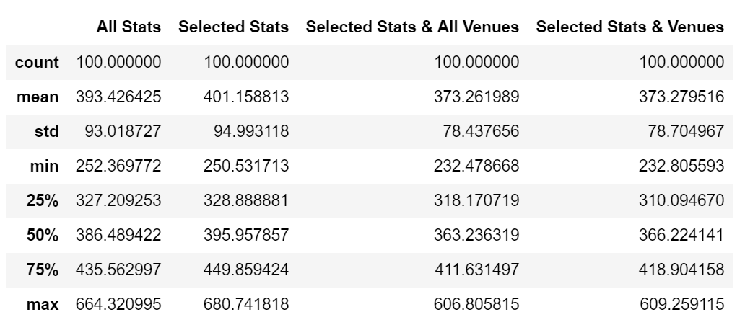
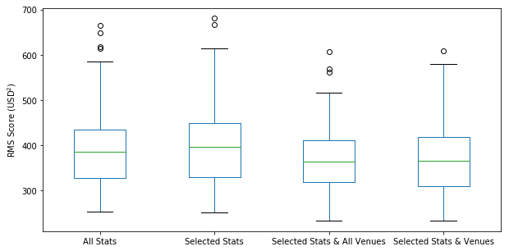
Model evaluation: RMS

Slide 11
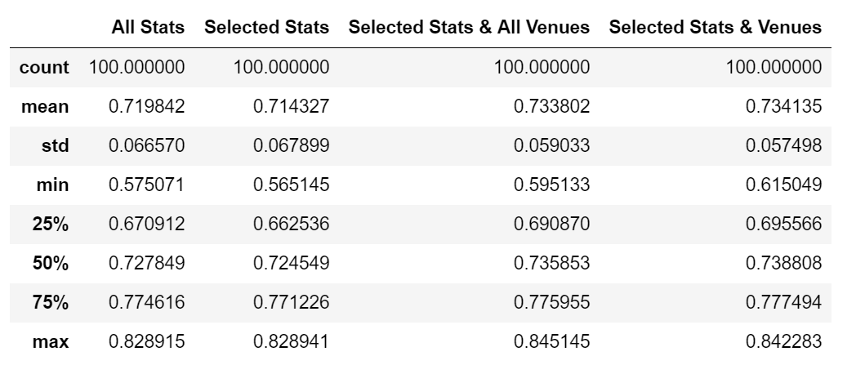
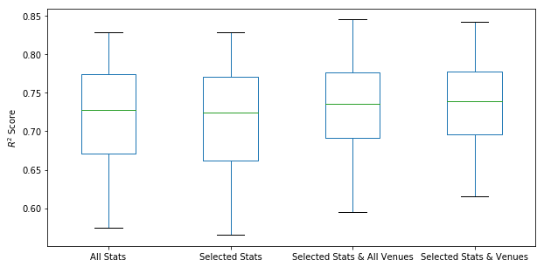
Model evaluation: R²
Selected Stats & Venues performs the best!

Slide 12
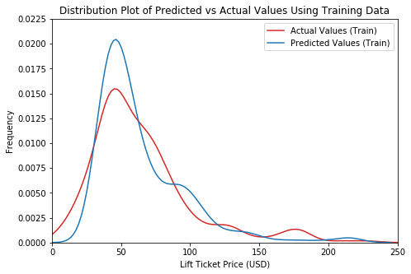
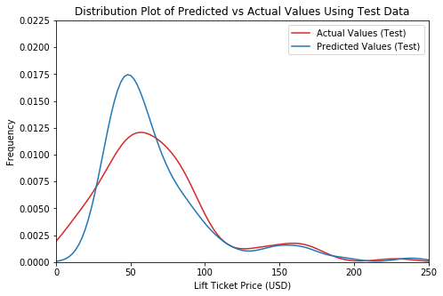
Best model performance

Slide 13
Best model coefficients
Coefficients suggest that the best predictors for lift ticket price are:
number of ski lifts
lengths of the green trails
number of hotels nearby
While this does not prove causality, this seems to be helpful in finding the most important on- and off-mountain infrastructure factors

Slide 14
Conclusion and future directions
Including the number of nearby restaurants and, especially, of hotels improves the model performance
Improvement is relatively small but the effect is robust: off-mountain infrastructure is important
Model improvement ideas:
select more specific venues nearby/filter the venue datasets/adjust the radius
include other basic resorts stats as the average annual snowfall
include the cost of living at the state
include one hot encoding of the resort owners [www.nsaa.org]
explore residuals for any non-linear behavior
cluster the resorts for more insights

