Slide 1
Vitamin Zang
Team Members:
Alex Ng, Zanna Sowka, Yirui Ruan, Rahel Gunaratne, Andrew Bell, Joel Sprinkle, Karen Lin, Kevin Burr
Client:
Paul Leroux

Slide 2
Agenda
Project Overview
Architectural Design
Technology
Dashboard Demo

Slide 3
Project Overview
Empowering patients to be independent and allows nurses to monitor patients medication status
Leverage automation through patient profiles to remind them to take medication according to the schedule
Acknowledgement from either nurses and patients to confirm that the schedule has been followed
IoT add-on: medication box can notify the monitoring system
Monitoring and notification can be extended to family members

Slide 10
Technology
Database - MySQL
GUI Design – Sketch App
Webserver - Amazon Web Service
Dynamic HTML - Node Java Script
Zang - Notification Engine
IoT - Arduino Micro Controller

Slide 11
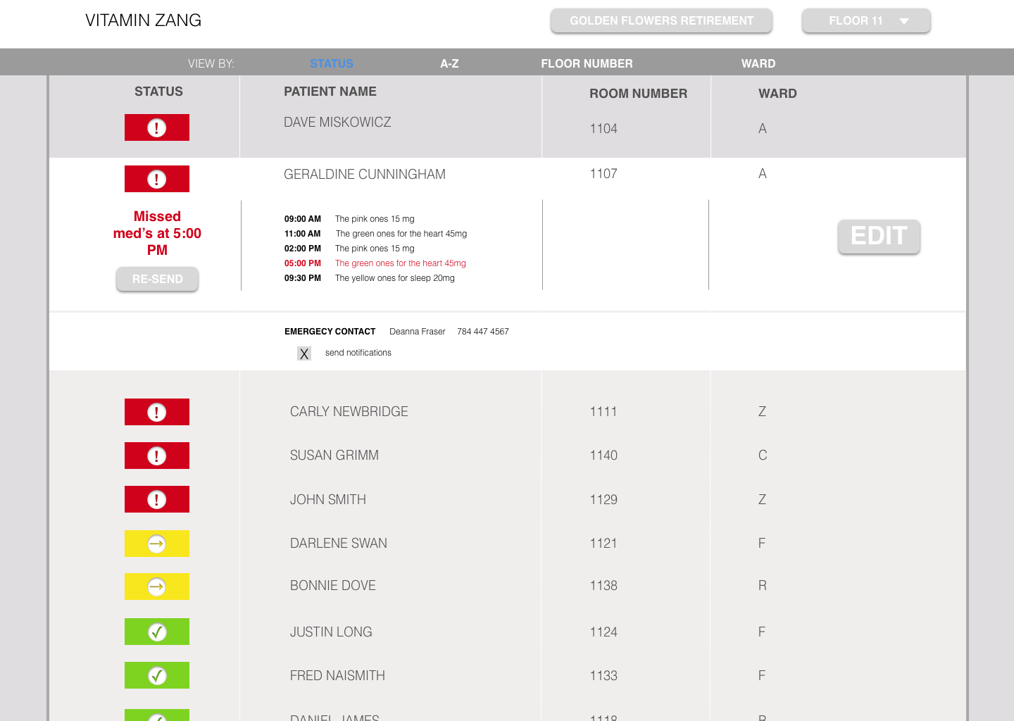

Slide 12
Demo
Nurse Dashboard
DEMO URL: http://54.237.239.59/

Slide 13
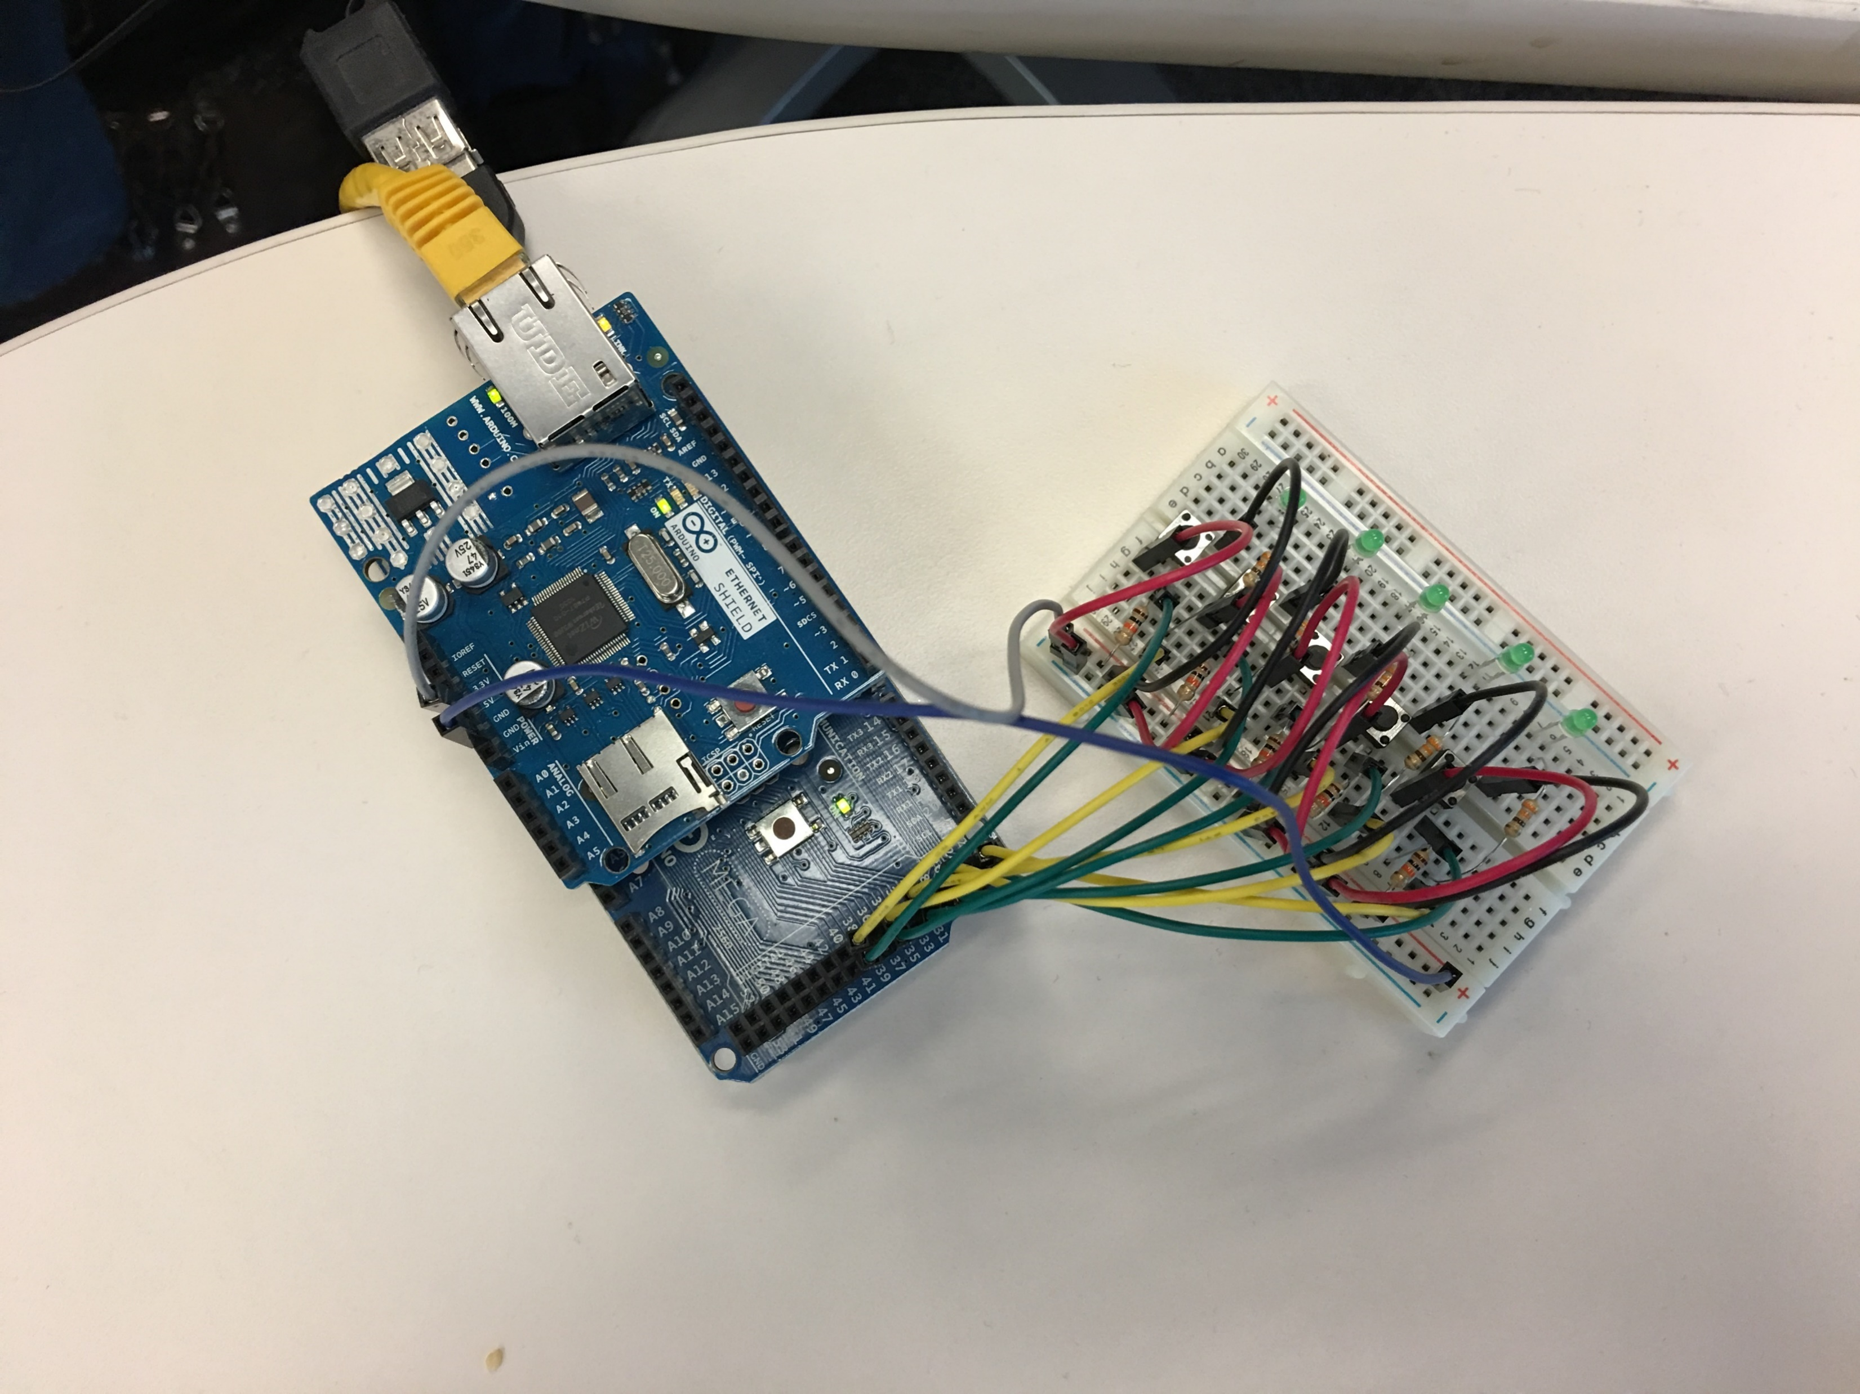
IoT - Demo

Slide 14
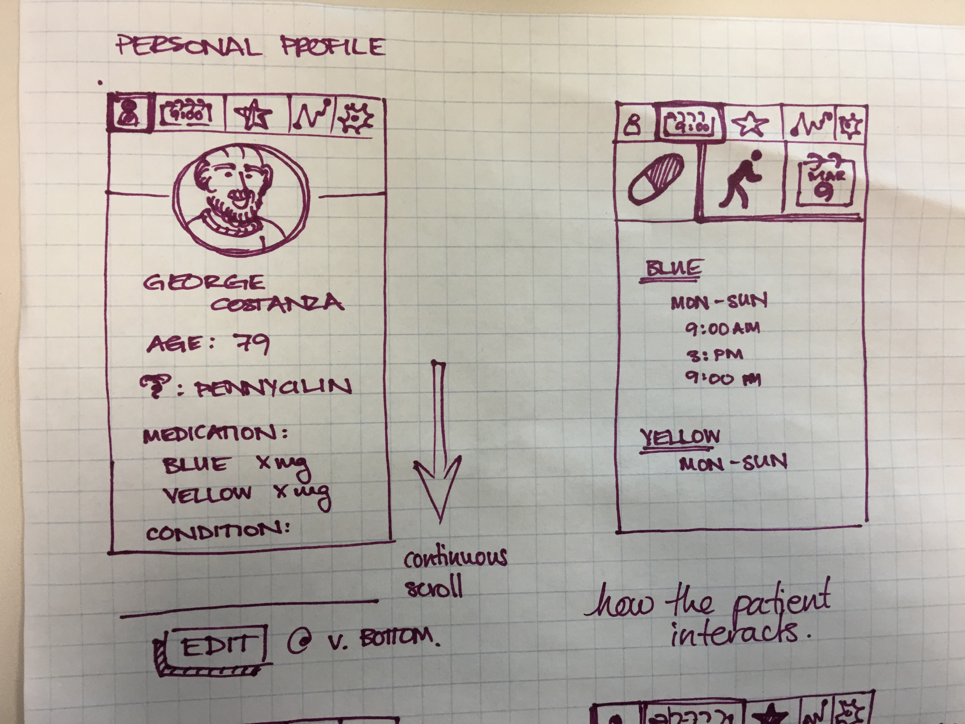
Patient Dashboard

Slide 15

Q & A

Slide 16
Extras

Slide 17
Architectural Design Nurse Use Case

Slide 18
Architectural Design Patient Use Case

Slide 19
Architectural Design Subscriber (family members) Use Case

Slide 20
Data Model

